Slide 1
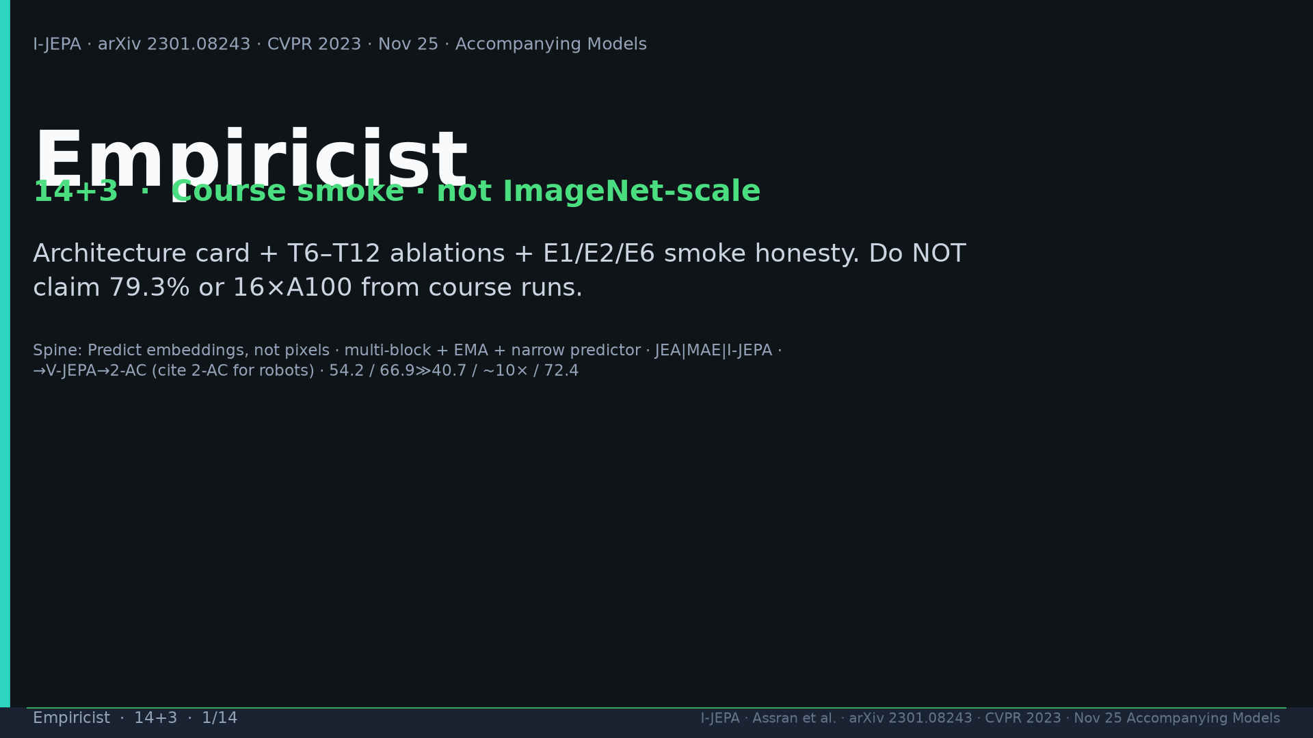
Notes:
Title. Course smoke not ImageNet-scale. Never claim 79.3% or 16×A100 from course.

Slide 2
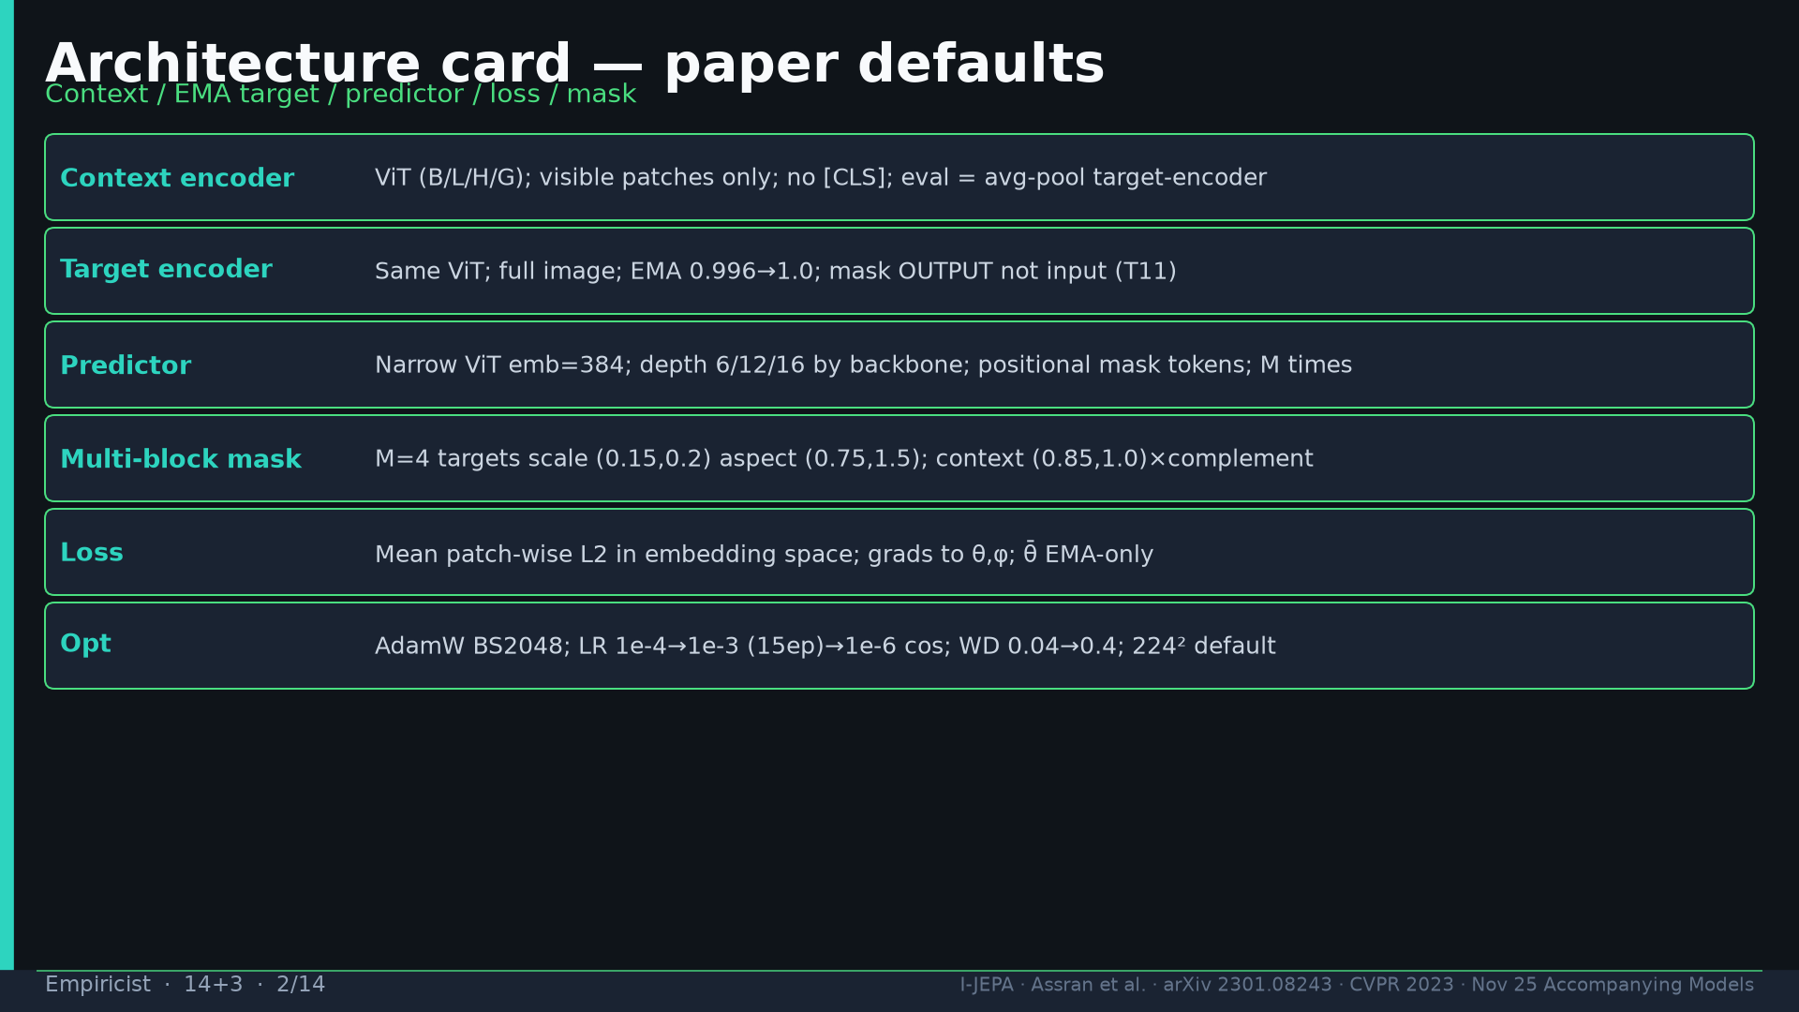
Notes:
Architecture card: context ViT; EMA target; narrow predictor 384; multi-block defaults; L2 emb; AdamW.

Slide 3
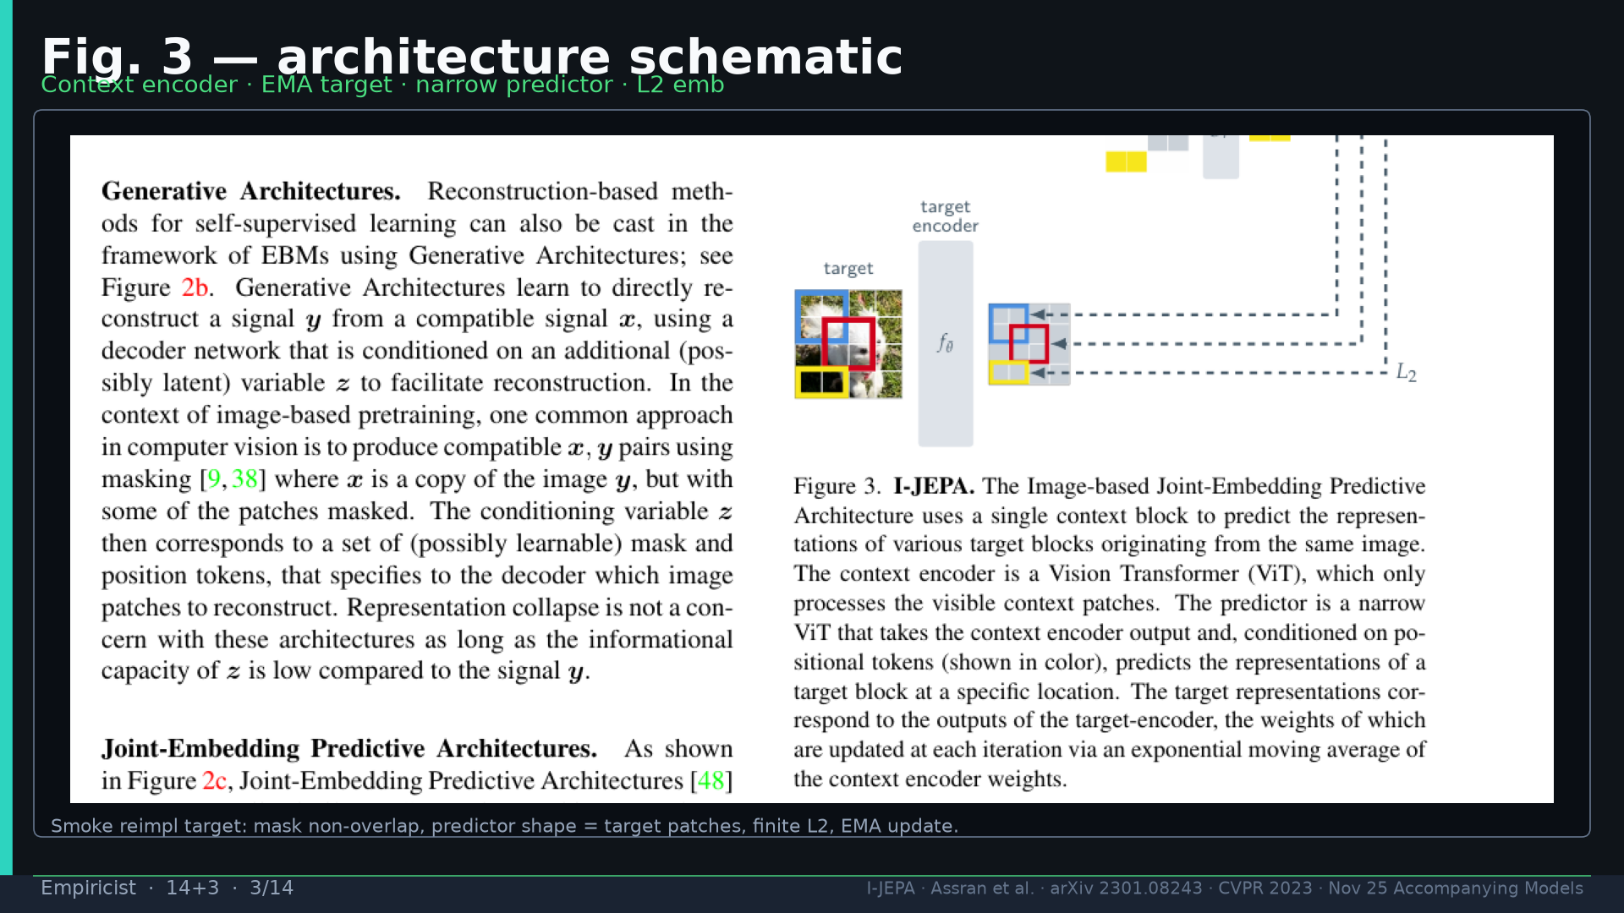
Notes:
Fig.3 schematic — unit-test mask, shapes, L2, EMA.

Slide 4
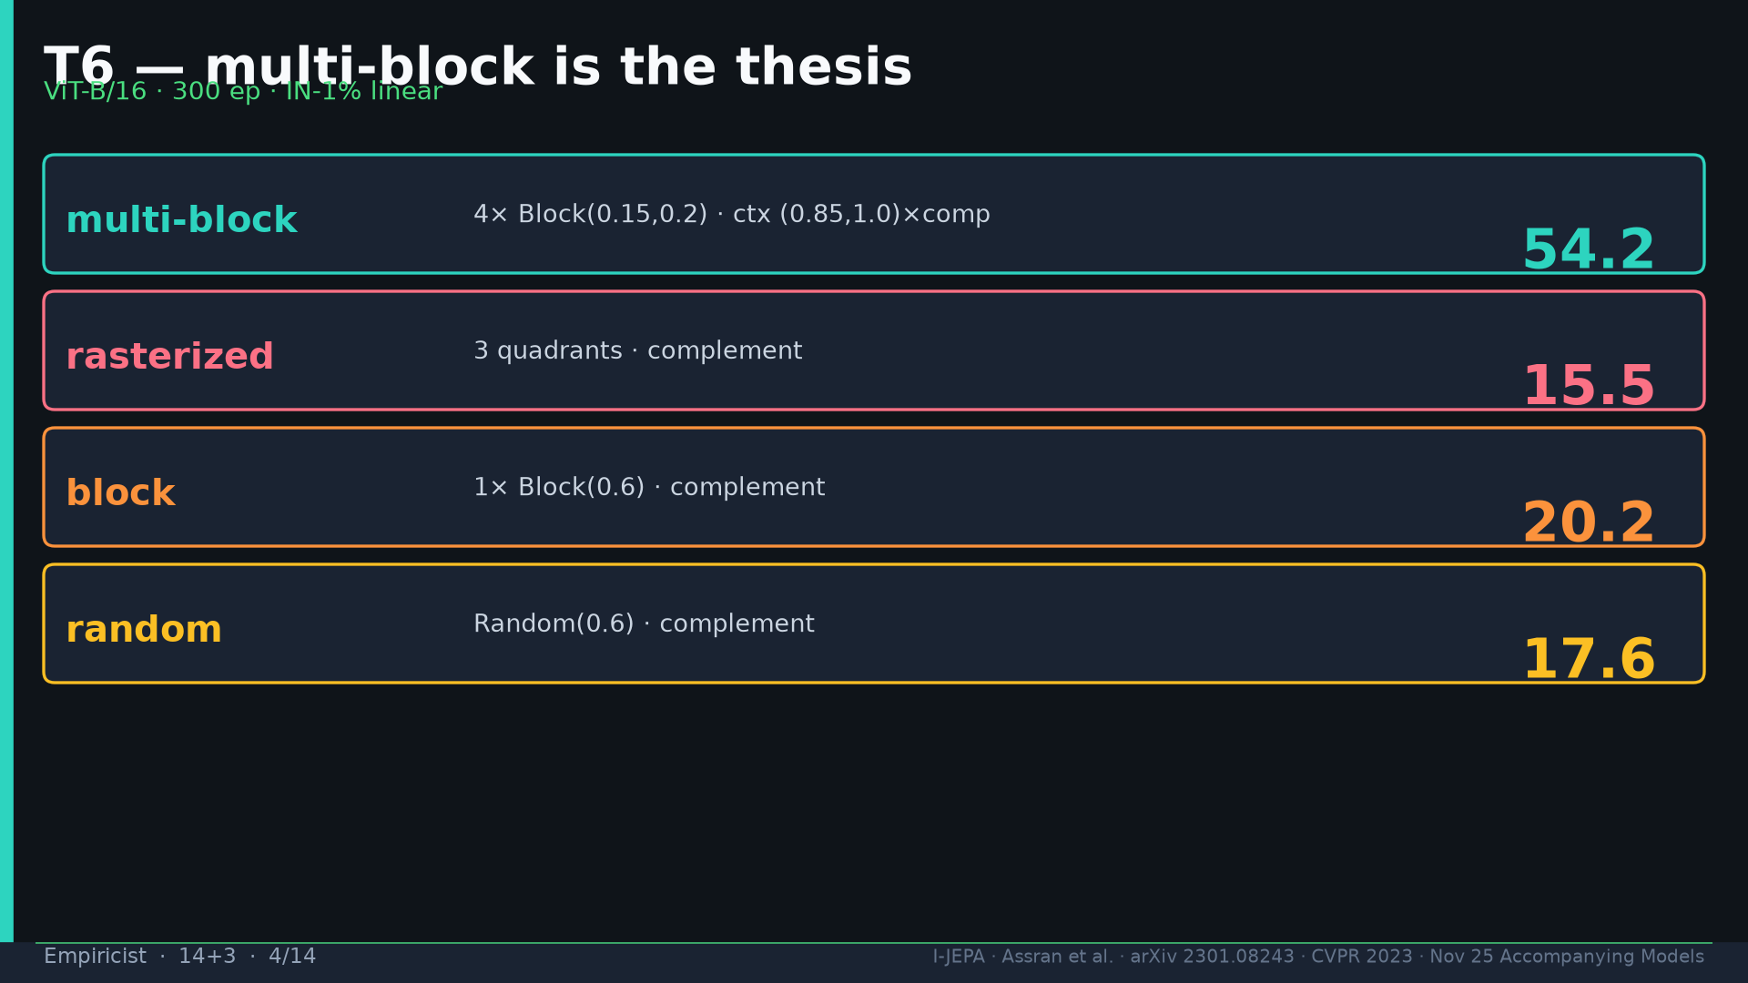
Notes:
T6: multi-block 54.2 vs raster 15.5 / block 20.2 / random 17.6. Thesis isolator.

Slide 5
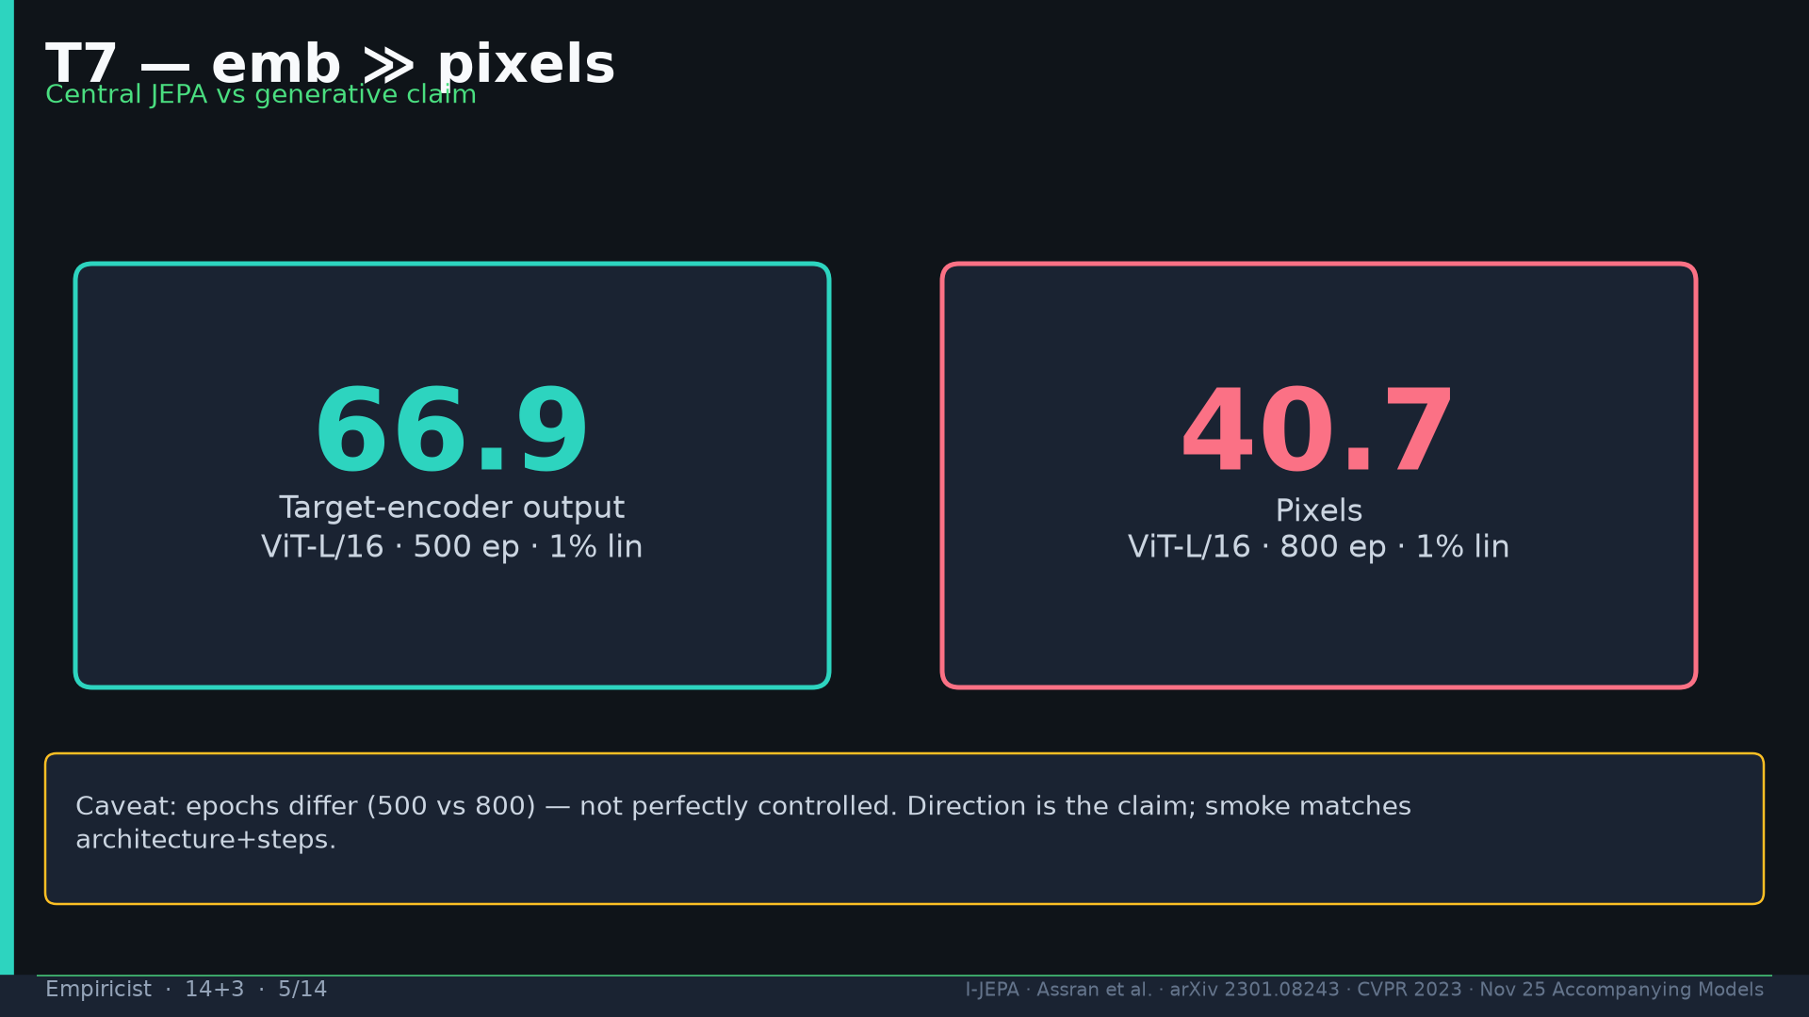
Notes:
T7: 66.9 emb vs 40.7 pixels. Epoch caveat 500 vs 800. Smoke matches steps.

Slide 6
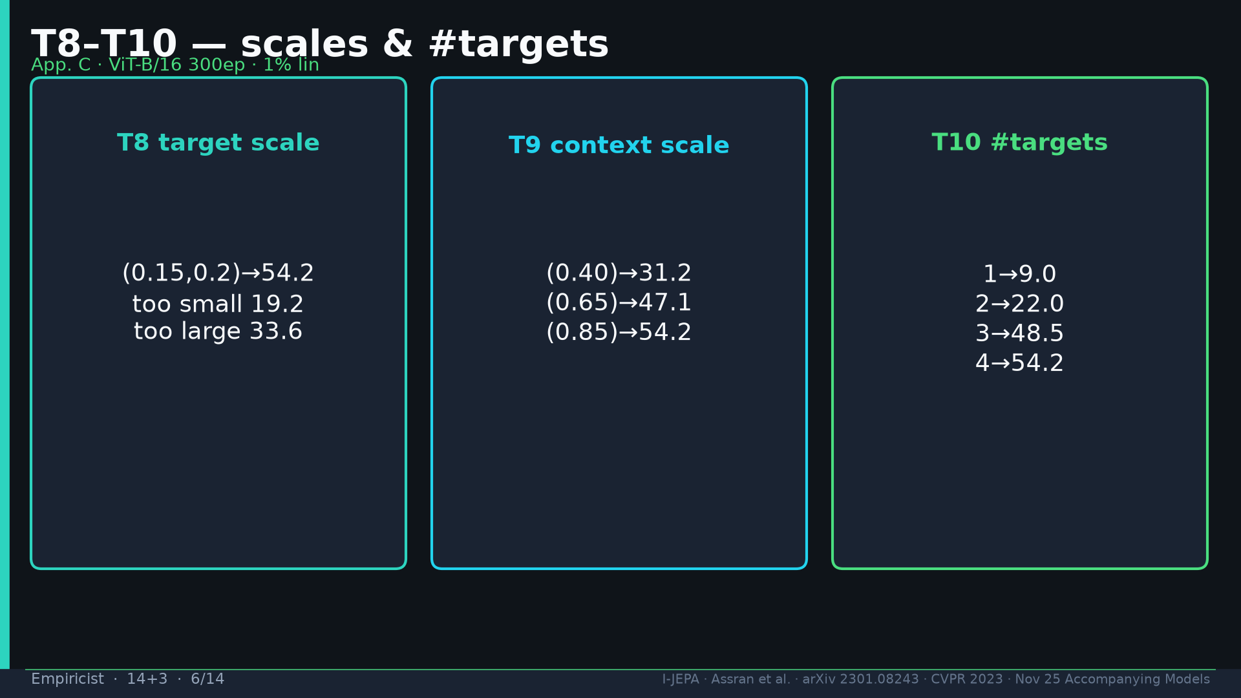
Notes:
T8–10: target scale sweet spot; context↑; #targets 1→4 = 9→54.2.

Slide 7
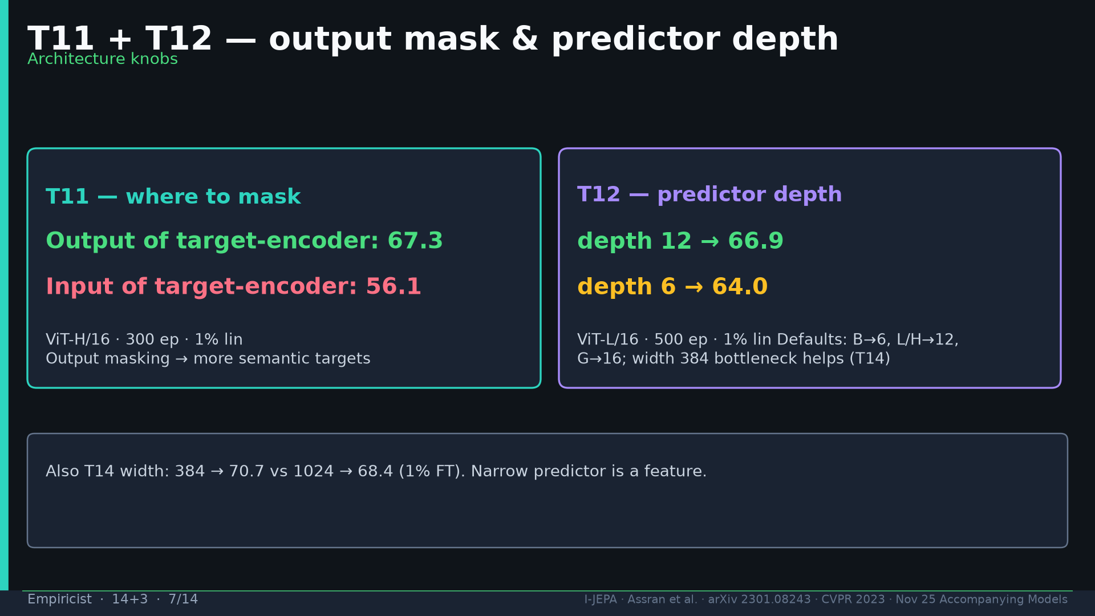
Notes:
T11 output 67.3 vs input 56.1; T12 depth 12→66.9 vs 6→64.0; T14 width bottleneck.

Slide 8
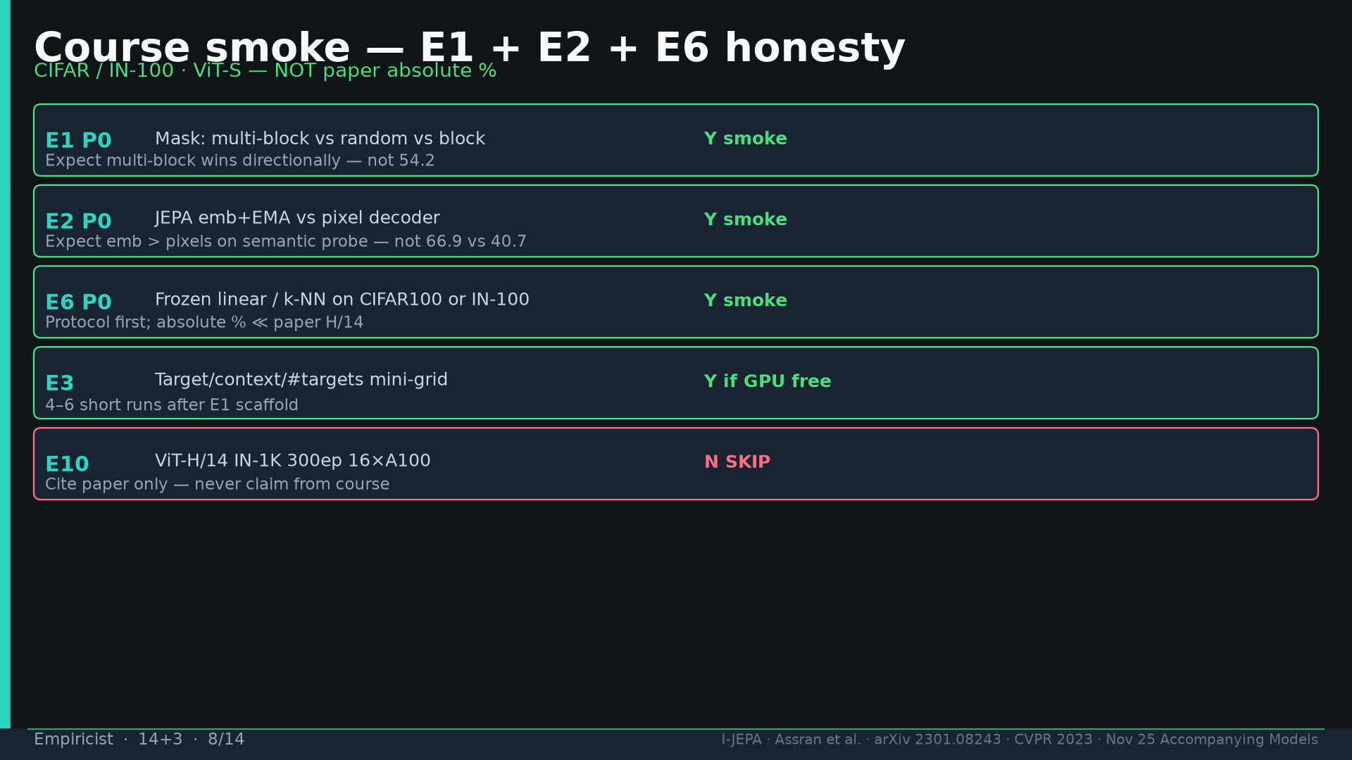
Notes:
Smoke E1+E2+E6 P0 on CIFAR/IN-100 ViT-S. E10 SKIP cite only.

Slide 9
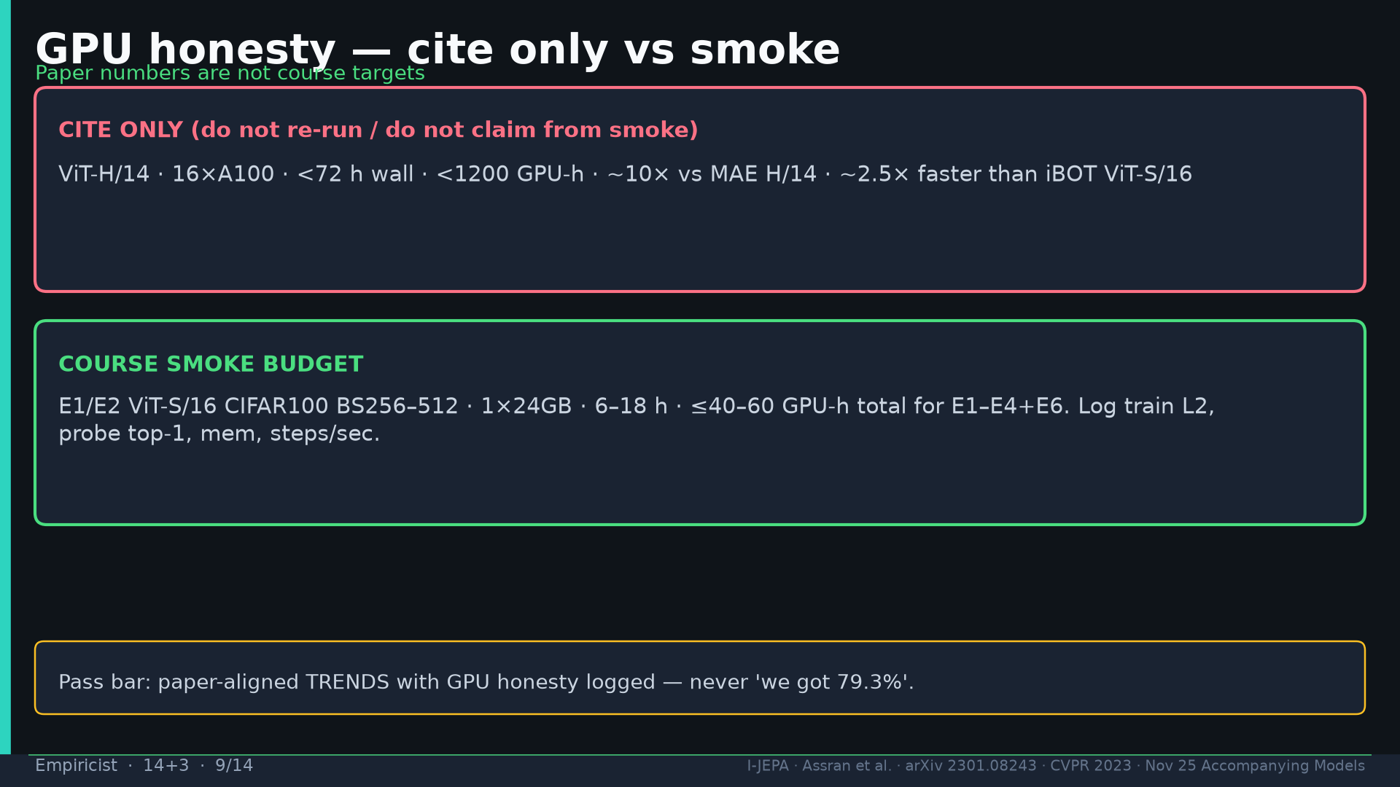
Notes:
GPU: paper <1200 / <72h cite only. Course ≤40–60 GPU-h. Pass = trends not absolute %.

Slide 10
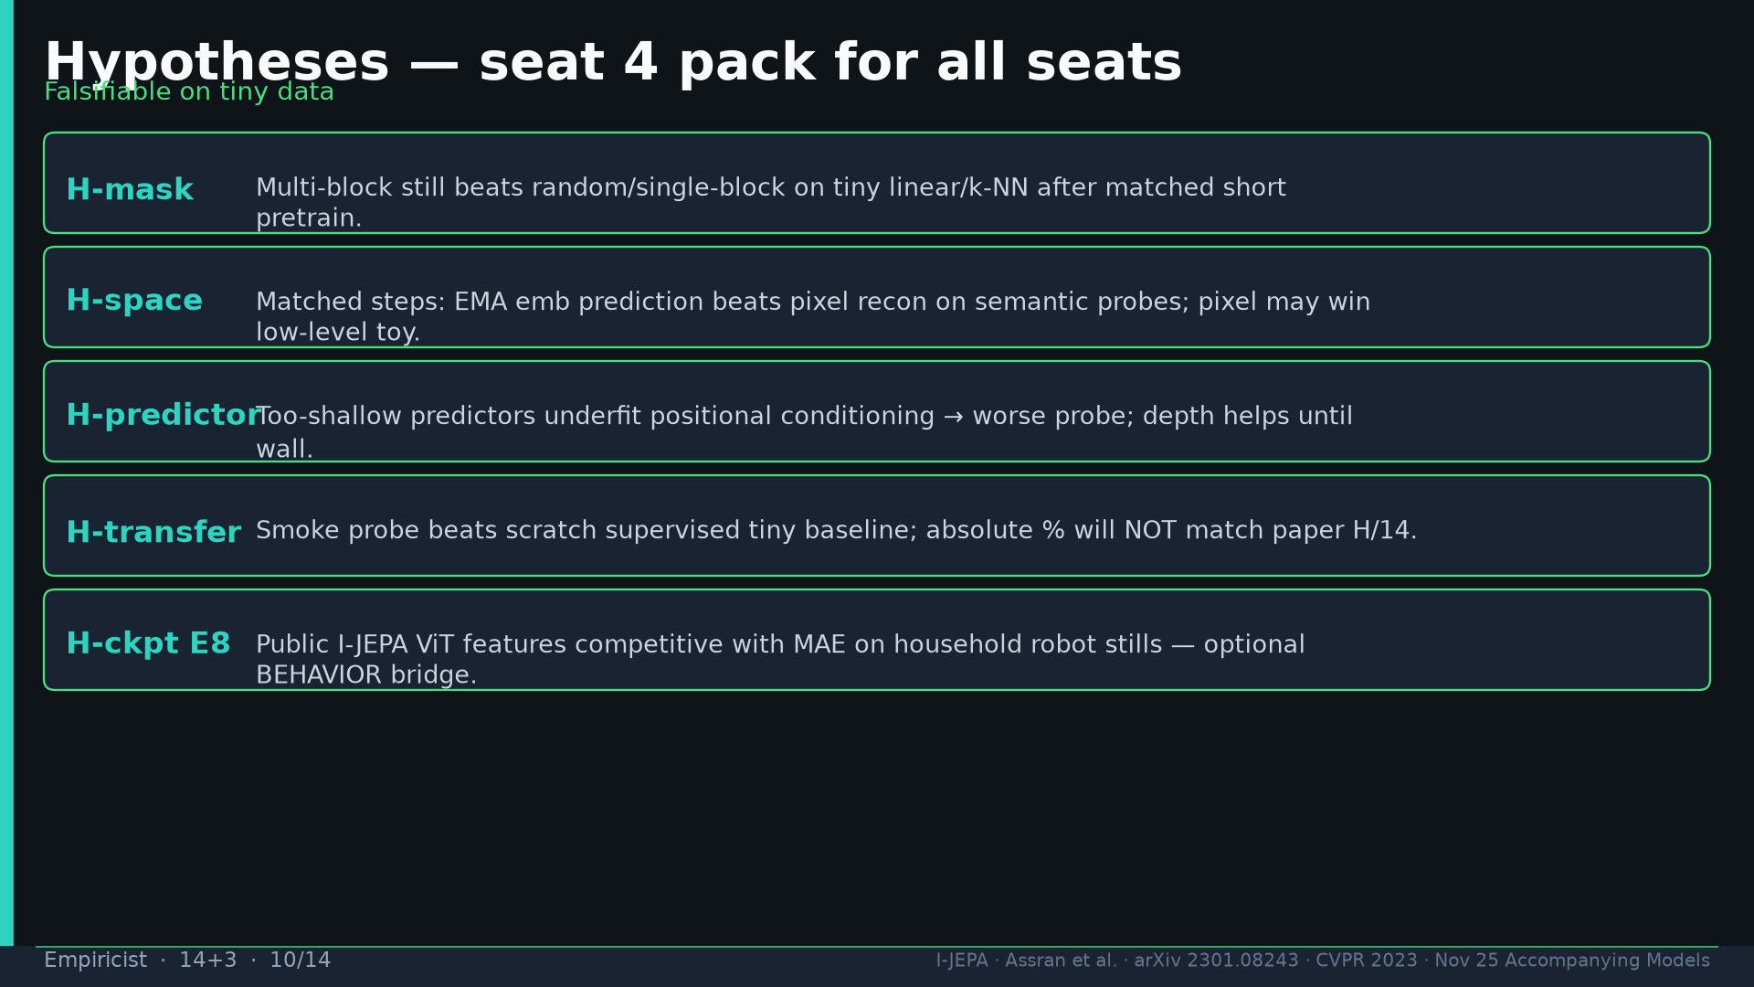
Notes:
Hypotheses H-mask/space/predictor/transfer/ckpt for all seats.

Slide 11
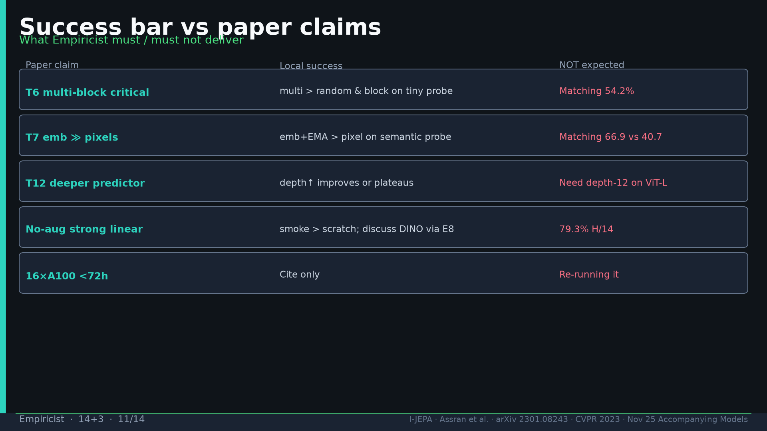
Notes:
Success bar table: local success vs NOT expected.

Slide 12
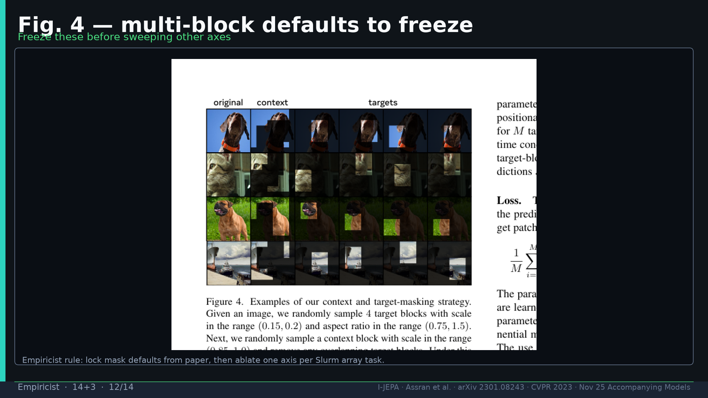
Notes:
Fig.4 freeze mask defaults before other axes.

Slide 13
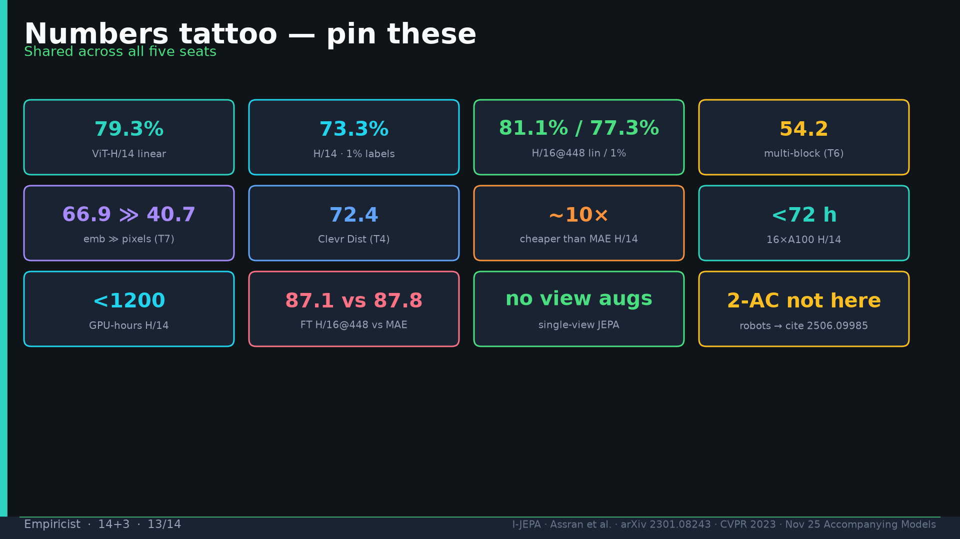
Notes:
Tattoo.

Slide 14
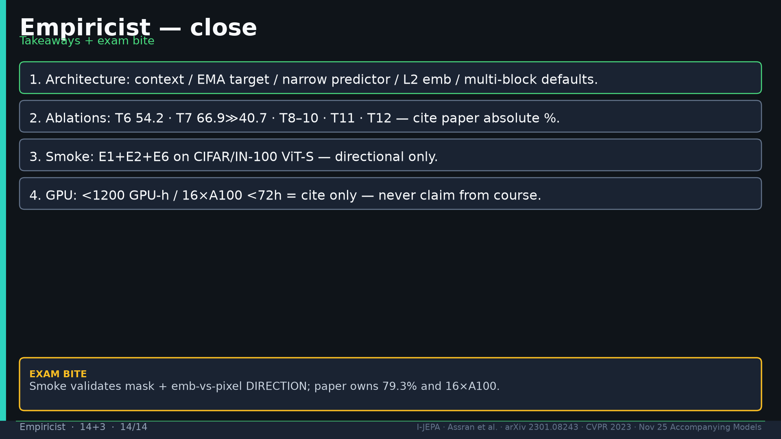
Notes:
Close: arch + ablations cite paper; smoke directional; GPU cite only.

