Slide 1
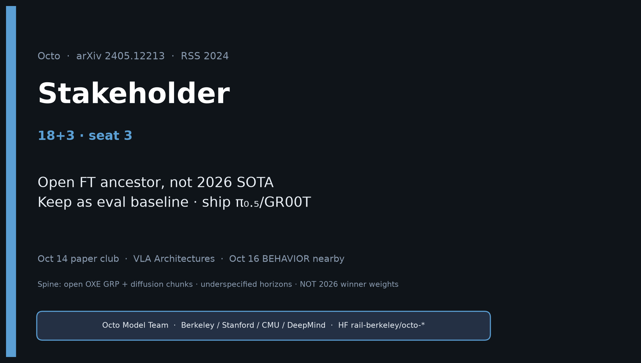
Stakeholder · 18+3 · 1/18
Notes:
STAKEHOLDER — seat 3 · 18+3. No Stakeholder redo later — this is the durable briefing.
You own: why Octo still matters as open FT ancestor / eval baseline, and why product stack ships π₀.₅/GR00T for BEHAVIOR.
One-liner: Octo proved open cross-embodiment pretrain + cheap FT; π₀ proved you still need VLM scale + better generative actions.

Slide 2
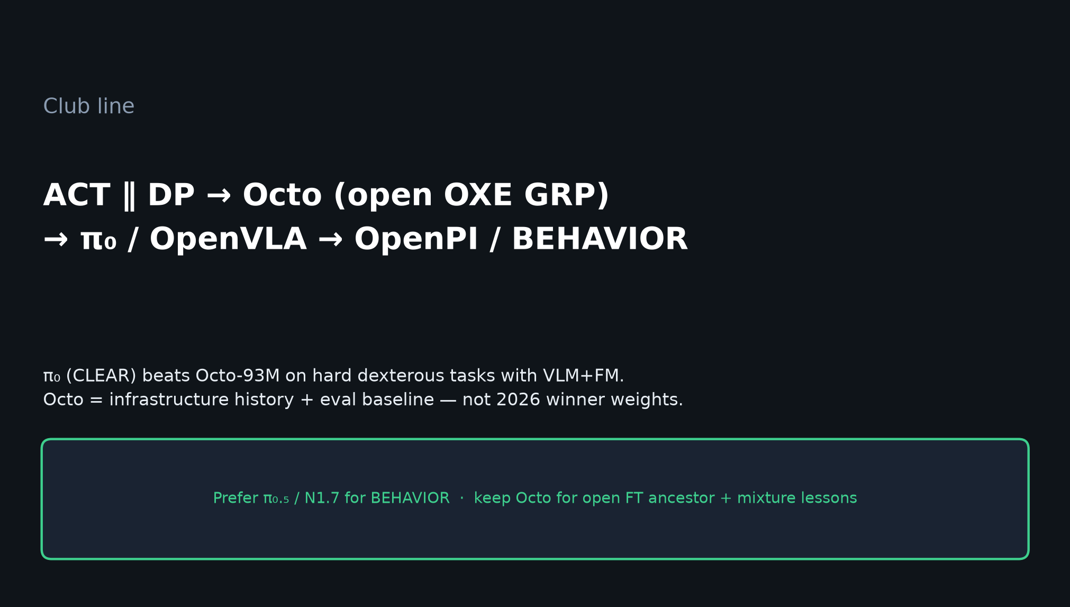
Stakeholder · 18+3 · 2/18
Notes:
CLUB LINE early — so leadership hears the placement.
ACT∥DP → Octo → π₀/OpenVLA → OpenPI/BEHAVIOR.
Octo = infrastructure history + eval baseline — not 2026 winner weights.

Slide 3
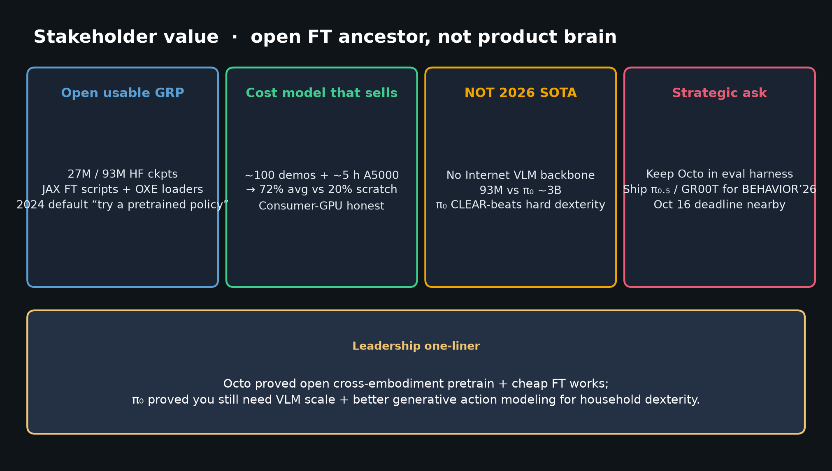
Stakeholder · 18+3 · 3/18
Notes:
VALUE CARDS — open usable GRP · cost model · NOT 2026 SOTA · strategic ask.
Buy/build: keep Octo (or successor open OXE mix) in eval harness; invest product in OpenPI π₀.₅ / GR00T.

Slide 4
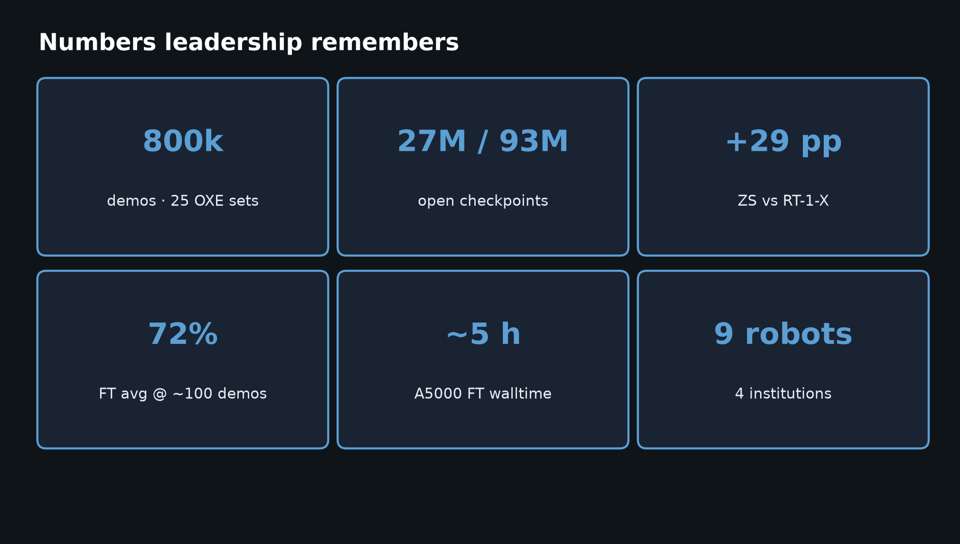
Stakeholder · 18+3 · 4/18
Notes:
NUMBERS leadership remembers.
800k demos / 25 OXE sets; open 27M/93M checkpoints; +29 pp ZS vs RT-1-X (caveated);
72% FT avg @ ~100 demos; ~5 h A5000; 9 robots / 4 institutions.
Say once; do not drown in ablations.

Slide 5
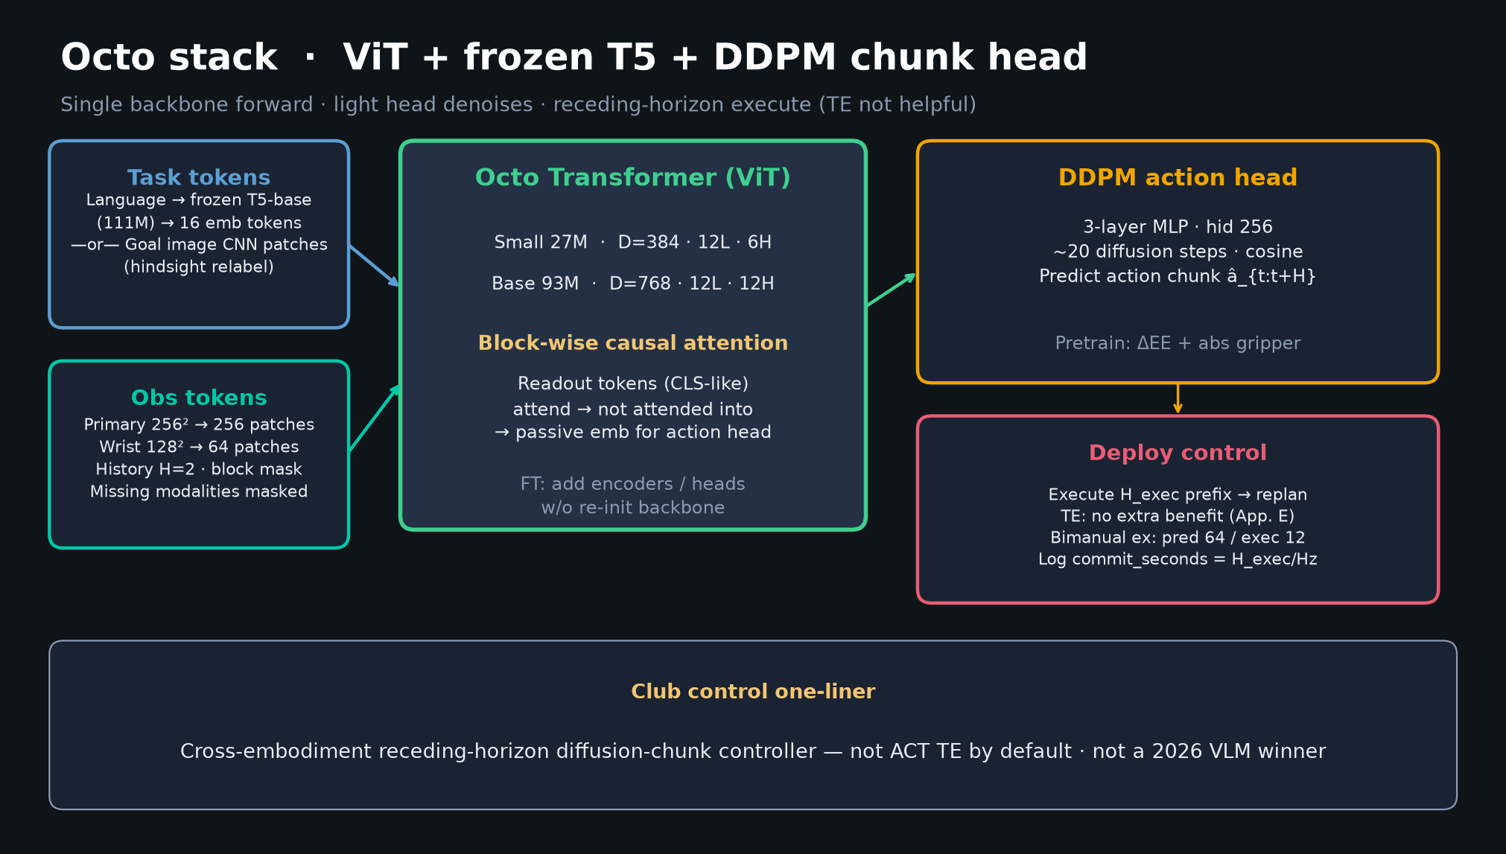
Stakeholder · 18+3 · 5/18
Notes:
ARCHITECTURE for non-specialists.
ViT backbone + frozen T5 + lightweight DDPM chunk head.
Flexible adapters: new cameras, F/T, joint, bimanual heads without full re-init.
Point: this is why FT is cheap and why Octo was usable infrastructure.

Slide 6
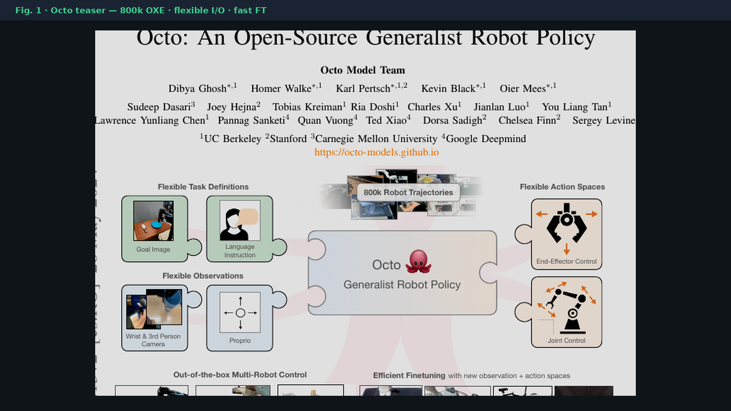
Stakeholder · 18+3 · 6/18
Notes:
PAPER TEASER Fig.1.
Flexible task (lang/goal) + obs + action spaces; 800k OXE; multi-robot OOB + efficient FT.
Use as the product-visual for “what is Octo?”

Slide 7
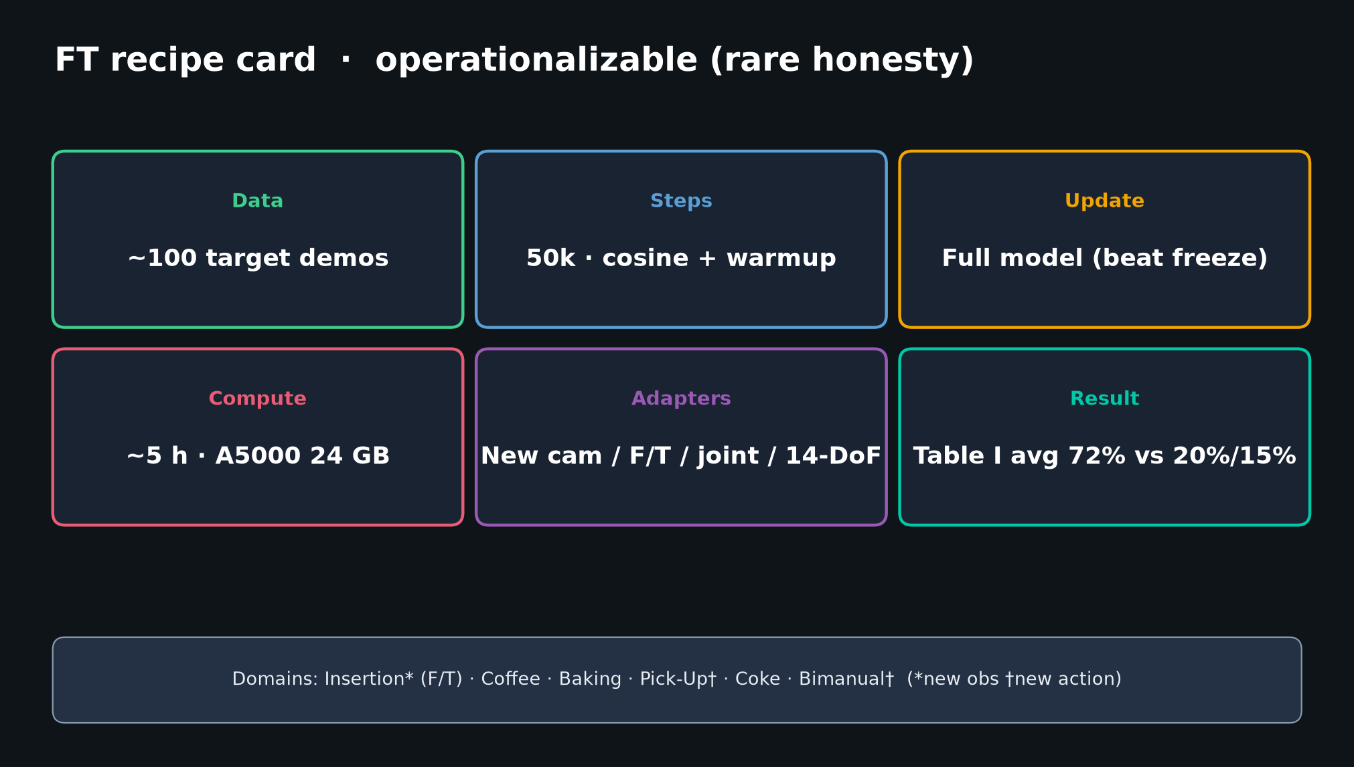
Stakeholder · 18+3 · 7/18
Notes:
FT RECIPE CARD — ~100 demos / 50k / full update / ~5h A5000 → 72%.
This is the product-relevant claim: consumer-GPU finetune.

Slide 8
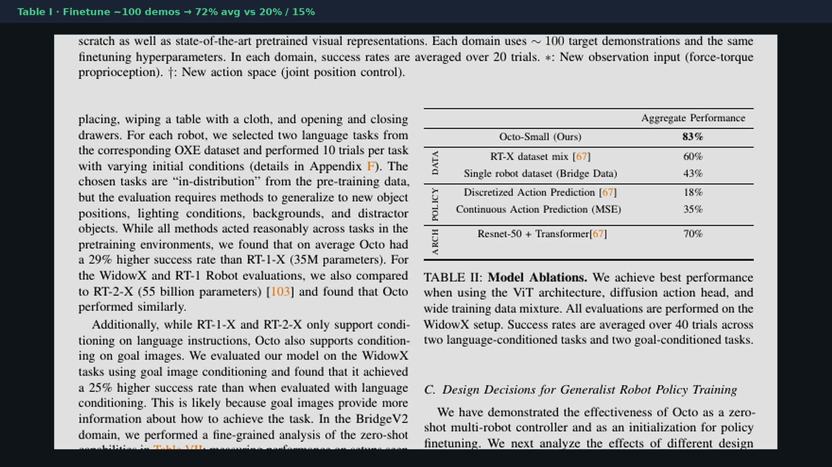
Stakeholder · 18+3 · 8/18
Notes:
TABLE I crop — FT headline.
72% avg vs scratch 20% / VC-1 15% under shared ~100-demo recipe.
Always pair with ~100 demos / 50k / A5000 — never a bare 72%.

Slide 9
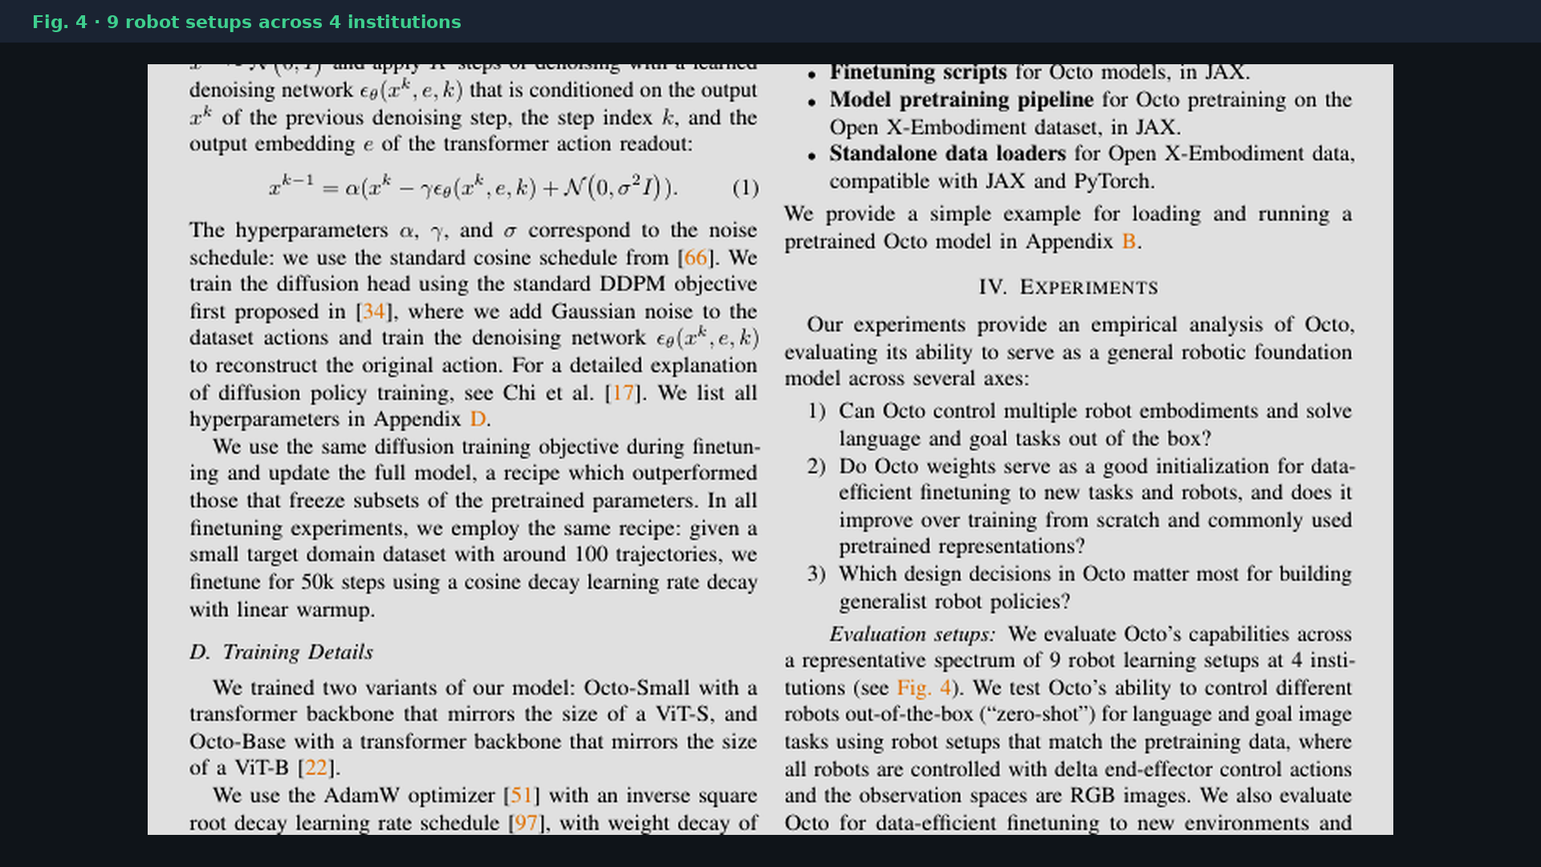
Stakeholder · 18+3 · 9/18
Notes:
9 ROBOT SETUPS — coverage story; not a unified benchmark protocol (Reviewer caveat).

Slide 10
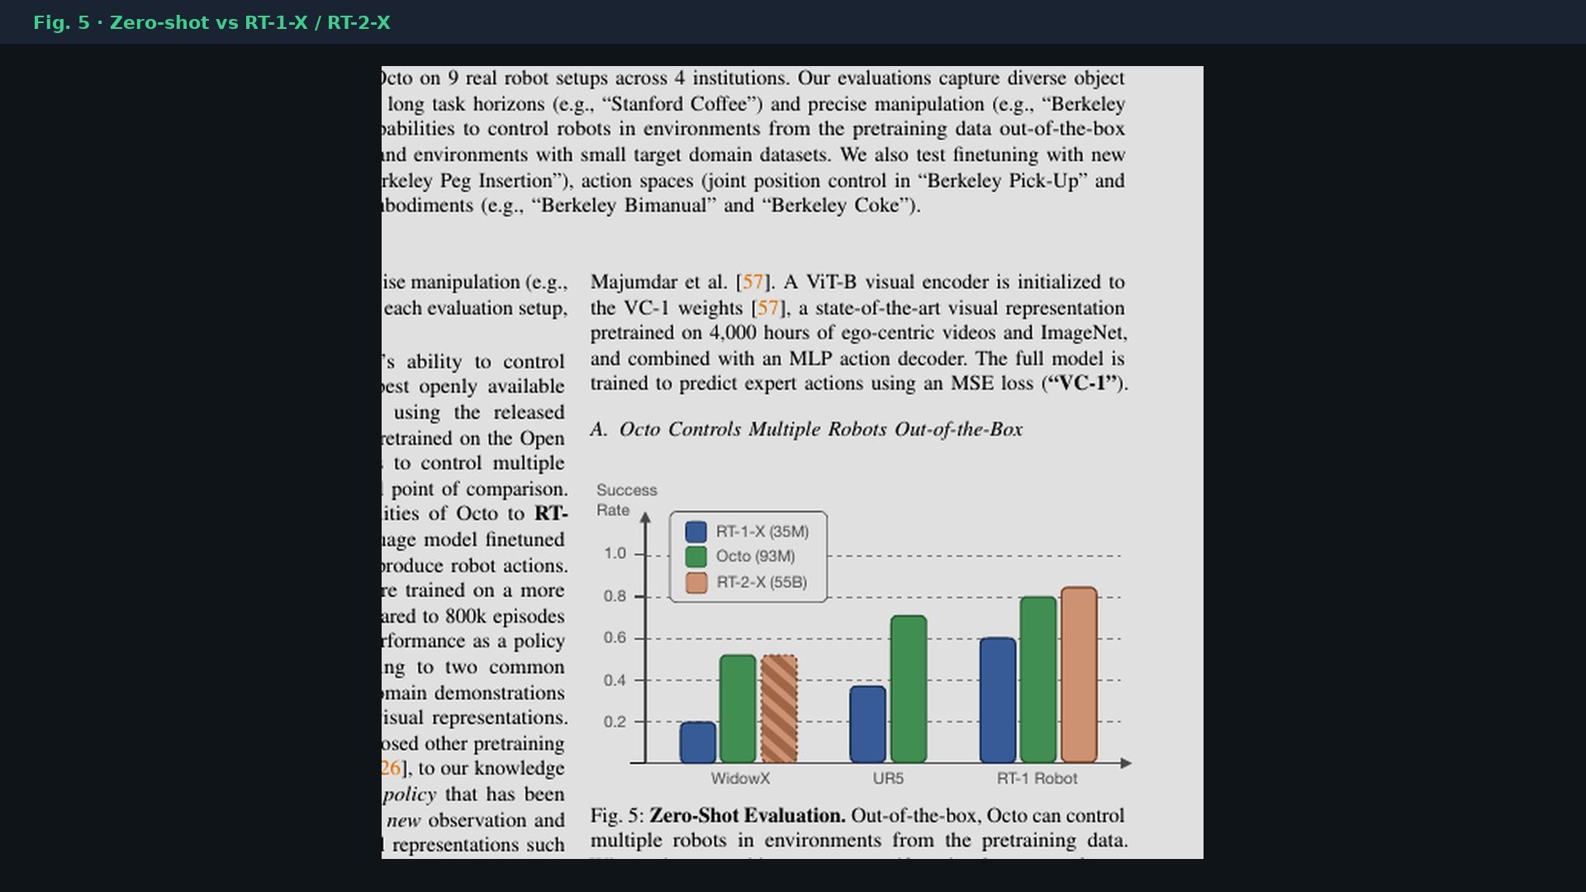
Stakeholder · 18+3 · 10/18
Notes:
ZERO-SHOT Fig.5.
+29% vs open RT-1-X on selected lang tasks. RT-2-X “similar” is task-limited / mixed provenance.
Do not let leadership hear “Octo ≈ 55B VLM.”

Slide 11
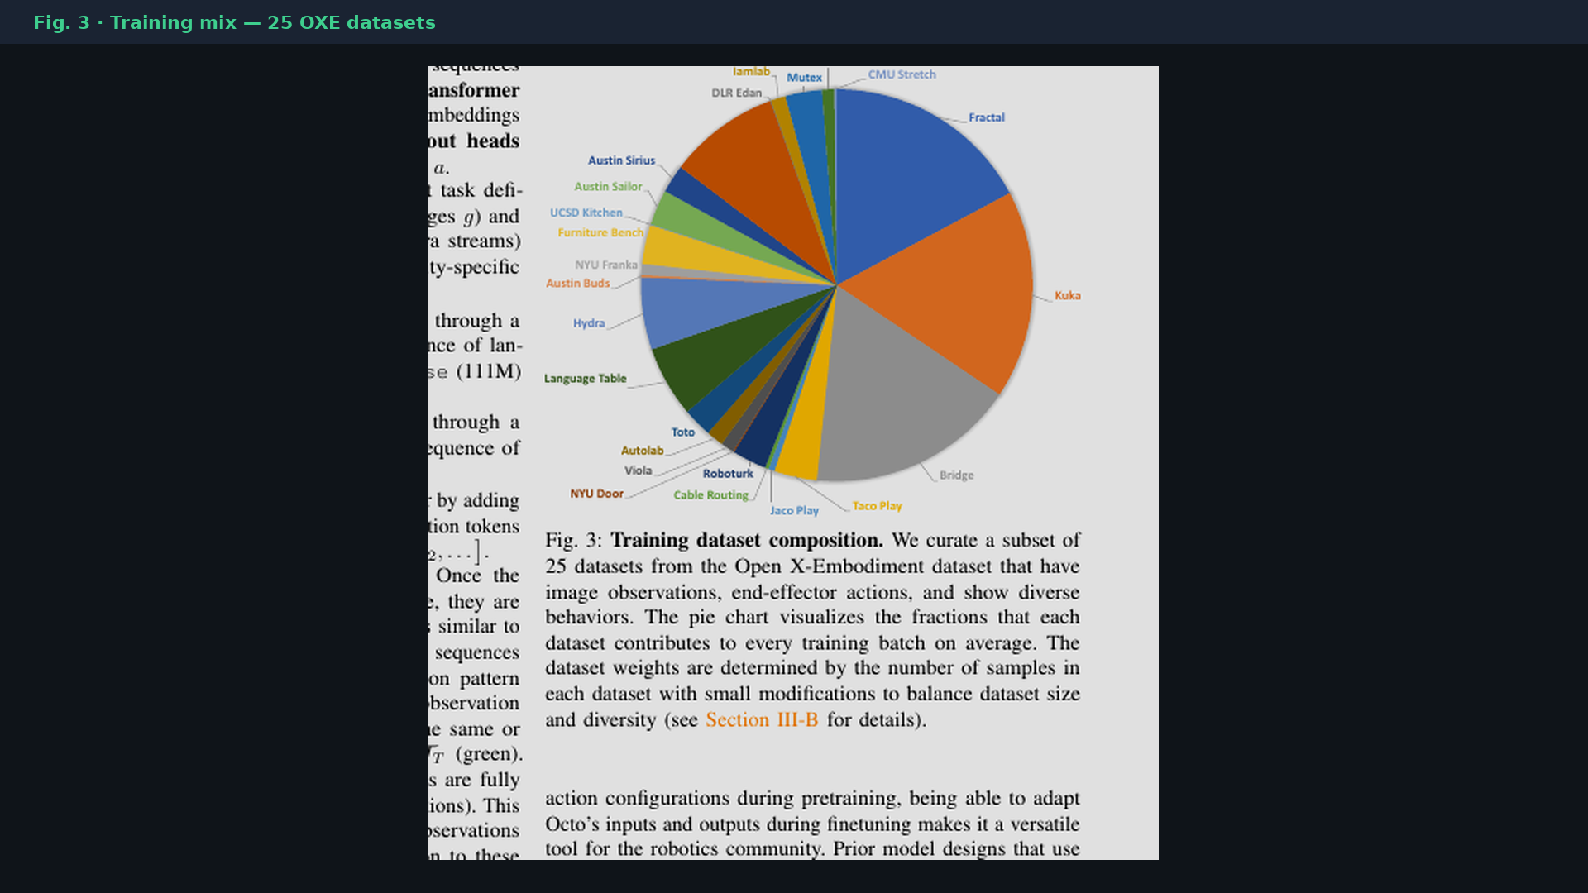
Stakeholder · 18+3 · 11/18
Notes:
DATA MIX pie Fig.3.
25 curated OXE datasets; Fractal/Kuka/Bridge dominate; diversity reweighted.
Mixture engineering may matter as much as architecture — keep mix cards in 2026.

Slide 12
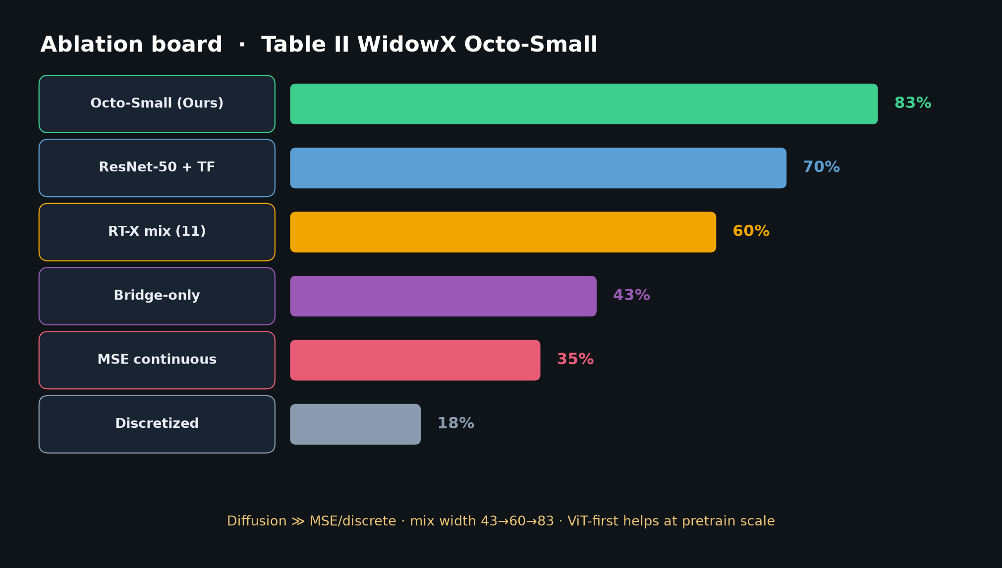
Stakeholder · 18+3 · 12/18
Notes:
ABLATIONS board.
Diffusion 83% ≫ MSE 35% ≫ discrete 18%; mix width 43→60→83.
Design lesson for future GRPs: generative chunk head + wide curated mix.

Slide 13
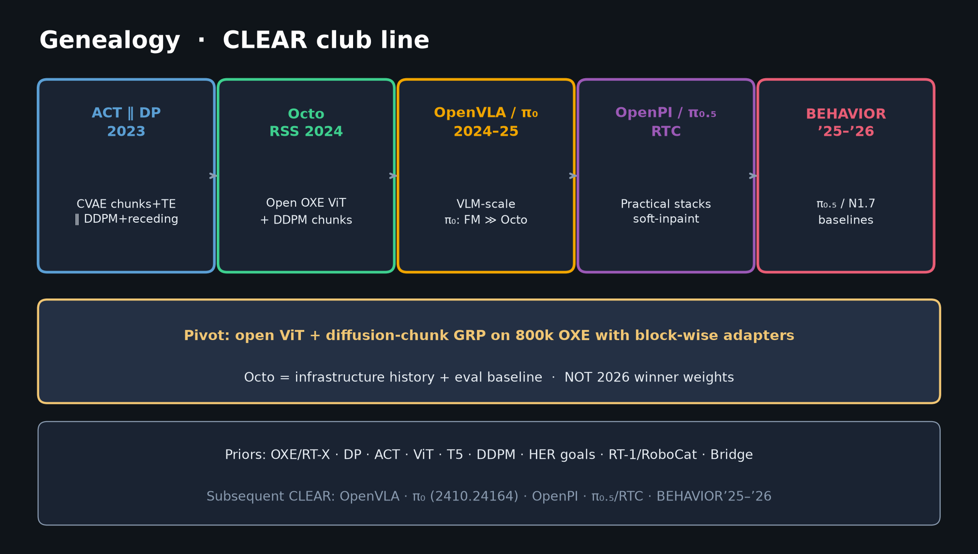
Stakeholder · 18+3 · 13/18
Notes:
GENEALOGY — placement for leadership.
ACT∥DP → Octo → π₀/OpenVLA → OpenPI/π₀.₅ → BEHAVIOR’25–’26.
Handoff: keep Octo in eval harness; ship π₀.₅/N1.7 for BEHAVIOR’26.

Slide 14
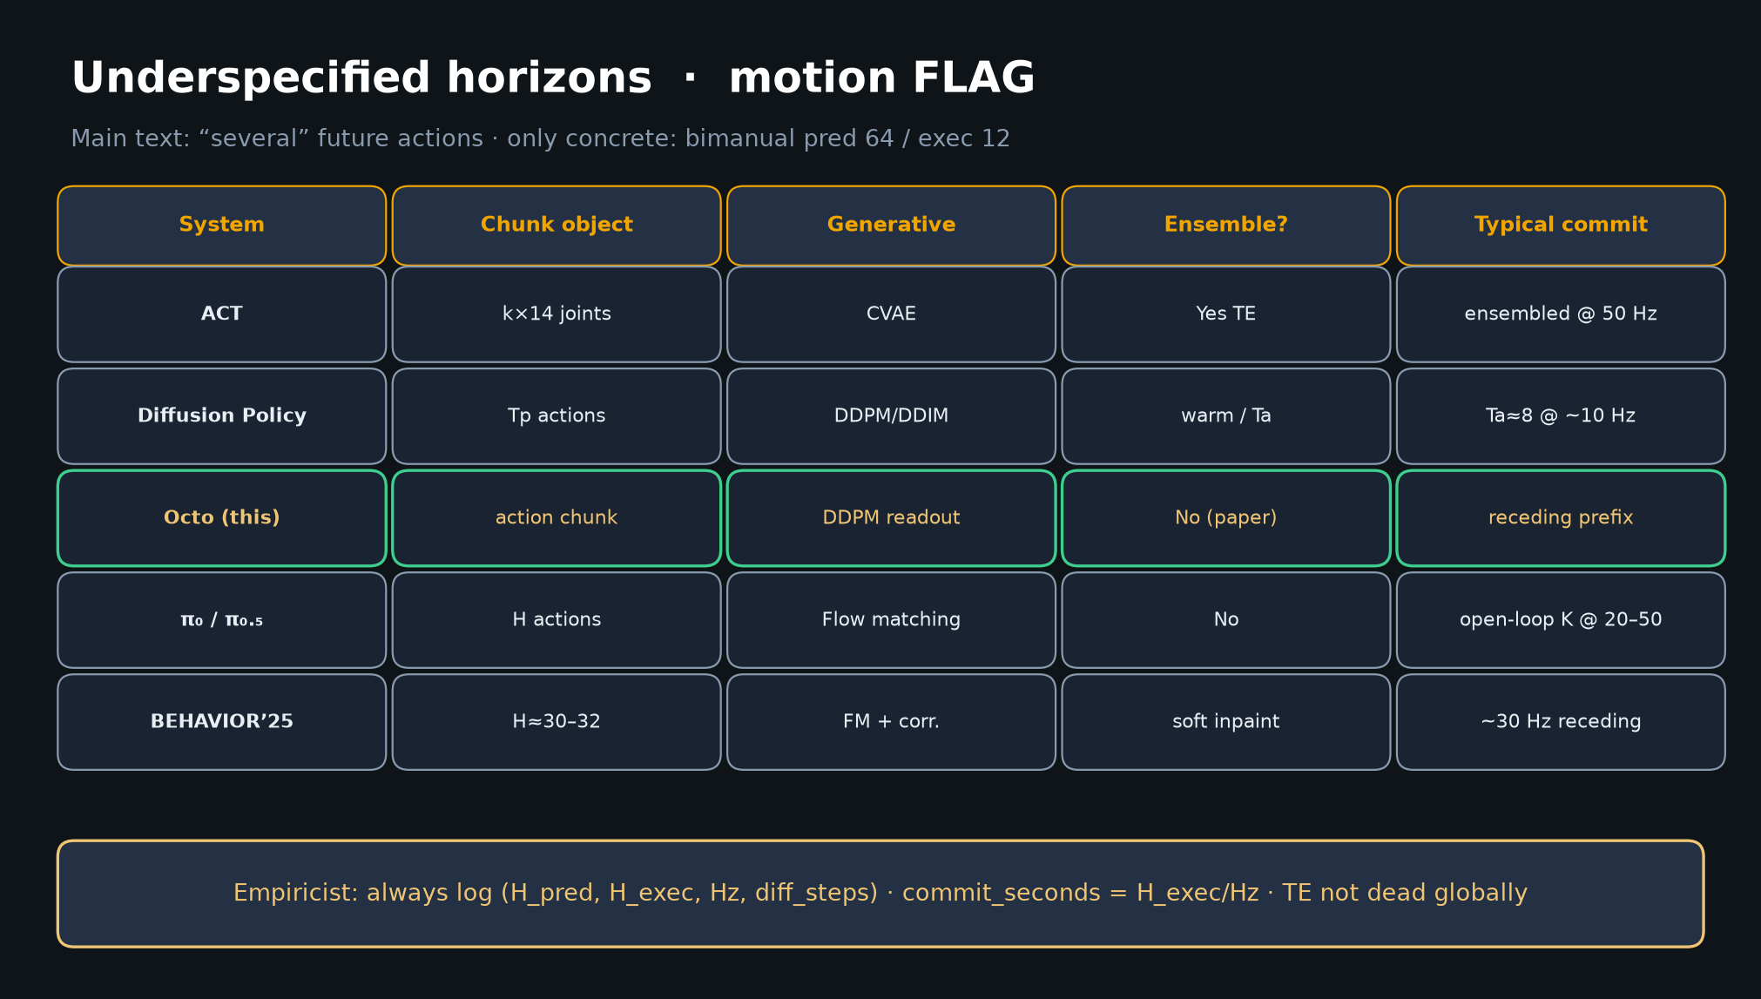
Stakeholder · 18+3 · 14/18
Notes:
HORIZONS — control inheritance.
Receding-horizon diffusion chunks; TE not Octo’s bet (App. E).
Later stacks keep chunks, change generative family and commit dialect.

Slide 15
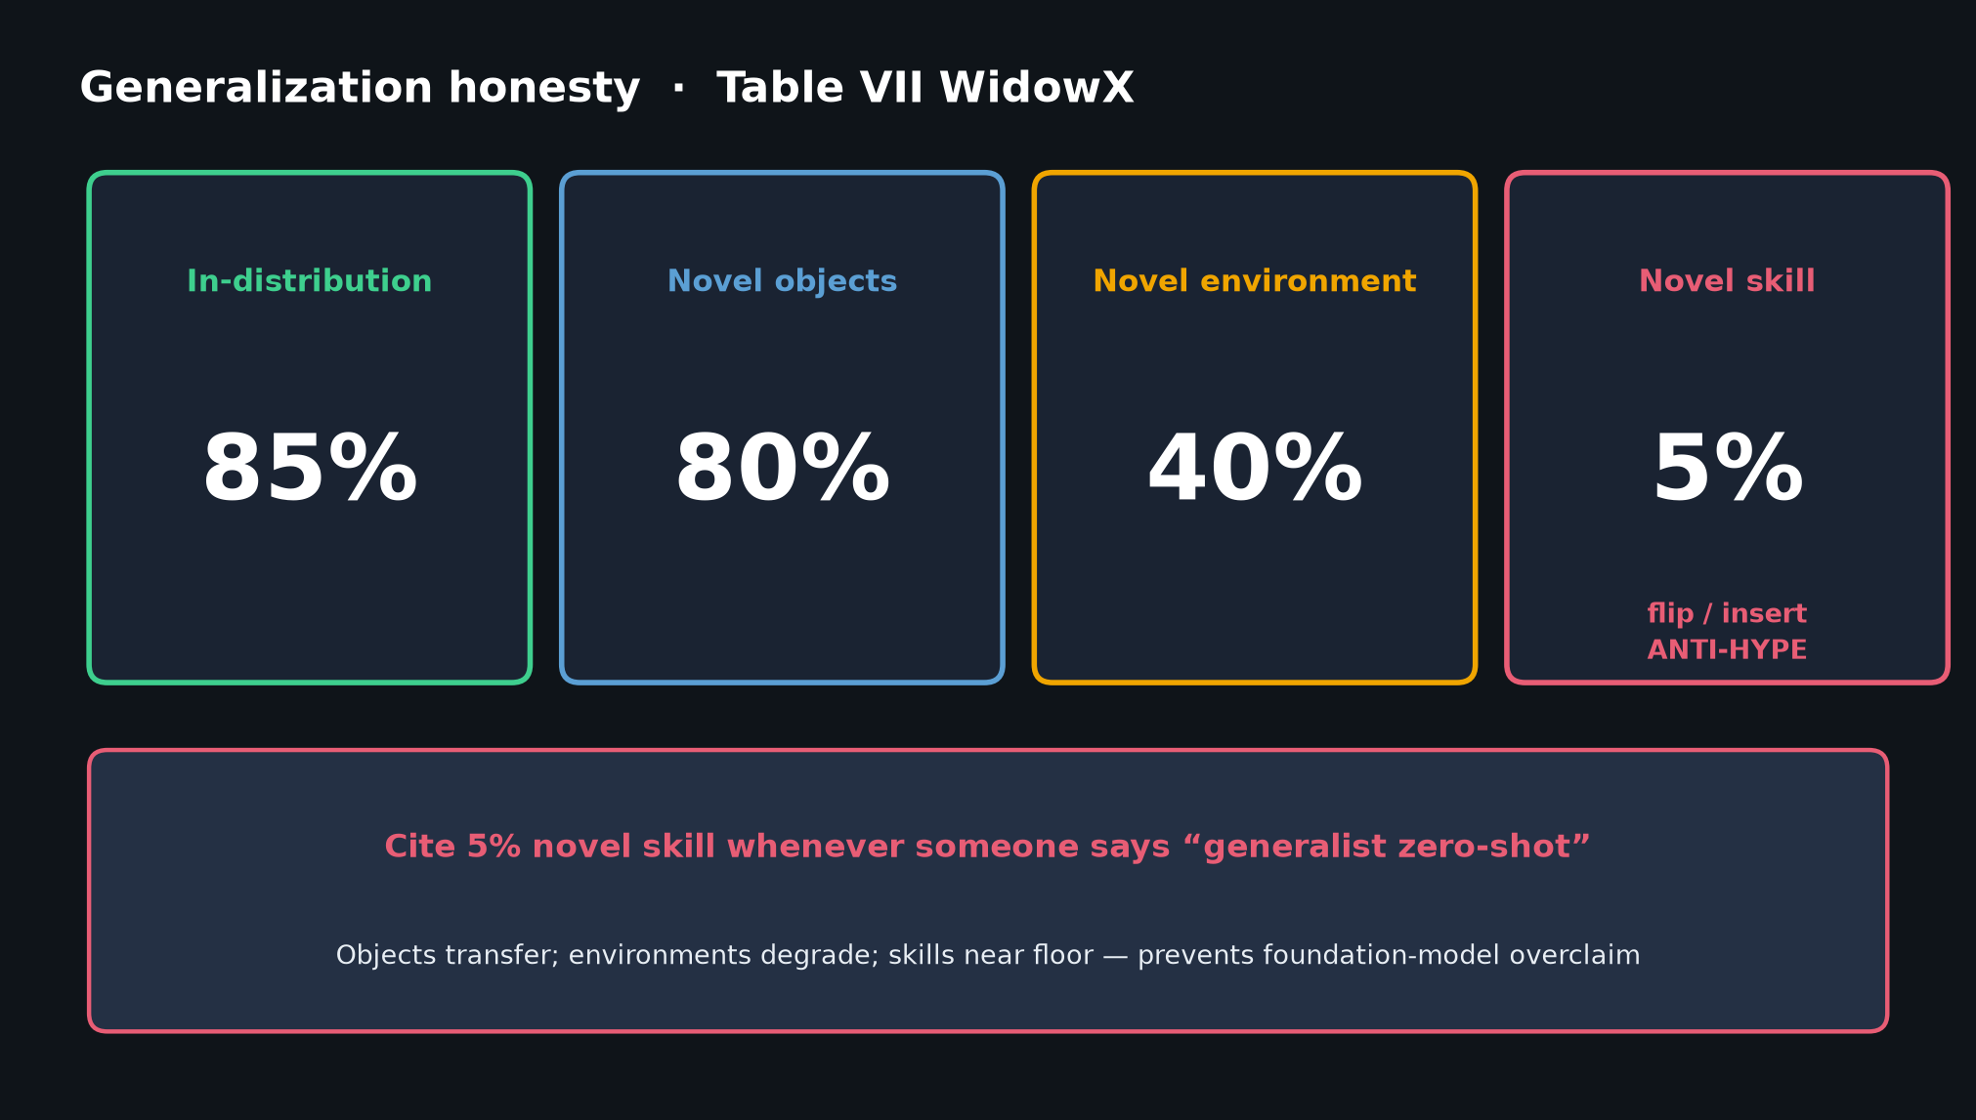
Stakeholder · 18+3 · 15/18
Notes:
HONEST LIMITS — novel skill 5%; wrist 27%; lang 56%. Prevents selling Octo as household SOTA.

Slide 16
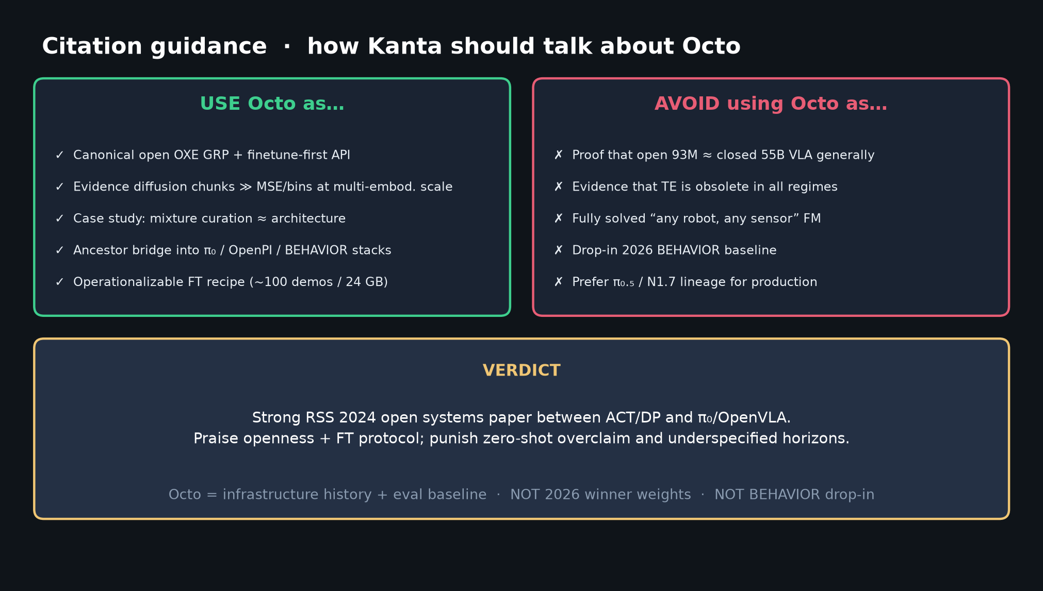
Stakeholder · 18+3 · 16/18
Notes:
CITATION BOUNDARY for leadership.
USE: open FT ancestor / eval baseline / mixture lessons.
AVOID: 2026 BEHAVIOR drop-in weights; open≈RT-2-X proof.

Slide 17
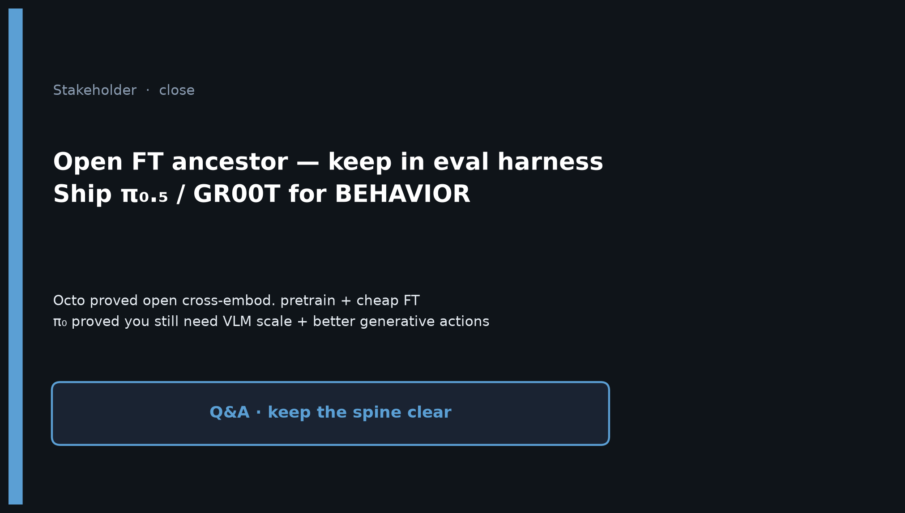
Stakeholder · 18+3 · 17/18
Notes:
CLOSE — keep Octo in eval harness; ship π₀.₅/GR00T for Oct 16 BEHAVIOR push.
Q&A: cost of FT, why not Octo weights in 2026, what we steal (adapters, mix discipline).

Slide 18
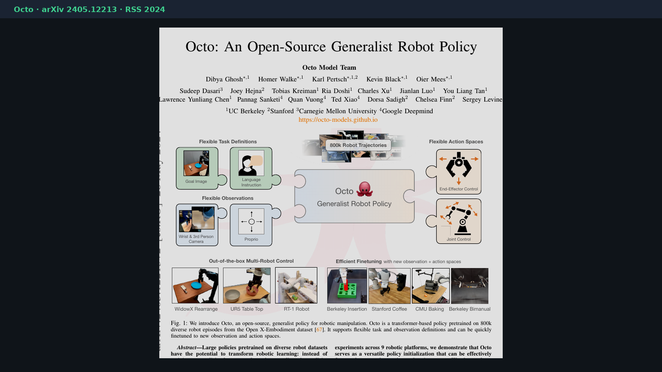
Stakeholder · 18+3 · 18/18
Notes:
BACKUP — paper cover / bibliography.
Octo Model Team, arXiv 2405.12213, RSS 2024. HF rail-berkeley/octo-base|small.

