Slide 1
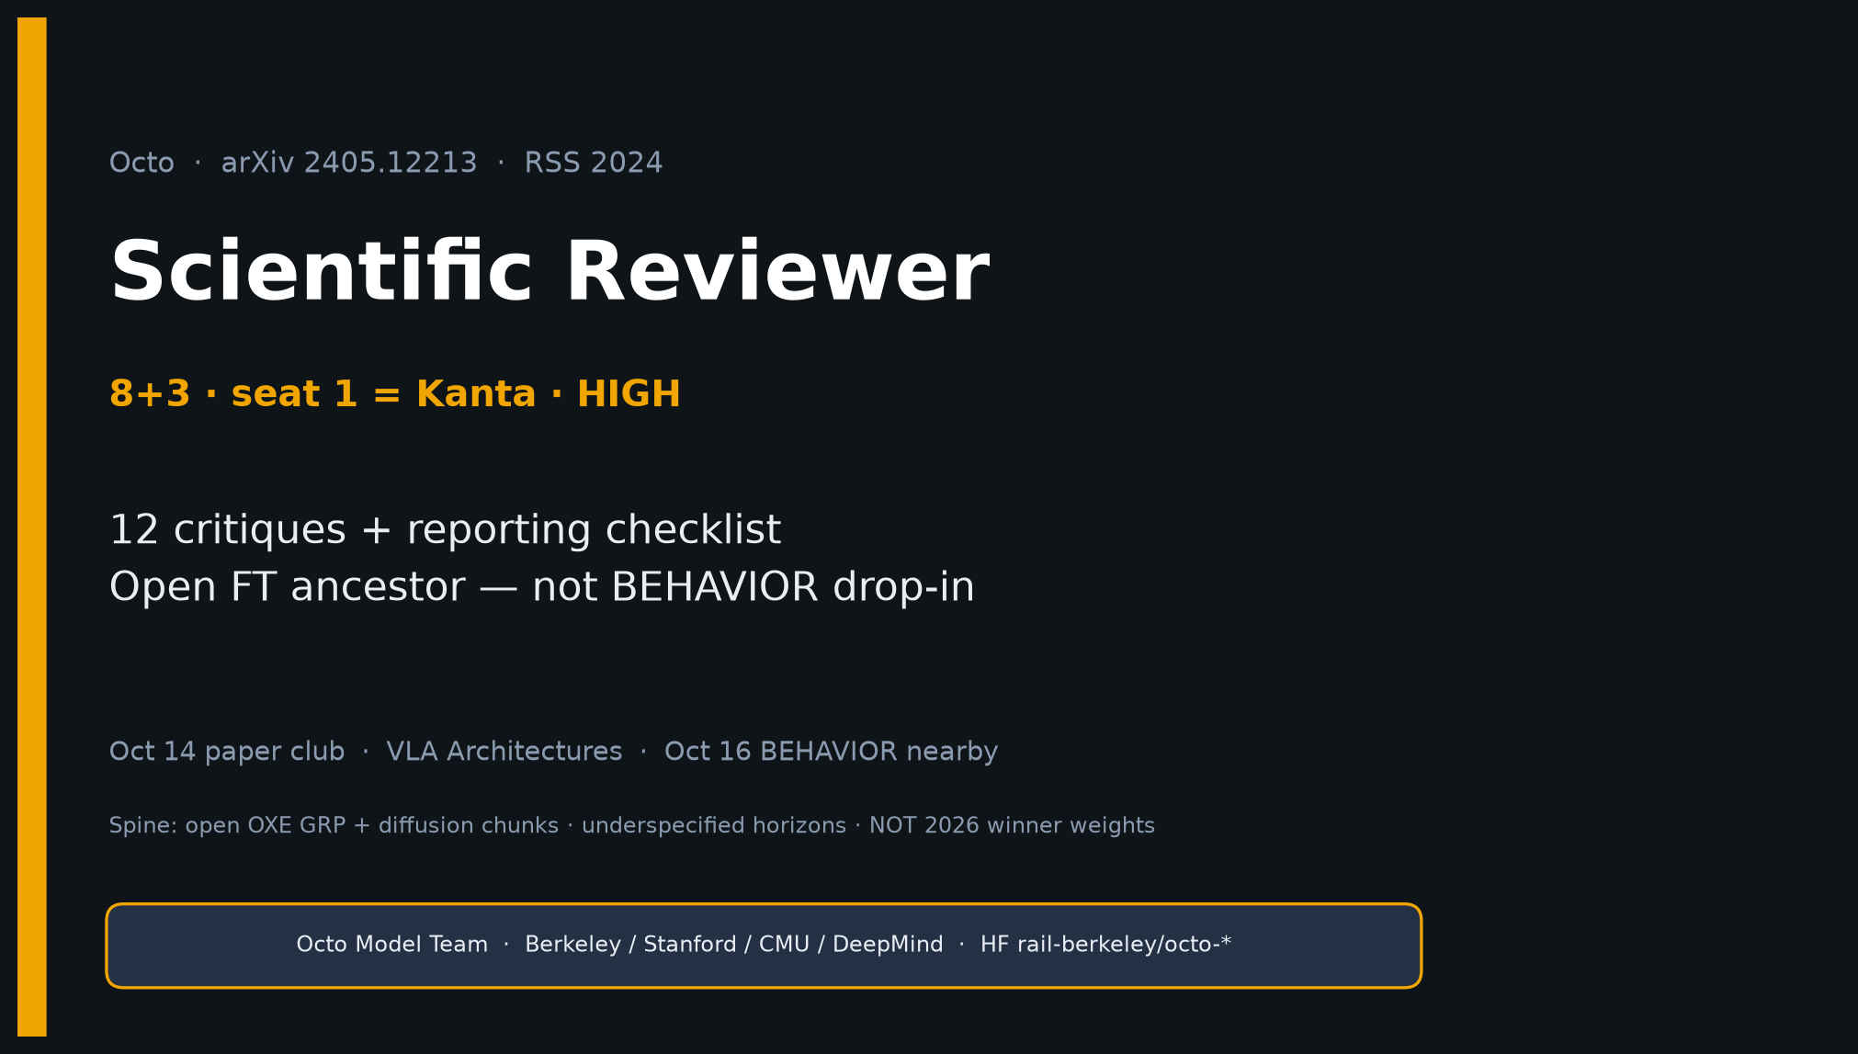
Scientific Reviewer · 8+3 · 1/14
Notes:
SCIENTIFIC REVIEWER — seat 1 = Kanta (YOU) · HIGH PRIORITY · timing 8+3.
ONE SENTENCE for the room:
Octo is a strong RSS 2024 open systems paper — open OXE GRP + diffusion chunks + operationalizable FT — between ACT/DP and π₀/OpenVLA. Not 2026 winner weights; not BEHAVIOR drop-in.
MUST DELIVER:
• Steelman (open + compositional I/O + diffusion chunks + FT recipe)
• ALL 12 actionable critiques (THE talk figure)
• Reporting checklist: pair 72% / +29% / 83% / cite 5% novel skill
• Citation guidance: open FT ancestor — NOT proof open≈RT-2-X or BEHAVIOR drop-in
• Verdict: praise openness+FT; punish zero-shot overclaim + underspecified horizons
GitHub title: [ECE 605] - Octo Making Scientific Reviewer

Slide 2
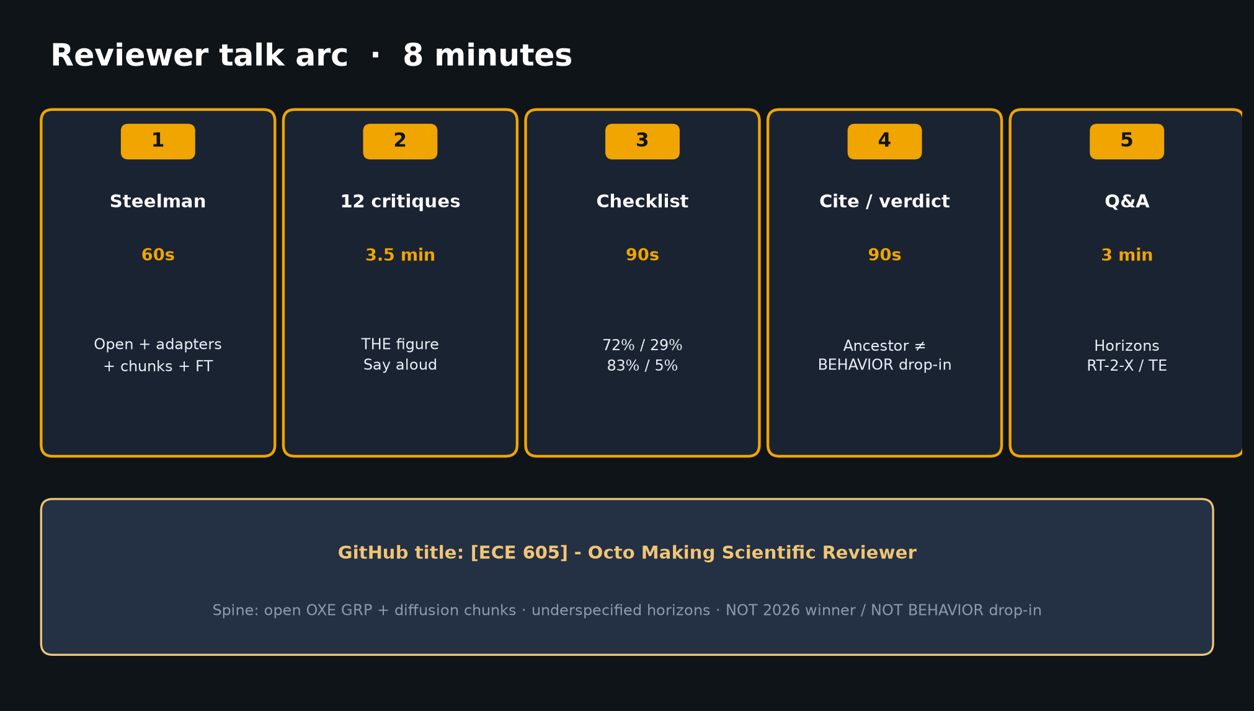
Scientific Reviewer · 8+3 · 2/14
Notes:
TALK ARC — 8 minutes. Do not overrun critiques.
1) Steelman ~60s
2) 12 critiques ~3.5 min — THE figure; say aloud
3) Reporting checklist ~90s
4) Cite guidance + verdict ~90s
5) Q&A 3 min — horizons, RT-2-X, TE
Spine: open OXE GRP + diffusion chunks; underspecified horizons; NOT 2026 winner / NOT BEHAVIOR drop-in.

Slide 3
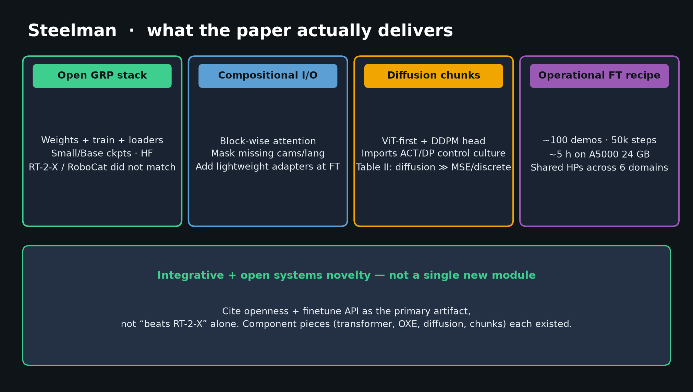
Scientific Reviewer · 8+3 · 3/14
Notes:
STEELMAN — what the paper actually delivers. Lead with praise so critiques land.
1. First widely used fully open GRP stack at OXE scale (weights+train+loaders).
2. Compositional I/O: block-wise attention + readout heads — long-term prior.
3. Diffusion chunk head on ViT-first — correct ACT/DP import; Table II diffusion ≫ MSE/discrete.
4. Standardized FT recipe (~100 demos, 50k, full update, hours on 24 GB) — rare honesty.
Say: “Integrative + open systems novelty — not a single new module. Cite openness + FT API as primary artifact, not ‘beats RT-2-X’ alone.”

Slide 4
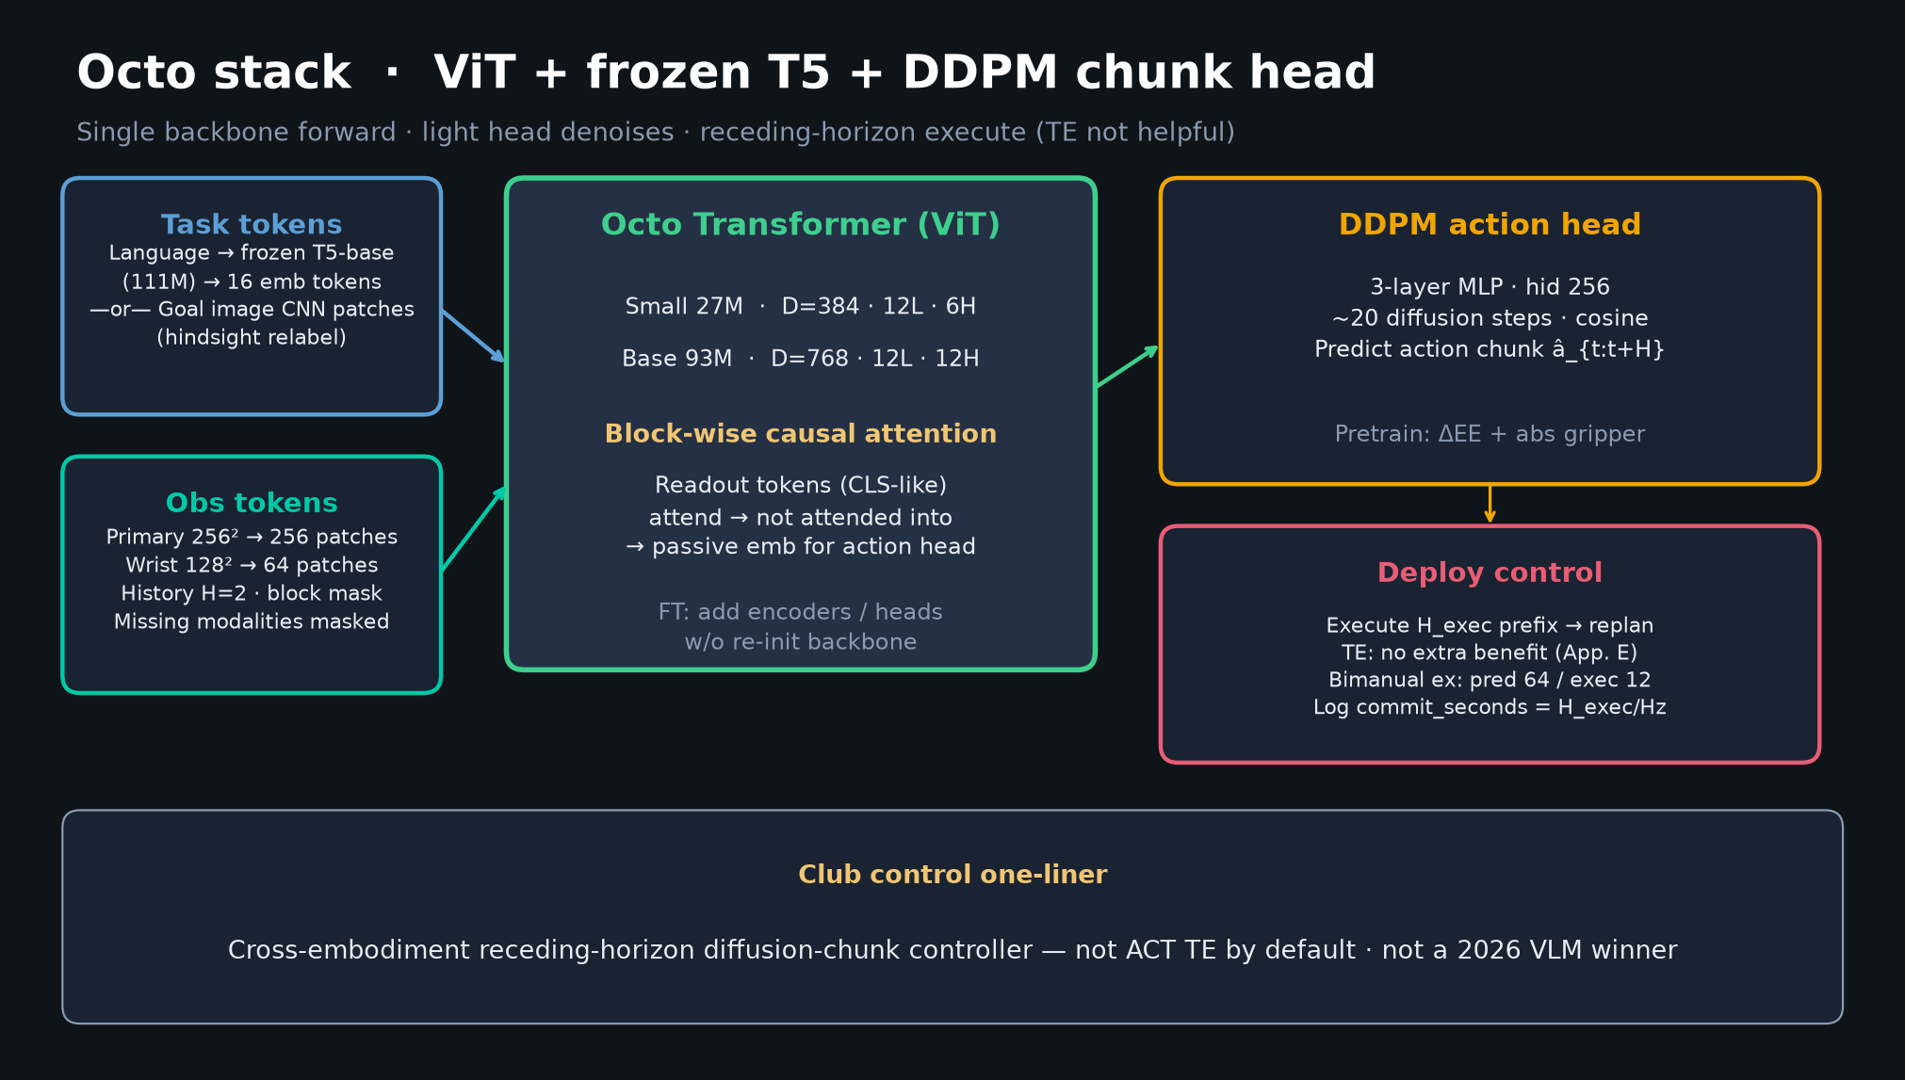
Scientific Reviewer · 8+3 · 4/14
Notes:
ARCHITECTURE — ViT + frozen T5 + DDPM chunk head. Point once for shared vocabulary.
• Task: T5-base frozen → 16 tokens OR goal image
• Obs: CNN patches; H=2; block mask
• Small 27M / Base 93M
• Readout → 3-layer MLP DDPM ~20 steps → action chunk
• Deploy: receding H_exec; TE not helpful (App. E); bimanual 64/12
• Log commit_seconds = H_exec/Hz
Underspecified horizons return in critiques #6.

Slide 5
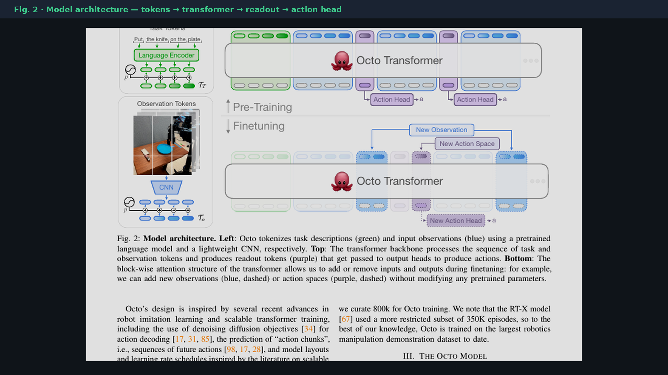
Scientific Reviewer · 8+3 · 5/14
Notes:
PAPER FIG 2 — bibliographic architecture crop. 20–30s glance if someone wants the paper diagram.

Slide 6
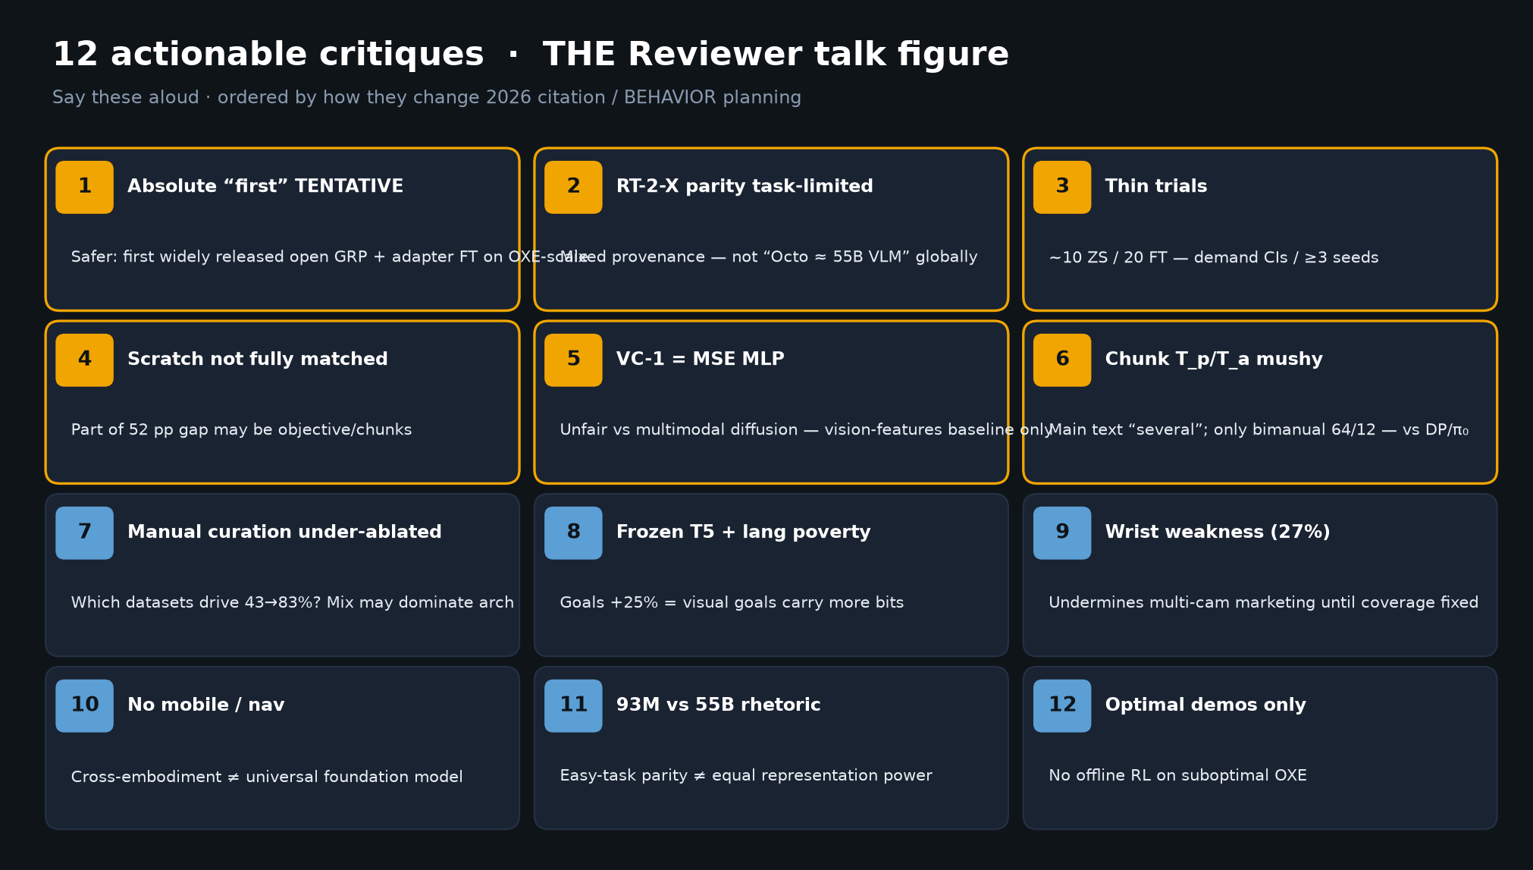
Scientific Reviewer · 8+3 · 6/14
Notes:
12 ACTIONABLE CRITIQUES — THE TALK FIGURE. Spend ~3.5 minutes. Say these aloud.
1 Absolute “first” TENTATIVE — safer: first widely released open GRP + adapter FT on OXE-scale
2 RT-2-X parity task-limited / mixed provenance — not Octo≈55B VLM
3 Thin trials (~10 ZS / 20 FT) — demand CIs/seeds
4 Scratch/VC-1 not fully matched to diffusion+chunks — part of 52pp may be objective
5 VC-1 uses MSE MLP — unfair vs multimodal diffusion
6 Chunk Tp/Ta underspecified (“several”); only bimanual 64/12 — mushy vs DP/π₀
7 Manual data curation under-ablated (which datasets drive 43→83%)
8 Frozen T5 + lang poverty; goals +25% = visual goals carry more bits
9 Wrist weakness admitted (27% coverage) — undermines multi-cam marketing
10 No mobile/nav — cross-embodiment ≠ universal FM
11 93M vs 55B compute rhetoric ≠ equal representation
12 Optimal demos only — no offline RL on suboptimal OXE
High severity cluster: 3, 4–5, 6, 7, 9.

Slide 7
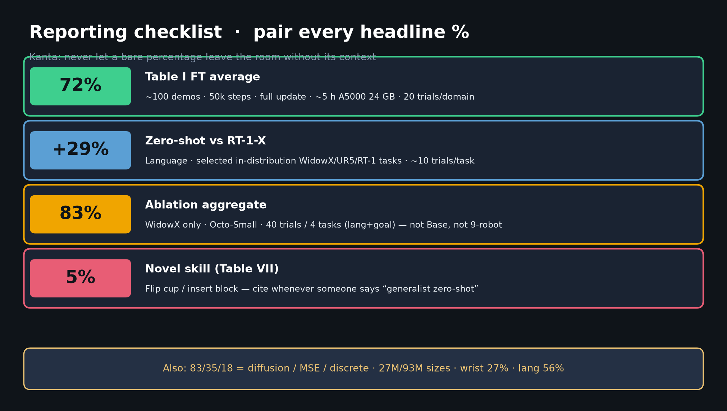
Scientific Reviewer · 8+3 · 7/14
Notes:
REPORTING CHECKLIST — pair every headline %.
• 72% ↔ Table I + ~100 demos / 50k / A5000 / 20 trials/domain
• +29% ↔ vs RT-1-X, selected lang, in-dist tasks
• 83% ↔ WidowX / Octo-Small / 40 trials — not Base, not 9-robot
• Cite 5% novel skill whenever someone says generalist zero-shot
Also tattoo: 83/35/18 · 27M/93M · wrist 27% · lang 56%.

Slide 8
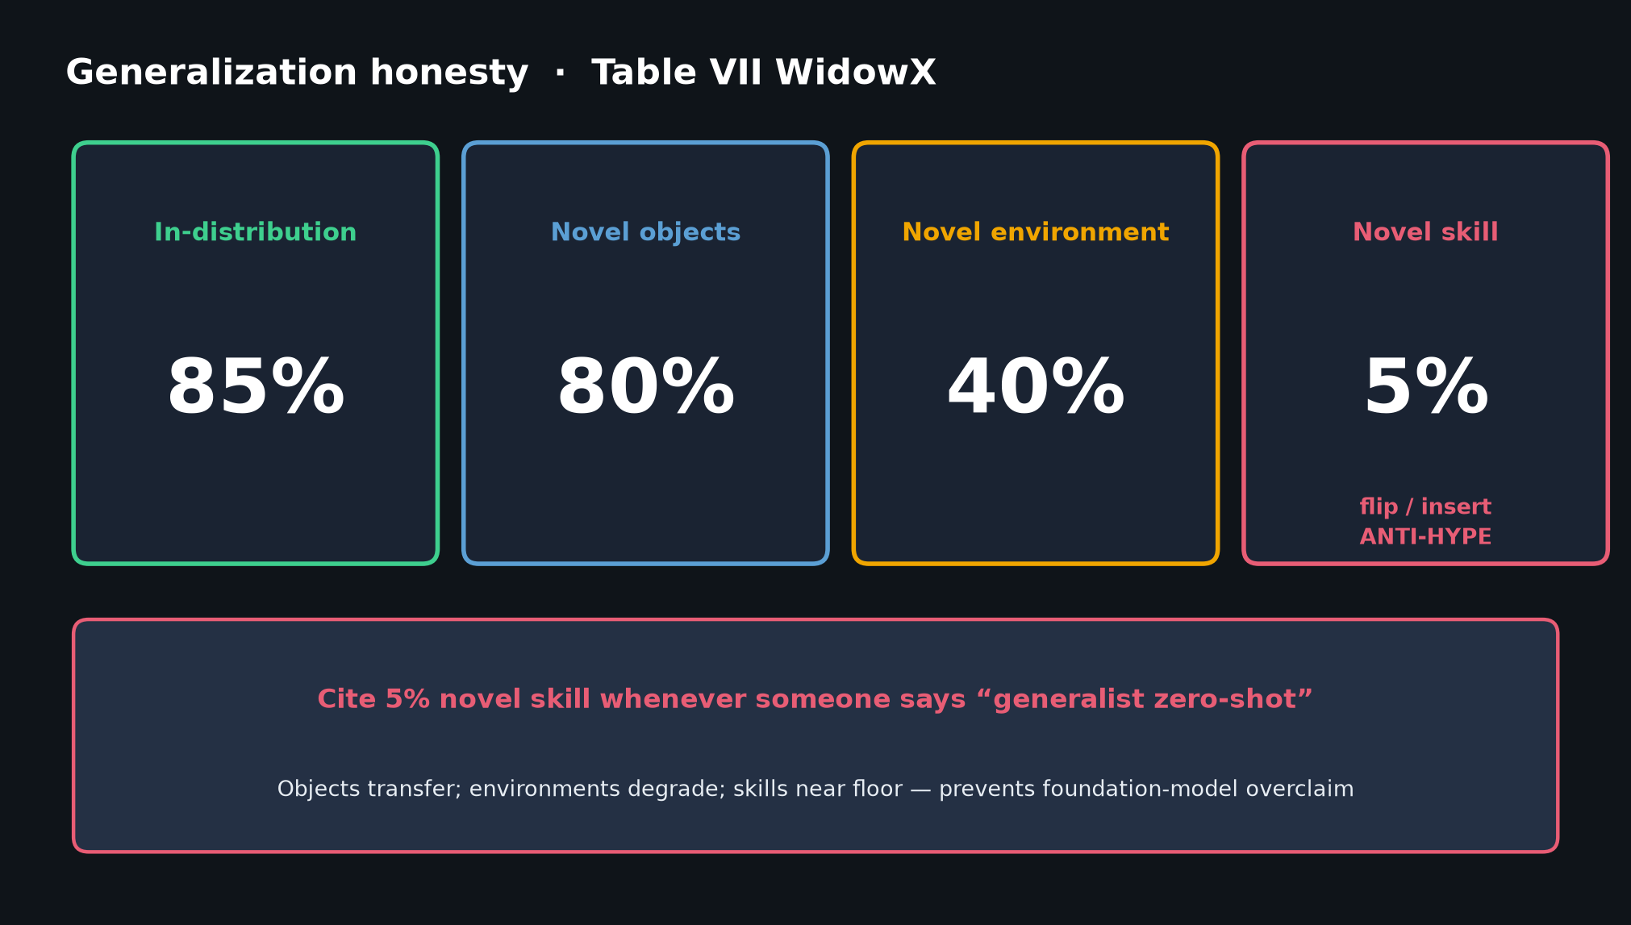
Scientific Reviewer · 8+3 · 8/14
Notes:
GENERALIZATION TABLE VII — anti-hype visual.
In-dist 85% · novel objects 80% · novel env 40% · novel skill 5%.
Say: “Objects transfer; environments degrade; skills near floor.”

Slide 9
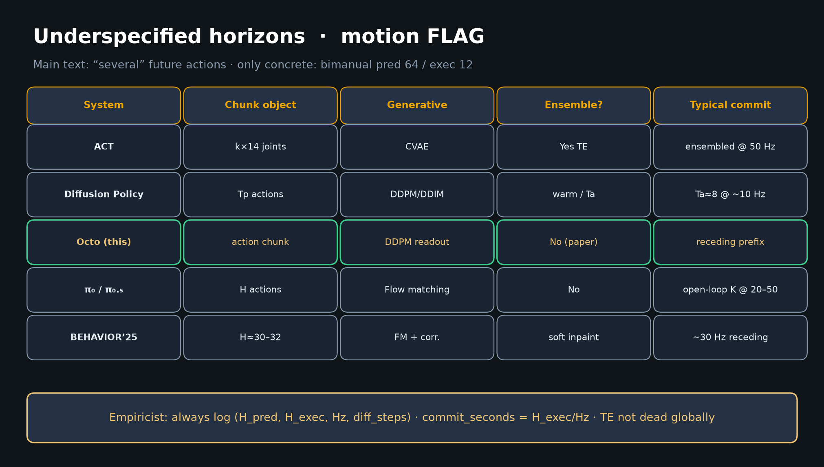
Scientific Reviewer · 8+3 · 9/14
Notes:
UNDERSPECIFIED HORIZONS — motion FLAG shared with Empiricist.
Octo: receding diffusion chunks; TE not helpful here — not “TE is dead globally.”
Normalize by commit_seconds vs ACT/DP/π₀/BEHAVIOR.
Demand (H_pred, H_exec, Hz, diff_steps) in every citation.

Slide 10
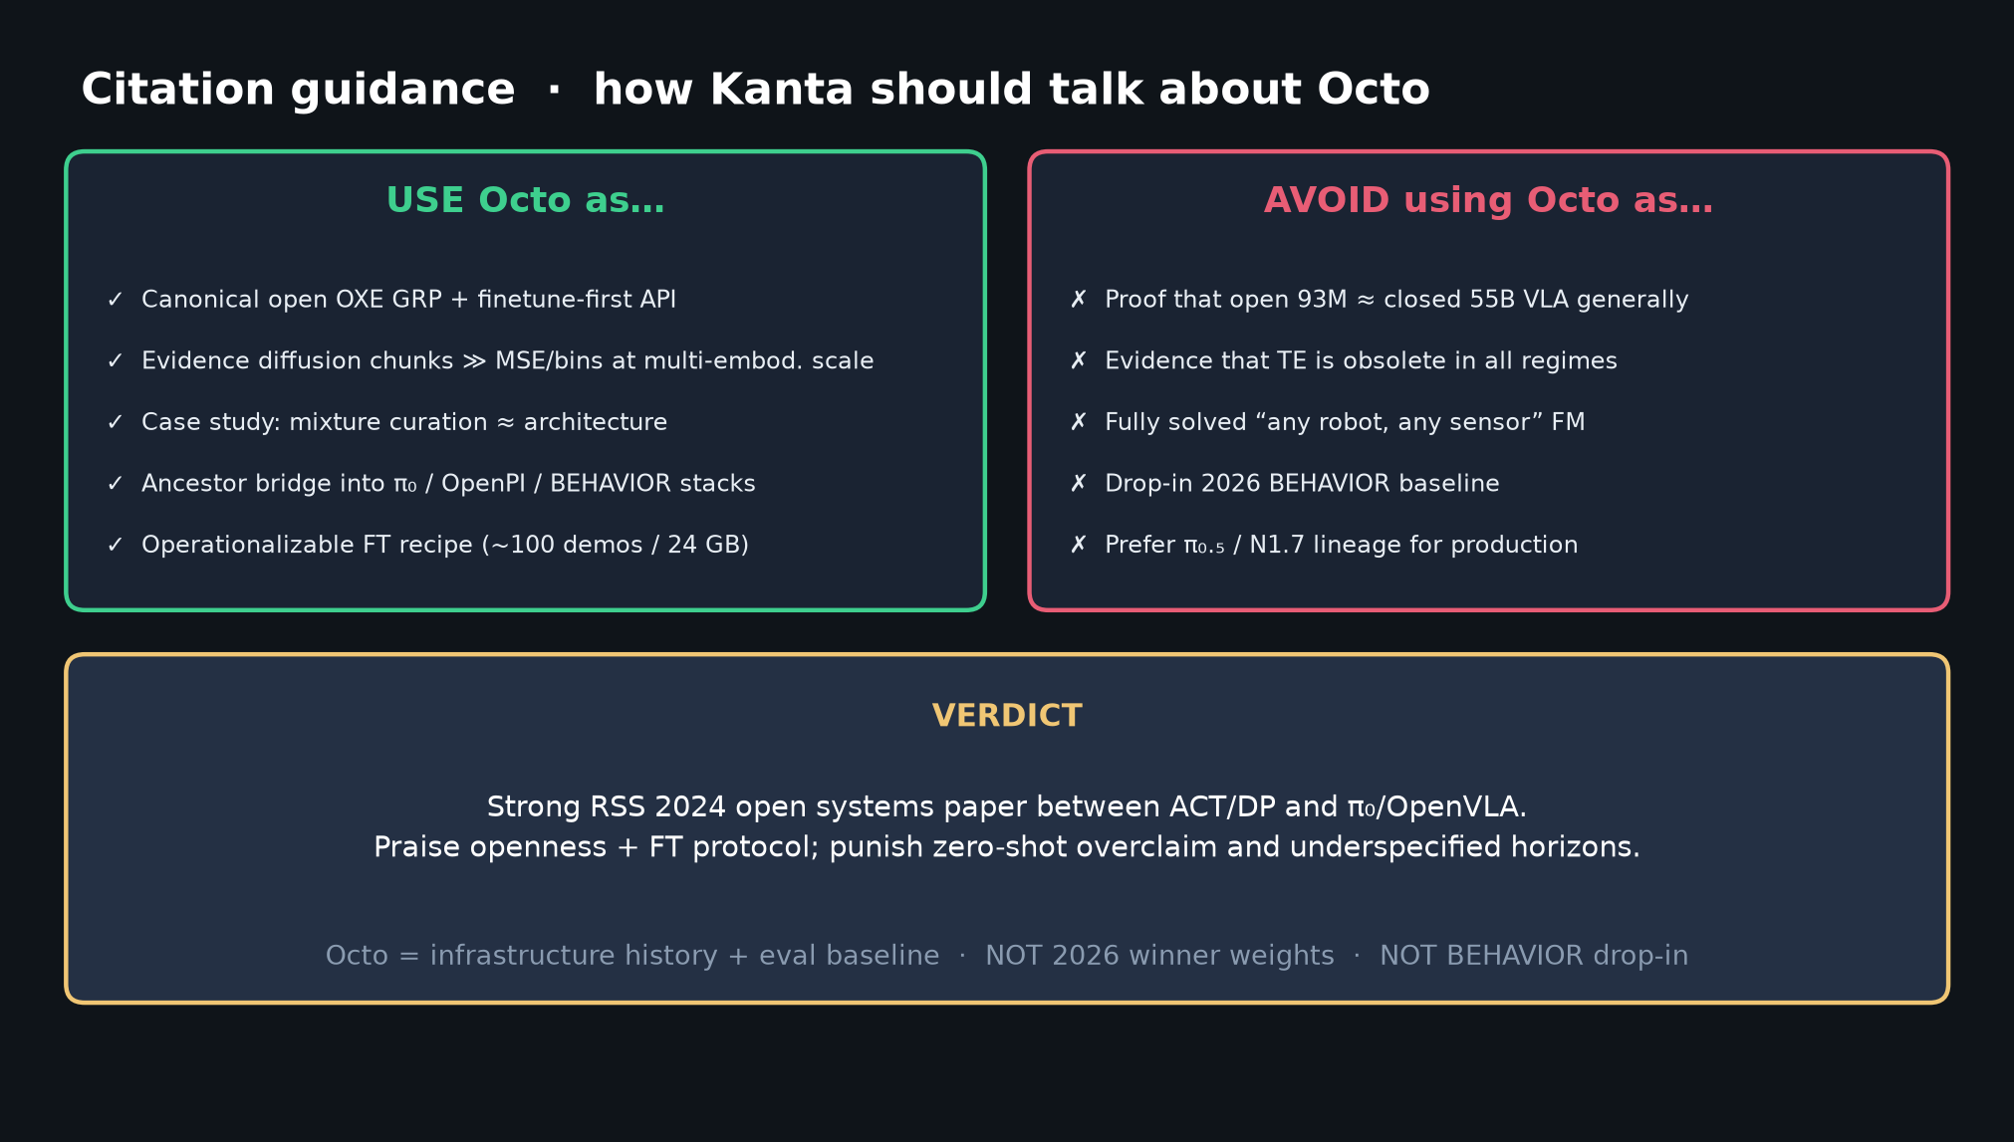
Scientific Reviewer · 8+3 · 10/14
Notes:
CITATION GUIDANCE + VERDICT.
USE: open FT ancestor / mixture case study / diffusion≻MSE evidence / bridge into π₀/OpenPI.
AVOID: proof open≈RT-2-X; TE obsolete everywhere; any-robot FM; 2026 BEHAVIOR drop-in (prefer π₀.₅/N1.7).
VERDICT: Strong RSS 2024 open systems paper between ACT/DP and π₀/OpenVLA.
Praise openness+FT protocol; punish zero-shot overclaim and underspecified horizons.

Slide 11
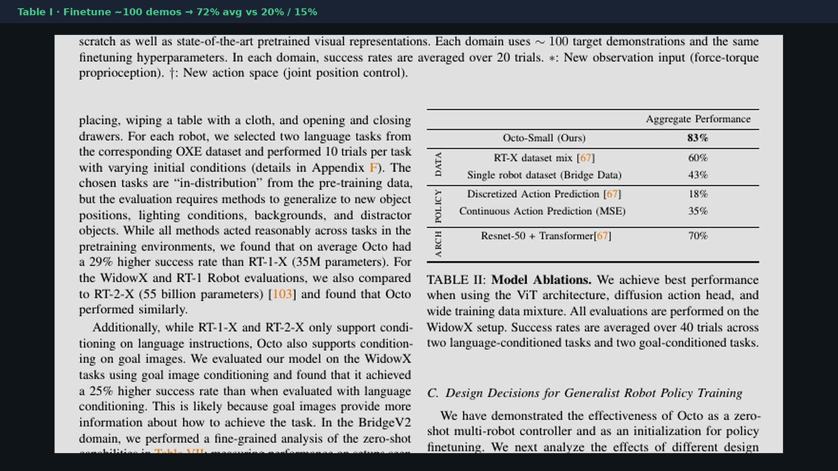
Scientific Reviewer · 8+3 · 11/14
Notes:
TABLE I evidence crop — FT 72% headline with context already in checklist.
Glance if challenged on the number.

Slide 12
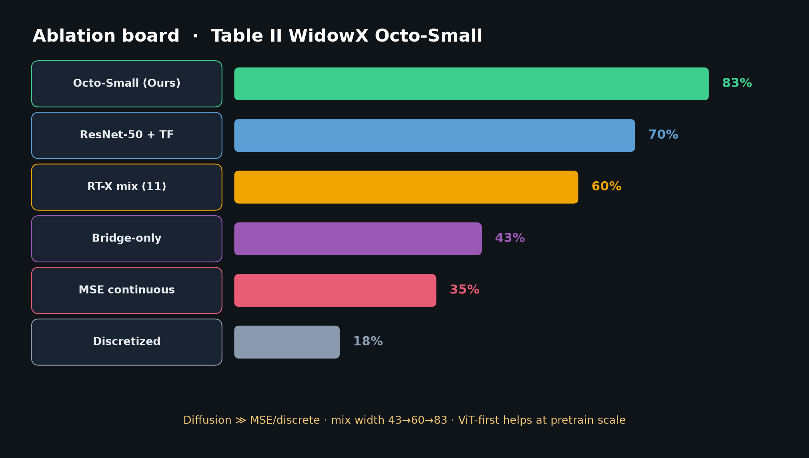
Scientific Reviewer · 8+3 · 12/14
Notes:
ABLATION BOARD — diffusion 83 vs MSE 35 vs discrete 18; mix 43→60→83.
Supports steelman #3 and critique #7.

Slide 13

Scientific Reviewer · 8+3 · 13/14
Notes:
Q&A CLOSE.
• “Is Octo ≈ RT-2-X?” → Only on limited shared tasks; mixed provenance; not 55B parity.
• “Is TE dead?” → Not globally; not helpful for Octo’s OXE FT settings.
• “Use for BEHAVIOR?” → Ancestor / eval baseline; ship π₀.₅/N1.7.
• “What’s underspecified?” → Chunk horizons in main text; demand commit_seconds.

Slide 14
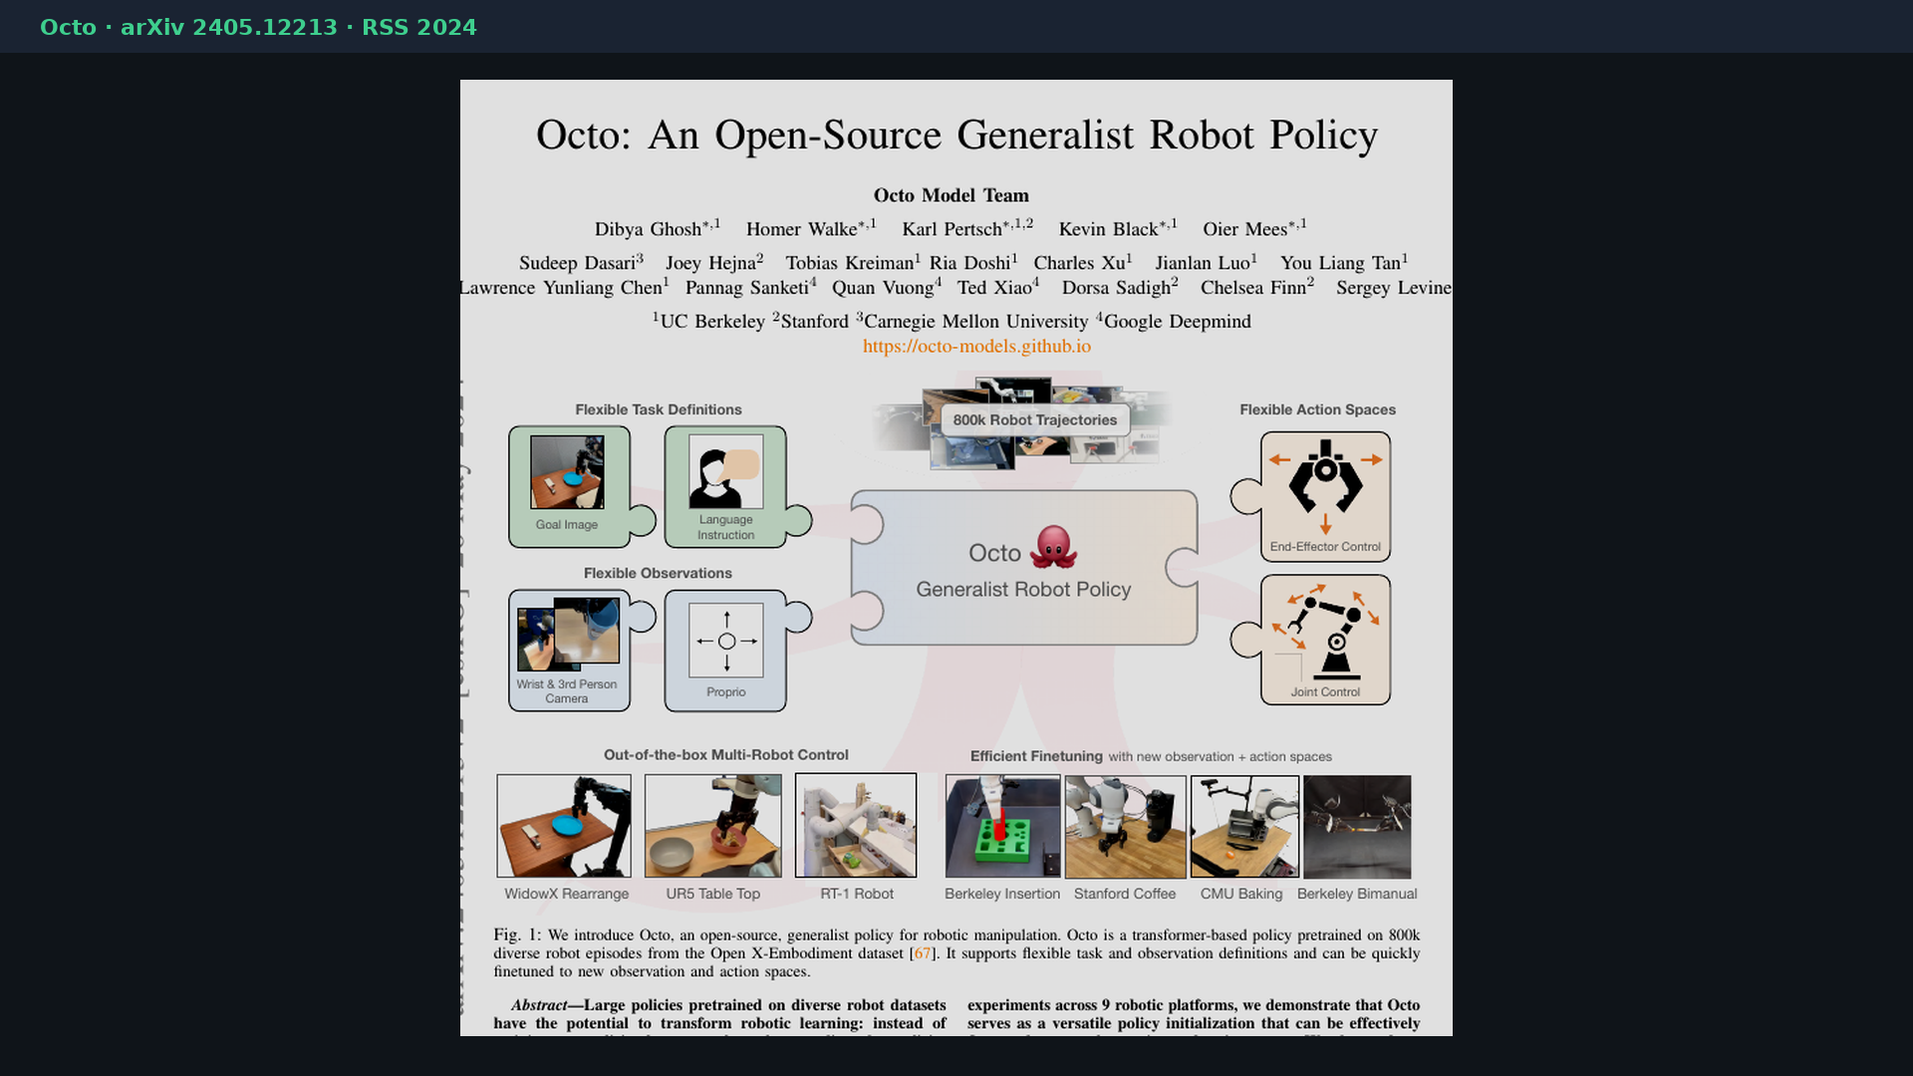
Scientific Reviewer · 8+3 · 14/14
Notes:
BACKUP — paper cover for bibliography if asked.
Octo: An Open-Source Generalist Robot Policy · arXiv 2405.12213 · RSS 2024.
Site: octo-models.github.io · code: github.com/octo-models/octo.

