Slide 1
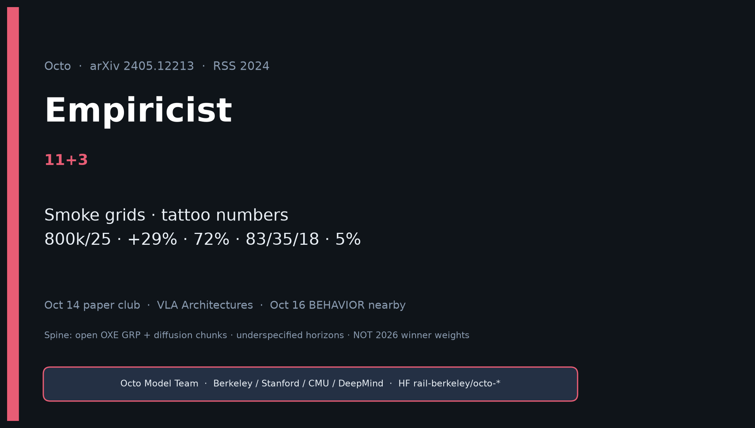
Empiricist · 11+3 · 1/14
Notes:
EMPIRICIST — 11+3. GPU-honest experiments; outlines only (no Slurm in quiet pack).
Tattoo aloud: 800k/25; +29%; 72%; 83/35/18; 27M/93M; novel skill 5%.
Pass bar: working open ckpt + Table II-aligned trends + one FT lift — not 9-robot parity.

Slide 2
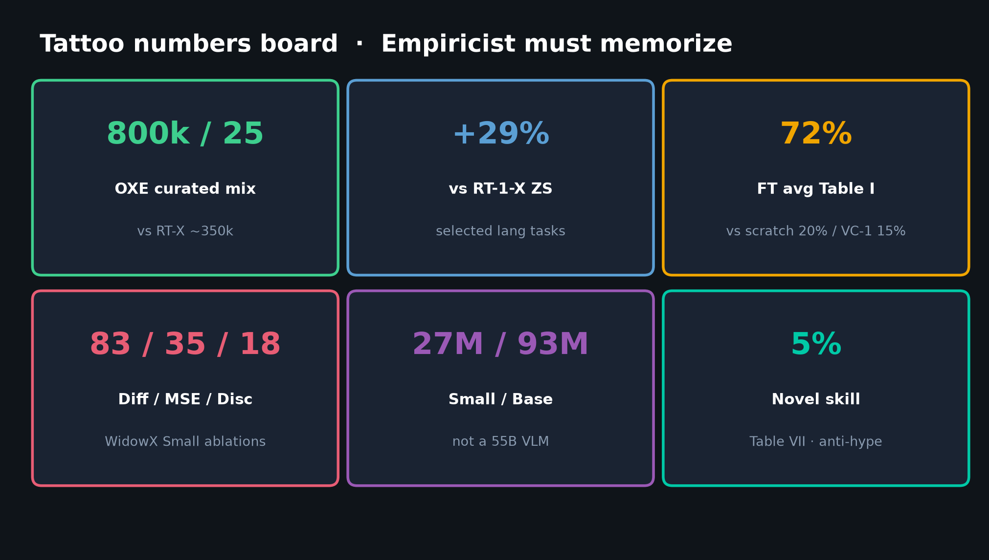
Empiricist · 11+3 · 2/14
Notes:
TATTOO NUMBERS BOARD — say aloud before any run.
800k/25; +29%; 72%; 83/35/18; 27M/93M; novel skill 5%.
Also: wrist 27%; lang 56%; goals +25 pp vs lang on WidowX.

Slide 3
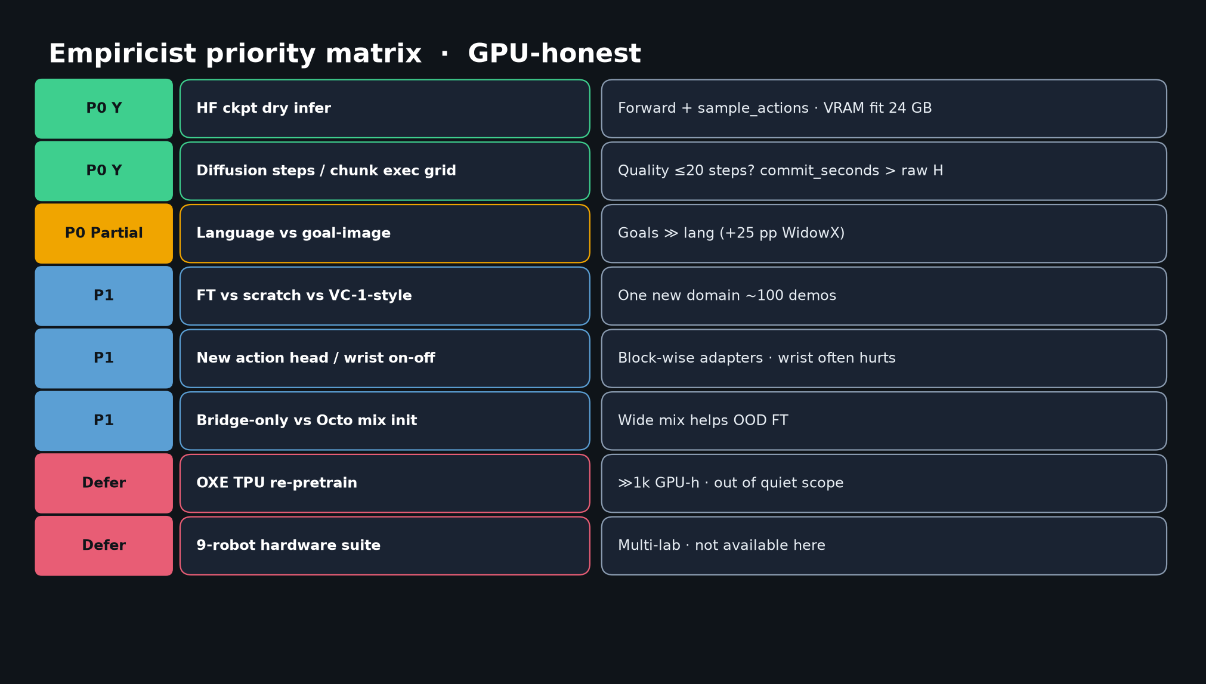
Empiricist · 11+3 · 3/14
Notes:
PRIORITY MATRIX — P0 dry infer + step/horizon grid; P0 Partial lang vs goal; P1 FT/adapters/mix; Defer TPU / 9-robot.

Slide 4
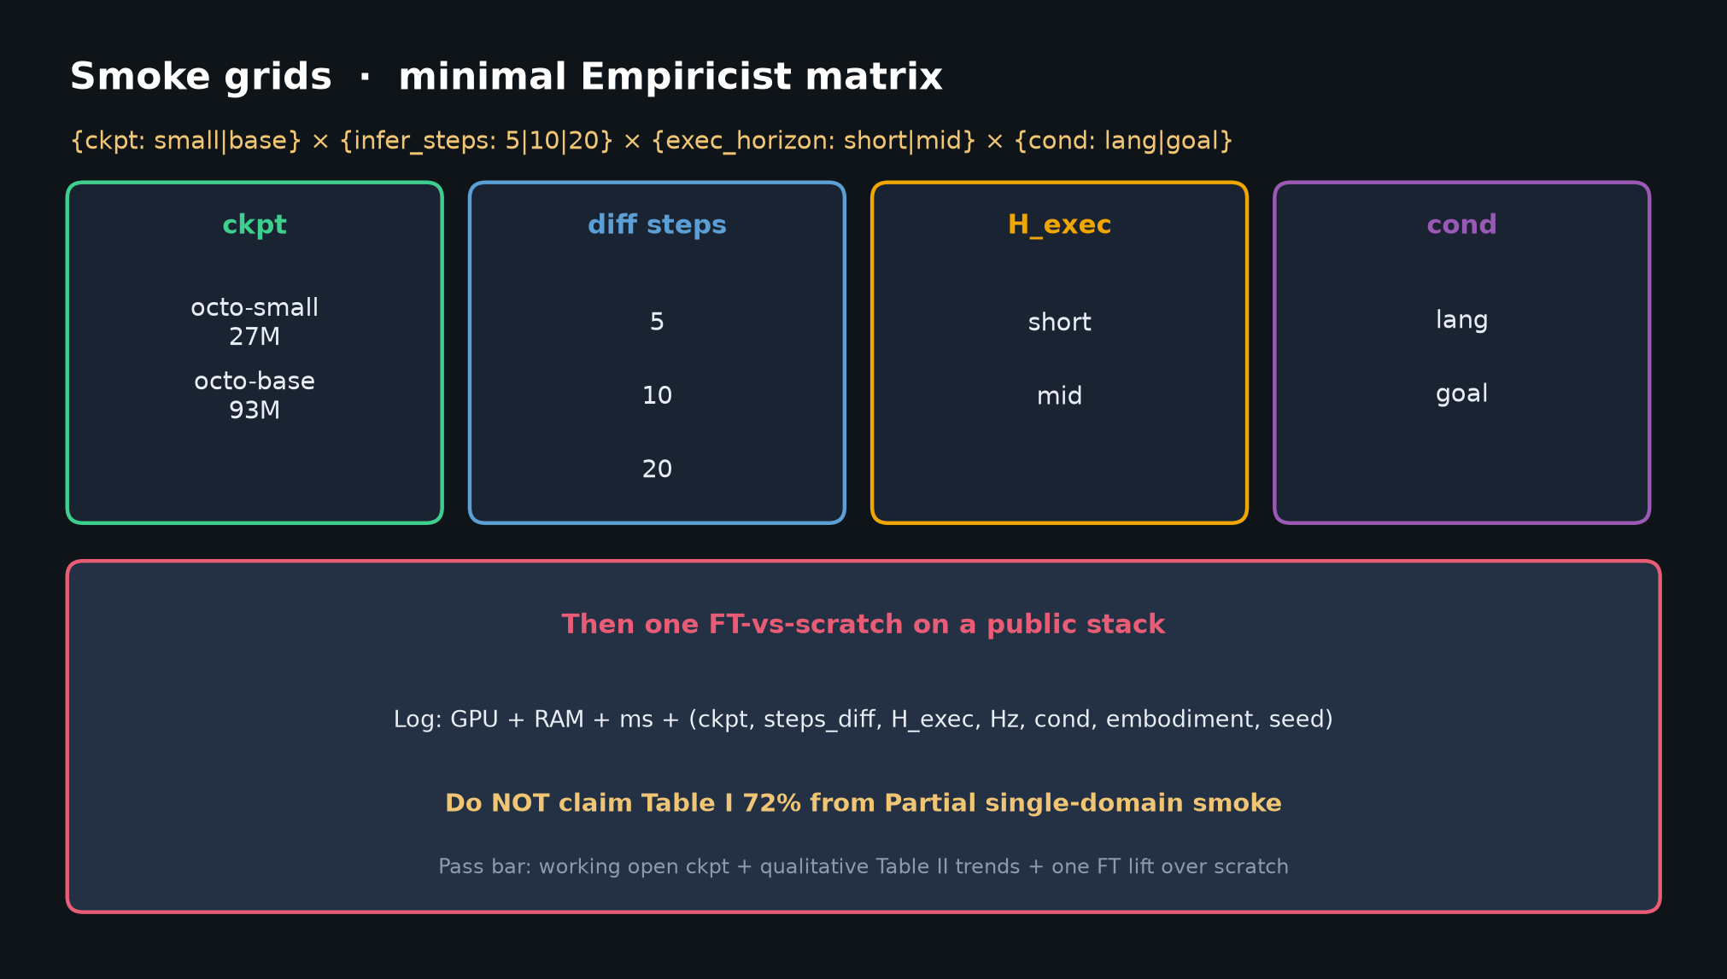
Empiricist · 11+3 · 4/14
Notes:
SMOKE GRIDS — {small|base} × {5|10|20} × {short|mid H_exec} × {lang|goal} then one FT-vs-scratch.
Log commit_seconds. Never claim Table I 72% from Partial smoke.

Slide 5
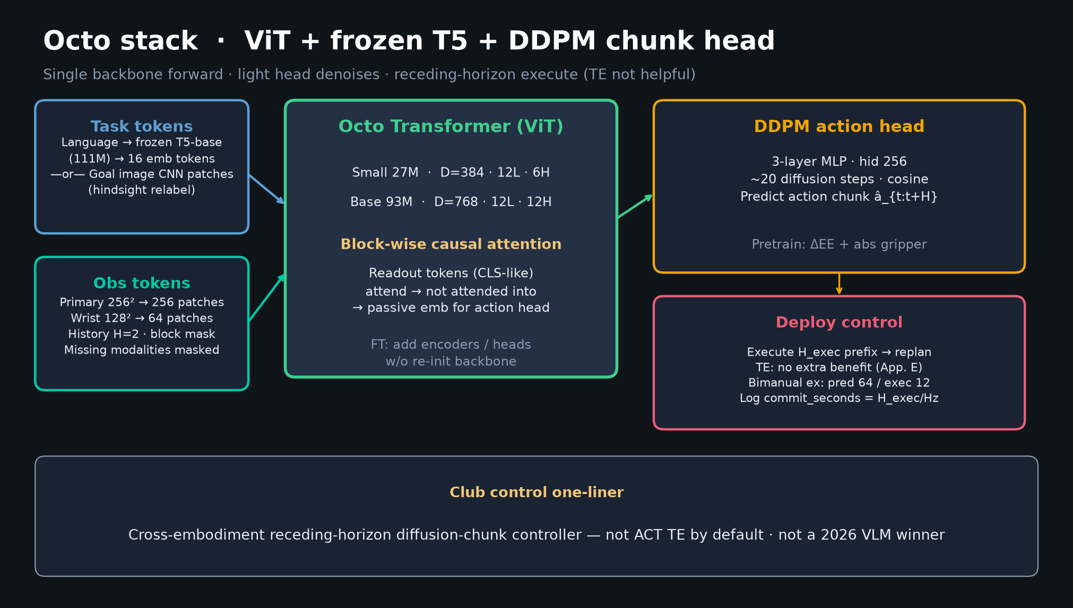
Empiricist · 11+3 · 5/14
Notes:
ARCHITECTURE checklist for implement.
Tokenizers → ViT (27M/93M) → readout → 3-layer MLP DDPM (~20 steps).
History H=2; block mask; FT add heads without backbone re-init.
Pin H_pred/H_exec from configs when cloning.

Slide 6
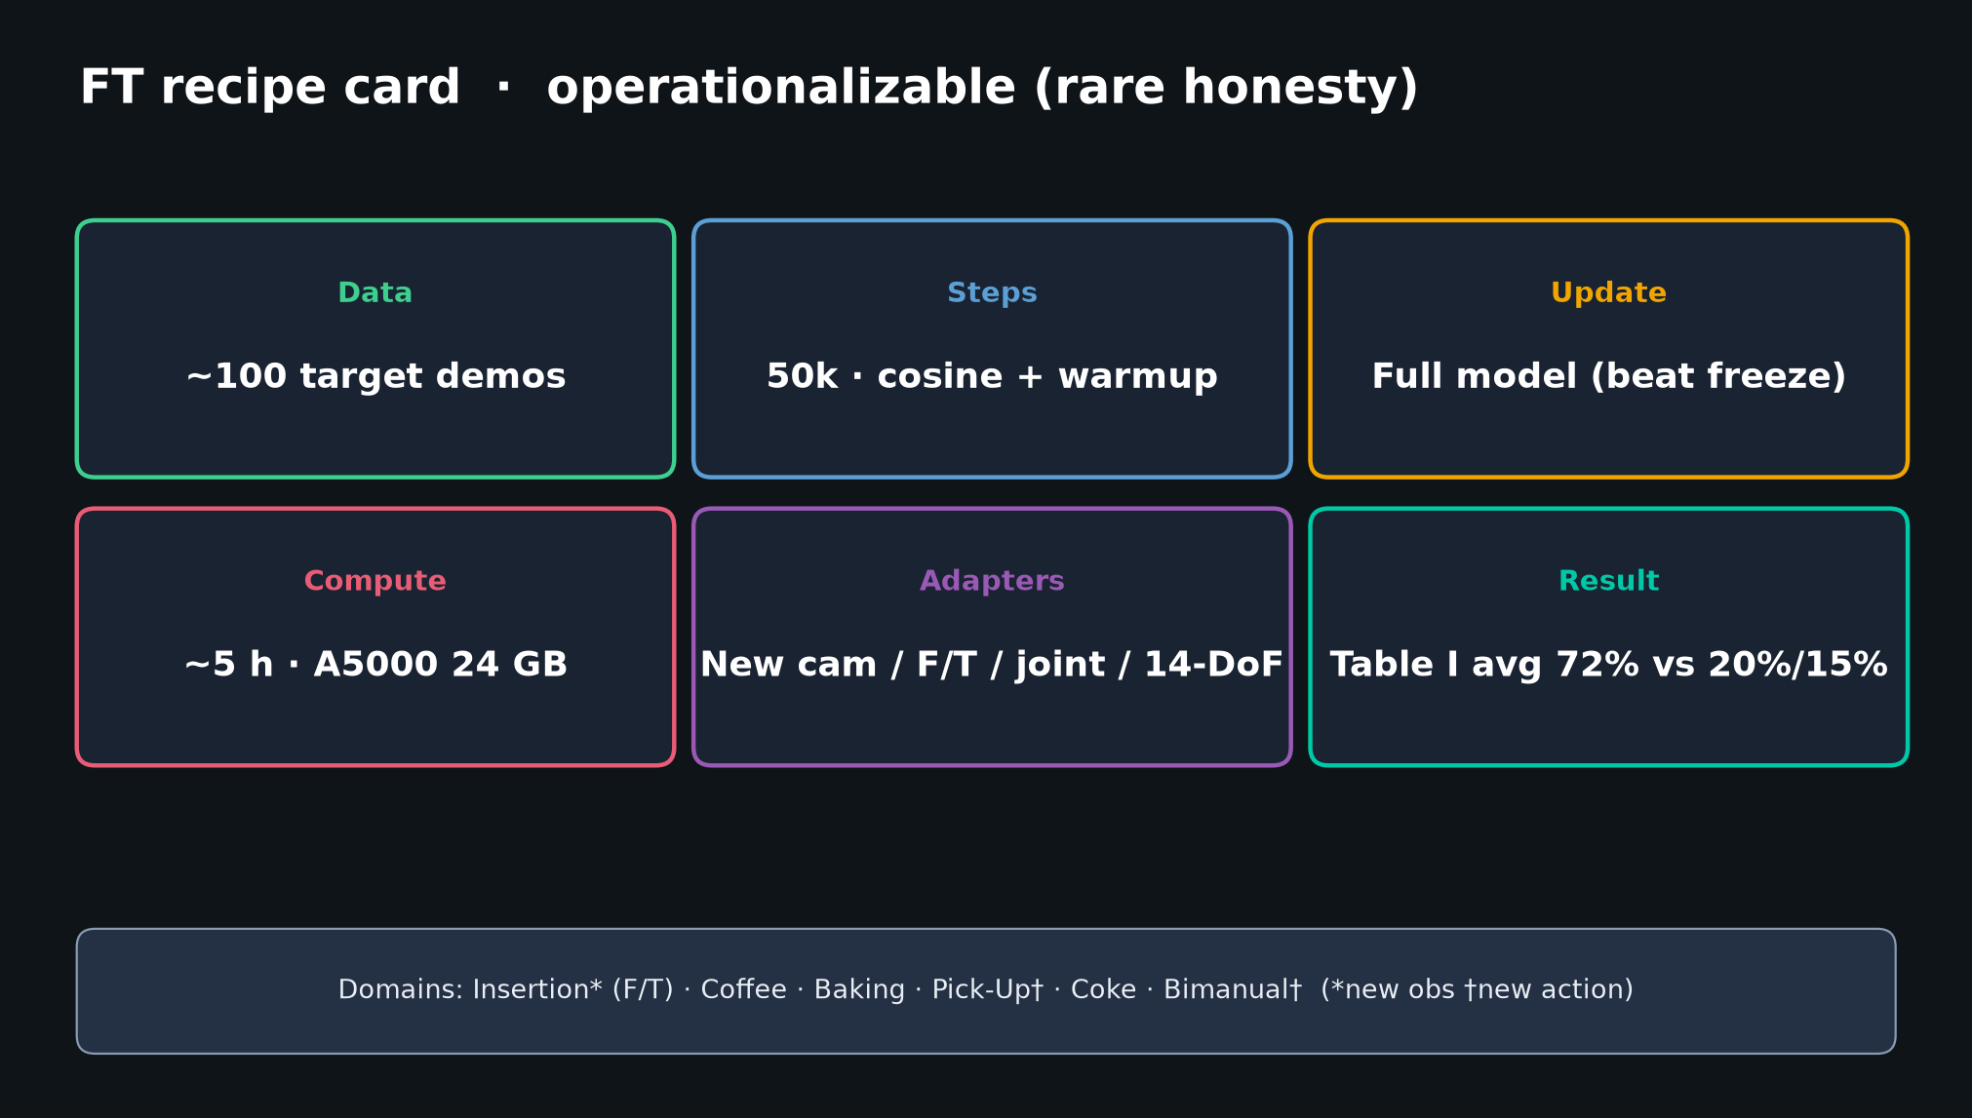
Empiricist · 11+3 · 6/14
Notes:
FT RECIPE — paper default.
~100 demos, 50k steps, cosine+warmup, full model update, ~5 h A5000 24 GB.
Shared HPs across domains is the claim — match it before citing Table I.

Slide 7
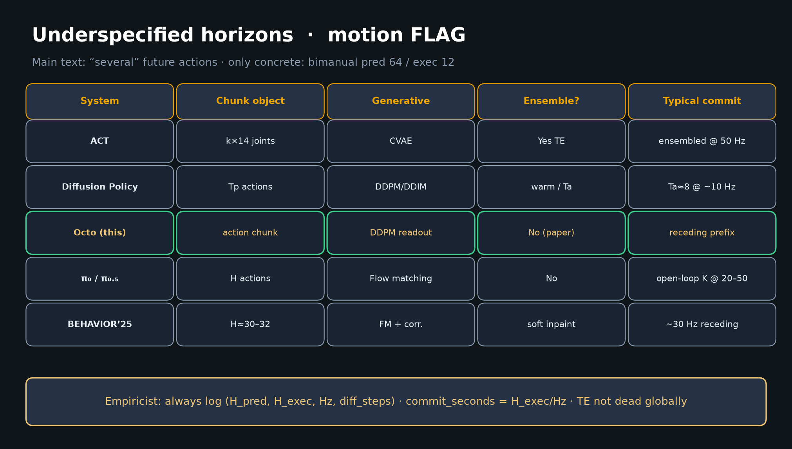
Empiricist · 11+3 · 7/14
Notes:
HORIZONS — Empiricist ownership.
Normalize vs ACT/DP/π₀ by commit_seconds = H_exec/Hz.
TE not required for Octo; do not import ACT TE blindly.
Always log (H_pred, H_exec, Hz, diff_steps, cond, seed).

Slide 8
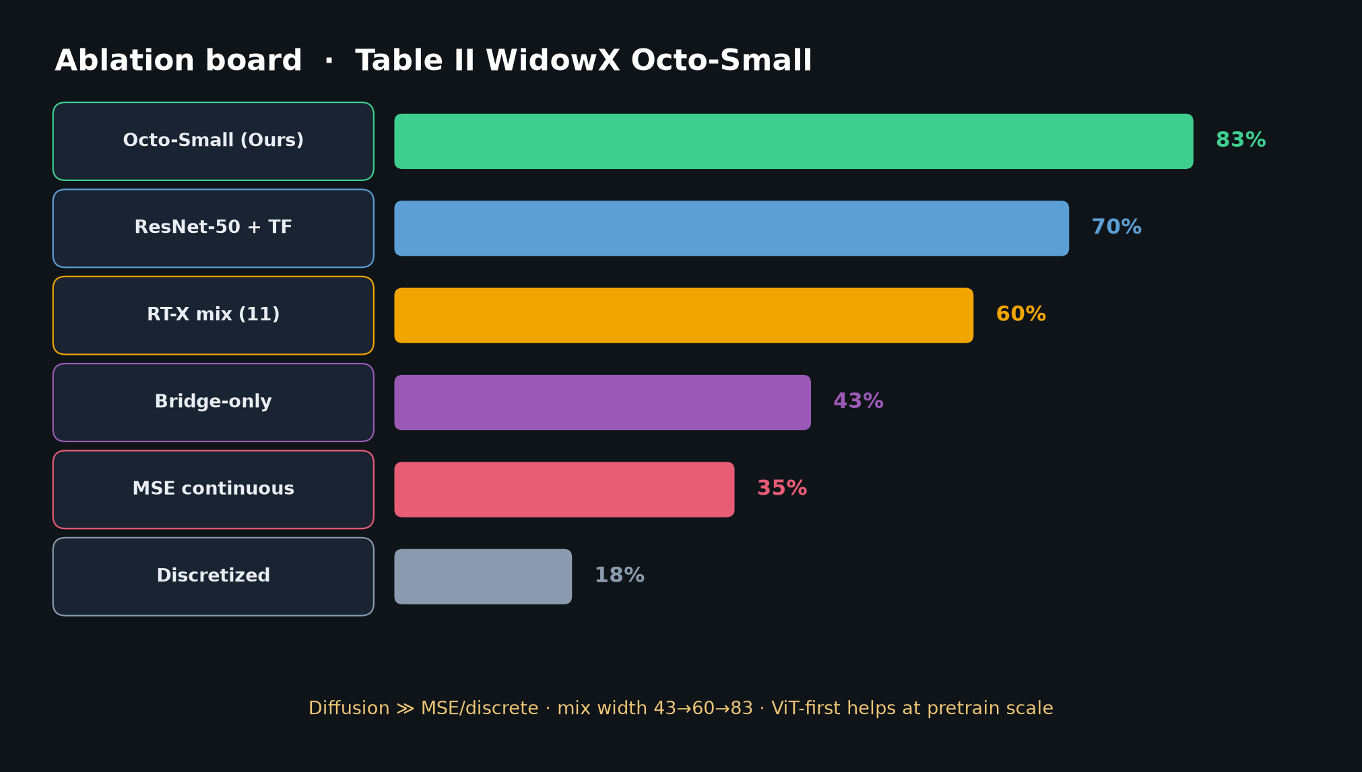
Empiricist · 11+3 · 8/14
Notes:
ABLATION TARGETS — reproduce rank order: diffusion > MSE > discrete; mix width helps.

Slide 9
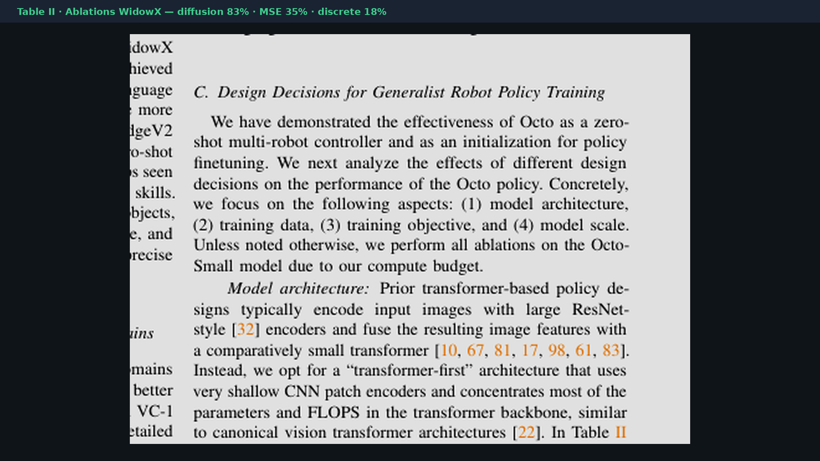
Empiricist · 11+3 · 9/14
Notes:
TABLE II paper crop — ablation targets.
Reproduce rank order: diffusion > MSE > discrete; wider mix helps.
WidowX Octo-Small aggregate — do not over-generalize to Base / 9 robots.

Slide 10
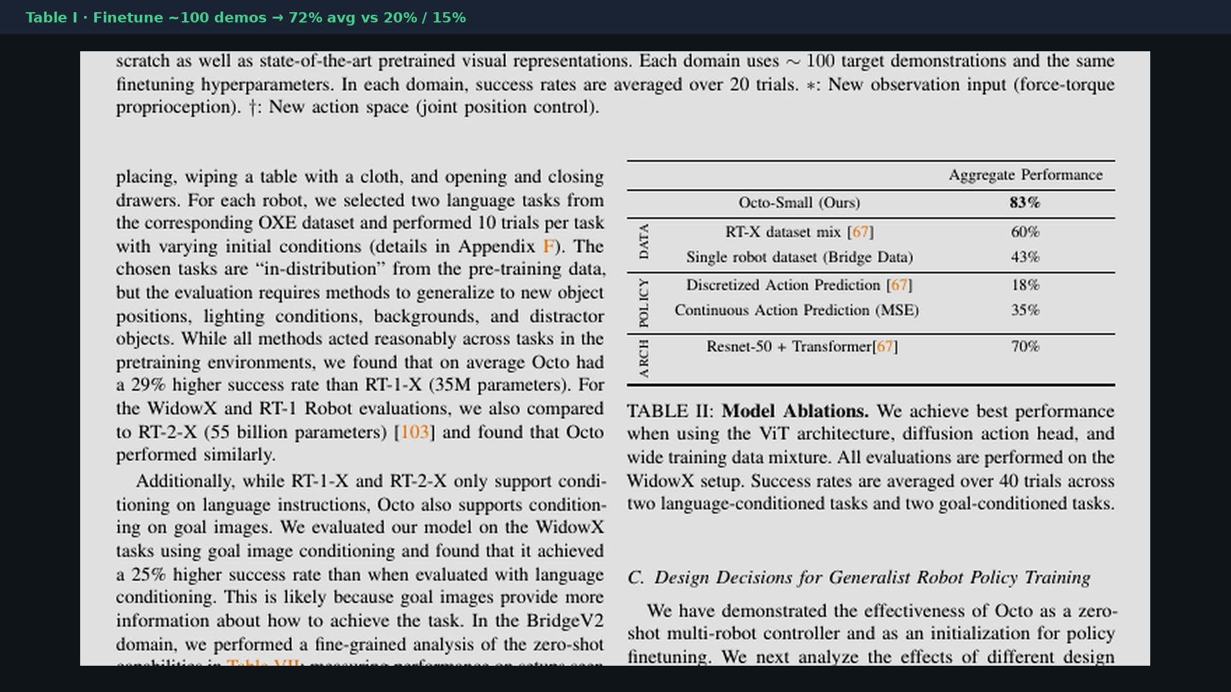
Empiricist · 11+3 · 10/14
Notes:
TABLE I — FT headline.
Only claim 72%-class after matched recipe on YOUR domain.
Partial single-domain smoke ≠ Table I average.

Slide 11
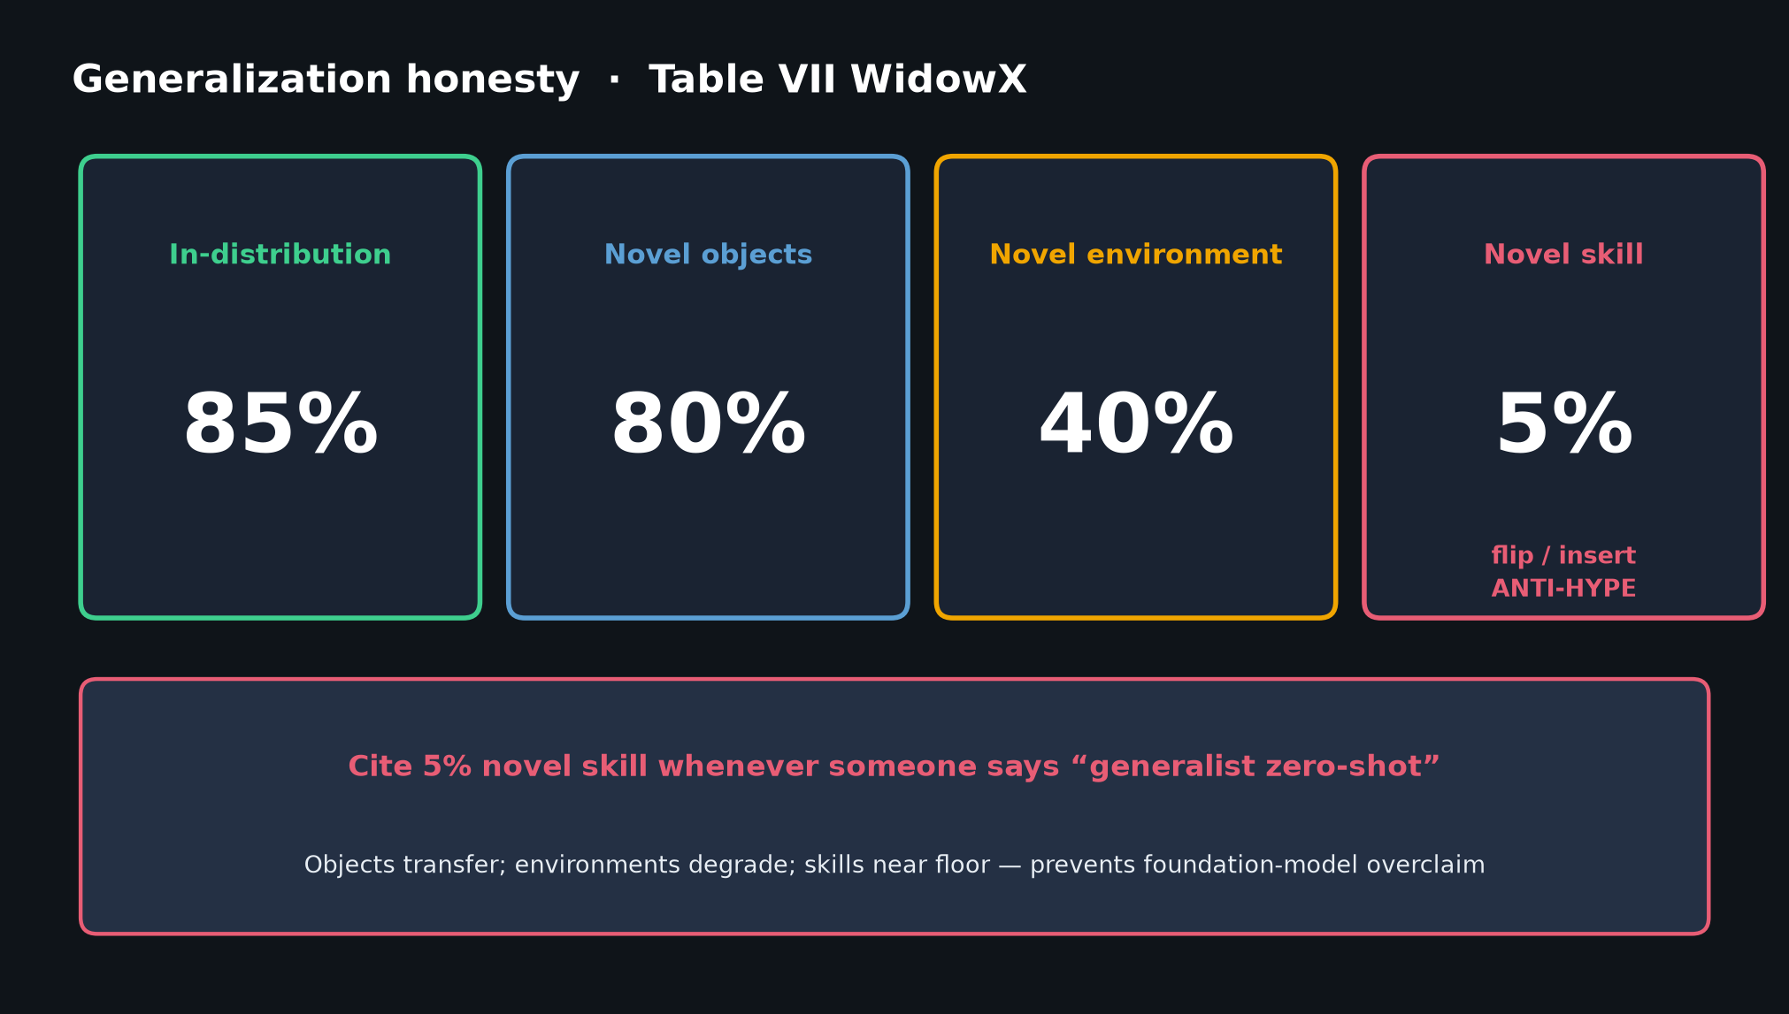
Empiricist · 11+3 · 11/14
Notes:
GEN / 5% — failure modes to expect.
Novel skills near floor; wrist underuse; language weaker than goals.
Falsifiers: MSE≈diffusion; scratch≈Octo FT; TE required.

Slide 12
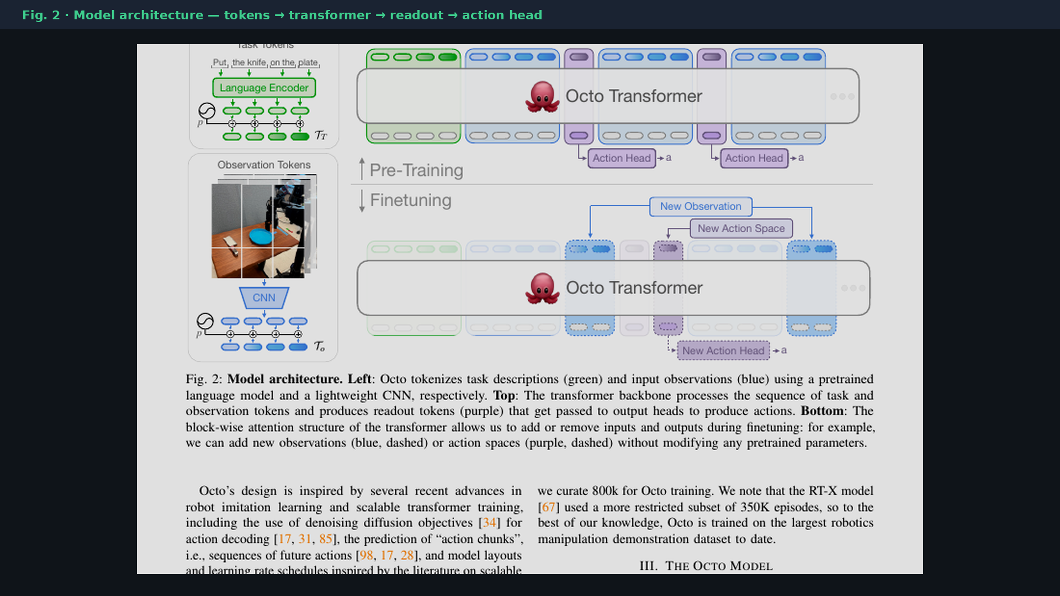
Empiricist · 11+3 · 12/14
Notes:
PAPER FIG 2 — implement visual.
Match token types, mask, readout, small diffusion head to code story.

Slide 13
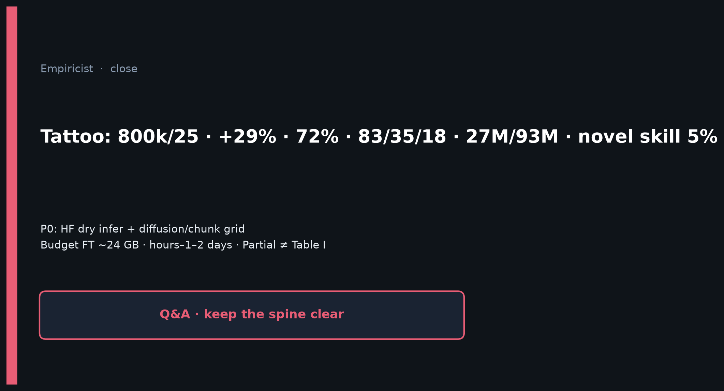
Empiricist · 11+3 · 13/14
Notes:
CLOSE — tattoos + P0 grids + honesty Partial≠Table I.
Env outlines: /workspace/octo-quiet/env_outline/

Slide 14
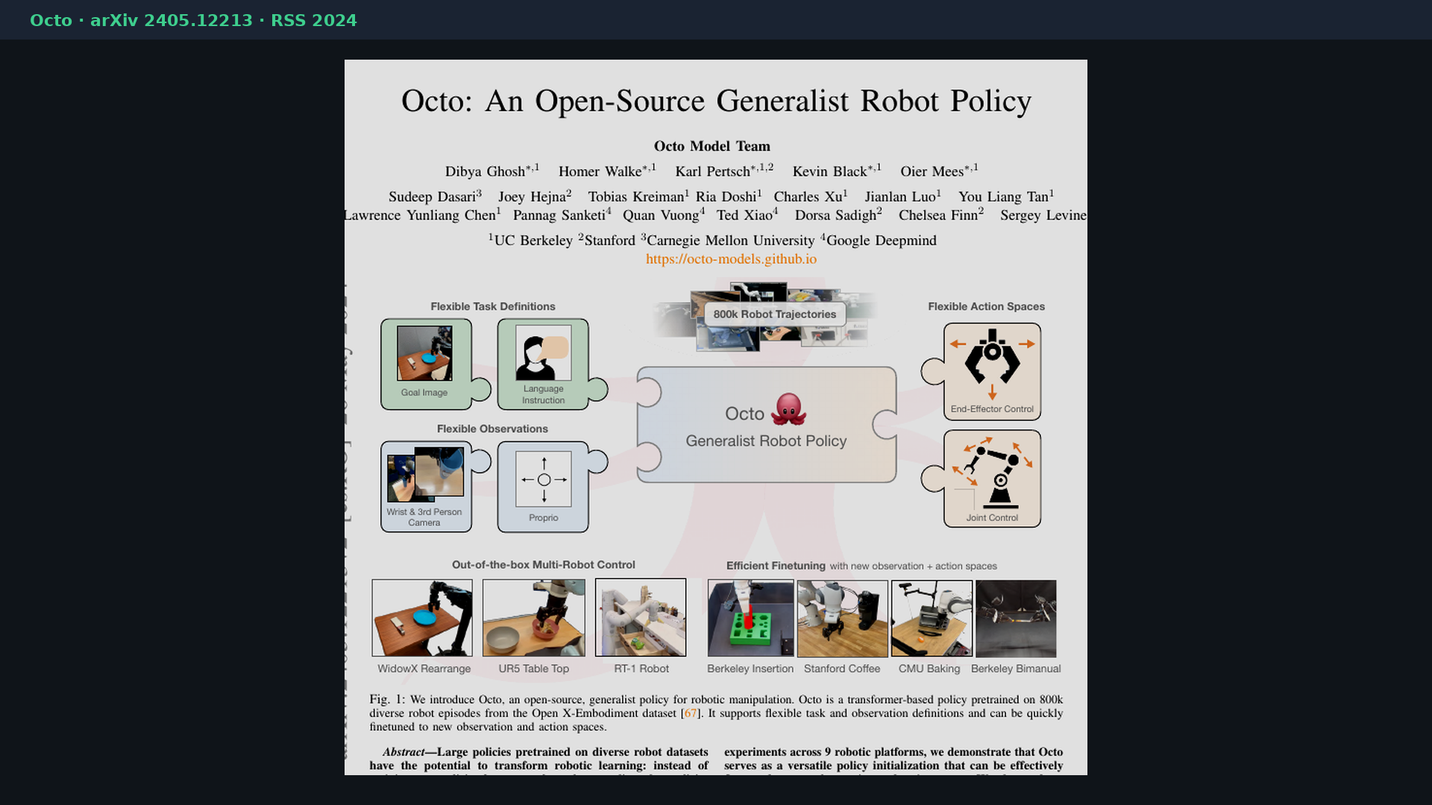
Empiricist · 11+3 · 14/14
Notes:
BACKUP cover.
Env outlines live at /workspace/octo-quiet/env_outline/ — quiet pack does not launch Slurm.

