Slide 1
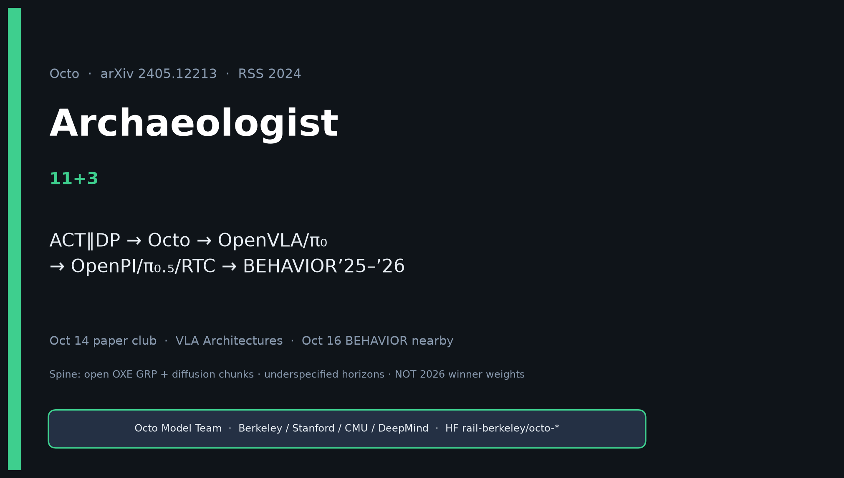
Archaeologist · 11+3 · 1/14
Notes:
ARCHAEOLOGIST — 11+3.
ONE SENTENCE:
ACT∥DP → Octo (open OXE ViT+diffusion GRP + adapters) → OpenVLA/π₀ → OpenPI/π₀.₅/RTC → BEHAVIOR’25–’26.
Pivot: open ViT + diffusion-chunk GRP on 800k OXE with block-wise adapters.
Octo = infrastructure history + eval baseline, not 2026 winner weights.

Slide 2
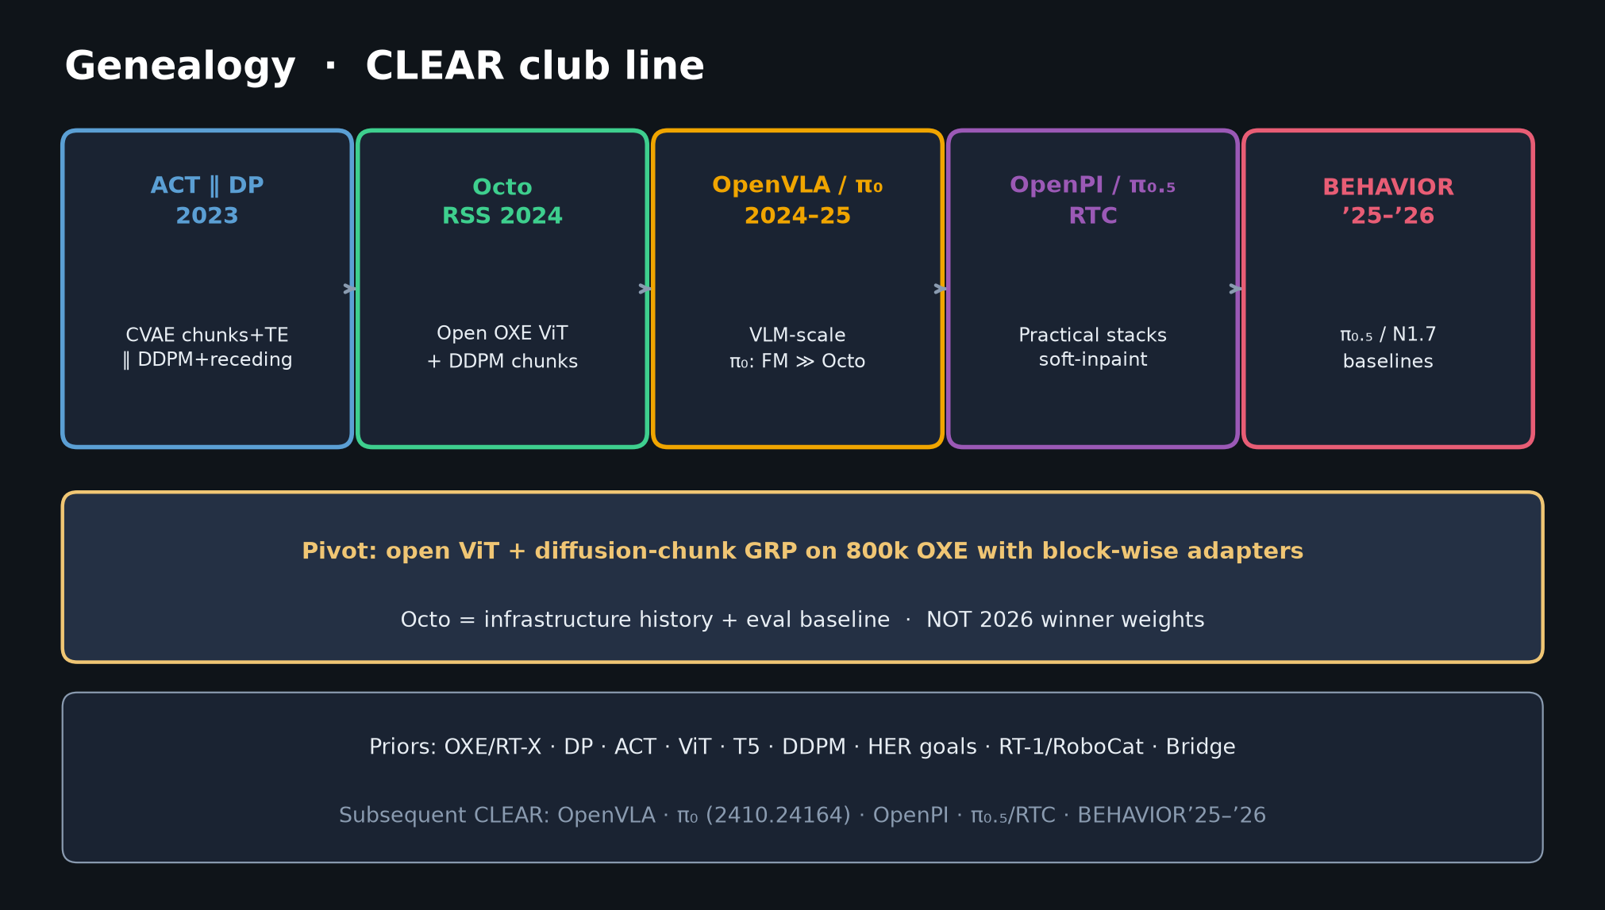
Archaeologist · 11+3 · 2/14
Notes:
GENEALOGY — THE must-hit slide. Spend 90–120s.
Priors → Octo → subsequent. CLEAR citations only.

Slide 3
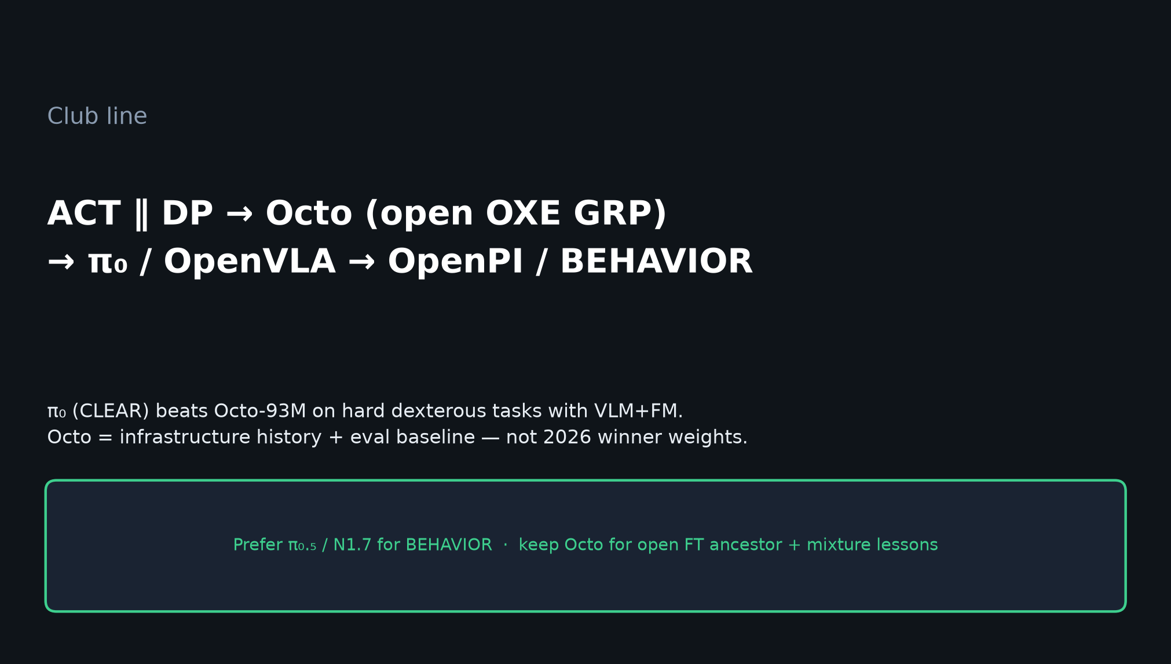
Archaeologist · 11+3 · 3/14
Notes:
CLUB LINE — sentence people leave with.
ACT∥DP → Octo (open OXE GRP) → π₀/OpenVLA → OpenPI/BEHAVIOR.
π₀ CLEAR-beats Octo-93M on hard dexterity with VLM+FM — Octo is bridge, not destination.

Slide 4
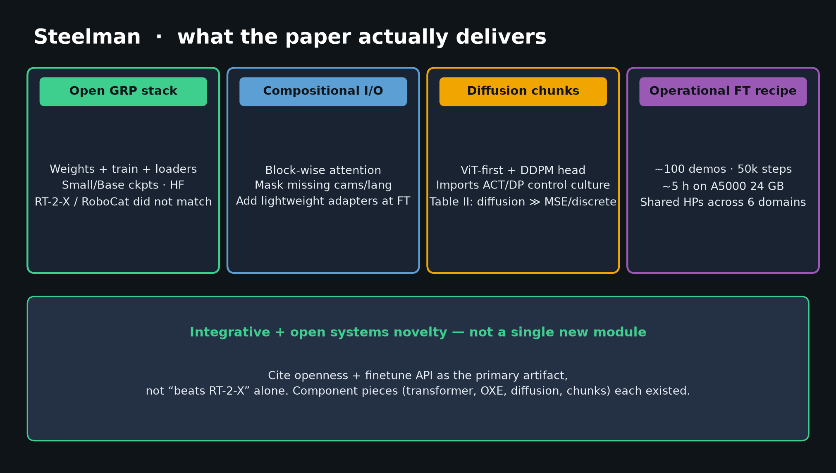
Archaeologist · 11+3 · 4/14
Notes:
PRIORS (spoken from notes): OXE/RT-X, DP, ACT, ViT, T5, DDPM, HER goals, RT-1/RoboCat, Bridge — all CLEAR.
Novelty is selection, scale, openness, finetune API — not inventing diffusion or transformers.

Slide 5
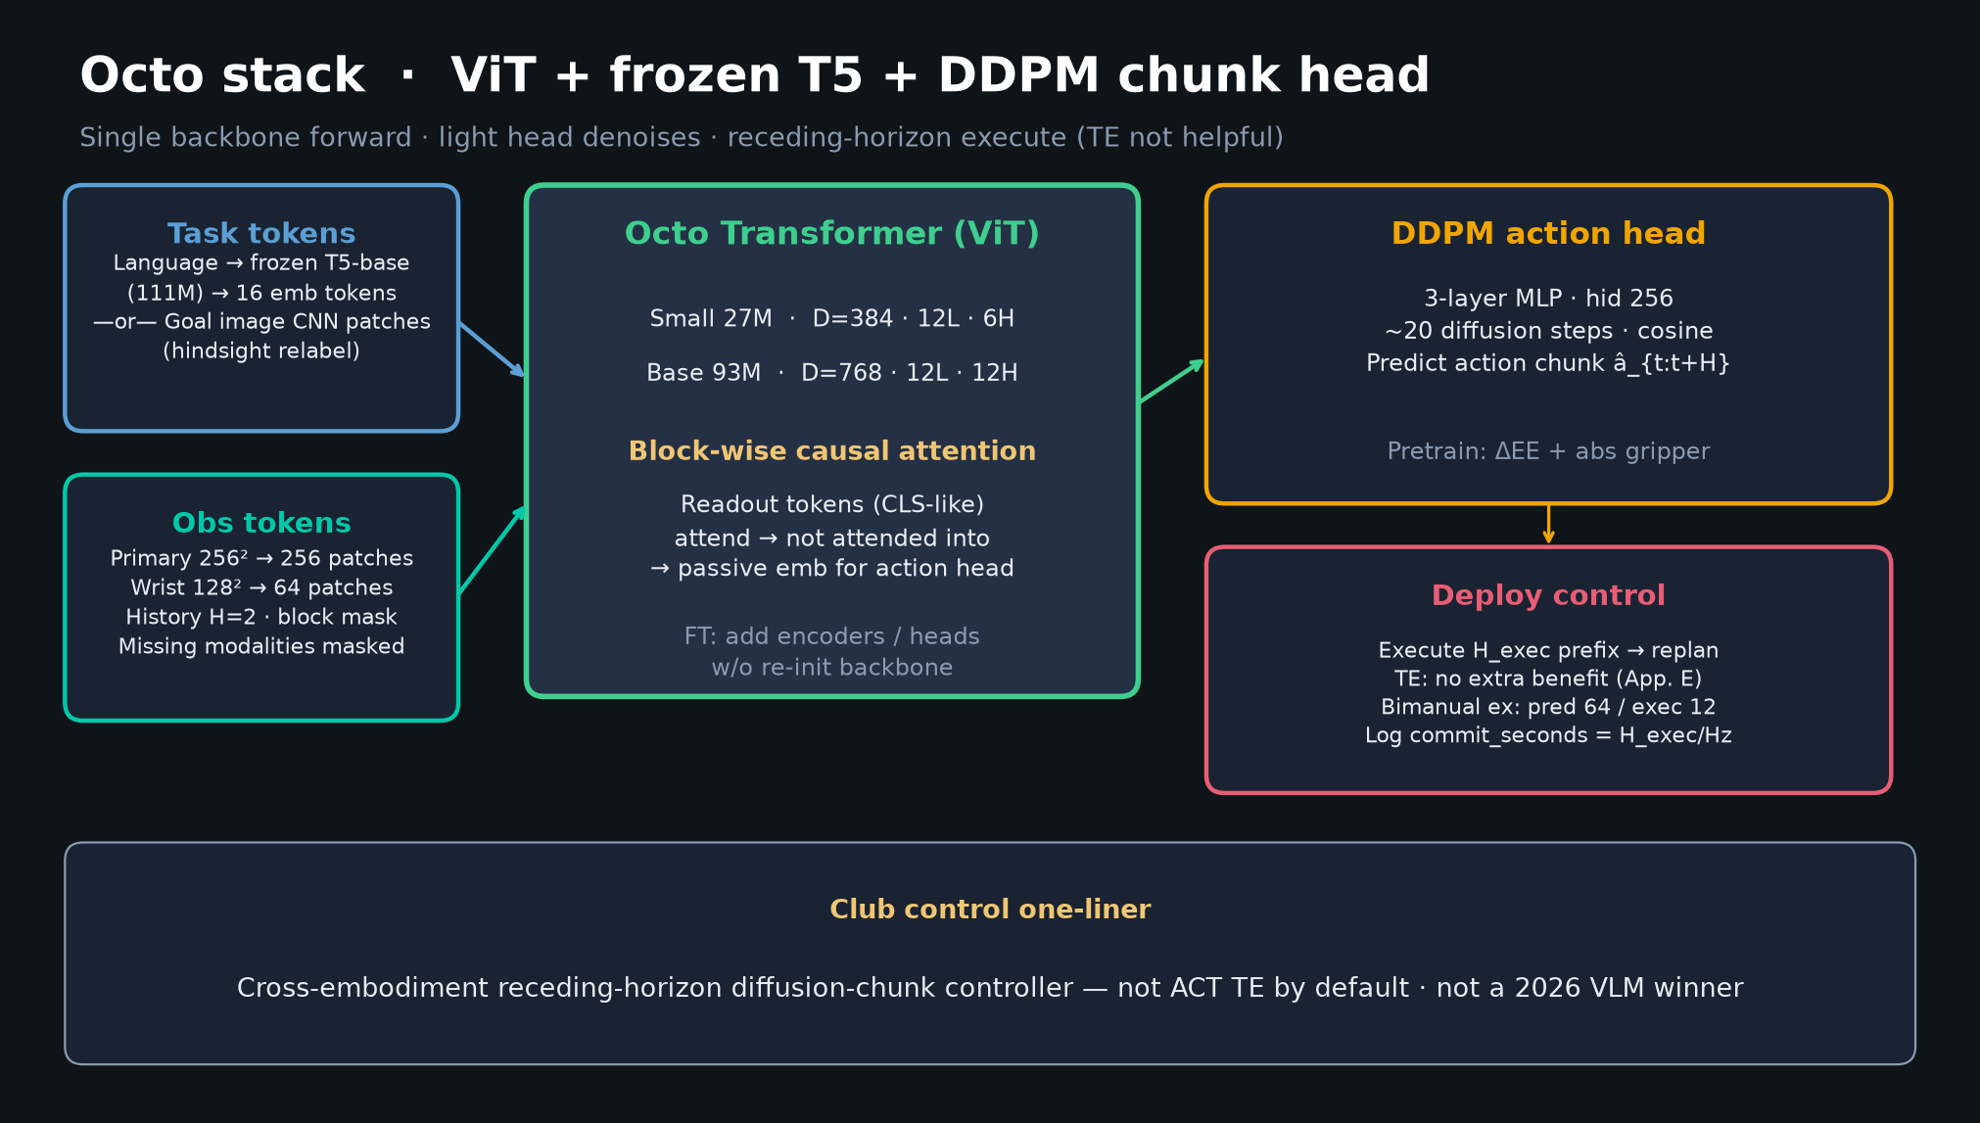
Archaeologist · 11+3 · 5/14
Notes:
ARCHITECTURE as historical artifact.
Block-wise I/O + readout diffusion operationalized ACT/DP at OXE scale with open release.
Component novelty low; systems + openness novelty high.

Slide 6
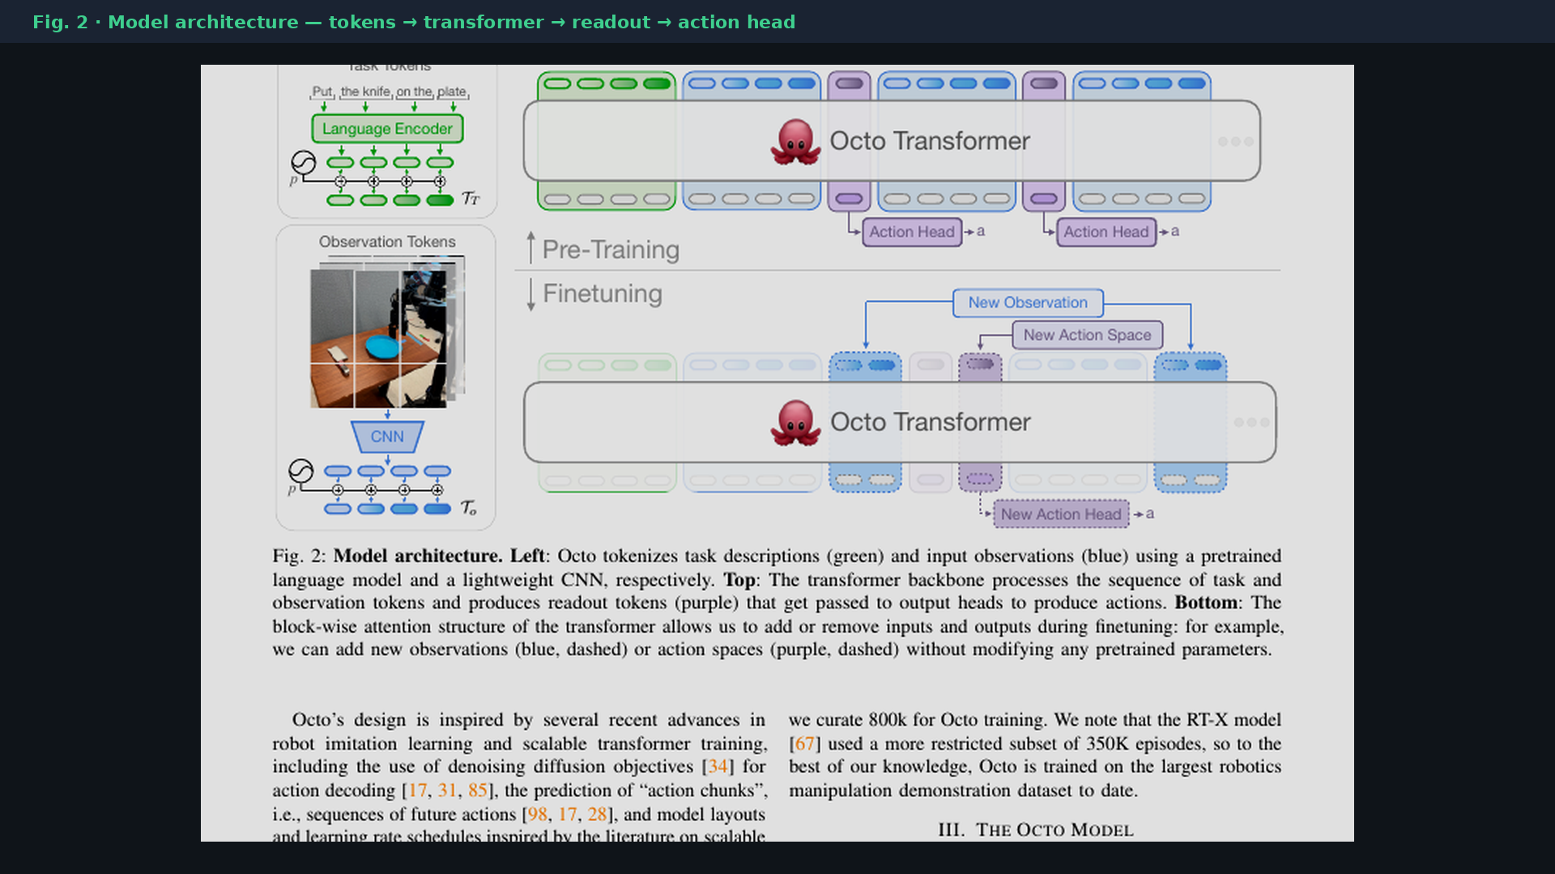
Archaeologist · 11+3 · 6/14
Notes:
PAPER FIG 2 — period diagram of the OXE-era open GRP.
Point when asked “what did Octo look like?”

Slide 7
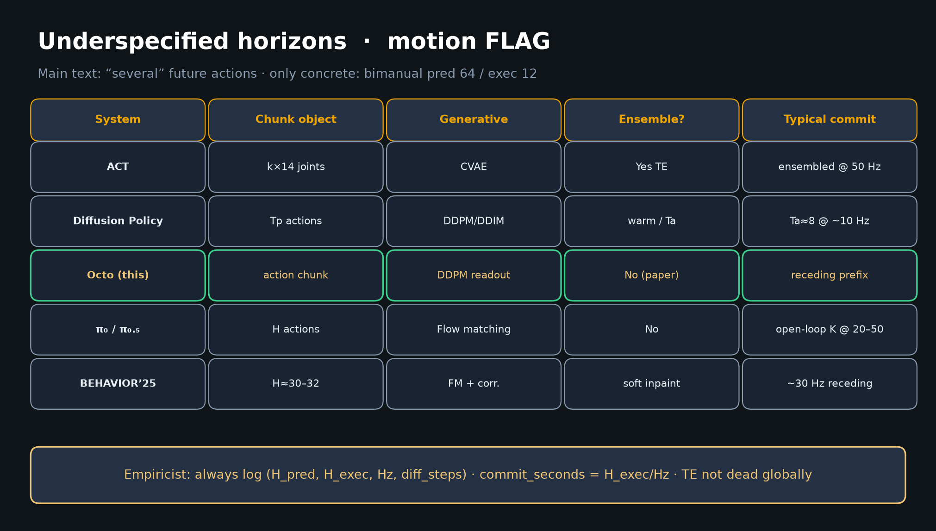
Archaeologist · 11+3 · 7/14
Notes:
CONTROL LINEAGE TABLE — ACT TE ∥ DP receding → Octo no-TE receding → π₀ FM → BEHAVIOR soft-inpaint.
Chunking shared; execution dialects differ.

Slide 8
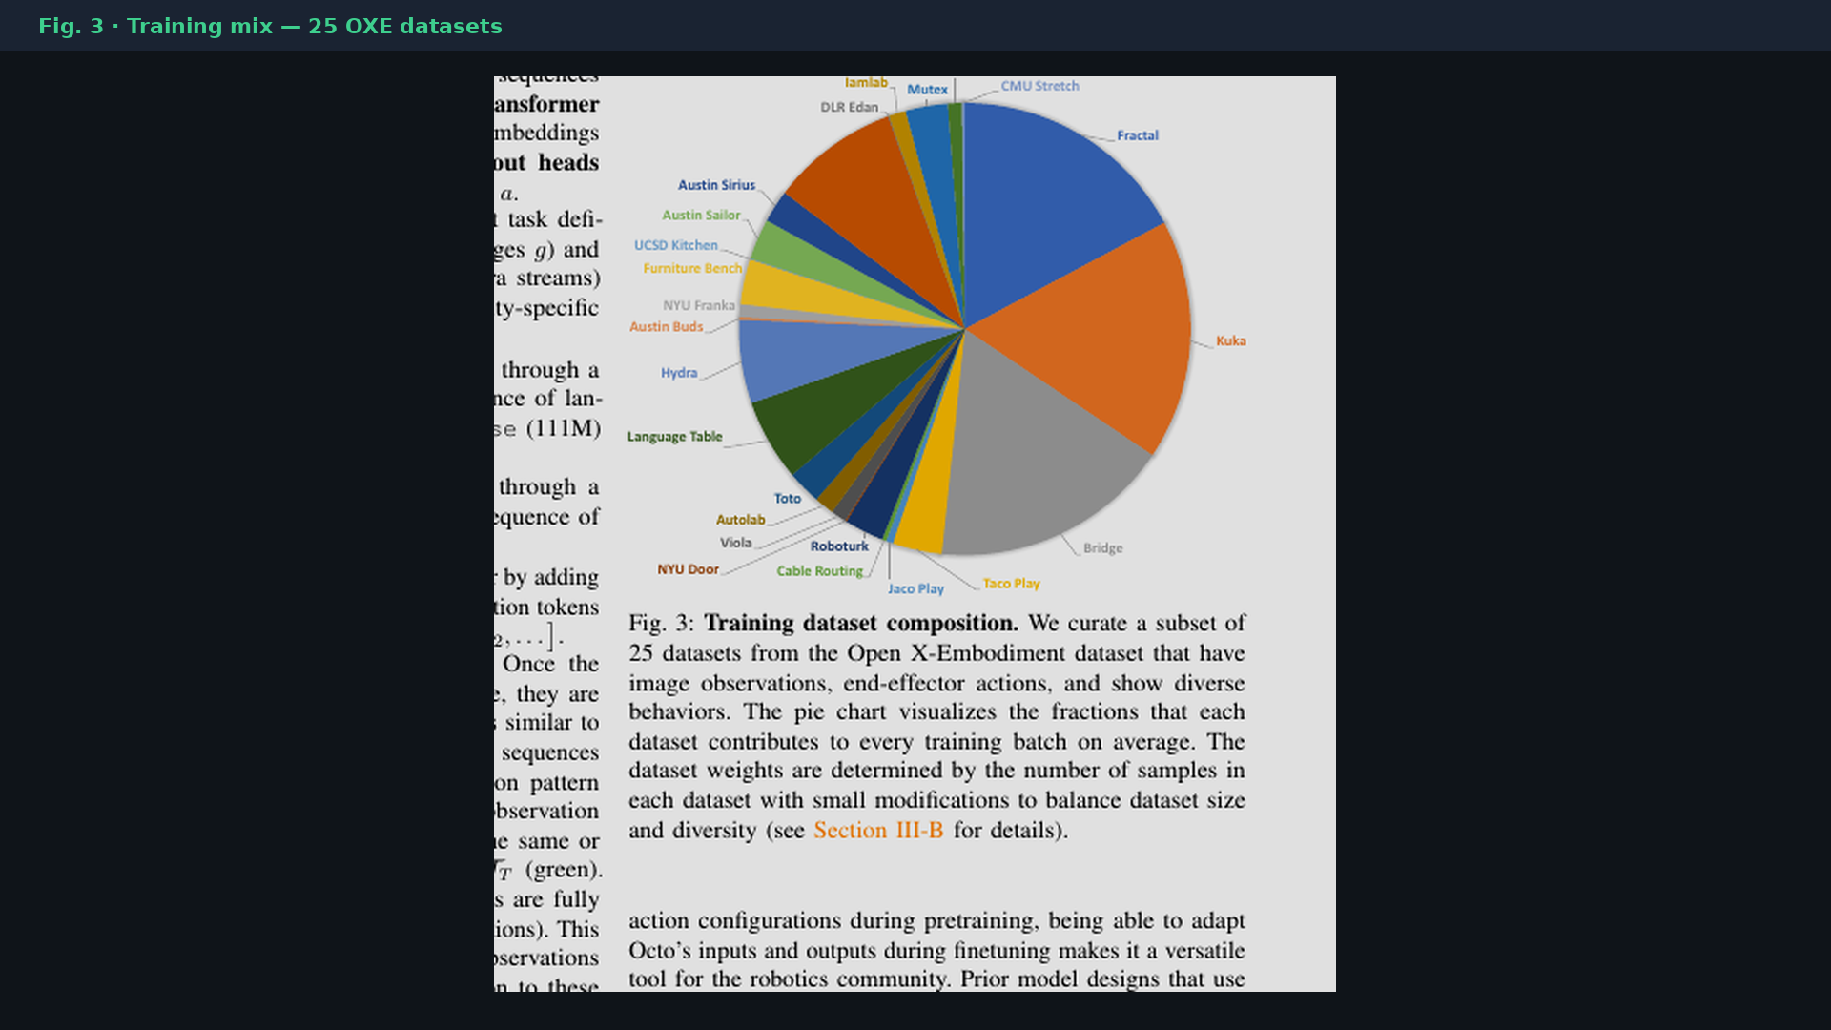
Archaeologist · 11+3 · 8/14
Notes:
DATA MIX as historical craft — Fig.3.
Manual curation; Reviewer #7: under-ablated which datasets drive gains.
Mixture remains a first-class open problem into BEHAVIOR’26.

Slide 9
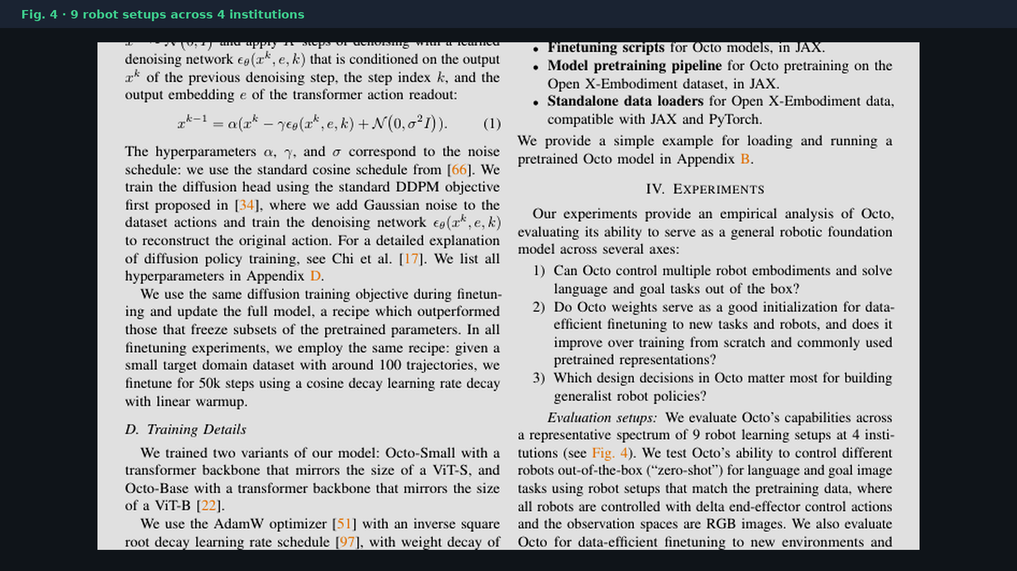
Archaeologist · 11+3 · 9/14
Notes:
EVAL SCOPE Fig.4 — multi-lab OXE-era culture.
9 setups / 4 institutions: impressive coverage, not a unified protocol.
Hand Reviewer the institutional-variance caveat.

Slide 10
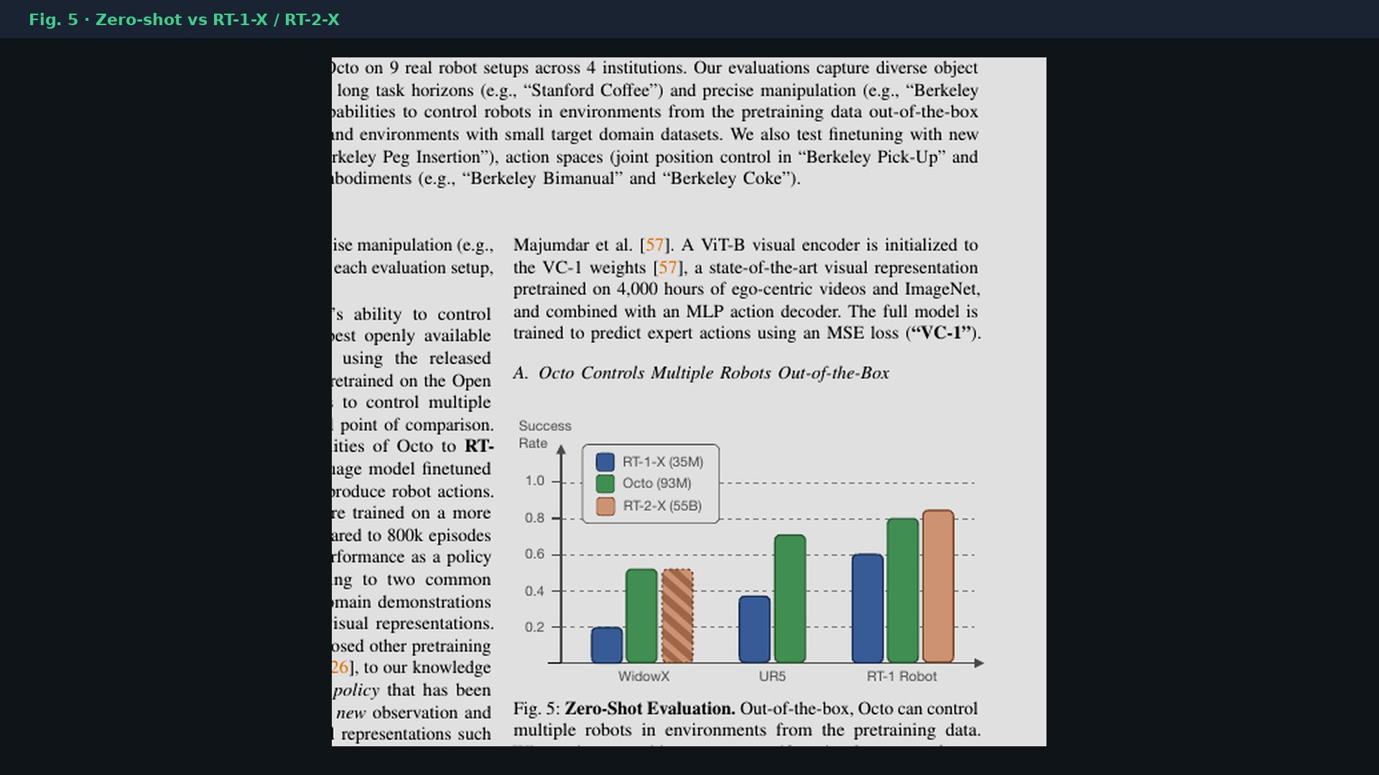
Archaeologist · 11+3 · 10/14
Notes:
π₀ CLEAR comparison era — OpenVLA/π₀ supersede as VLM-scale; Octo remains open diffusion GRP ancestor.

Slide 11
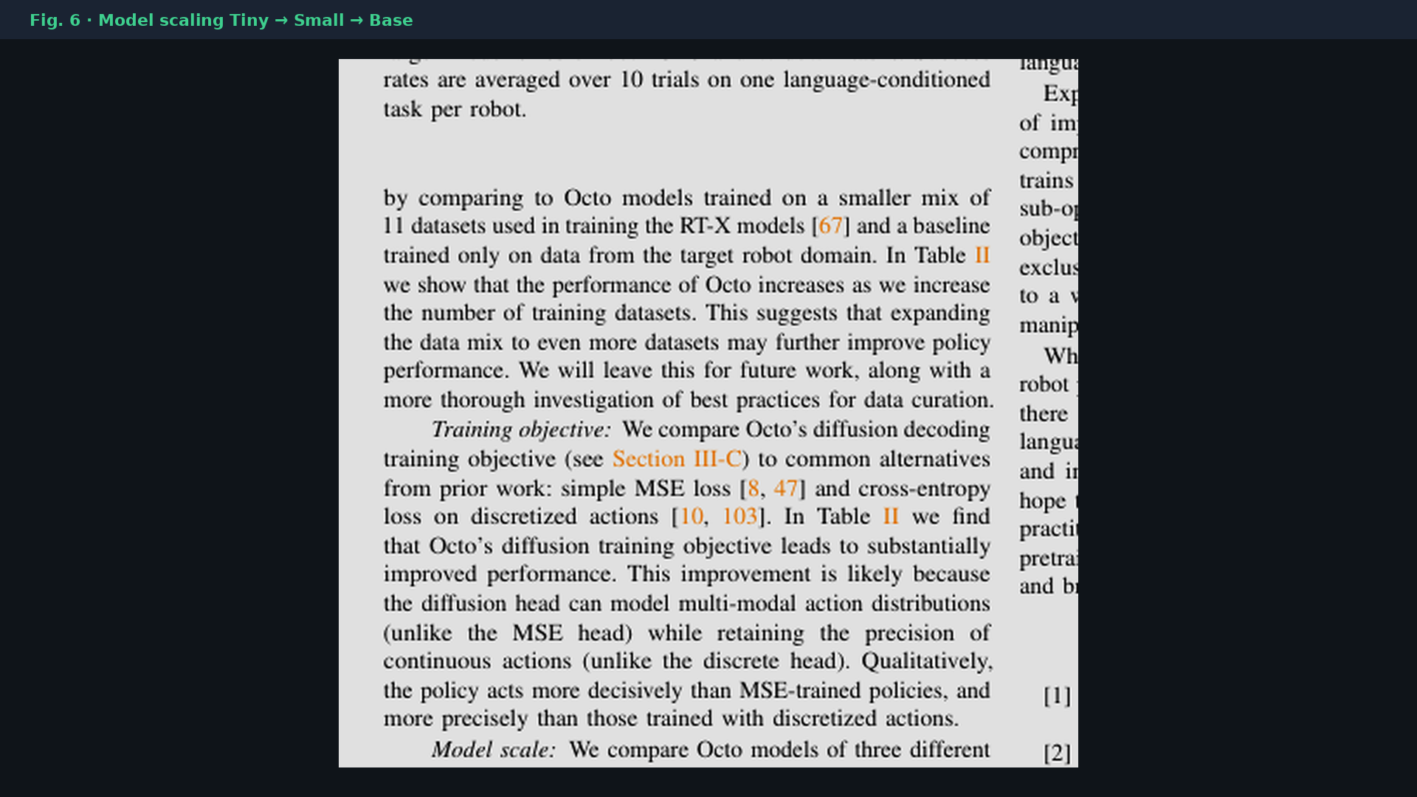
Archaeologist · 11+3 · 11/14
Notes:
SCALING Fig.6 — Tiny→Small→Base before the VLM jump.
Capacity story of non-VLM GRPs; later π₀ changes the scale class.

Slide 12
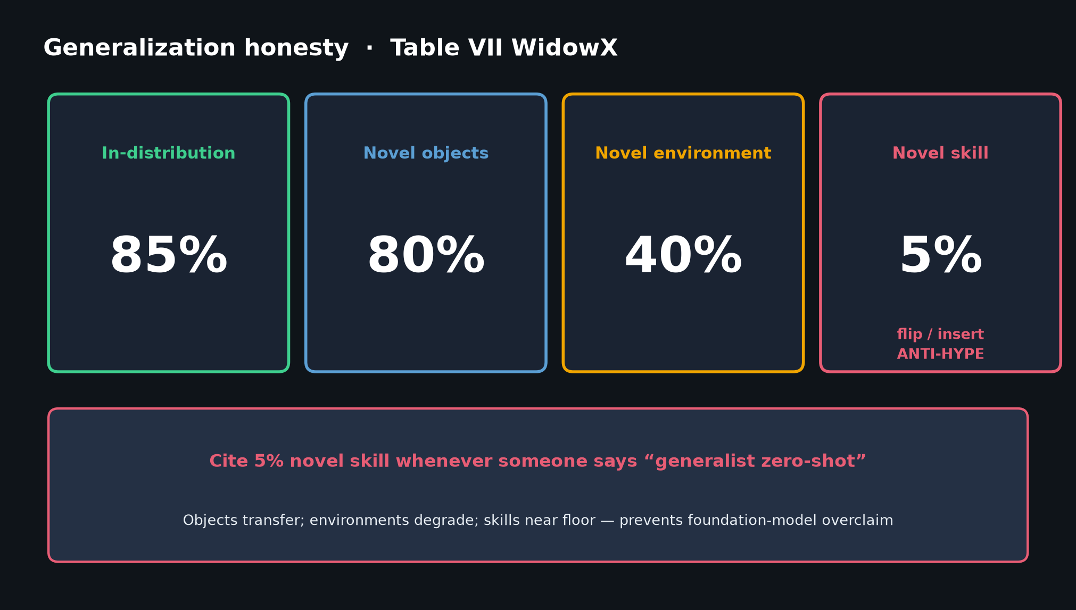
Archaeologist · 11+3 · 12/14
Notes:
HONEST LIMITS enter the history — novel skill 5% prevents overclaiming foundation model.

Slide 13
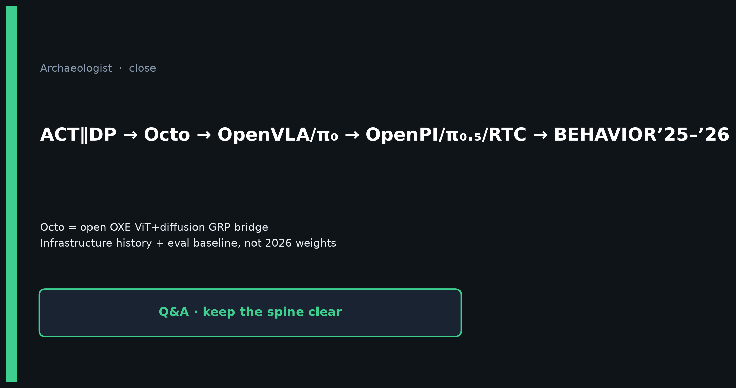
Archaeologist · 11+3 · 13/14
Notes:
CLOSE — restate genealogy; Octo = bridge not destination.
Q&A: Did π₀ kill Octo? No — replaced weights, kept chunk+open ethos.

Slide 14
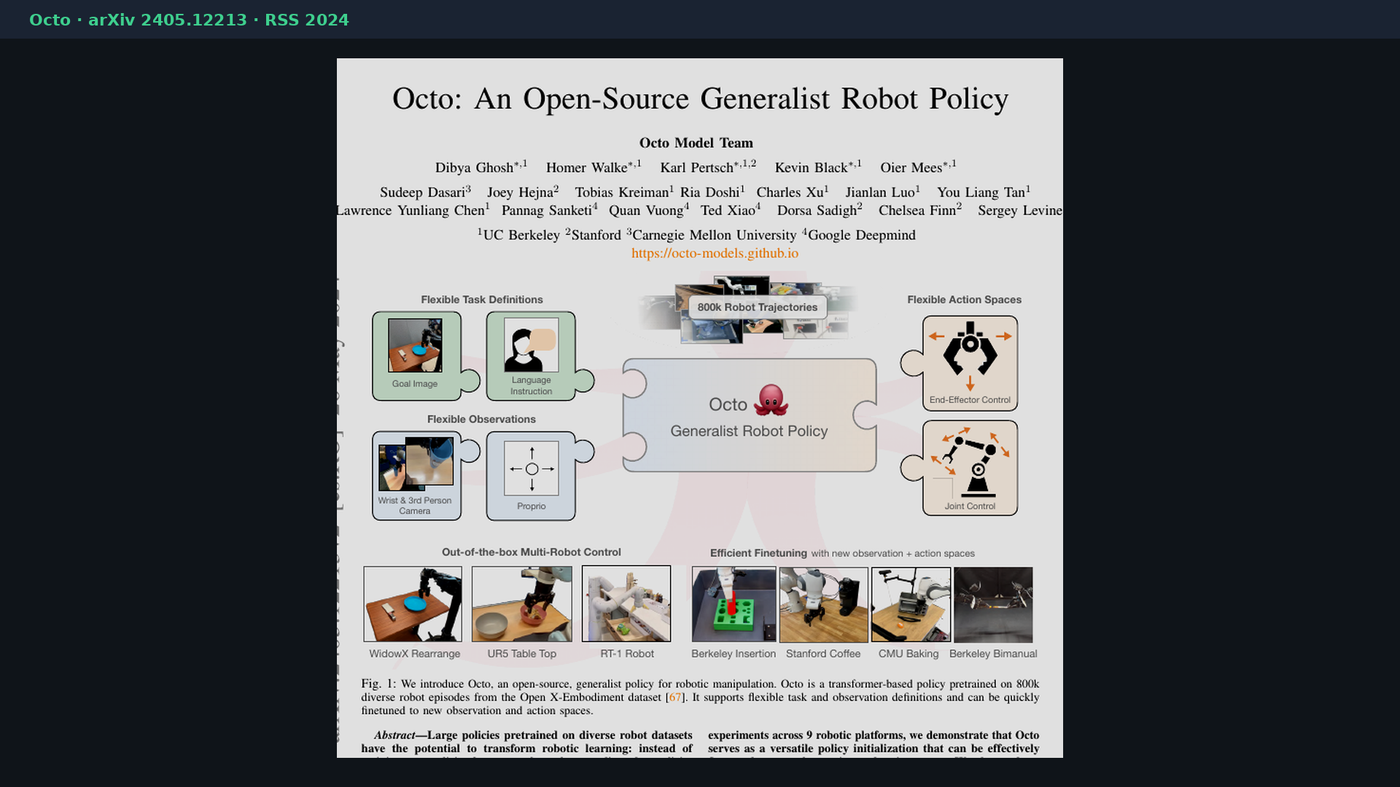
Archaeologist · 11+3 · 14/14
Notes:
BACKUP cover.
Genealogy one-liner CLEAR: ACT∥DP → Octo → OpenVLA/π₀ → OpenPI/π₀.₅/RTC → BEHAVIOR’25–’26.

