Slide 1
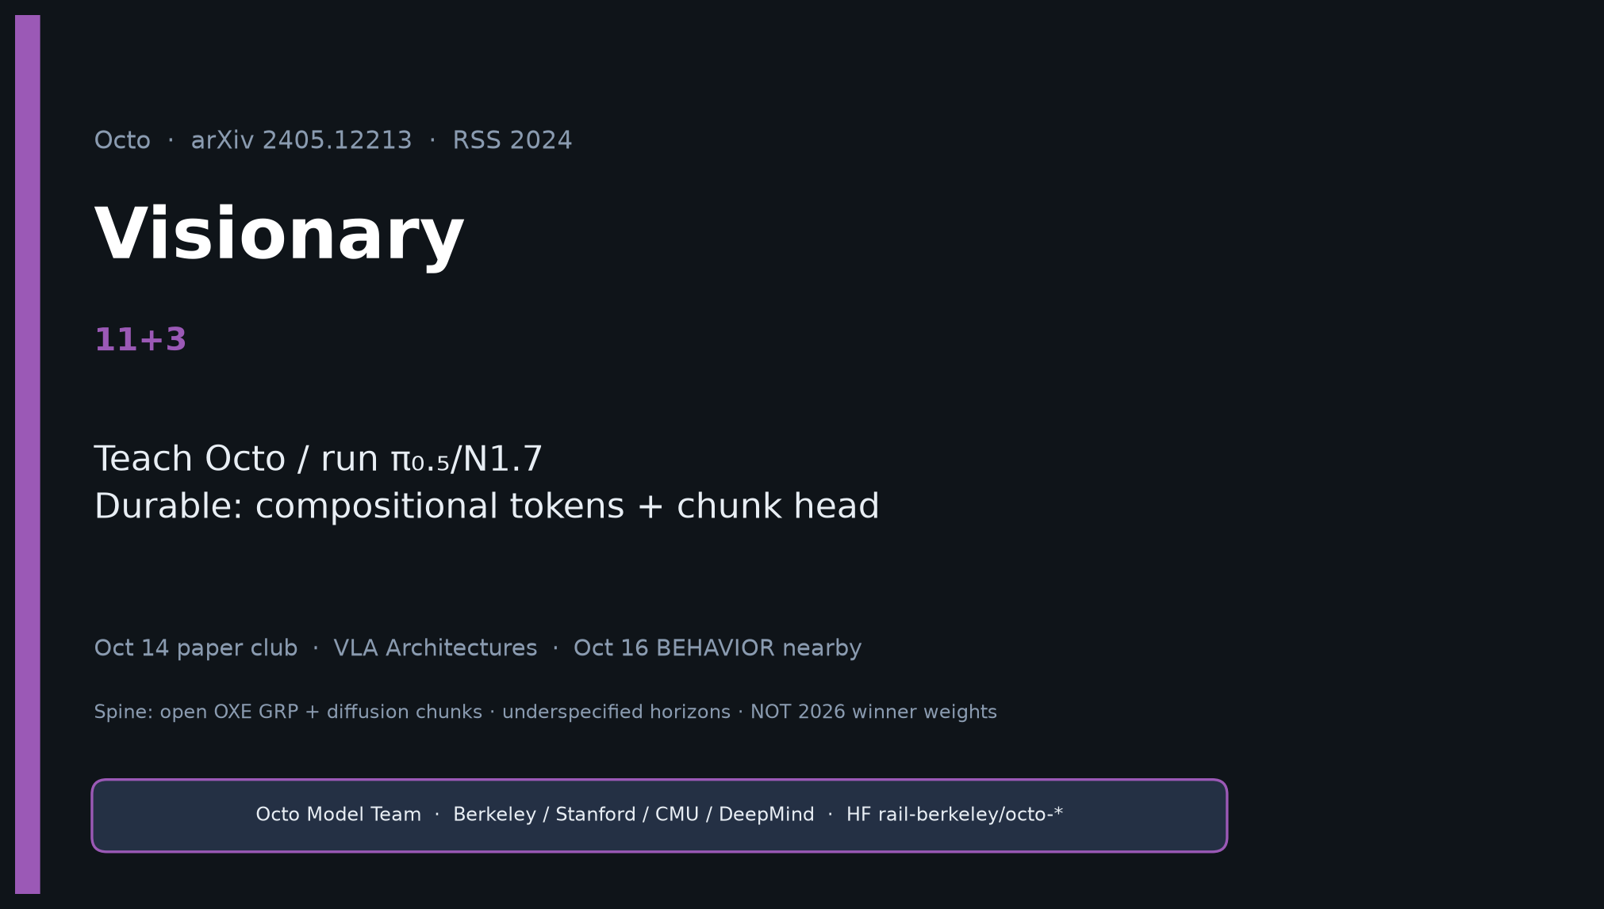
Visionary · 11+3 · 1/12
Notes:
VISIONARY — 11+3 → 2026 BEHAVIOR. Skip Discord/Drive entirely.
Frame: Teach Octo / run π₀.₅/N1.7. Steal eval virtues. Durable idea = compositional tokenization + generative chunk head.

Slide 2
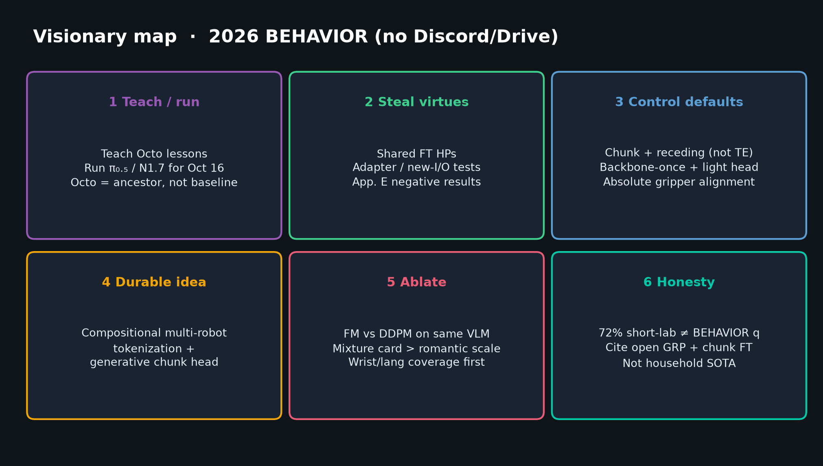
Visionary · 11+3 · 2/12
Notes:
VISIONARY MAP — six bets. Walk clockwise.
Teach/run · steal virtues · control defaults · durable idea · ablate · honesty.
Do NOT invent Discord/Drive sources — pack + sibling quiet packs only.

Slide 3
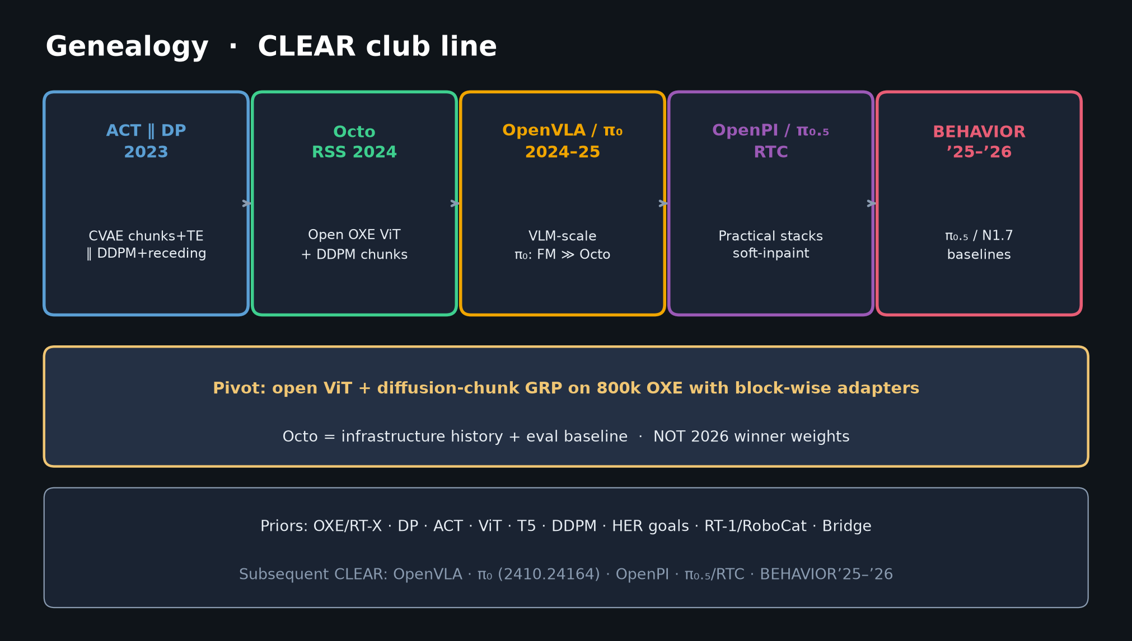
Visionary · 11+3 · 3/12
Notes:
GENEALOGY placement.
Octo is ancestor for ablation history (diffusion vs FM, adapters, mixture).
Race for Oct 16 on π₀.₅ / N1.7 substrates, not WidowX zero-shot replay.

Slide 4
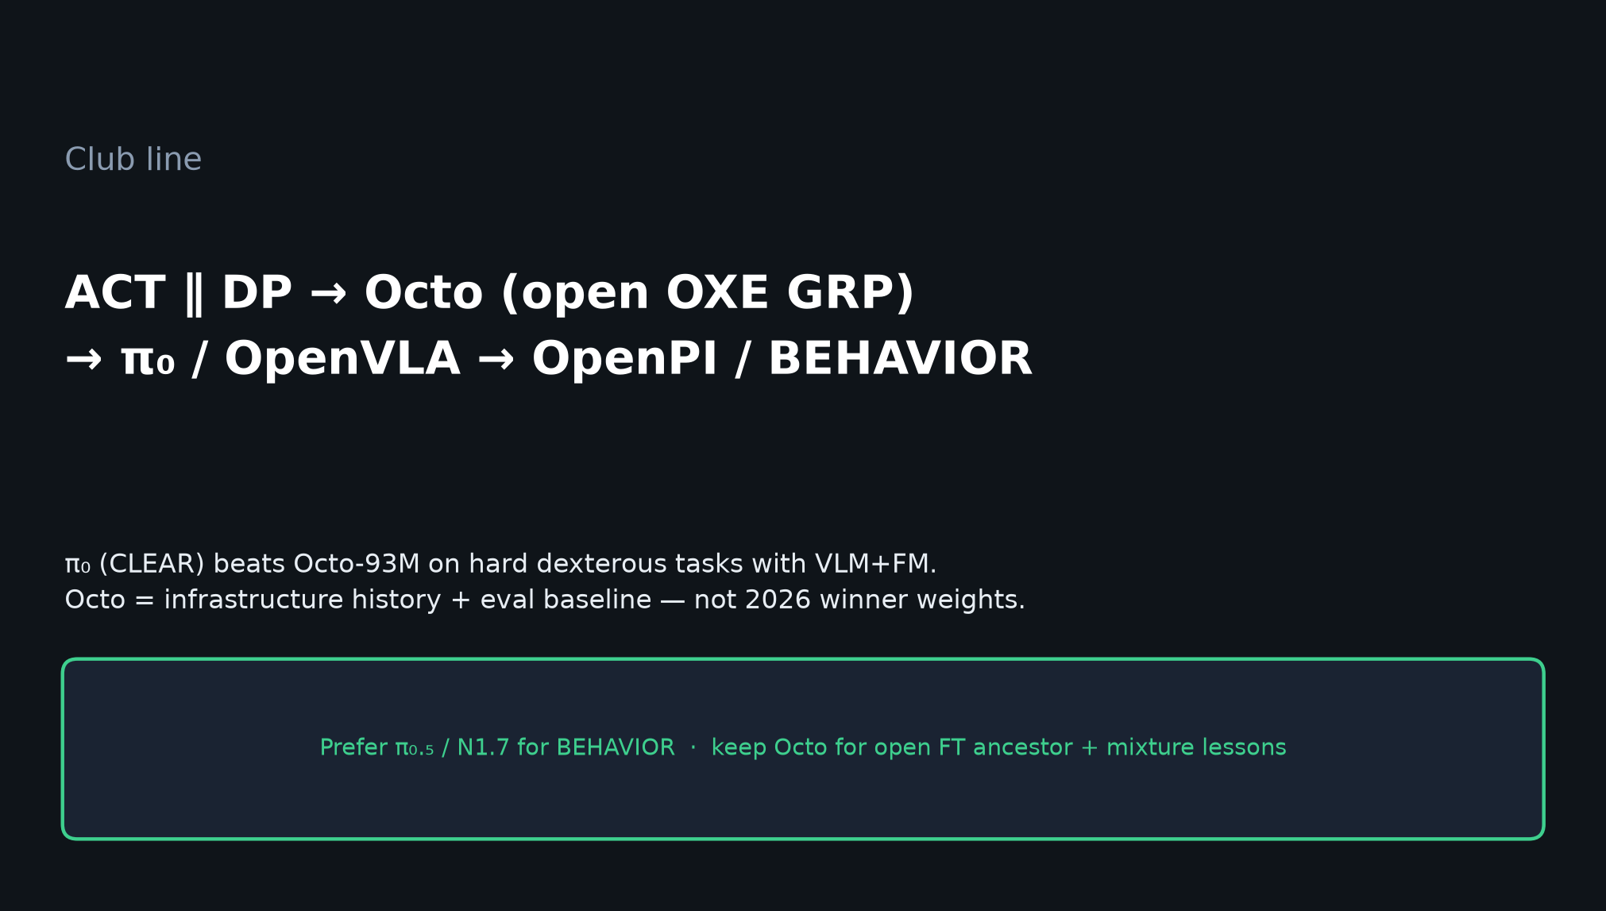
Visionary · 11+3 · 4/12
Notes:
CLUB LINE — 2025 kept chunks + open ethos; replaced DDPM with FM+stages.
Goal-image crutches do not transfer to multi-stage household tasks.

Slide 5
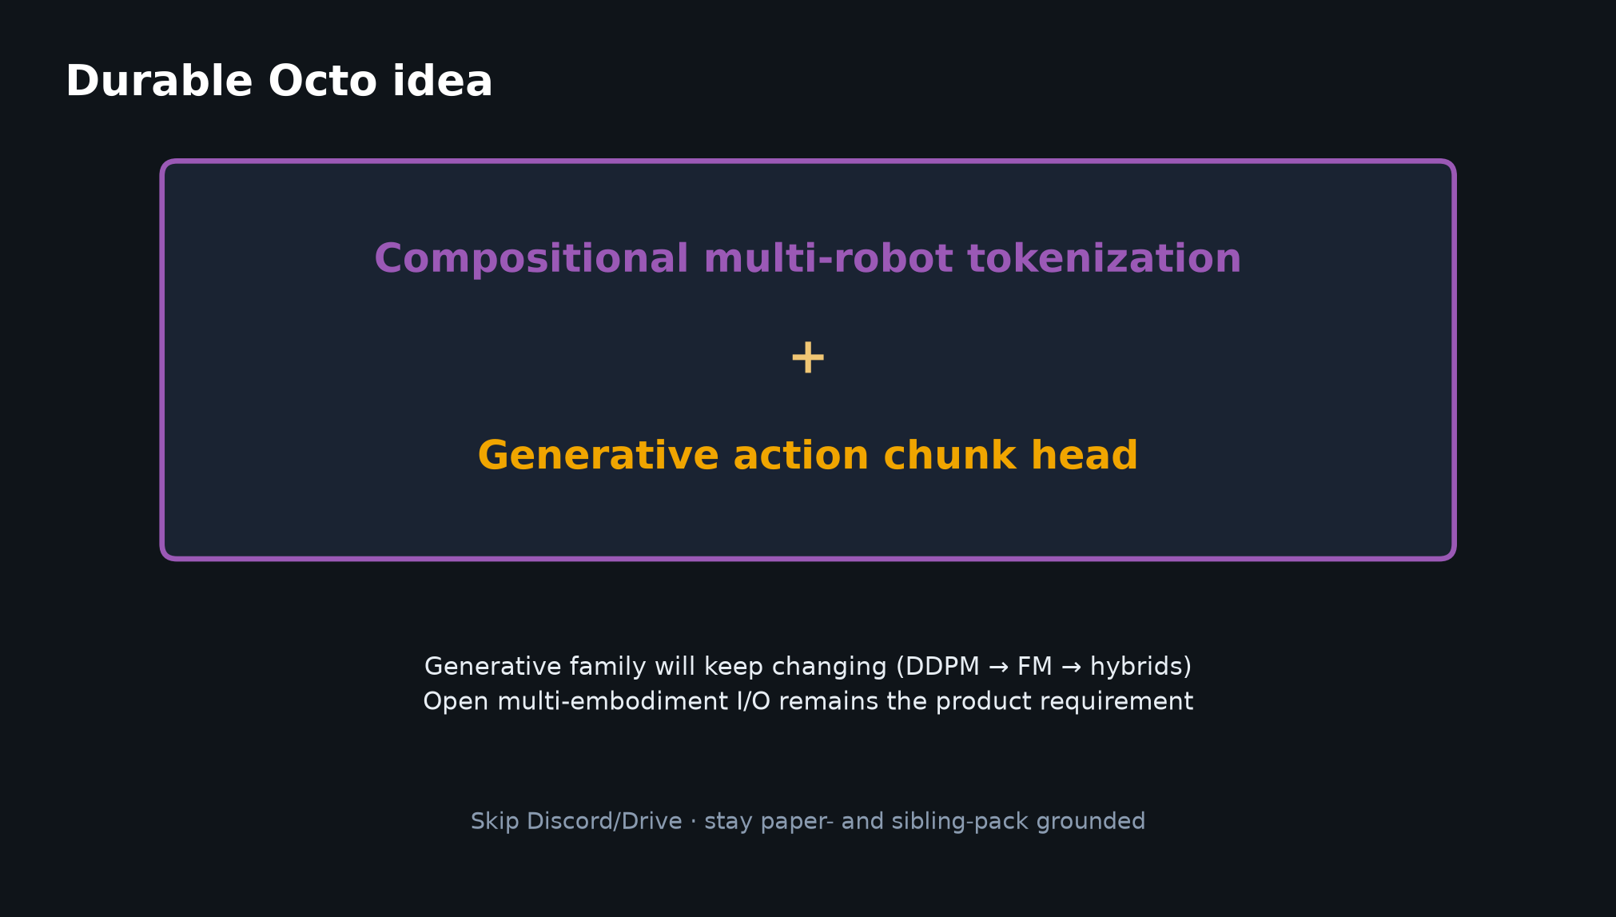
Visionary · 11+3 · 5/12
Notes:
DURABLE IDEA slide — compositional multi-robot tokens + generative chunk head.
Family churns; open multi-embod. I/O stays.

Slide 6
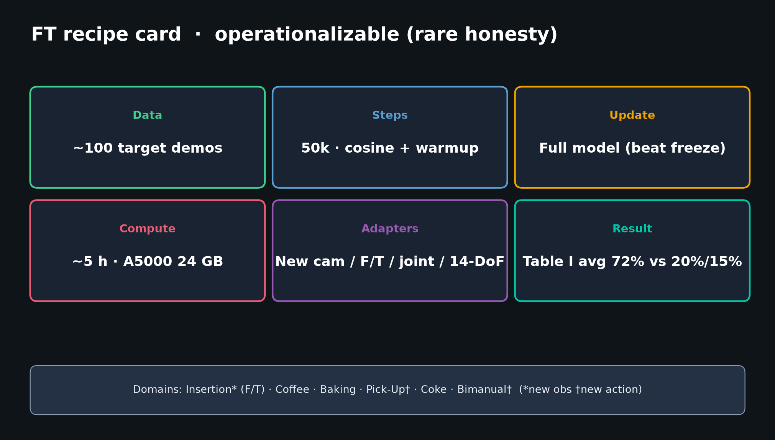
Visionary · 11+3 · 6/12
Notes:
STEAL FT virtues from Octo.
Shared finetune HPs; explicit new-obs/new-action tests; App. E negatives; consumer ~100-demo recipe as sanity baseline.

Slide 7
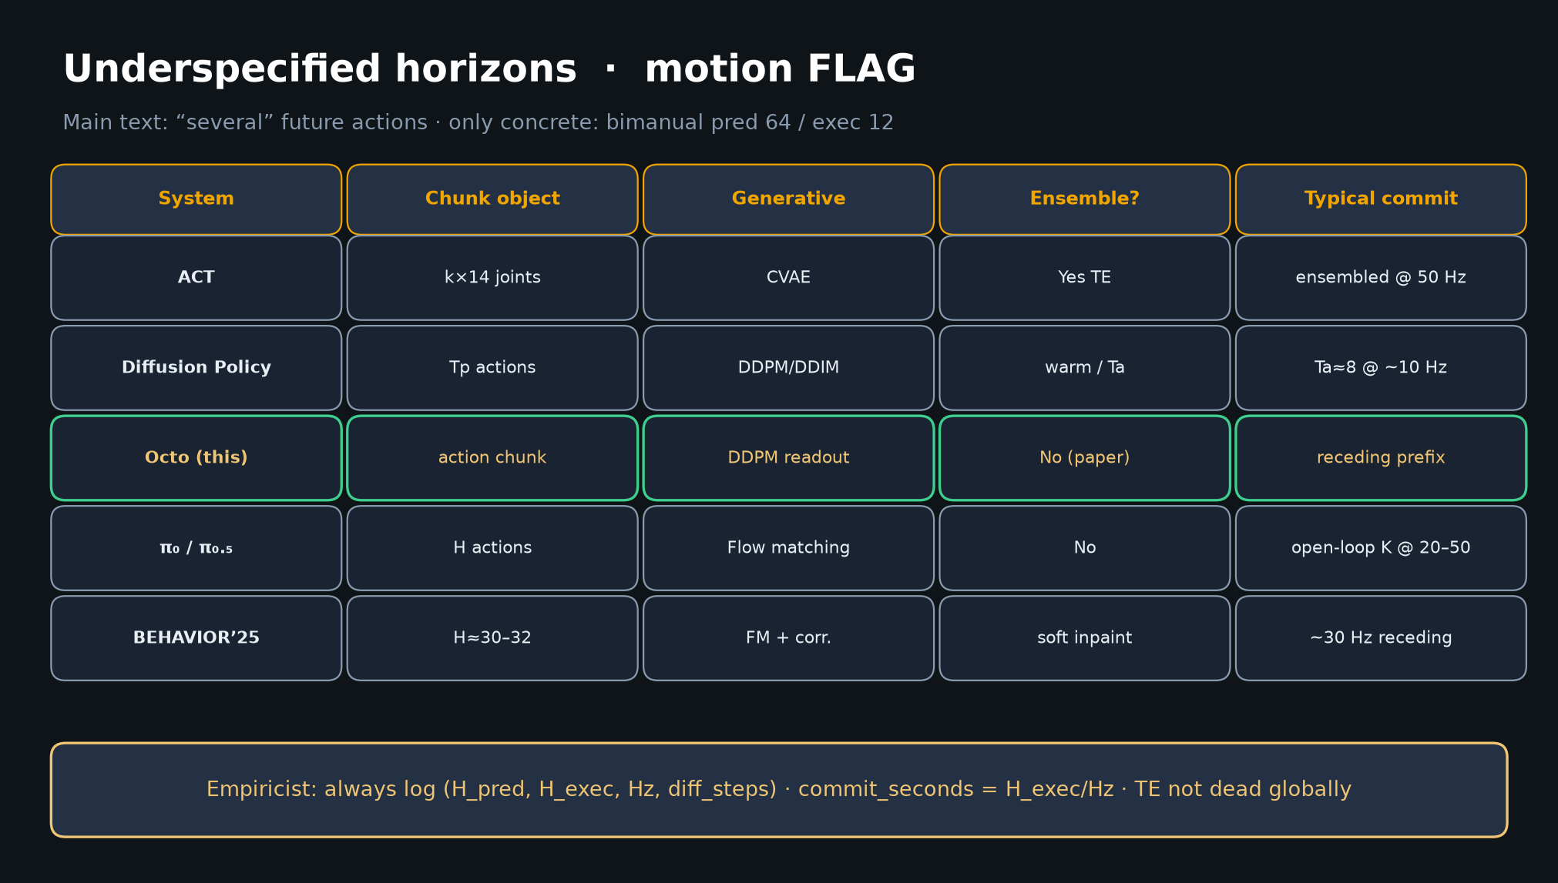
Visionary · 11+3 · 7/12
Notes:
STEAL: control defaults — chunk + receding; backbone-once + light head; no TE default.

Slide 8
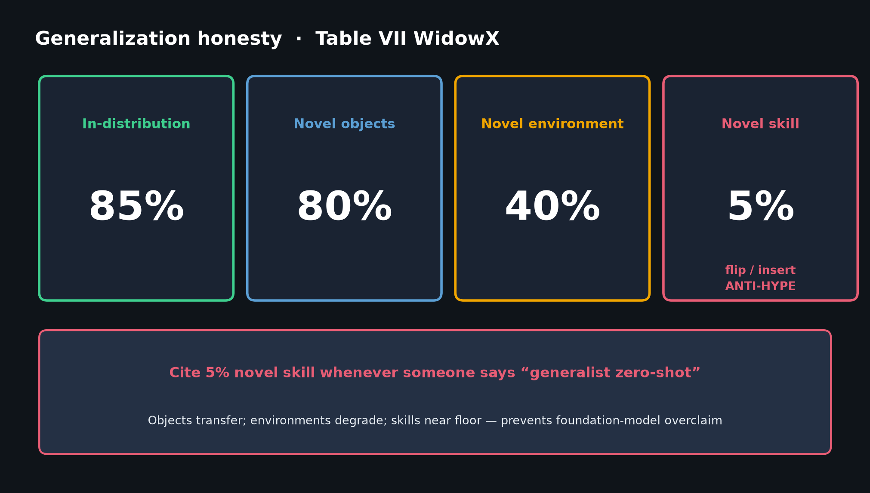
Visionary · 11+3 · 8/12
Notes:
FIX Octo’s holes at BEHAVIOR scale — wrist 27% / lang 56% / novel skill 5%.
Don’t expect goal-image crutches on multi-stage household tasks.

Slide 9
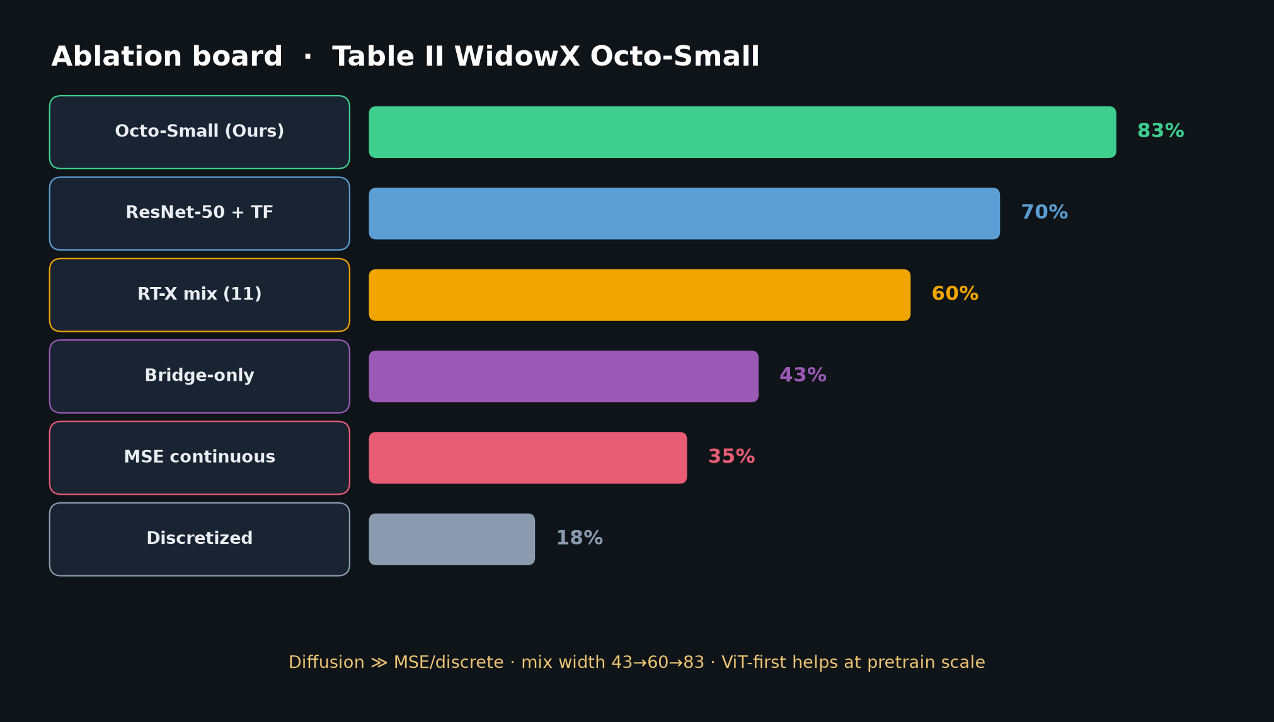
Visionary · 11+3 · 9/12
Notes:
MIXTURE > romantic scale — Table II ladder 43→60→83. Maintain explicit mix card in 2026.

Slide 10
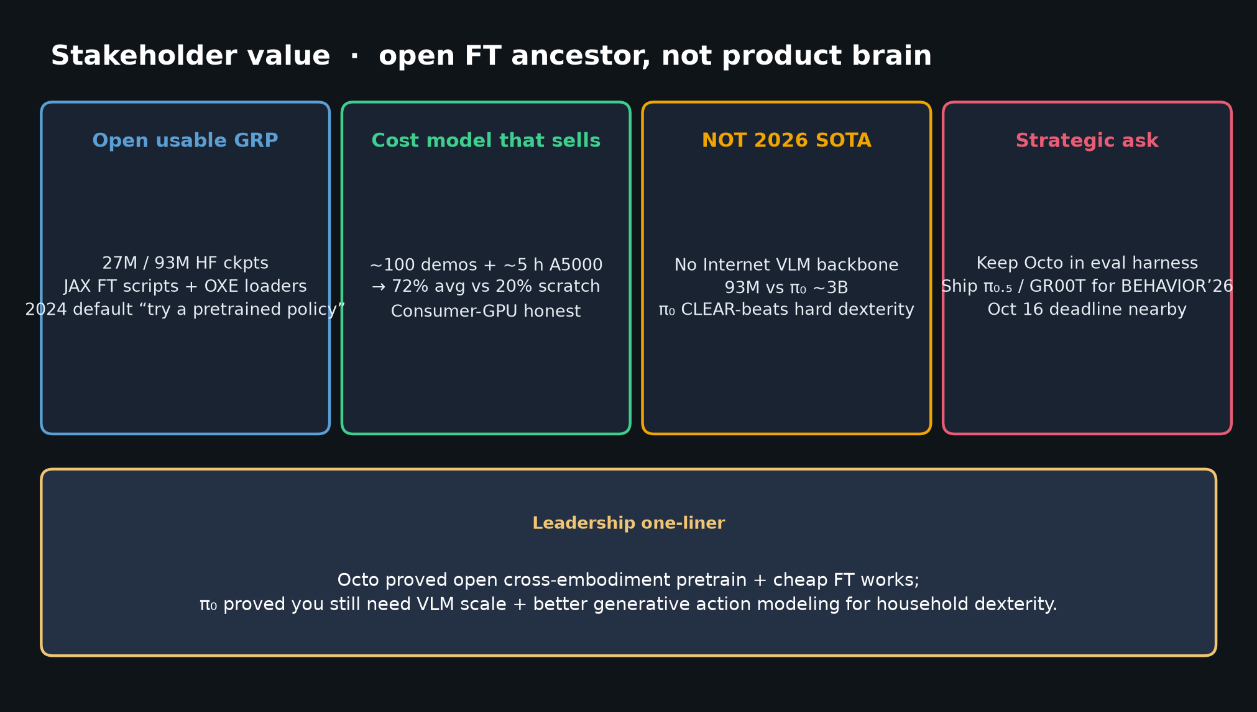
Visionary · 11+3 · 10/12
Notes:
STAKEHOLDER ALIGNMENT.
Keep Octo (or successor open mix) in eval harness.
Ship OpenPI π₀.₅ / GR00T-class models for BEHAVIOR’26.

Slide 11
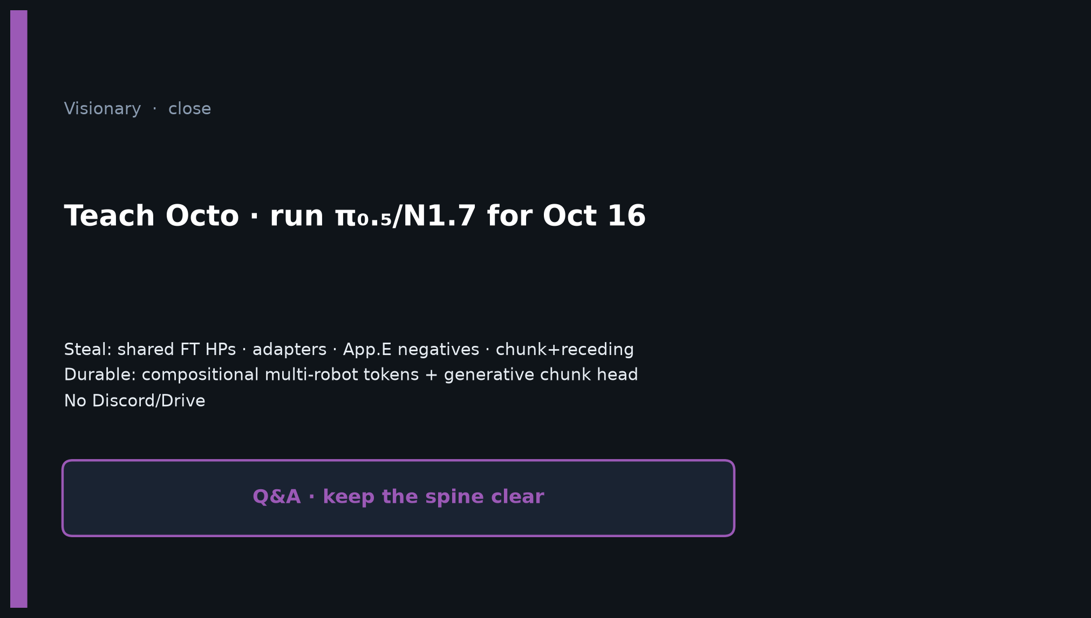
Visionary · 11+3 · 11/12
Notes:
CLOSE — Teach Octo lessons; run π₀.₅/N1.7 for Oct 16; no Discord/Drive.
Q&A: What to ablate (FM vs DDPM on same VLM); what not to retrain (full OXE TPU).

Slide 12
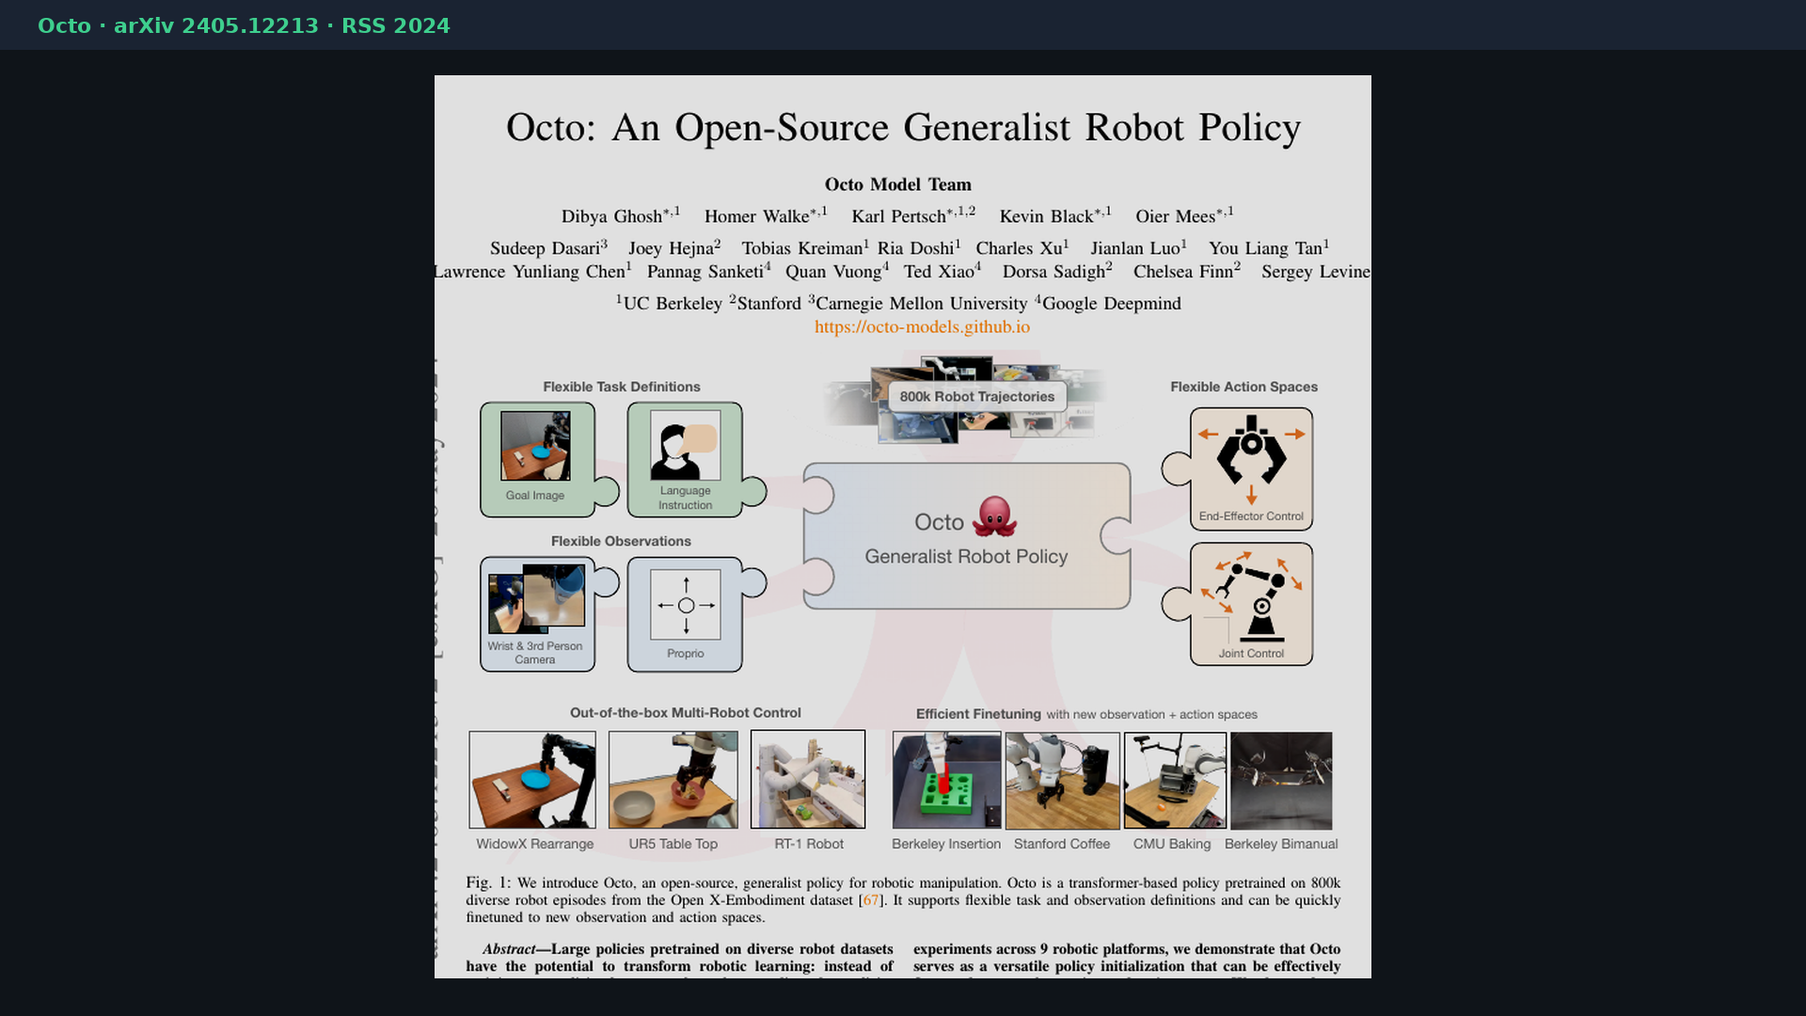
Visionary · 11+3 · 12/12
Notes:
BACKUP cover.
No Discord/Drive. Durable idea: compositional multi-robot tokenization + generative chunk head.

