Slide 1
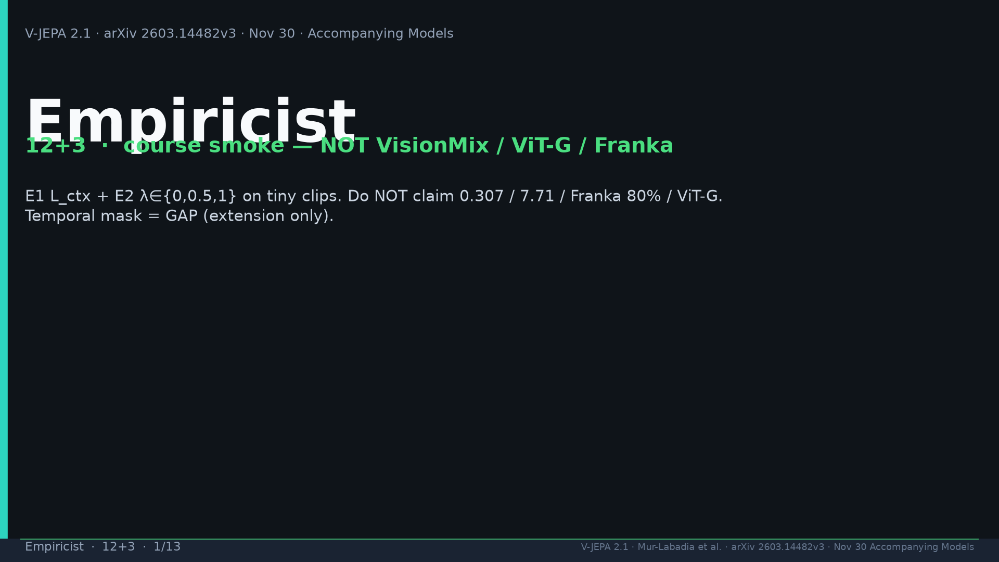
Notes:
Title. Course smoke not VisionMix/ViT-G/Franka. Never claim 0.307/7.71/80%.

Slide 2
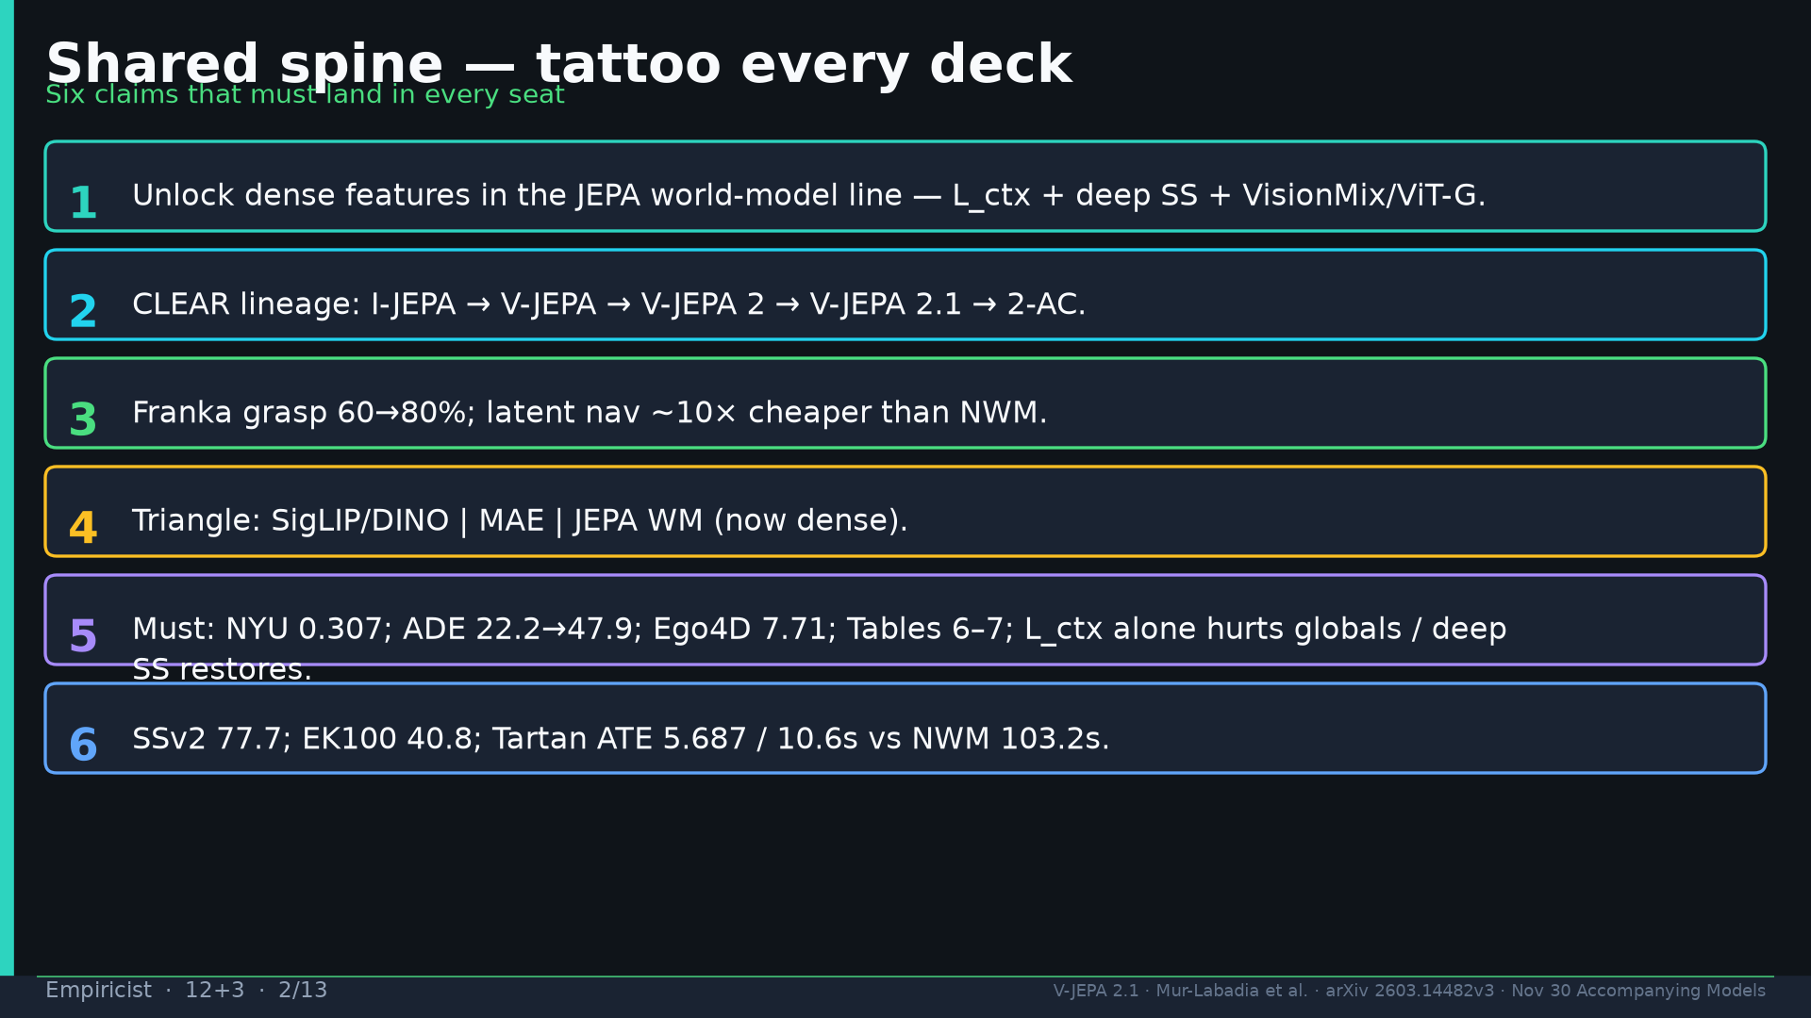
Notes:
Shared spine.

Slide 3
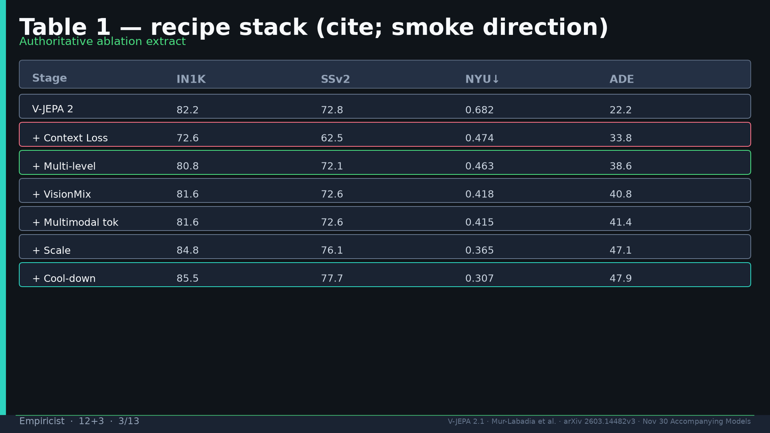
Notes:
Table 1 recipe stack — L_ctx hurts globals; deep SS restores.

Slide 4
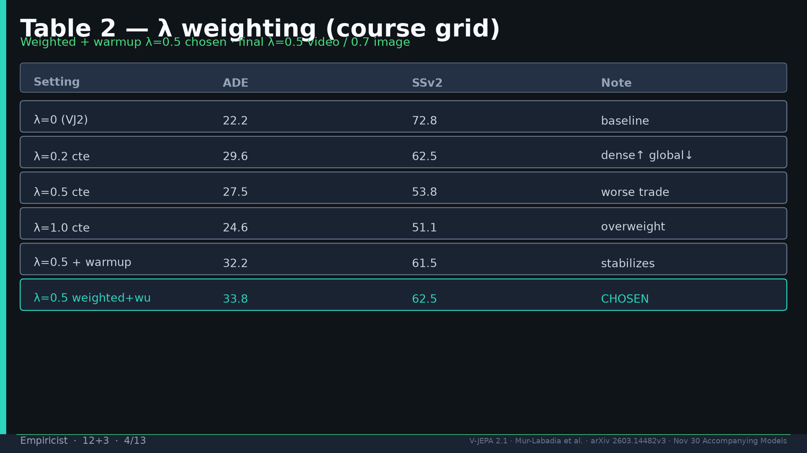
Notes:
Table 2 λ — weighted+warmup 0.5 chosen; course λ∈{0,0.5,1}.

Slide 5
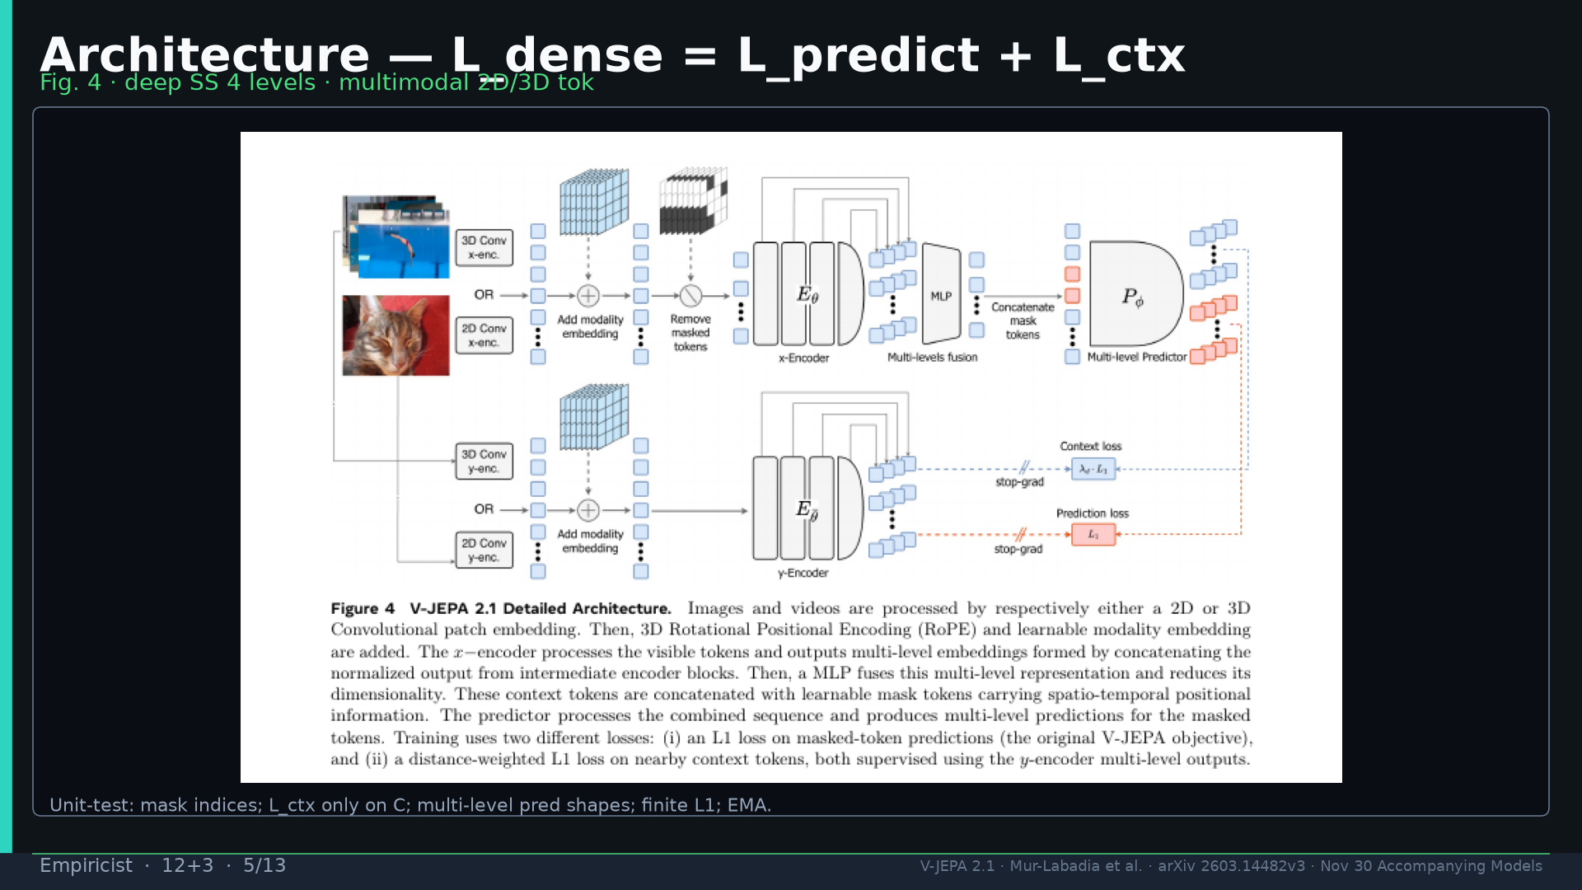
Notes:
Fig.4 arch L_dense=L_predict+L_ctx; deep SS 4 levels.

Slide 6
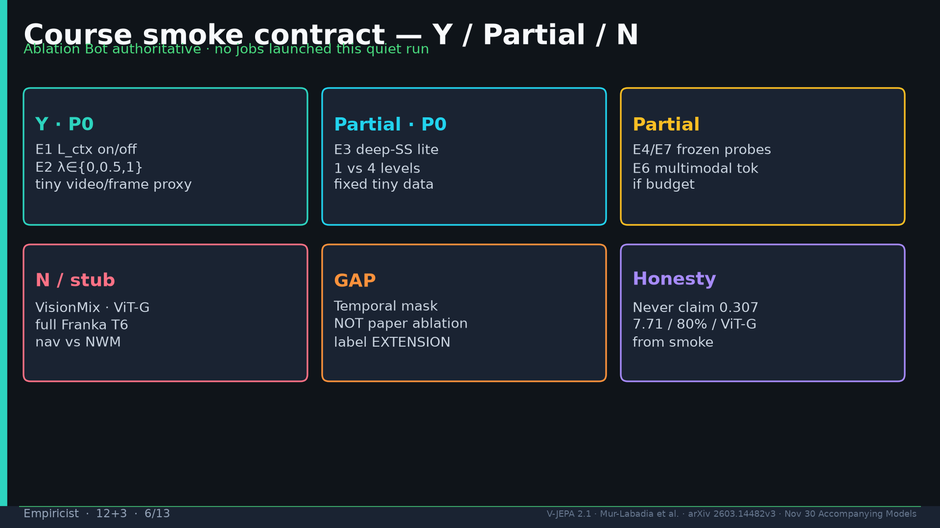
Notes:
Smoke contract Y=E1+E2; Partial=E3; N=VisionMix/ViT-G/Franka; GAP=temporal.

Slide 7
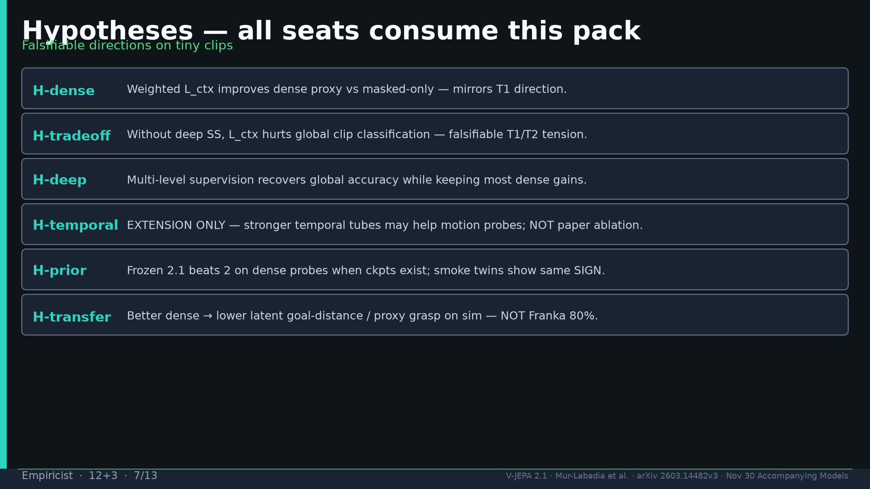
Notes:
Hypotheses H-dense/tradeoff/deep/temporal(ext)/prior/transfer.

Slide 8
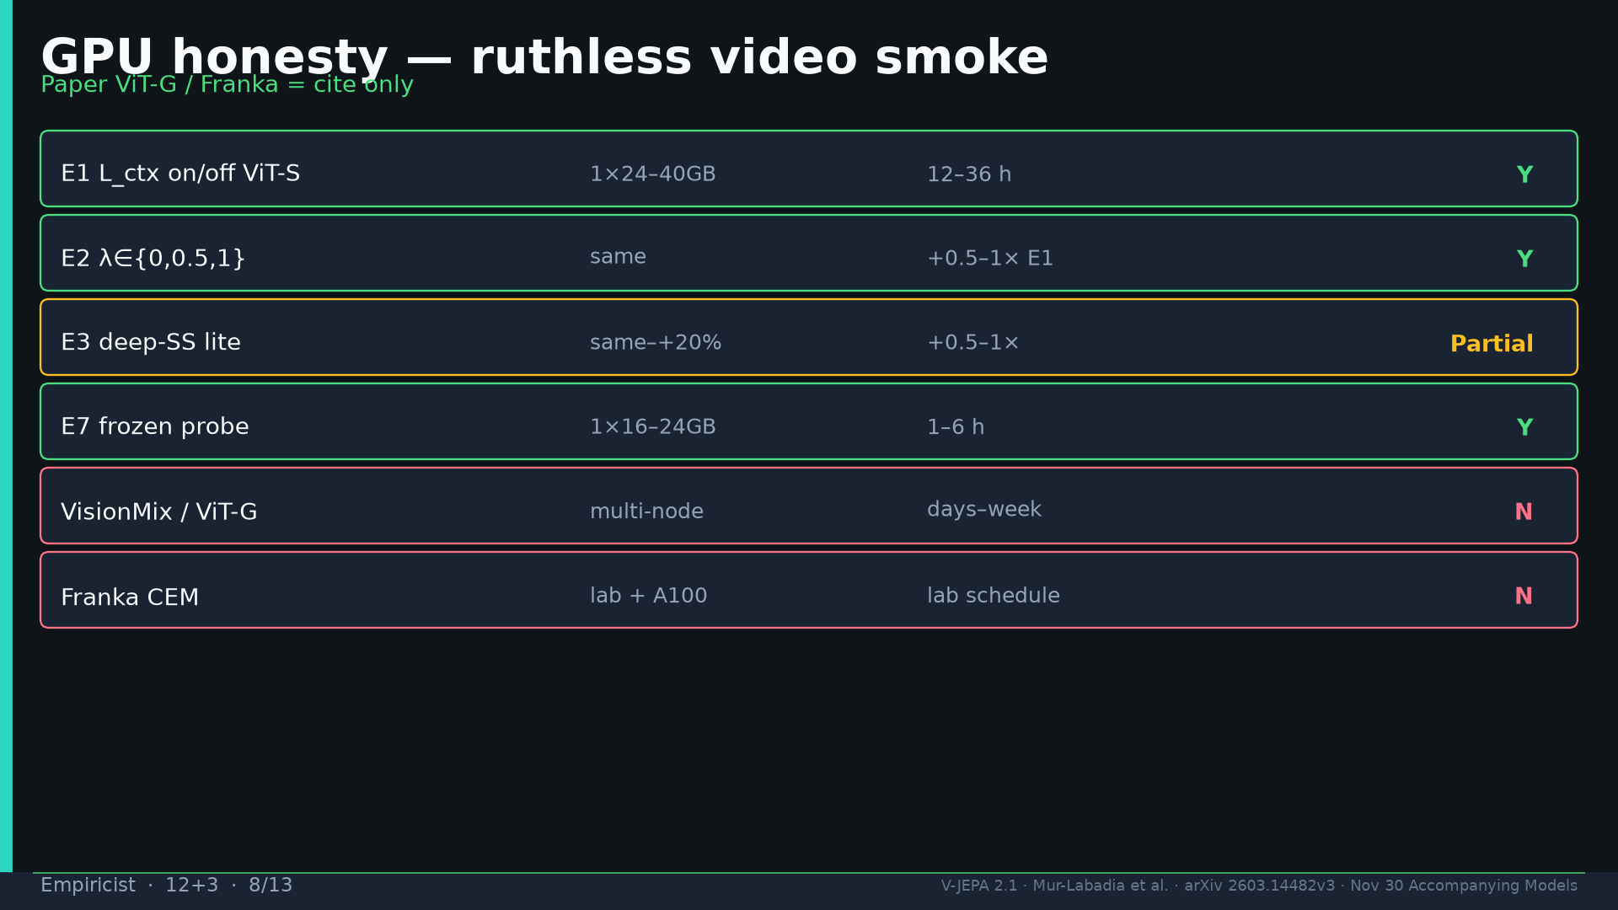
Notes:
GPU honesty — paper ViT-G/Franka cite only.

Slide 9
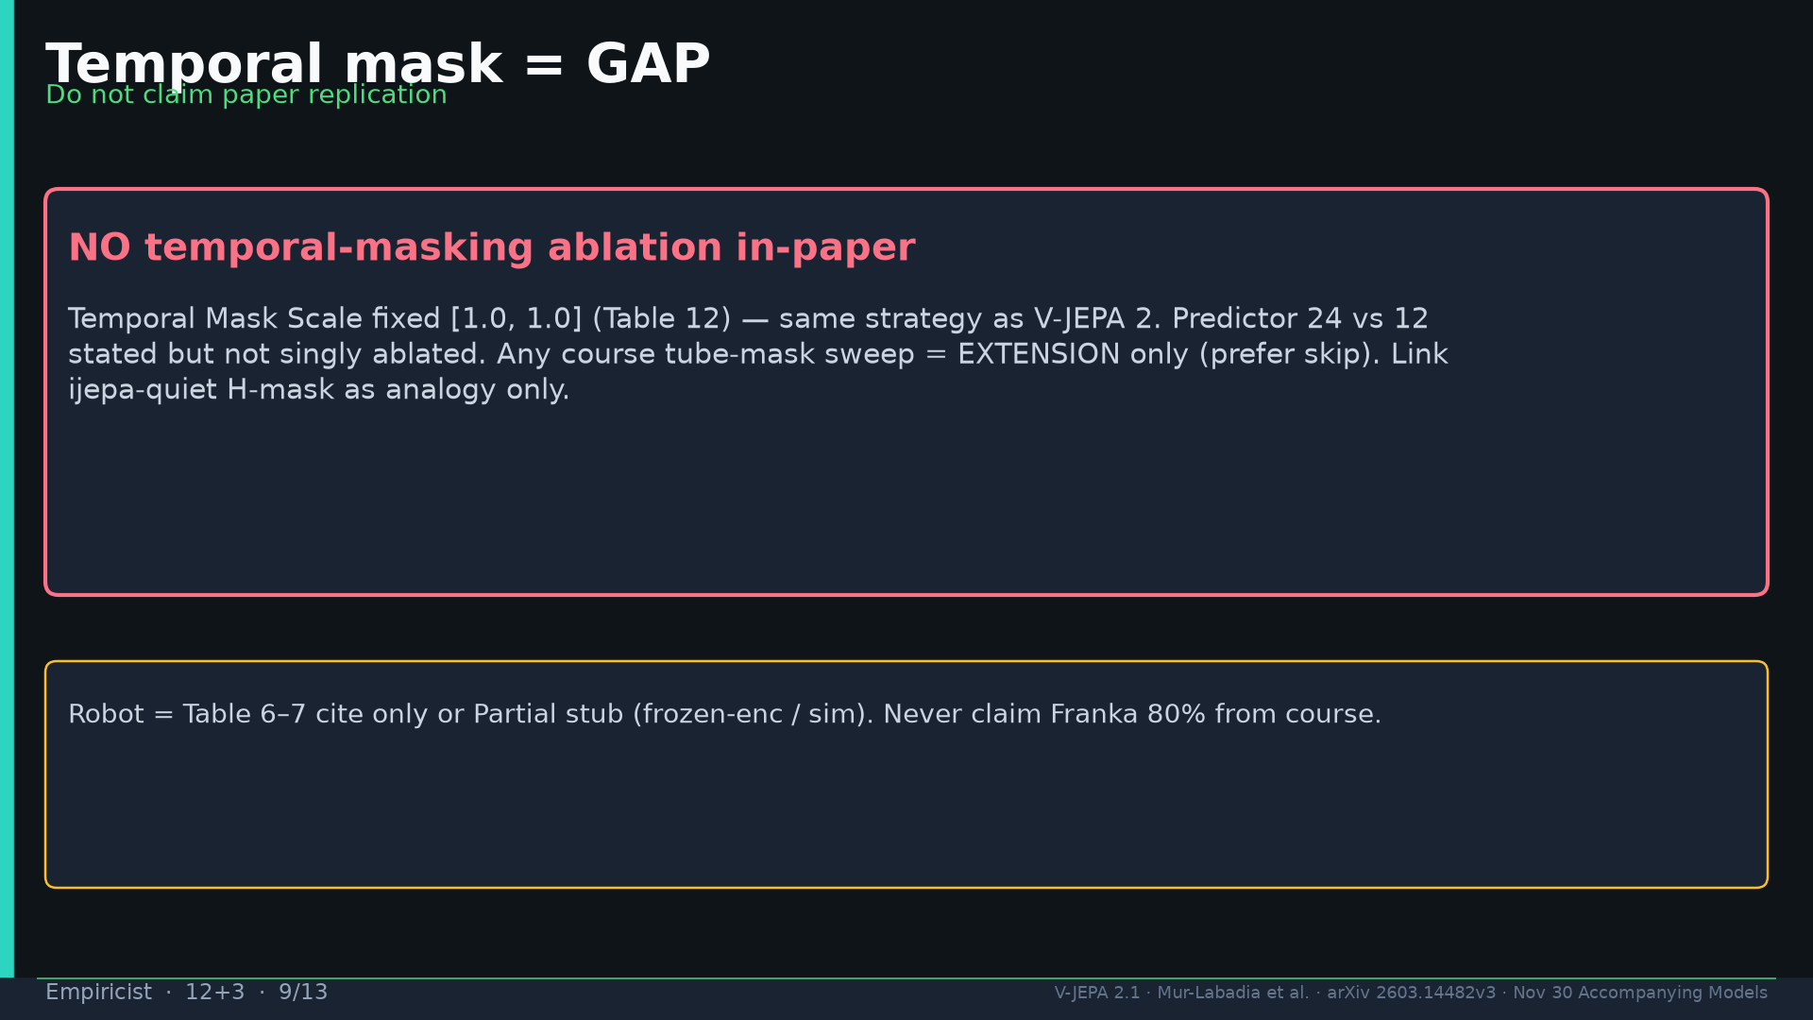
Notes:
Temporal mask GAP — extension only, not paper ablation.

Slide 10
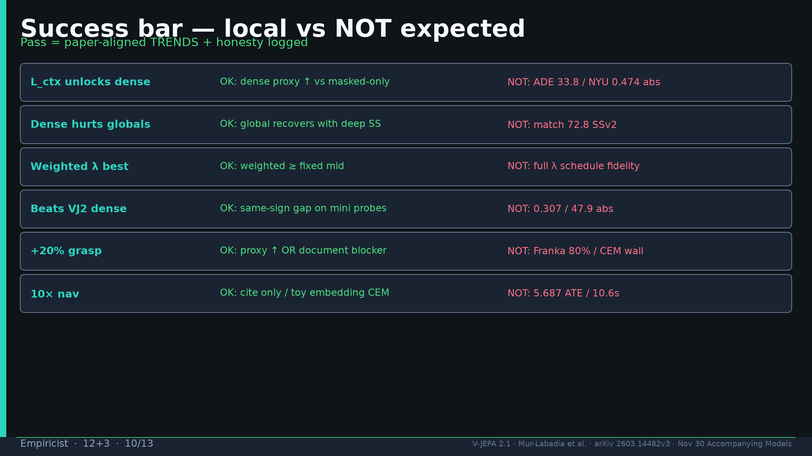
Notes:
Success bar: trends OK; absolute paper % NOT expected.

Slide 11
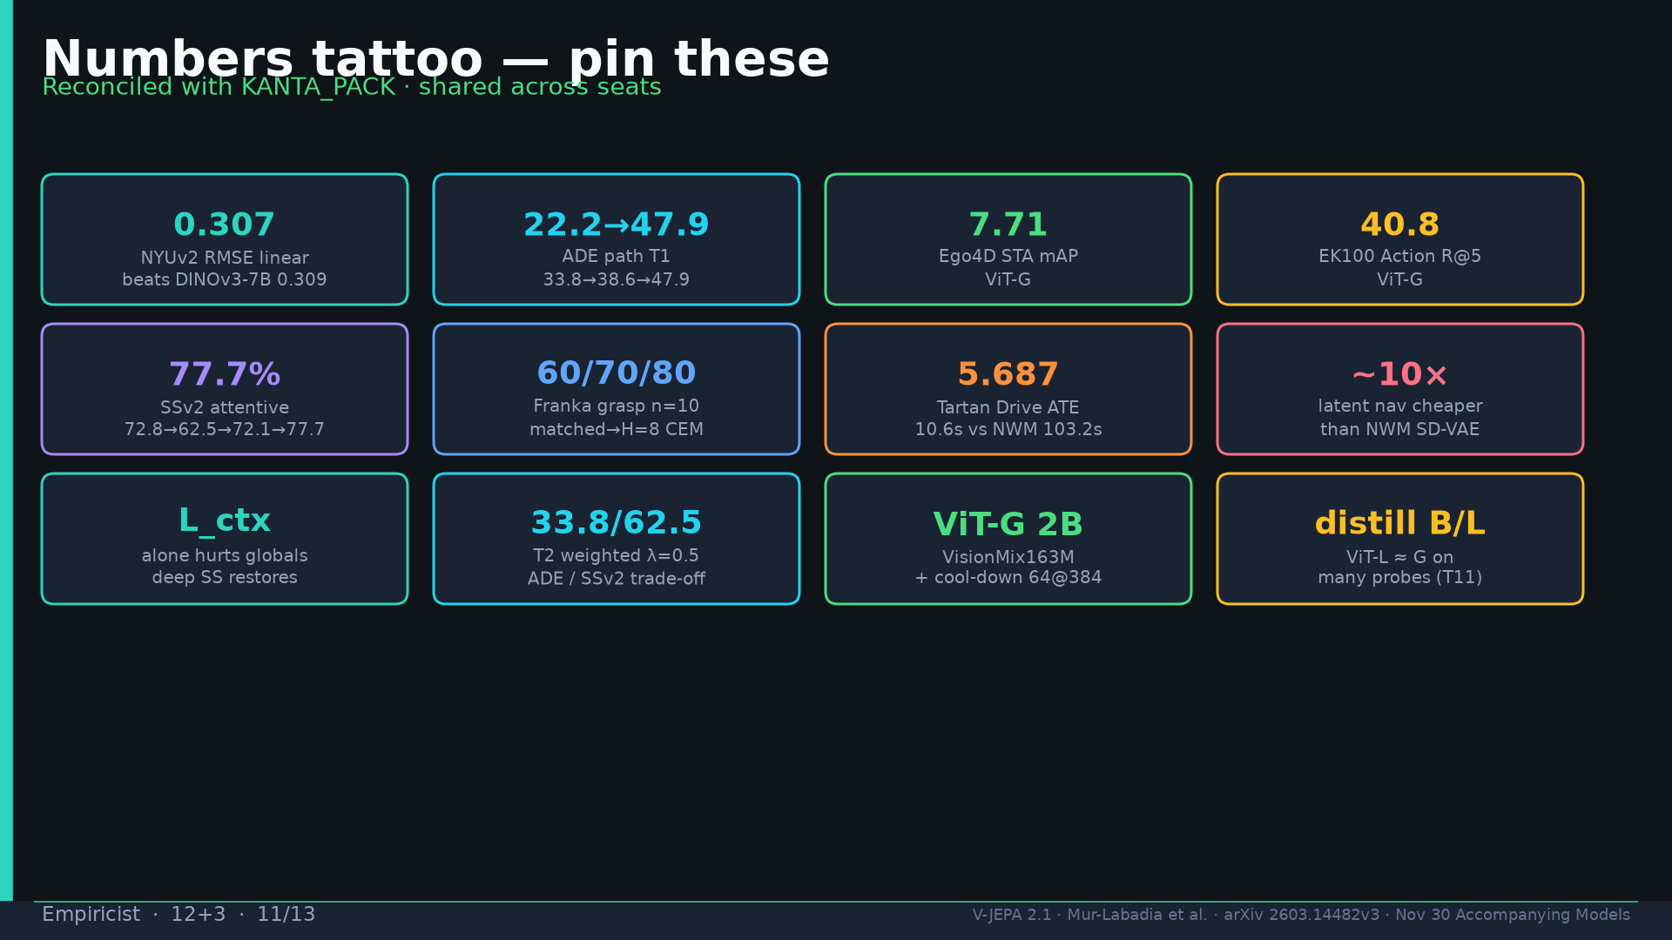
Notes:
Tattoo.

Slide 12
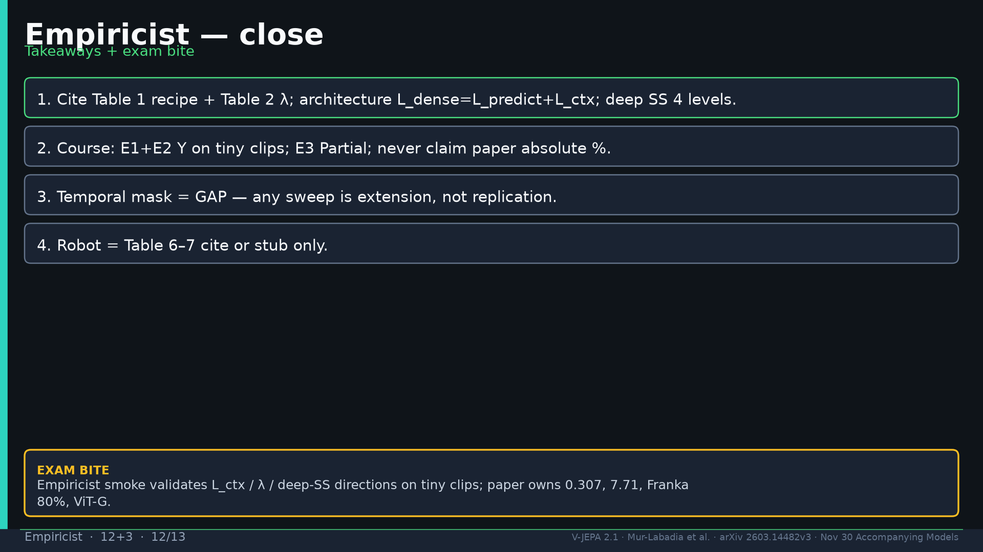
Notes:
Close.

Slide 13
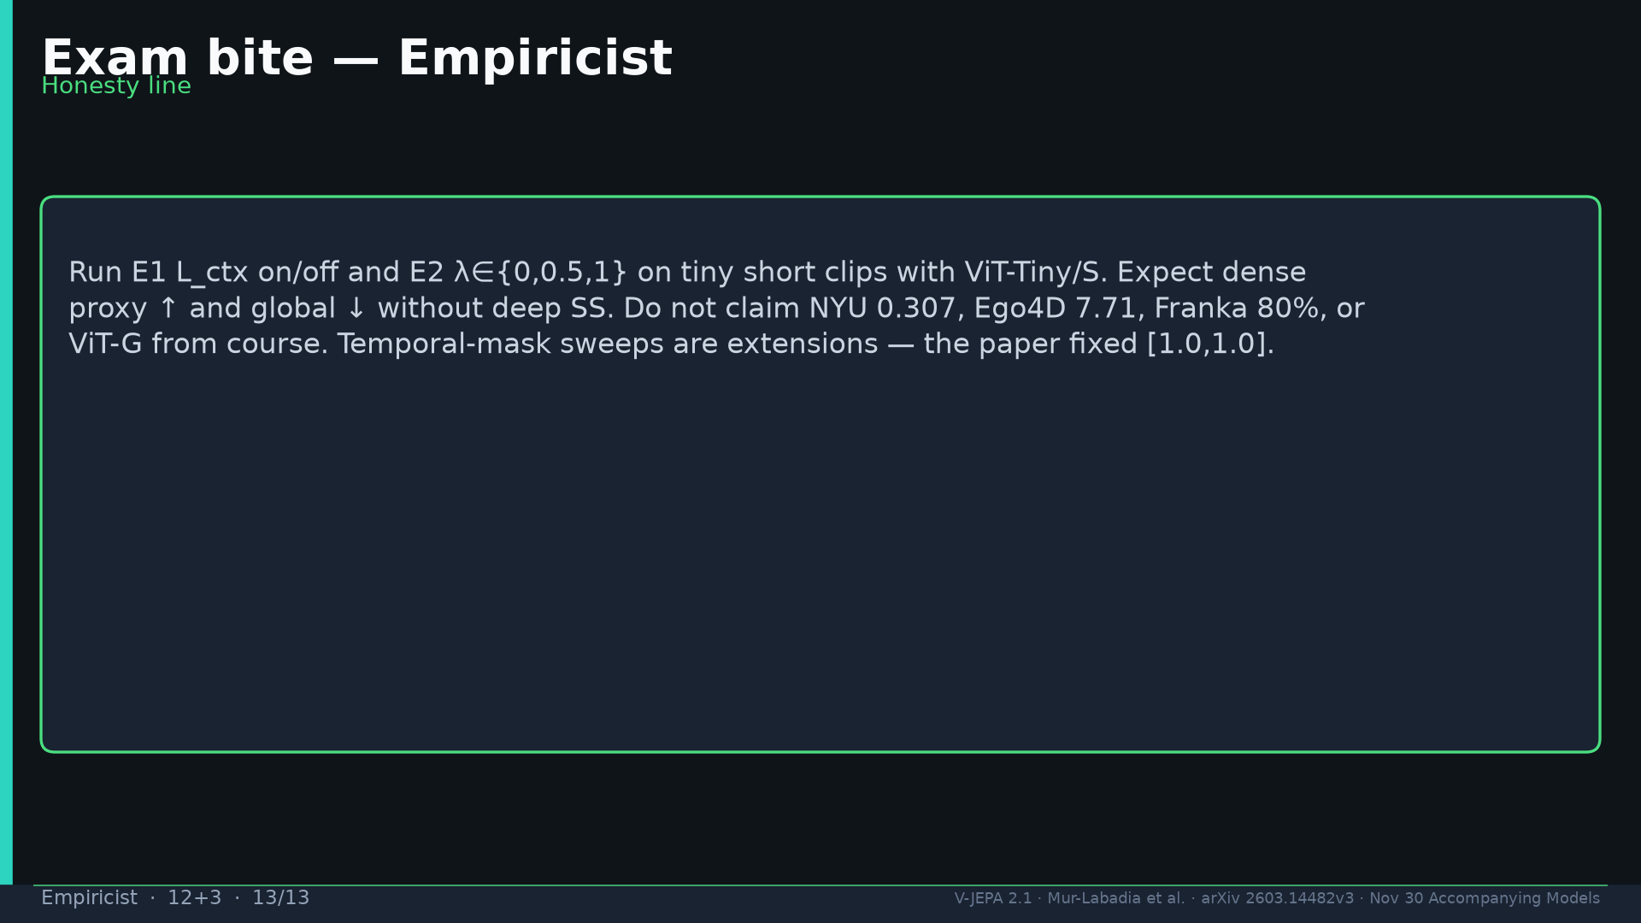
Notes:
Exam honesty line.

