Slide 1
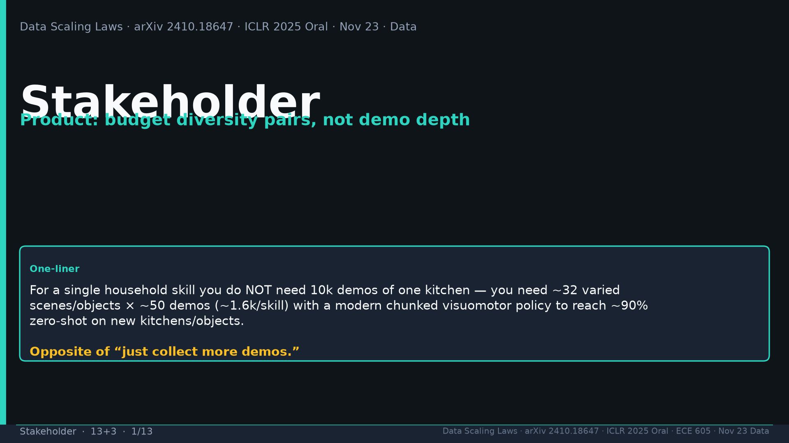
Notes:
Title. Product one-liner: ~32 varied scenes/objects × ~50 demos ≈1.6k/skill → ~90% ZS. Opposite “just more demos.”

Slide 2
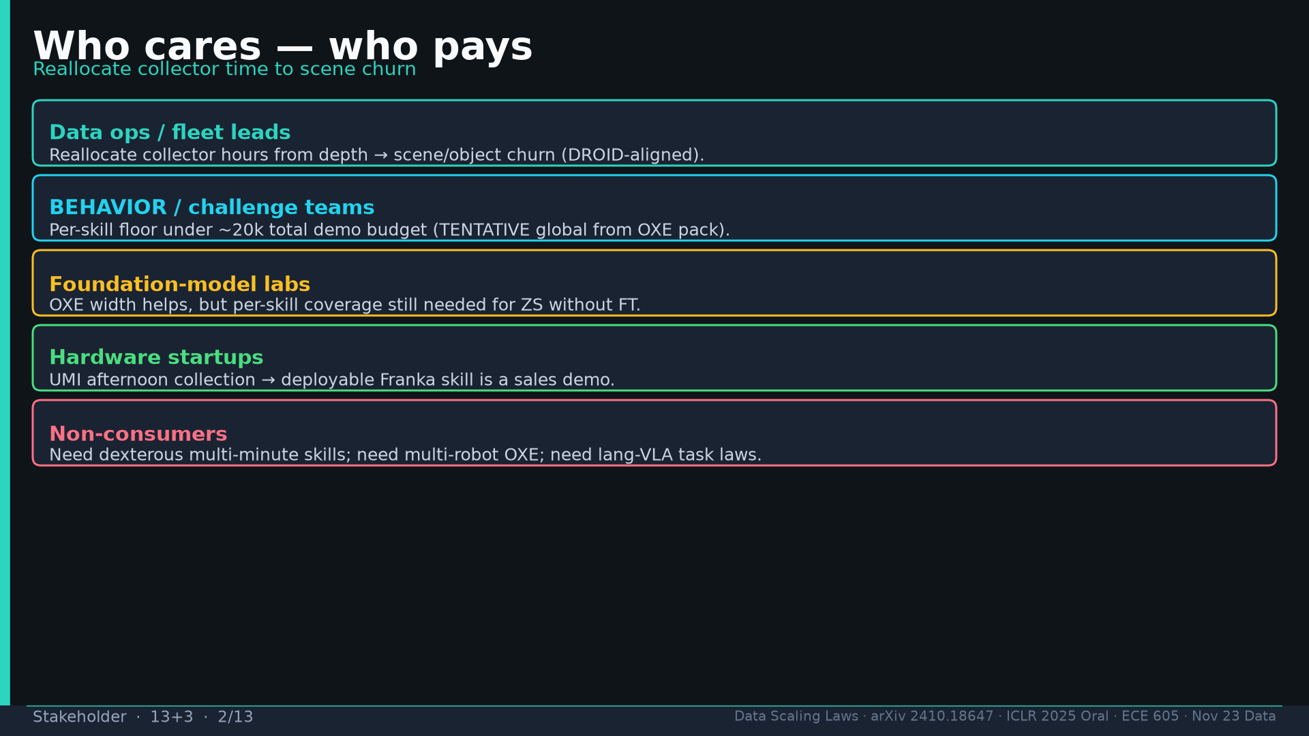
Notes:
Who pays: data ops/fleet (scene churn); BEHAVIOR teams (per-skill floor under ~20k TENTATIVE); foundation labs; hardware startups. Non-consumers: dex multi-minute, multi-robot OXE, lang-VLA laws.

Slide 3
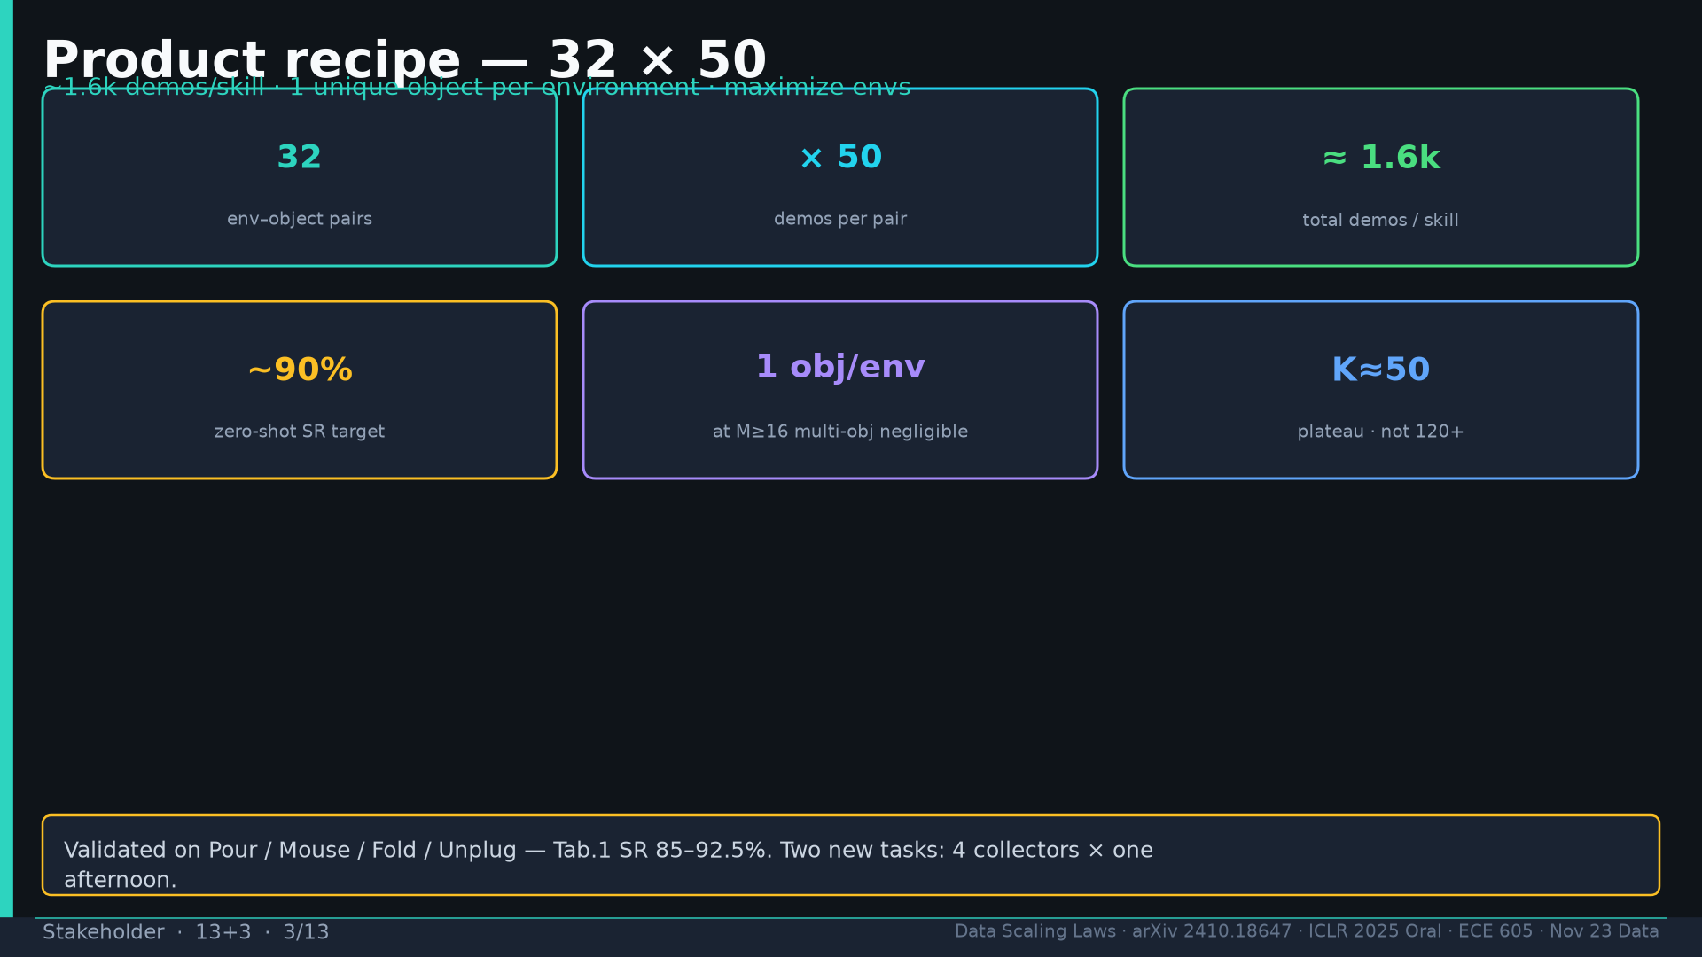
Notes:
Recipe 32×50: 1 obj/env; K≈50 plateau; Tab.1 85–92.5%; 4 collectors × afternoon for 2 new tasks.

Slide 4
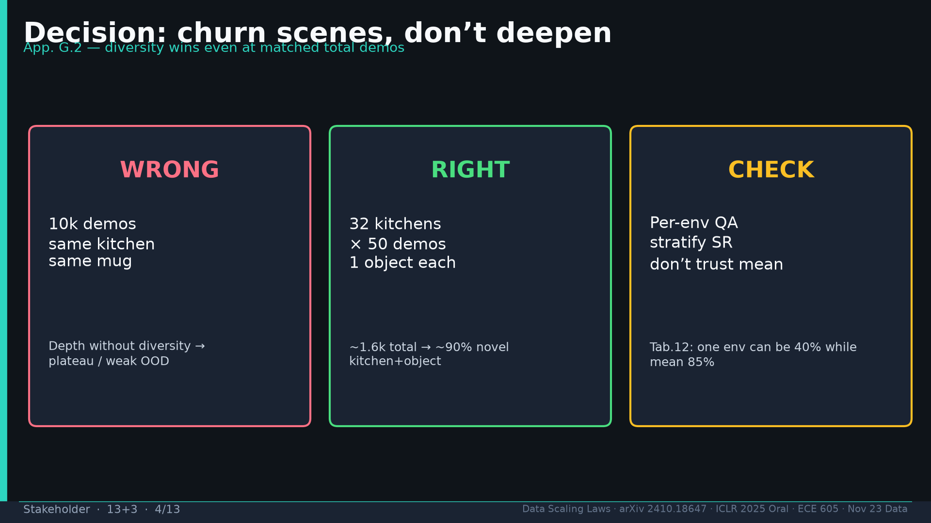
Notes:
Decision: WRONG=10k same kitchen; RIGHT=32×50; CHECK=per-env QA (Tab.12 env#2=40%).

Slide 5
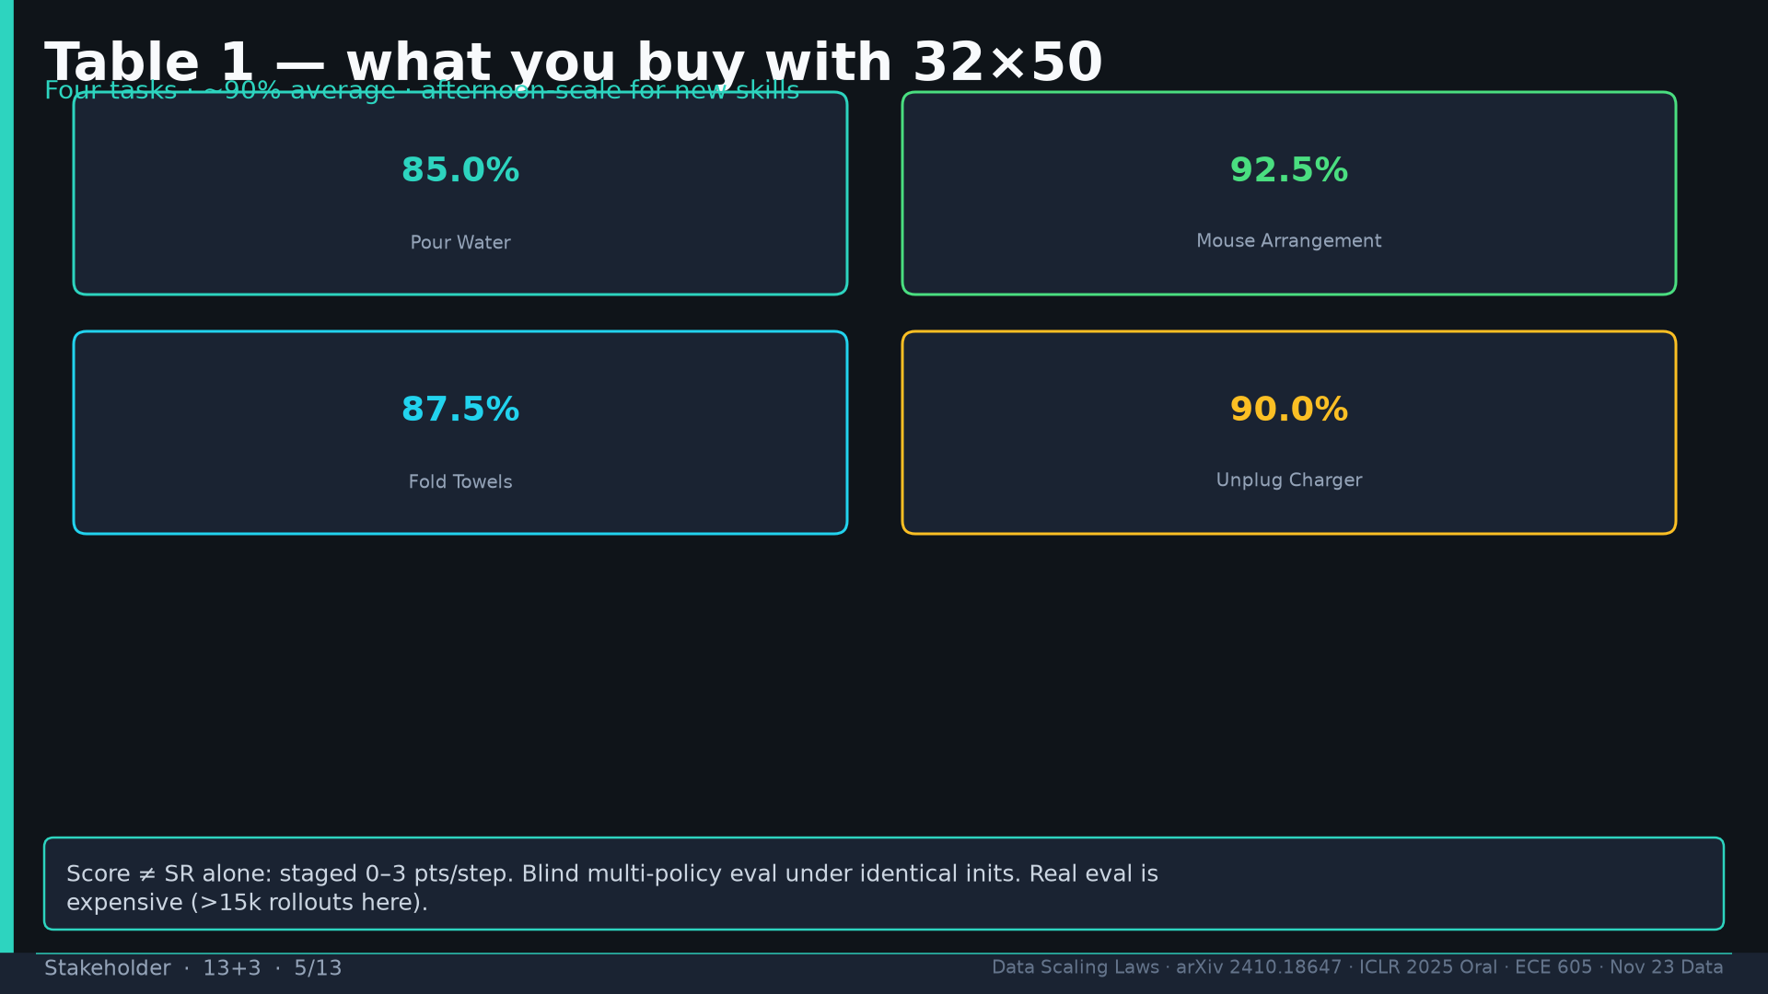
Notes:
Table1 SR: Pour 85 / Mouse 92.5 / Fold 87.5 / Unplug 90. Staged scores; blind eval; >15k rollouts expensive.

Slide 6
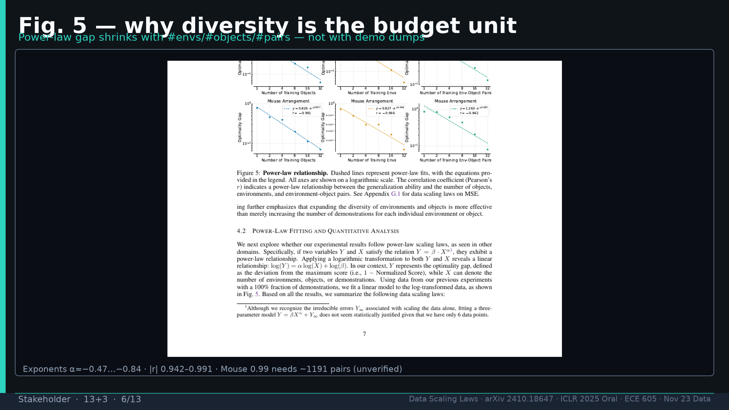
Notes:
Fig.5: power-law gap vs M/N/pairs; α≈−0.47…−0.84; Mouse 0.99→1191 unverified.

Slide 7
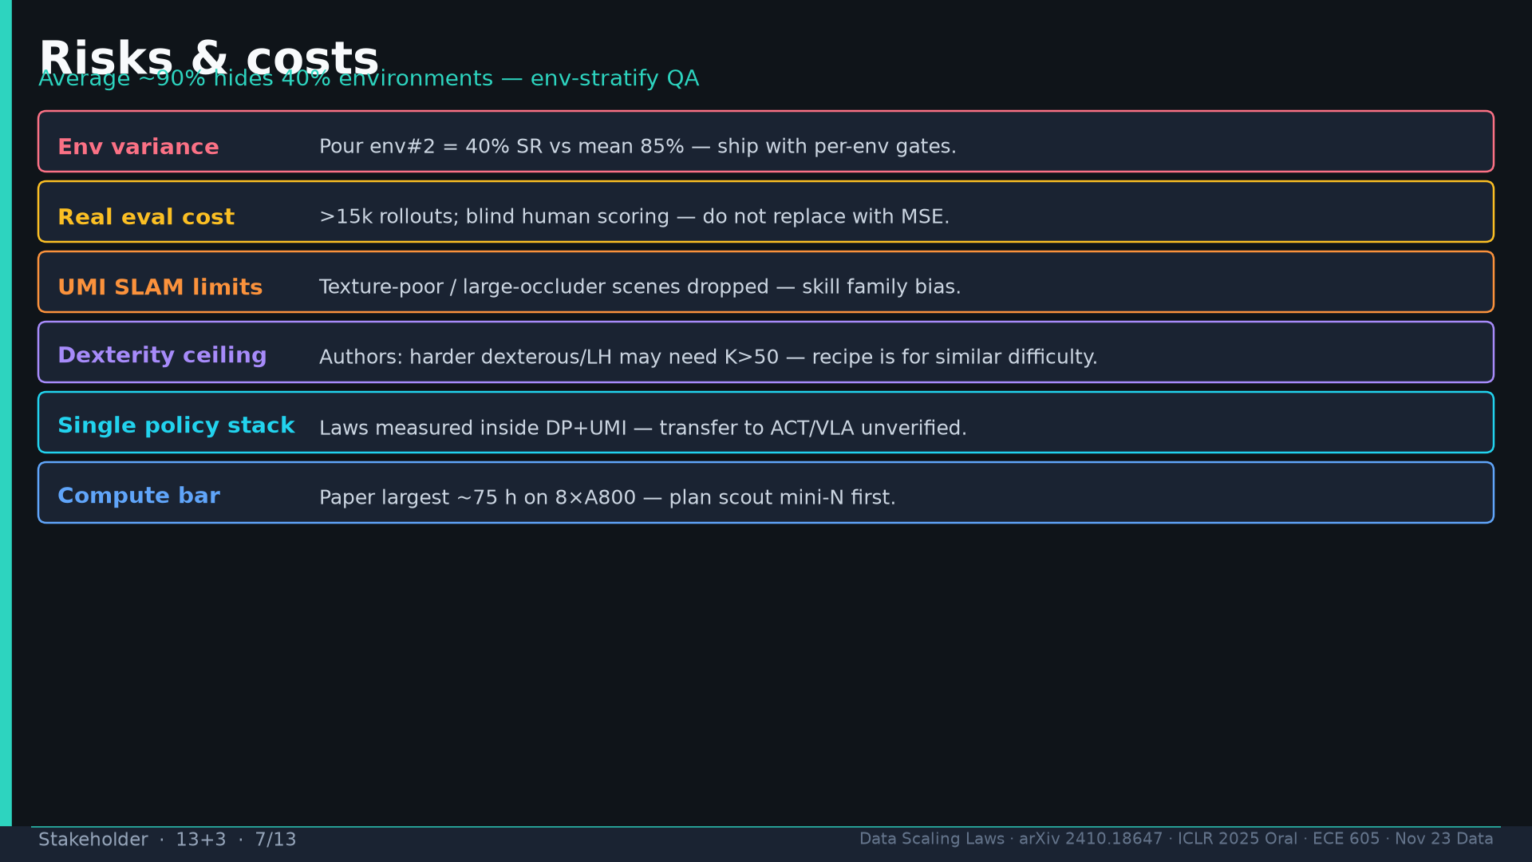
Notes:
Risks: env variance 40%; real eval cost; UMI SLAM limits; dexterity ceiling K>50; DP-only; 75h/8×A800.

Slide 8
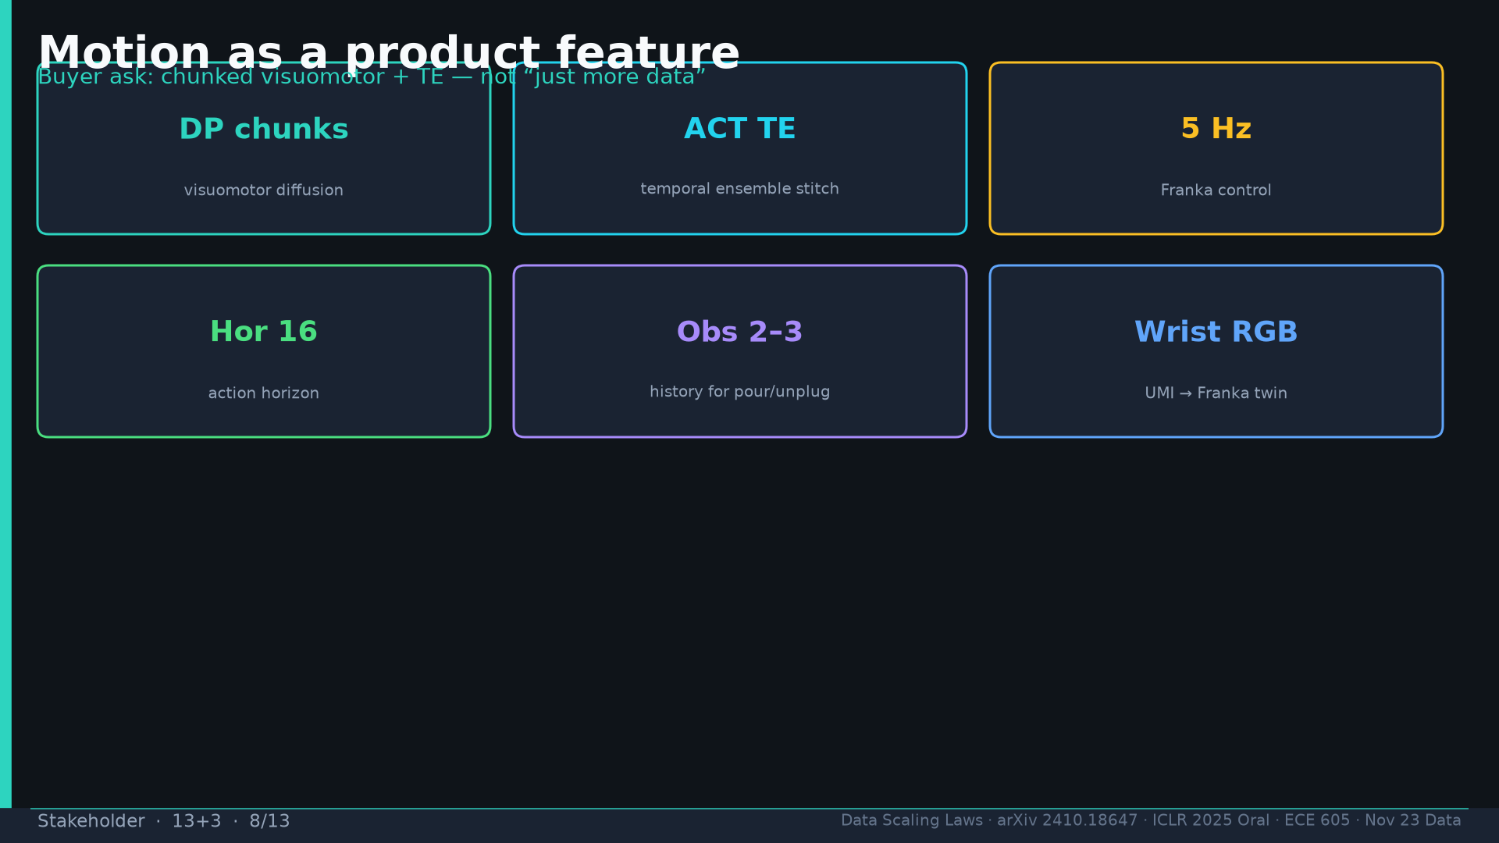
Notes:
Motion product: DP + ACT TE @5Hz; hor 16; obs 2–3; wrist RGB UMI→Franka.

Slide 9
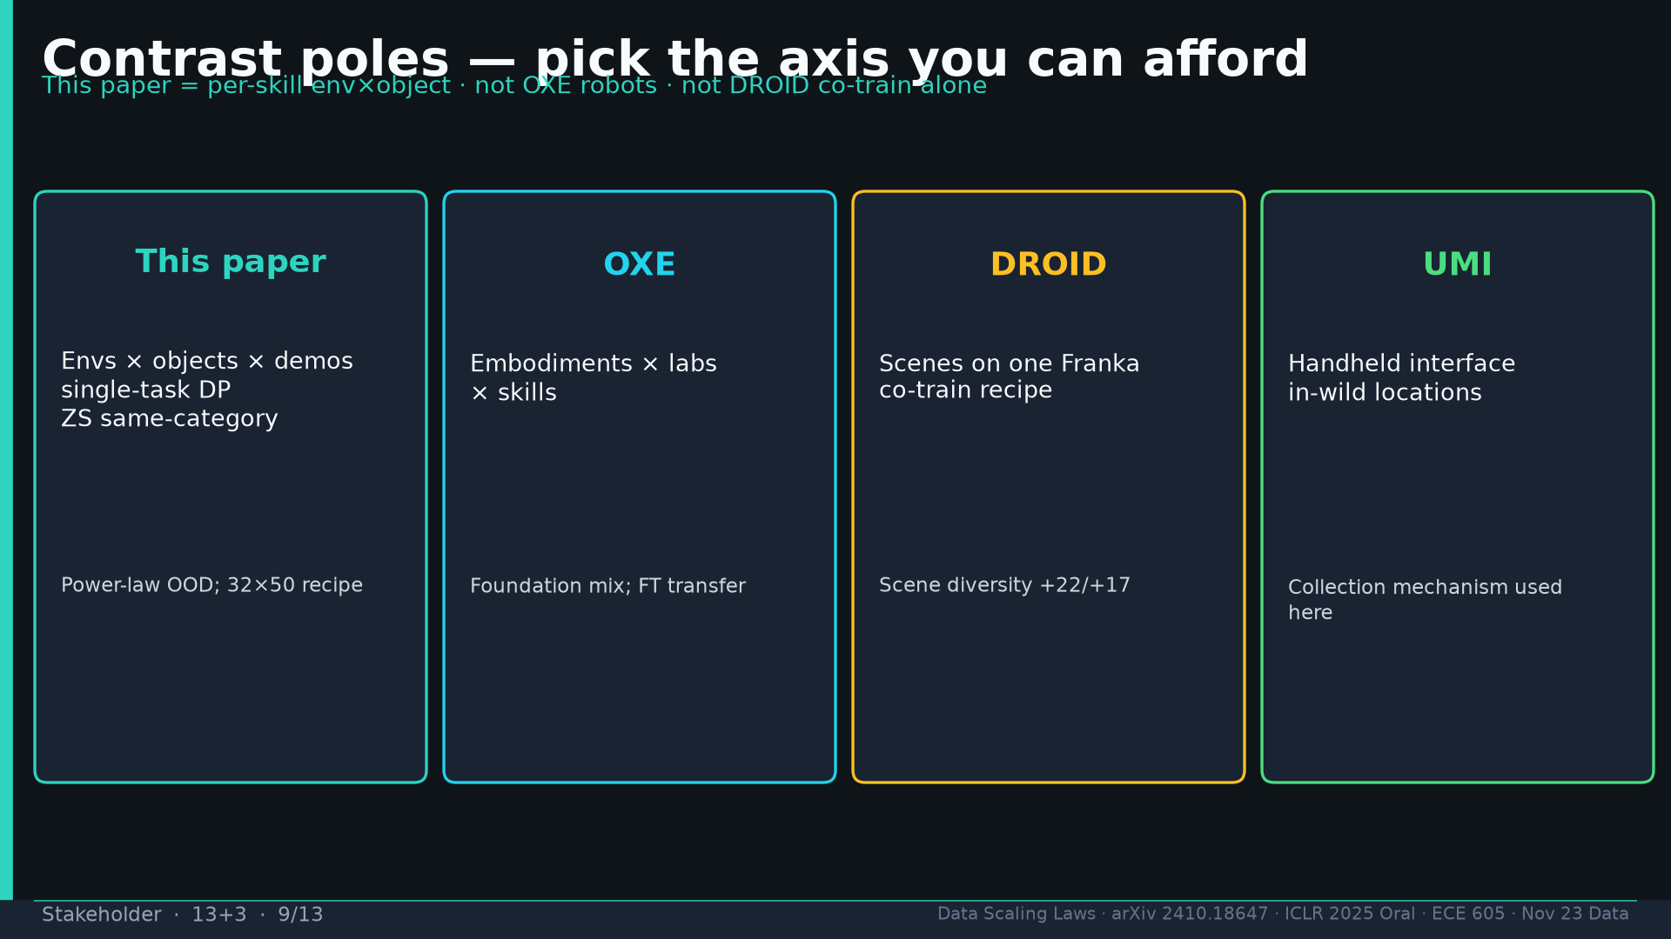
Notes:
Poles: this paper env×obj; OXE robots; DROID scenes; UMI interface — pick affordable axis.

Slide 10
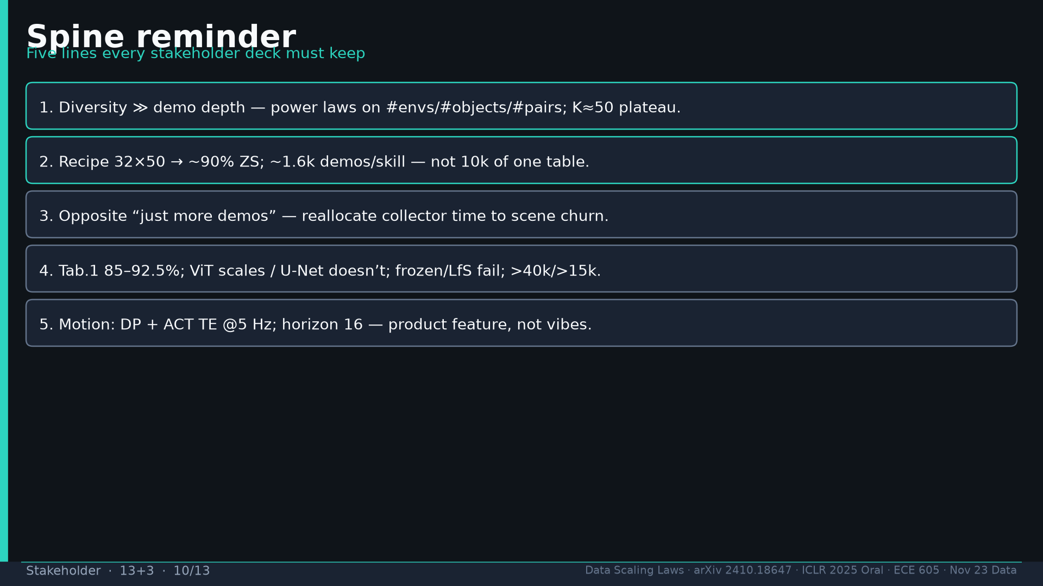
Notes:
Spine 1–5 reminder: diversity≫depth; 32×50; opposite more-demos; Tab.1/ViT/U-Net/frozen; DP+ACT TE.

Slide 11
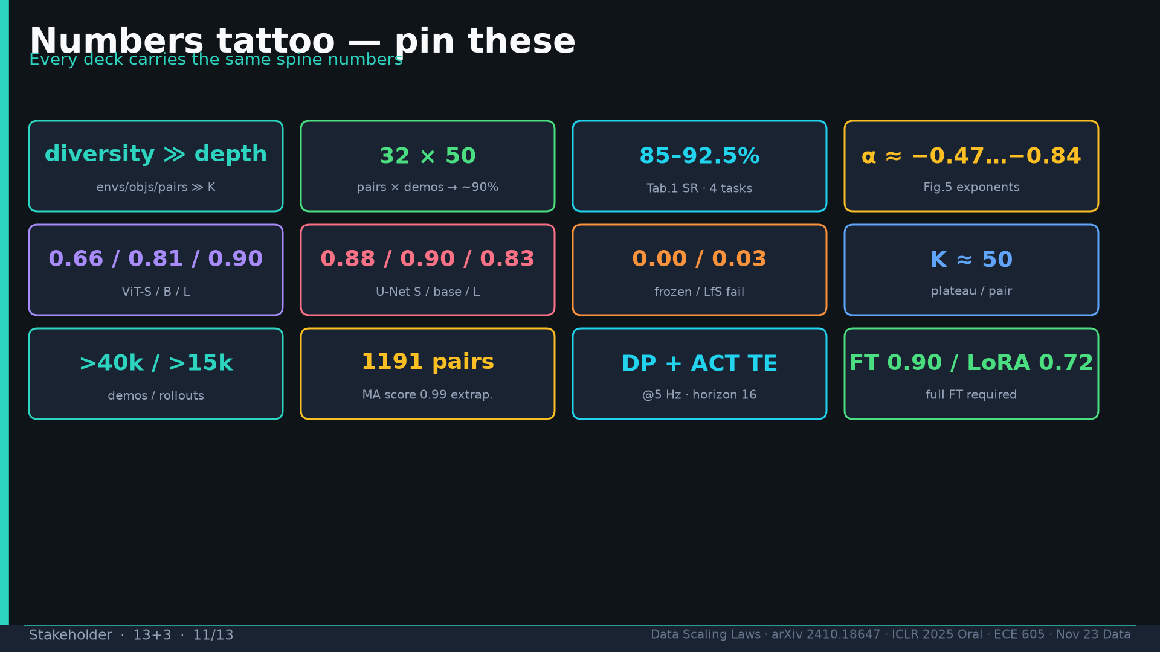
Notes:
Tattoo numbers shared.

Slide 12
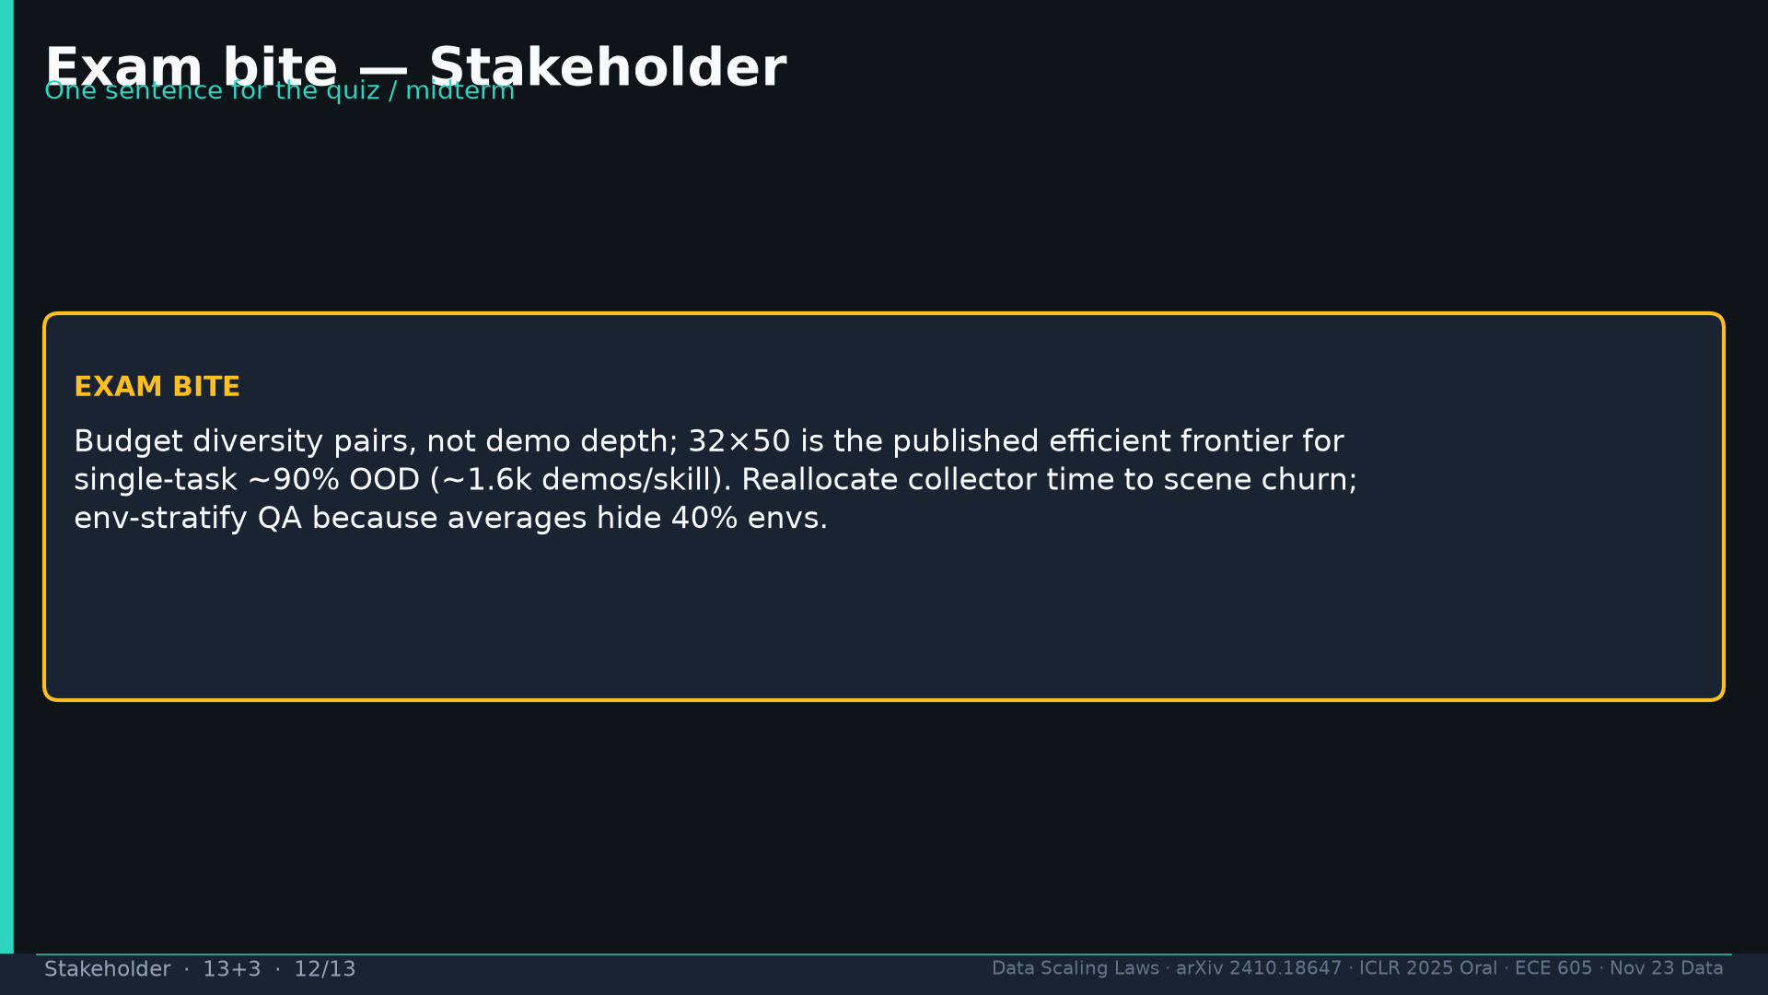
Notes:
Exam: budget diversity pairs not depth; 32×50 efficient frontier; reallocate to scene churn; env-stratify QA.

Slide 13
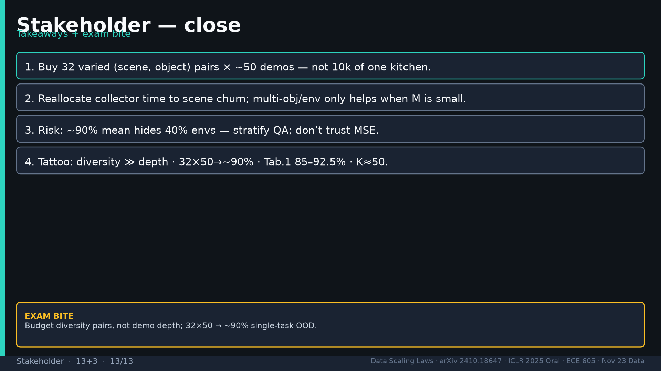
Notes:
Close four takeaways. Q&A.

