Slide 1
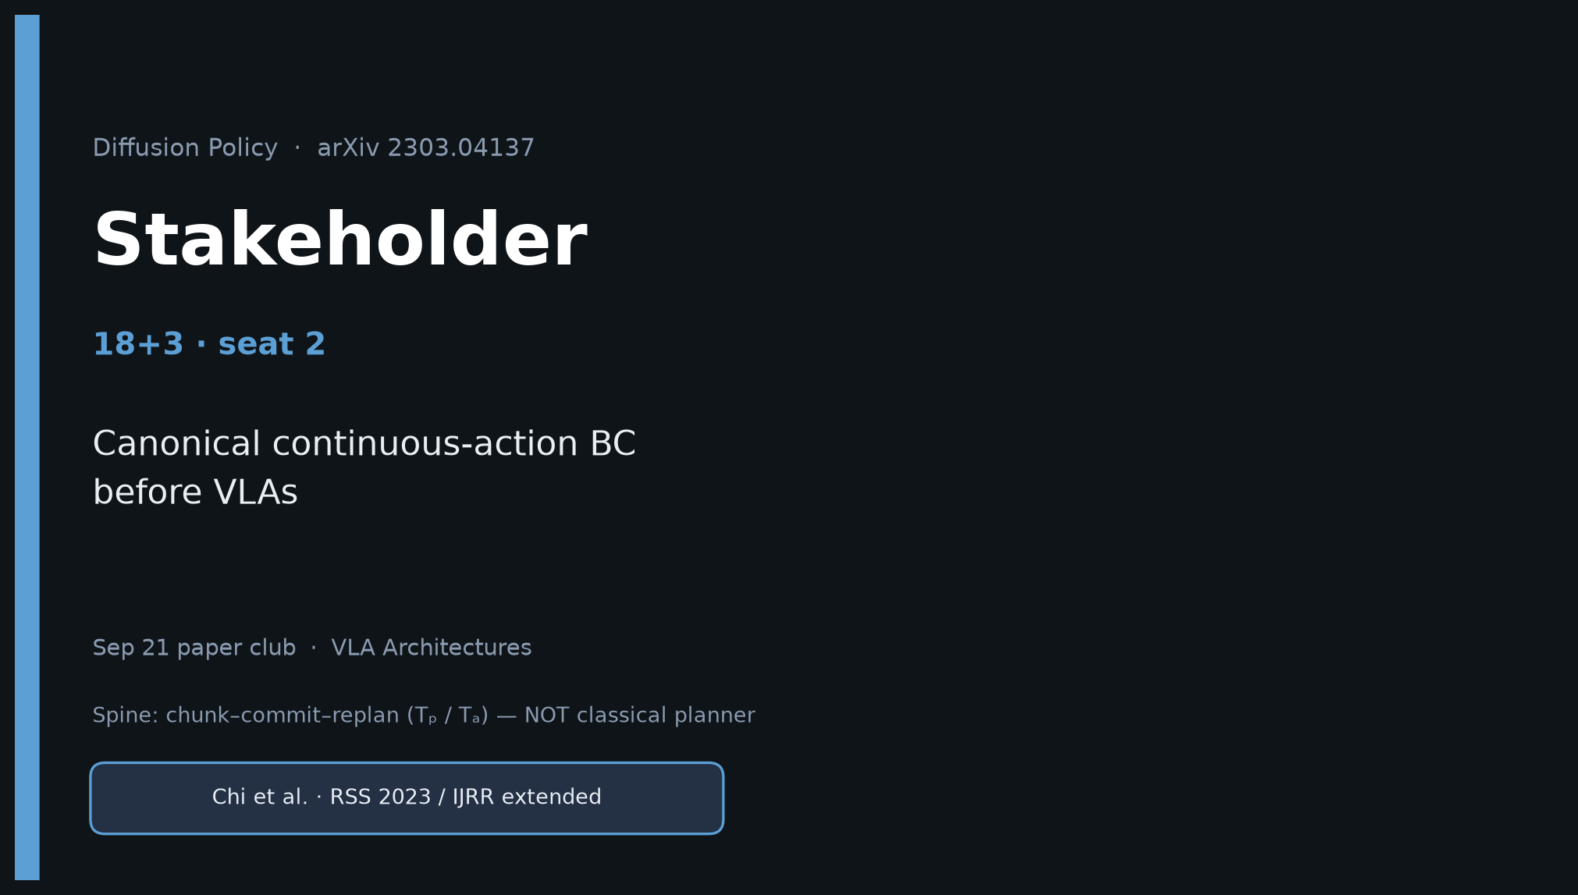
Stakeholder · 18+3 · 1/14
Notes:
STAKEHOLDER — seat 2 · 18+3.
You own: why this paper still matters for lab / product planning in 2026.
Do NOT redo Archaeologist’s full citation archaeology. Steal the club line once, then stay on value.

Slide 2
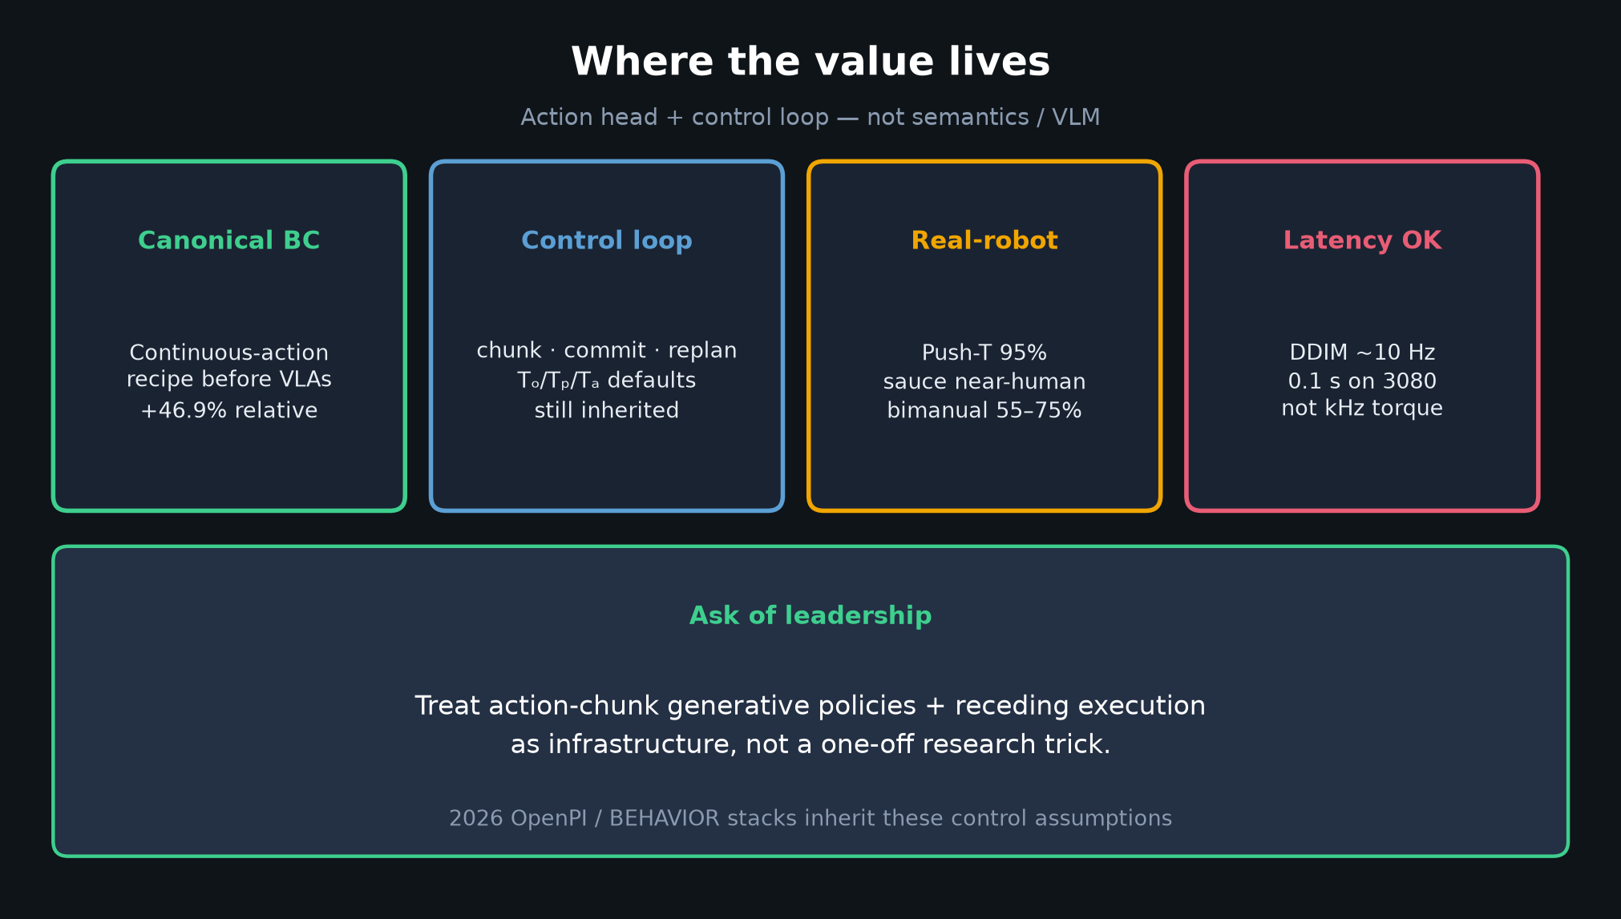
Stakeholder · 18+3 · 2/14
Notes:
WHERE THE VALUE LIVES.
Canonical continuous-action BC before VLAs.
Value = action head + control loop — NOT semantics / language / web pretrain.
Real-robot credible; DDIM keeps ~10 Hz.
Ask: treat chunk generative + receding exec as infrastructure.

Slide 3
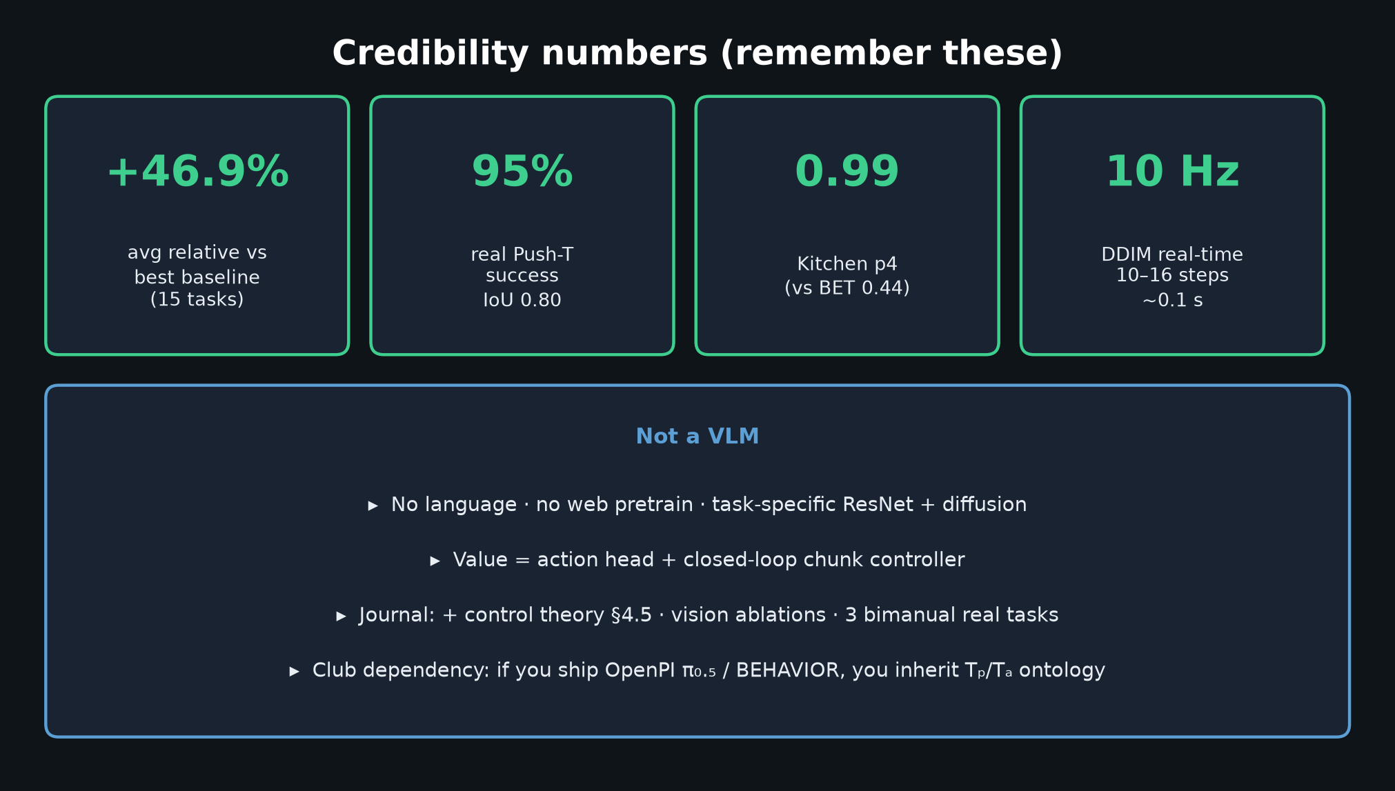
Stakeholder · 18+3 · 3/14
Notes:
NUMBERS TO REMEMBER.
+46.9% avg relative · real Push-T 95% / IoU 0.80 · Kitchen p4 0.99 · ~10 Hz DDIM.
Not a VLM — task-specific ResNet+diffusion.
If your 2026 stack is OpenPI π₀.₅ / BEHAVIOR, you inherit Tₚ/Tₐ ontology whether or not you still train a DDPM.

Slide 4
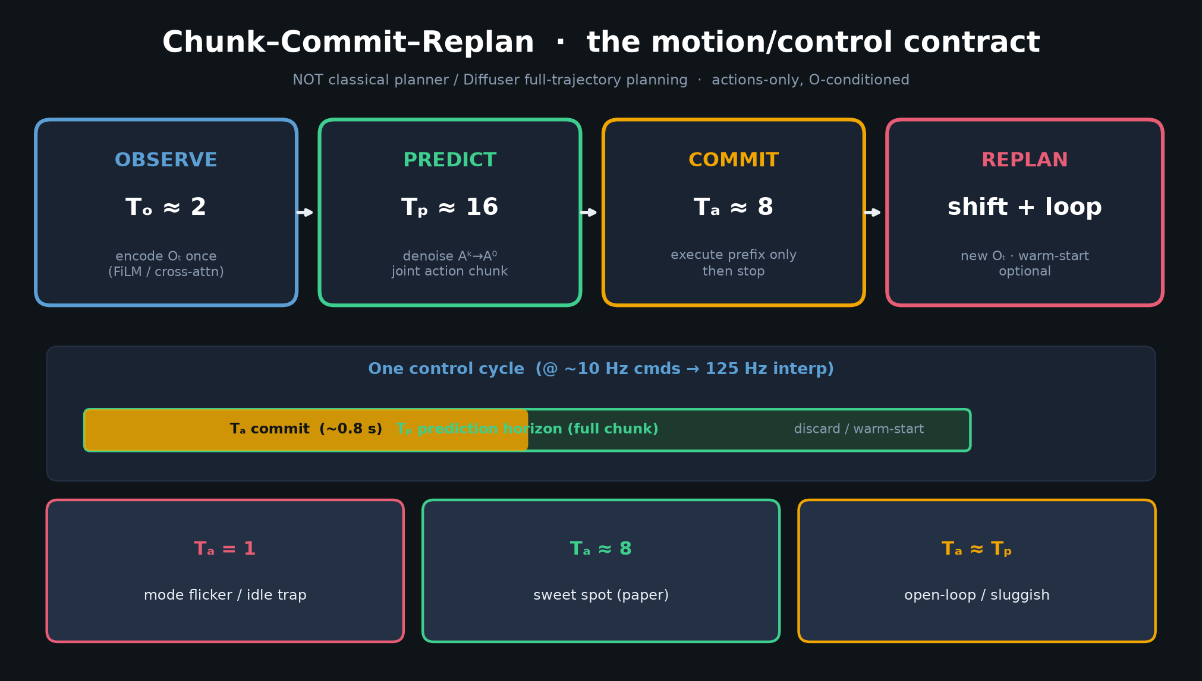
Stakeholder · 18+3 · 4/14
Notes:
SPINE for leadership — chunk–commit–replan.
Defaults Tₒ≈2, Tₚ≈16, Tₐ≈8. This is the motion/control contract OpenPI/BEHAVIOR still assume.
NOT a classical motion planner.

Slide 5
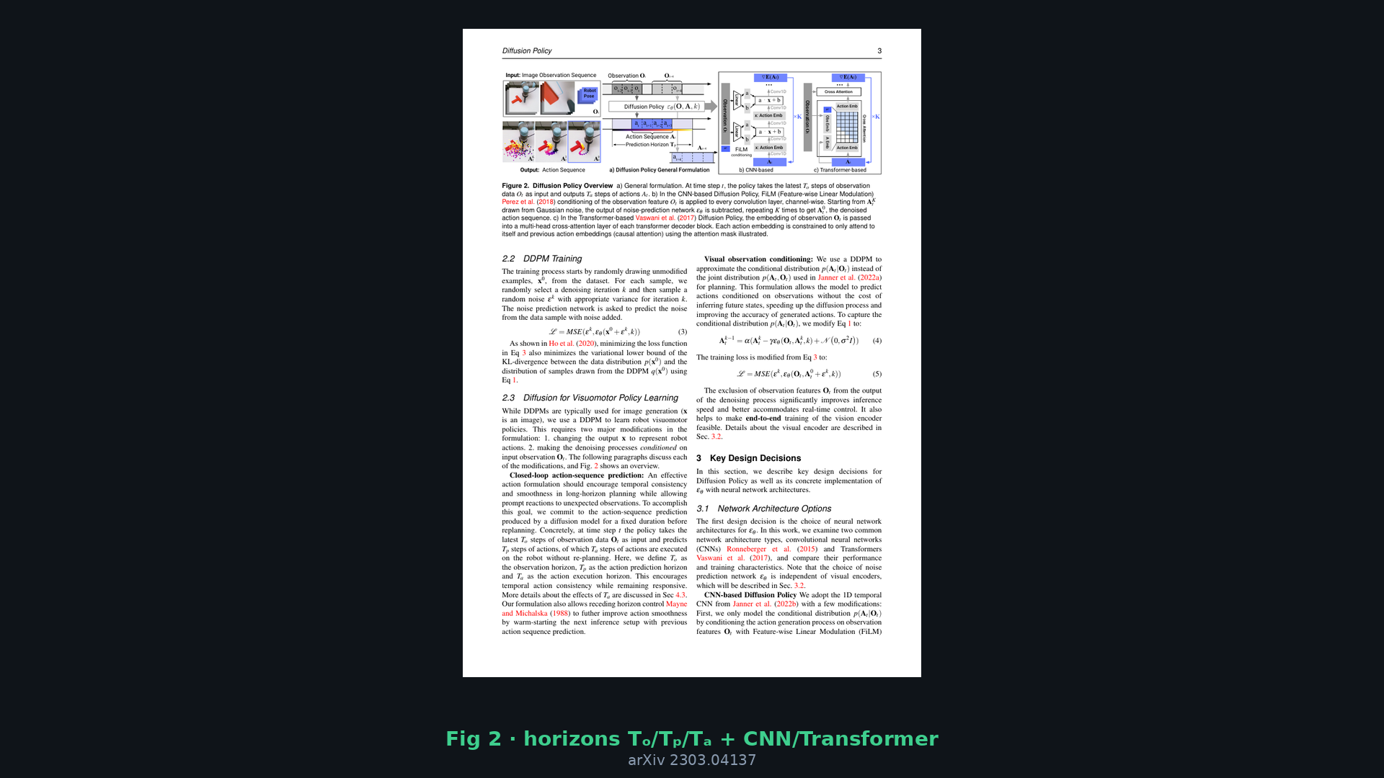
Stakeholder · 18+3 · 5/14
Notes:
Paper Fig 2 — show the original diagram so leadership sees it’s not your invention; it’s the paper’s.

Slide 6
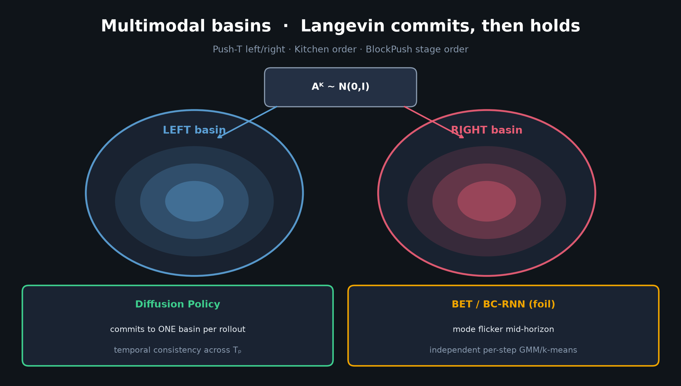
Stakeholder · 18+3 · 6/14
Notes:
Multimodal basins — why this beat BC-RNN/IBC/BET on hard tasks.
Commits to a mode; doesn’t flicker. That is a product-quality property for teleop-trained policies.

Slide 7
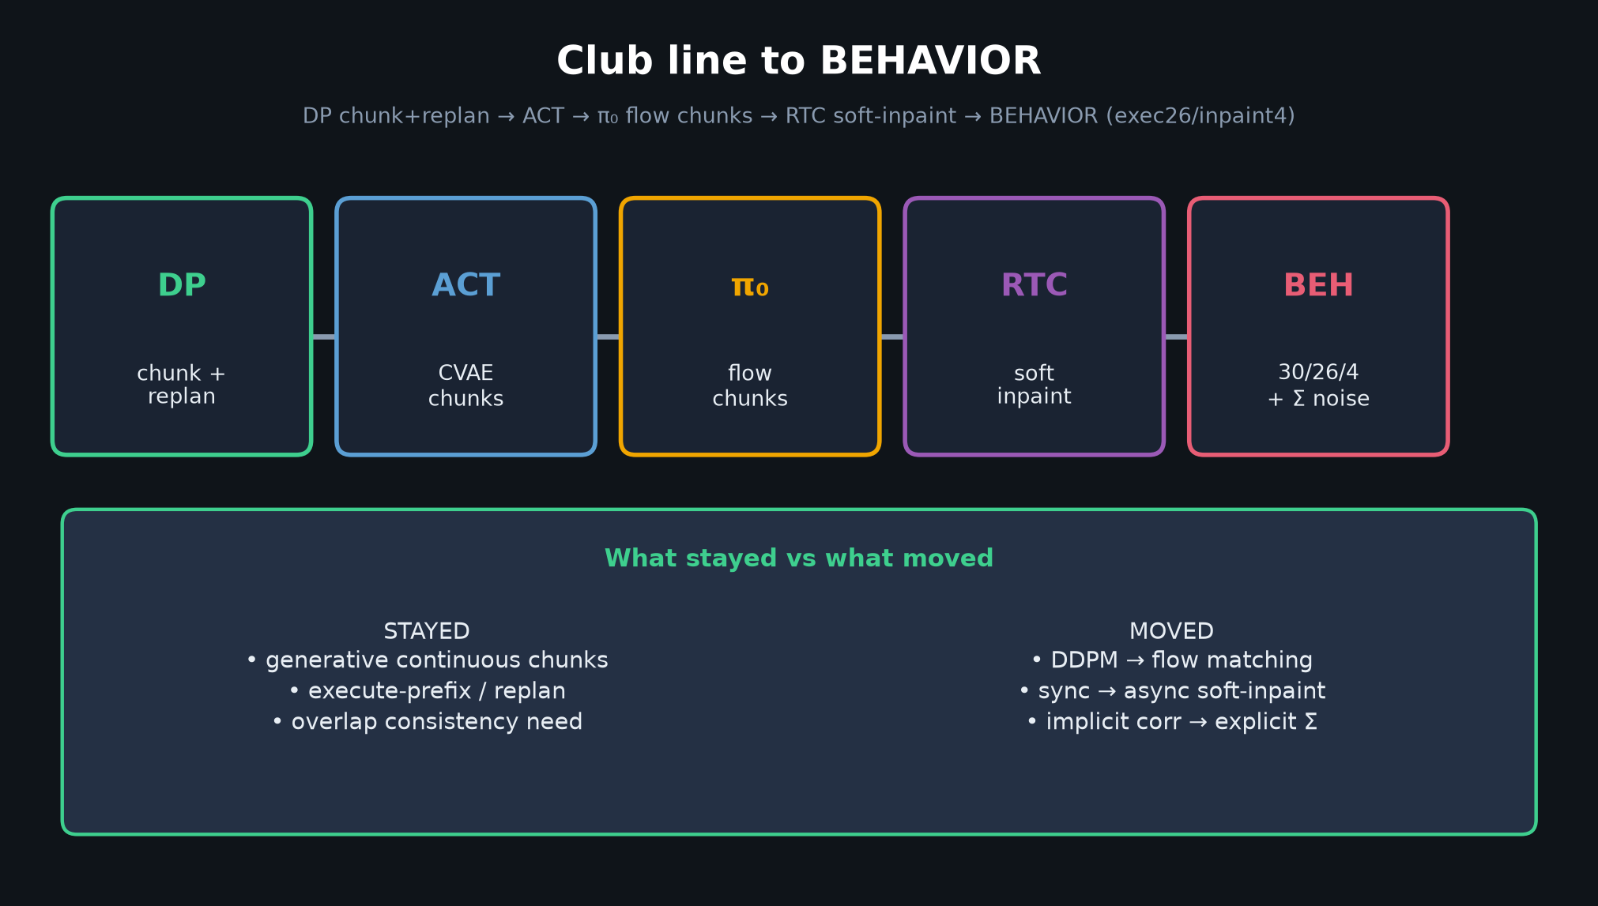
Stakeholder · 18+3 · 7/14
Notes:
Club line — strategic dependency.
DP → ACT → π₀ flow → RTC → BEHAVIOR (30/26/4).
Denoiser moved; control habit stayed. Your roadmap bets should treat the habit as infra.

Slide 8
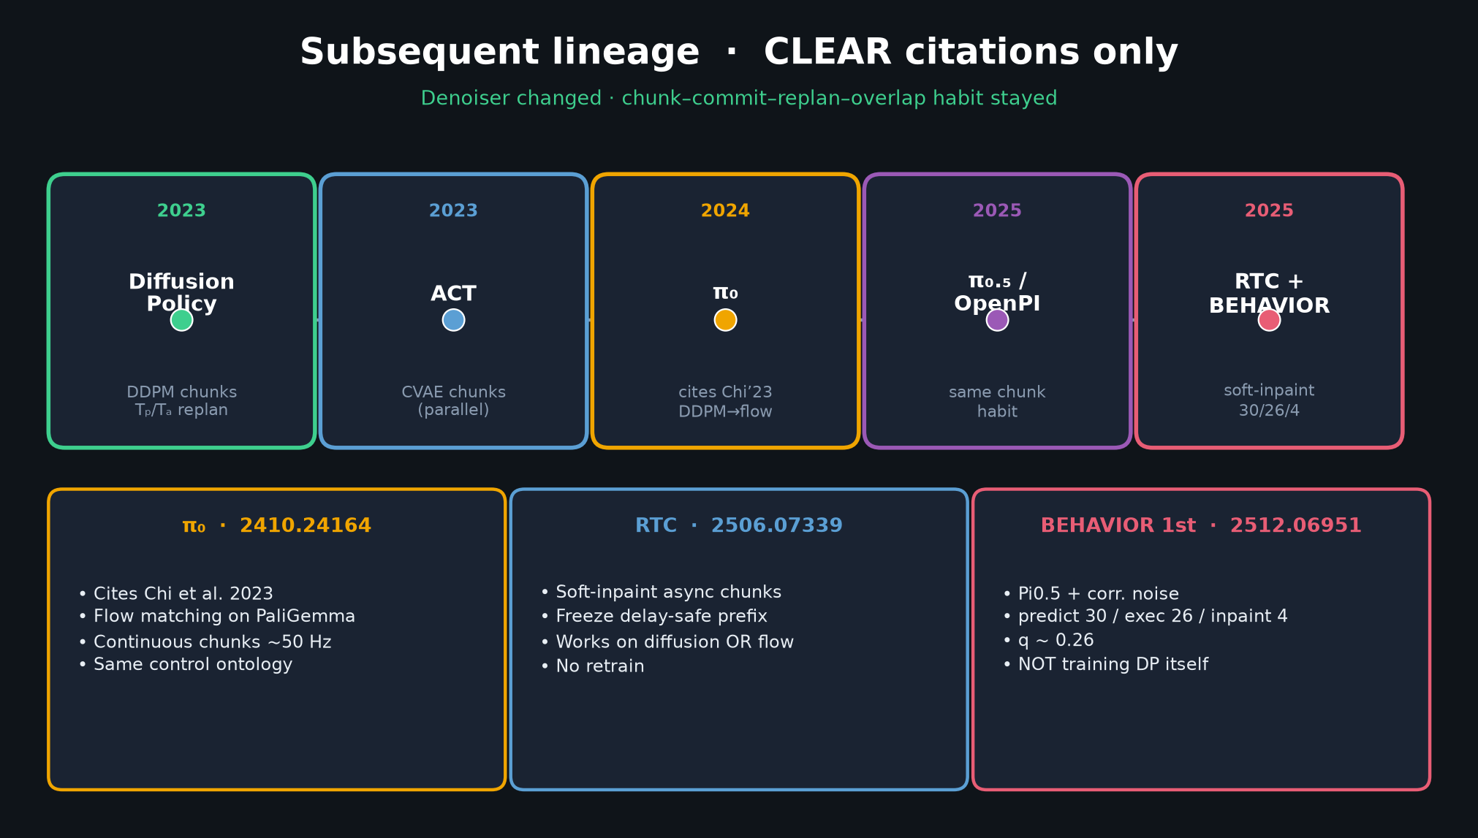
Stakeholder · 18+3 · 8/14
Notes:
Subsequent timeline — compressed for stakeholder (who / when / what changed).
π₀ cites Chi’23. RTC soft-inpaint. BEHAVIOR 1st = Pi0.5 + corr noise + exec26/inpaint4.
Do NOT claim BEHAVIOR trains DP.

Slide 9
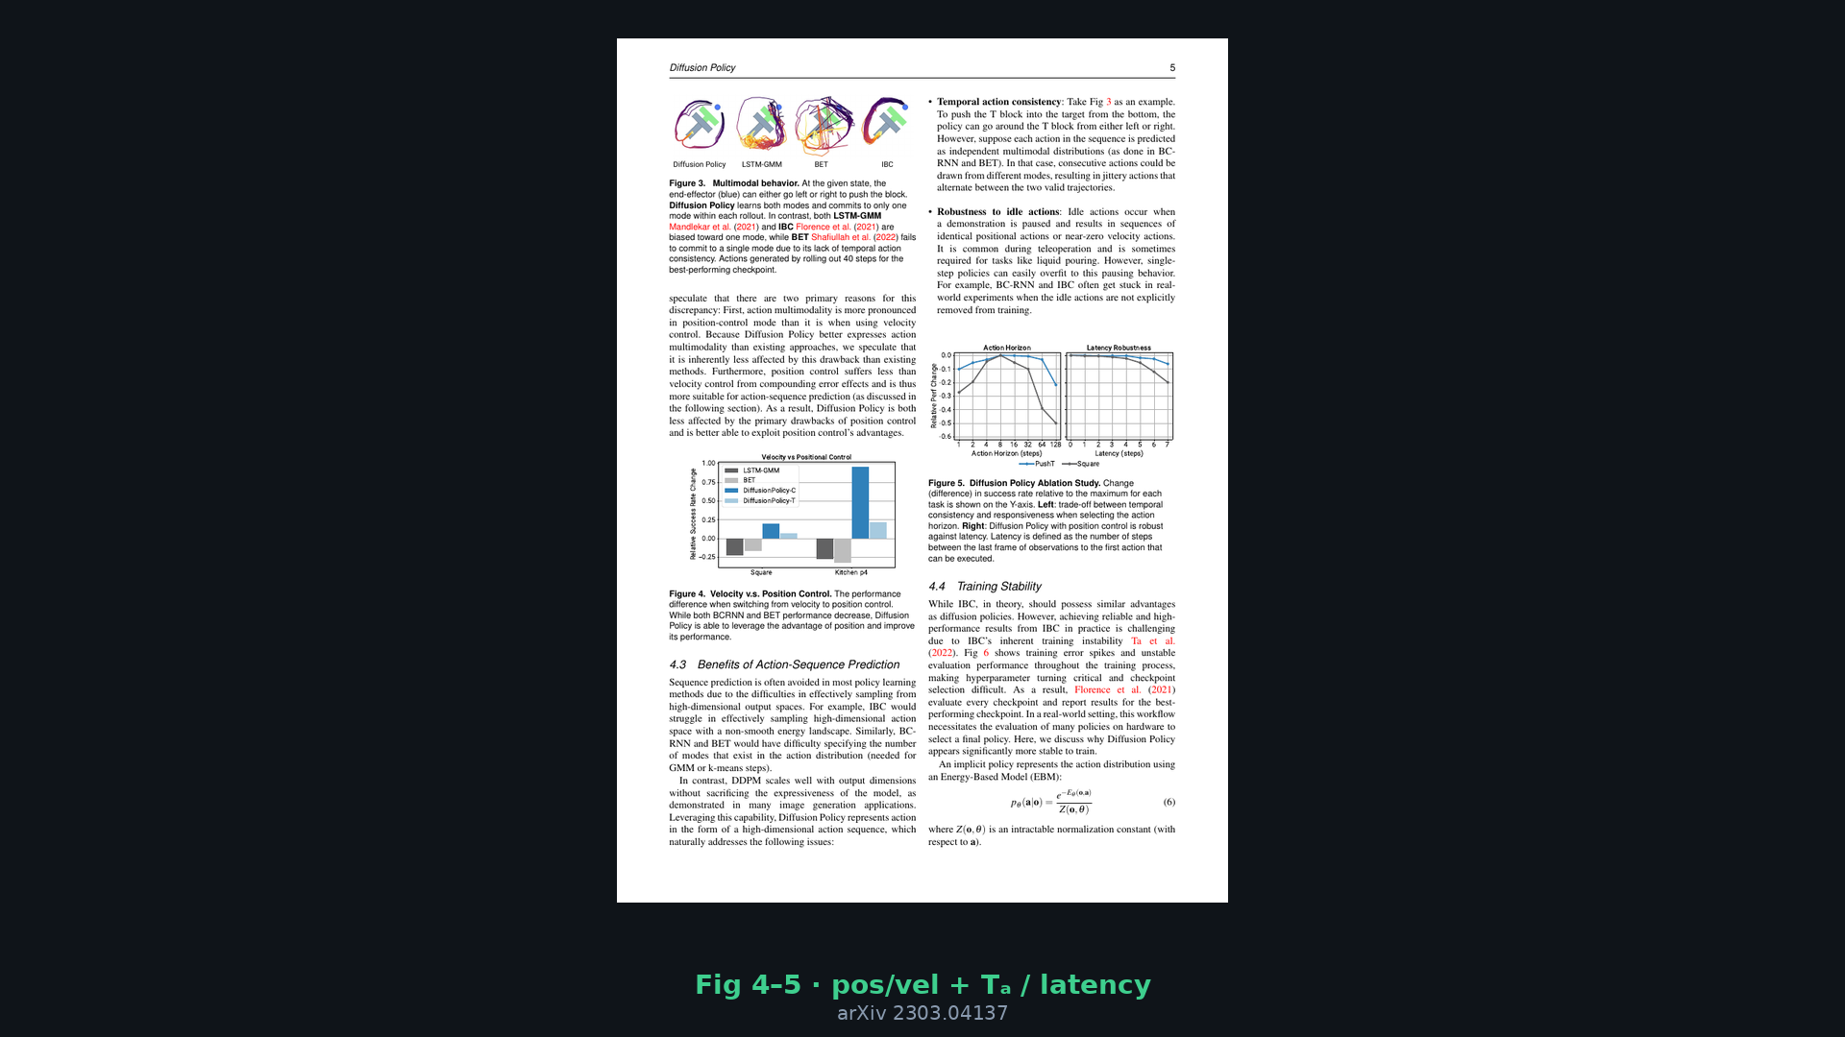
Stakeholder · 18+3 · 9/14
Notes:
Real-robot credibility — Fig 4–5 / tables vibe.
Position control synergy; latency robustness; Tₐ sweet spot.
Real: Push-T, sauce pour/spread, mug flip, bimanual egg/mat/shirt.

Slide 10
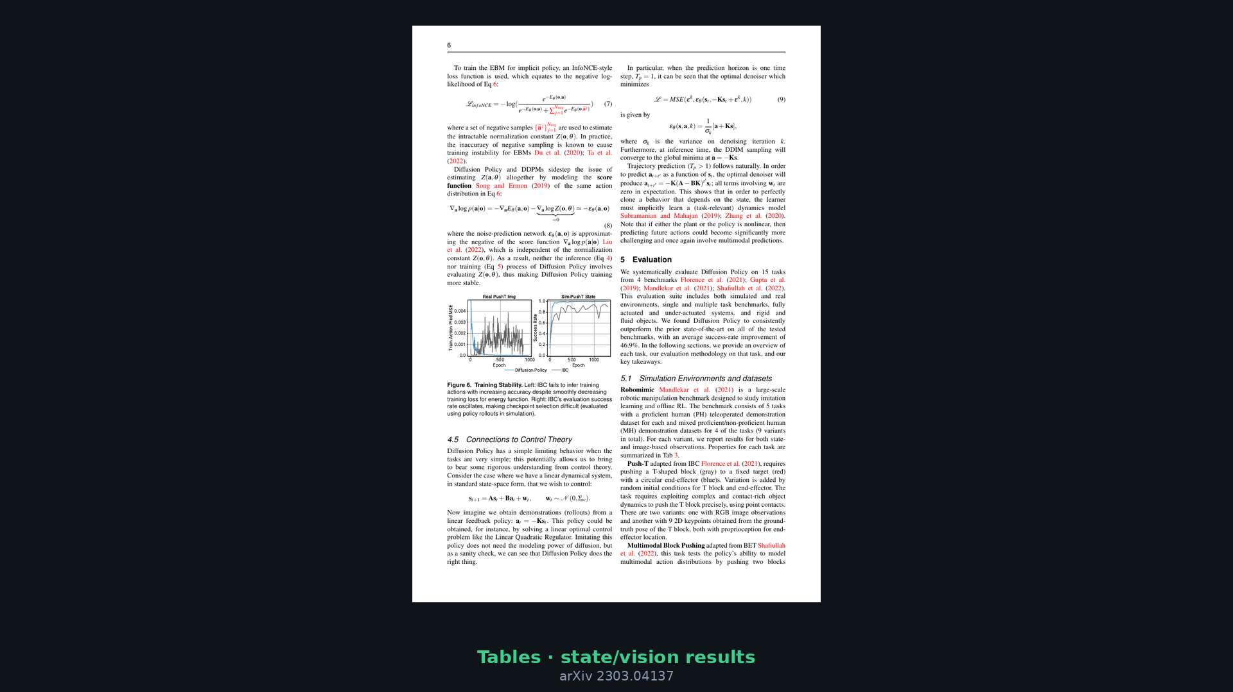
Stakeholder · 18+3 · 10/14
Notes:
Tables glance — breadth of eval is the stakeholder proof, not one cherry-picked task.

Slide 11
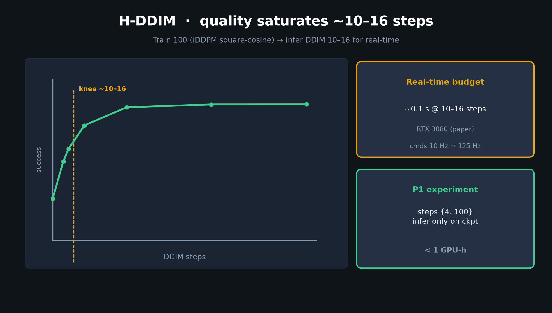
Stakeholder · 18+3 · 11/14
Notes:
DDIM / latency — cost of iterative denoising is real; mitigated to ~10 Hz.
Fine for many arms; not for kHz torque. Set expectations.

Slide 12
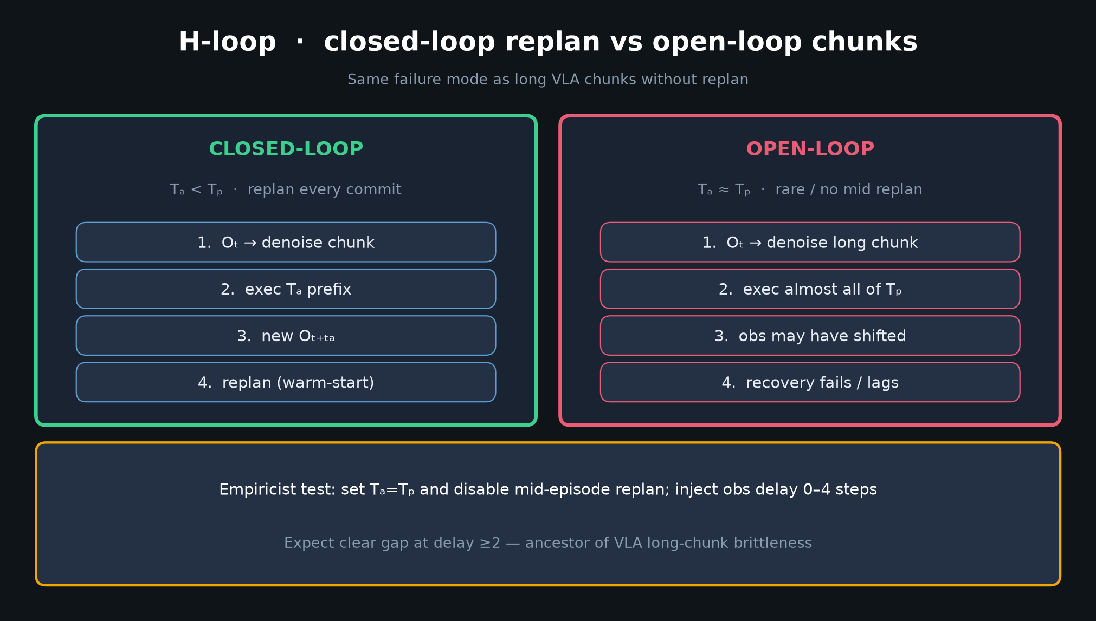
Stakeholder · 18+3 · 12/14
Notes:
Closed vs open — why replan frequency is a product KPI for VLA chunks too.

Slide 13
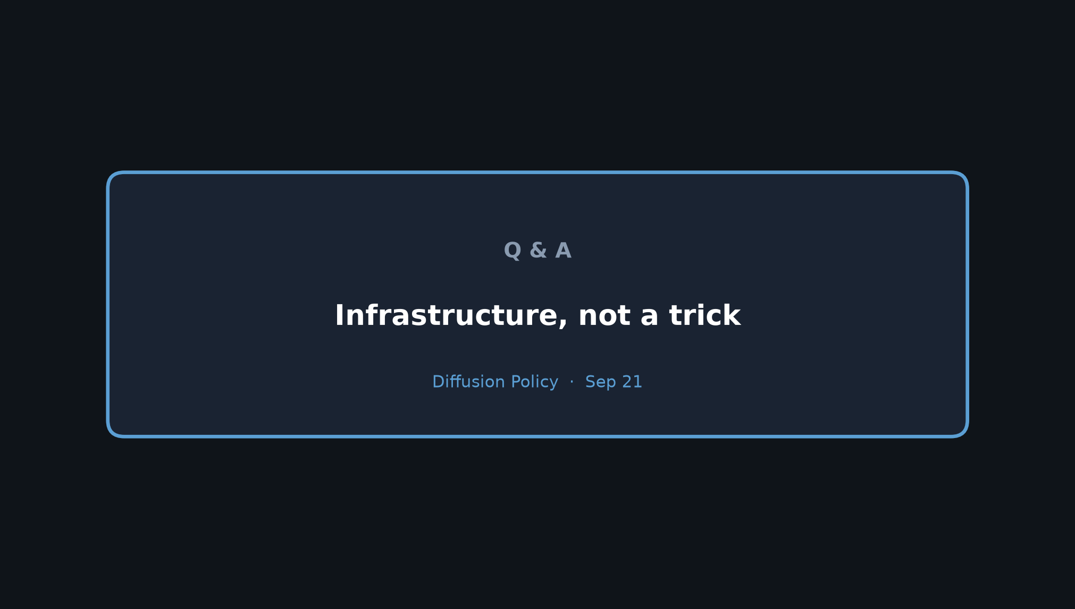
Stakeholder · 18+3 · 13/14
Notes:
Ask again: infrastructure, not a trick. Hand off to Reviewer/Empiricist for hygiene and knobs.

Slide 14
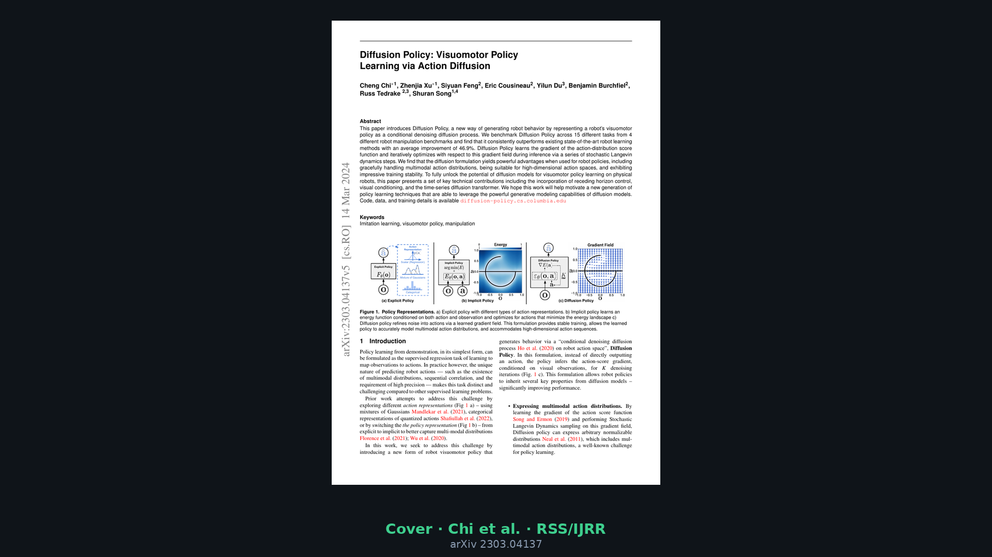
Stakeholder · 18+3 · 14/14
Notes:
Backup cover for bibliography if asked.

