Slide 1
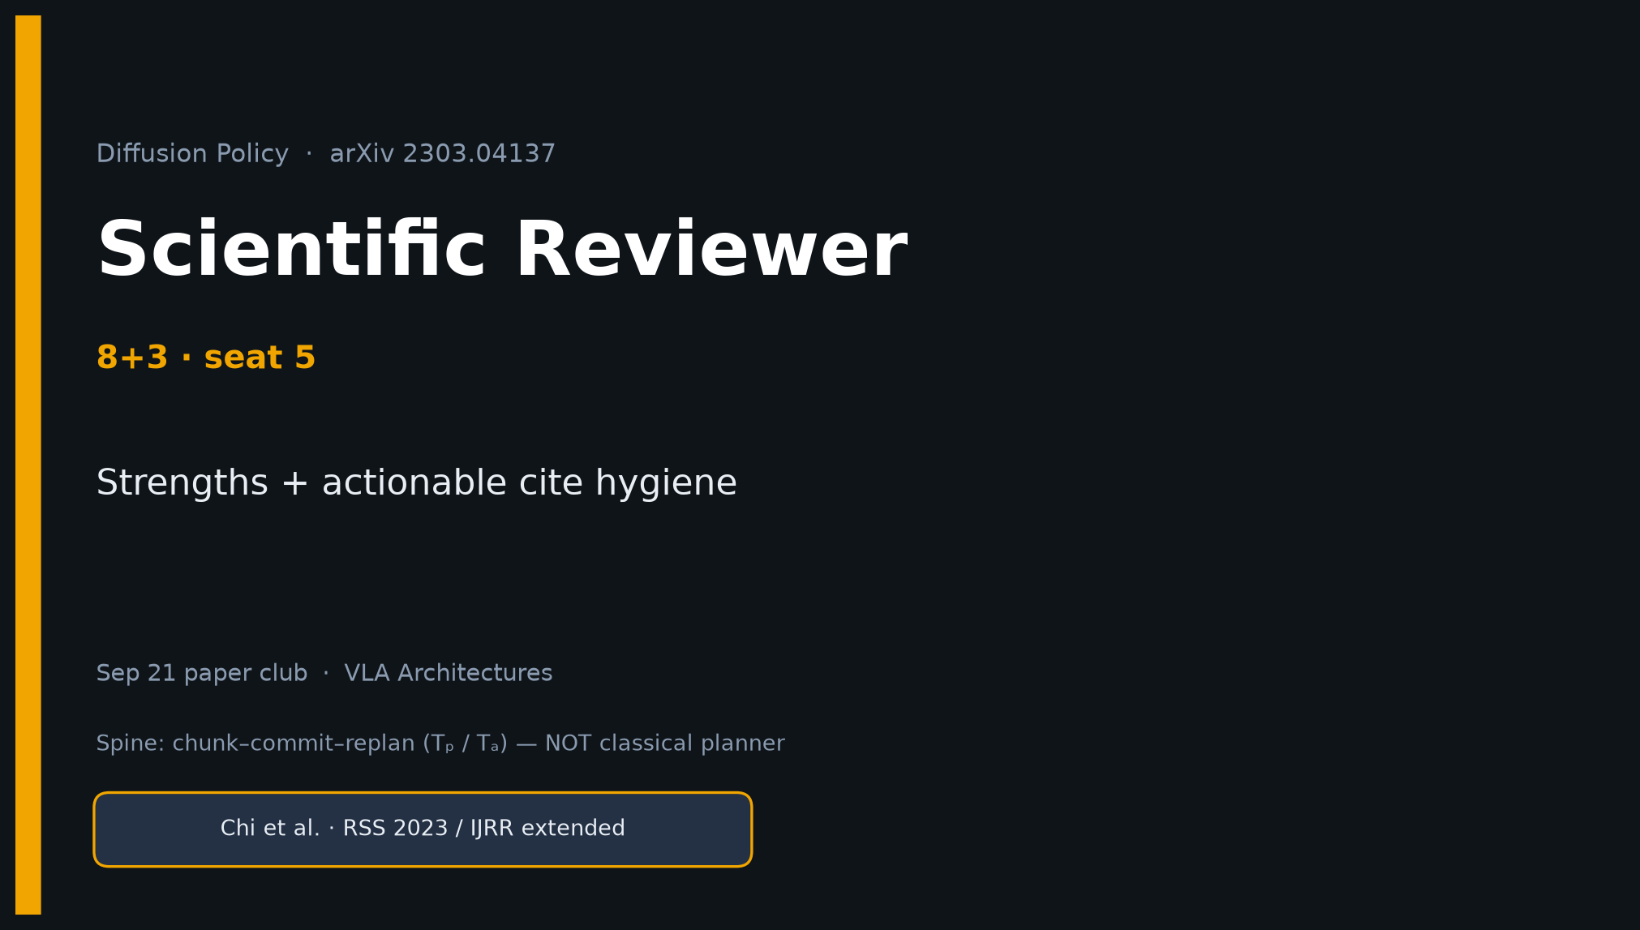
Scientific Reviewer · 8+3 · 1/9
Notes:
SCIENTIFIC REVIEWER — seat 5 · 8+3. Short talk. Strengths then actionable hygiene. Verdict at end.

Slide 2
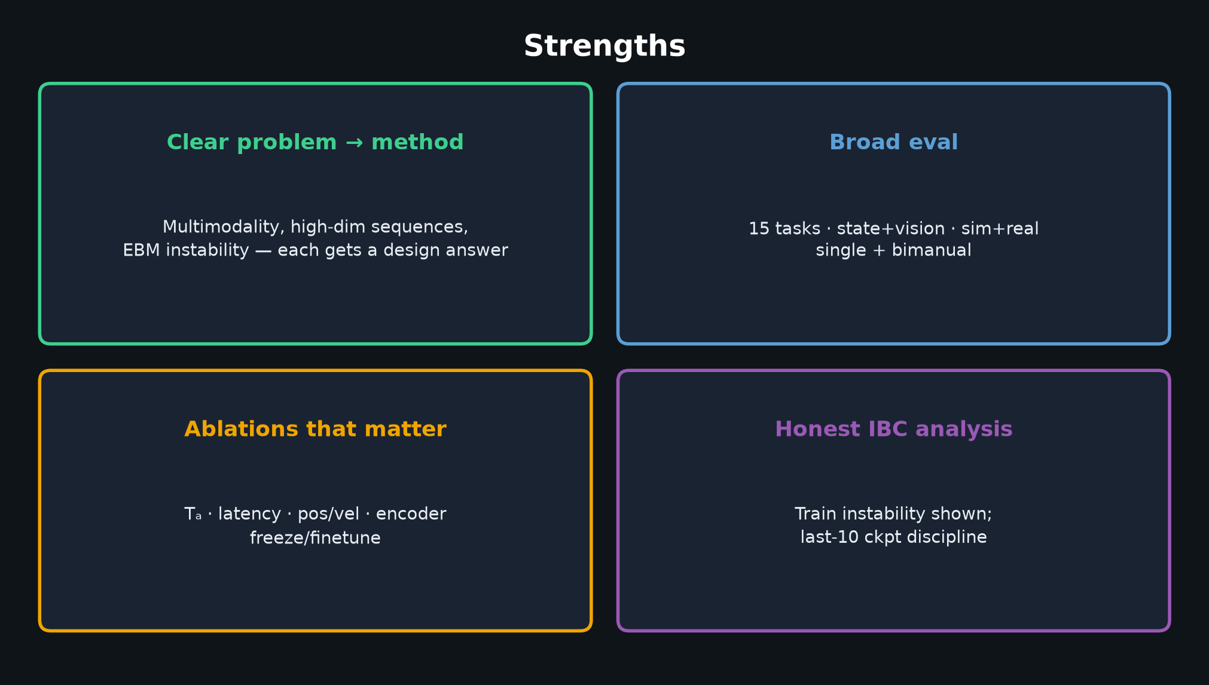
Scientific Reviewer · 8+3 · 2/9
Notes:
STRENGTHS (60–90s).
Clear problem→method. 15-task sim+real+bimanual. Ablations that matter (Tₐ, latency, pos/vel). Honest IBC instability.
This is still a strong RSS/IJRR contribution.

Slide 3
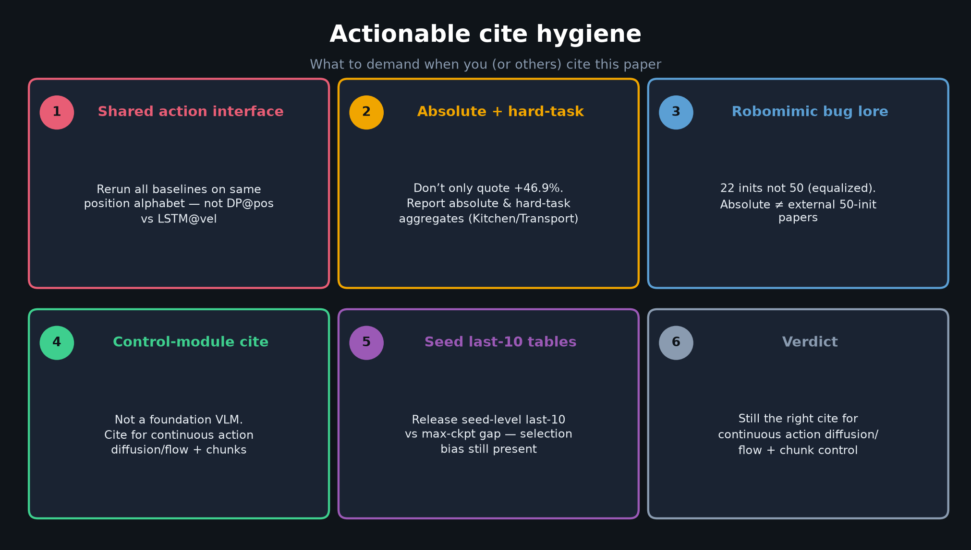
Scientific Reviewer · 8+3 · 3/9
Notes:
ACTIONABLE CITE HYGIENE — THE talk figure for this seat.
1 Shared action interface (DP@pos vs baselines@vel confound)
2 Absolute + hard-task aggregates — not only +46.9%
3 Robomimic 22-init bug lore (equalized; abs ≠ external 50-init)
4 Mark as control-module paper, not foundation VLM
5 Seed-level last-10 tables (selection bias on max-ckpt)
6 Verdict: still the right cite for continuous action diffusion/flow + chunks
Spend most of your 8 minutes here.

Slide 4
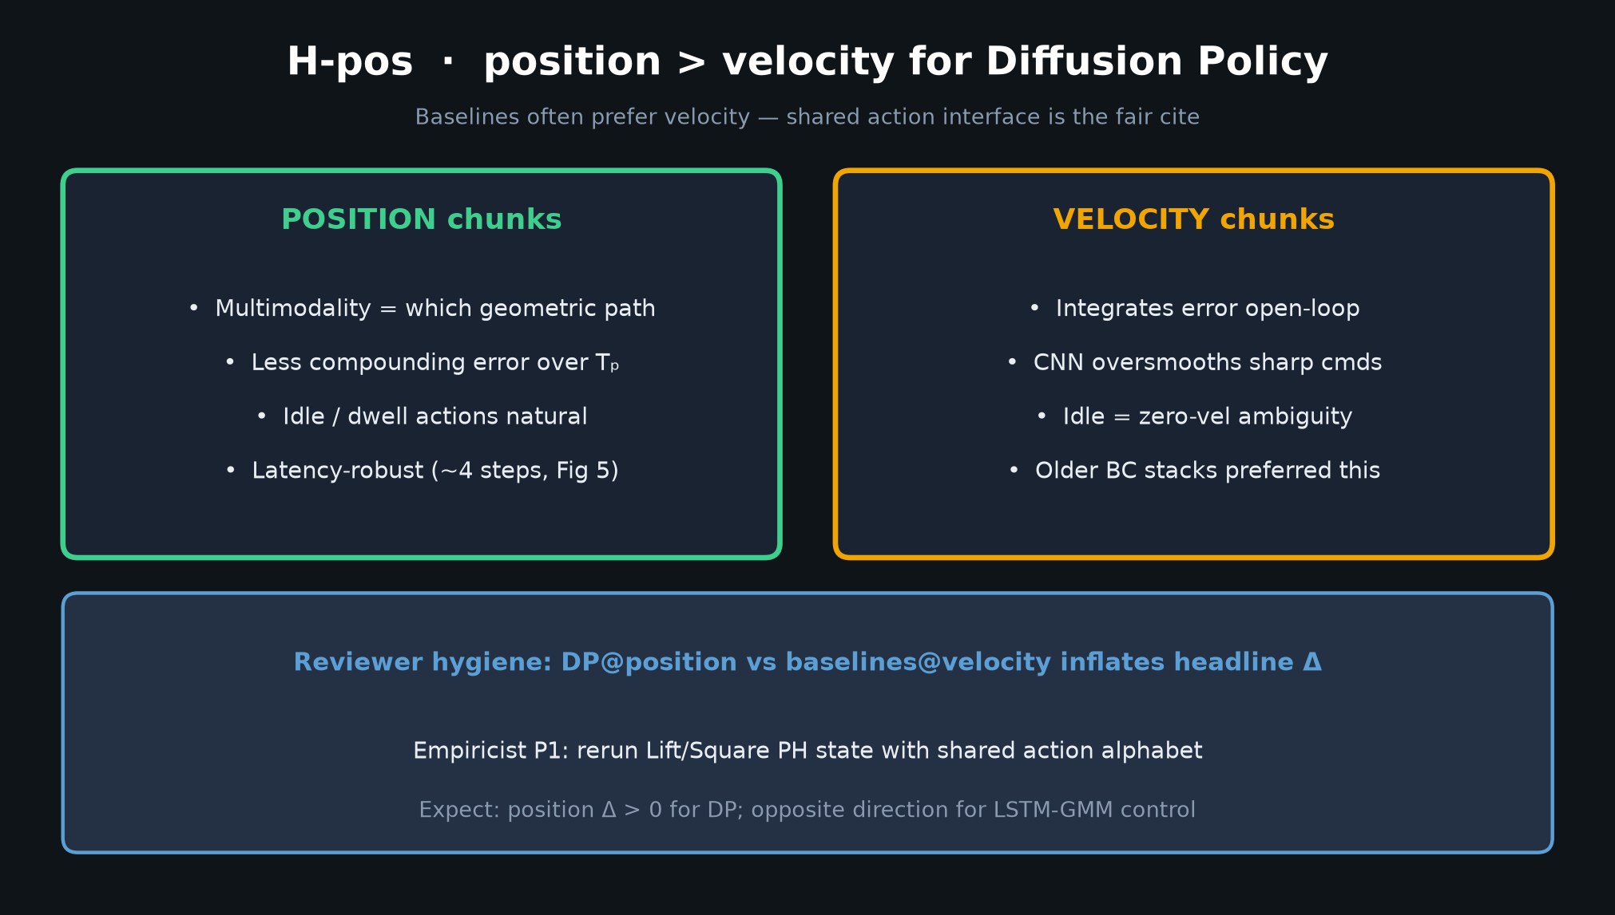
Scientific Reviewer · 8+3 · 4/9
Notes:
Pos/vel confound visual — reinforces hygiene #1.

Slide 5
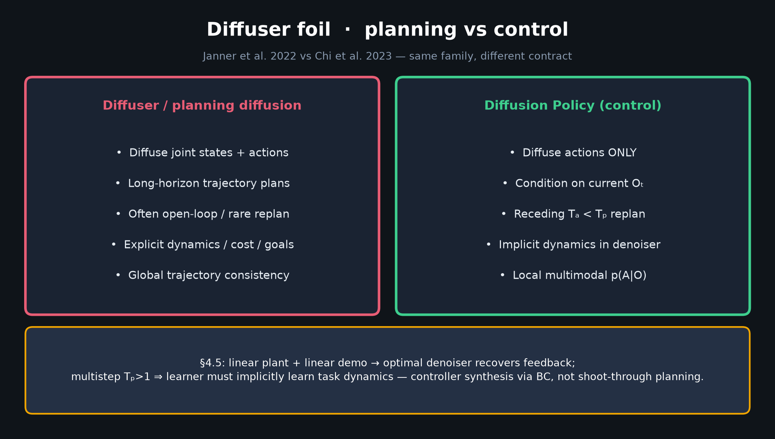
Scientific Reviewer · 8+3 · 5/9
Notes:
Diffuser foil — also a cite-hygiene issue: don’t mis-cite DP as a planner.

Slide 6
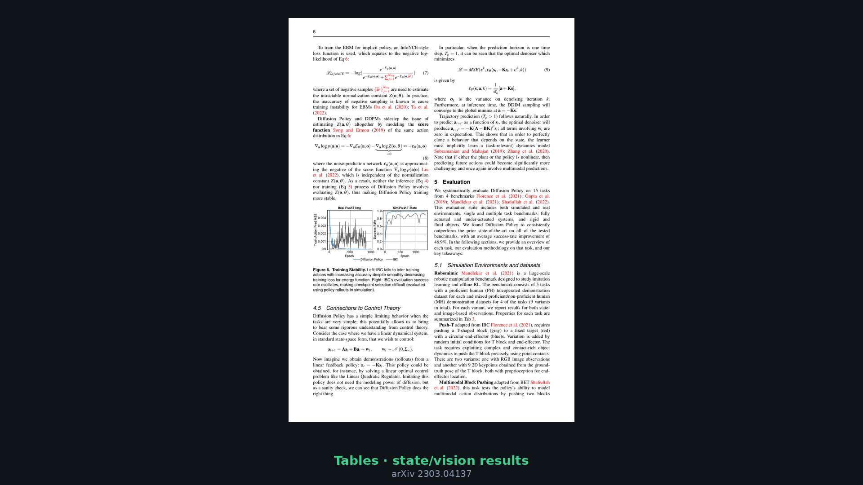
Scientific Reviewer · 8+3 · 6/9
Notes:
Paper tables — when you say “report absolute,” gesture here.

Slide 7
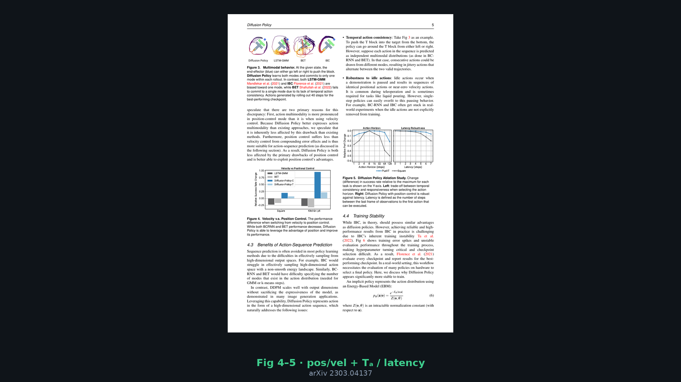
Scientific Reviewer · 8+3 · 7/9
Notes:
Fig 4–5 — ablations that matter; also where latency/Tₐ claims live for fair review.

Slide 8
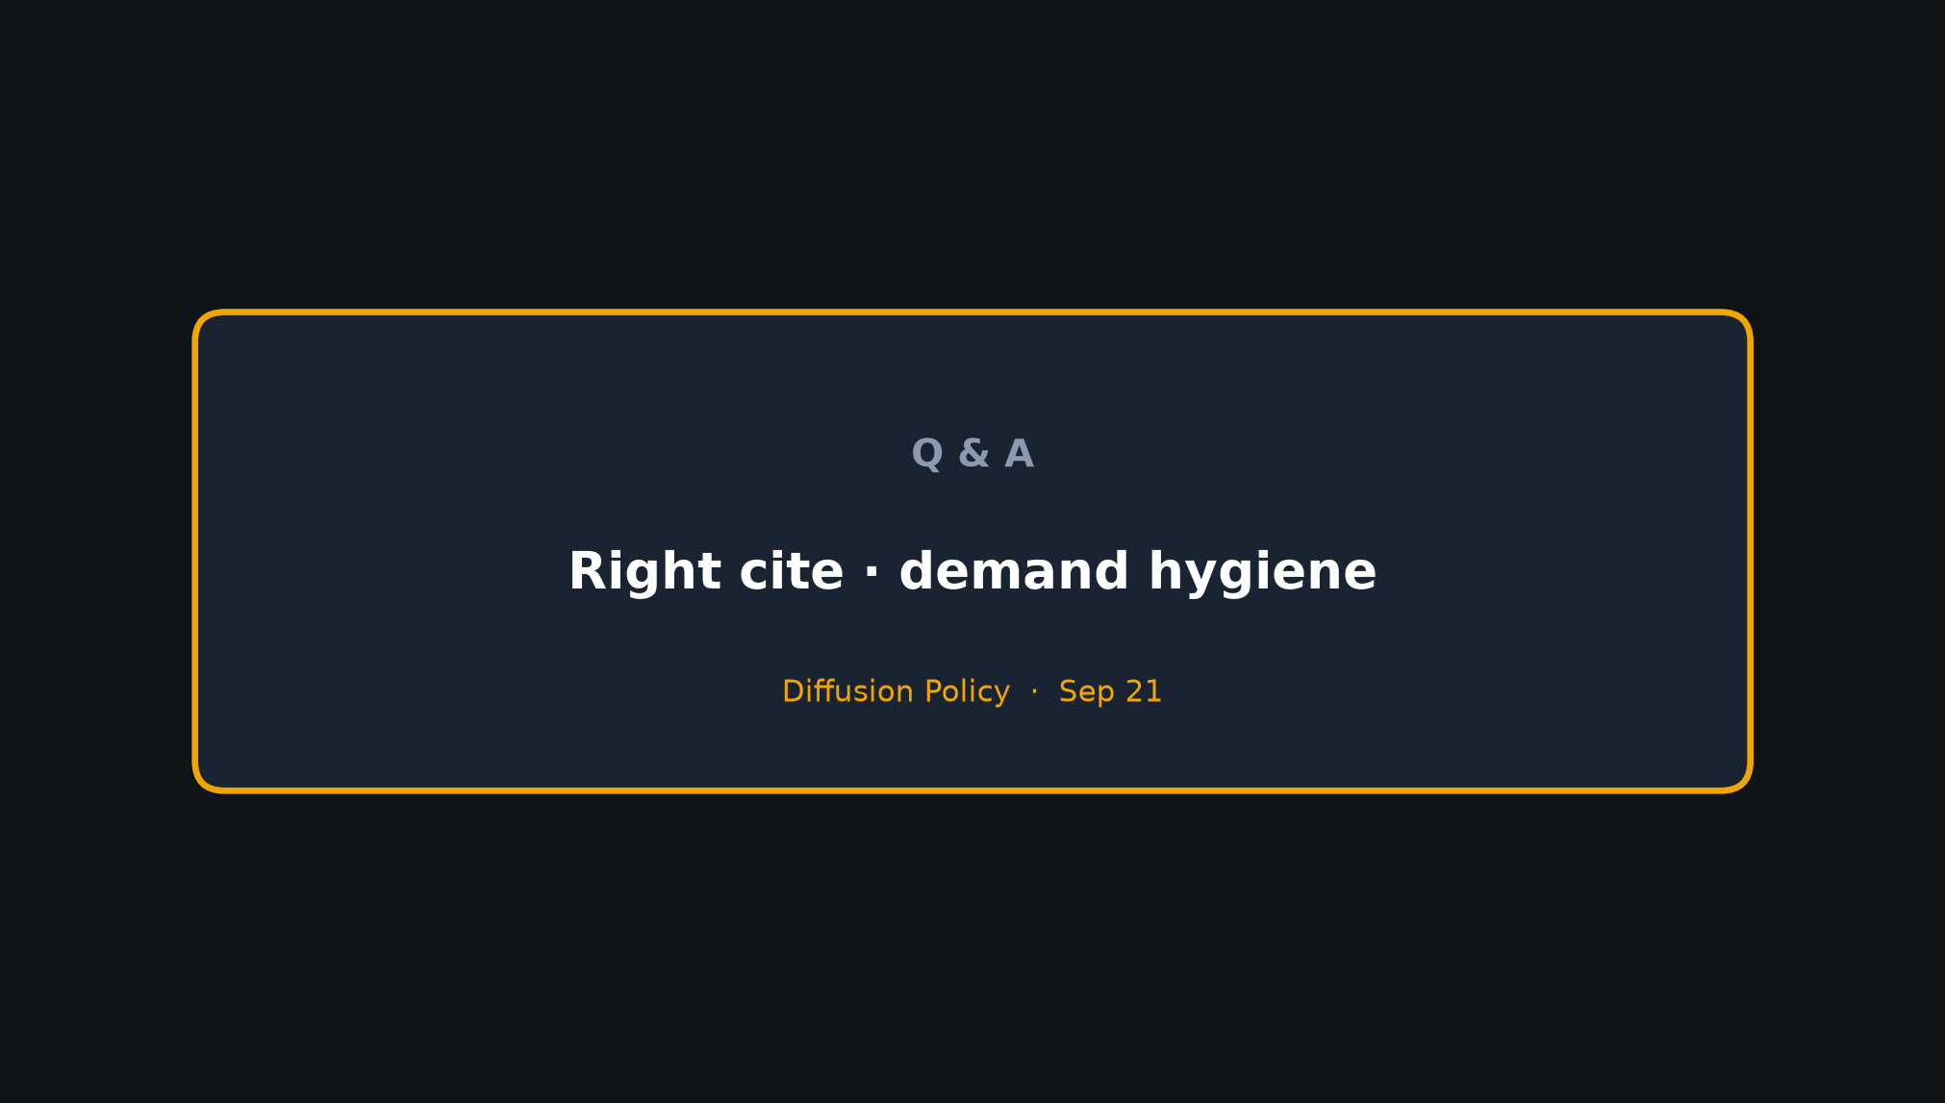
Scientific Reviewer · 8+3 · 8/9
Notes:
VERDICT: Strong contribution; right citation for continuous action diffusion/flow + chunk control.
Demand hygiene when others (or we) reuse +46.9%.

Slide 9
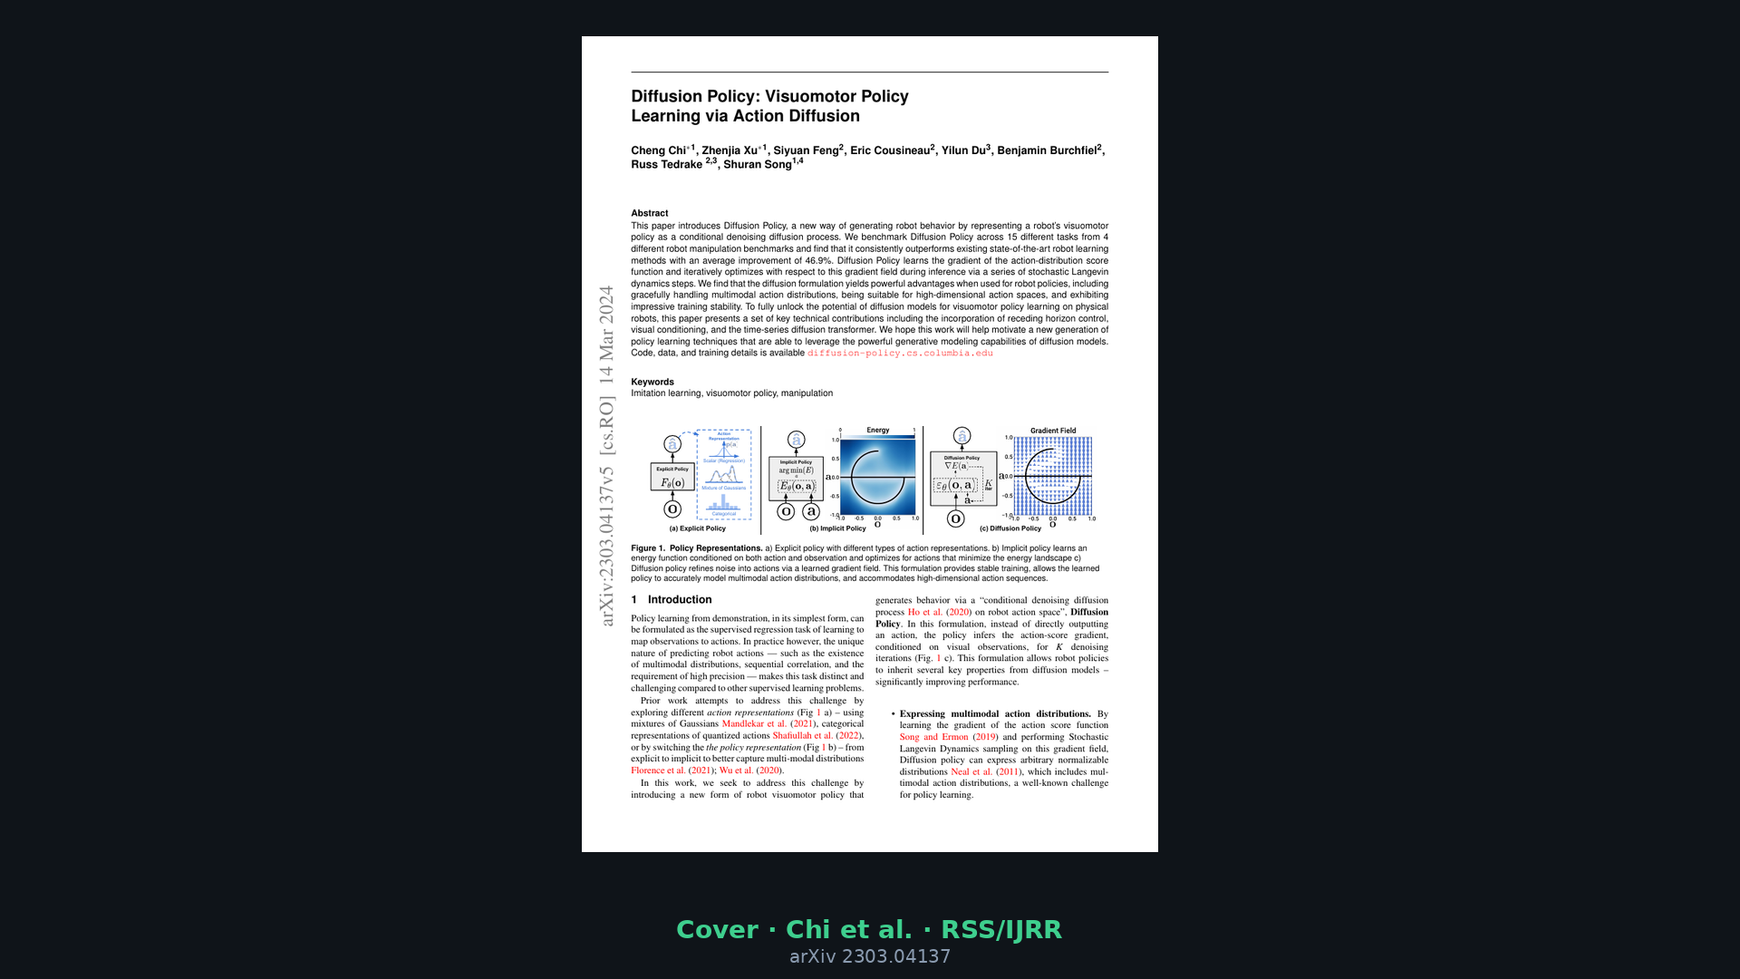
Scientific Reviewer · 8+3 · 9/9
Notes:
Backup cover.

