Slide 1
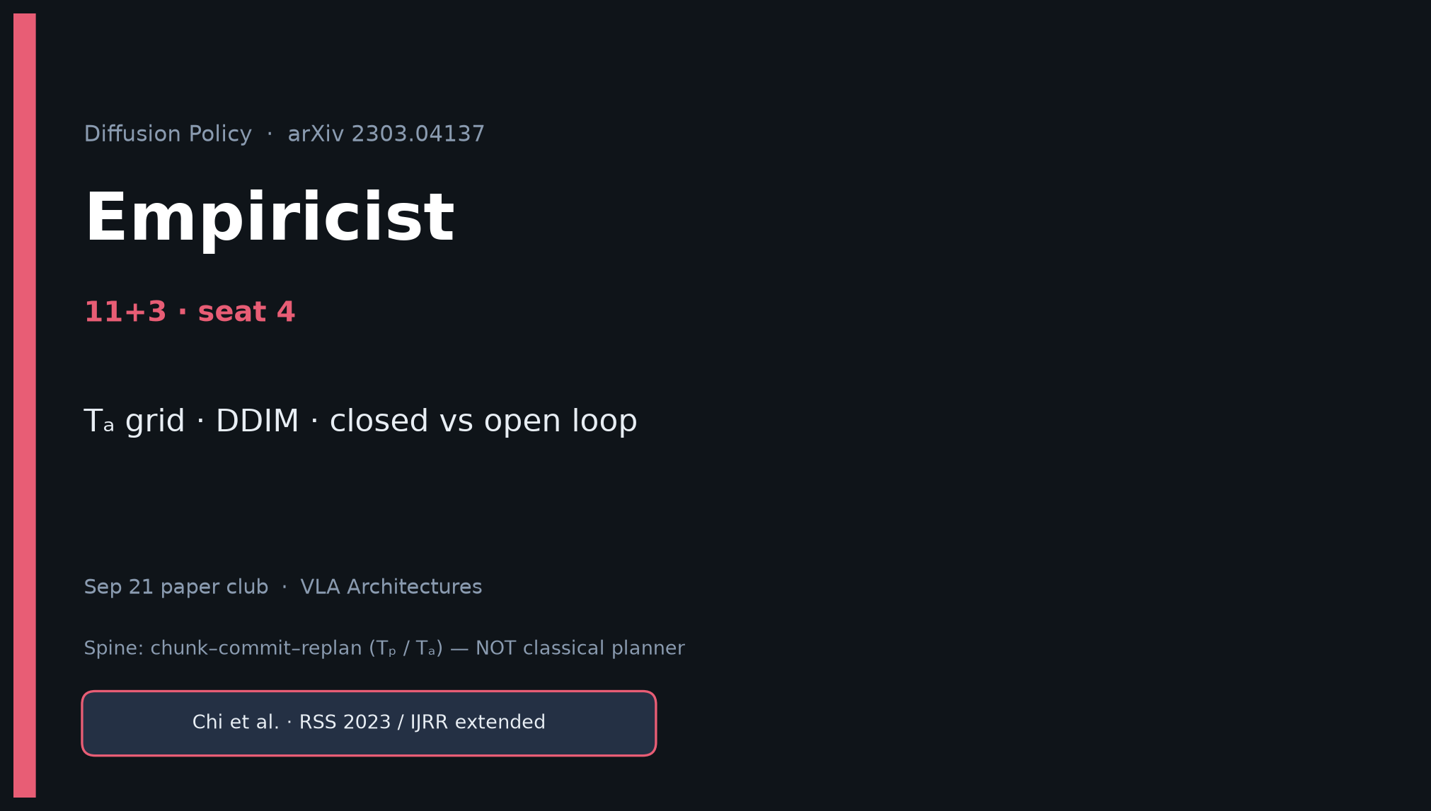
Empiricist · 11+3 · 1/12
Notes:
EMPIRICIST — seat 4 · 11+3.
You own the control-stack knobs: Tₐ, DDIM, pos/vel, closed vs open.
Quiet scout ≤~50 GPU-h; Push-T state first. Outlines in env_outline/ — no cluster jobs in quiet mode.
Pass bar: qualitative paper trends, NOT +46.9%.

Slide 2
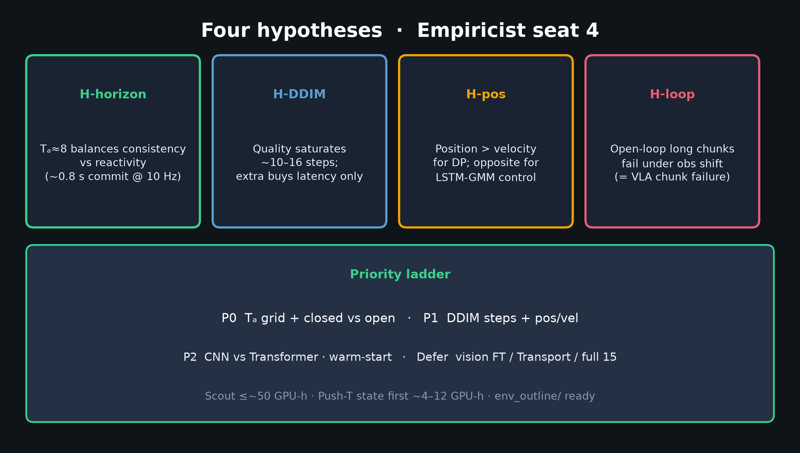
Empiricist · 11+3 · 2/12
Notes:
FOUR HYPOTHESES.
H-horizon: Tₐ≈8 sweet spot.
H-DDIM: knee ~10–16.
H-pos: position > velocity for DP.
H-loop: open-loop long chunks fail under obs shift (= VLA failure mode).
Priority: P0 horizon+loop · P1 DDIM+pos/vel · P2 CNN/T / warm-start · defer vision/Transport/full 15.

Slide 3
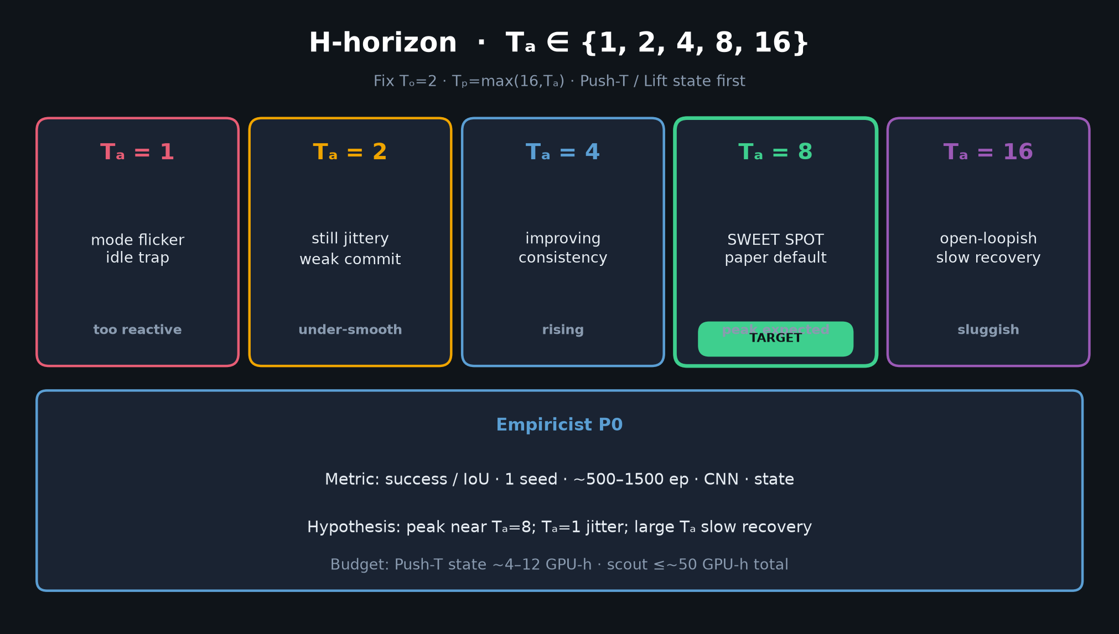
Empiricist · 11+3 · 3/12
Notes:
Tₐ GRID — THE Empiricist figure.
Sweep {1,2,4,8,16}; fix Tₒ=2; Tₚ=max(16,Tₐ).
Expect peak near 8; flicker at 1; sluggish at 16.
Push-T state CNN, 1 seed, 500–1500 ep, ~4–12 GPU-h.

Slide 4
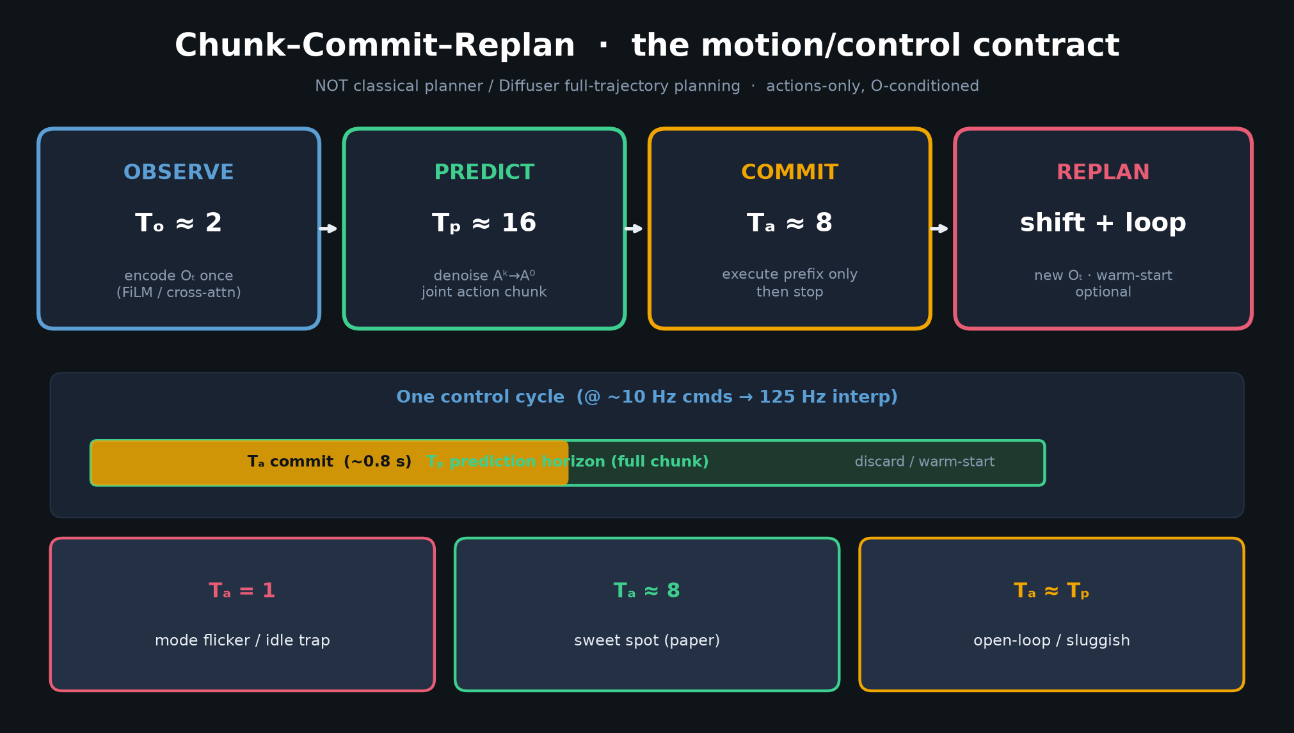
Empiricist · 11+3 · 4/12
Notes:
Chunk–commit–replan — map Tₐ to control bandwidth.
Closed-loop rate ≈ 1/(Tₐ Δt); Δt=0.1s → Tₐ=8 ≈ replan every 0.8s.

Slide 5
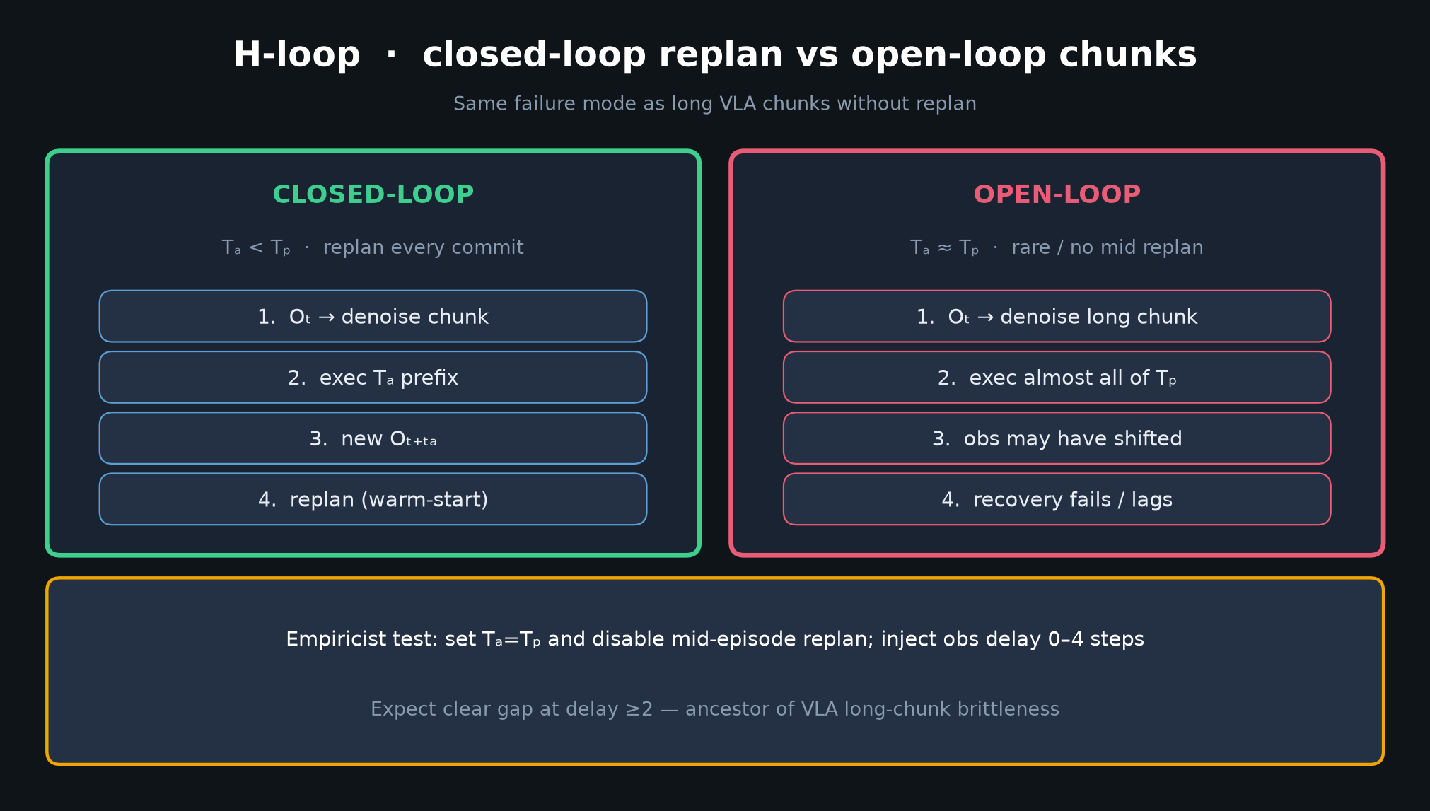
Empiricist · 11+3 · 5/12
Notes:
CLOSED VS OPEN — P0 paired experiment.
Set Tₐ=Tₚ, disable mid-episode replan; inject delay 0–4 steps.
Expect gap at delay ≥2. Same failure mode as long VLA chunks.

Slide 6
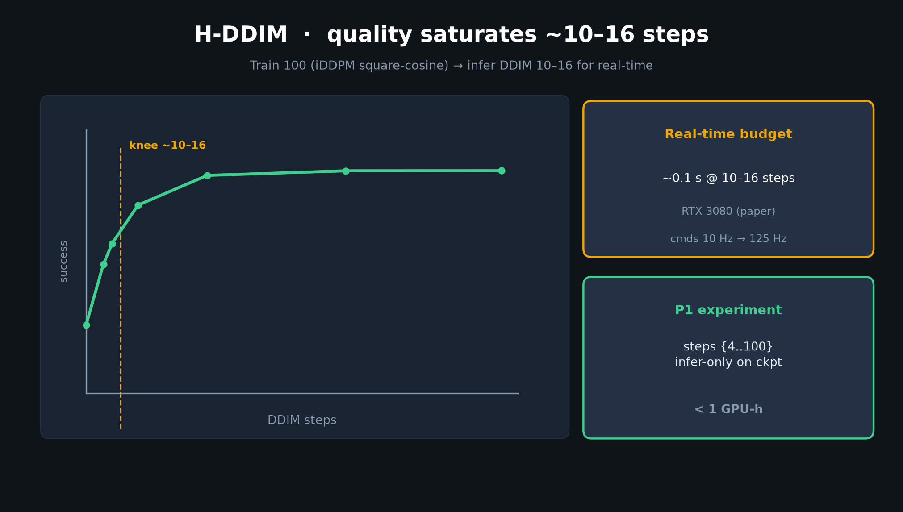
Empiricist · 11+3 · 6/12
Notes:
DDIM CURVE — P1 infer-only, <1 GPU-h.
Train 100; sweep infer {4,8,10,16,32,100}.
Quality saturates ~10–16; latency ~0.1s on 3080.

Slide 7
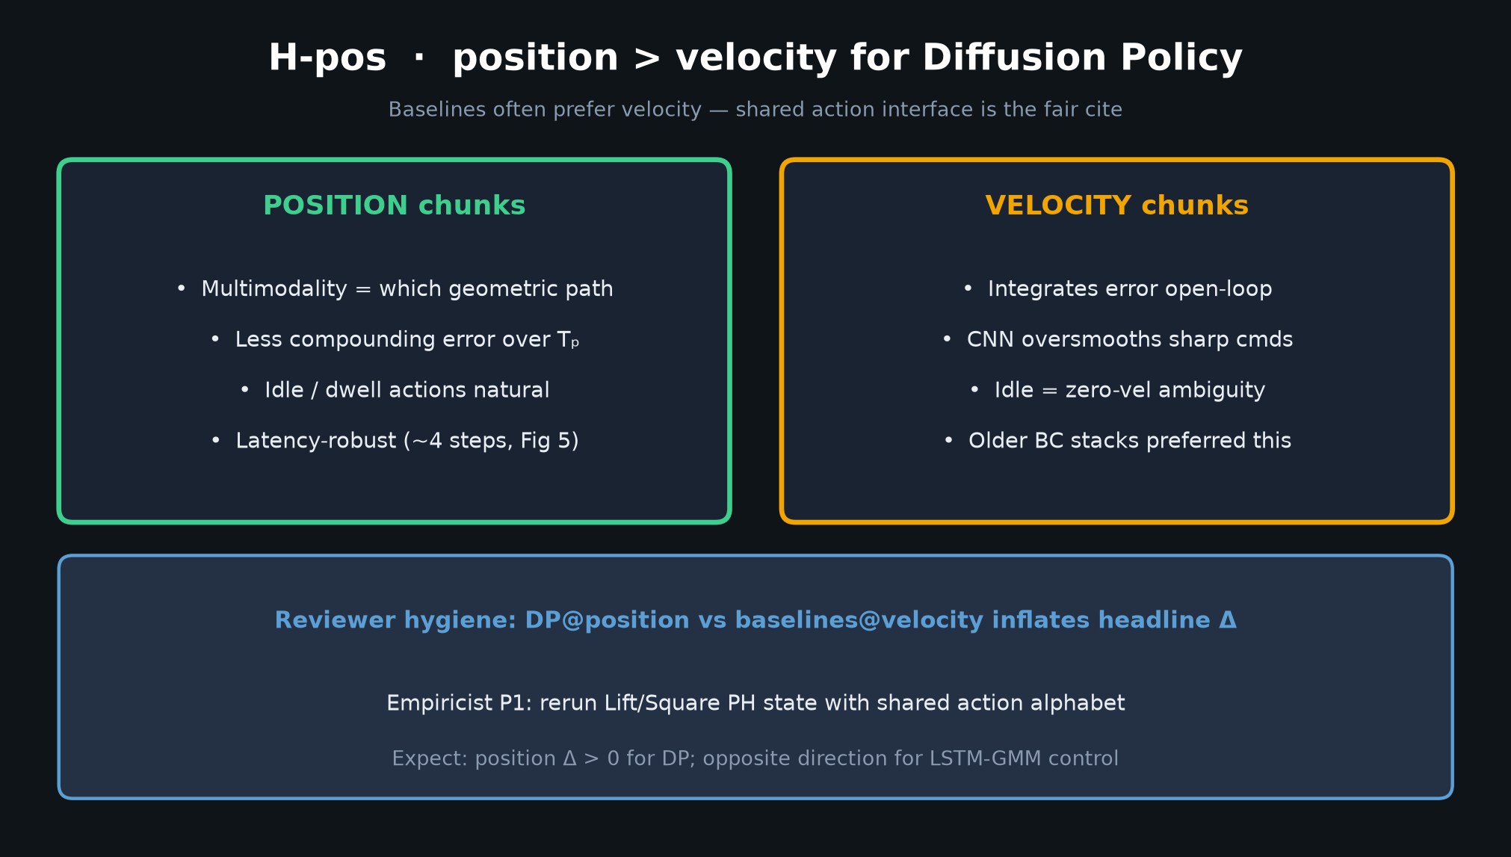
Empiricist · 11+3 · 7/12
Notes:
H-pos — shared action alphabet for fairness (Reviewer will thank you).
Lift/Square PH state; expect DP position Δ>0.

Slide 8
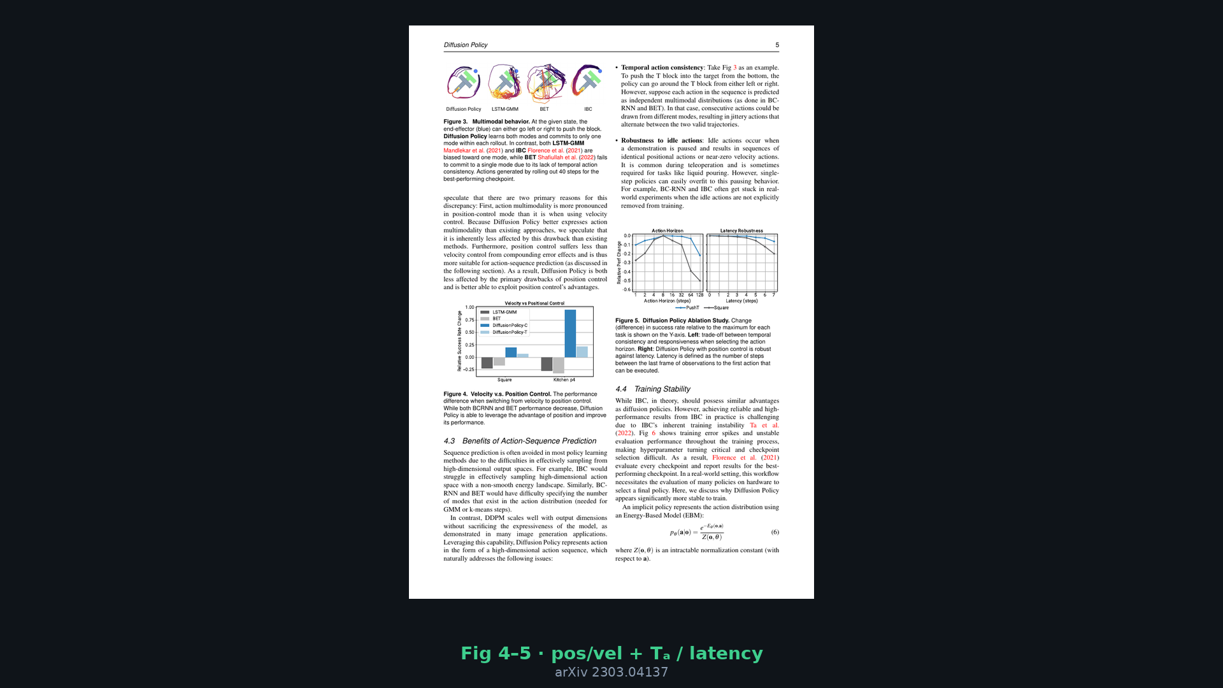
Empiricist · 11+3 · 8/12
Notes:
Paper Fig 4–5 — ground truth shapes you are trying to reproduce qualitatively.

Slide 9
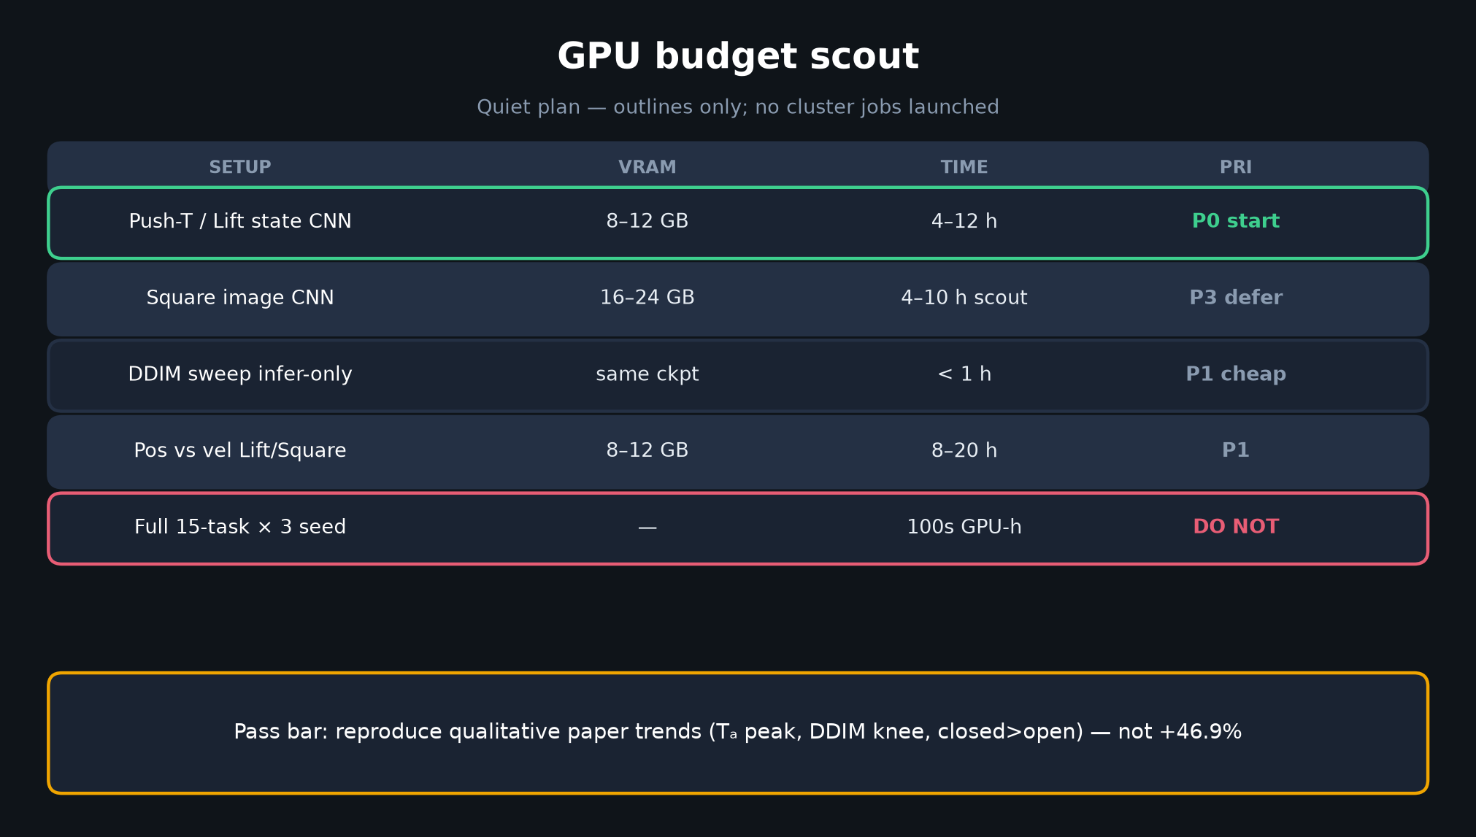
Empiricist · 11+3 · 9/12
Notes:
GPU BUDGET — be honest.
Scout ≤50h. Push-T state 4–12h. Do NOT start with full 15-task × 3 seed.
env_outline/ has conda + Slurm sketches.

Slide 10
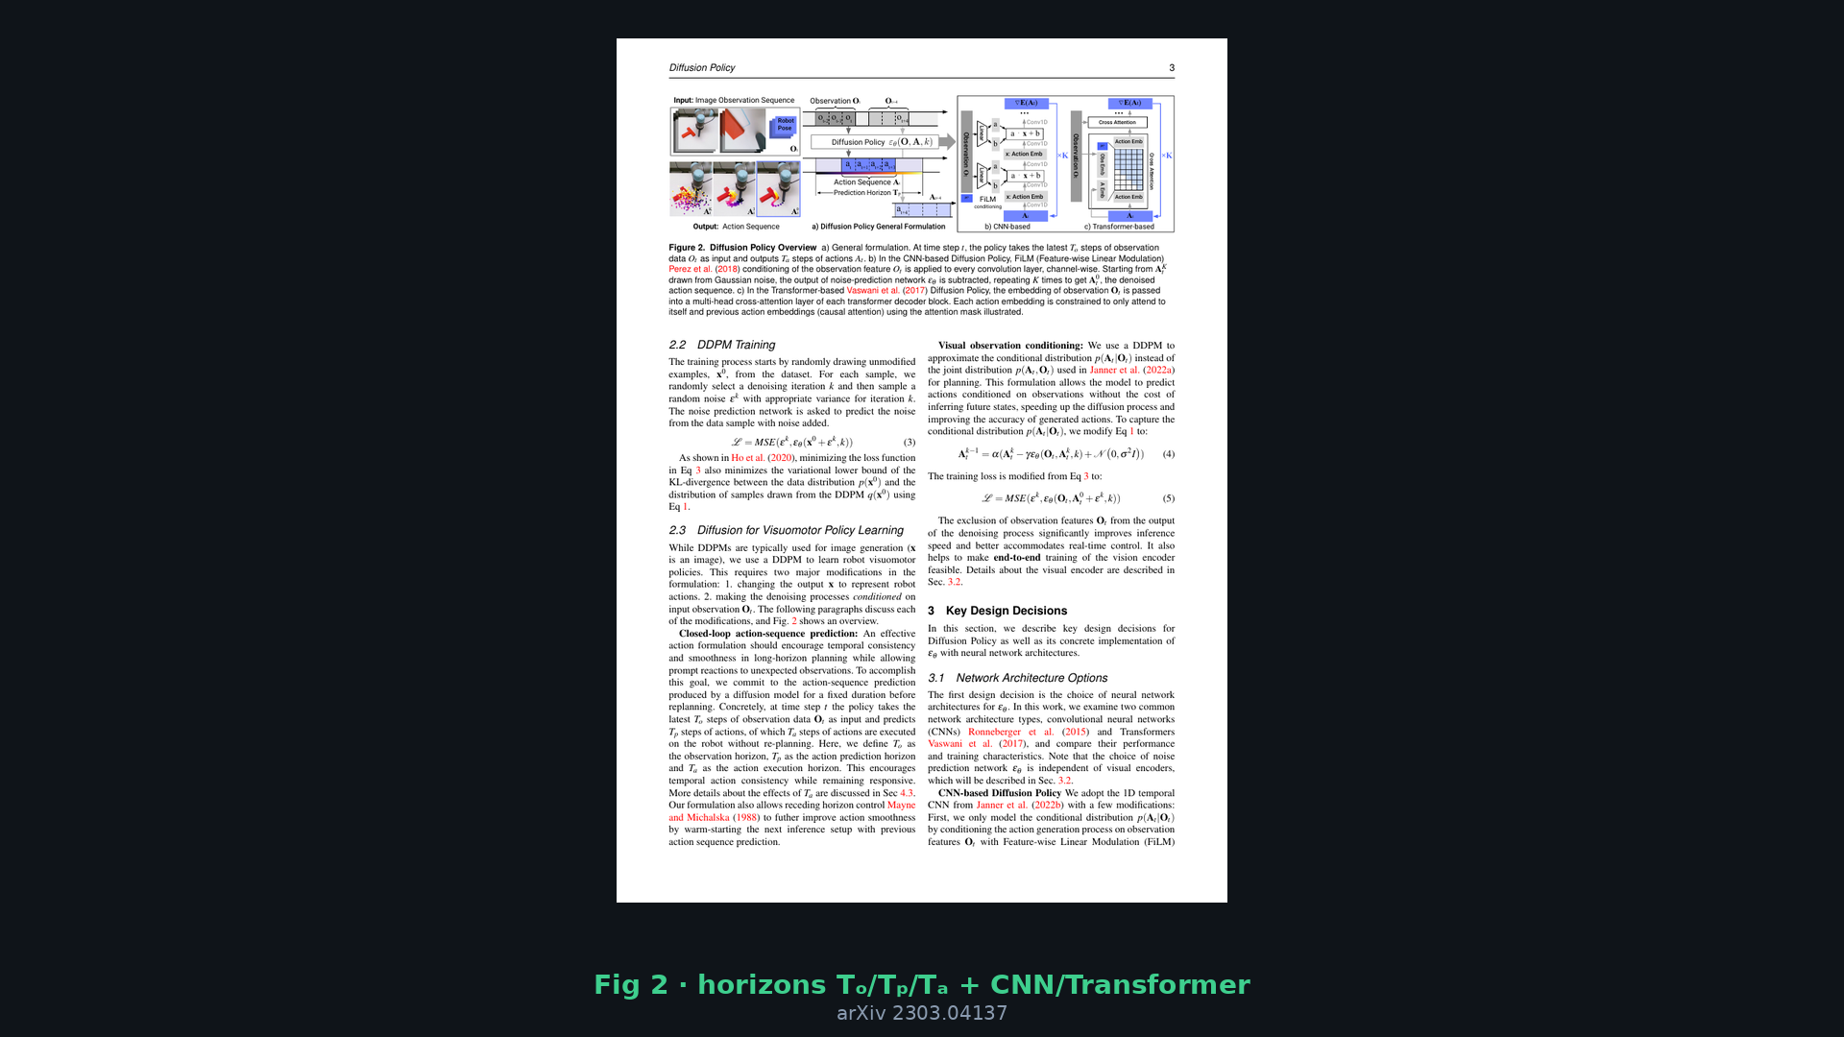
Empiricist · 11+3 · 10/12
Notes:
Paper Fig 2 — implementation checklist reminder: encode O once; FiLM/cross-attn; EMA/GroupNorm; actions in [-1,1].

Slide 11
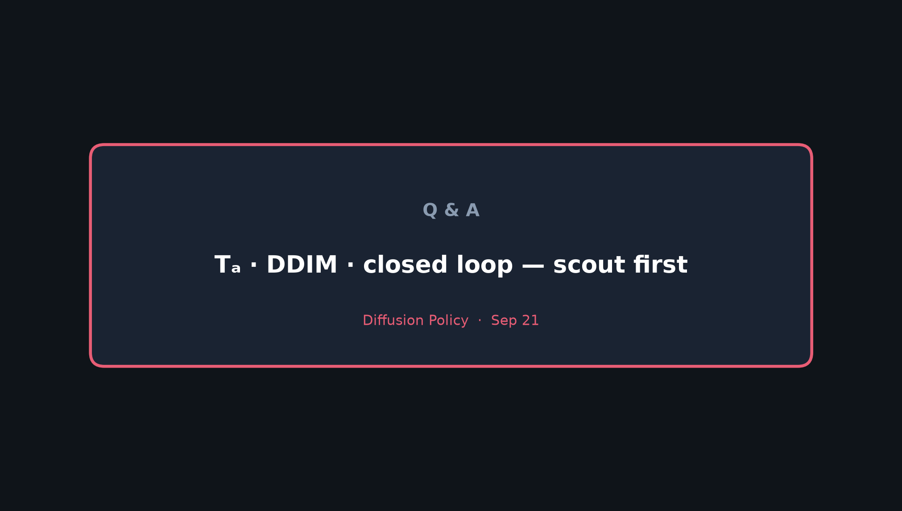
Empiricist · 11+3 · 11/12
Notes:
Close: Tₐ · DDIM · closed loop — scout first. Hand qualitative curves to Archaeologist for Sec 4.3/4.5 narrative.

Slide 12
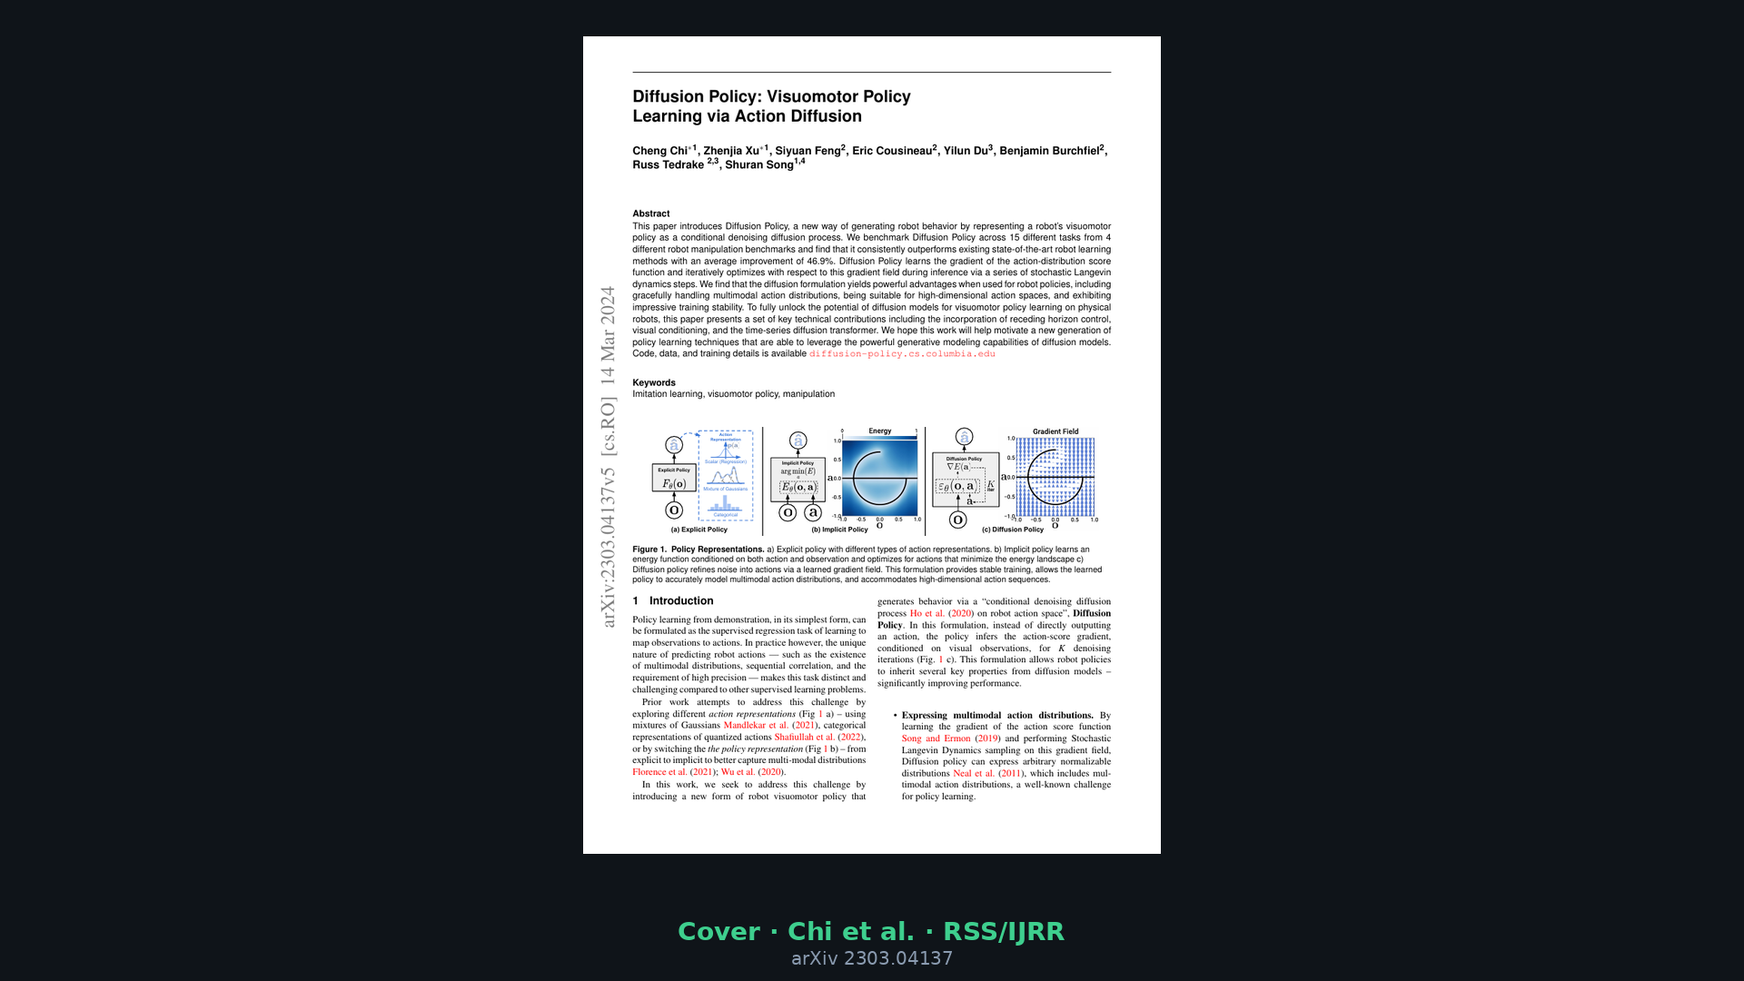
Empiricist · 11+3 · 12/12
Notes:
Backup cover.

