Slide 1
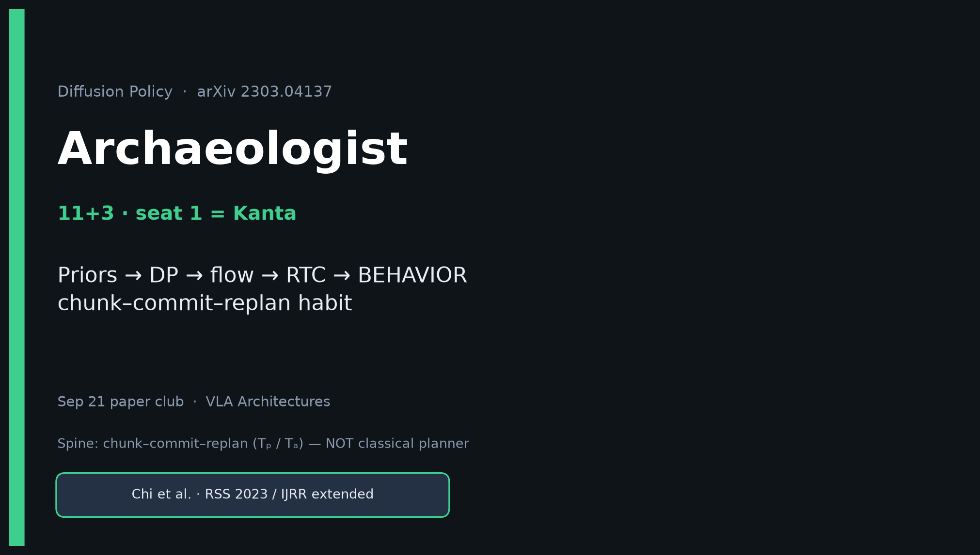
Archaeologist · 11+3 · 1/14
Notes:
ARCHAEOLOGIST OPENING — seat 1 = Kanta (YOU). Timing 11+3.
You own the intellectual history and the control-stack through-line.
ONE SENTENCE for the room:
Diffusion Policy locked the generative chunk–commit–replan contract that 2026 VLAs still live inside — even after DDPM became flow and replan became soft-inpaint.
Do NOT claim BEHAVIOR trains DP itself.
Do NOT claim DP invented ACT chunking (parallel).
Do NOT call DP a classical planner / Diffuser-style full-trajectory planner.
Spine you will repeat: Tₒ≈2, Tₚ≈16, Tₐ≈8; DDIM 100→10–16.
Club line: DP → ACT → π₀ flow → RTC → BEHAVIOR (30/26/4).

Slide 2
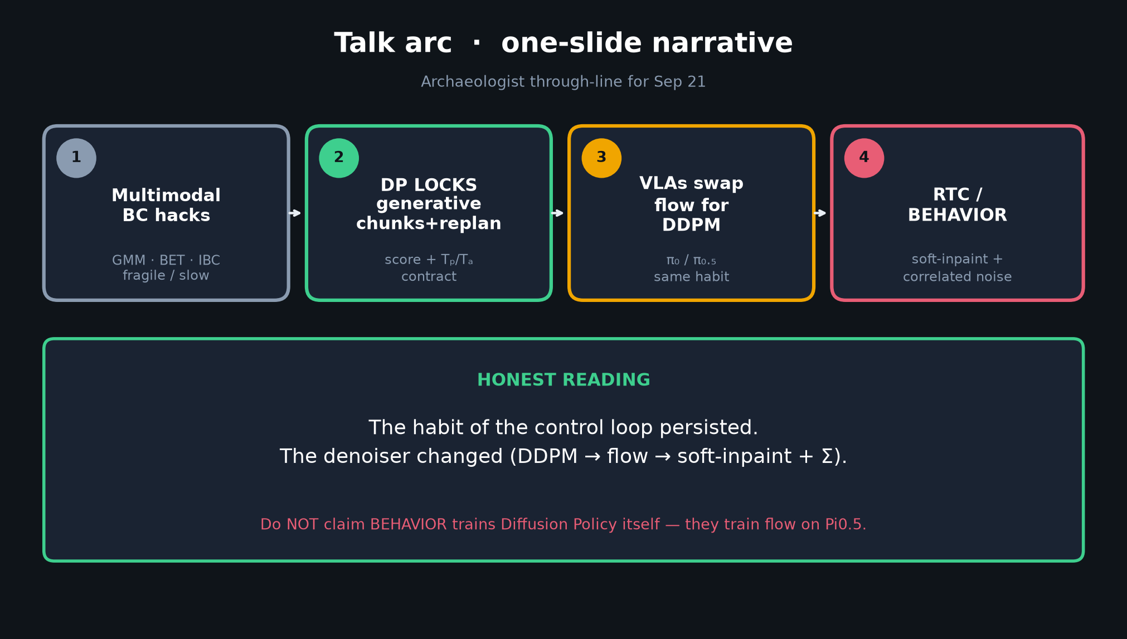
Archaeologist · 11+3 · 2/14
Notes:
TALK ARC (one-slide narrative) — deliver this early so the room knows where you are going.
1) Multimodal BC hacks: GMM, BET, IBC — fragile or slow.
2) DP LOCKS generative continuous chunks + closed-loop replan.
3) VLAs swap flow matching for DDPM (π₀ cites Chi’23) but keep the habit.
4) RTC / BEHAVIOR: soft-inpaint + correlated noise — latency-aware upgrade of the same contract.
HONEST READING (say aloud):
“The habit of the control loop persisted. The denoiser changed.”
Flag: BEHAVIOR winners train flow on Pi0.5 — they do NOT train Diffusion Policy.

Slide 3
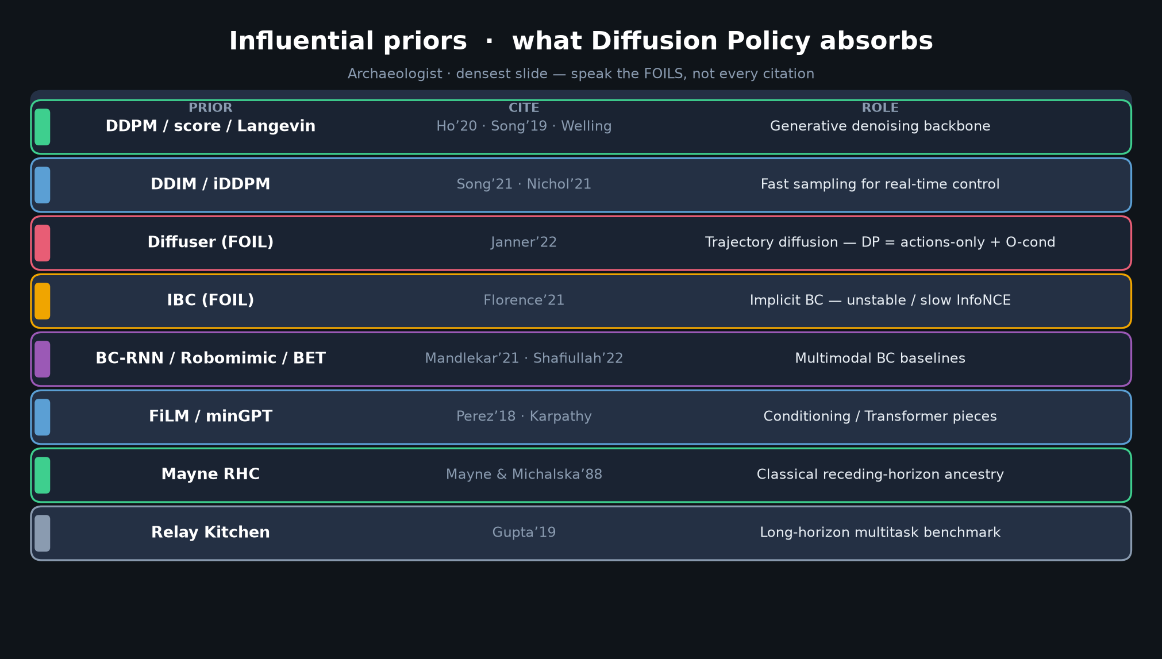
Archaeologist · 11+3 · 3/14
Notes:
PRIOR TABLE — densest slide. Do NOT read every row. Speak the FOILS.
Must-hit foils:
• Diffuser (Janner’22): trajectory diffusion of states+actions. DP = actions-only, O-conditioned, receding replan. FOIL for “is this a planner?”
• IBC (Florence’21): multimodal motivation; InfoNCE instability is why score matching wins.
Must-hit ancestry:
• DDPM / score / Langevin — generative backbone
• DDIM / iDDPM — real-time sampling
• Mayne RHC’88 — classical receding-horizon ancestry of Tₐ commit
• BC-RNN / Robomimic / BET — explicit multimodal BC baselines DP beats
• FiLM / minGPT — conditioning + Transformer pieces
• Relay Kitchen — long-horizon multitask benchmark
Say: “Priors are generative + control + multimodal BC. The novelty is the contract, not inventing diffusion.”

Slide 4
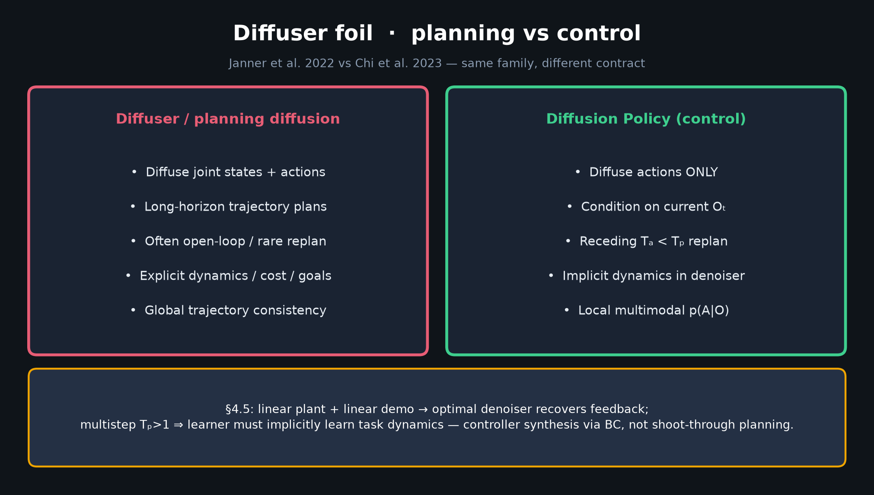
Archaeologist · 11+3 · 4/14
Notes:
DIFFUSER FOIL — spend 45–60s. This is the #1 misconception to kill.
Diffuser / Planning-with-Diffusion:
diffuse joint (s,a) over long horizon; often open-loop; explicit dynamics/cost/goals.
Diffusion Policy:
diffuse actions ONLY; condition on Oₜ; execute Tₐ < Tₚ then replan; implicit dynamics inside denoiser (§4.5).
§4.5 one-liner: linear plant + linear demo → optimal denoiser recovers feedback; multipstep Tₚ>1 means the learner must implicitly learn task dynamics. That is controller synthesis via BC — NOT shoot-through planning.
If someone asks “isn’t this just Diffuser for robots?” → point at this slide.

Slide 5
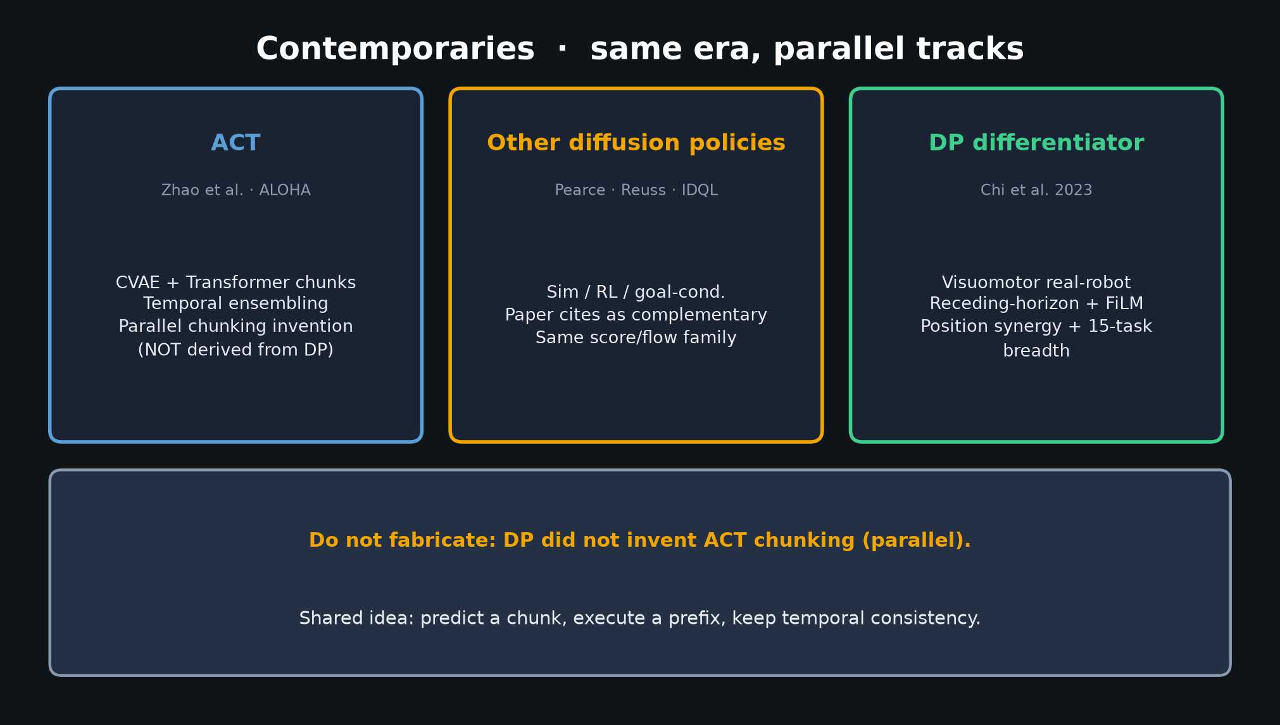
Archaeologist · 11+3 · 5/14
Notes:
CONTEMPORARIES — parallel track honesty.
ACT (Zhao / ALOHA): CVAE+Transformer chunks + temporal ensembling. Parallel invention of chunking — do NOT say DP invented ACT or vice versa.
Pearce / Reuss / IDQL: concurrent diffusion policies (sim/RL/goal). Complementary.
DP differentiator for our club: visuomotor real-robot + receding-horizon + FiLM/Transformer + 15-task breadth that became the cite for continuous VLA action heads.

Slide 6
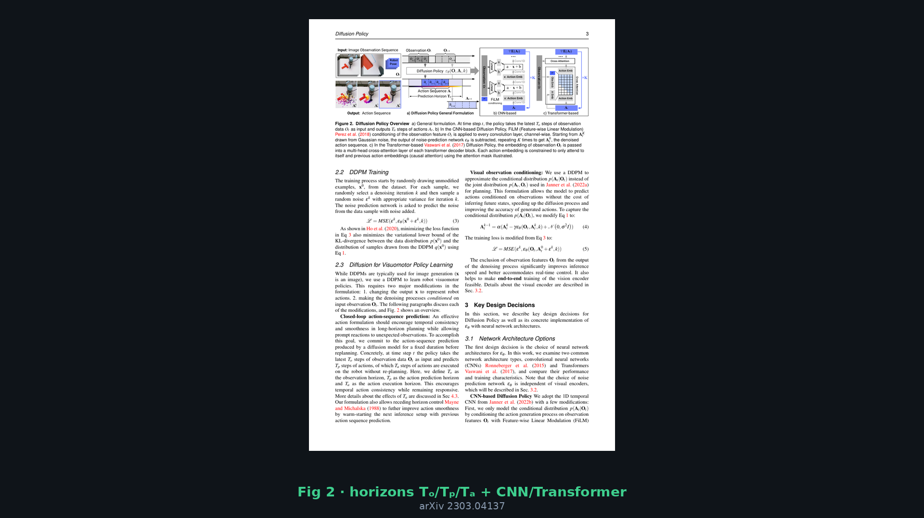
Archaeologist · 11+3 · 6/14
Notes:
PAPER FIG 2 — the canonical diagram. Point at Tₒ / Tₚ / Tₐ.
Left: observe history → denoise noise to action sequence → execute only Tₐ.
Right: CNN+FiLM vs Transformer+causal cross-attn.
Defaults to memorise: Tₒ≈2, Tₚ≈16 (CNN), Tₐ≈8 (sometimes 6 on real Push-T).
Train 100 diffusion steps; real uses DDIM 10–16.
This figure IS the motion/control contract. Everything after 2023 is a dialect of this.

Slide 7
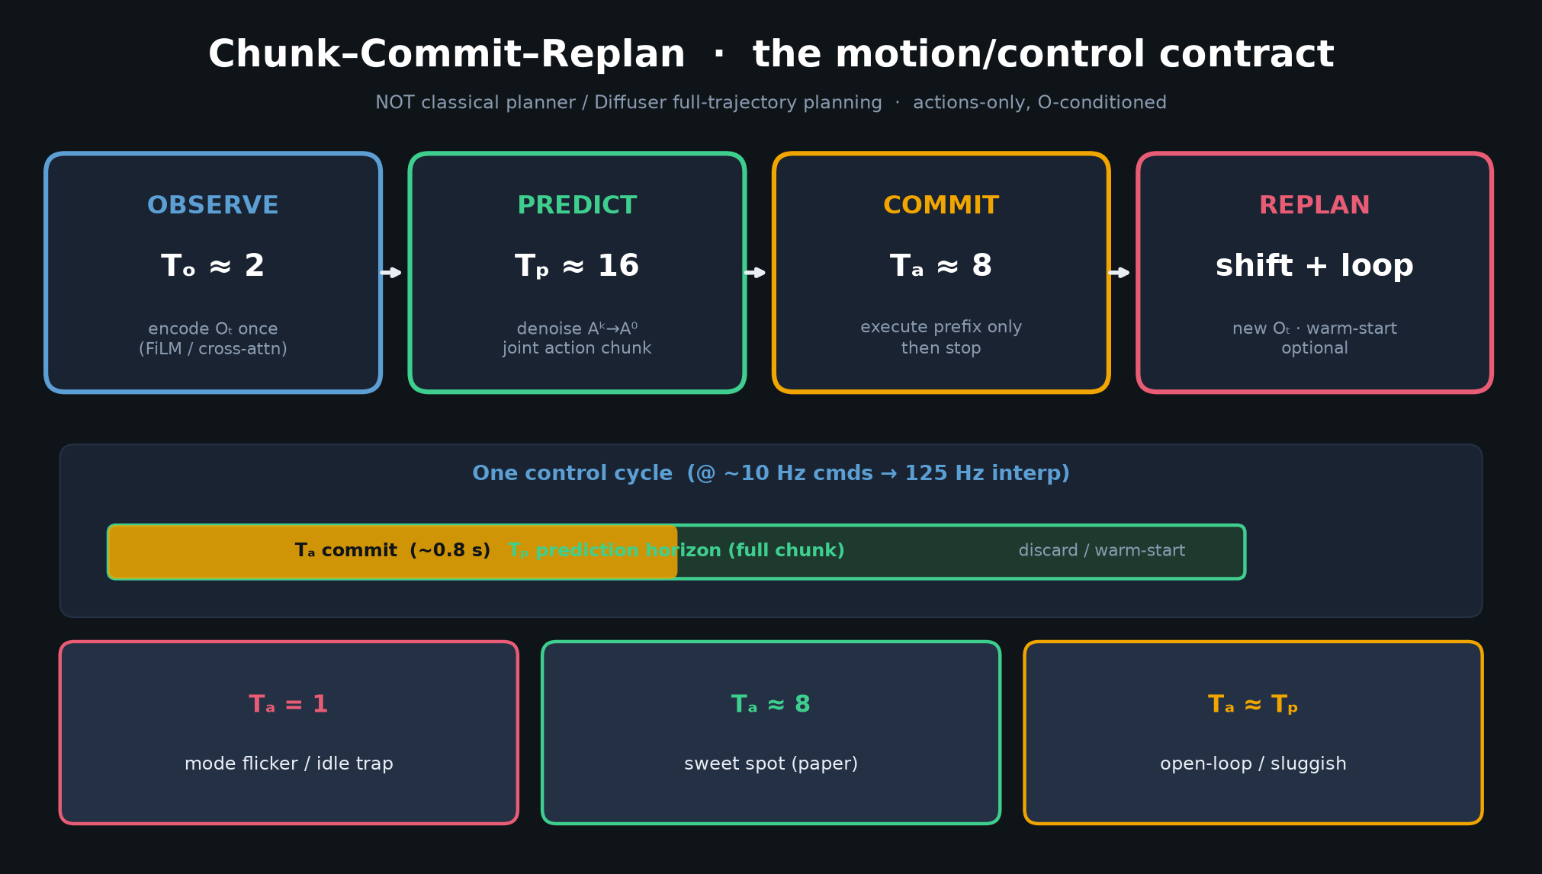
Archaeologist · 11+3 · 7/14
Notes:
CHUNK–COMMIT–REPLAN diagram (our redraw of the spine).
OBSERVE (Tₒ) → PREDICT (Tₚ) → COMMIT (Tₐ) → REPLAN.
Callouts:
• Tₐ=1 → mode flicker / idle trap
• Tₐ≈8 → sweet spot (~0.8s commit @ 10 Hz)
• Tₐ≈Tₚ → open-loop / sluggish
Warm-start optional (MPC-like shift of previous chunk suffix).
Emphasize: this is the control module, not a foundation VLM.

Slide 8
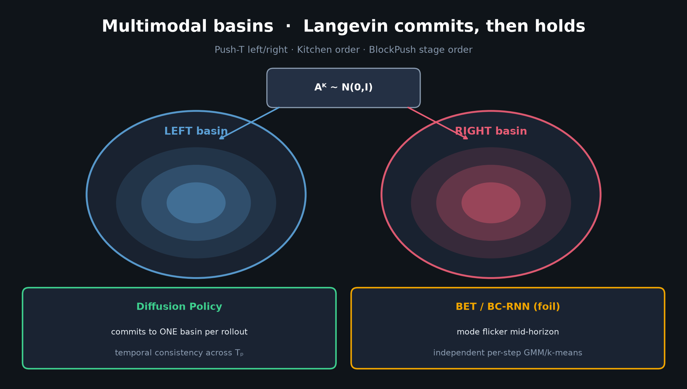
Archaeologist · 11+3 · 8/14
Notes:
MULTIMODAL BASINS — Fig 3 story without needing the page crop as primary.
Langevin / stochastic init lands in LEFT or RIGHT basin (Push-T); DP commits for the whole chunk.
BET/BC-RNN flicker modes mid-horizon (independent per-step).
Also: Kitchen object order, BlockPush stage order, mug grasp-vs-push.
Why score matching beat IBC: multimodal capacity WITHOUT negative-sample / Z instability.

Slide 9
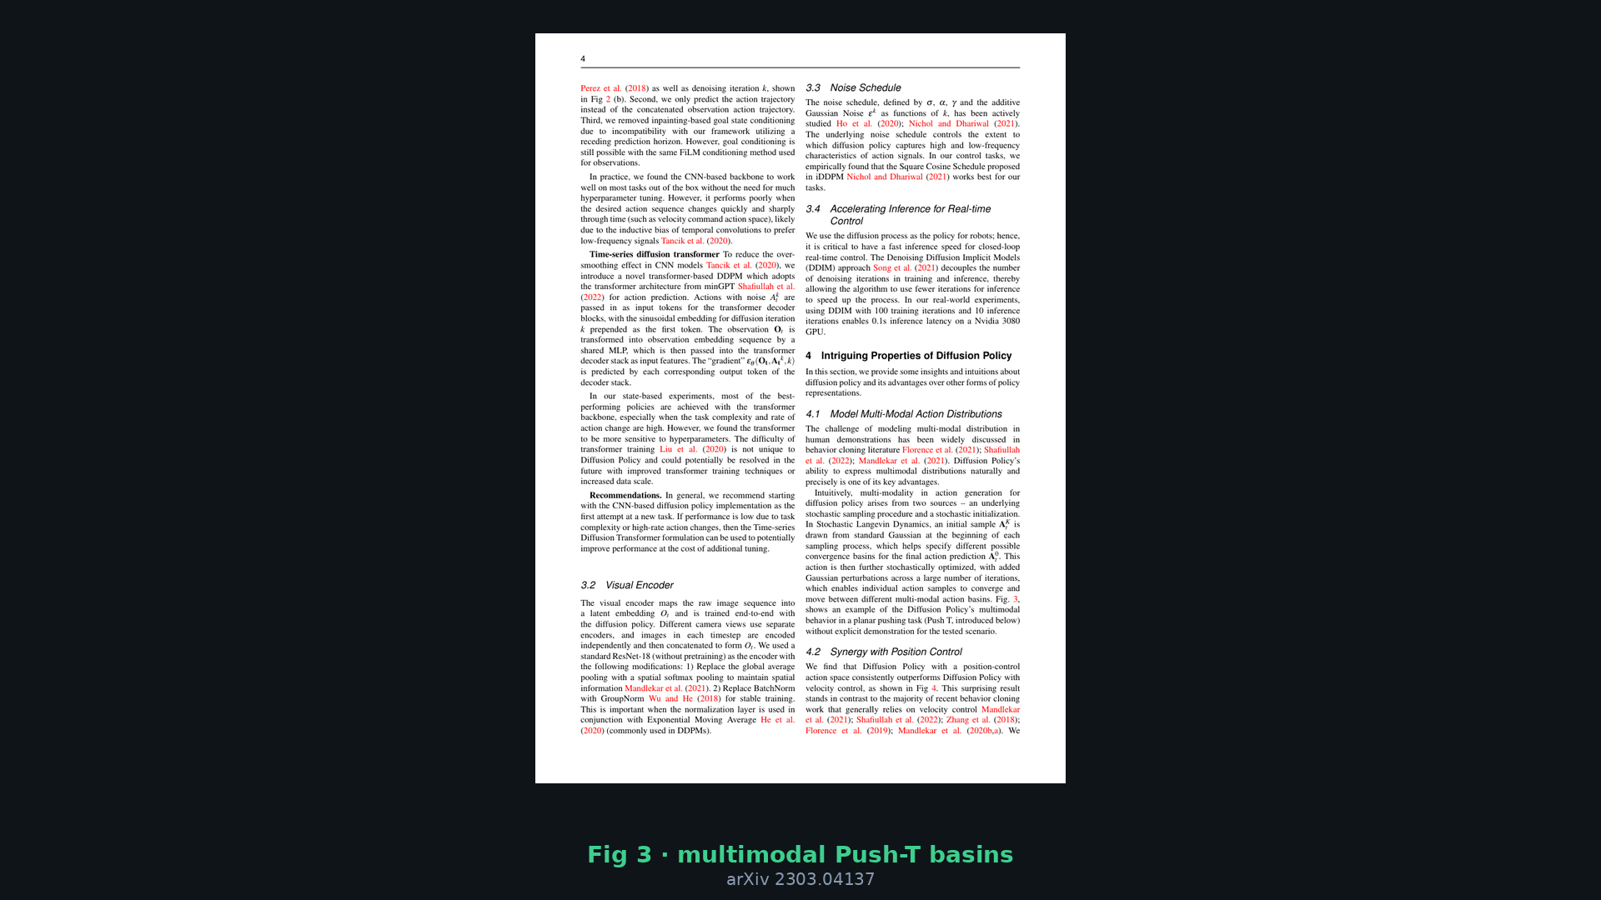
Archaeologist · 11+3 · 9/14
Notes:
PAPER FIG 3 crop — visual evidence for basin commit. Glance 20s if time; otherwise skip to timeline.
Left/right approaches both valid; DP picks one and stays; baselines chatter.

Slide 10
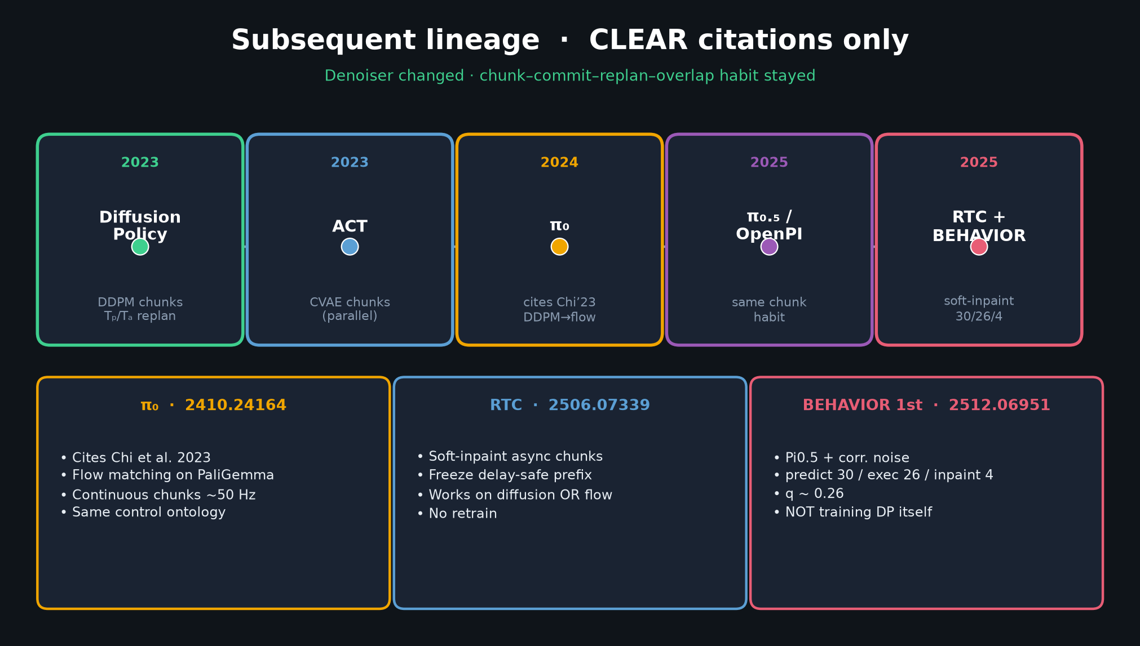
Archaeologist · 11+3 · 10/14
Notes:
SUBSEQUENT TIMELINE — CLEAR citations only. This is your payoff slide.
2023 DP: DDPM chunks + Tₚ/Tₐ replan
2023 ACT: parallel CVAE chunks
2024 π₀ (2410.24164): cites Chi’23; DDPM→flow on PaliGemma; ~50 Hz chunks
2025 π₀.₅ / OpenPI: same chunked generative habit
2025 RTC (2506.07339): soft-inpaint async chunks; freeze delay-safe prefix; no retrain
2025 BEHAVIOR 1st (2512.06951): Pi0.5 + correlated noise; predict 30 / exec 26 / inpaint 4; q~0.26
Comet (2512.10071): parallel RH / horizon ablations in challenge solutions
SAY CLEARLY: BEHAVIOR does NOT train DP. Flow on Pi0.5 + control-loop upgrades.

Slide 11
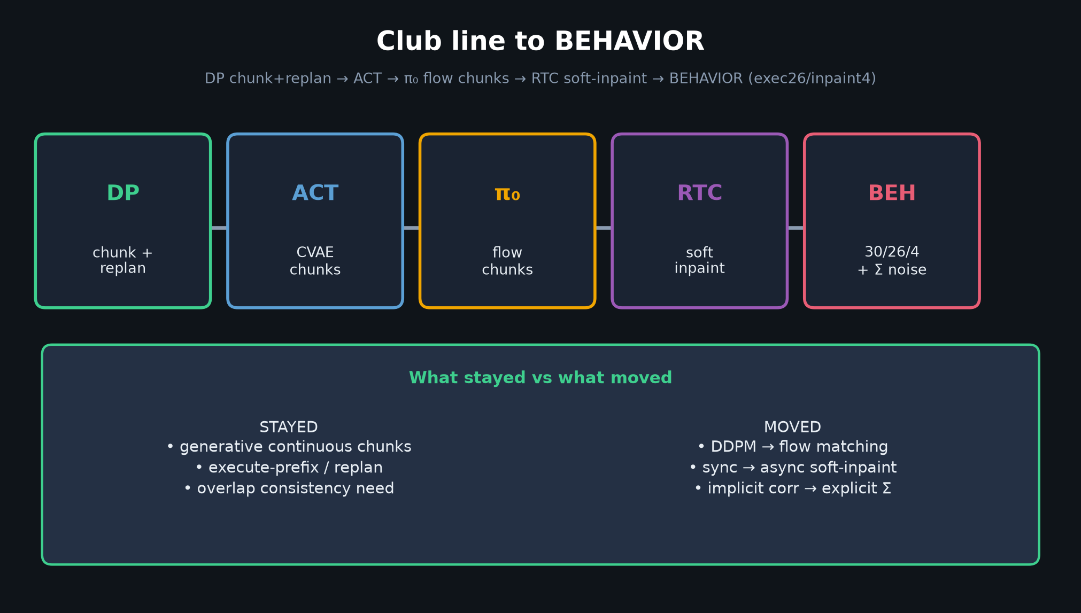
Archaeologist · 11+3 · 11/14
Notes:
CLUB LINE — the sentence people should leave with.
DP chunk+replan → ACT → π₀ flow chunks → RTC soft-inpaint → BEHAVIOR (exec26/inpaint4).
STAYED: generative continuous chunks; execute-prefix/replan; overlap consistency need.
MOVED: DDPM→flow; sync→async soft-inpaint; implicit correlation→explicit Σ.
If Empiricist later talks Tₐ grids — this is why those knobs still matter in 2026.

Slide 12
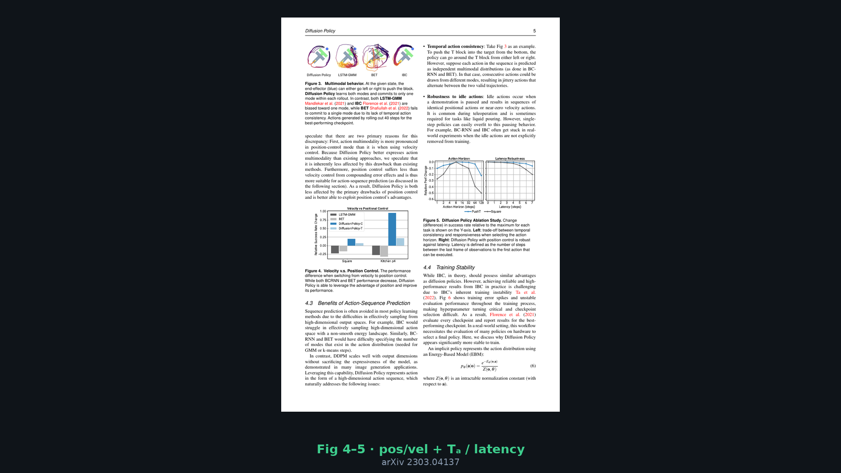
Archaeologist · 11+3 · 12/14
Notes:
HONEST CLOSE slide before Q&A — restate talk-arc honesty.
“Habit of control loop persisted; denoiser changed.”
Optional Fig 4–5 glance: position synergy + Tₐ sweet spot + latency robustness — those ablations are why the control knobs survived into VLAs.

Slide 13
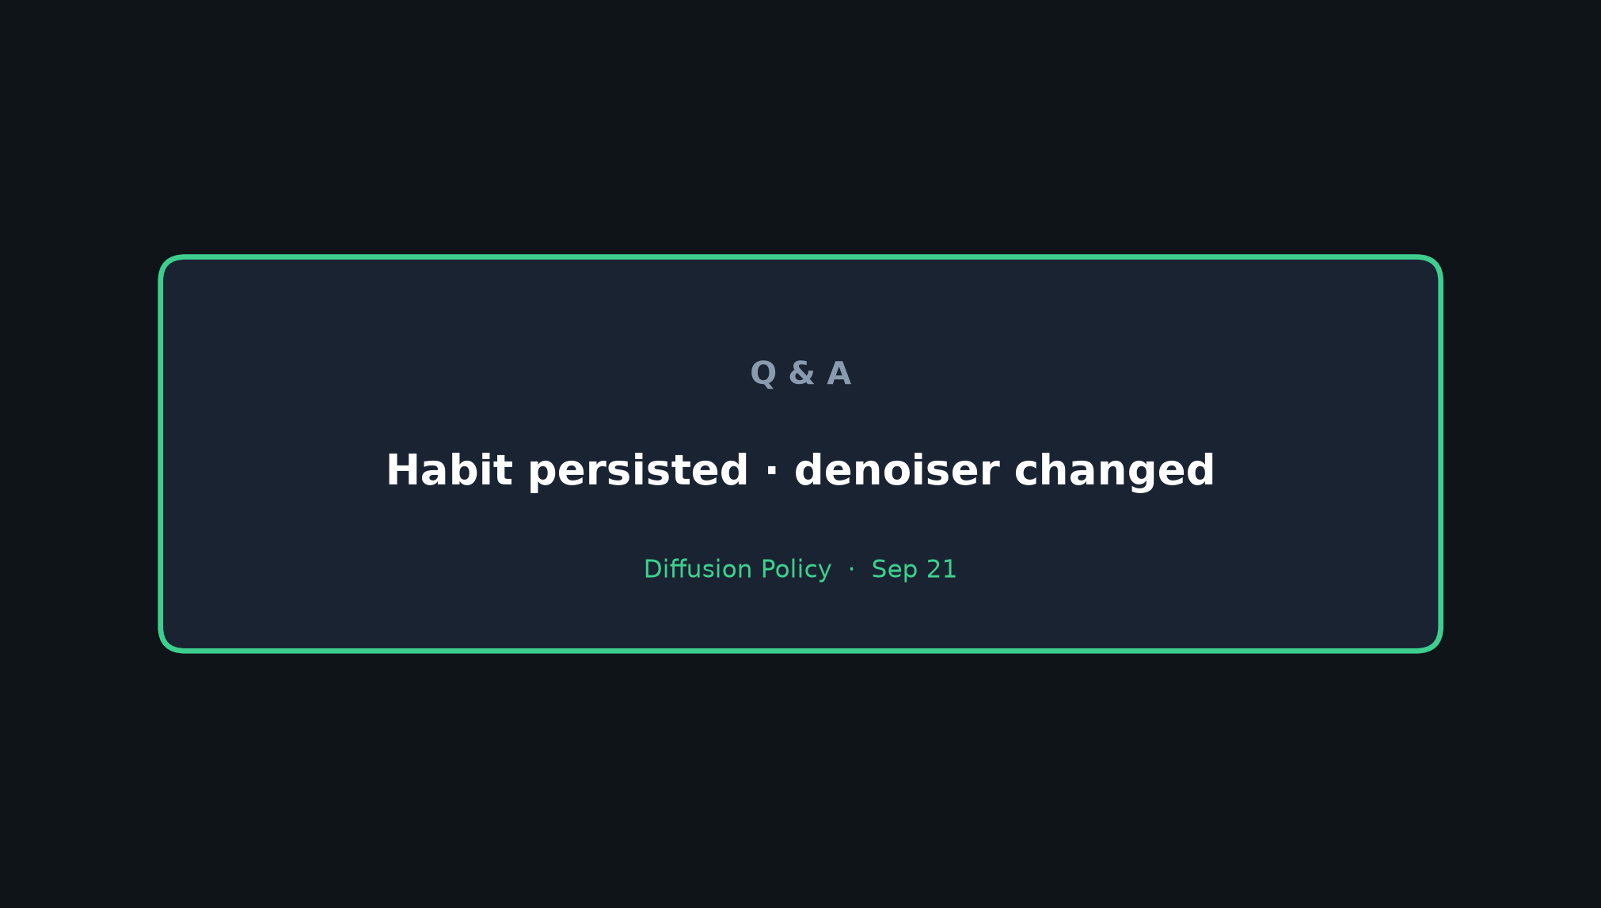
Archaeologist · 11+3 · 13/14
Notes:
Q&A PROMPTS (seat 1):
• “Is DP a planner?” → Diffuser foil slide; actions-only + receding.
• “Did BEHAVIOR use DP?” → No; flow on Pi0.5; inherited the control habit.
• “What about ACT?” → Parallel chunking; different generative model.
• “What should we cite DP for in 2026?” → Continuous action diffusion/flow + chunk–commit–replan control module — not foundation VLM.
Leave on: Habit persisted · denoiser changed.

Slide 14
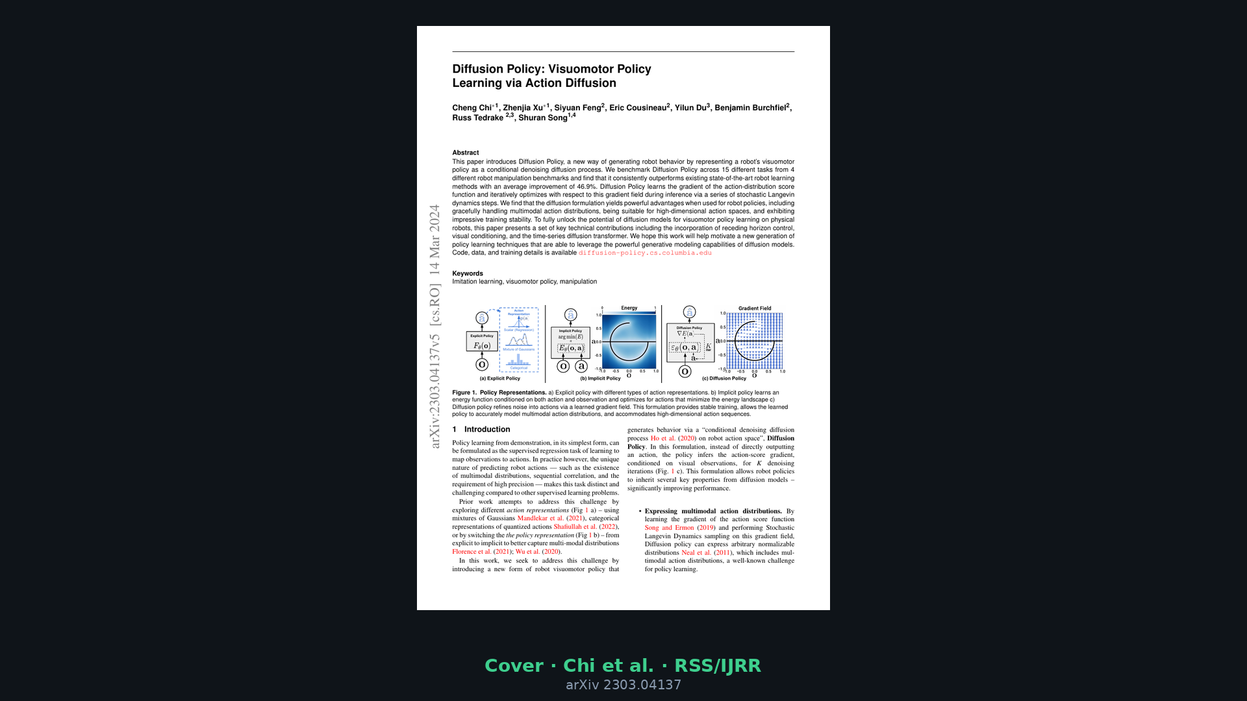
Archaeologist · 11+3 · 14/14
Notes:
SPARE / BACKUP — paper cover if someone wants bibliographic slide.
Chi*, Xu* et al. Columbia / TRI / MIT / Stanford. RSS 2023 + IJRR extended. diffusion-policy.cs.columbia.edu

