Slide 1
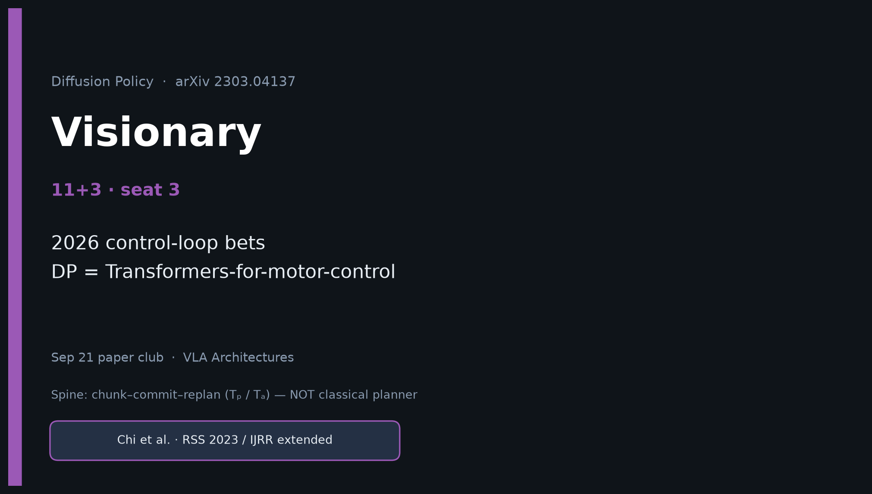
Visionary · 11+3 · 1/11
Notes:
VISIONARY — seat 3 · 11+3.
NO Discord / Drive digressions. Stay on 2026 control-loop bets.
One-liner: DP is to continuous VLA motor control what early Transformers were to NLP sequences.

Slide 2
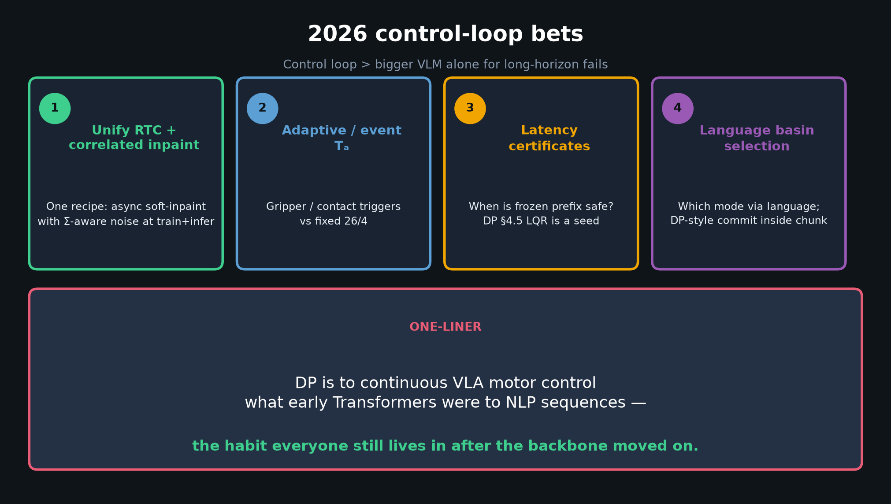
Visionary · 11+3 · 2/11
Notes:
ONE-LINER + four bets — THE Visionary slide.
1 Unify RTC + correlated inpaint
2 Adaptive / event-triggered Tₐ
3 Latency certificates (frozen-prefix safety)
4 Language-conditioned basin selection + DP-style commitment

Slide 3
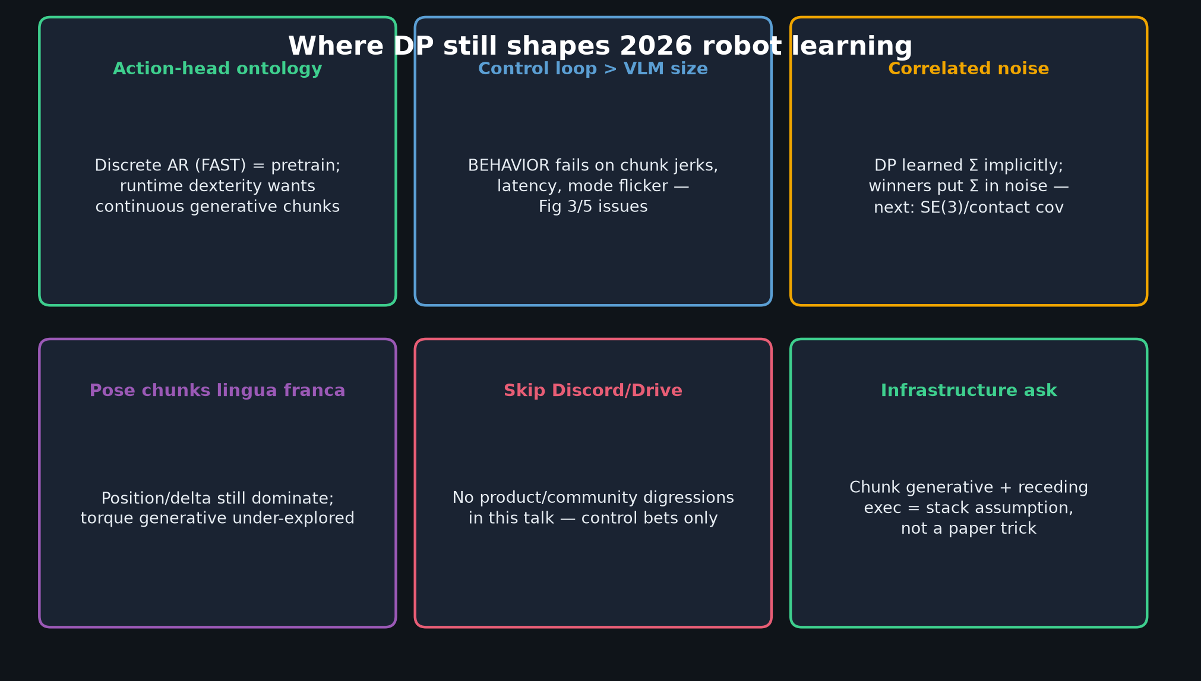
Visionary · 11+3 · 3/11
Notes:
Where DP still shapes 2026 — action-head ontology, control loop > VLM size, correlated noise, pose lingua franca.
Skip Discord/Drive.

Slide 4
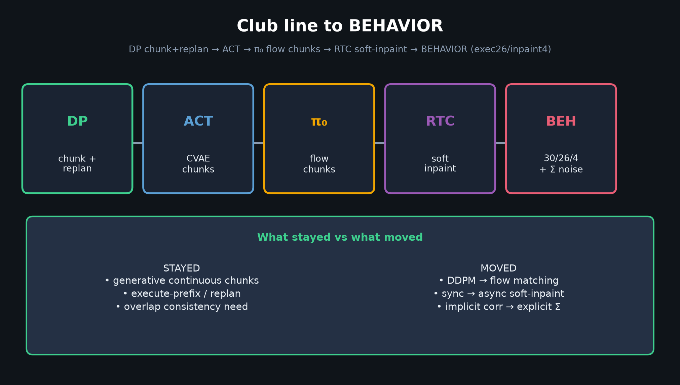
Visionary · 11+3 · 4/11
Notes:
Club line — show inheritance path into BEHAVIOR without claiming DP training.

Slide 5
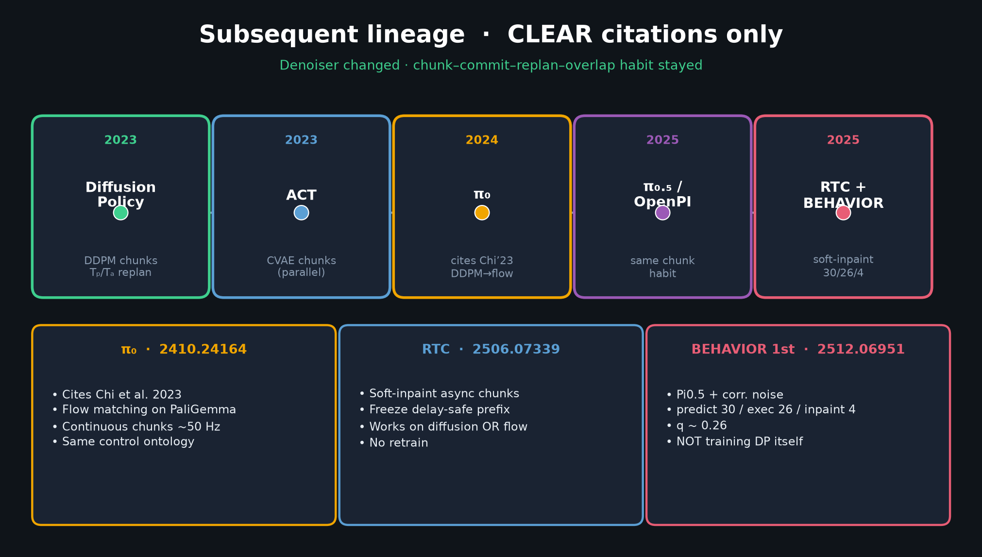
Visionary · 11+3 · 5/11
Notes:
Timeline detail for bets 1–2 (RTC soft-inpaint → BEHAVIOR 30/26/4).

Slide 6
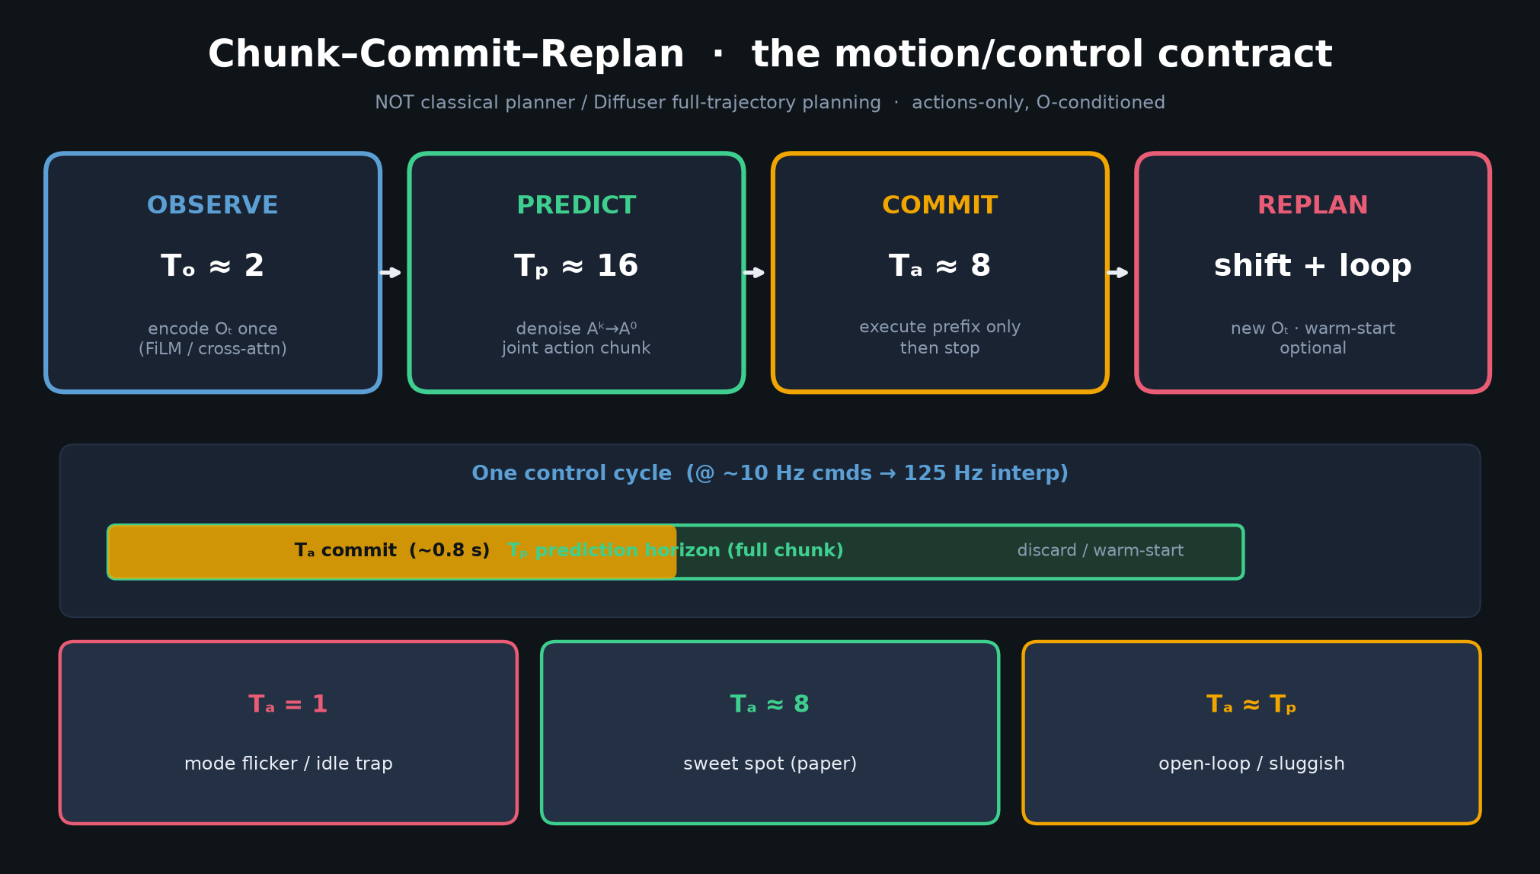
Visionary · 11+3 · 6/11
Notes:
Chunk–commit–replan — the habit that adaptive Tₐ would modulate.

Slide 7
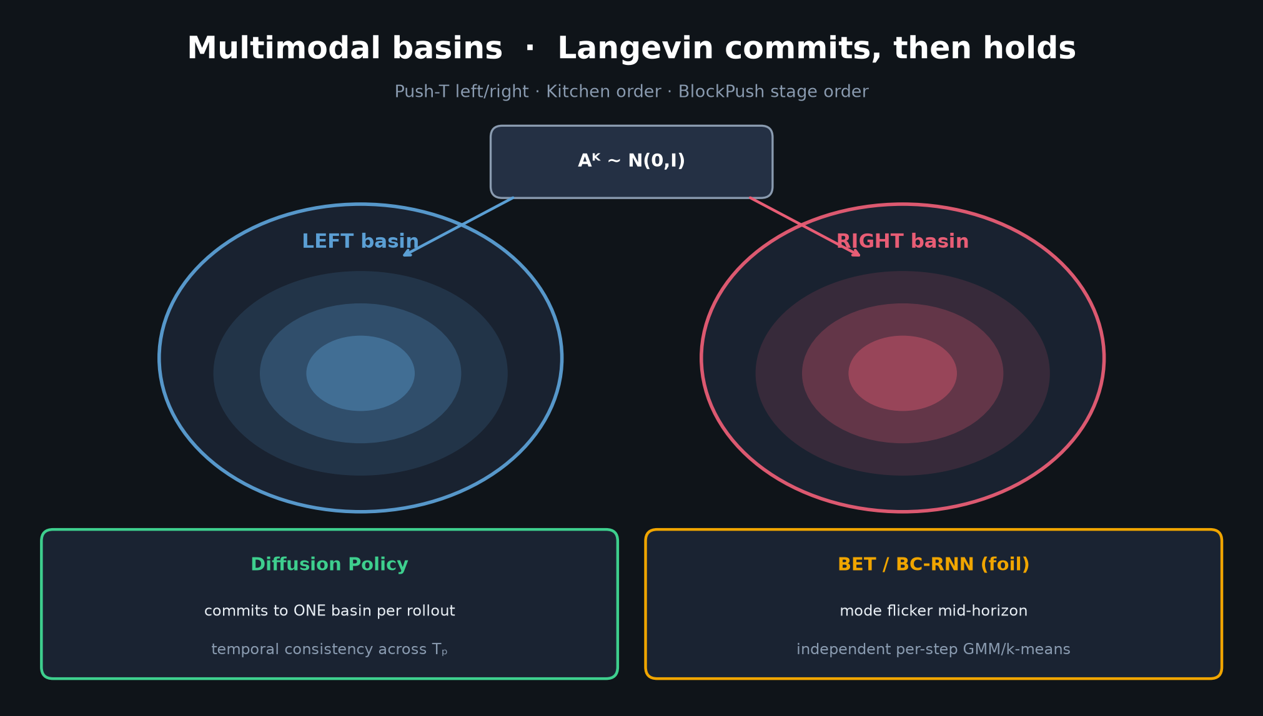
Visionary · 11+3 · 7/11
Notes:
Multimodal basins — bet 4: language selects basin; DP-style commit holds it inside the chunk.

Slide 8
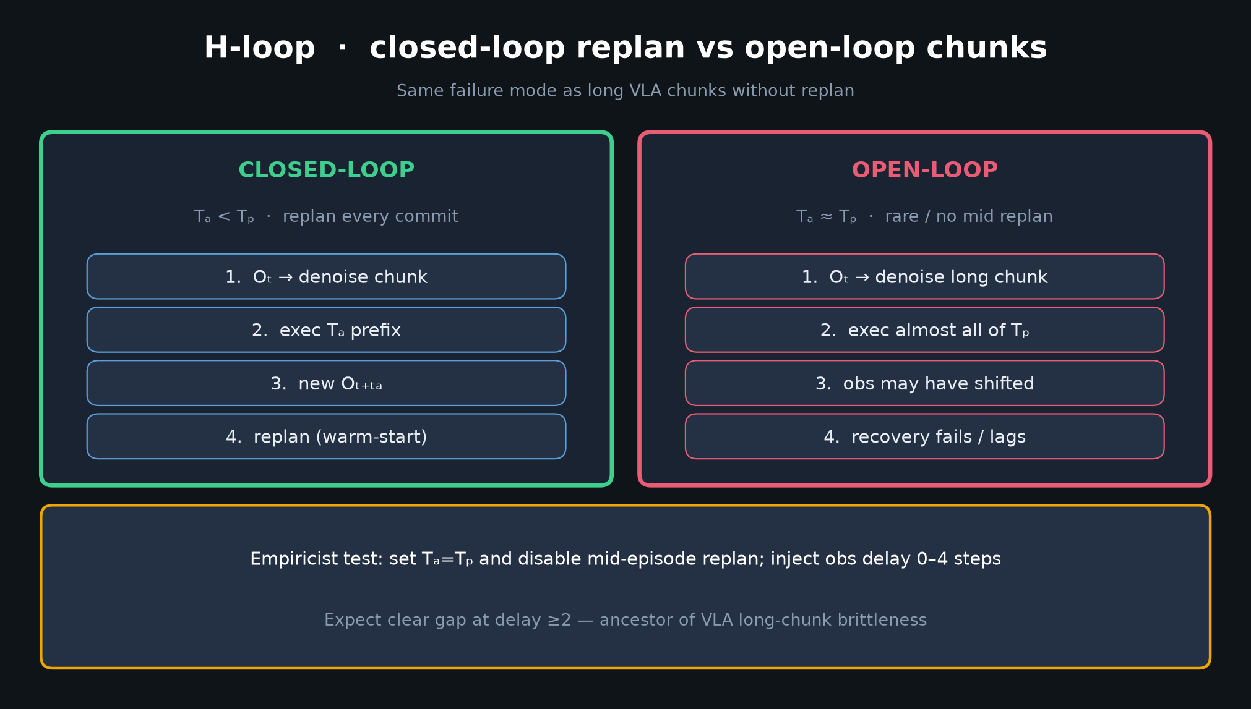
Visionary · 11+3 · 8/11
Notes:
Closed vs open — why latency certificates matter; open-loop long chunks are the failure mode BEHAVIOR still fights.

Slide 9
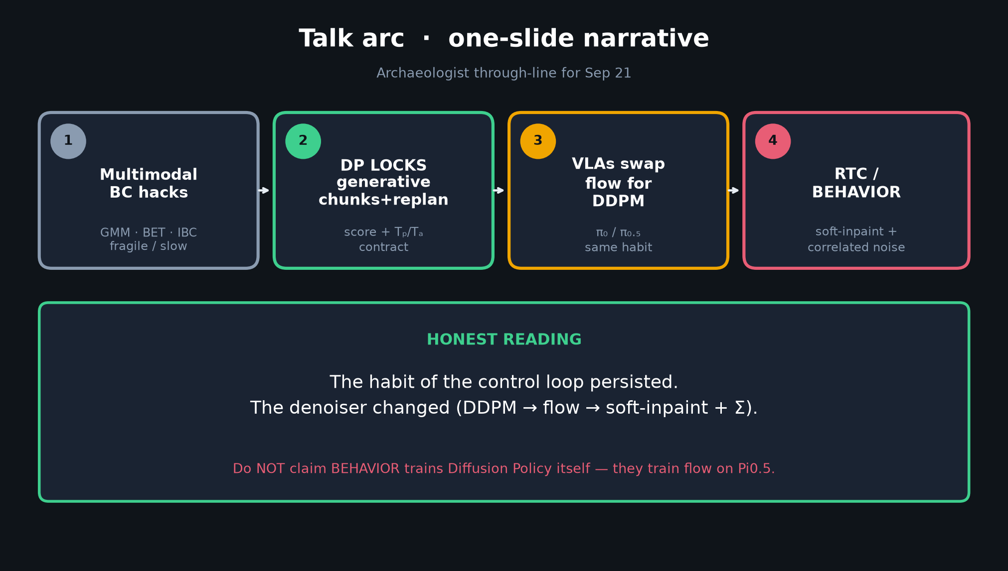
Visionary · 11+3 · 9/11
Notes:
Talk arc honesty — denoiser changed, habit stayed — frames why bets are about the loop, not another backbone swap.

Slide 10
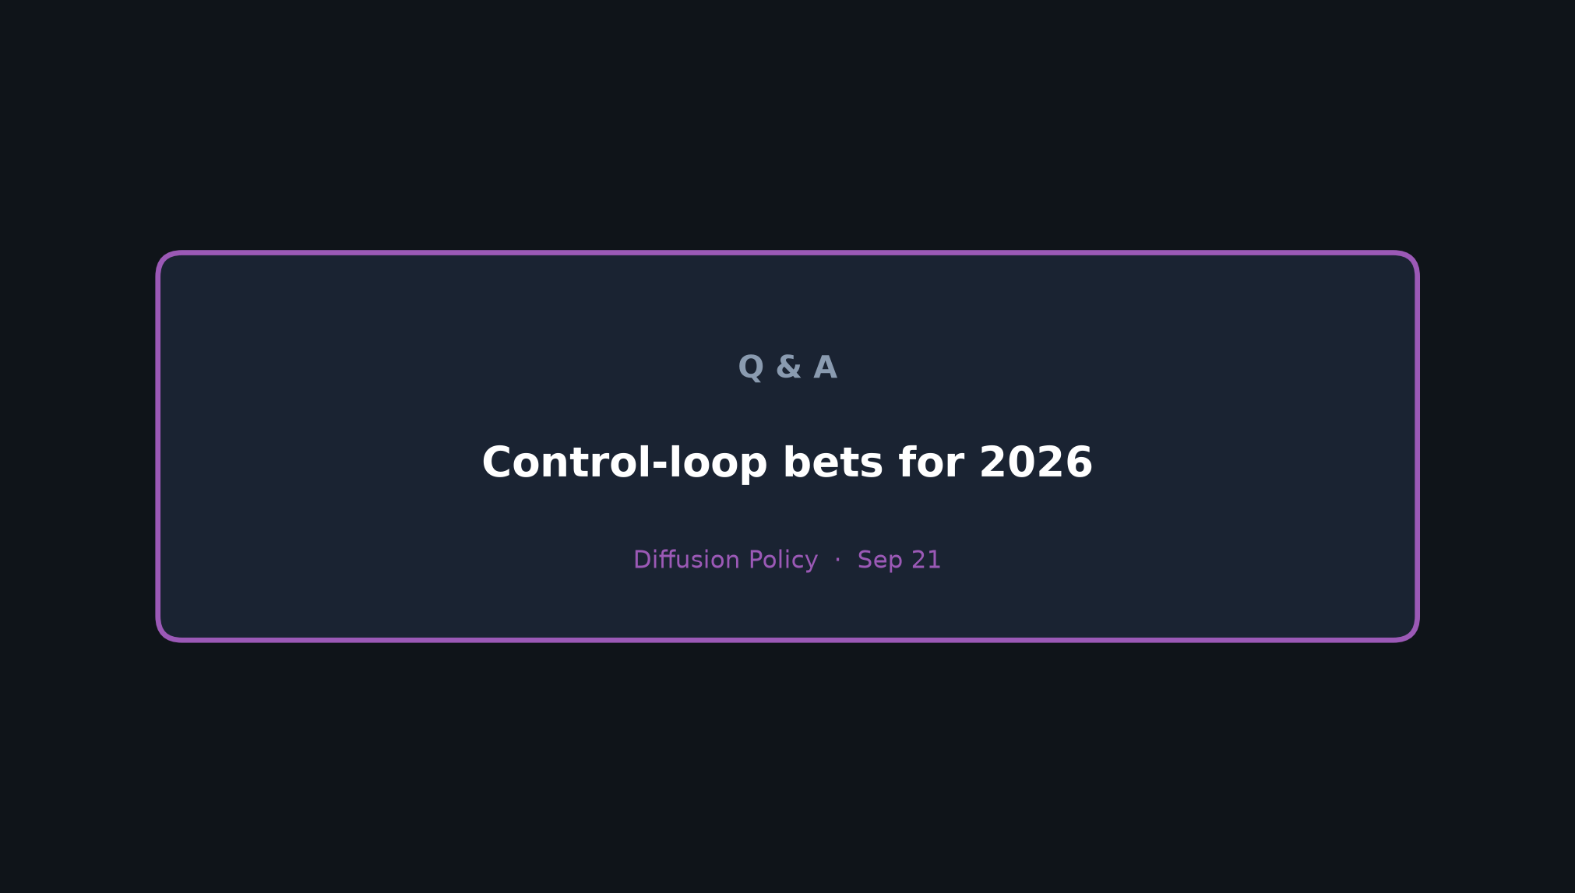
Visionary · 11+3 · 10/11
Notes:
Close on the one-liner. Q&A: adaptive horizons, certificates, language basin selection.

Slide 11
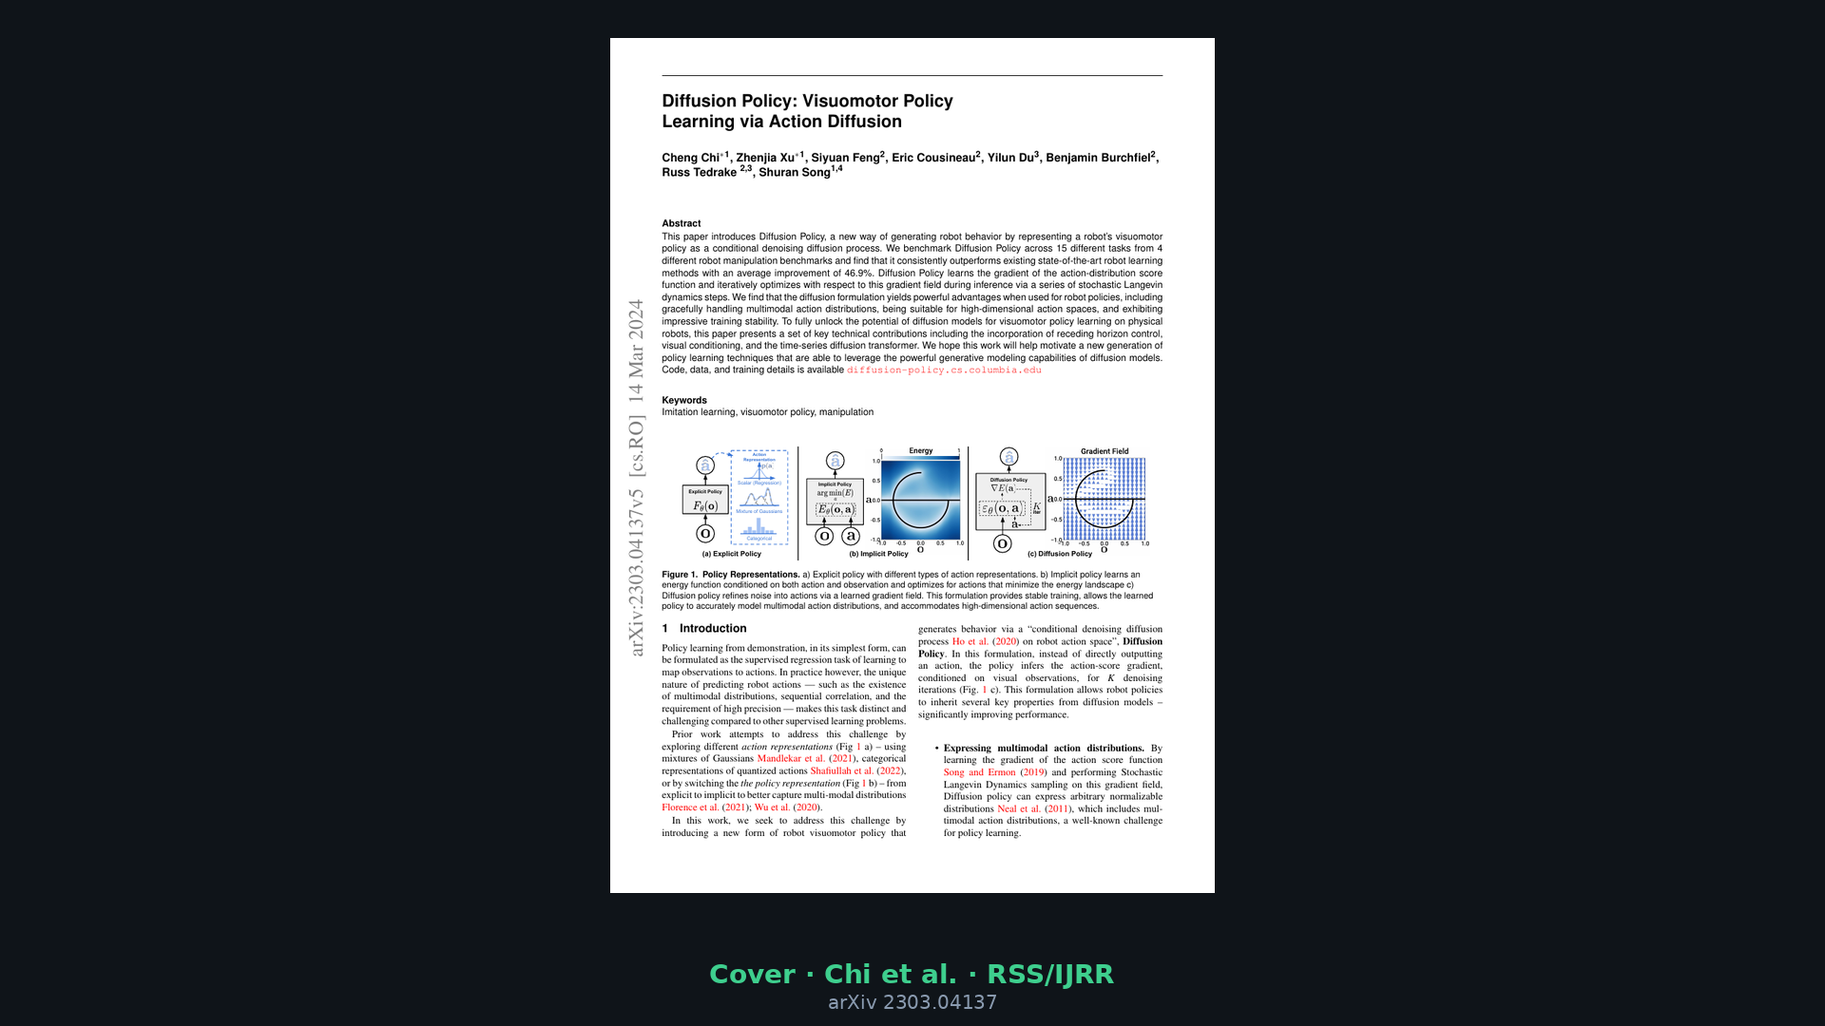
Visionary · 11+3 · 11/11
Notes:
Backup cover.

