Slide 1
OpenPI Comet
Stakeholder · Kanta
OpenPI Comet / BEHAVIOR Challenge / 2nd place
18+3 min
arXiv 2512.10071 · BEHAVIOR Challenge 2025 · smoke-run paper club
Notes:
Welcome. I'm Stakeholder for OpenPI Comet. Goal: system diagram, leaderboard, coverage ladder, method+findings in ~18 minutes. Paper: Team Comet adapts public π0.5 (OpenPI) to 50 long-horizon BEHAVIOR-1K household tasks.

Slide 2
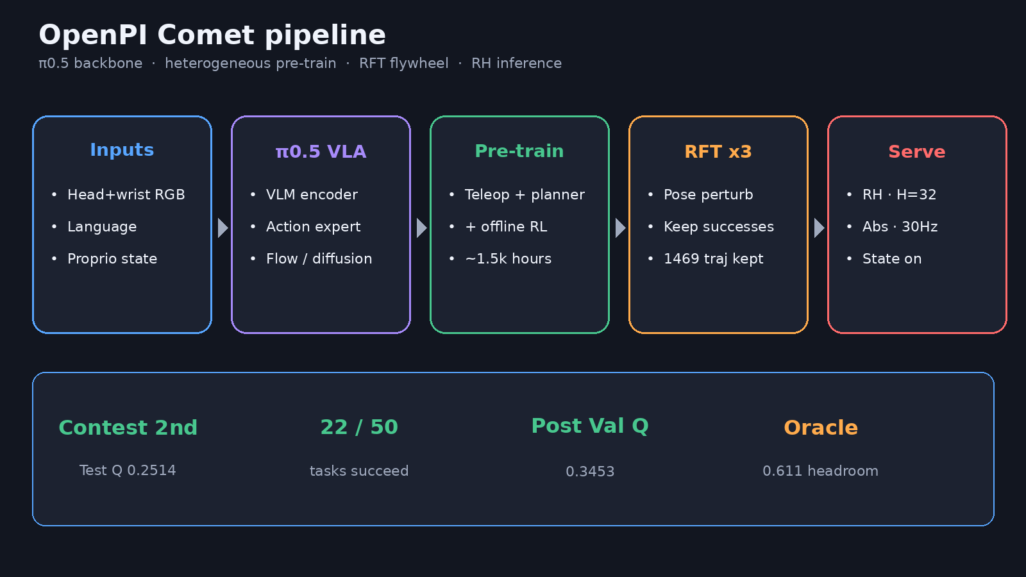
System / method pipeline
Notes:
MOTIVATION: Minute-scale household skill chaining fails; BEHAVIOR is the public scoreboard.
PROBLEM: 50 full BDDL activities; rank by test Q; bet one end-to-end public VLA can compete without a skill graph.
METHOD: π0.5 + heterogeneous pre-train (coverage ladder) + 3-round RFT + RH control (H=32), abs/30Hz/state/RGB.
Visual: head+wrist RGB + language + proprio → transformer action expert → continuous control.

Slide 3
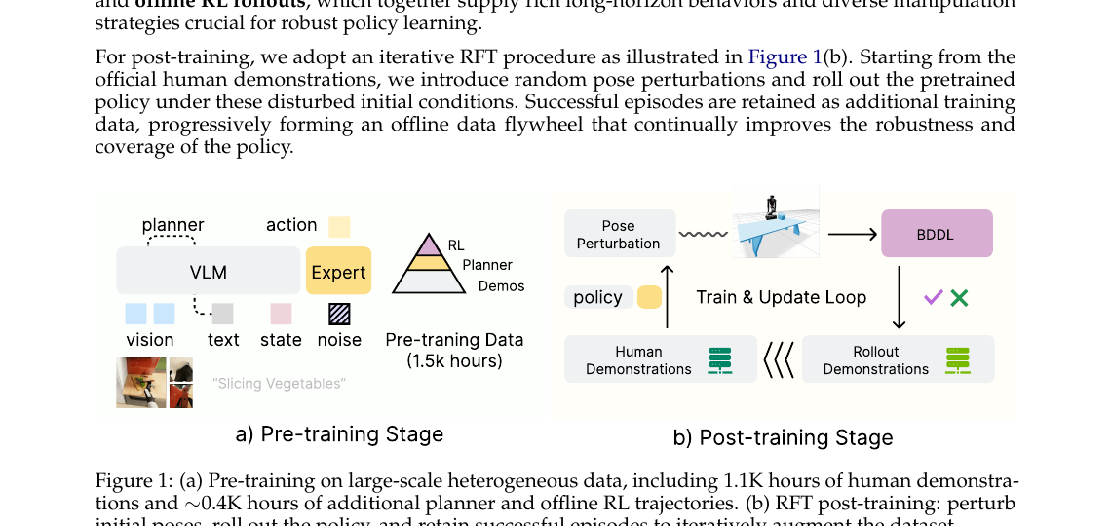
Fig 1 — Pre-train + RFT flywheel (paper)
Notes:
Paper Figure 1(a): pre-training on large-scale heterogeneous data (~1.5k hours: human demos + planner + offline RL).
Figure 1(b): iterative RFT — pose perturbation → rollout → BDDL success filter → keep successes → retrain.
No modular skill chaining — end-to-end adaptation of public VLA.

Slide 4
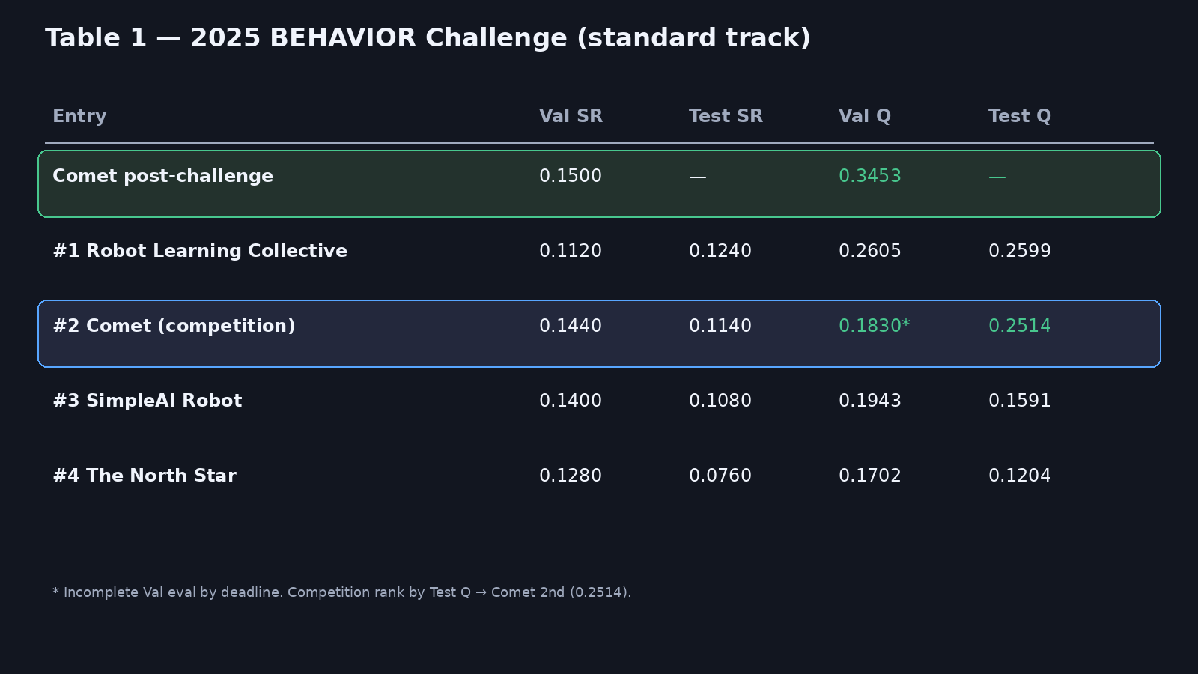
Leaderboard — Table 1
Notes:
FINDINGS contest: 2nd place — test Q 0.2514, 22/50 tasks (winner 0.2599).
Competition Val Q incomplete footnote (0.1830) vs stronger Test — ranking is by Test Q.
Post-challenge (refined balancing): val Q 0.3453, SR 0.1500 — above winner's val Q 0.2605.
Note post-challenge has no published test Q.

Slide 5
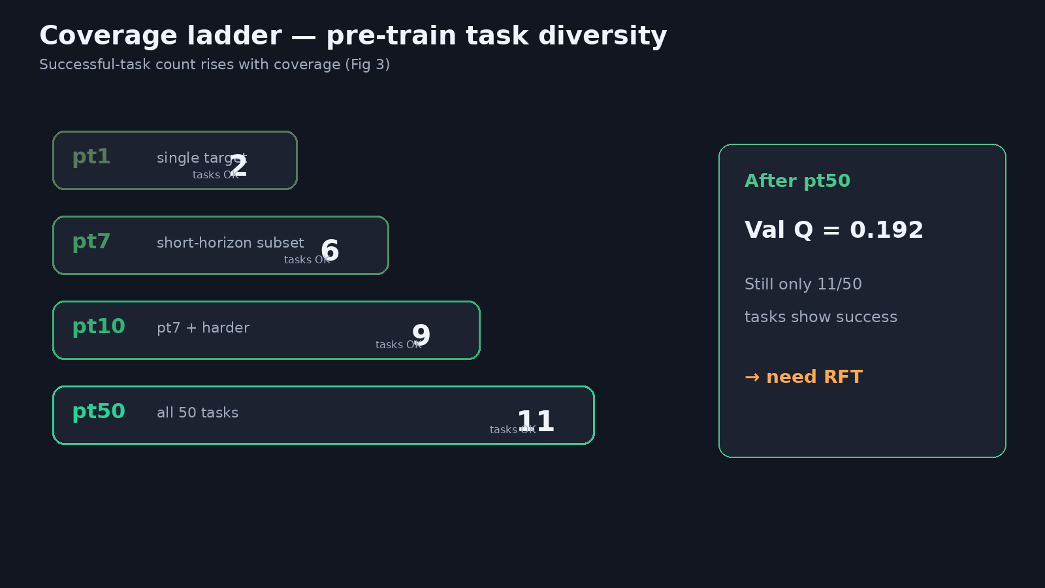
Coverage ladder — pt1 → pt7 → pt10 → pt50
Notes:
Pre-train coverage ablation (Fig 3): successful tasks 2 → 6 → 9 → 11 as coverage expands.
pt1 only succeeds on 2 tasks; purely task-specific adaptation insufficient.
After pt50 pre-train: Val Q 0.192 — still need post-train.

Slide 6
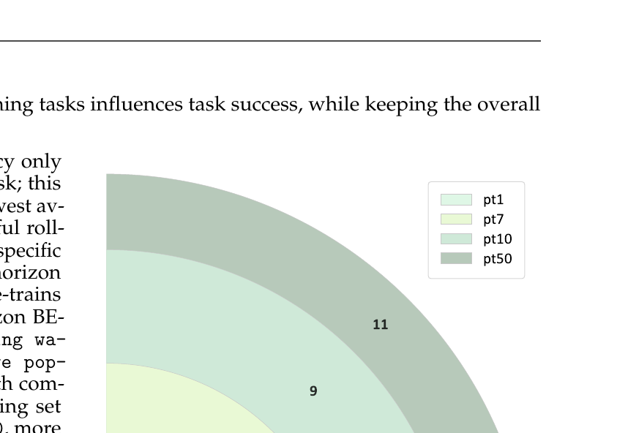
Fig 3 — paper coverage figure
Notes:
Paper Figure 3 nested coverage visualization. Broader task coverage improves generalization.
Talk to the ladder story, then transition to RFT for the remaining gap.

Slide 7
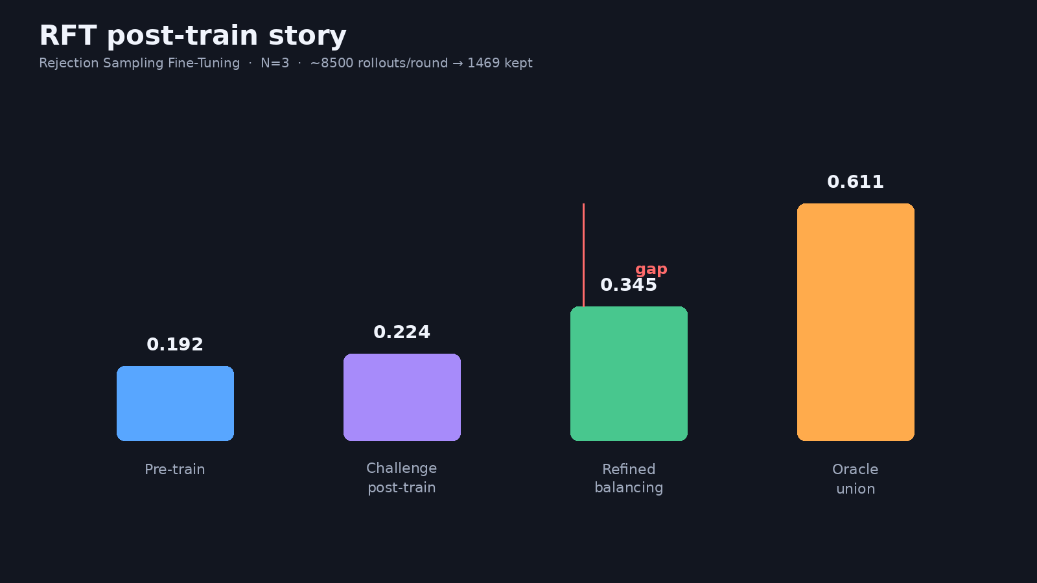
RFT post-train — 0.192 → 0.345 · oracle 0.611
Notes:
RFT N=3 (~8500 rollouts/round → 1469 kept after dedup/balancing).
Challenge-era post-train Val Q 0.224; refined balancing → 0.345 with two checkpoints.
Theoretical best aggregating historical successes: Val Q 0.611 (SR 0.35) = headroom, NOT a deployable policy.
Story: public VLA + flywheel works; hard half and oracle gap remain.

Slide 8
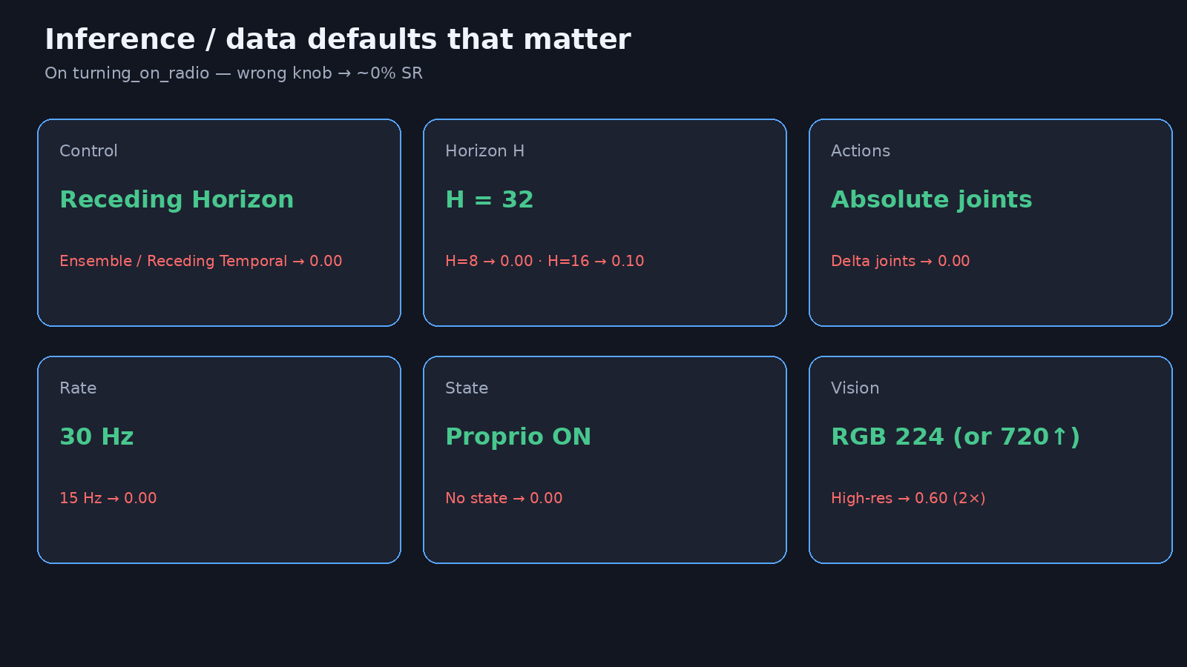
Defaults that matter
Notes:
Key inference/data defaults: RH, H=32, abs joints, 30Hz, state on, RGB.
Wrong controller/Hz/frame → ~0% on turning_on_radio probe.
High-res (720/480) doubles probe SR 0.30→0.60.
These knobs are as important as the backbone.

Slide 9
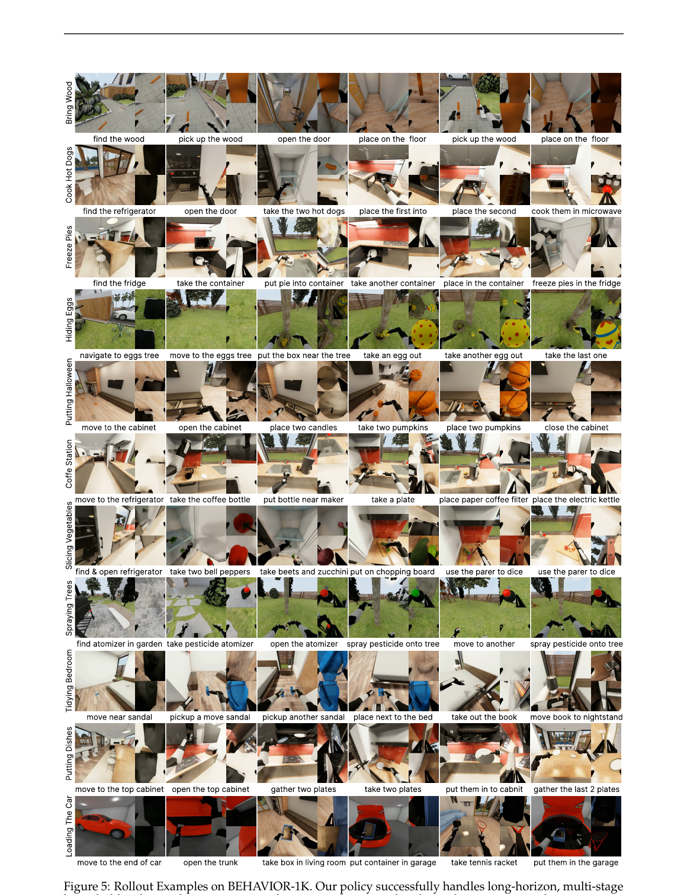
Qualitative rollouts (Fig 5)
Notes:
Long-horizon multi-stage household tasks: nav, fine manip, tool use.
Completes 22/50 — easy tasks robust; many zero-success remain.
Use as visual proof of breadth before takeaway.

Slide 10
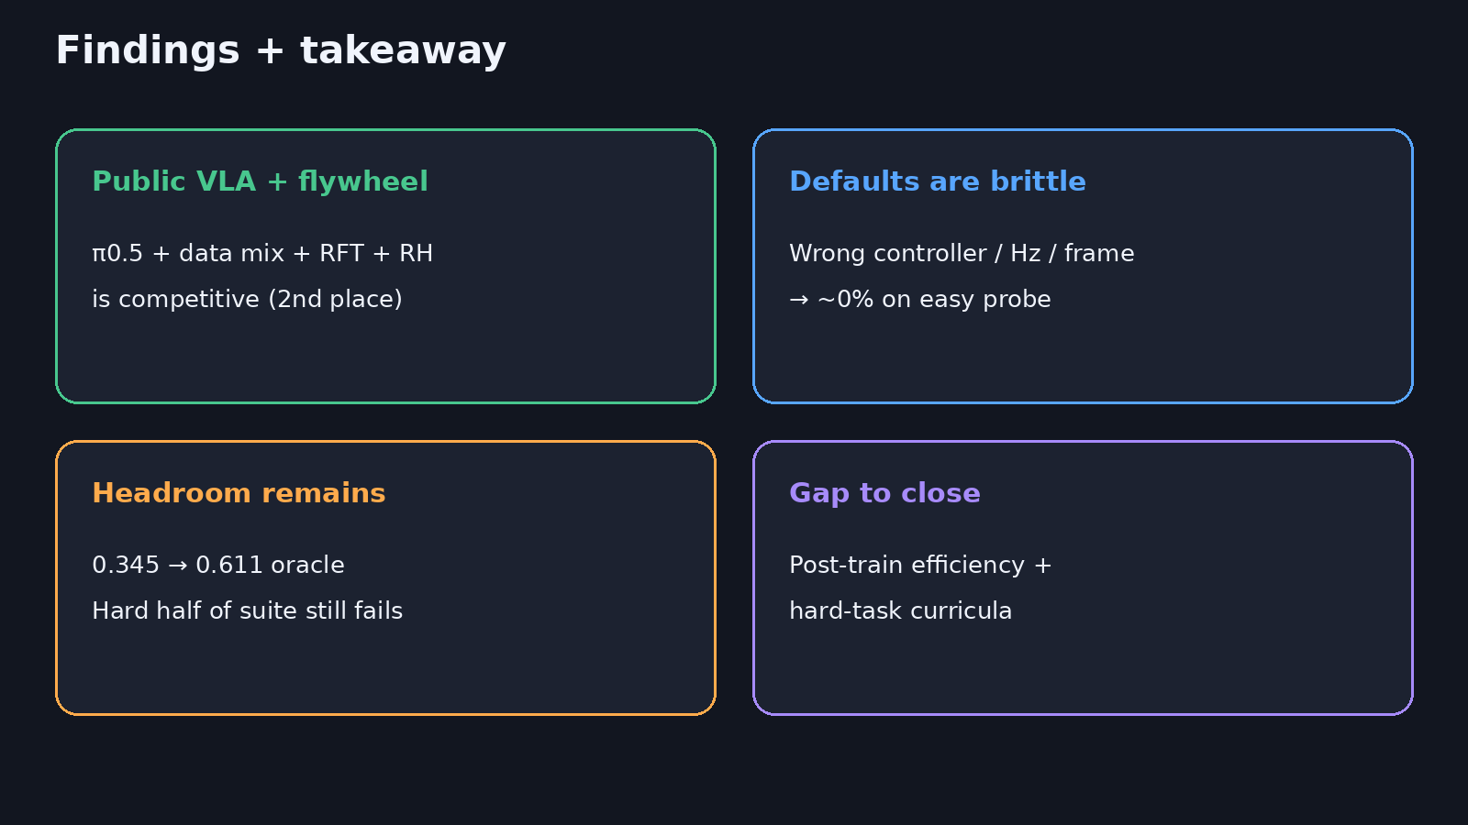
Findings + takeaway
18+3
Notes:
FINDINGS: Contest 2nd (0.2514); post-challenge val Q 0.3453; wrong controller/Hz/frame → ~0%; high-res doubles probe SR; oracle 0.611 = headroom.
TAKEAWAY: Public VLA + flywheel works; gap is post-train efficiency + hard tasks.

Slide 11
Public VLA + data flywheel is competitive — close the hard-task gap next.
Q&A · timing 18+3
Notes:
Open for Q&A (~3 min). Point reviewers to code: github.com/mli0603/openpi-comet · HF sunshk/openpi_comet.

