Slide 1
OpenPI Comet
Scientific Reviewer
Strengths · Weaknesses · Actionable fixes (NOT a paper tour)
8+3 min
arXiv 2512.10071 · BEHAVIOR Challenge 2025 · smoke-run paper club
Notes:
Reviewer role: critique, not summary. Skip motivation/background already covered by Stakeholder.
Structure: strengths → weaknesses → ablation critique → fixes. ~8 minutes.

Slide 2
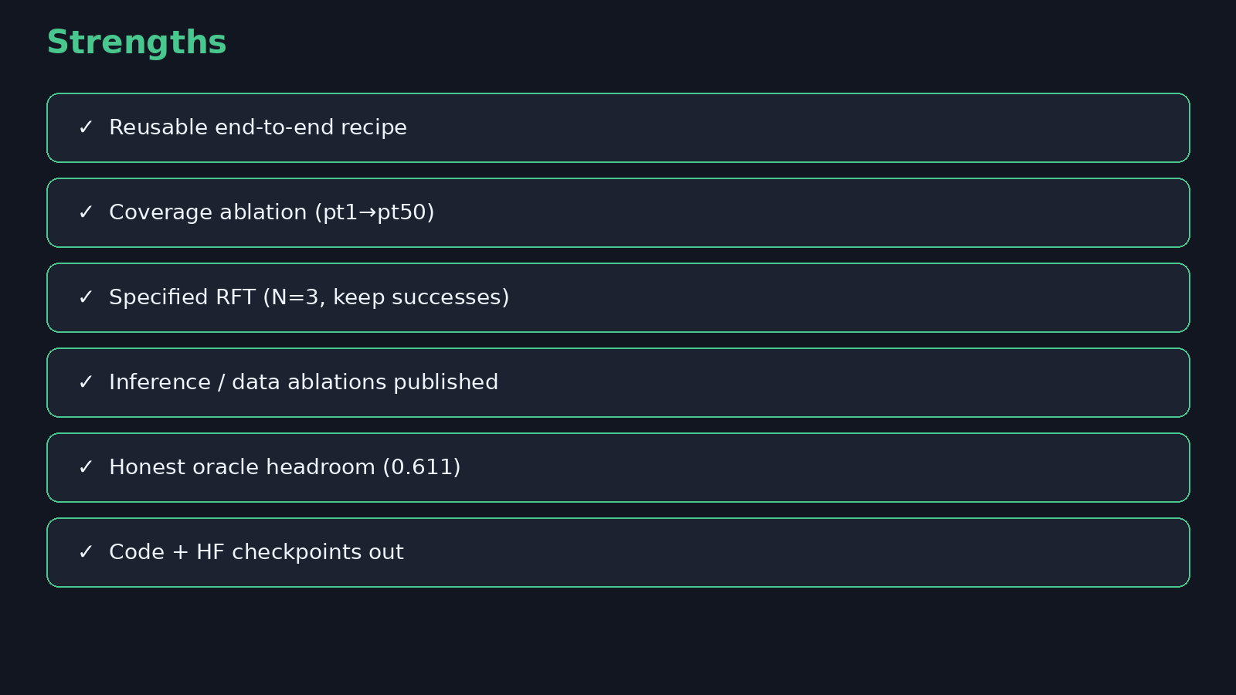
Strengths
Notes:
STRENGTHS: Reusable recipe; coverage ablation; specified RFT; inference/data ablations; honest headroom; code out.
Credit the engineering clarity and reproducibility intent.

Slide 3
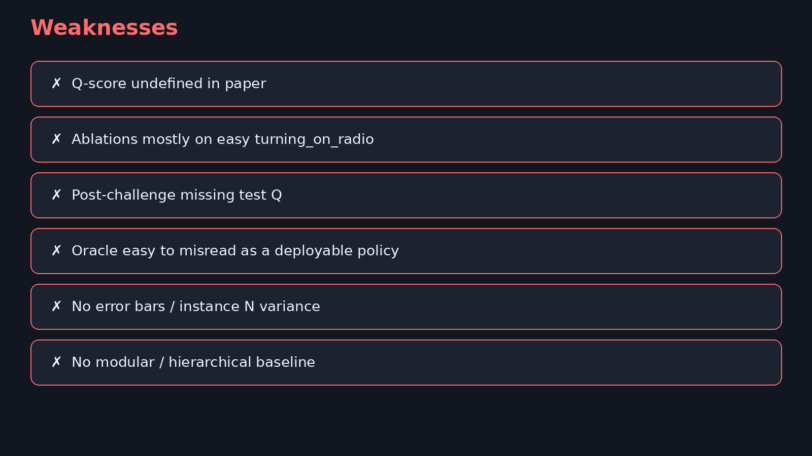
Weaknesses
Notes:
WEAKNESSES: Q undefined; ablations mostly on easy turning_on_radio; post-challenge missing test Q; oracle easy to misread; no error bars; no modular baseline.
Also: incomplete competition Val Q footnote; planner/offline-RL contribution not isolated.

Slide 4
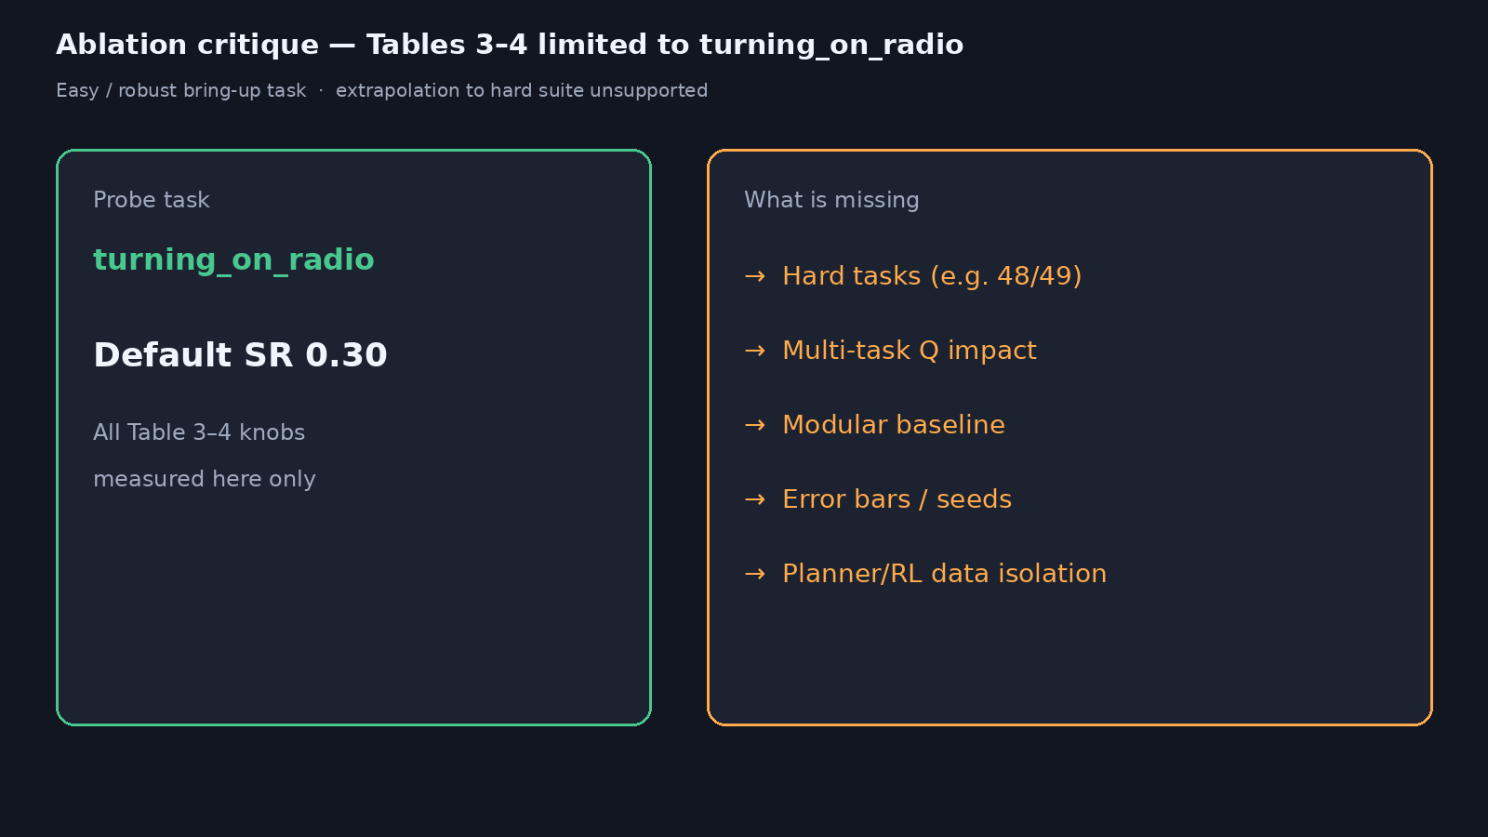
Ablation critique — Tables 3–4
Notes:
Tables 3–4 almost entirely on turning_on_radio (easy/robust). Extrapolation to Tasks 48/49 / full Q unsupported.
Largest single-task deltas (horizon, resolution, abs vs delta) need hard-task panel.

Slide 5
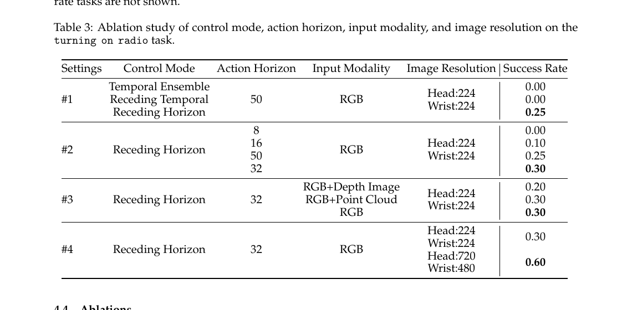
Table 3 as published (radio only)
Notes:
Walk the table briefly: control mode, horizon, modality, resolution — all on one easy task.
Ask: which deltas survive on long-horizon failures?

Slide 6
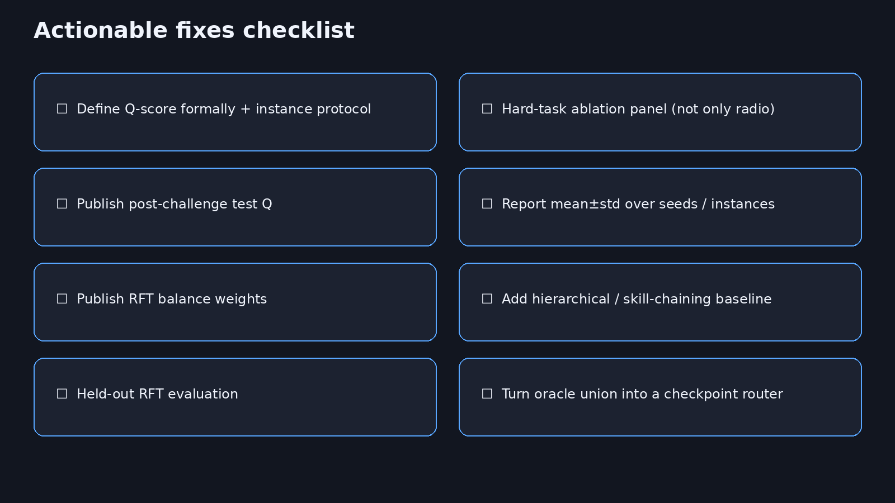
Actionable fixes
8+3
Notes:
ACTIONABLE FIXES: Define Q; hard-task ablation panel; post-challenge test Q; mean±std; publish balance weights; hierarchical baseline; held-out RFT; turn oracle into a router.
Prioritize define-Q + hard-task panel + error bars for next revision.

Slide 7
Strong recipe paper — strengthen claims with hard-task evidence and defined metrics.
Q&A · timing 8+3
Notes:
Q&A (~3). Avoid re-describing method; stay on critique and fixes.

