Slide 1
OpenPI Comet
Empiricist · seat 4
H1 horizon ablation · setup/run · GPU budget
11+3 min
arXiv 2512.10071 · BEHAVIOR Challenge 2025 · smoke-run paper club
Notes:
Empiricist: one falsifiable smoke. H1 under RH+abs+proprio+RGB, H=32 ≫ H=8 on turning_on_radio (paper 0.30 vs 0.00).
No Stakeholder redo — jump to hypothesis and implement.

Slide 2
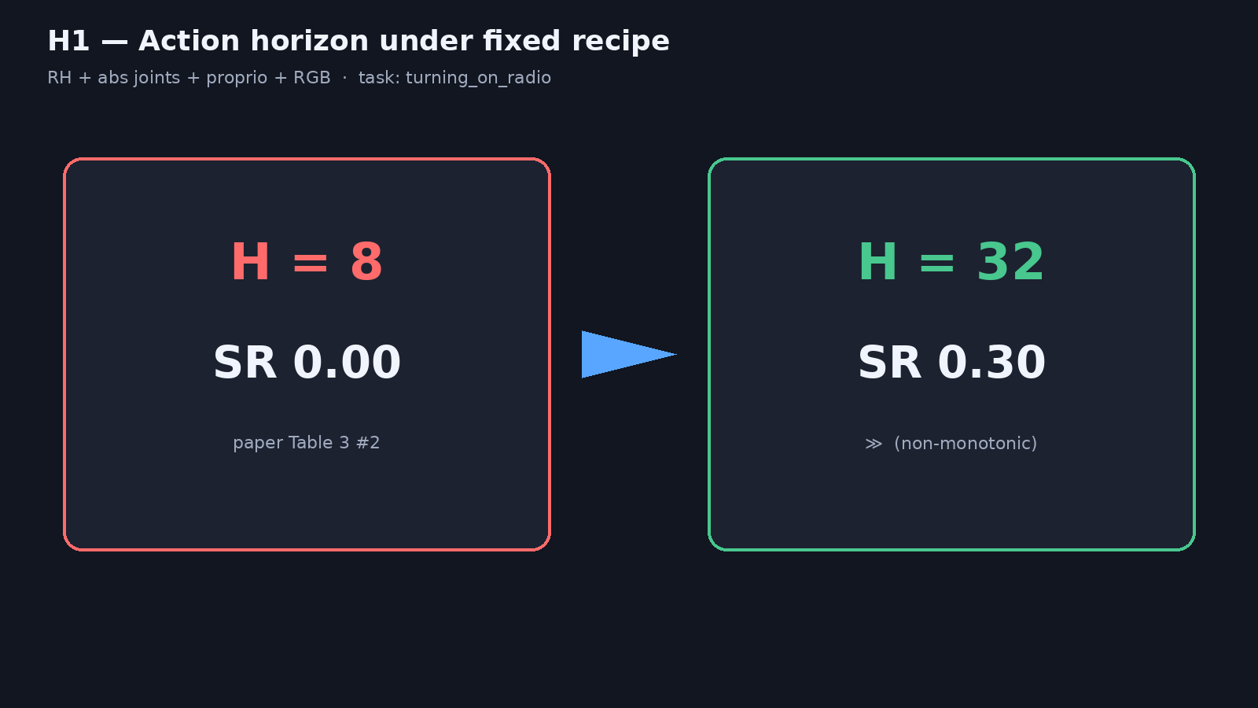
H1 statement
Notes:
H1: Under RH + abs joints + proprio + RGB, action horizon H=32 yields substantially higher success than H=8 on turning_on_radio, reproducing Table 3 #2 directionality (paper: 0.30 vs 0.00).
Short SFT from released Comet ckpt enough for large ordinal gap even if absolute SR < paper.

Slide 3
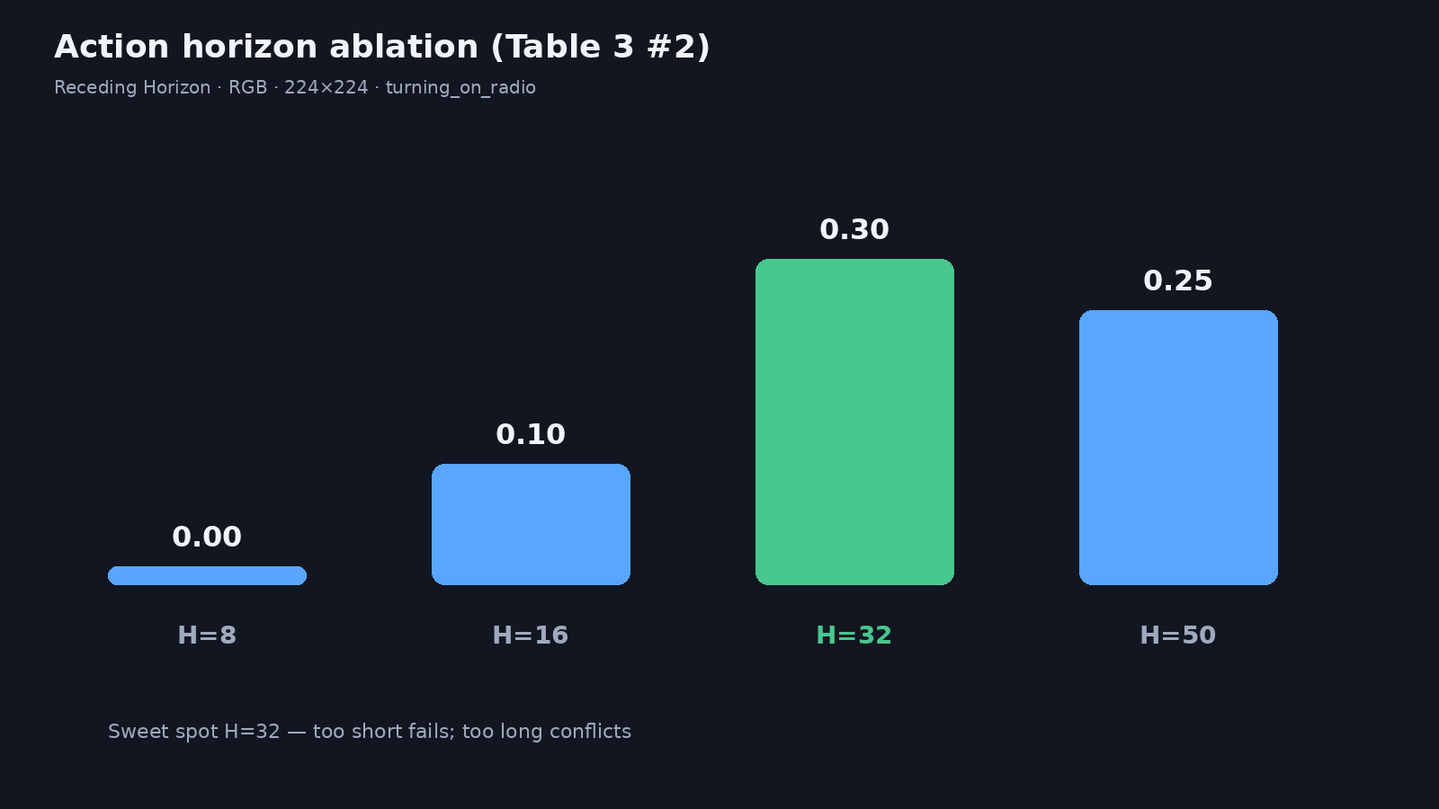
Horizon table — Table 3 #2
Notes:
Non-monotonic: 8→0.00, 16→0.10, 50→0.25, 32→0.30 best.
Moderate horizons help multi-stage; too long introduces conflicting temporal deps.
This is the clearest controlled long-horizon claim with a numeric ladder.

Slide 4
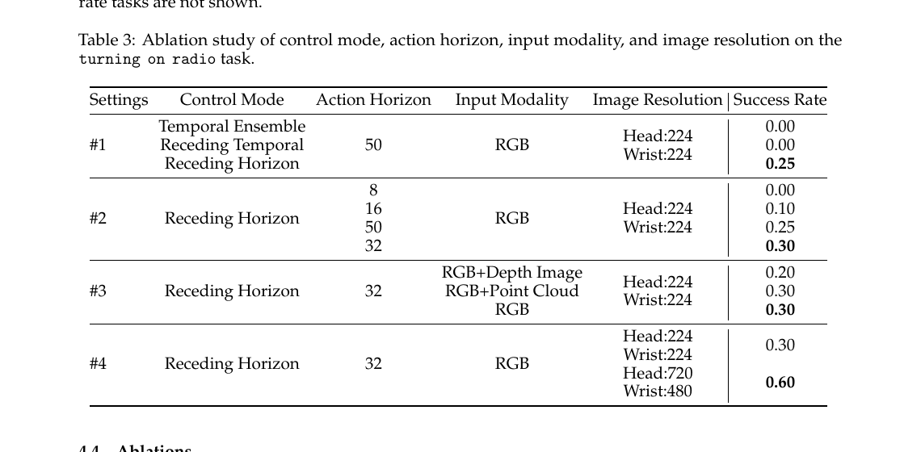
Table 3 excerpt (paper)
Notes:
Point to #2 Action Horizon rows. Hold fixed: Receding Horizon, RGB, 224.
Mention optional E02 control-mode as lighter alt (eval-only).

Slide 5
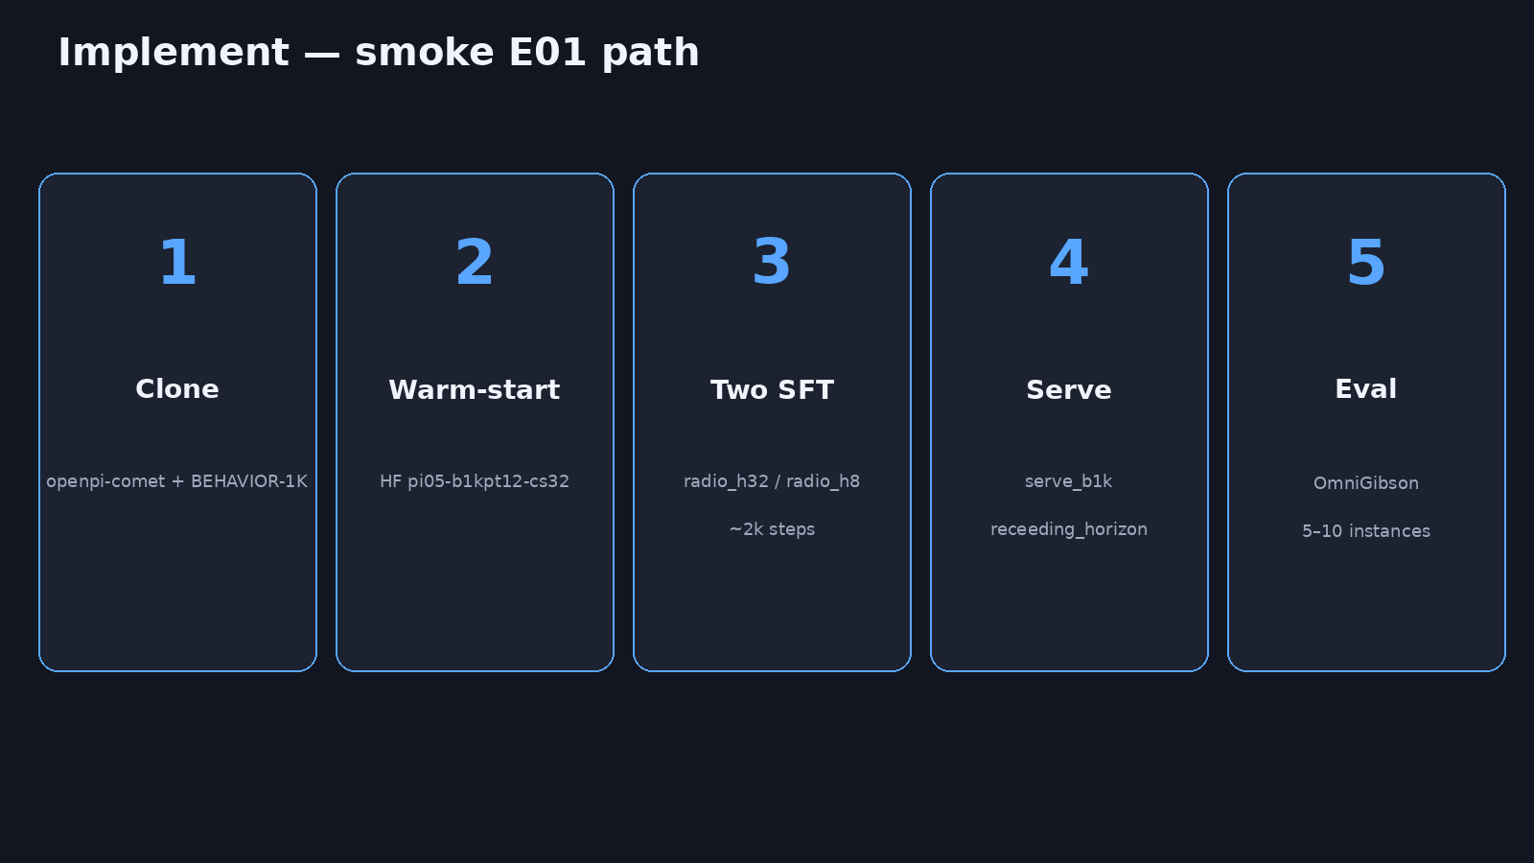
Implement steps
Notes:
IMPLEMENT: (1) clone openpi-comet + BEHAVIOR-1K; (2) warm-start HF pi05-b1kpt12-cs32; (3) two short SFT configs radio_h32 / radio_h8 ~2k steps; (4) serve_b1k receeding_horizon; (5) eval 5–10 instances OmniGibson.
Configs: Pi0Config action_horizon 32|8, tasks=[turning_on_radio], LR 2.5e-6 if adapting.

Slide 6
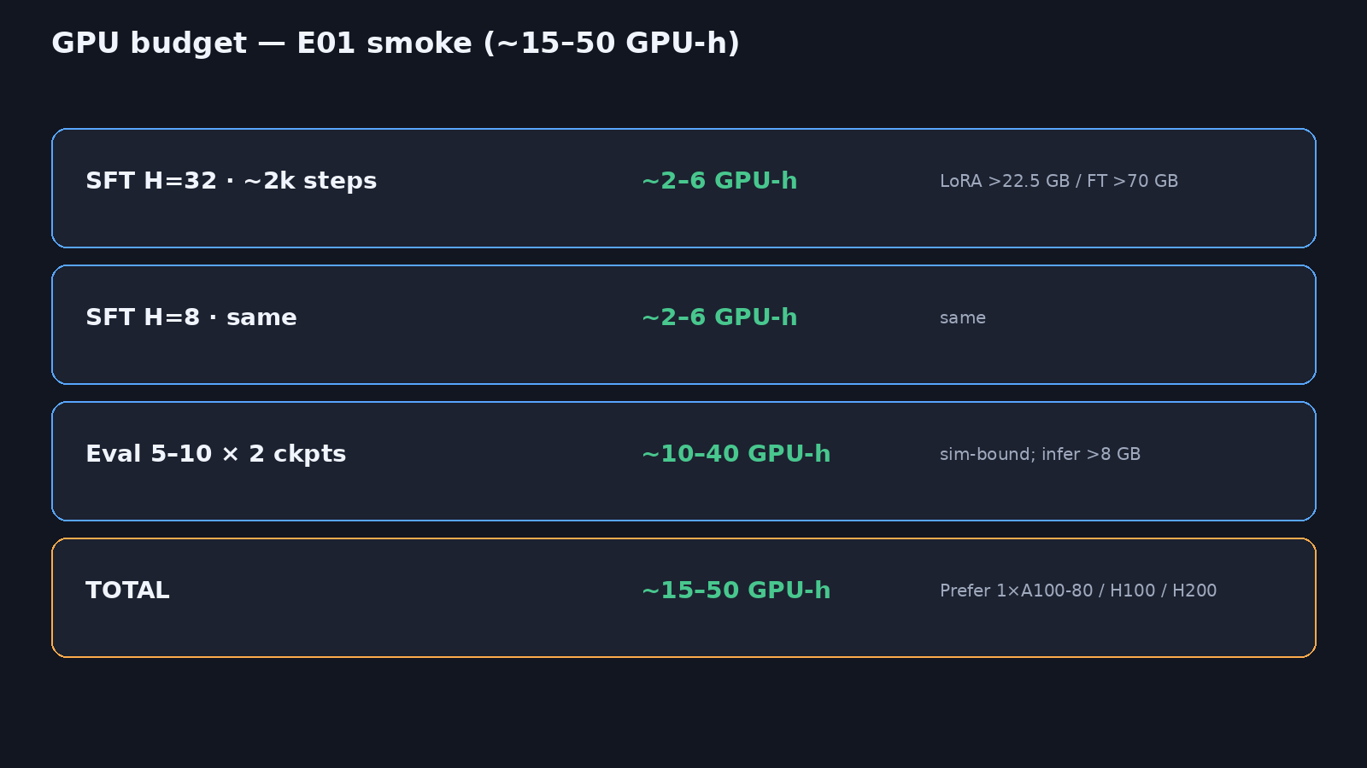
GPU budget
Notes:
Budget ~15–50 GPU-h total. SFT each ~2–6 GPU-h; eval sim-bound ~10–40.
LoRA >22.5 GB or full FT >70 GB — prefer 1×A100-80 / H100 / H200.
Paper full recipe (8×H200, 50k PT, 3×RFT) is orders of magnitude larger — do not promise parity.

Slide 7
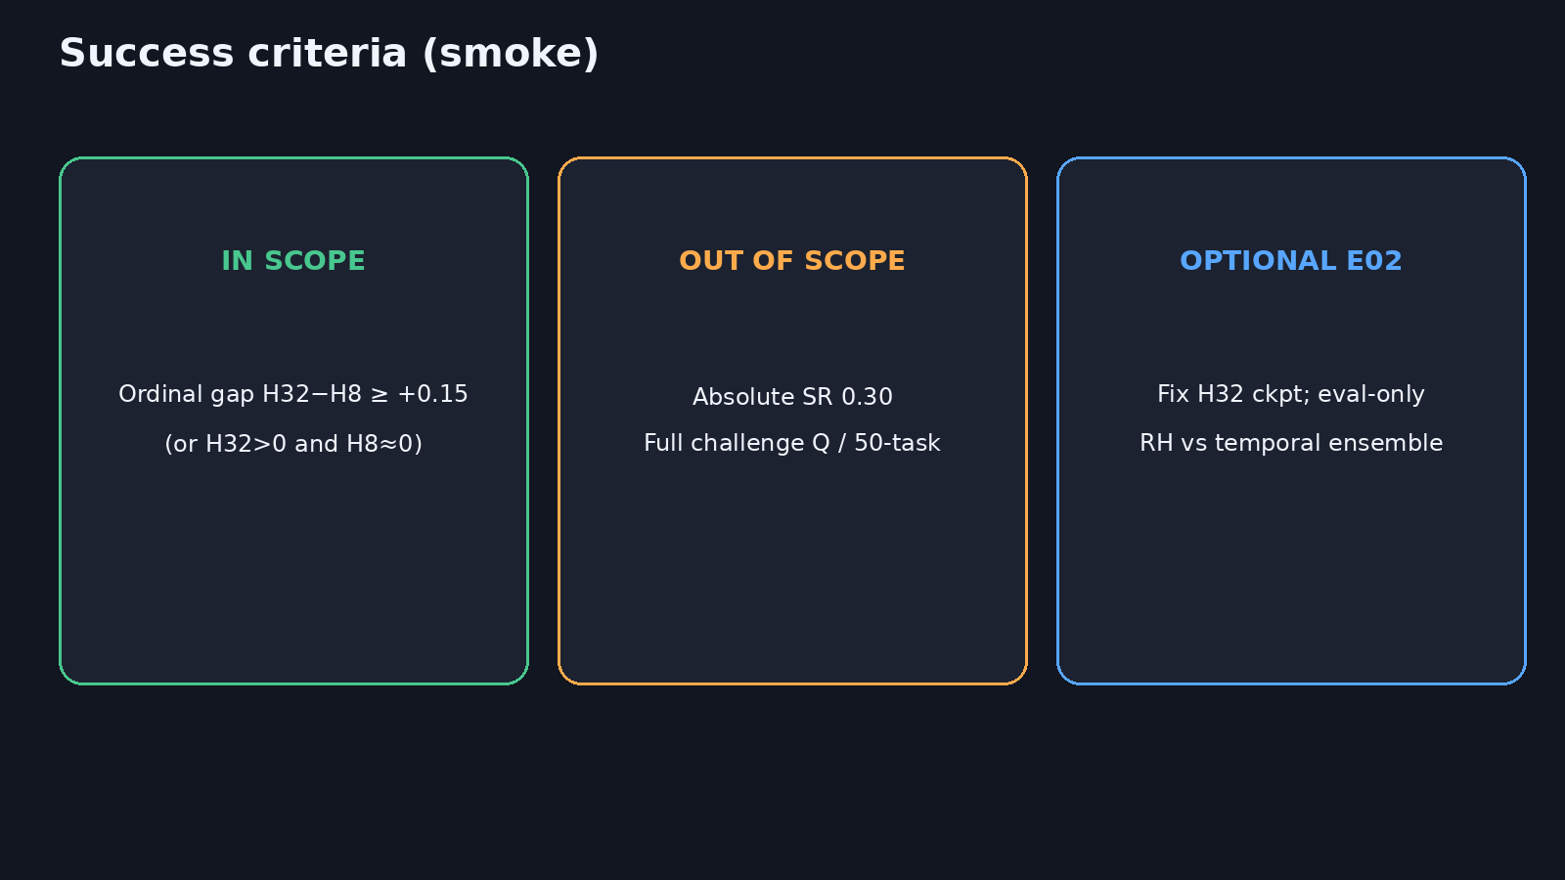
Success criteria
11+3
Notes:
SUCCESS: ordinal gap H32−H8 ≥ +0.15 (or H32>0, H8≈0). Absolute 0.30 / full Q OUT OF SCOPE for smoke.
OPTIONAL lighter alt E02: fix H32 ckpt; eval-only RH vs temporal ensemble.
Cite undertraining + fewer instances if absolute SR < 0.30.

Slide 8
Falsify the horizon claim on one easy task first — then scale.
Q&A · timing 11+3
Notes:
Q&A (~3). Point to env_outline/ sbatch scripts and DELIVERABLE E01 row.

