Slide 1
OpenPI Comet
Archaeologist
Prior lineage + subsequent releases
11+3 min
arXiv 2512.10071 · BEHAVIOR Challenge 2025 · smoke-run paper club
Notes:
Archaeologist: where Comet sits in the literature. Adaptation study, not new VLA arch.
No Stakeholder motivation redo.

Slide 2
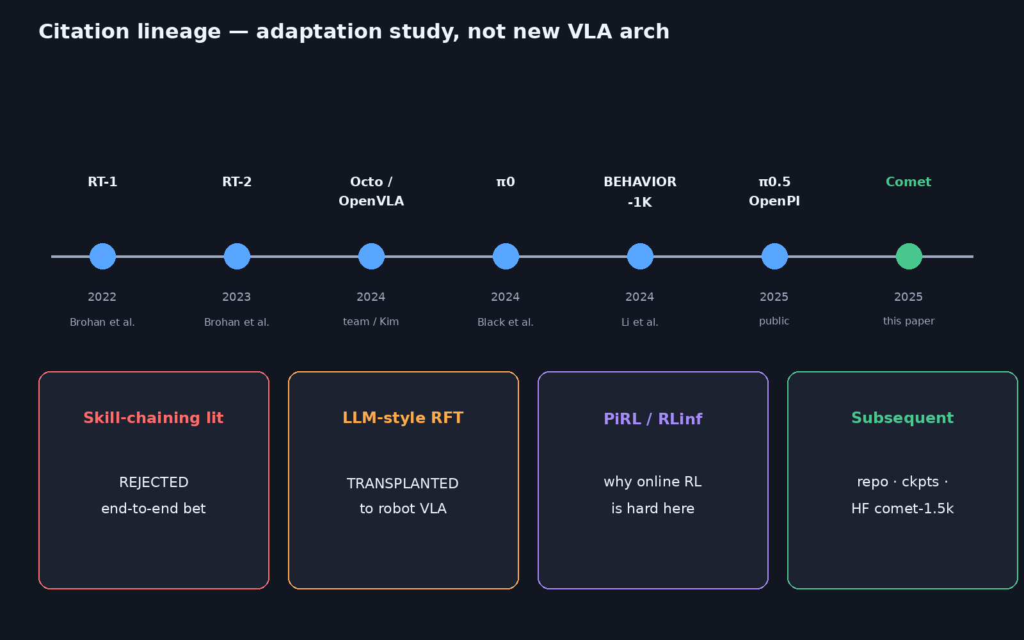
Citation timeline / lineage map
Notes:
PRIORS: π0 (Black et al.); RT-1/RT-2; Octo/OpenVLA; BEHAVIOR-1K (Li et al. 2024); skill-chaining lit (REJECTED — end-to-end bet); LLM-style RFT TRANSPLANTED; PiRL/RLinf (why online RL is hard here).
Walk the timeline left→right, then bottom boxes.

Slide 3
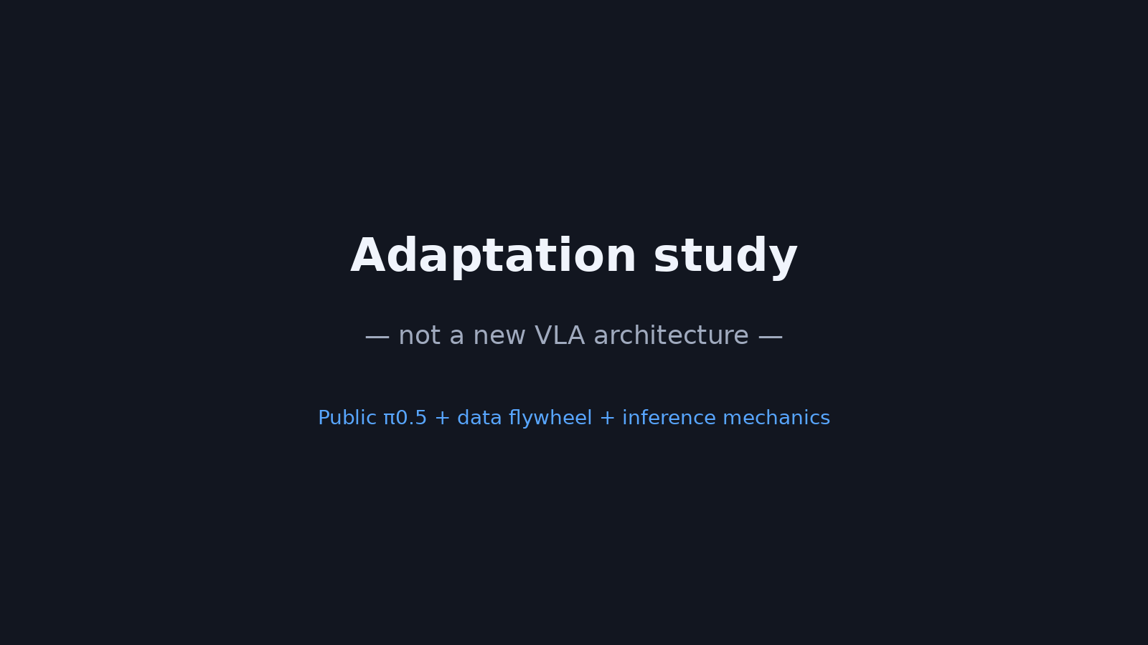
Adaptation study — not a new VLA arch
Notes:
LINEAGE claim: Adaptation study, not a new VLA architecture.
Public π0.5 + data flywheel + inference mechanics. Novelty is the BEHAVIOR competition recipe + ablations, not a new backbone.

Slide 4
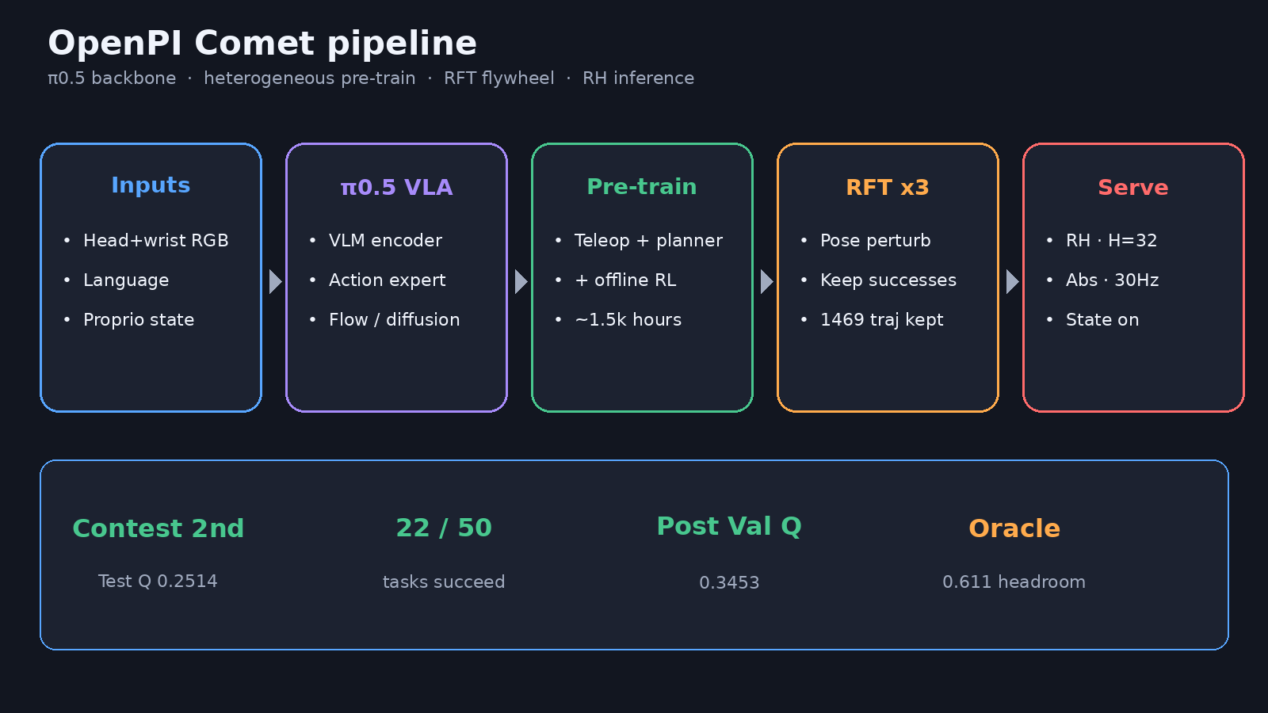
Skill-chaining rejected → RFT transplant
Notes:
Intro critiques subtask chaining / skill graphs as incompatible with end-to-end VLA training.
RFT transplanted from LLM/VLM rejection sampling literature (Ahn, Touvron, etc.).
Online RL (PiRL/RLinf context) rejected for sample inefficiency + heterogeneous GPU needs (sim RT vs train Tensor).

Slide 5
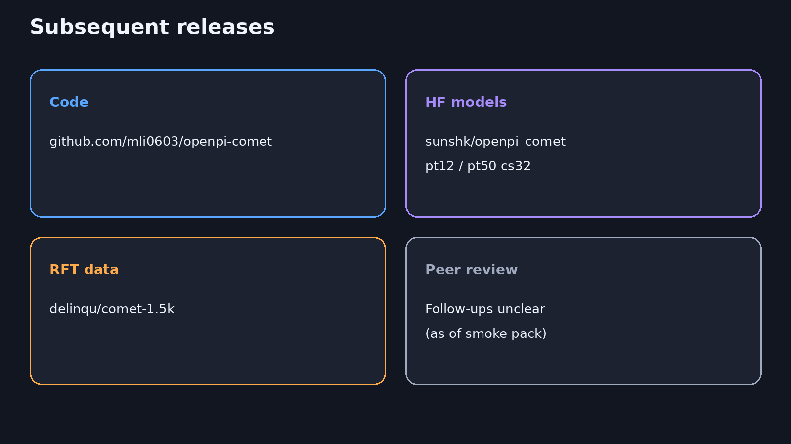
Subsequent releases
11+3
Notes:
SUBSEQUENT: Peer-reviewed follow-ups unclear; team released repo, post-challenge ckpts, HF RFT set (comet-1.5k).
Code: mli0603/openpi-comet · HF: sunshk/openpi_comet · RFT data: delinqu/comet-1.5k.
Released ckpts: pi05-b1kpt12-cs32, pi05-b1kpt50-cs32.

Slide 6
Comet is a competition adaptation paper with a reusable public stack.
Q&A · timing 11+3
Notes:
Q&A (~3). Emphasize lineage honesty over hype.

