Slide 1
OpenPI Comet
Visionary
2026 BEHAVIOR bridge + follow-ups
11+3 min
arXiv 2512.10071 · BEHAVIOR Challenge 2025 · smoke-run paper club
Notes:
Visionary: content only — no Discord/Drive logistics.
Gap story → 2026 edge → follow-up map → don't overclaim.

Slide 2
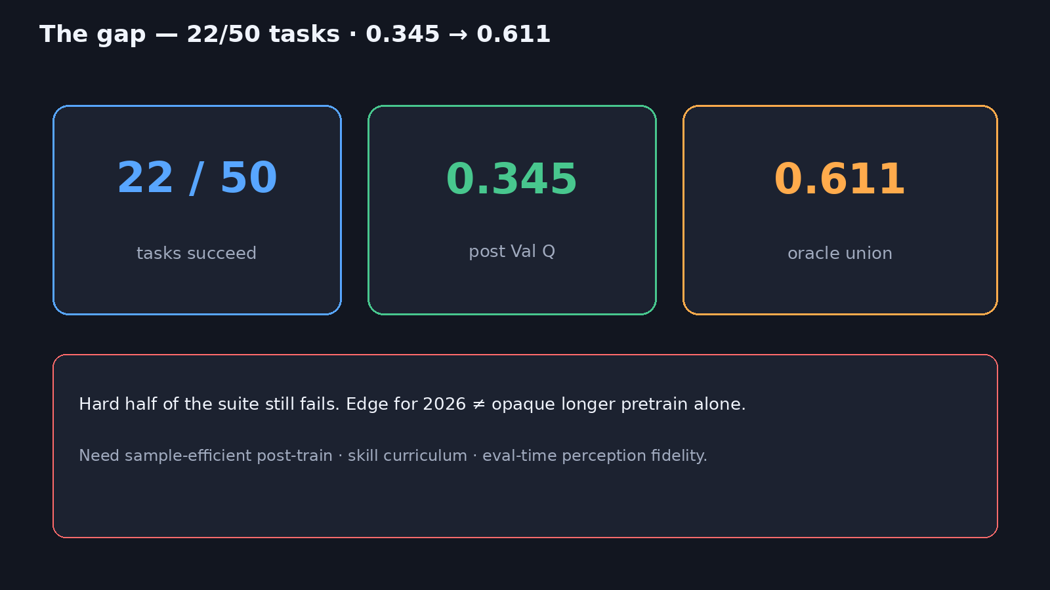
Gap story — 22/50 · 0.345 → 0.611
Notes:
OpenPI Comet shows foundation VLA + data flywheel + inference mechanics can take 2nd and push Val Q to 0.345, yet leave ~0.61 theoretical headroom and many zero-success long-horizon tasks.

Slide 3
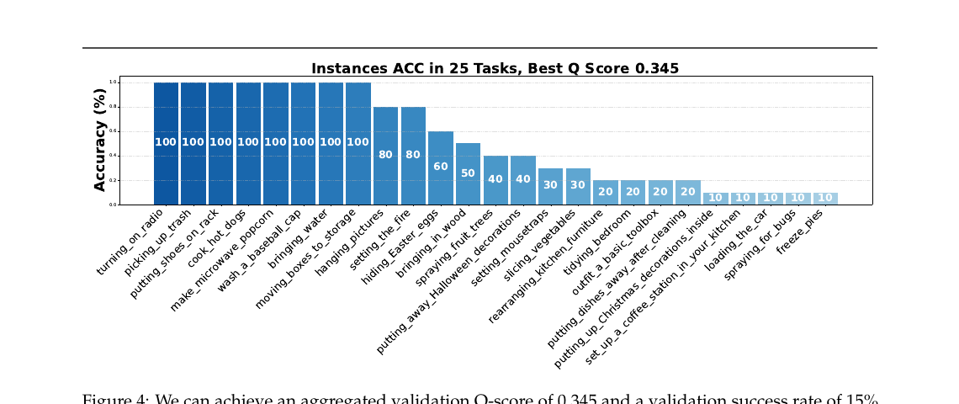
Per-task instance accuracy (Fig 4)
Notes:
Easy tasks near 100% instance ACC; long tail collapses. Aggregated Val Q 0.345, SR 15% across 50 (zeros hidden).
Visual of the hard half problem.

Slide 4
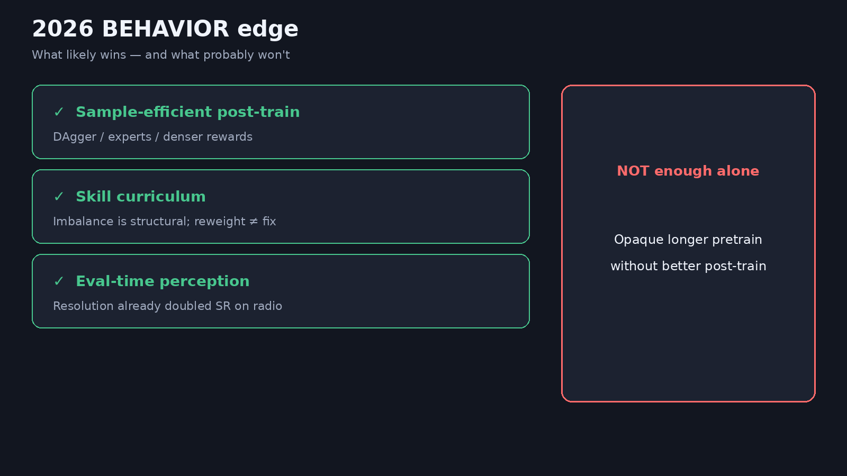
2026 edge
Notes:
→ 2026 BEHAVIOR: Edge = sample-efficient post-train (DAgger/experts/rewards), skill curriculum, eval-time perception fidelity — NOT opaque longer pretrain alone.
Authors themselves flag denser rewards / privileged experts in conclusion.

Slide 5
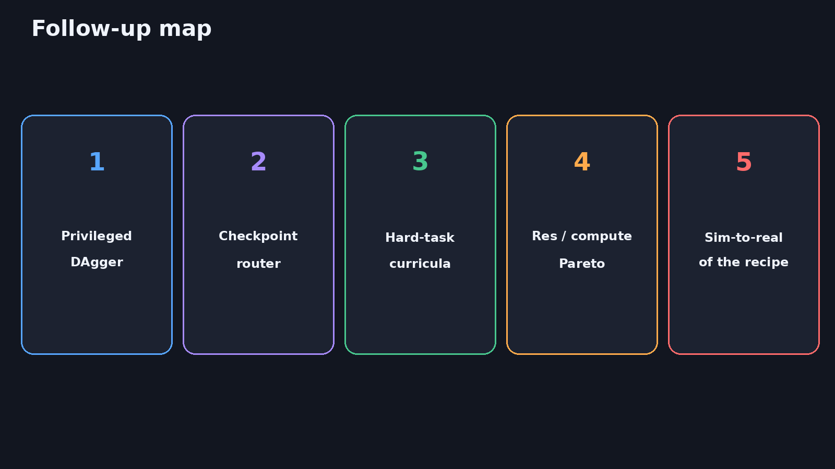
Follow-up map
Notes:
FOLLOW-UPS: Privileged DAgger; checkpoint router (oracle→deployable); hard-task curricula; resolution/compute Pareto; sim-to-real of the *recipe* (not just weights).
Empiricist smokes (horizon, control-mode) are the on-ramp.

Slide 6
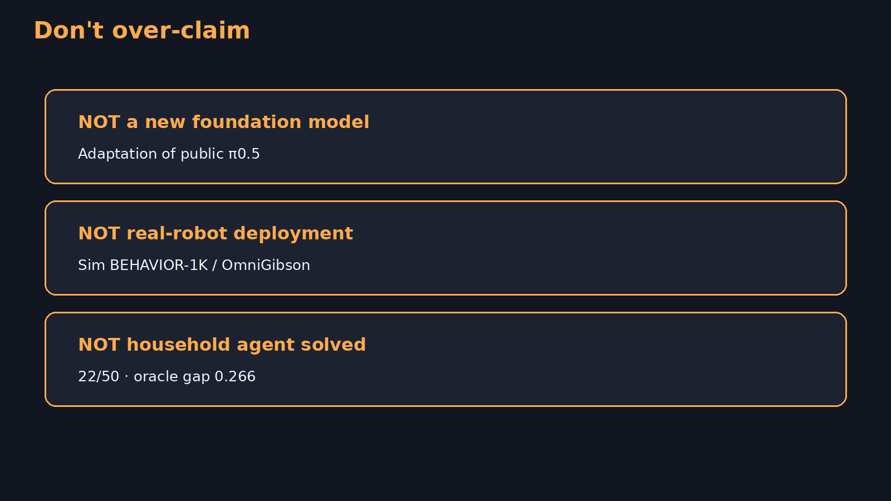
Don't over-claim
11+3
Notes:
DON'T OVER-CLAIM: Not a new foundation model; not real-robot deployment; household agent not solved.
Honest framing strengthens the 2026 research agenda.

Slide 7
Close 0.345→0.611 with better post-train — not just more pretrain.
Q&A · timing 11+3
Notes:
Q&A (~3). No logistics. Keep focus on research bridge.

