Slide 1
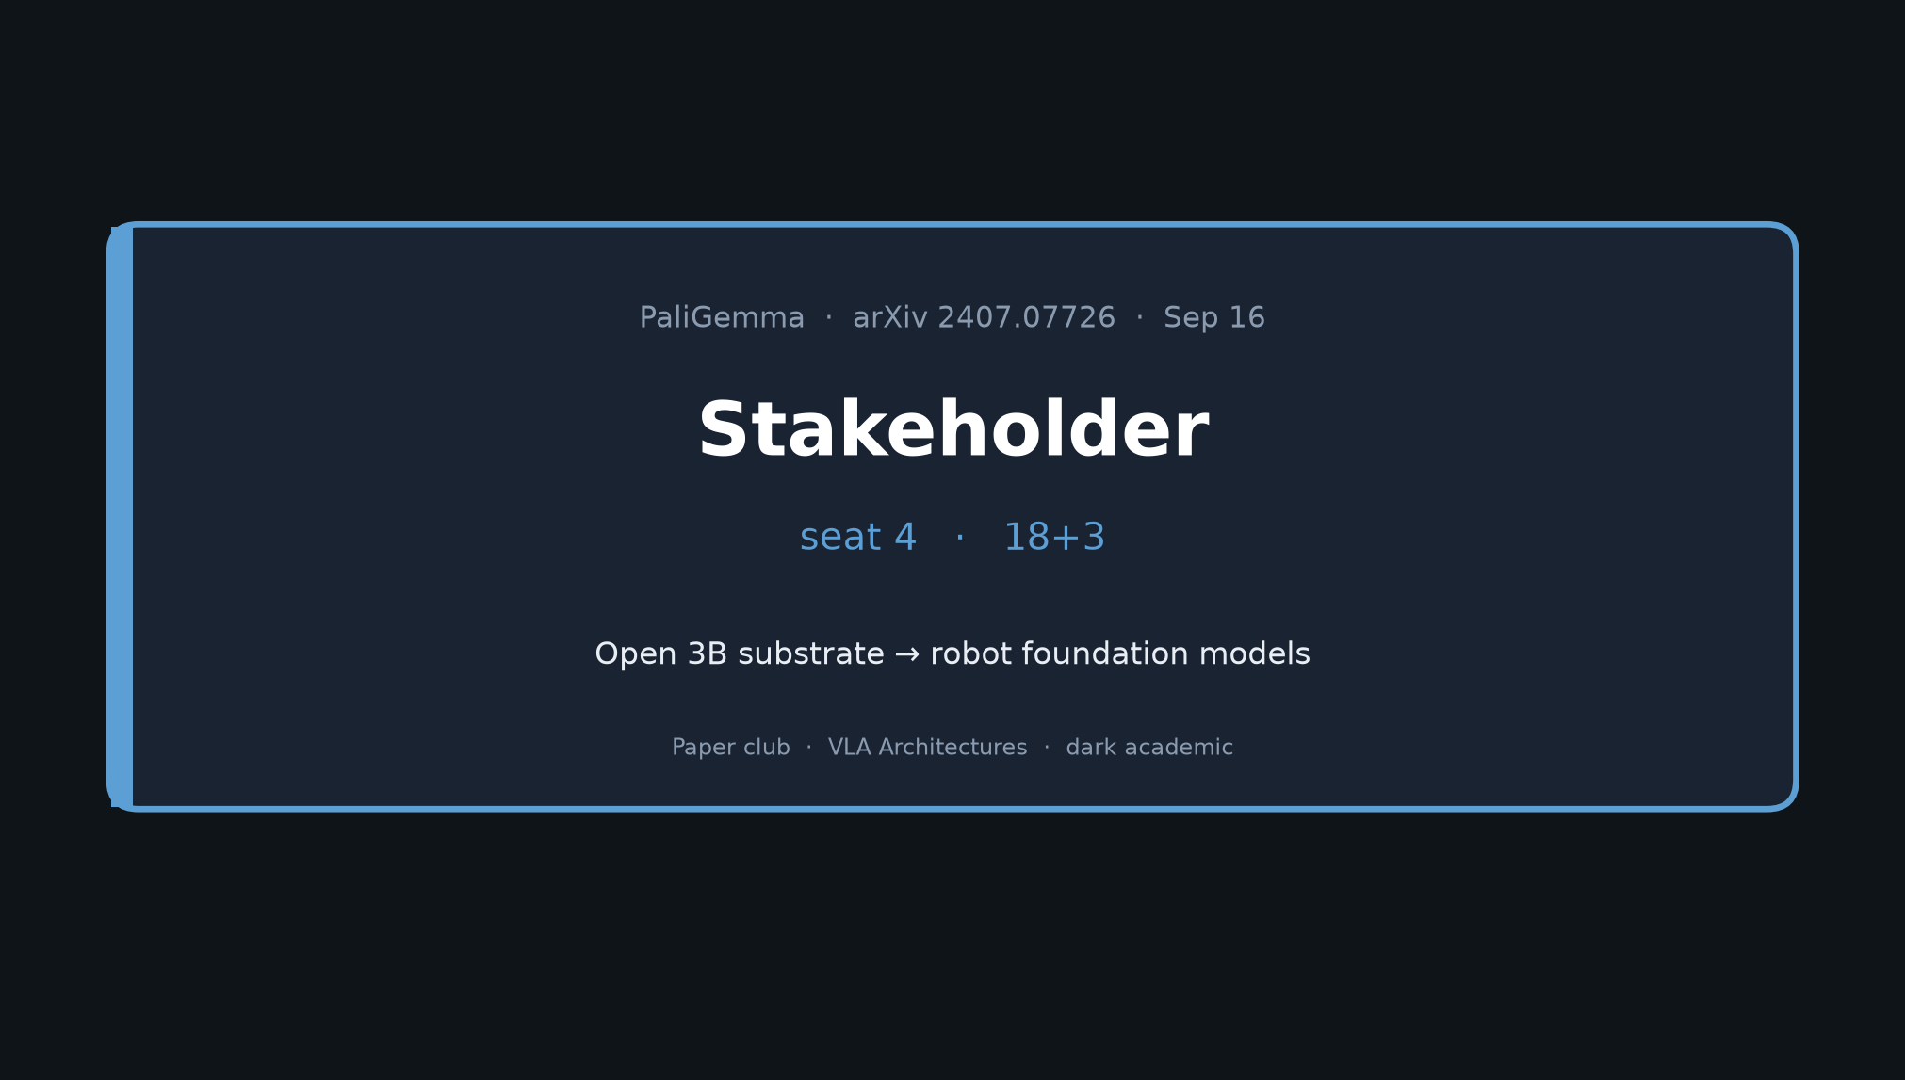
Stakeholder · 18+3 · 1/12
Notes:
STAKEHOLDER — seat 4 — 18+3
You set context for the room. Later roles do NOT redo this tour.
Arc: open 3B substrate → architecture/stages → headline transfers → club chain → risks → buy guidance.

Slide 2
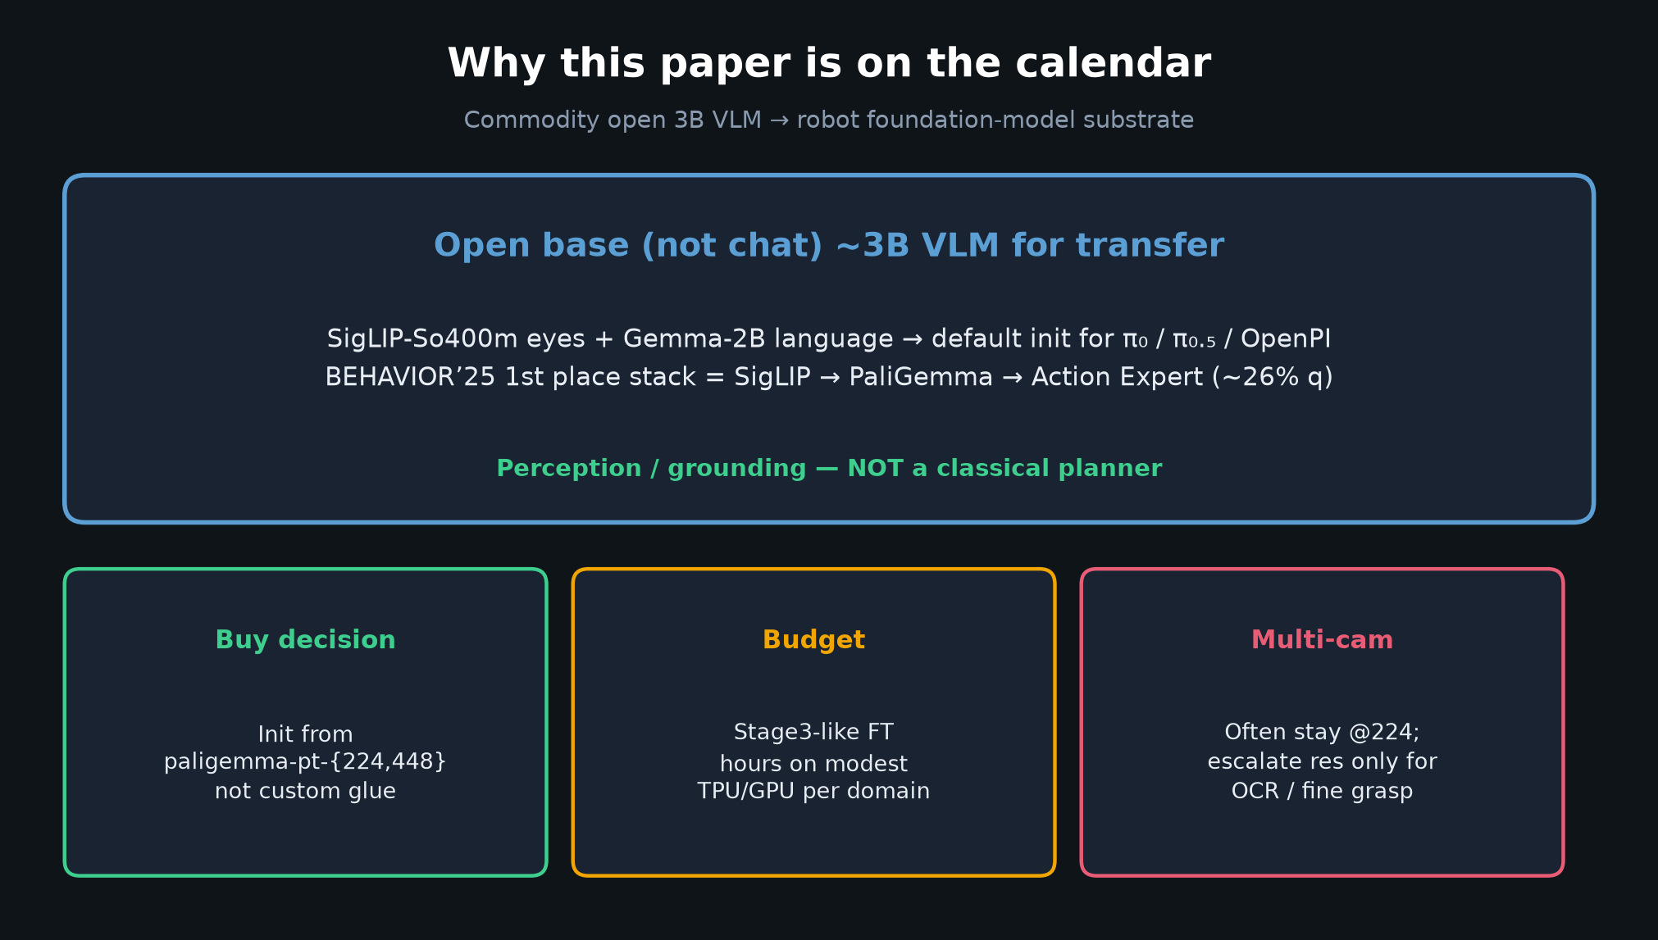
Stakeholder · 18+3 · 2/12
Notes:
WHY THIS PAPER
Commodity open 3B VLM for robot foundation models.
Default open substrate for π₀ / π₀.₅ / OpenPI; BEHAVIOR’25 1st = SigLIP → PaliGemma → Action Expert.
Buy: init from paligemma-pt-{224,448}; budget Stage3-like FT; multi-cam often @224.
Perception/grounding — NOT classical planner.

Slide 3
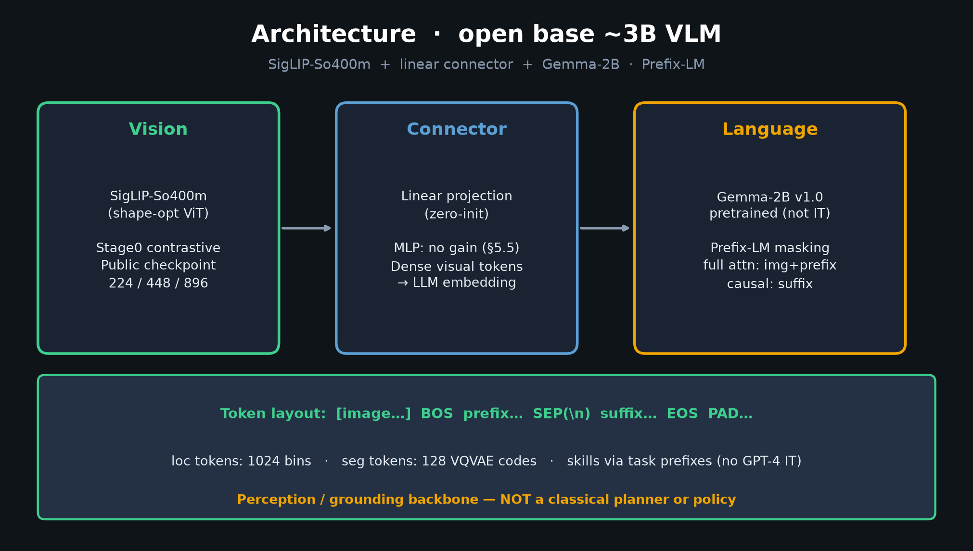
Stakeholder · 18+3 · 3/12
Notes:
ARCHITECTURE
SigLIP-So400m + linear connector + Gemma-2B.
Prefix-LM: full attention on image+prefix; causal on suffix.
Loc 1024 bins + seg 128 VQVAE tokens. Skills via task prefixes — no GPT-4 IT in pretrain.

Slide 4
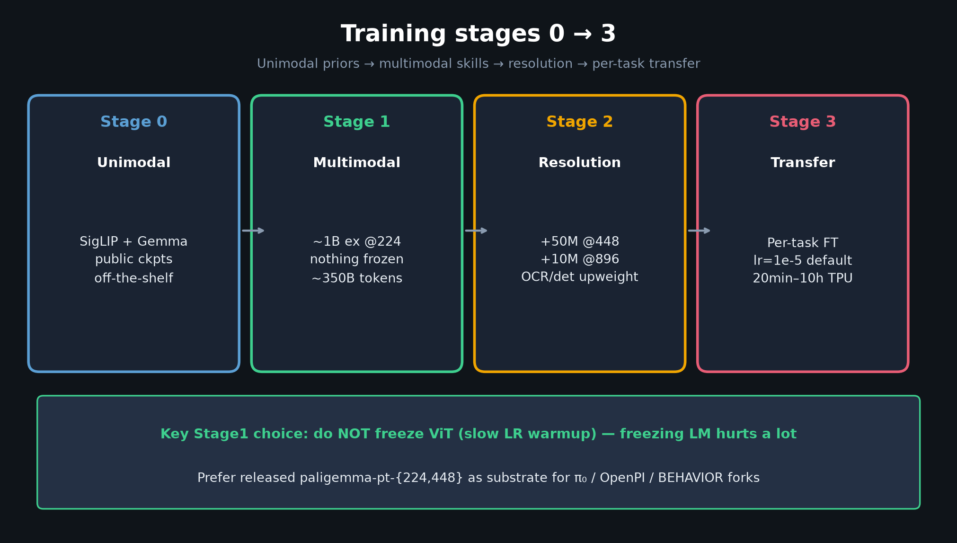
Stakeholder · 18+3 · 4/12
Notes:
STAGES 0–3
0 unimodal public ckpts → 1 multimodal ~1B@224 nothing frozen → 2 res uplift 448/896 → 3 per-task FT.
Key: do NOT freeze ViT in Stage1 (slow warmup). Prefer released pt checkpoints over custom glue.

Slide 5
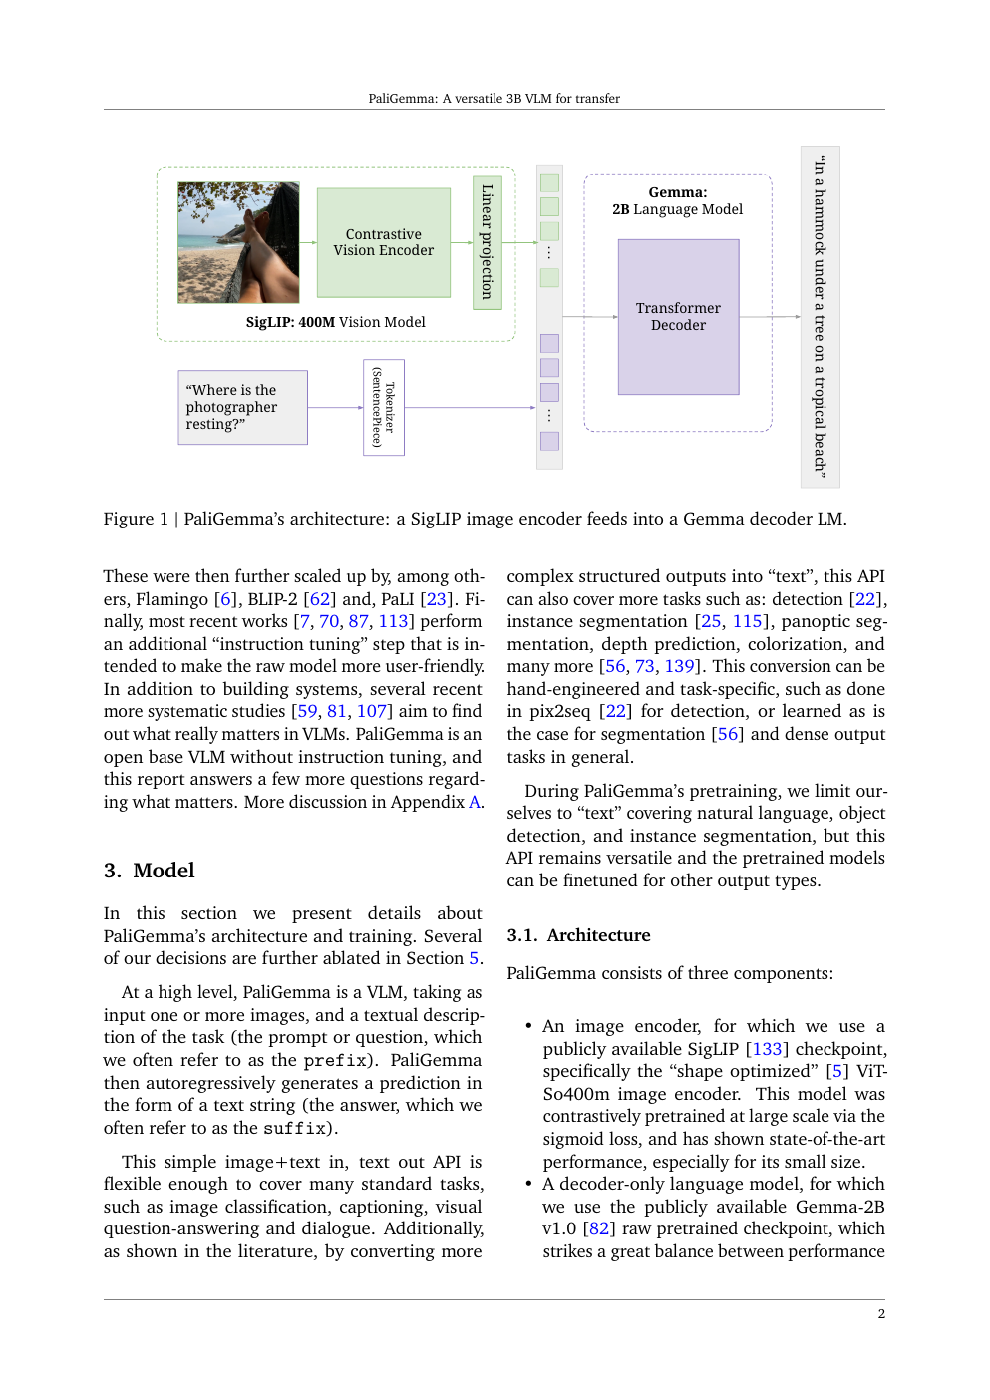
Paper architecture / method context
Stakeholder · 18+3 · 5/12
Notes:
PAPER ARTIFACT — opening pages
Show the real paper composition briefly; don’t linger — numbers next.

Slide 6
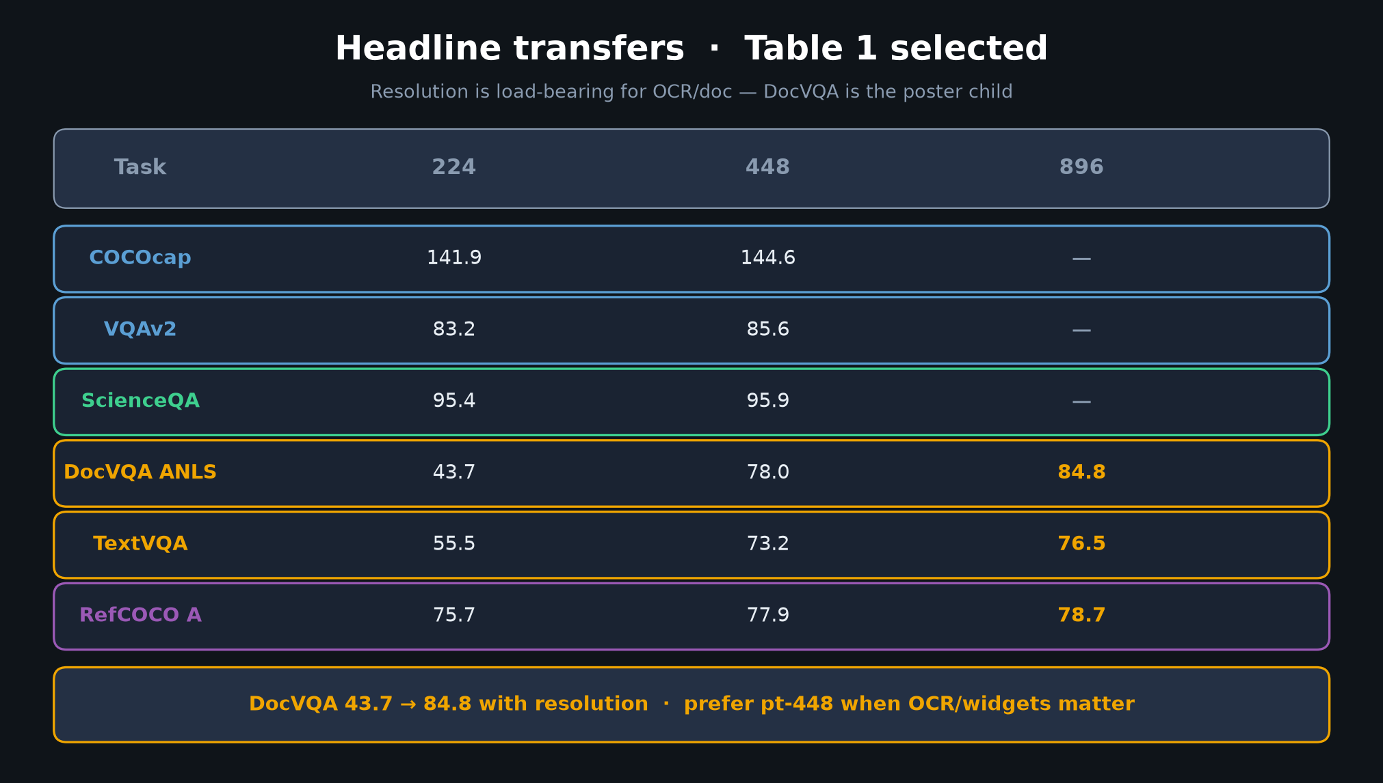
Stakeholder · 18+3 · 6/12
Notes:
HEADLINE TRANSFERS
DocVQA 43.7→84.8 is the poster child for resolution.
VQAv2 ~83–86; ScienceQA ~95%@224; COCOcap ~142–145.
Prefer 448 when OCR/widgets matter; 224 for multi-cam latency.

Slide 7
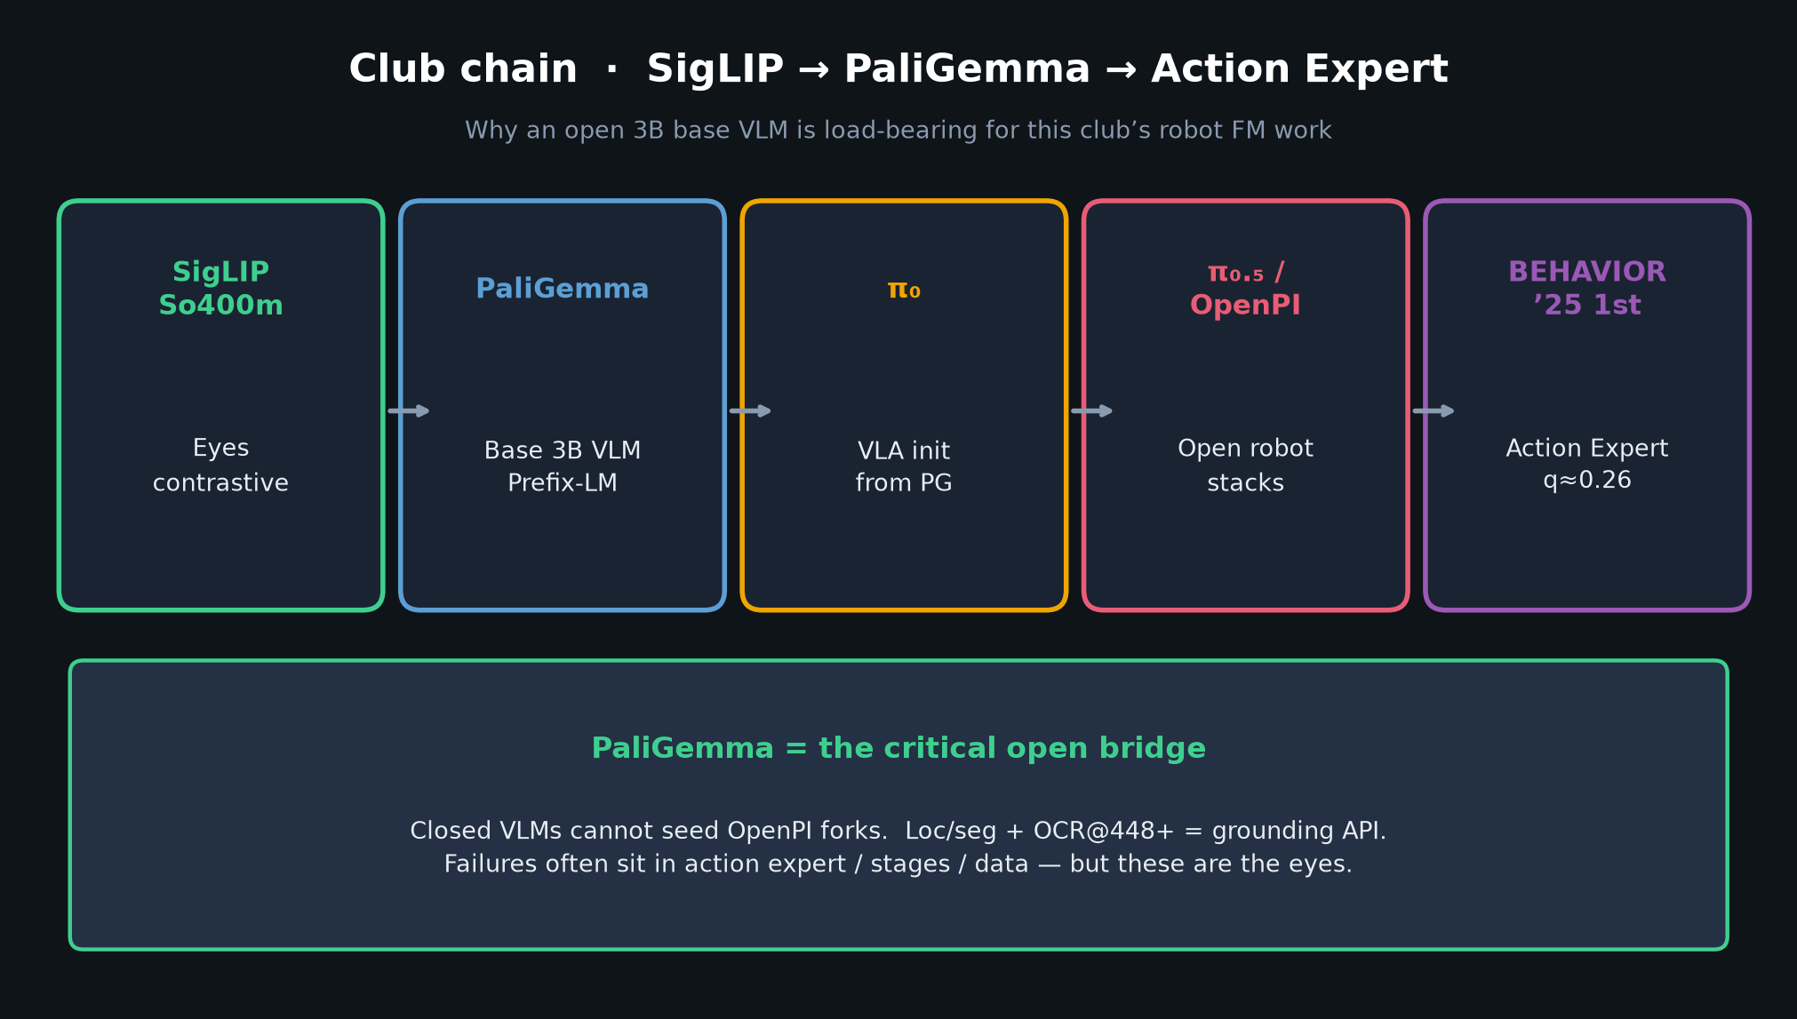
Stakeholder · 18+3 · 7/12
Notes:
CLUB CHAIN
SigLIP → PaliGemma → π₀ → π₀.₅/OpenPI → BEHAVIOR’25 Action Expert.
Closed VLMs cannot seed OpenPI. Open weights are load-bearing.
Failures often sit in action expert / stages / data — but these are the eyes+language.

Slide 8
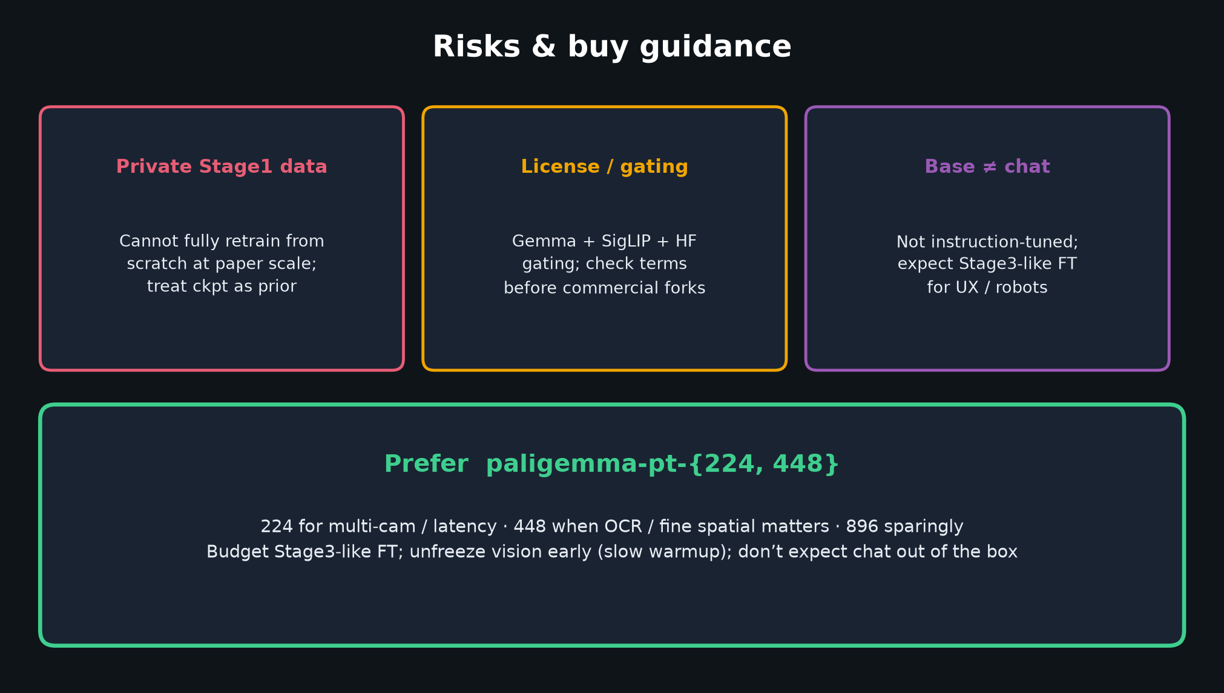
Stakeholder · 18+3 · 8/12
Notes:
RISKS
Private Stage1 data; license/gating (Gemma/SigLIP/HF); base ≠ chat.
Square crop may need robotics-specific image pipelines.

Slide 9
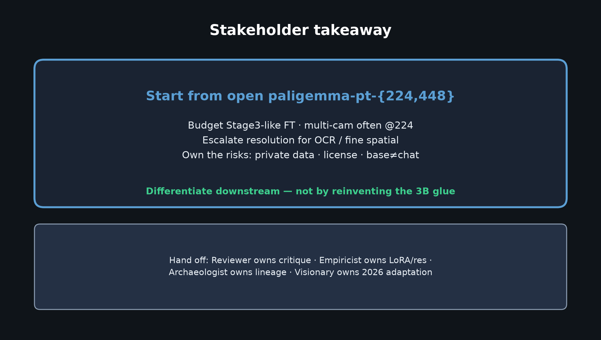
Stakeholder · 18+3 · 9/12
Notes:
BUY GUIDANCE (restate)
Prefer paligemma-pt-{224,448}.
Budget Stage3-like FT per embodiment.
Escalate resolution only when OCR / fine spatial demands it.

Slide 10
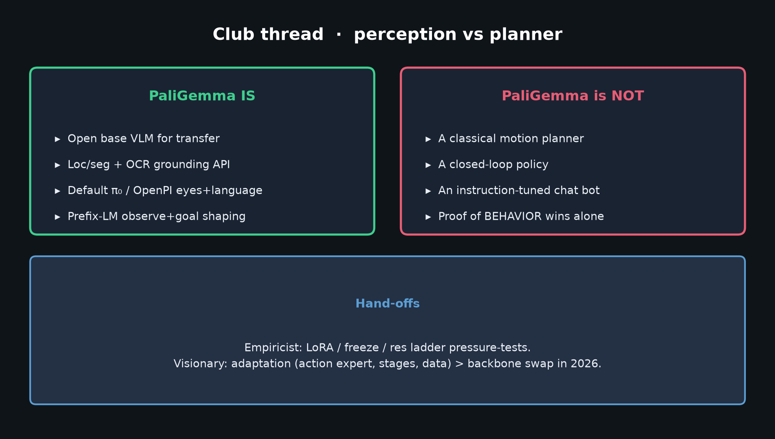
Stakeholder · 18+3 · 10/12
Notes:
VLA NOTE (30s)
Perception/grounding backbone (loc/seg, OCR@448+), not a policy.
Prefix-LM fits observe+goal→action shaping; don’t freeze vision early.
Hand deep critique to Reviewer; LoRA plan to Empiricist; lineage to Archaeologist; 2026 to Visionary.

Slide 11
Stakeholder · 18+3 · 11/12
Notes:
OPTIONAL — stages figure again if room asks compute
TPUv5e-256 <3 days Stage1; Stage3 20min–10h on TPUv3-32. GPU story = Empiricist.

Slide 12
Stakeholder close
Start from paligemma-pt-{224,448} · own the risks · hand off deep dives
Stakeholder · 18+3 · 12/12
Notes:
STAKEHOLDER CLOSE / Q&A
Restate: open pt-{224,448} substrate; club chain; risks owned.
Invite Q on buy decision / multi-cam res — then hand off. Do not steal later roles.

