Slide 1
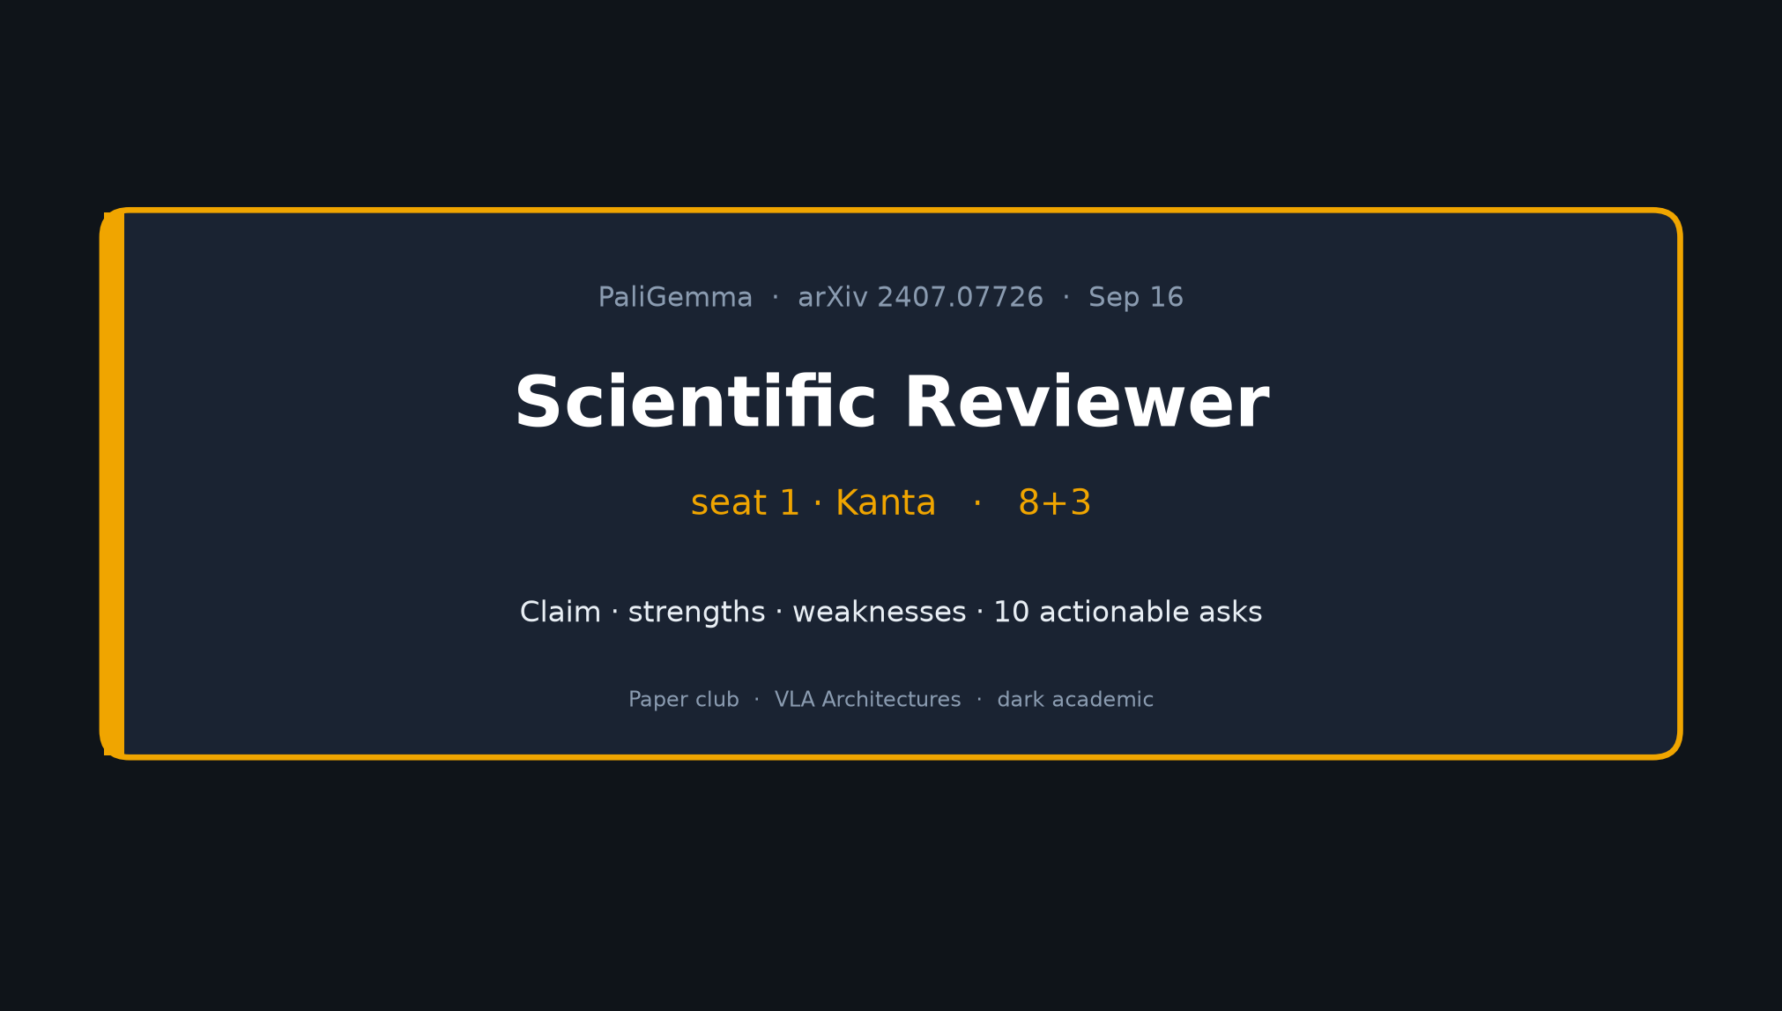
Scientific Reviewer · 8+3 · 1/9
Notes:
SCIENTIFIC REVIEWER OPENING — seat 1 = Kanta — 8 min + 3 Q&A
You OWN critique. No Stakeholder motivation tour. No lineage tour.
Tonight's arc (tight):
1) Claim under review
2) Strengths (base vs IT; PaLI scaling; deep ablations; contamination; loc/seg; systems)
3) Weaknesses (private Stage1; Table1 self-vs-res; macro-avg; Stage3≠robotics; square resize; TPU-centric)
4) TEN actionable asks — THE talk figure — say them aloud
5) Score intuition close
Spine: open base 3B VLM (SigLIP-So400m + Gemma-2B) as π₀/OpenPI/BEHAVIOR substrate.
Perception/grounding — NOT classical planner.
Pace: ~45–60s claim · ~90s strengths · ~90s weaknesses · ~2.5–3 min on the 10 asks · ~60s score · Q&A.

Slide 2
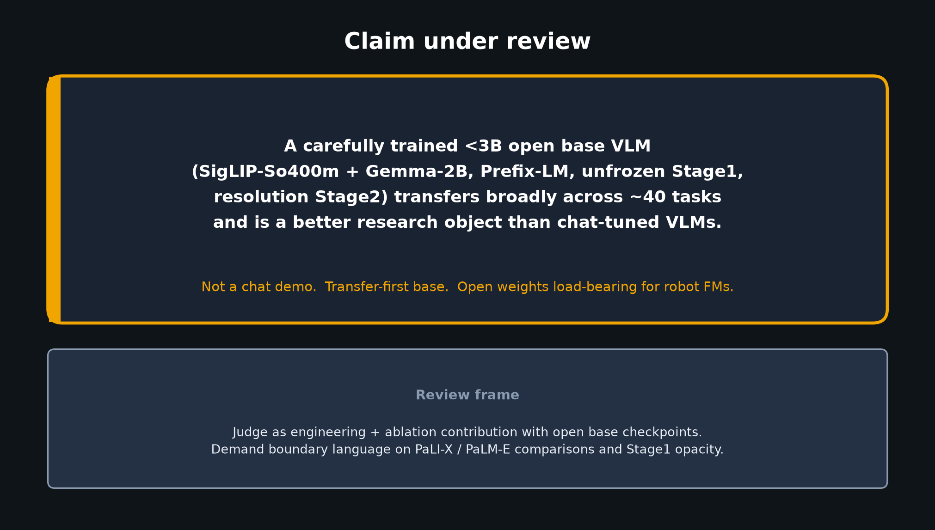
Scientific Reviewer · 8+3 · 2/9
Notes:
CLAIM UNDER REVIEW — read slowly, then pause
“A carefully trained <3B open *base* VLM (SigLIP-So400m + Gemma-2B, Prefix-LM, unfrozen Stage1, resolution Stage2) transfers broadly across ~40 tasks and is a better research object than chat-tuned VLMs.”
Emphasize BASE not chat. Emphasize RESEARCH OBJECT.
Do not over-claim robotics utility from Table 1 alone — that is later roles / outside paper.
Review frame: engineering + ablation contribution with open checkpoints. Demand boundary language on PaLI-X/PaLM-E comparisons and Stage1 opacity.

Slide 3
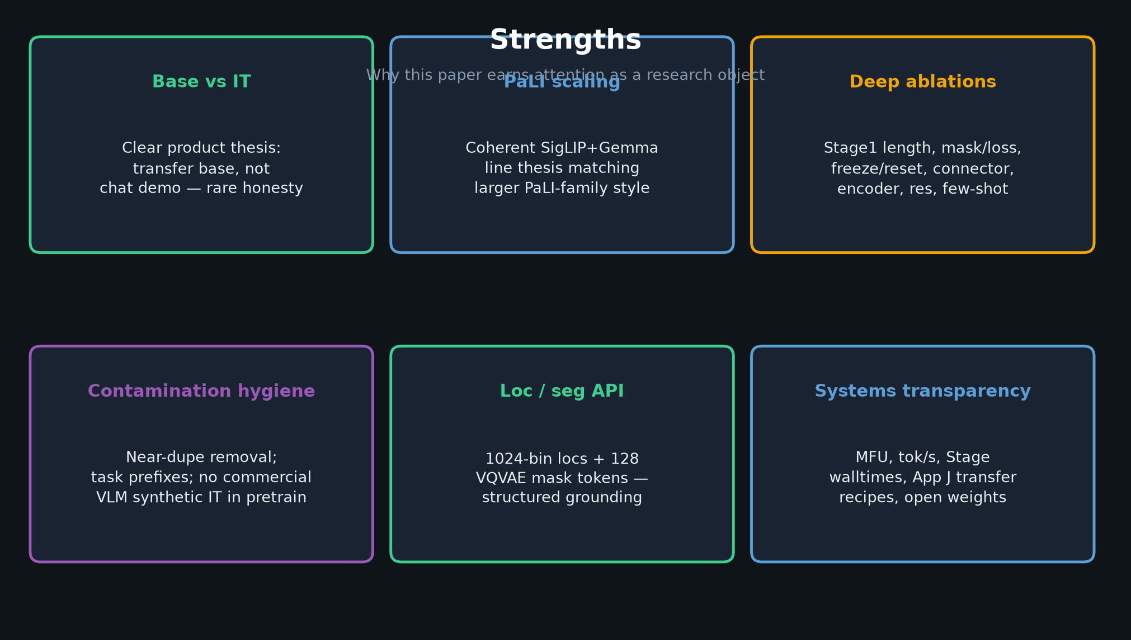
Scientific Reviewer · 8+3 · 3/9
Notes:
STRENGTHS — walk the six cards (~90s)
1. Base vs IT — rare honesty vs LLaVA-style IT narratives.
2. PaLI scaling — coherent SigLIP+Gemma line thesis.
3. Deep ablations — Stage1 length, mask/loss, freeze/reset, connector, encoder, resolution, few-shot. Genuinely useful.
4. Contamination hygiene — near-dupe removal; task prefixes; no commercial VLM synthetic IT in pretrain.
5. Loc/seg API — 1024-bin locs + 128 VQVAE mask tokens; structured grounding.
6. Systems transparency — MFU, tok/s, walltimes, App J recipes, open weights.
Say: this is why lean-accept as an engineering/ablation paper is fair.

Slide 4
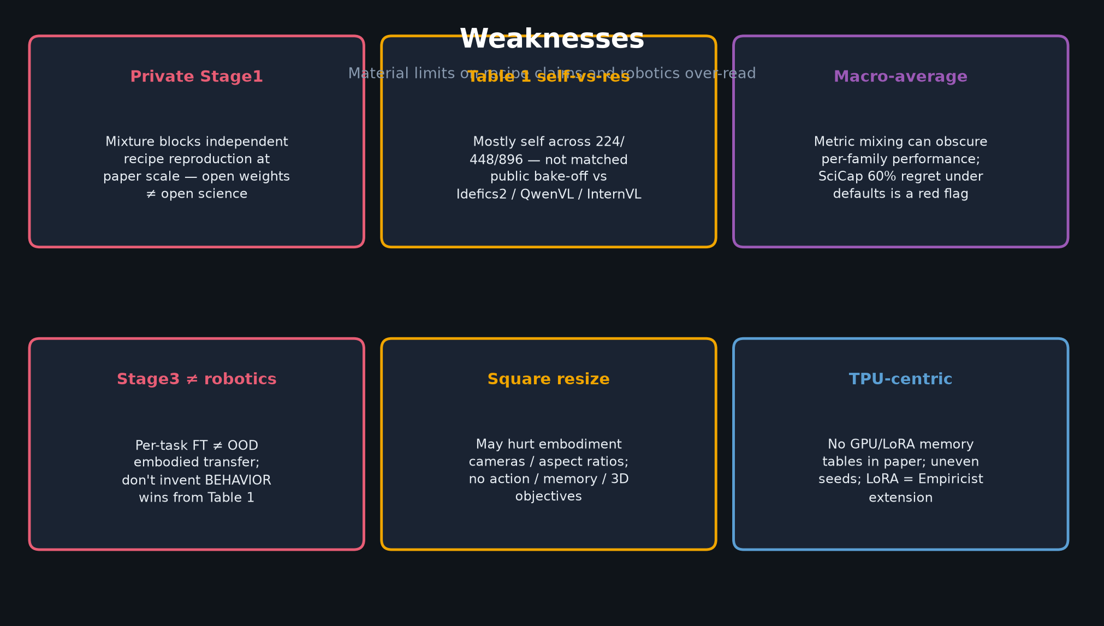
Scientific Reviewer · 8+3 · 4/9
Notes:
WEAKNESSES — walk the six cards (~90s). Be crisp, not mean.
1. Private Stage1 mixture — open weights ≠ open science for recipe claims at paper scale.
2. Table 1 mostly self-vs-resolution — not matched public bake-off (Idefics2 / QwenVL / InternVL) under same transfer recipe.
3. Macro-average / metric mixing — SciCap 60% regret under defaults is a red flag for “unified recipe.”
4. Stage3 ≠ OOD robotics transfer — do NOT invent BEHAVIOR wins from Table 1.
5. Square resize — may hurt embodiment cameras; no action / memory / 3D objectives.
6. TPU-centric — no GPU/LoRA memory tables; LoRA is Empiricist extension.
These weaknesses MOTIVATE the 10 asks on the next slide.

Slide 5
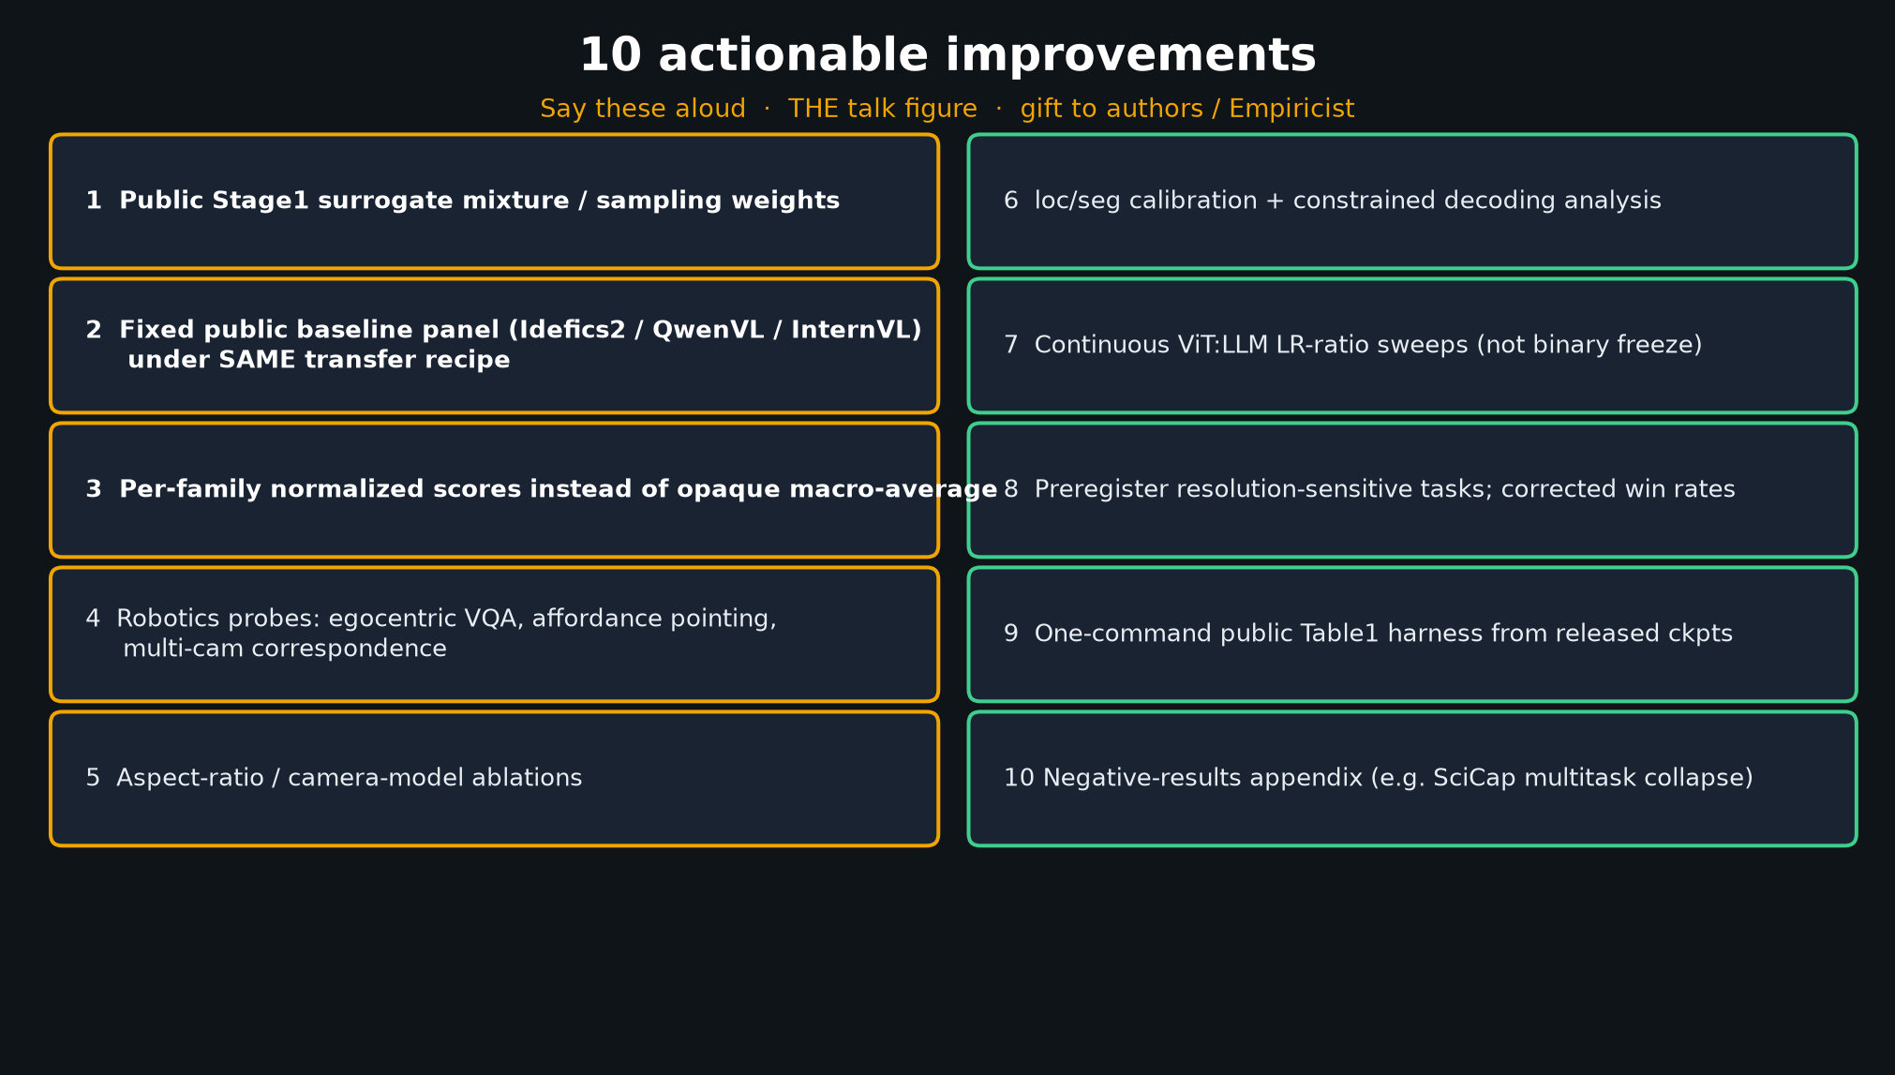
Scientific Reviewer · 8+3 · 5/9
Notes:
TEN ACTIONABLE IMPROVEMENTS — THE TALK FIGURE — say these aloud (~2.5–3 min)
This is your gift to authors and to Empiricist. Numbered. Deliver 1–3 slowly; 4–10 can be slightly faster but still clear.
1. Public Stage1 surrogate mixture / sampling weights
2. Fixed public baseline panel (Idefics2 / QwenVL / InternVL) under SAME transfer recipe
3. Per-family normalized scores instead of opaque macro-average
4. Robotics probes: egocentric VQA, affordance pointing, multi-cam correspondence
5. Aspect-ratio / camera-model ablations
6. loc/seg calibration + constrained decoding analysis
7. Continuous ViT:LLM LR-ratio sweeps (not binary freeze)
8. Preregister resolution-sensitive tasks; corrected win rates
9. One-command public Table1 harness from released ckpts
10. Negative-results appendix (e.g. SciCap multitask collapse)
If time is short: nail 1, 2, 4, 9, 10 aloud and gesture at the rest.

Slide 6
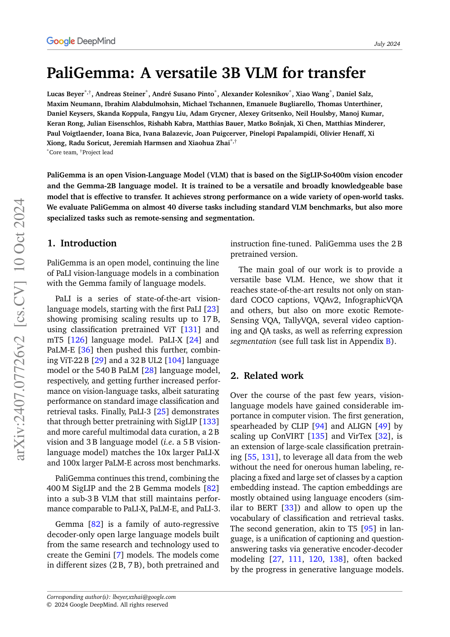
Paper cover / Fig. 1 context — open base 3B composition
Scientific Reviewer · 8+3 · 6/9
Notes:
PAPER ARTIFACT — architecture / opening figure (cite, don’t re-derive)
Point at SigLIP + connector + Gemma composition. Prefix-LM. Loc/seg tokens.
Use this as evidence that the *architecture* is clear even when Stage1 data is not.
Hand spatial/OCR numbers to Empiricist; hand lineage to Archaeologist.

Slide 7
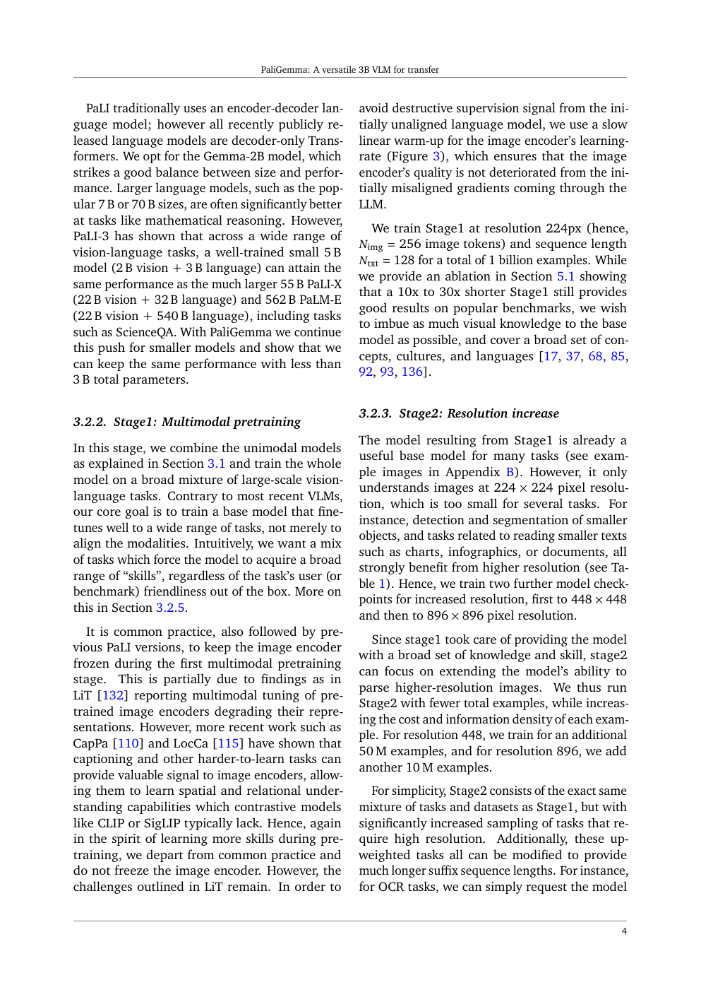
Paper Table 1 region — self-vs-resolution duality
Scientific Reviewer · 8+3 · 7/9
Notes:
OPTIONAL EVIDENCE — Table 1 page if room asks “where are the numbers?”
Self-vs-resolution is BOTH a strength (honest resolution story: DocVQA 43.7→84.8)
AND a weakness (not a matched public bake-off). Name that duality aloud.

Slide 8
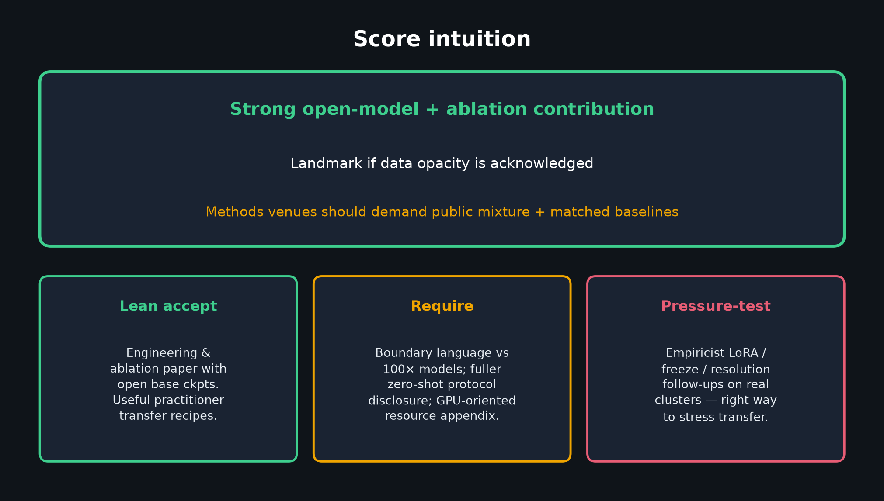
Scientific Reviewer · 8+3 · 8/9
Notes:
SCORE INTUITION — deliver slowly
Strong open-model + ablation contribution.
Landmark *if* data opacity is acknowledged.
Methods venues should demand public mixture + matched baselines.
Lean accept as engineering & ablation paper with open base checkpoints.
Require: boundary language vs 100× models; fuller zero-shot protocol disclosure; GPU resource appendix.
Pressure-test via Empiricist LoRA/freeze/resolution on real clusters.
Internal stance from DELIVERABLE §7.4 — you can soft-state lean accept without pretending journal finality.

Slide 9
Reviewer close
Base claim real · Stage1 opacity real · 10 asks are the gift
Scientific Reviewer · 8+3 · 9/9
Notes:
REVIEWER CLOSE / Q&A (3 min)
Restate: base-not-chat claim is credible; Stage1 opacity + Table1 hygiene are the load-bearing critiques; the 10 asks are the contribution of this talk.
Invite Q on: private mixture; matched baselines; whether robotics probes belong in a VLM transfer paper.
Do NOT redo Stakeholder takeaways. Do NOT steal Empiricist experiment plan — point them at asks 4–7.
Hand off.

