Slide 1
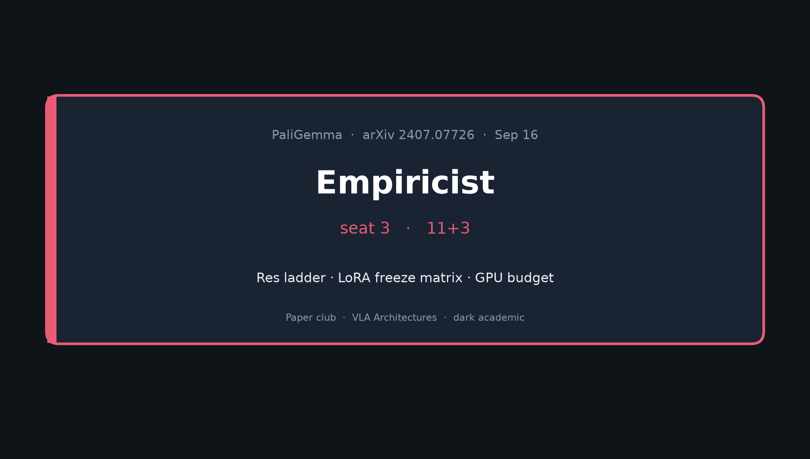
Empiricist · 11+3 · 1/10
Notes:
EMPIRICIST — seat 3 — 11+3
NO Stakeholder redo. Dive into H1/H2/H3 → res ladder → LoRA matrix → GPU budget → P0 E1–E3.
LoRA is an EXTENSION — paper is TPU full-FT; say that honesty aloud.

Slide 2
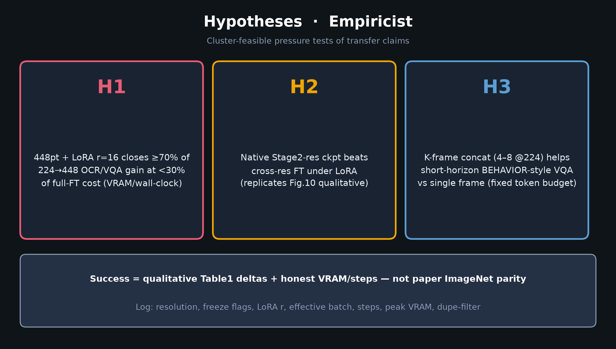
Empiricist · 11+3 · 2/10
Notes:
HYPOTHESES — read slowly
H1: 448pt + LoRA r=16 closes ≥70% of 224→448 OCR/VQA gain at <30% full-FT cost
H2: Native Stage2-res ckpt beats cross-res FT under LoRA
H3: K-frame concat (4–8 @224) helps short-horizon BEHAVIOR-style VQA vs single frame
Success = qualitative Table1 deltas + honest VRAM/steps — not paper parity.

Slide 3
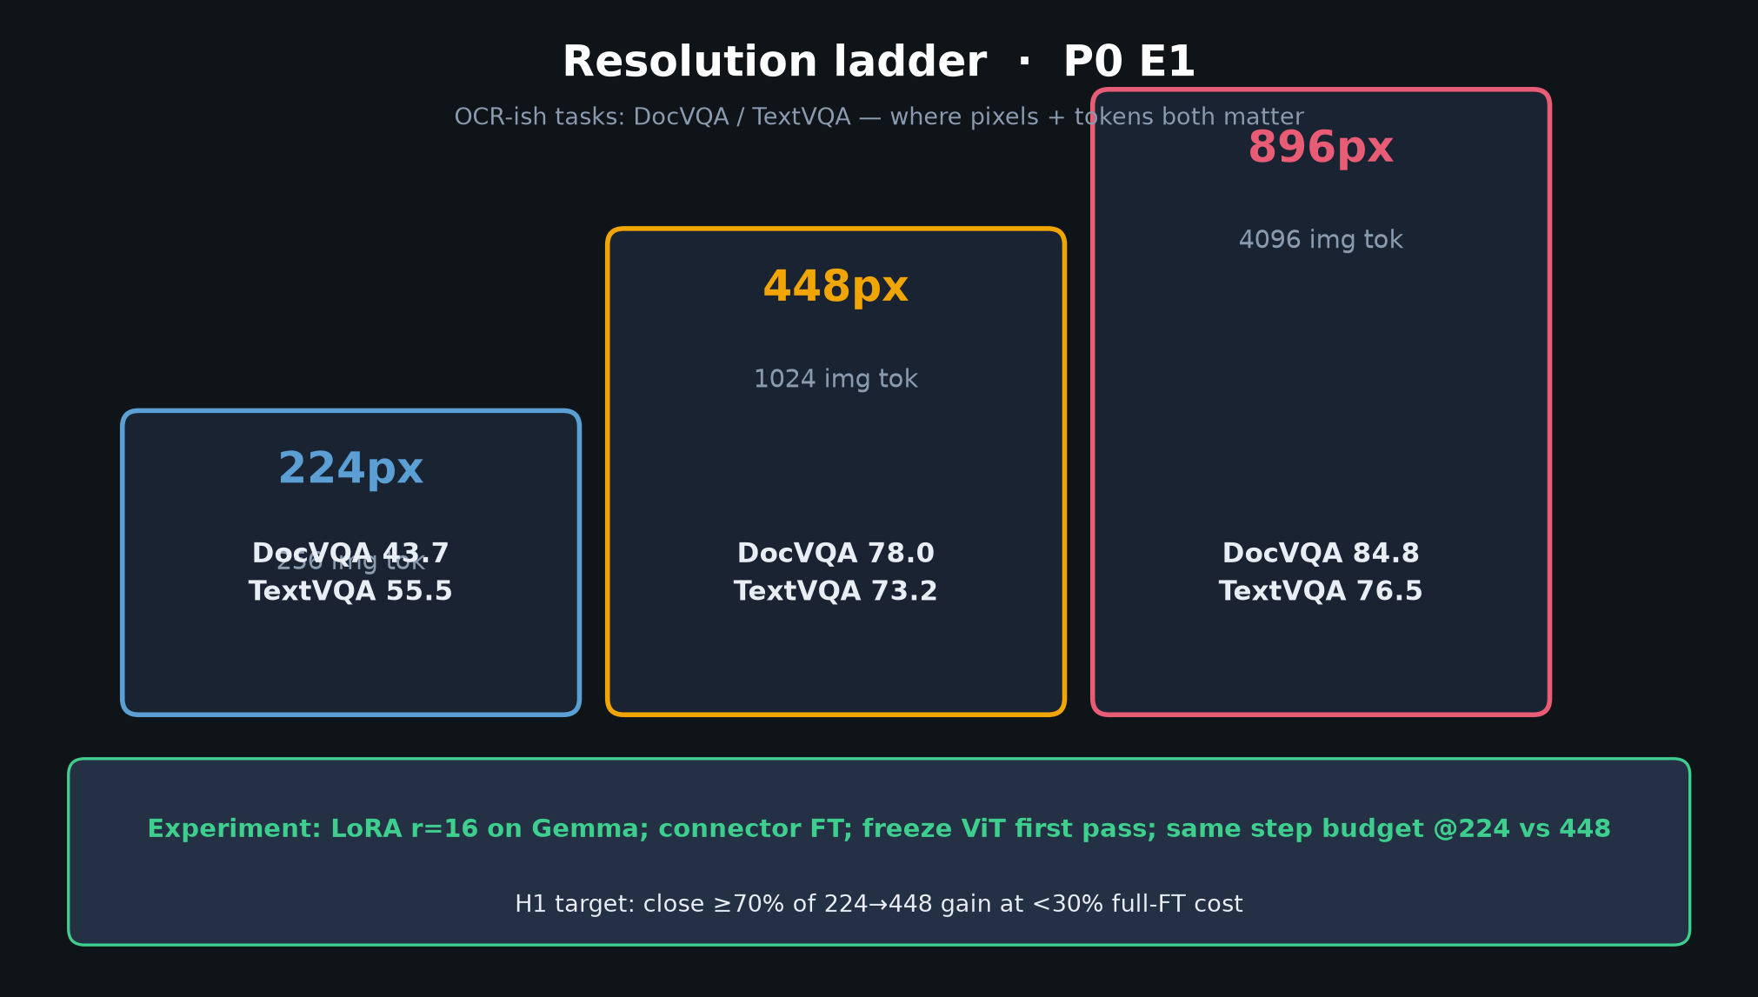
Empiricist · 11+3 · 3/10
Notes:
RESOLUTION LADDER — P0 E1 — core visual
DocVQA 43.7 / 78.0 / 84.8; TextVQA 55.5 / 73.2 / 76.5.
Recipe: LoRA r=16 Gemma; connector FT; freeze ViT first pass; same step budget.
H1 target: ≥70% of gain at <30% cost.

Slide 4
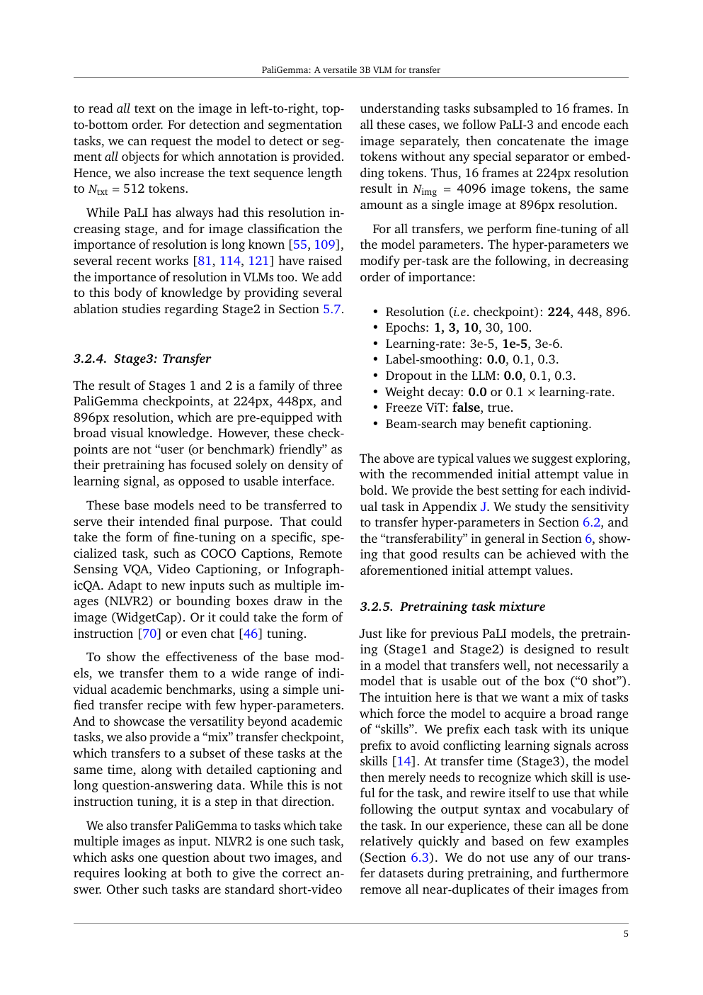
Paper context — resolution / transfer evidence
Empiricist · 11+3 · 4/10
Notes:
PAPER ARTIFACT — resolution / Table region
Cite paper numbers; don’t re-digitize curves. Native Stage2 > cross-res > windowing (Fig 10 story).

Slide 5
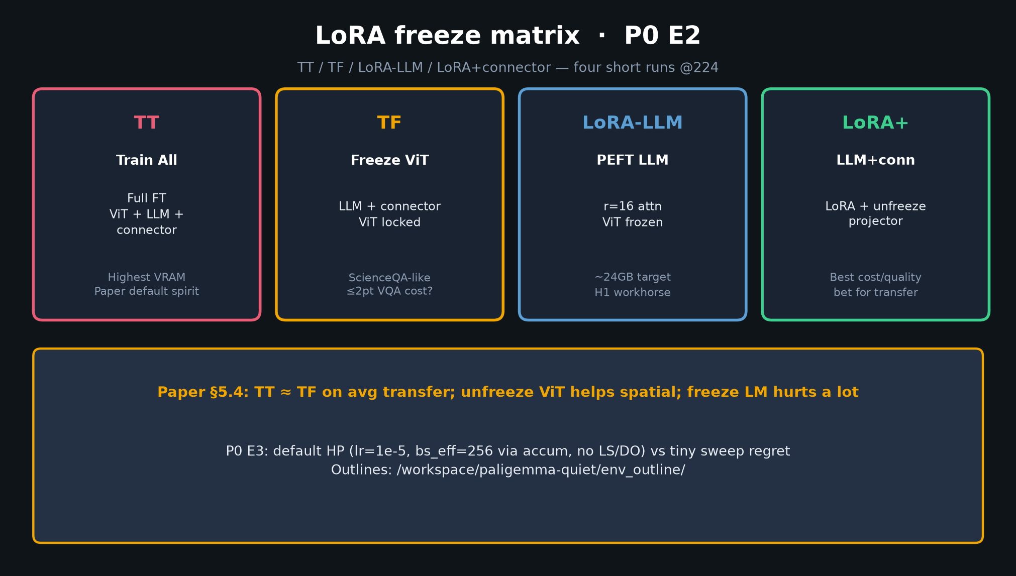
Empiricist · 11+3 · 5/10
Notes:
LoRA FREEZE MATRIX — P0 E2
TT / TF / LoRA-LLM / LoRA+connector — four short runs @224.
Paper: TT≈TF avg; unfreeze ViT helps spatial; freeze LM hurts.
LoRA+connector is the cost/quality bet for cluster transfer.

Slide 6
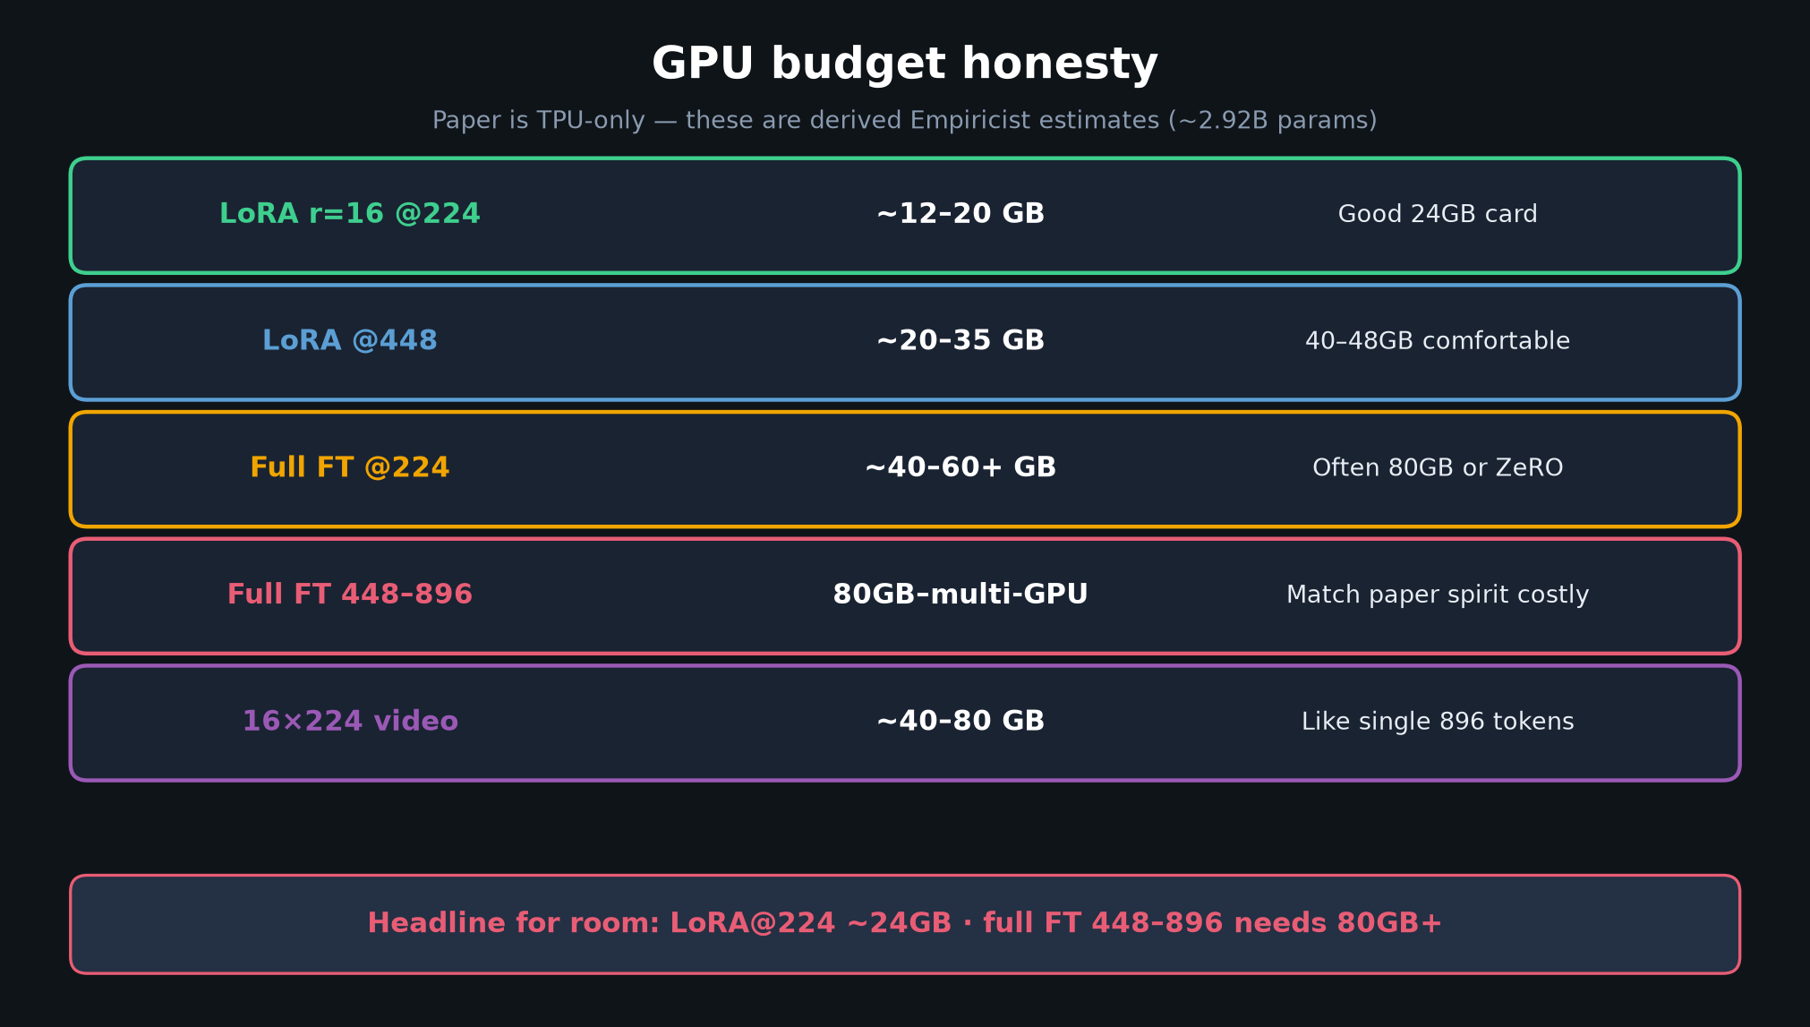
Empiricist · 11+3 · 6/10
Notes:
GPU BUDGET — say the headline
LoRA@224 ~24GB; full FT 448–896 needs 80GB+.
Paper reports TPU only — these are derived estimates (~2.92B class).
Report effective batch honestly when you can’t hit 256.

Slide 7
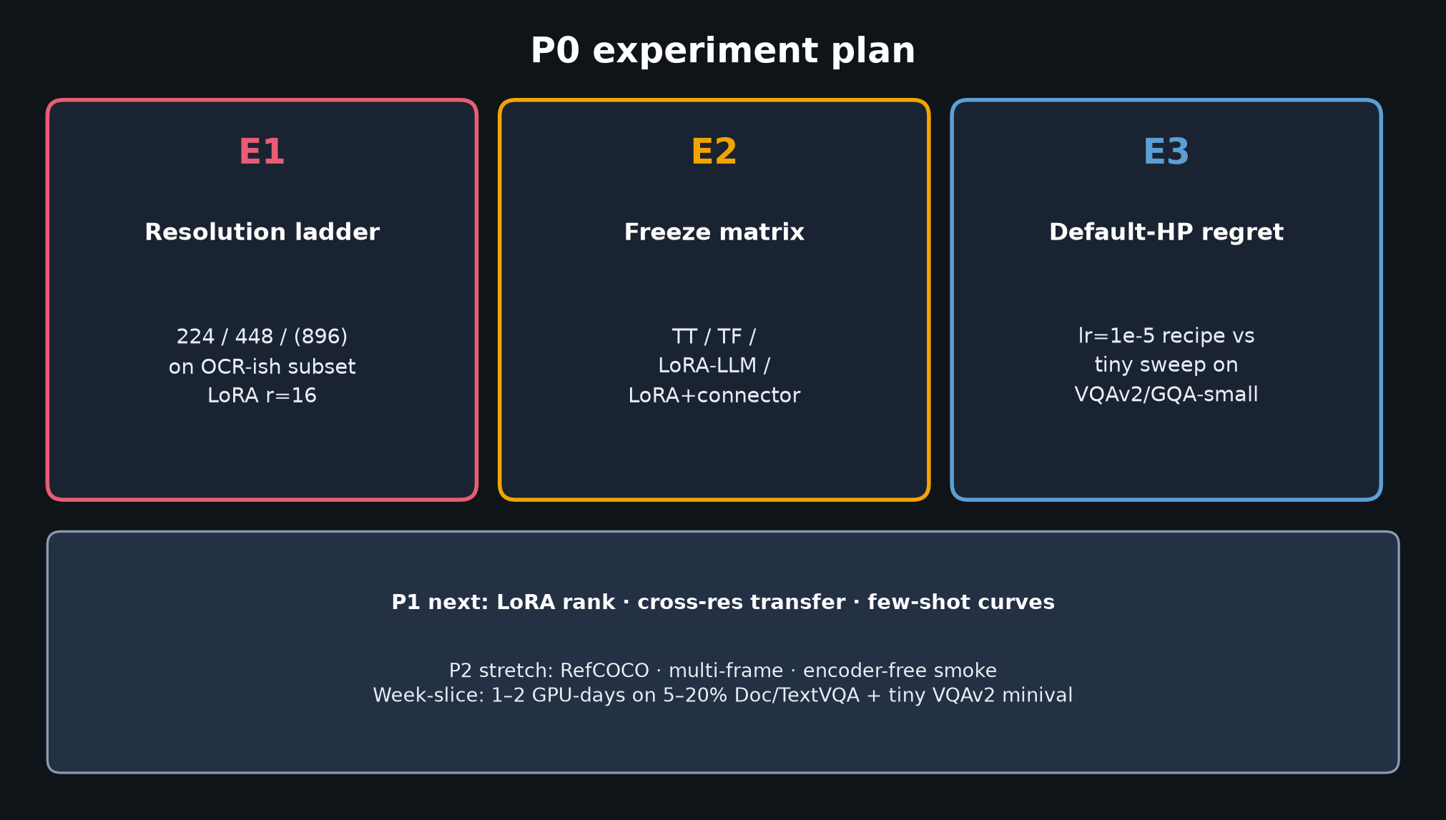
Empiricist · 11+3 · 7/10
Notes:
P0 PLAN
E1 res ladder · E2 freeze matrix · E3 default-HP regret.
P1: LoRA rank, cross-res, few-shot. P2: RefCOCO, multi-frame, encoder-free.
Env outlines: /workspace/paligemma-quiet/env_outline/

Slide 8
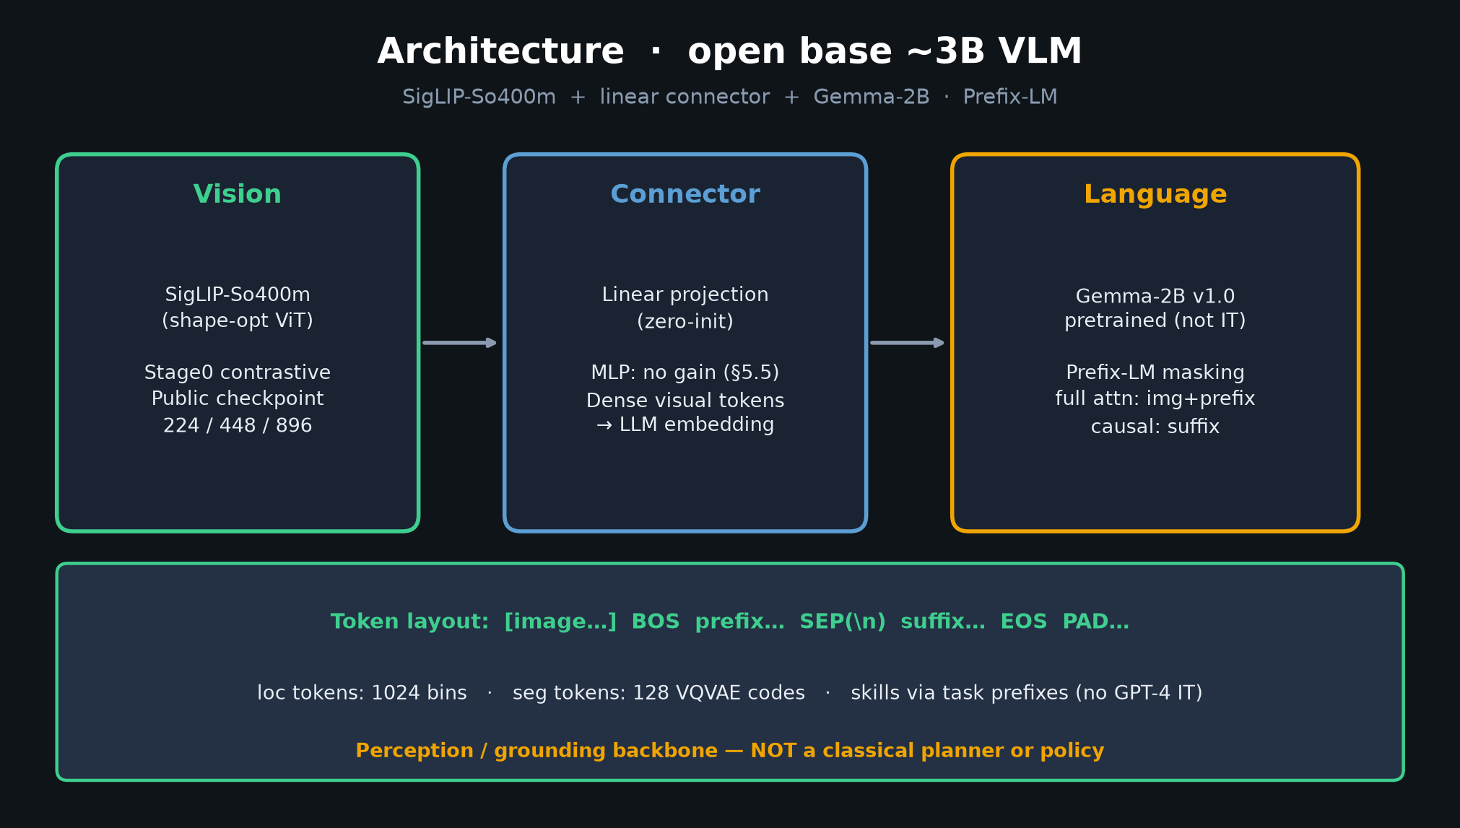
Empiricist · 11+3 · 8/10
Notes:
ARCHITECTURE REMINDER (30s) — what you fine-tune
SigLIP + linear connector + Gemma. Prefix-LM. You’re adapting a base, not chatting.
Don’t freeze vision early without measuring spatial/OCR cost.

Slide 9
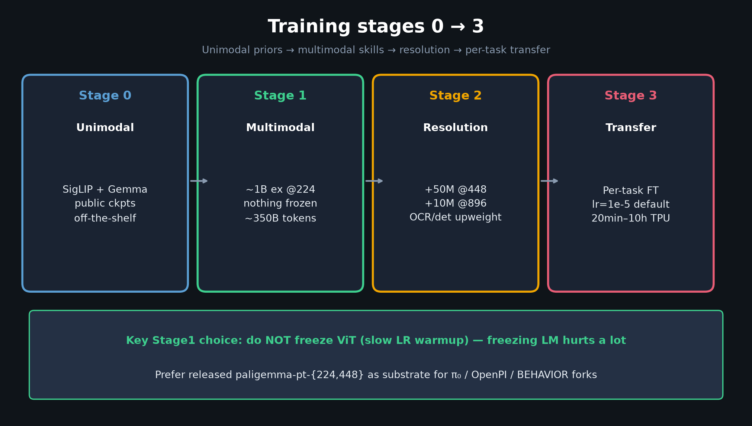
Empiricist · 11+3 · 9/10
Notes:
STAGES — where Empiricist sits
You mostly live in Stage3-like FT / LoRA on released pt ckpts.
You are NOT reproducing Stage1 1B examples — Reviewer owns that opacity critique.

Slide 10
Empiricist close
H1 LoRA@448 · freeze matrix · 24GB vs 80GB+ honesty
Empiricist · 11+3 · 10/10
Notes:
EMPIRICIST CLOSE / Q&A
Restate H1 as the primary bet; name 24GB vs 80GB+ honestly.
Invite Q on DocVQA subset size, LoRA rank, multi-frame token budget.
Hand robotics probes that need new data to Reviewer asks 4–5 / Visionary.

