Slide 1
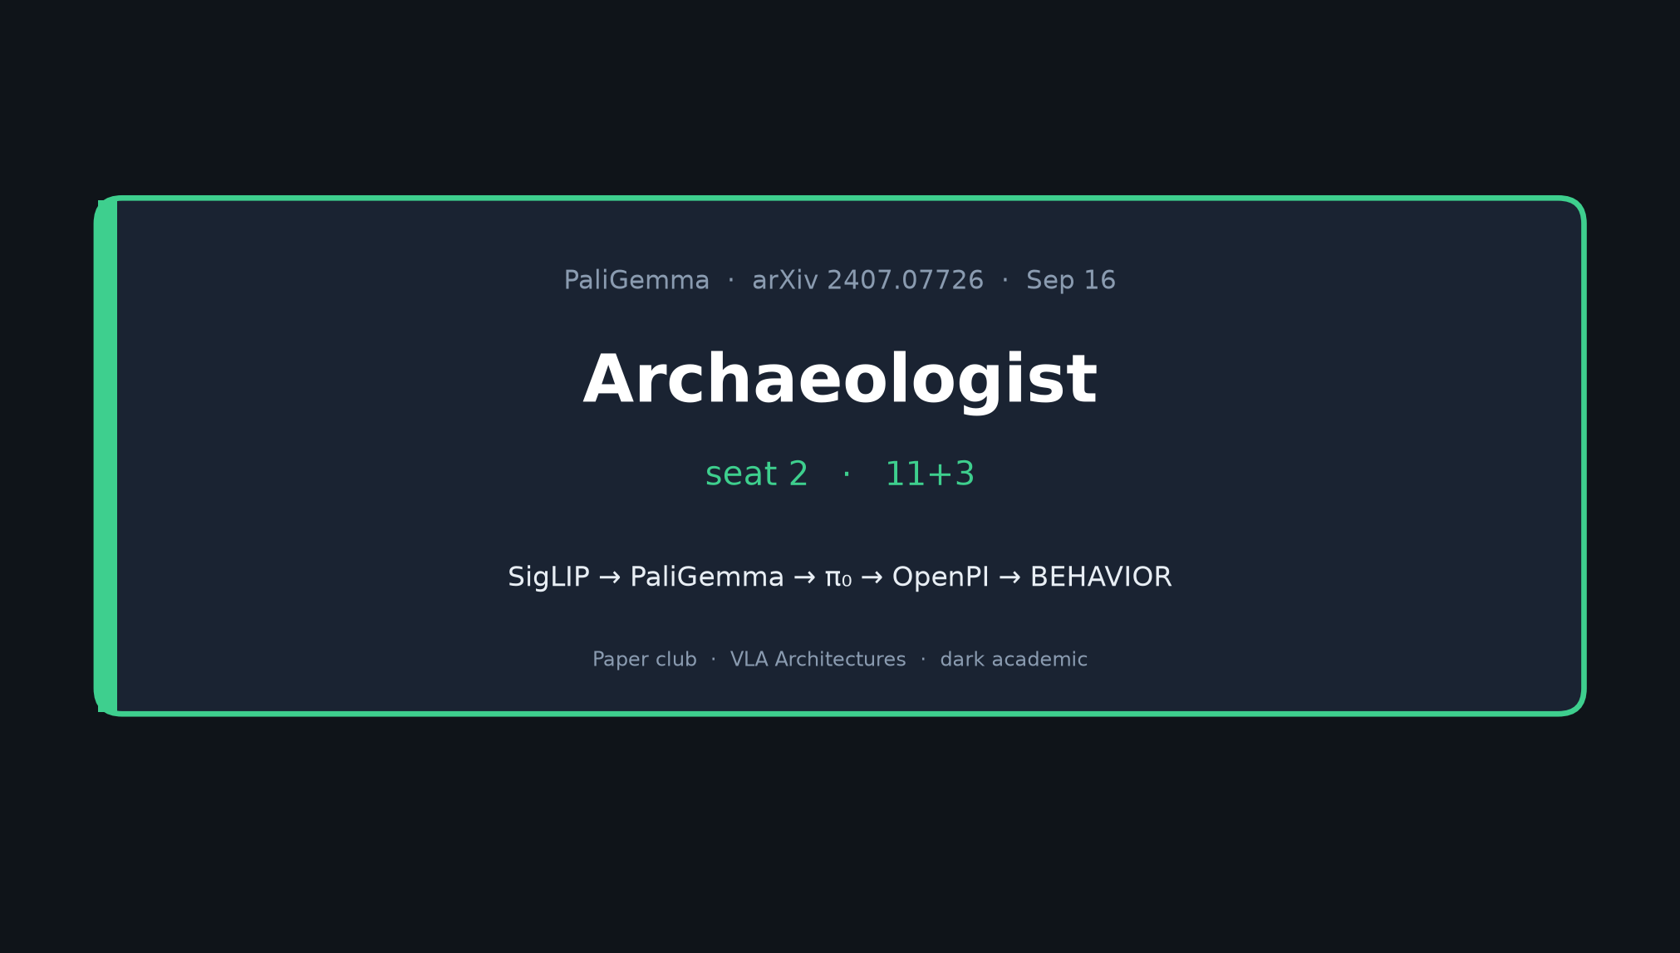
Archaeologist · 11+3 · 1/10
Notes:
ARCHAEOLOGIST — seat 2 — 11+3
You OWN lineage. No Stakeholder motivation tour.
Job: priors table → subsequent timeline → one-sentence lineage + hedges → perception vs planner.

Slide 2
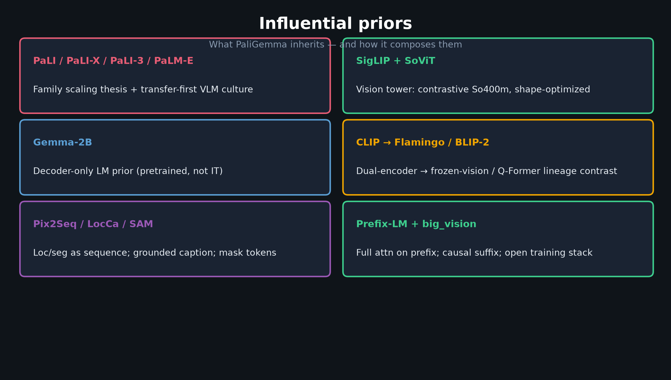
Archaeologist · 11+3 · 2/10
Notes:
INFLUENTIAL PRIORS — walk the table (~3 min)
PaLI family; SigLIP+SoViT; Gemma-2B; CLIP→Flamingo/BLIP-2 contrast; Pix2Seq/LocCa/SAM; Prefix-LM + big_vision.
Emphasize: PaliGemma *composes* these — it is the open bridge, not the first VLM.

Slide 3
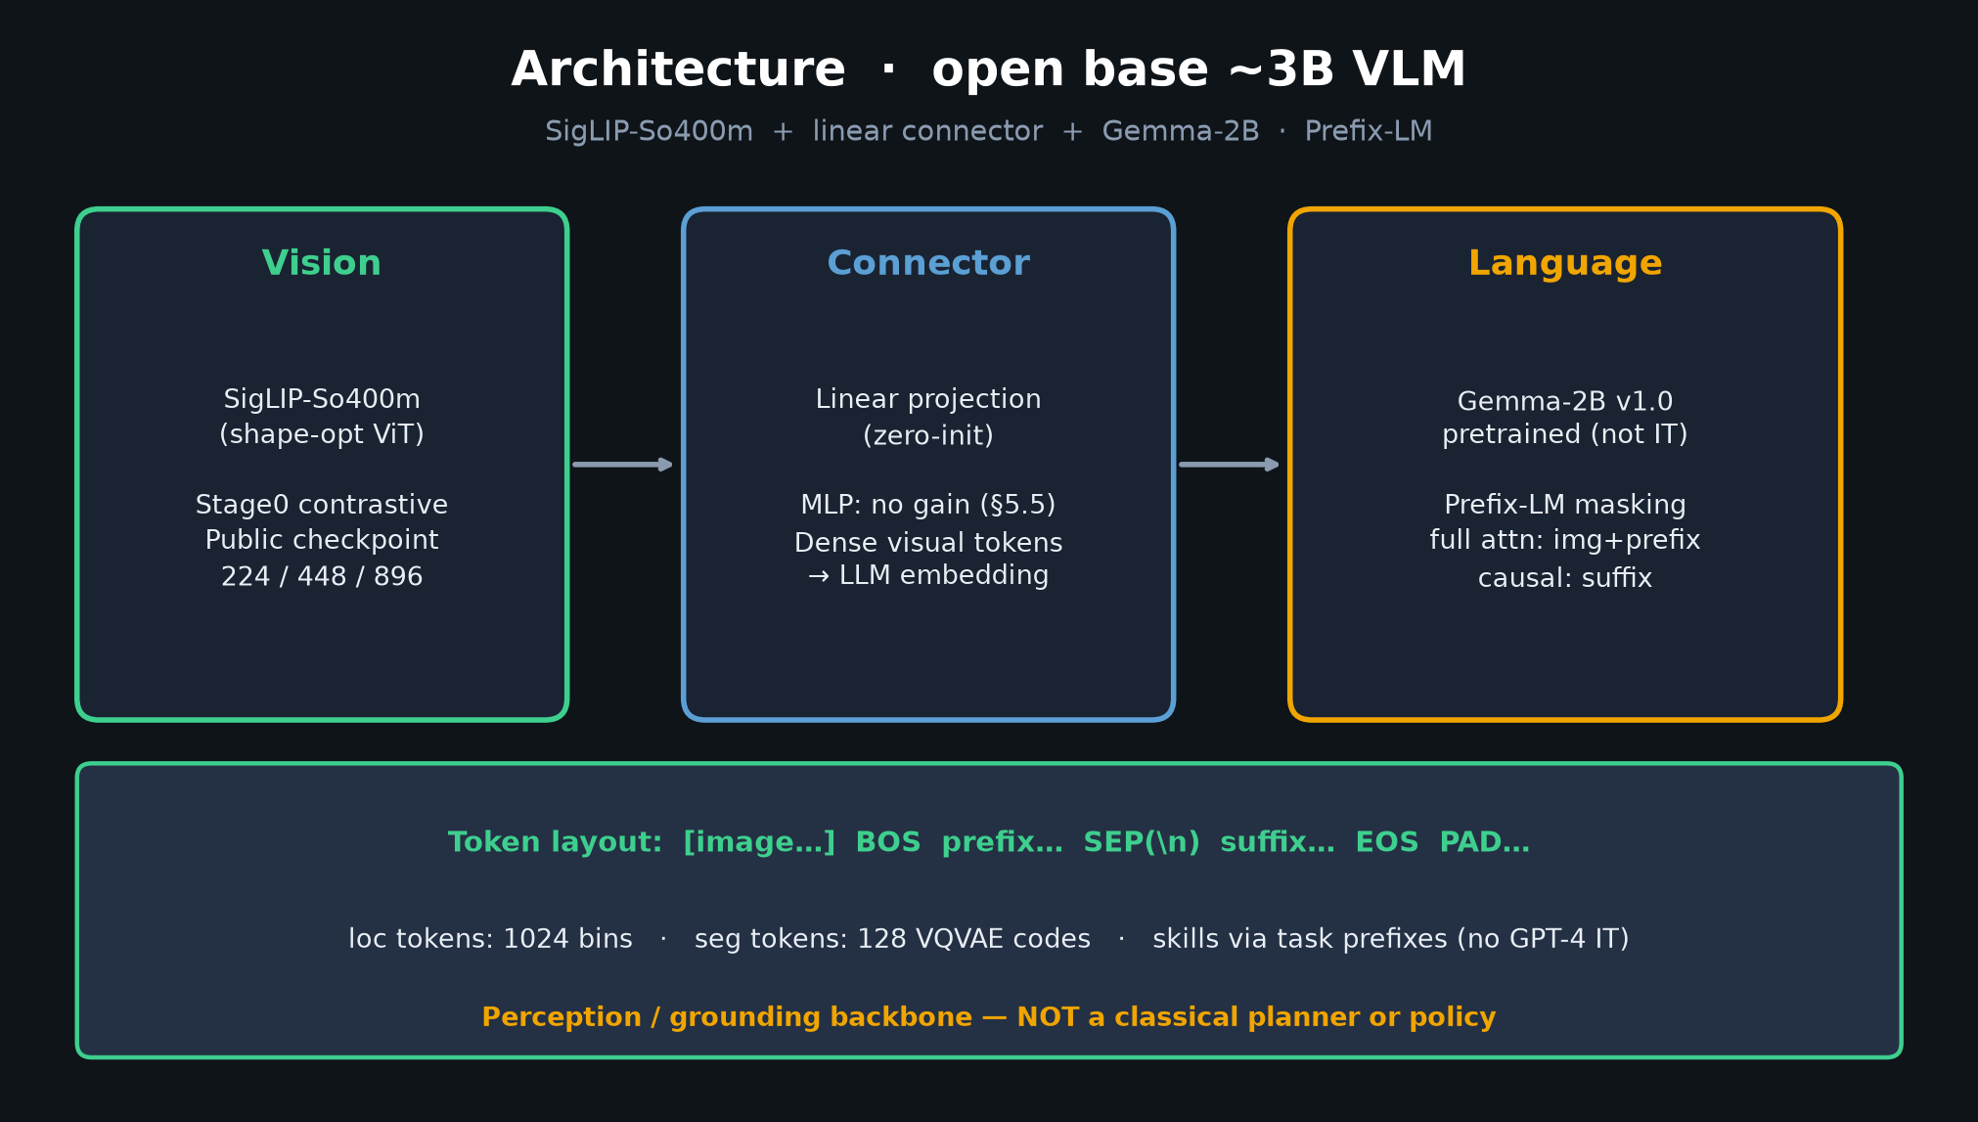
Archaeologist · 11+3 · 3/10
Notes:
ARCHITECTURE AS COMPOSITION
Show how priors land in the box: SigLIP eyes, linear glue, Gemma decoder, Prefix-LM, loc/seg tokens.

Slide 4
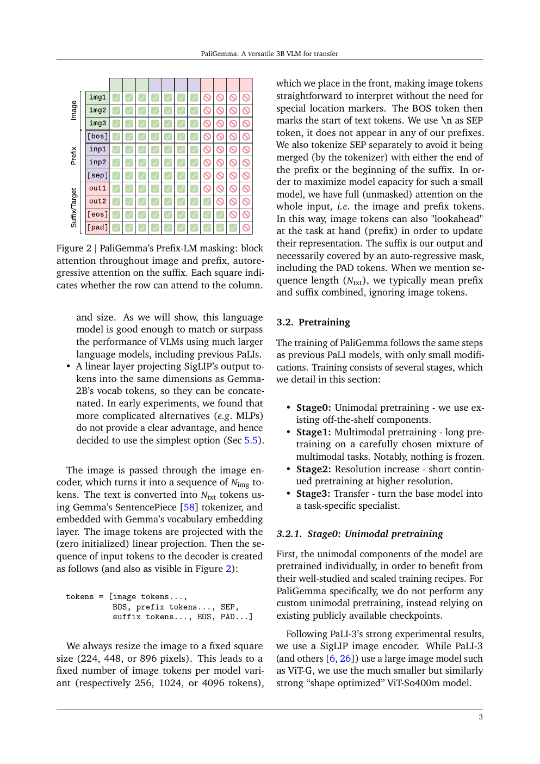
Paper method / family context
Archaeologist · 11+3 · 4/10
Notes:
PAPER ARTIFACT
Cite the paper’s own framing of the family / method. Don’t re-derive Empiricist numbers.

Slide 5
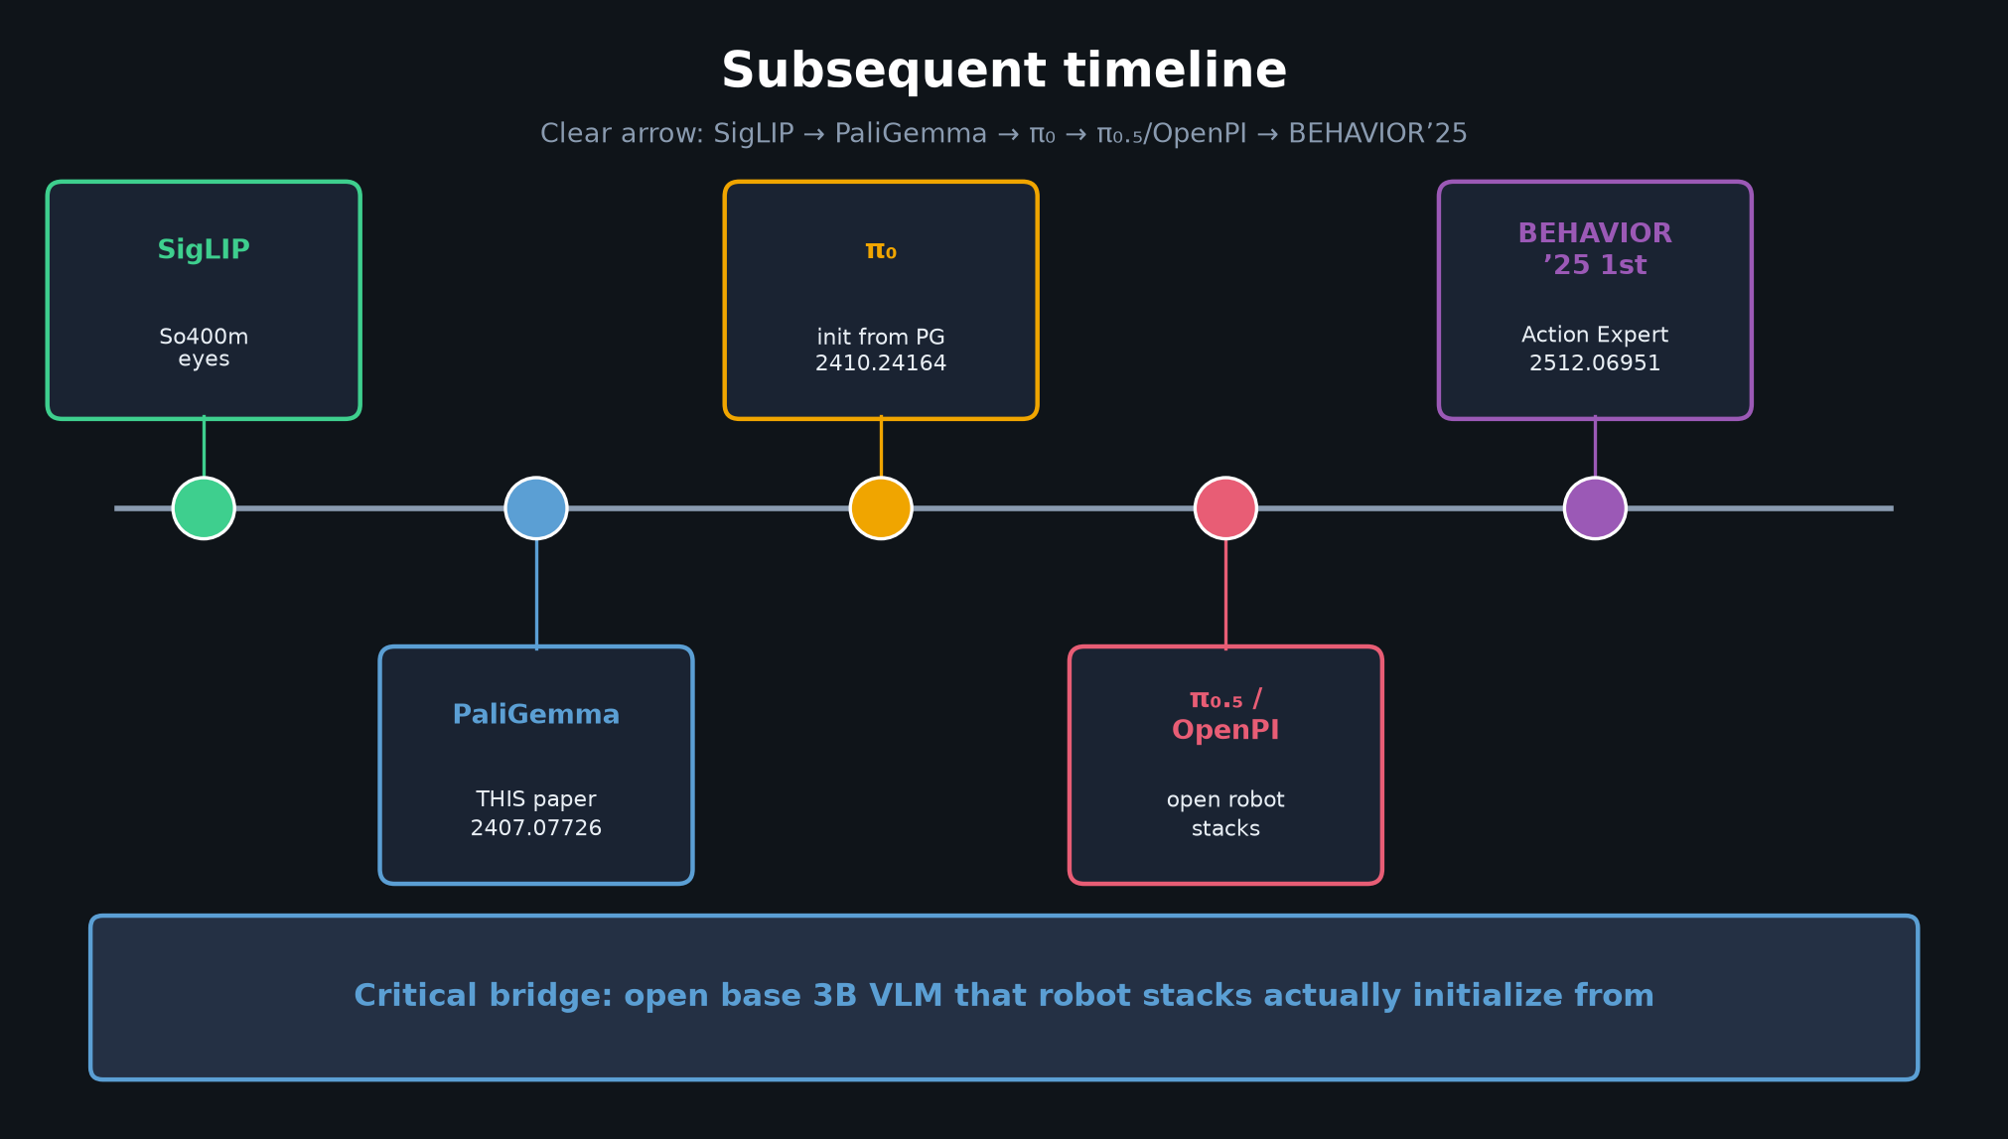
Archaeologist · 11+3 · 5/10
Notes:
SUBSEQUENT TIMELINE — core visual (~3–4 min)
SigLIP → **PaliGemma** → π₀ → π₀.₅/OpenPI → BEHAVIOR’25 1st (Action Expert, ~26% q).
Point: THIS paper is the critical open bridge robot stacks initialize from.

Slide 6
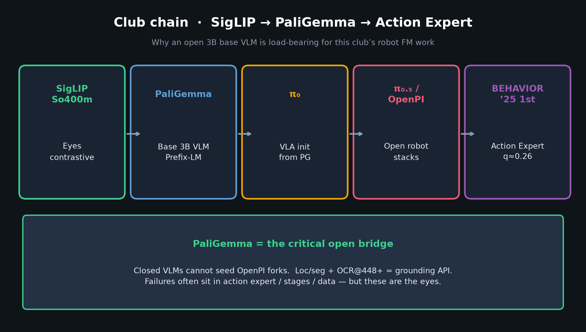
Archaeologist · 11+3 · 6/10
Notes:
CLUB CHAIN ZOOM
Same arrow with Action Expert endpoint. Perception backbone standardized — not the planner.

Slide 7
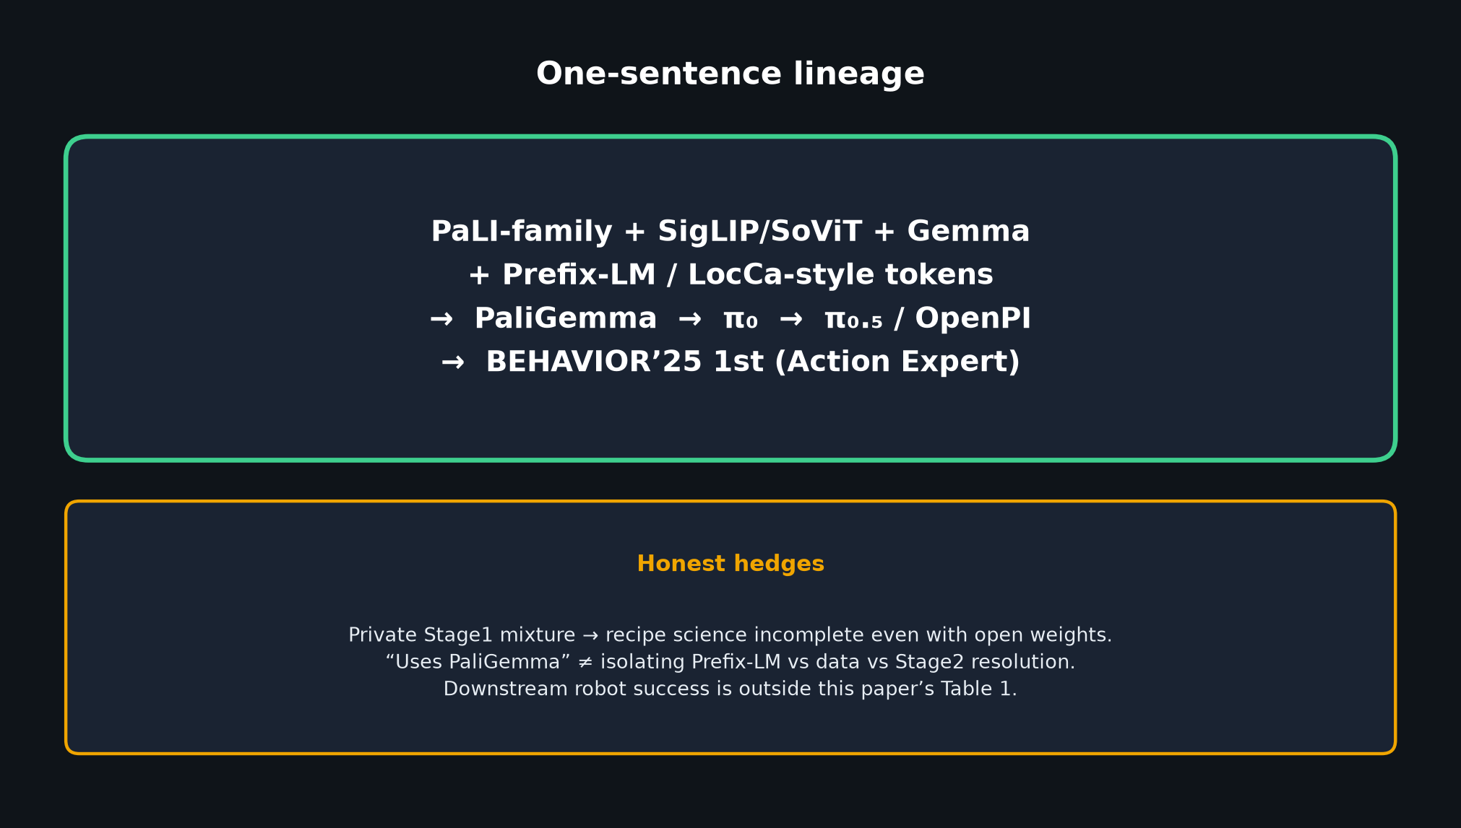
Archaeologist · 11+3 · 7/10
Notes:
ONE-SENTENCE LINEAGE — memorize and deliver slowly
“PaLI-family + SigLIP/SoViT + Gemma + Prefix-LM/LocCa-style tokens → PaliGemma → π₀ → π₀.₅/OpenPI → BEHAVIOR’25 1st.”
HONEST HEDGES:
• Private Stage1 → recipe science incomplete even with open weights
• “Uses PaliGemma” ≠ isolating Prefix-LM vs data vs Stage2
• Downstream robot success is outside Table 1

Slide 8
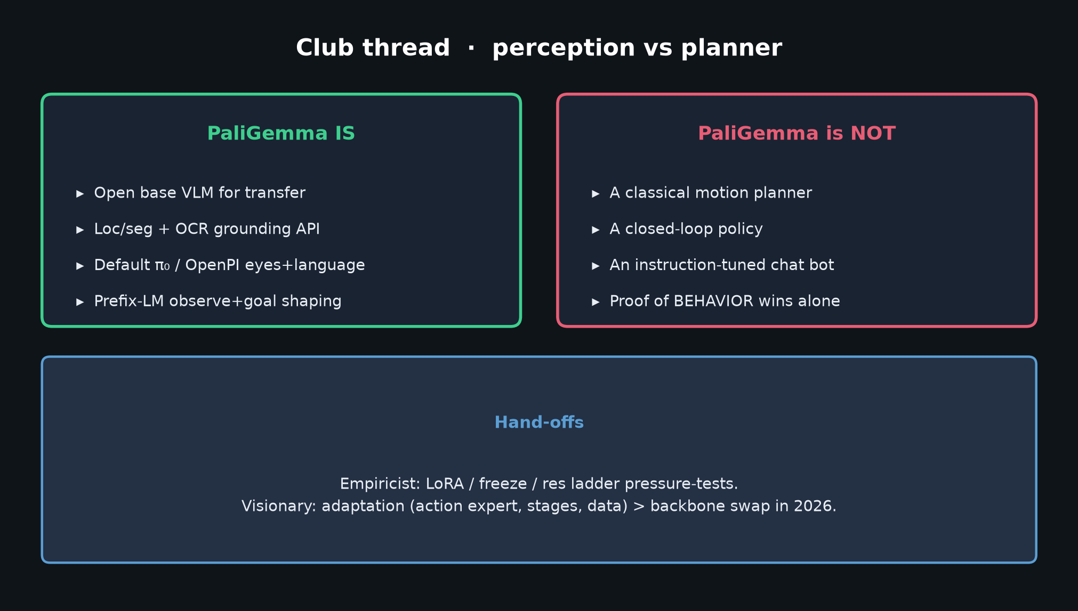
Archaeologist · 11+3 · 8/10
Notes:
PERCEPTION VS PLANNER
IS: open base VLM; loc/seg+OCR API; default π₀/OpenPI eyes+language; Prefix-LM shaping.
IS NOT: classical planner; closed-loop policy; chat bot; proof of BEHAVIOR wins alone.
Hand Empiricist LoRA/res; Visionary adaptation>swap.

Slide 9
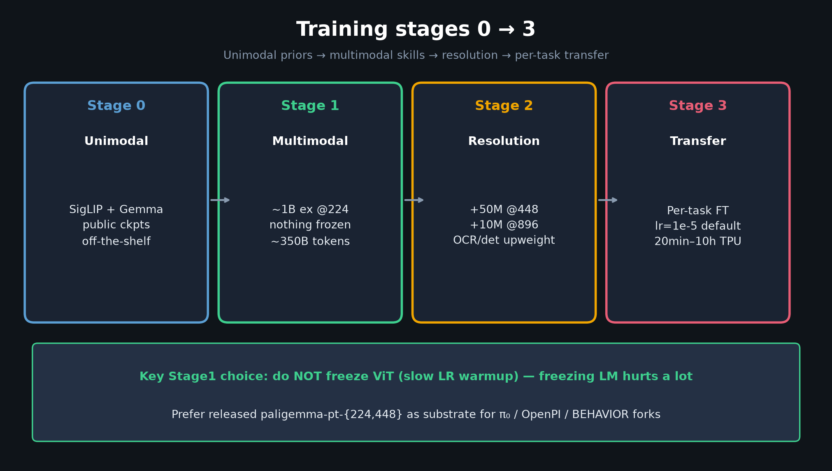
Archaeologist · 11+3 · 9/10
Notes:
STAGES IN HISTORICAL CONTEXT
Stage0–3 recipe is part of the PaLI-line culture this paper inherits and open-sources at 3B.
Subsequent work mostly consumes Stage0+released pt weights — not redoing Stage1.

Slide 10
Archaeologist close
SigLIP → PaliGemma → π₀ → OpenPI → BEHAVIOR · hedges intact
Archaeologist · 11+3 · 10/10
Notes:
ARCHAEOLOGIST CLOSE / Q&A
Restate one sentence + hedges.
Invite Q on which priors matter most; whether BEHAVIOR isolates the VLM; freeze/unlock docs in forks.
Do NOT redo Stakeholder.

