Slide 1
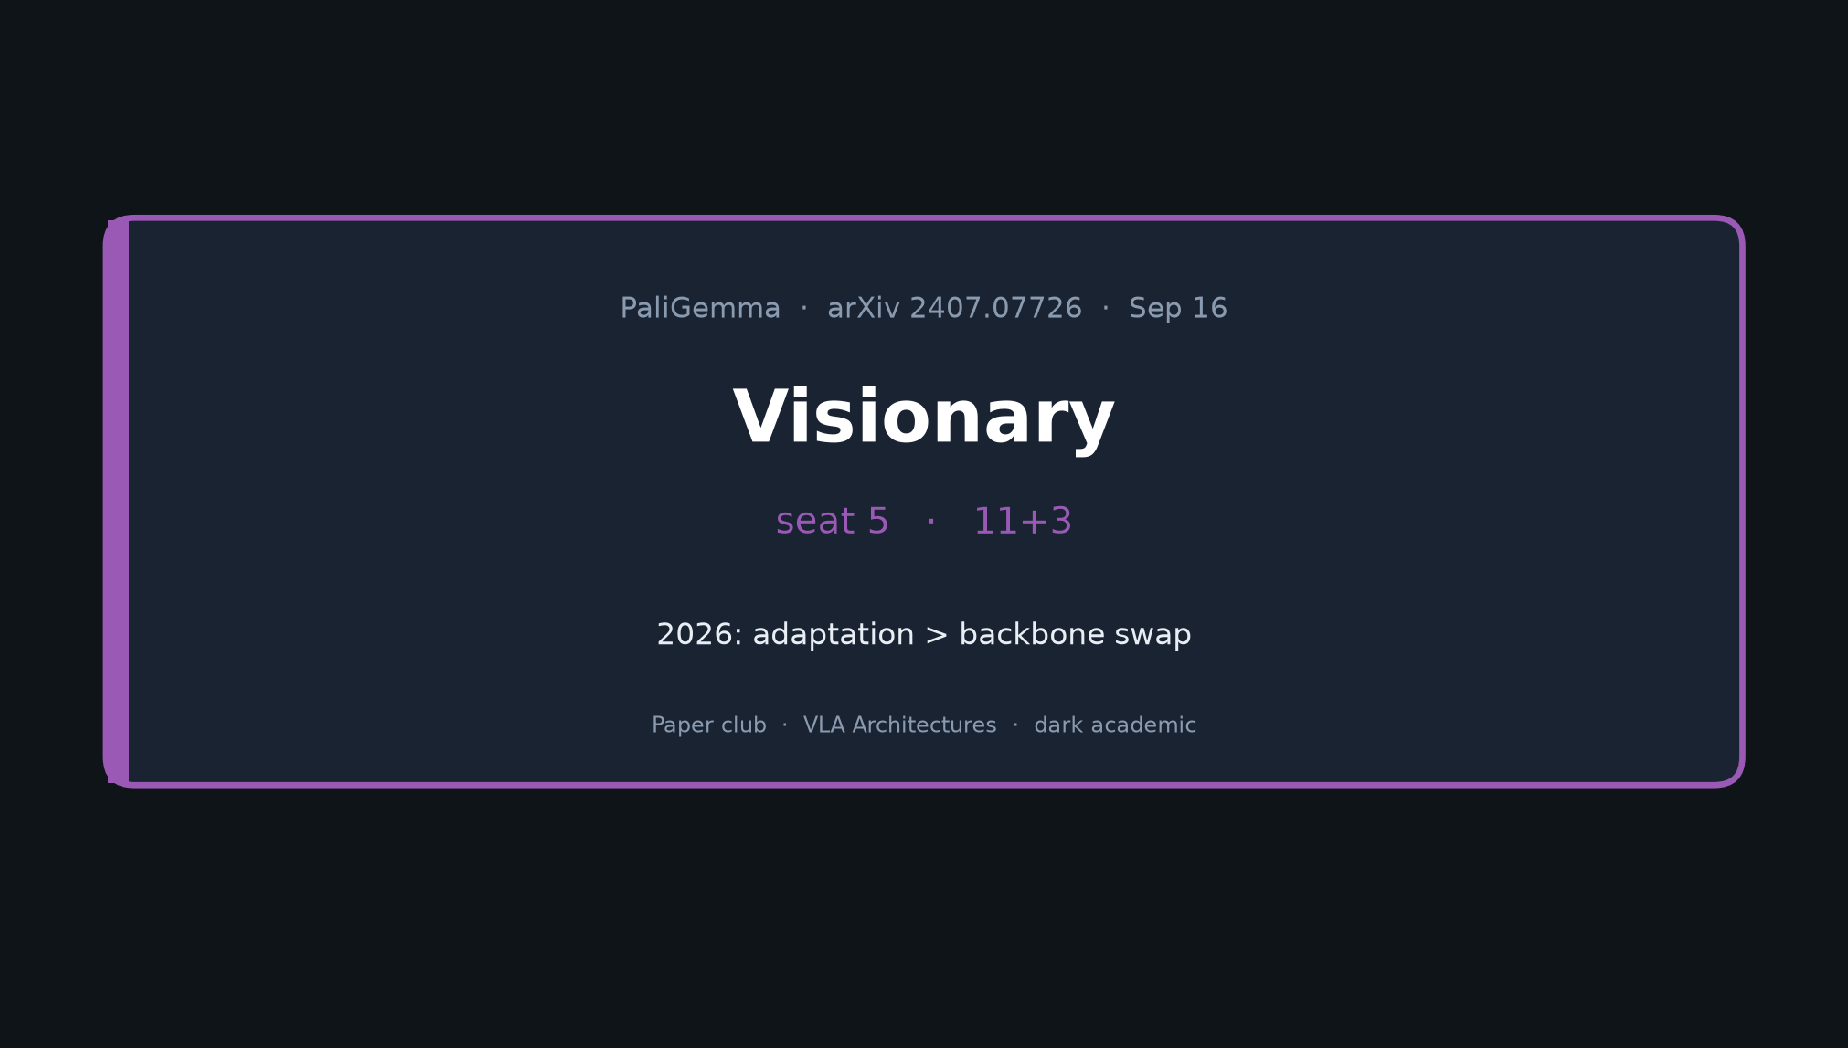
Visionary · 11+3 · 1/10
Notes:
VISIONARY — seat 5 — 11+3
NO Stakeholder redo. NO Discord. NO Drive.
Thesis: 2026 upside = adaptation (action expert, noise, stages, data) > backbone swap.
PG-class remains default open VLA init until better open ego/video 3–4B appears.

Slide 2
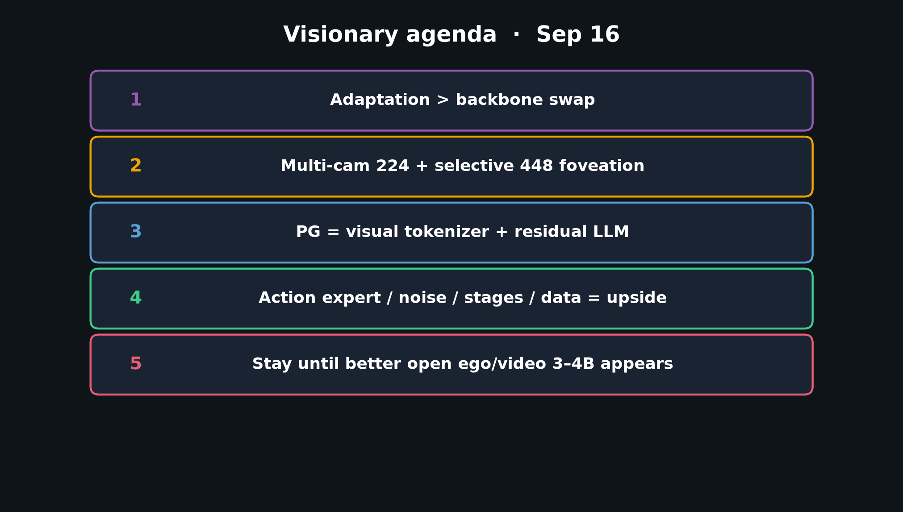
Visionary · 11+3 · 2/10
Notes:
AGENDA — five points
1 Adaptation > backbone swap
2 Multi-cam 224 + selective 448 foveation
3 PG = visual tokenizer + residual LLM
4 Action expert / noise / stages / data = upside
5 Stay until better open ego/video 3–4B appears

Slide 3
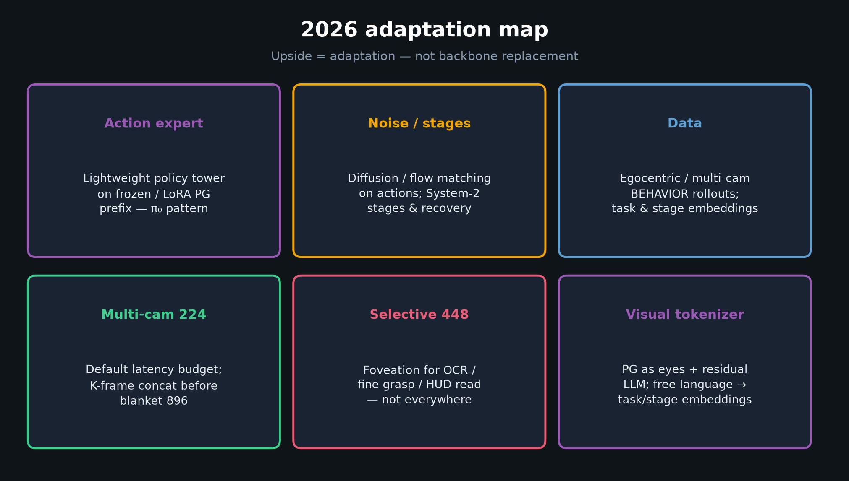
Visionary · 11+3 · 3/10
Notes:
2026 ADAPTATION MAP — core visual
Action expert · noise/stages · data · multi-cam 224 · selective 448 · visual tokenizer view.
Walk the six cards; spend time on action expert + foveation.

Slide 4
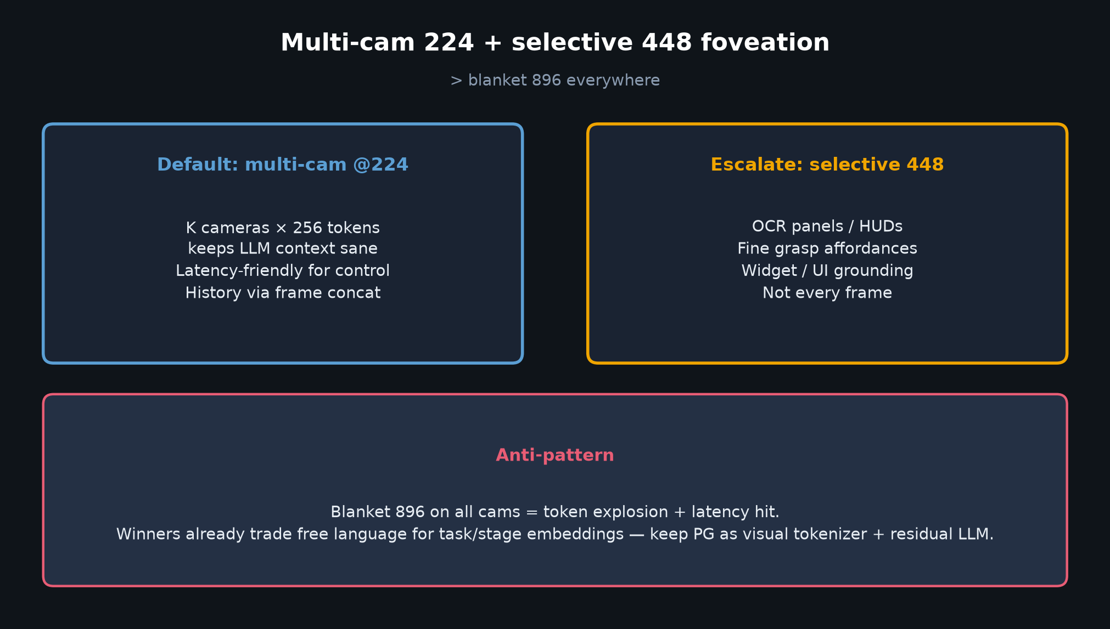
Visionary · 11+3 · 4/10
Notes:
FOVEATION
Default multi-cam @224; escalate selective 448 for OCR/HUD/fine grasp — not blanket 896.
Anti-pattern: token explosion + latency on all cams.

Slide 5
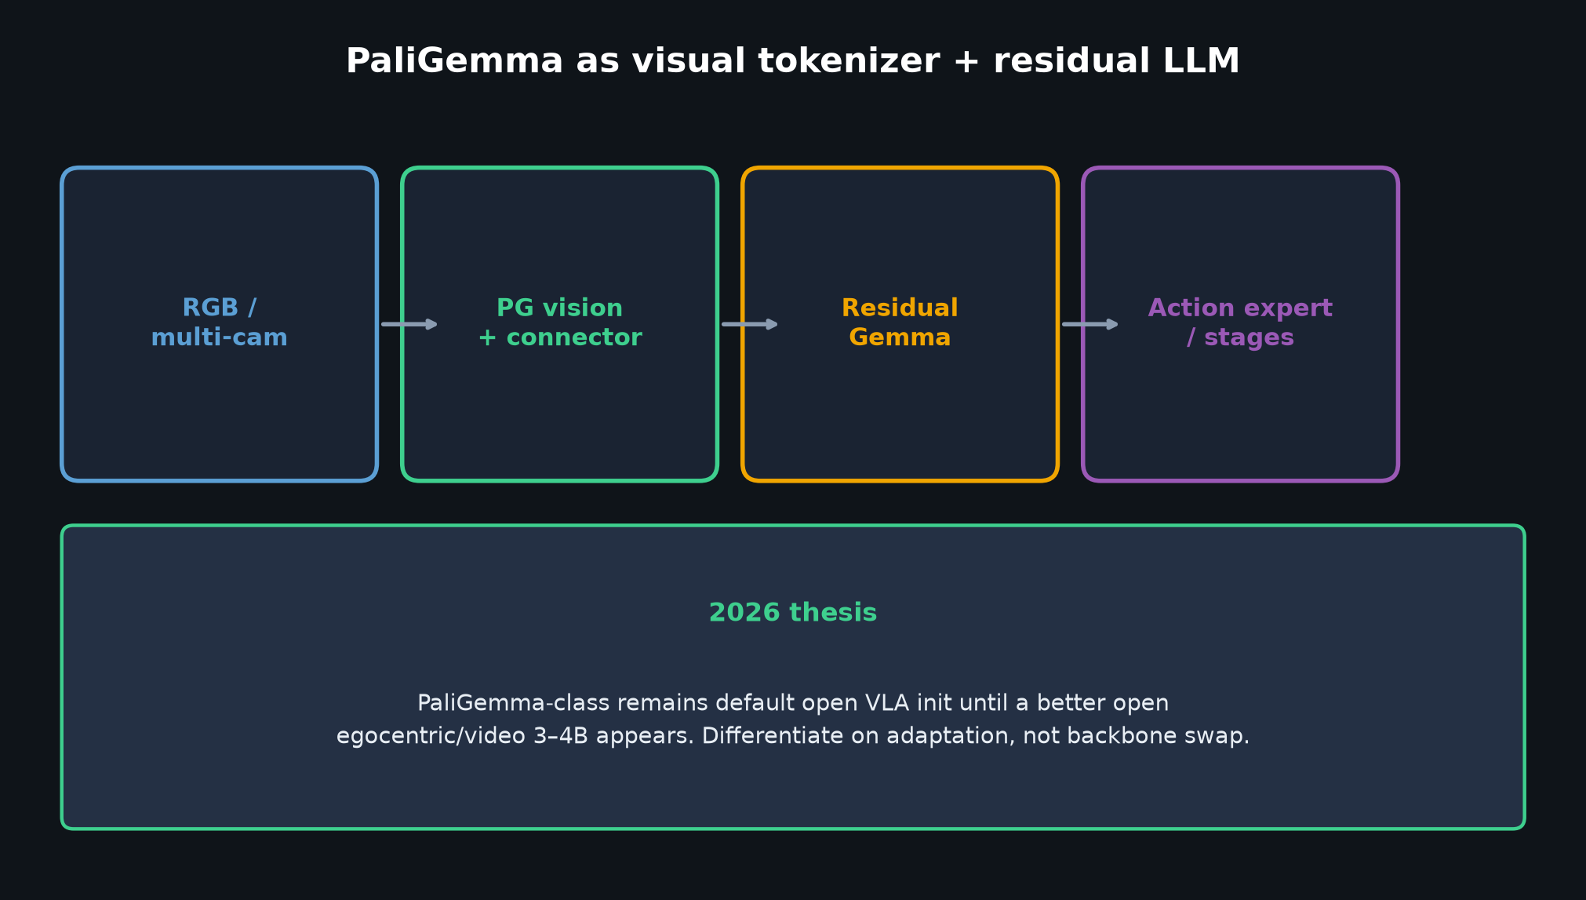
Visionary · 11+3 · 5/10
Notes:
VISUAL TOKENIZER + RESIDUAL LLM
Winners already swap free language for task/stage embeddings.
Treat PG as eyes + residual language; put differentiation in action expert / stages / data.

Slide 6
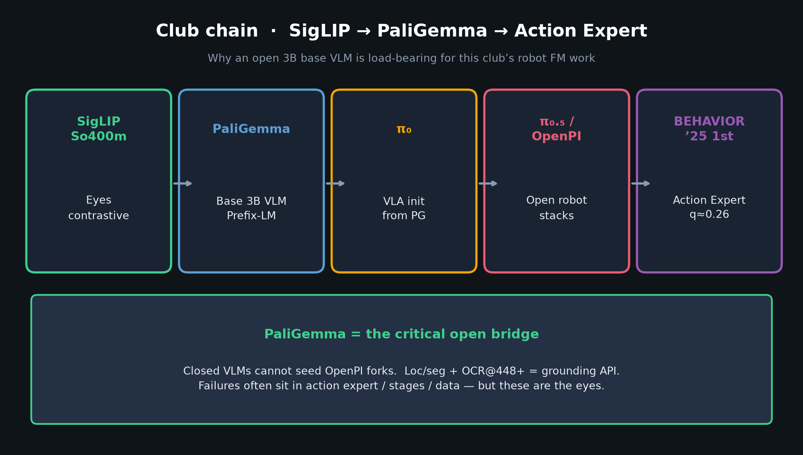
Visionary · 11+3 · 6/10
Notes:
CLUB CHAIN — why not swap yet
SigLIP → PG → π₀ → OpenPI → BEHAVIOR Action Expert already works as open substrate.
Swapping backbone without adaptation gains is a distraction.

Slide 7
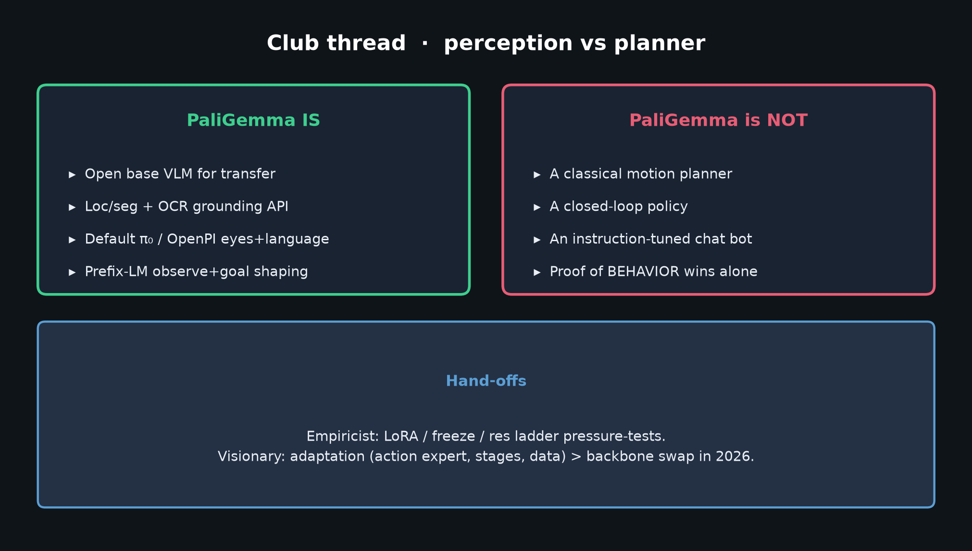
Visionary · 11+3 · 7/10
Notes:
PERCEPTION BOUNDARY
Still not a planner. Visionary owns *where* adaptation lives downstream of PG.

Slide 8
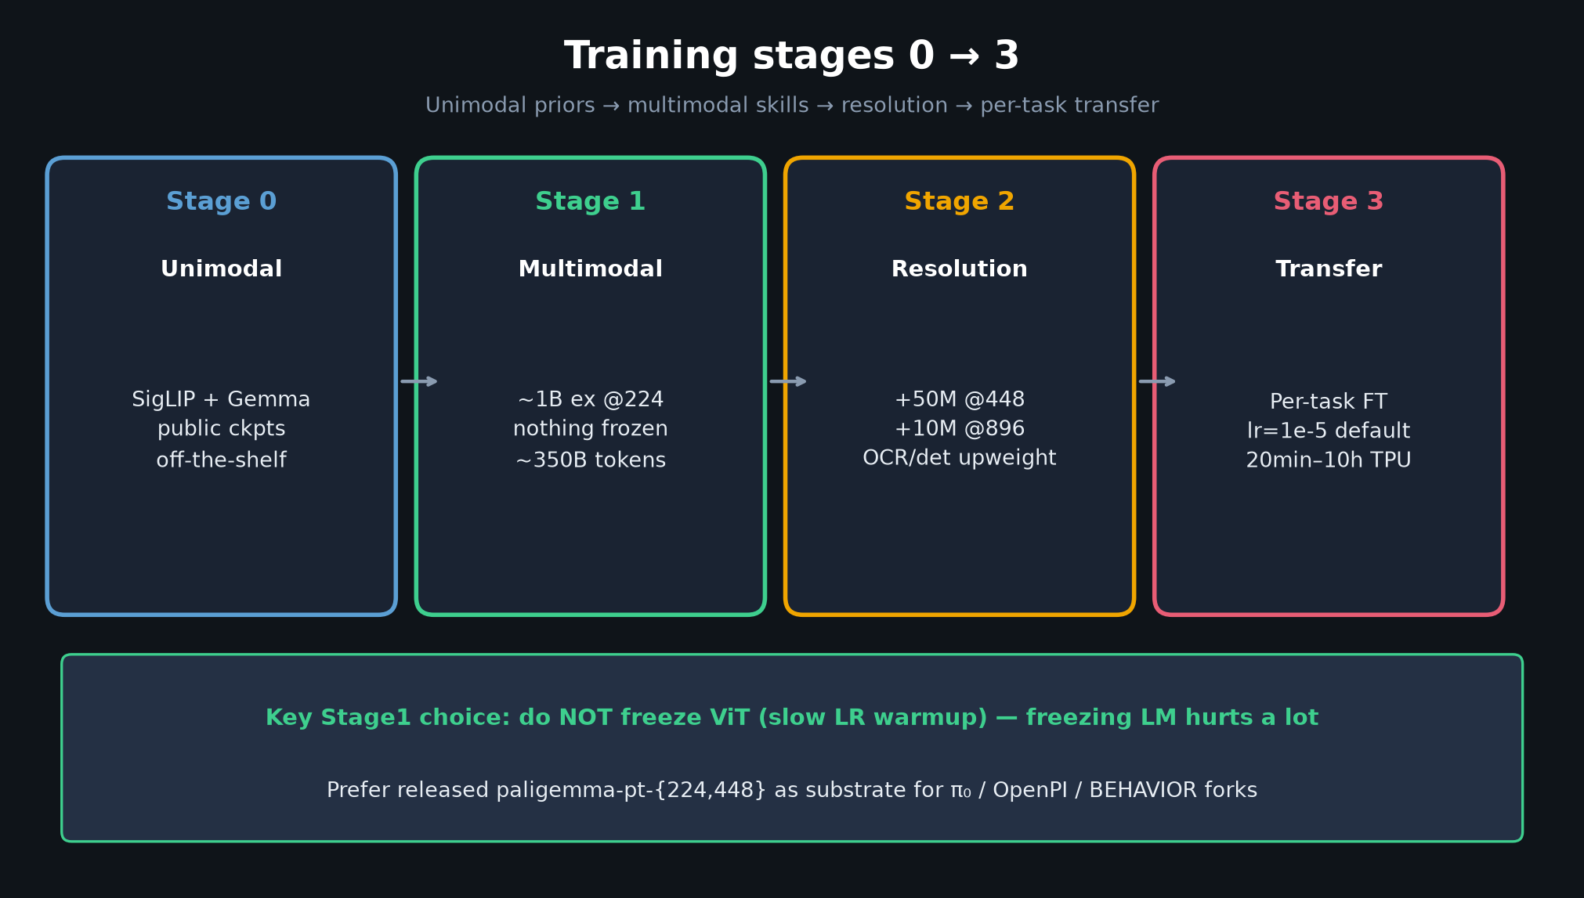
Visionary · 11+3 · 8/10
Notes:
STAGES — adaptation sits after released pt
You don’t need to redo Stage1. Stage3-like + action expert + data is the 2026 lever.

Slide 9
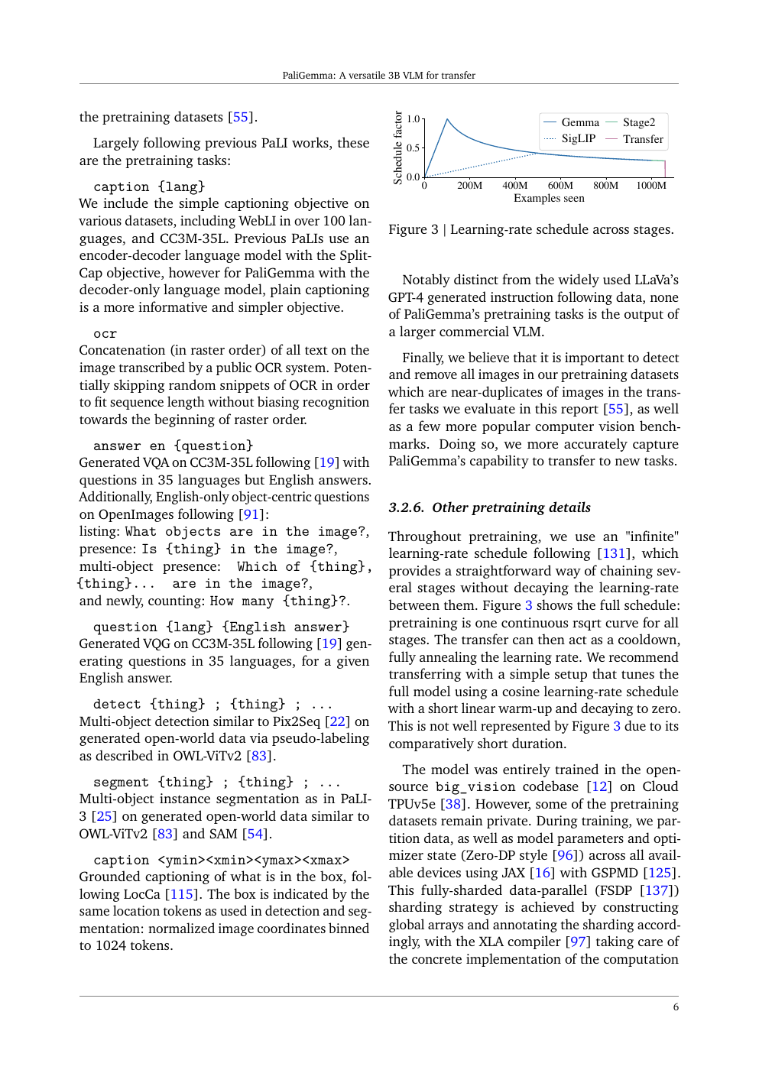
Paper artifact — grounding / transfer context for adaptation
Visionary · 11+3 · 9/10
Notes:
OPTIONAL PAPER CROP — grounding API exists
Loc/seg tokens already give a structured interface for affordance pointing / UI widgets.
Foveation @448 exploits OCR path the paper proved.

Slide 10
Visionary close
Adaptation > backbone swap · 224 + selective 448 · tokenizer view
Visionary · 11+3 · 10/10
Notes:
VISIONARY CLOSE / Q&A
Restate: adaptation > swap; 224+selective 448; tokenizer+residual LLM.
Invite Q on action-expert design, when to foveate, what would dethrone PG-class (open ego/video 3–4B).
No Discord/Drive. Hand back to facilitator.

