Slide 1
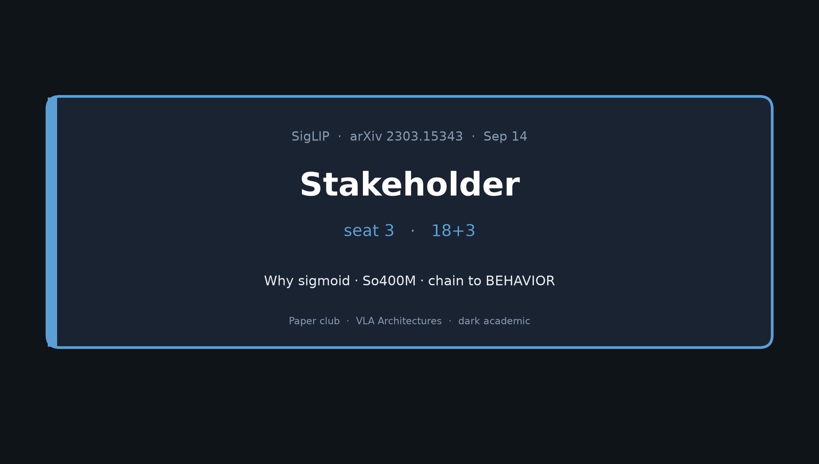
Stakeholder · 18+3 · 1/12
Notes:
STAKEHOLDER — seat 3 — 18+3
Motivation → problem → method → findings → So400M chain → 2026 takeaway.
You set context; later roles do NOT redo this tour.

Slide 2
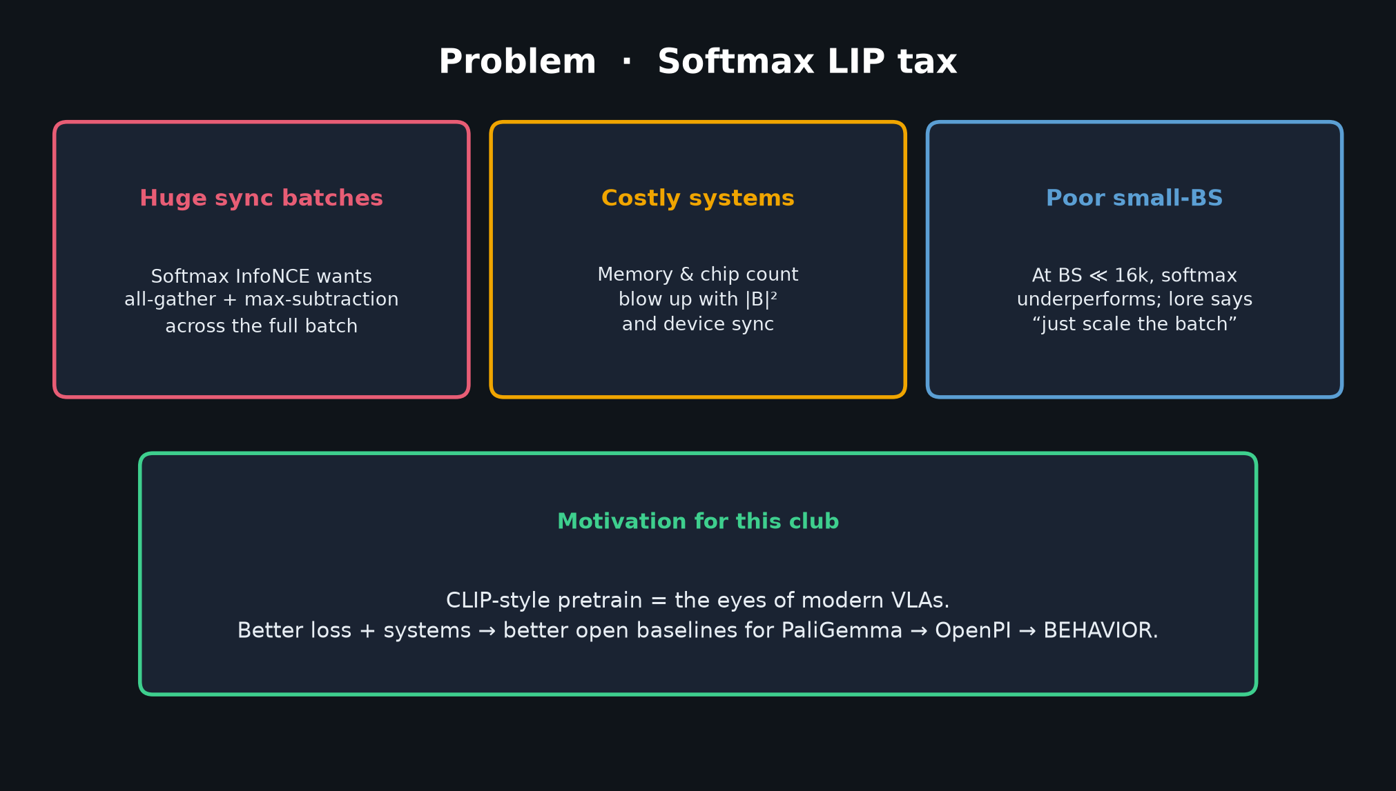
Stakeholder · 18+3 · 2/12
Notes:
MOTIVATION
CLIP-style language–image pretrain is the eyes of modern VLAs.
Better loss + systems = better open baselines for robot stacks.
This club cares because SigLIP-So400m → PaliGemma → π₀/OpenPI → BEHAVIOR vision.

Slide 3
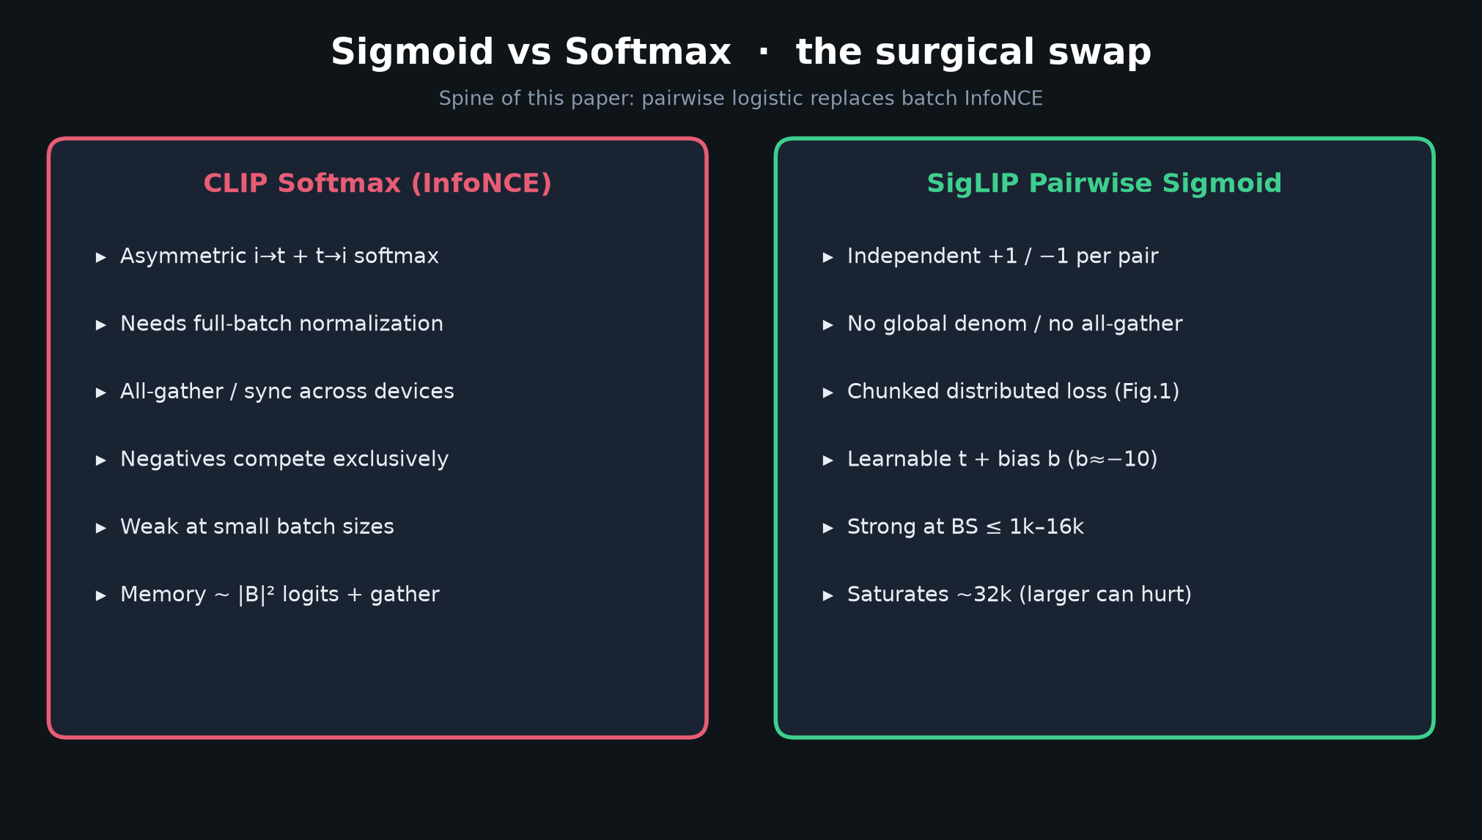
Stakeholder · 18+3 · 3/12
Notes:
METHOD — the surgical swap
Softmax InfoNCE → pairwise sigmoid over all image–text pairs.
Learnable temperature t + bias b (init ≈ −10).
Chunked distributed implementation — no full-batch all-gather.
Recipes: SigLiT (locked), SigLIP (from scratch), mSigLIP (multilingual).

Slide 4
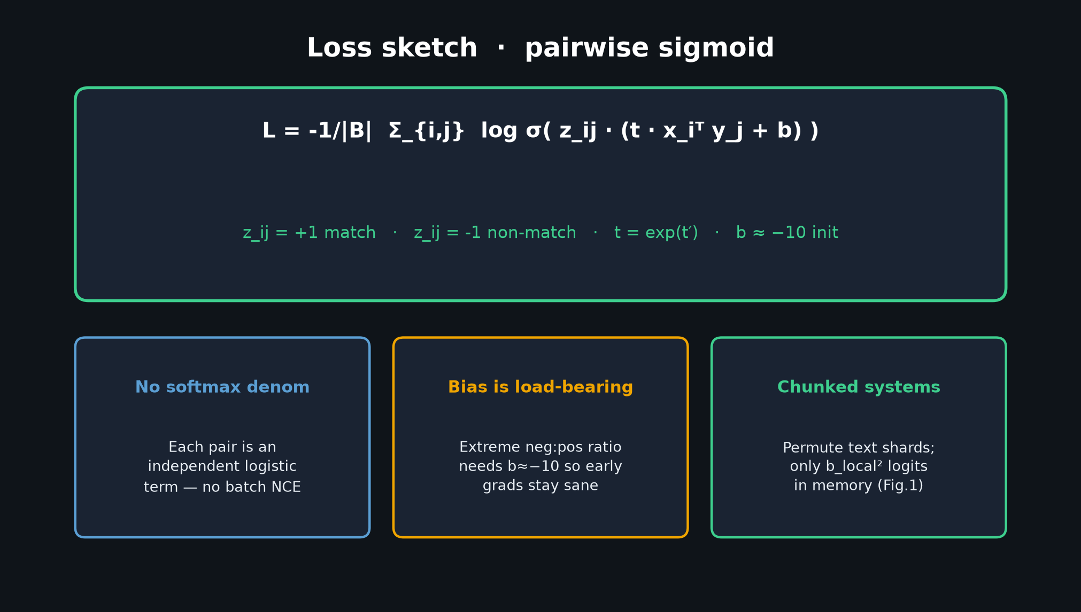
Stakeholder · 18+3 · 4/12
Notes:
LOSS SKETCH
L = −1/|B| ∑_{i,j} log σ(z_ij (t x_i·y_j + b)), z=±1.
Bias is load-bearing under extreme neg:pos imbalance.
Systems: permute text shards; only local block of logits in memory.

Slide 5
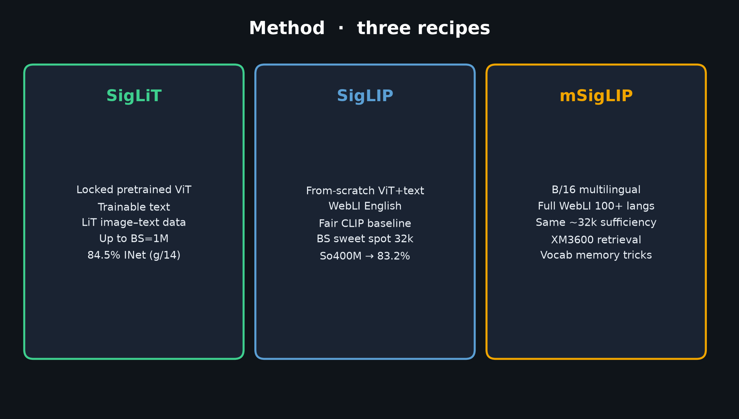
Stakeholder · 18+3 · 5/12
Notes:
THREE RECIPES
SigLiT: locked pretrained vision — 84.5% INet on 4×TPUv4 ~2 days.
SigLIP: from-scratch WebLI — fair CLIP baseline; public So400M 83.2%.
mSigLIP: multilingual, same ~32k sufficiency.

Slide 6
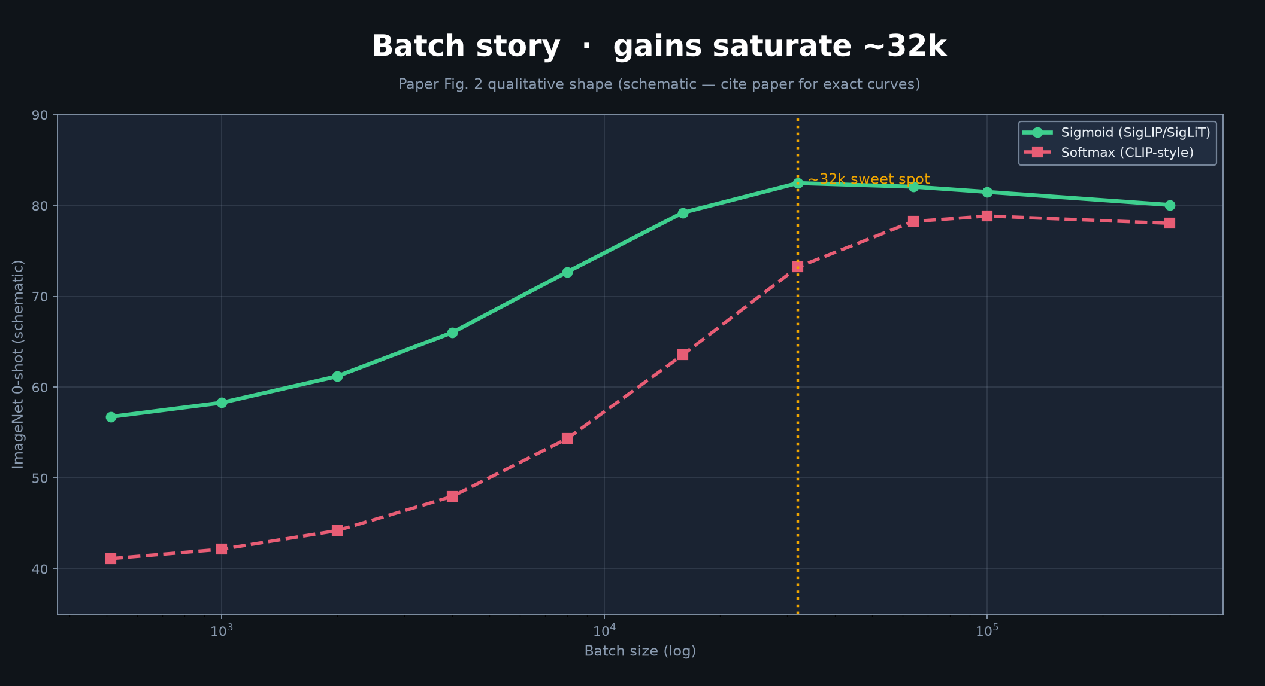
Stakeholder · 18+3 · 6/12
Notes:
BATCH SATURATION (Fig. 2 story)
Sigmoid ≫ softmax at small BS (<~16k).
Both saturate ~32k; larger (307k) can hurt.
Don’t chase million-batch lore blindly.

Slide 7
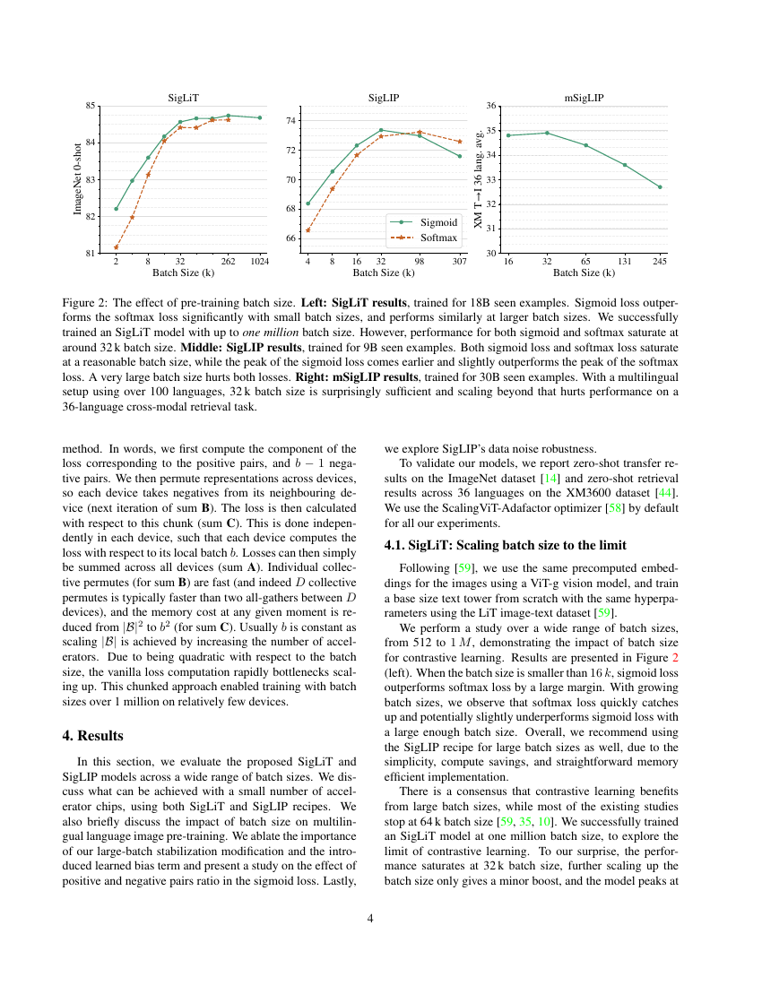
Paper Fig. 2 — batch size effect
Stakeholder · 18+3 · 7/12
Notes:
PAPER Fig. 2 — show the real figure
Use this as the visual proof of the batch narrative.

Slide 8
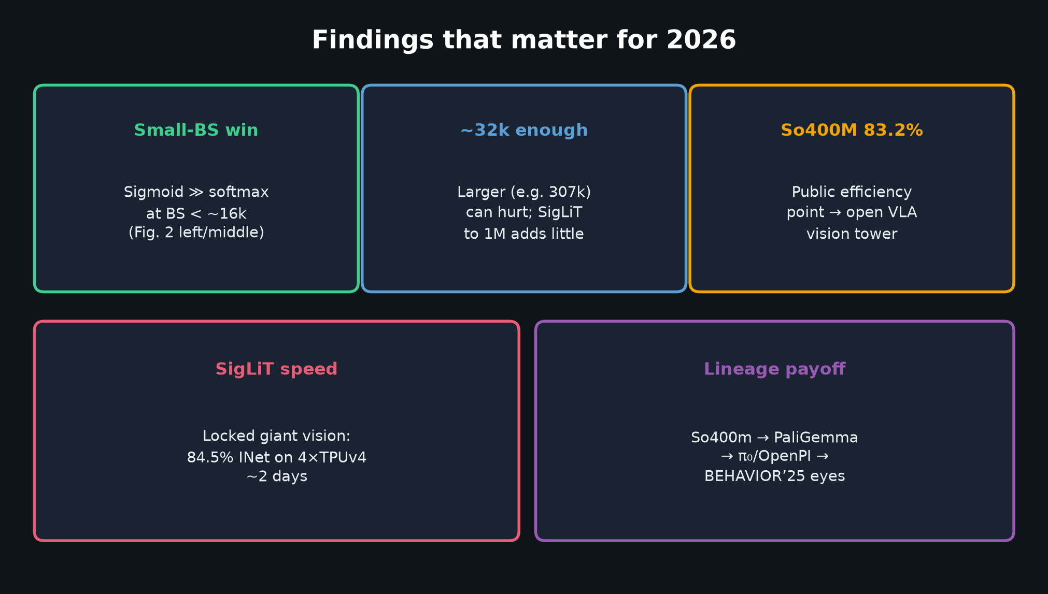
Stakeholder · 18+3 · 8/12
Notes:
FINDINGS FOR THIS CLUB
Small-BS win; ~32k enough; So400M 83.2%; SigLiT efficiency; lineage into VLA stacks.

Slide 9
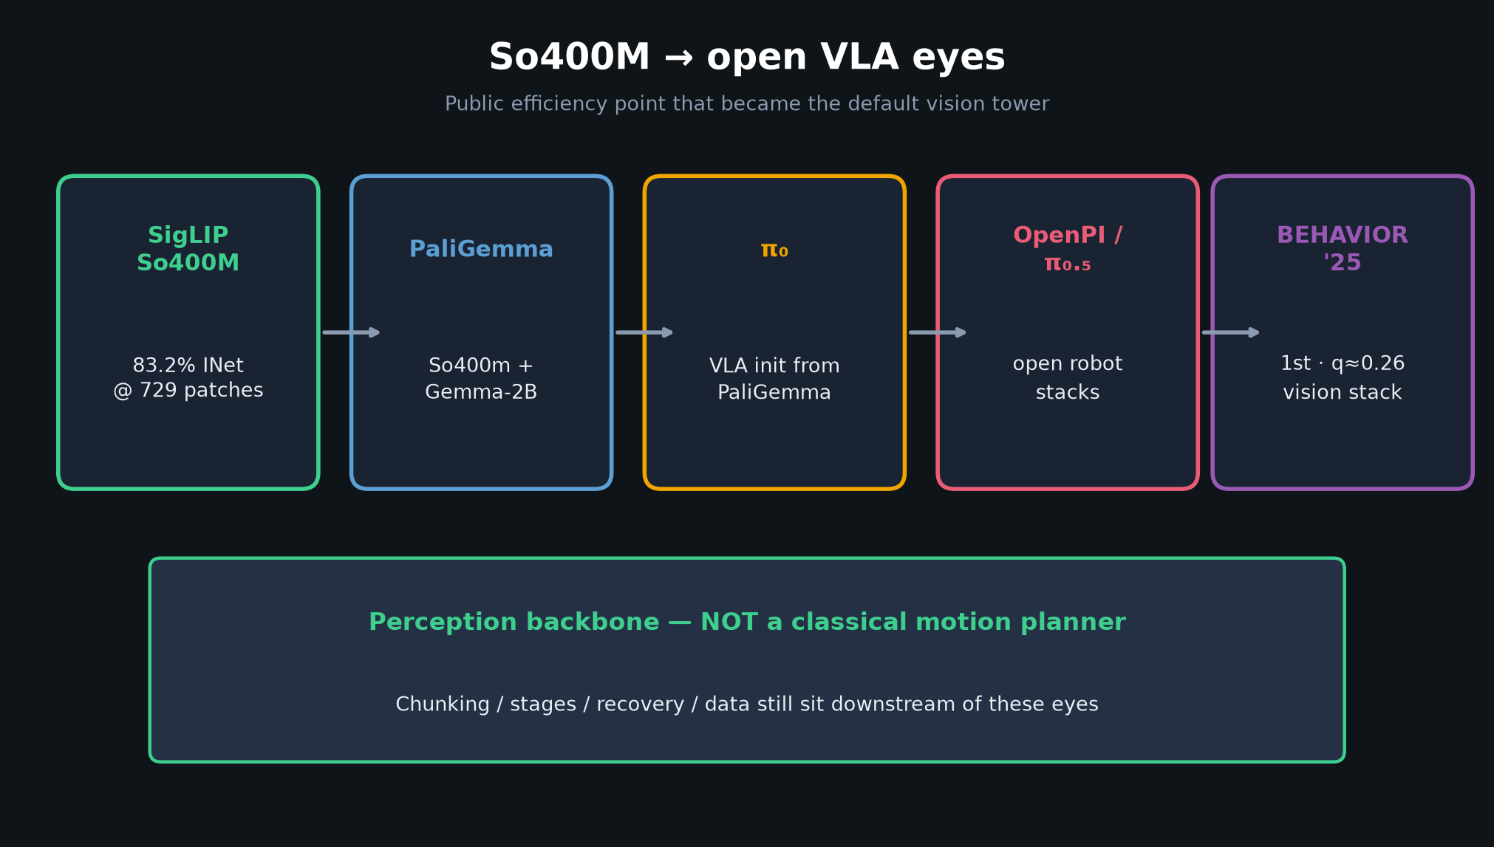
Stakeholder · 18+3 · 9/12
Notes:
SO400M → PALIGEMMA → OPENPI → BEHAVIOR
This is why a 2023 ICCV oral is on the Sep 14 calendar.
Perception backbone standardized the eyes — not the planner.

Slide 10
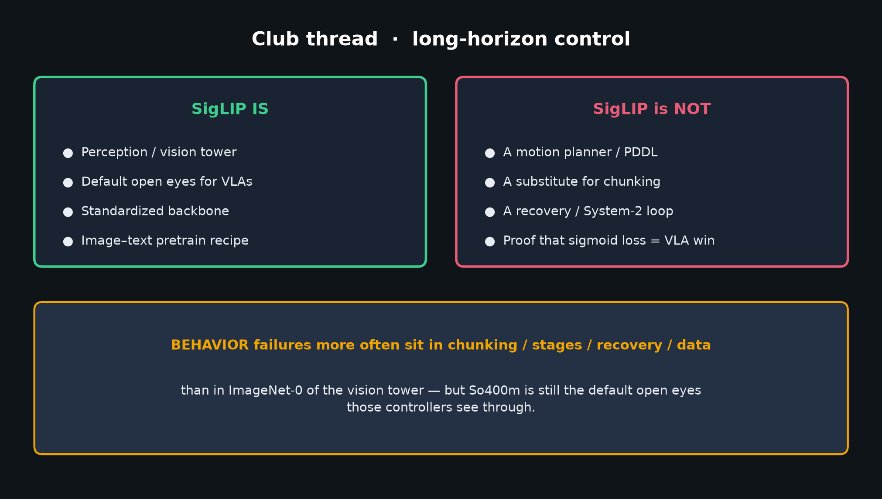
Stakeholder · 18+3 · 10/12
Notes:
PERCEPTION NOT PLANNER
BEHAVIOR failures often live in chunking/stages/recovery/data.
Still: So400m is the default open eyes those controllers use.

Slide 11
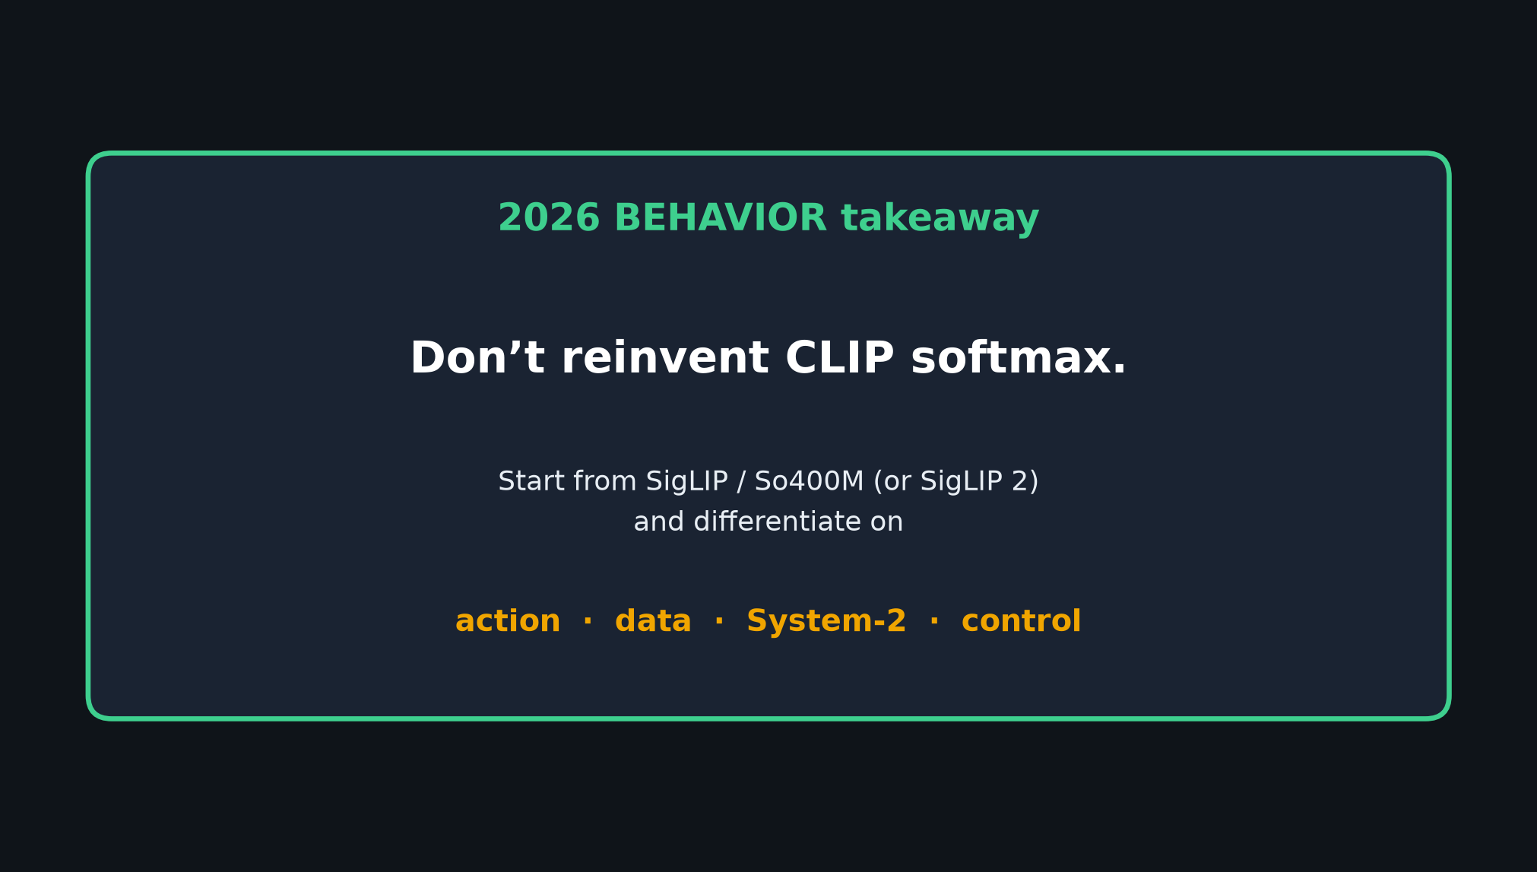
Stakeholder · 18+3 · 11/12
Notes:
2026 TAKEAWAY — deliver slowly
Don’t reinvent CLIP softmax.
Start from SigLIP/So400M (or SigLIP 2).
Differentiate on action / data / System-2 / control.

Slide 12
Stakeholder close
Don’t reinvent CLIP softmax · start from SigLIP/So400M
Stakeholder · 18+3 · 12/12
Notes:
STAKEHOLDER CLOSE / Q&A
Invite questions on batch lore, So400M adoption, why sigmoid mattered for open VLAs.
Hand off — later roles go deep, not redo.

