Slide 1
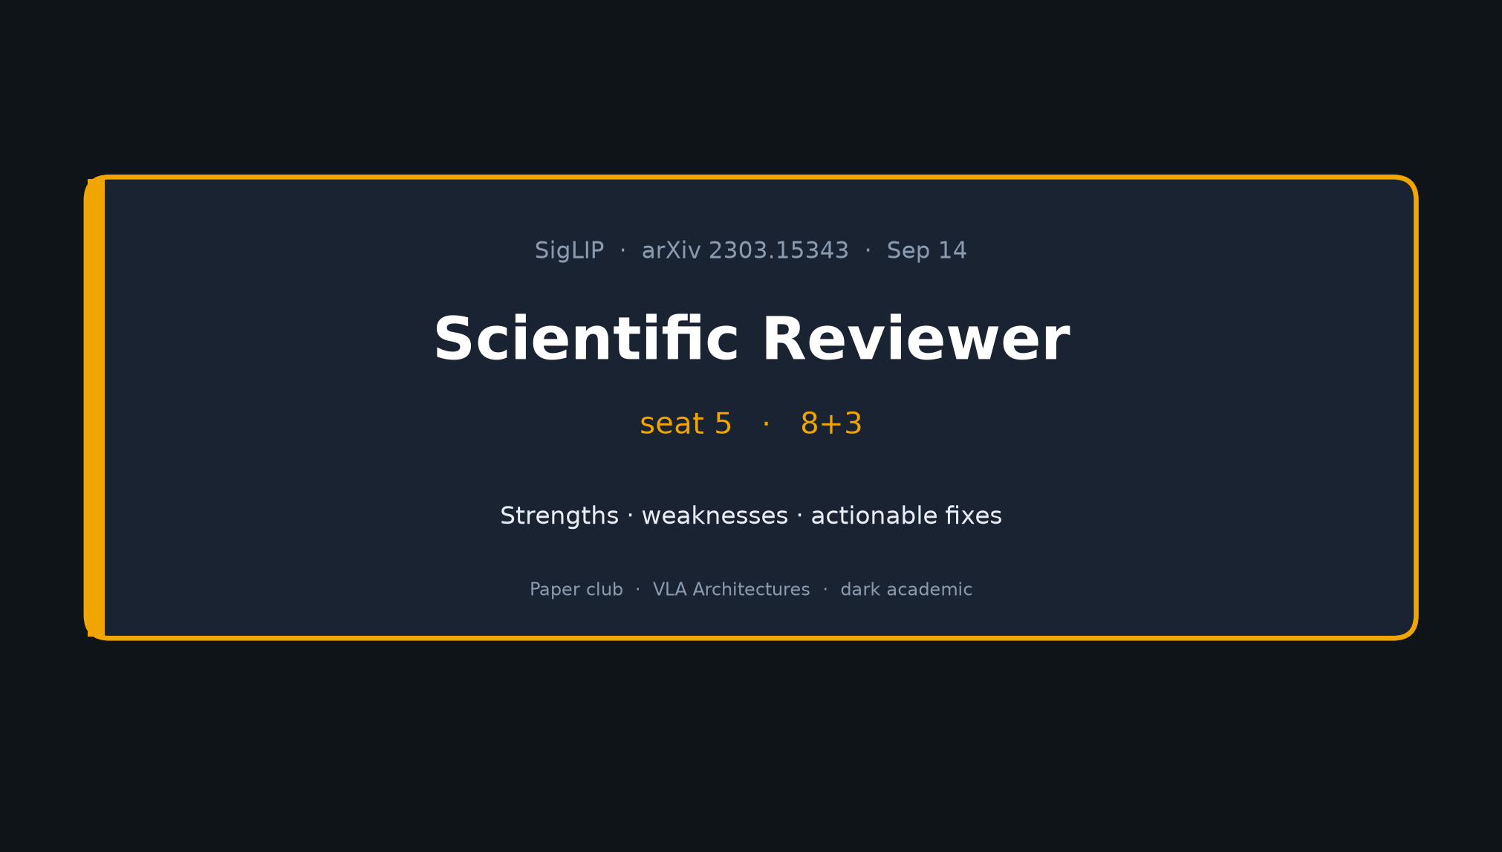
Scientific Reviewer · 8+3 · 1/7
Notes:
SCIENTIFIC REVIEWER — seat 5 — 8+3
NO motivation tour. Strengths → weaknesses → actionable fixes.
Pace tightly.

Slide 2
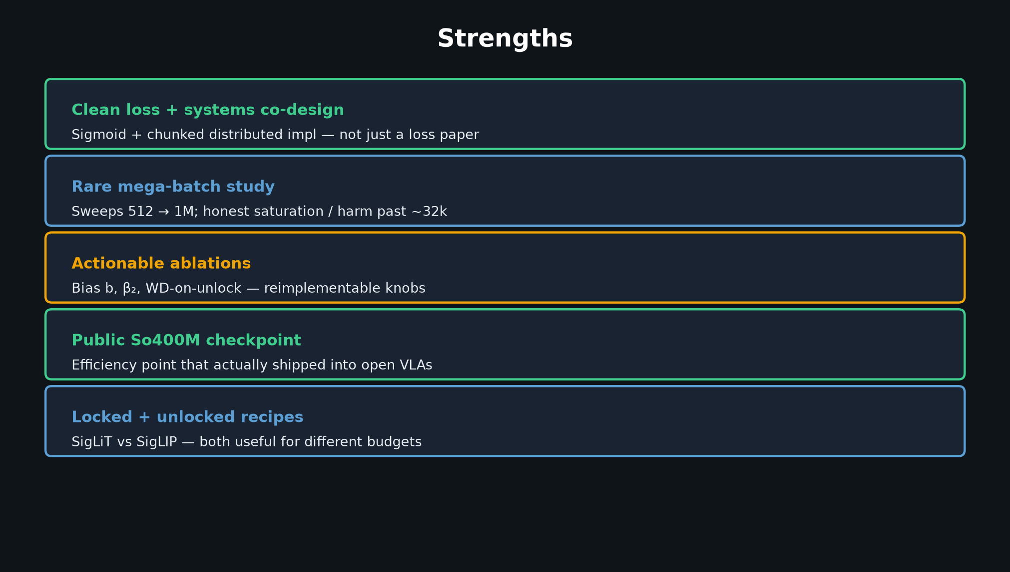
Scientific Reviewer · 8+3 · 2/7
Notes:
STRENGTHS
Clean loss+systems co-design; rare mega-batch study; honest saturation;
actionable ablations (bias, β₂, WD); public So400M; locked+unlocked recipes.

Slide 3
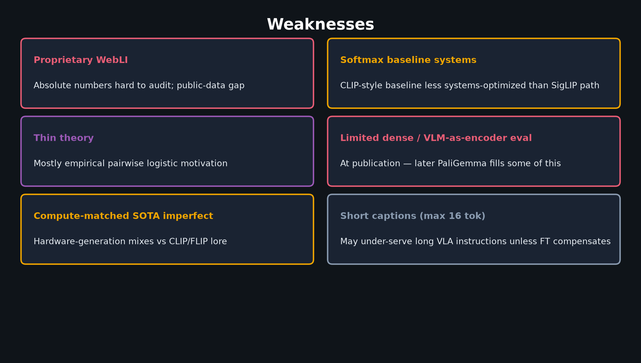
Scientific Reviewer · 8+3 · 3/7
Notes:
WEAKNESSES
Proprietary WebLI; softmax baseline less systems-optimized; thin theory;
limited dense/VLM-as-encoder eval at publication; compute-matched SOTA imperfect;
short captions (max 16 tok) for VLA language.

Slide 4
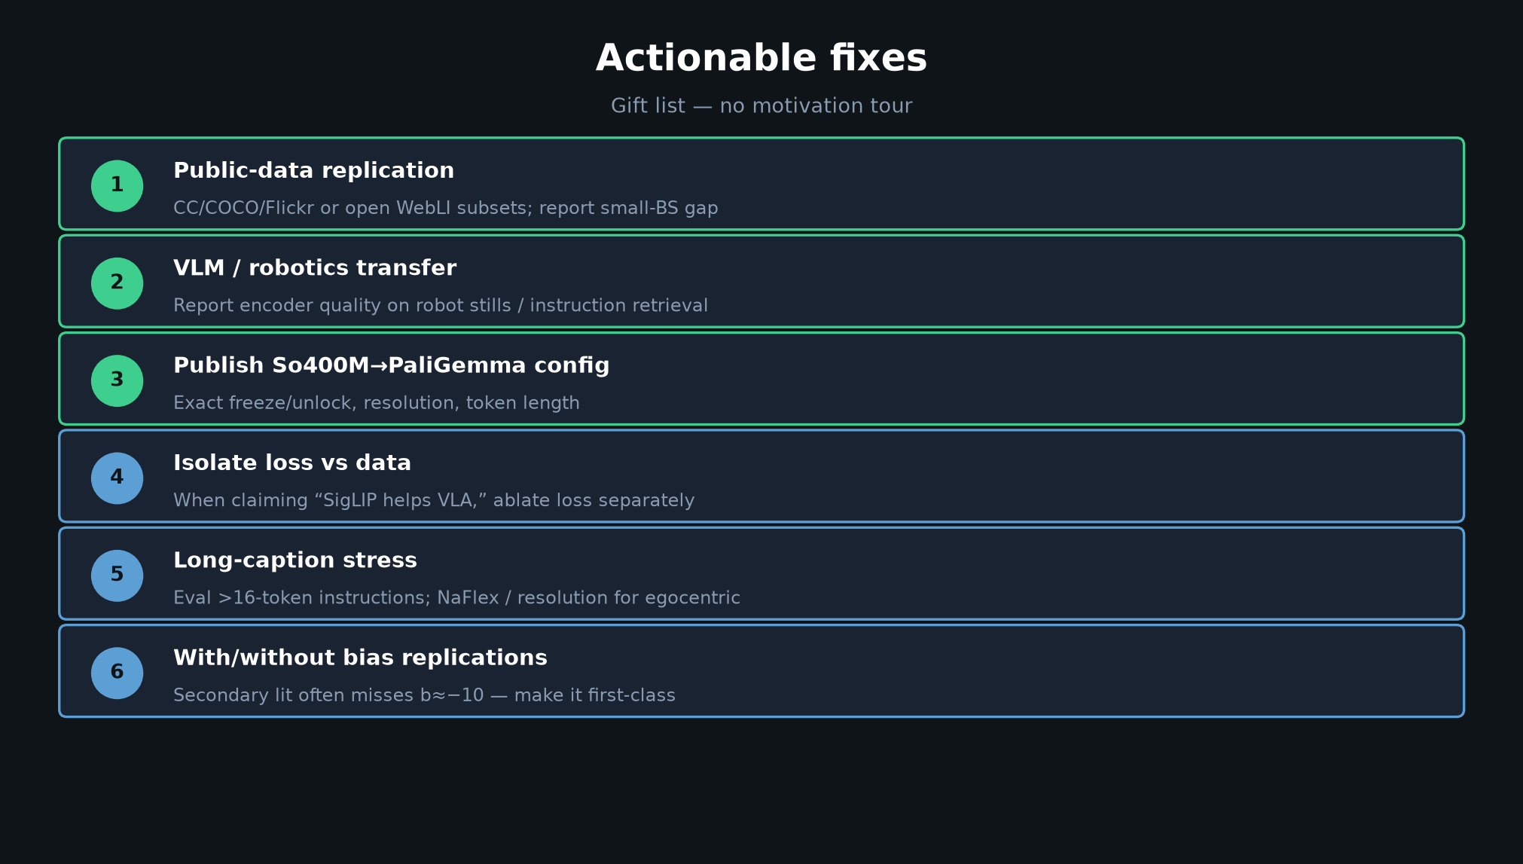
Scientific Reviewer · 8+3 · 4/7
Notes:
ACTIONABLE — gift to Empiricist / authors
1 Public-data replication
2 Report VLM/robotics transfer
3 Publish exact So400M→PaliGemma config
4 Isolate loss vs data when claiming “SigLIP helps VLA”
5 Long-caption / egocentric stress
6 With/without bias as first-class replication

Slide 5
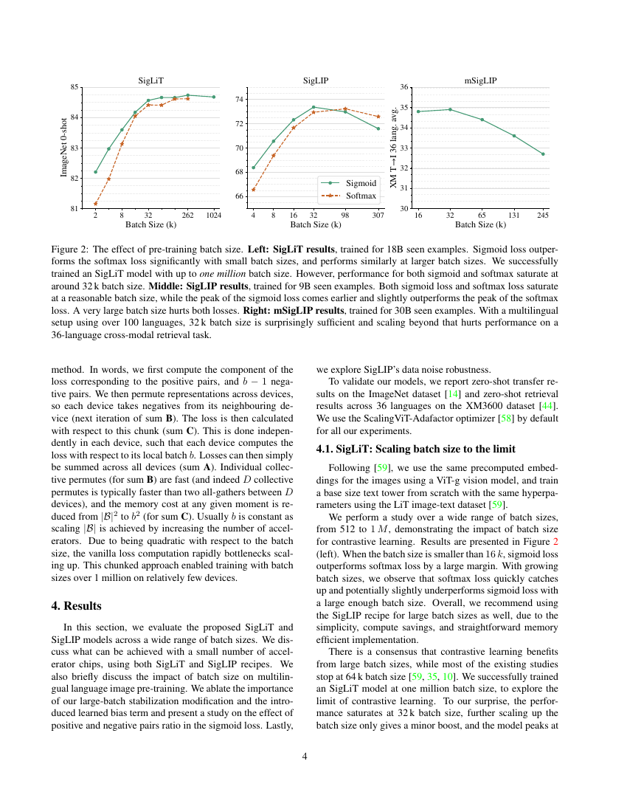
Evidence to cite when reviewing the batch narrative
Scientific Reviewer · 8+3 · 5/7
Notes:
CONFIRMED PAPER ARTIFACT — Fig. 2
When criticizing batch narrative, point at the paper’s own saturation/harm claim — strength AND invitation to multi-framework replication.

Slide 6
Extra critique notes
Negatives · bias under-sold · downstream ≠ loss · locked-vision speed
Scientific Reviewer · 8+3 · 6/7
Notes:
EXTRA CRITIQUE NOTES (if time)
Negative assumption on web data; bias under-emphasized in blogs;
downstream ≠ pretraining loss confounder for VLA talks;
“4 chips / 2 days” SigLiT uses locked giant vision — not from-scratch CLIP lore.

Slide 7
Reviewer close
Strengths real · WebLI gap · isolate loss vs data
Scientific Reviewer · 8+3 · 7/7
Notes:
REVIEWER CLOSE
Strengths real; WebLI/repro gap real; ask for isolation of loss vs data in VLA claims.
Q&A on critique only — don’t steal Empiricist plan.

