Slide 1
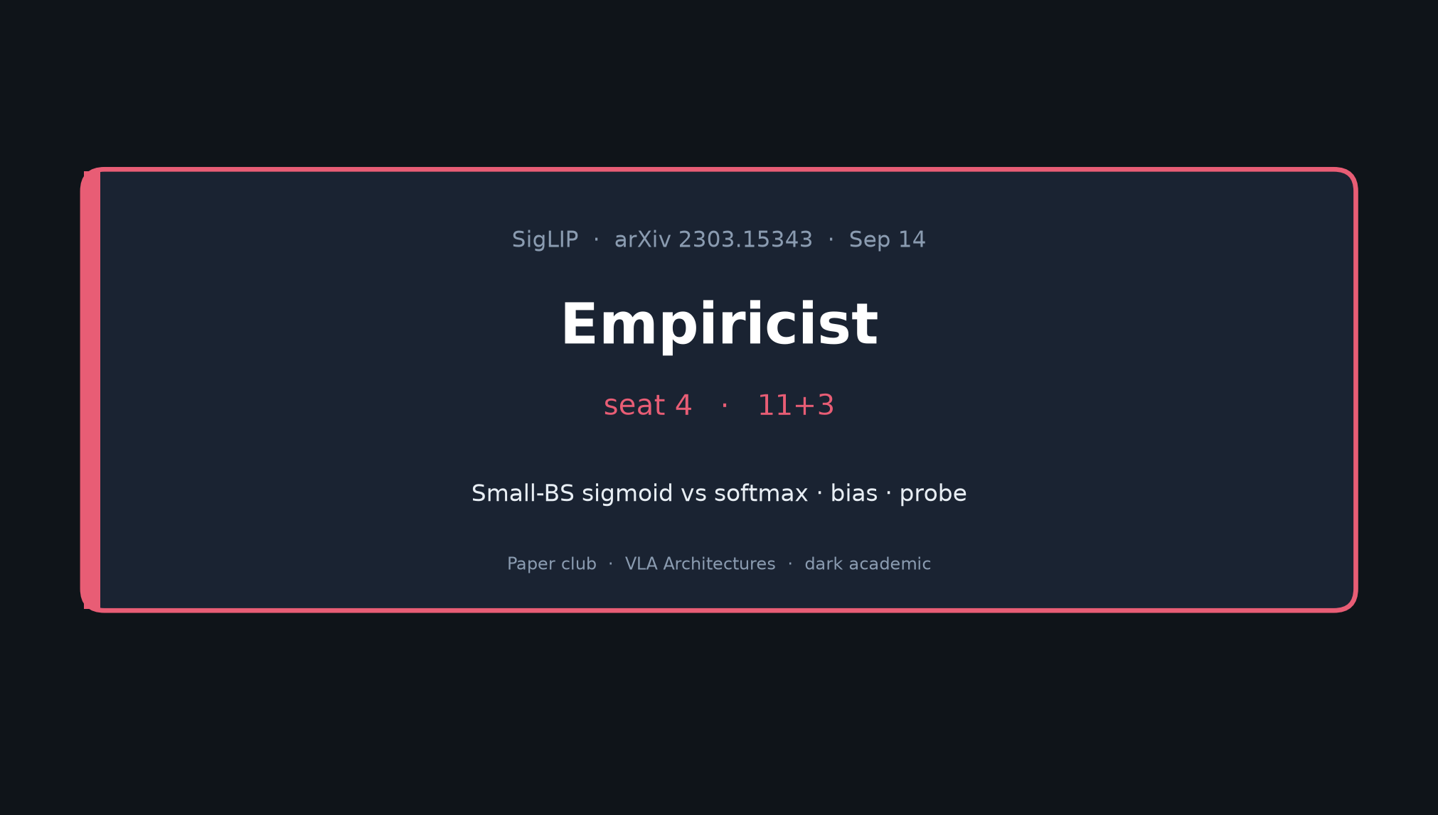
Empiricist · 11+3 · 1/10
Notes:
EMPIRICIST — seat 4 — 11+3
NO Stakeholder redo. Dive into H → E1/E2/E3 → budget → success = Fig.2 gap.
Skip full WebLI.

Slide 2
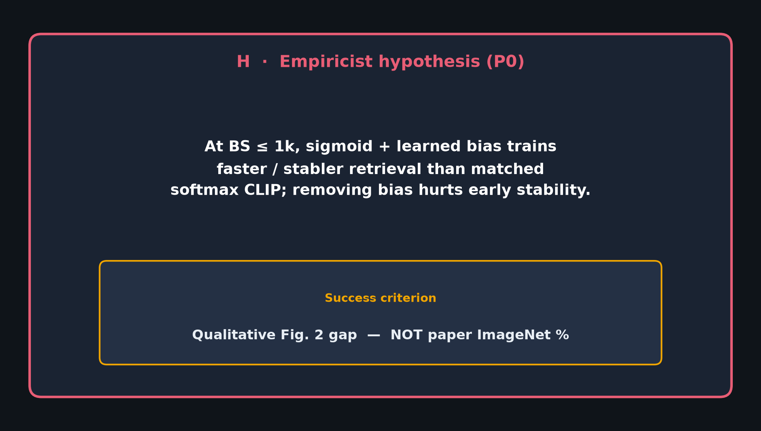
Empiricist · 11+3 · 2/10
Notes:
HYPOTHESIS (read slowly)
At BS≤1k, sigmoid+learned bias trains faster/stabler retrieval than matched softmax CLIP;
removing bias hurts early stability.
Success = qualitative Fig.2 gap, NOT paper ImageNet %.

Slide 3
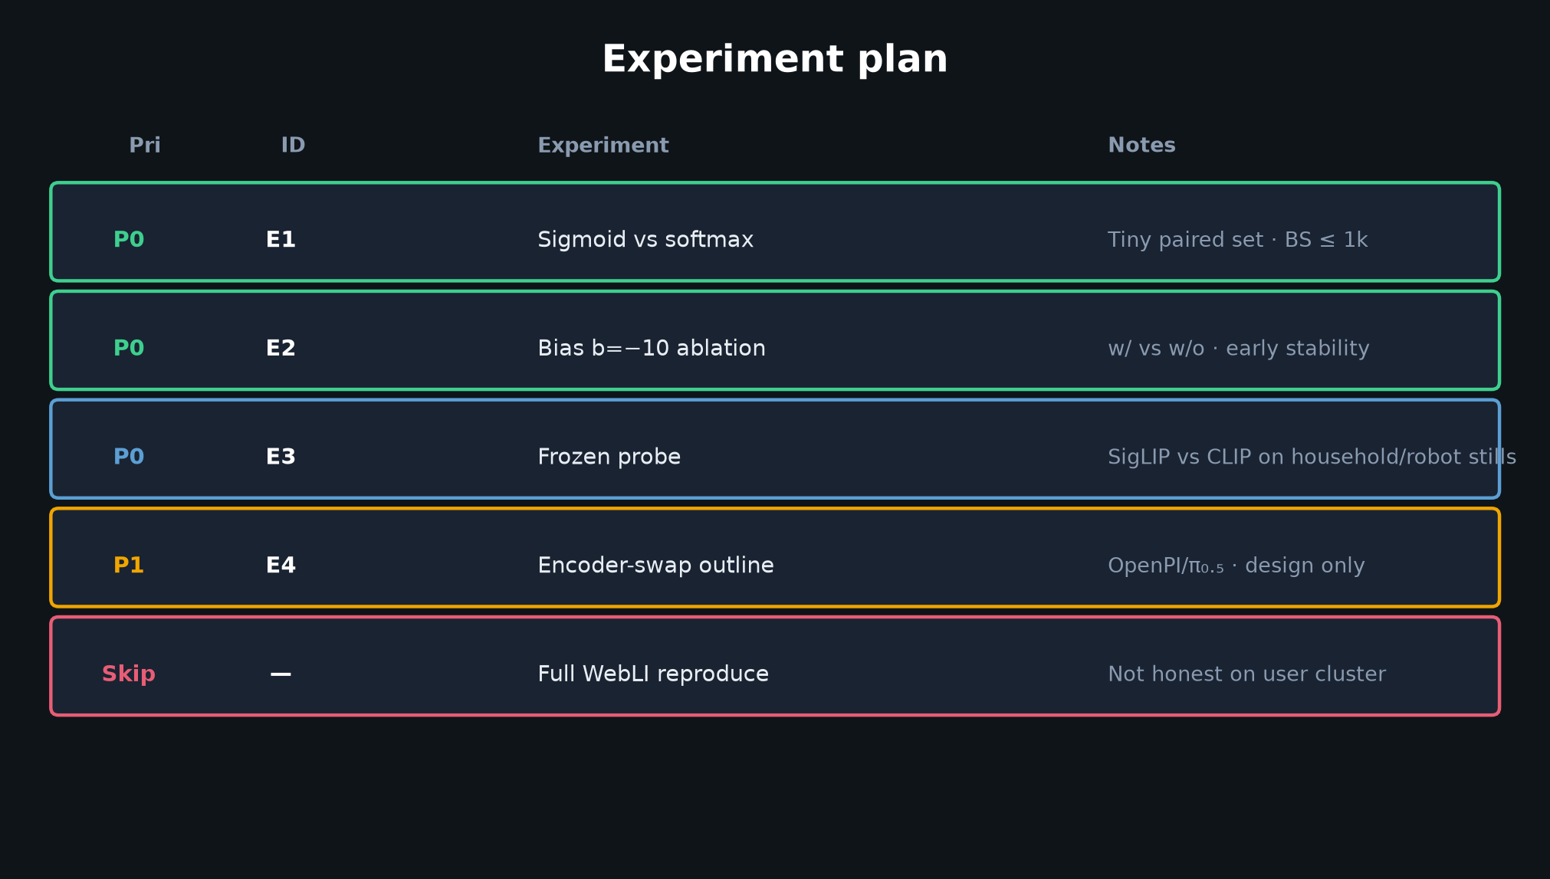
Empiricist · 11+3 · 3/10
Notes:
EXPERIMENT PLAN
P0 E1: sigmoid vs softmax on tiny paired set (BS≤1k)
P0 E2: bias b=−10 ablation
P0 E3: frozen SigLIP vs CLIP probe on household/robot stills
P1 E4: OpenPI encoder-swap OUTLINE only
SKIP: full WebLI-scale reproduce

Slide 4
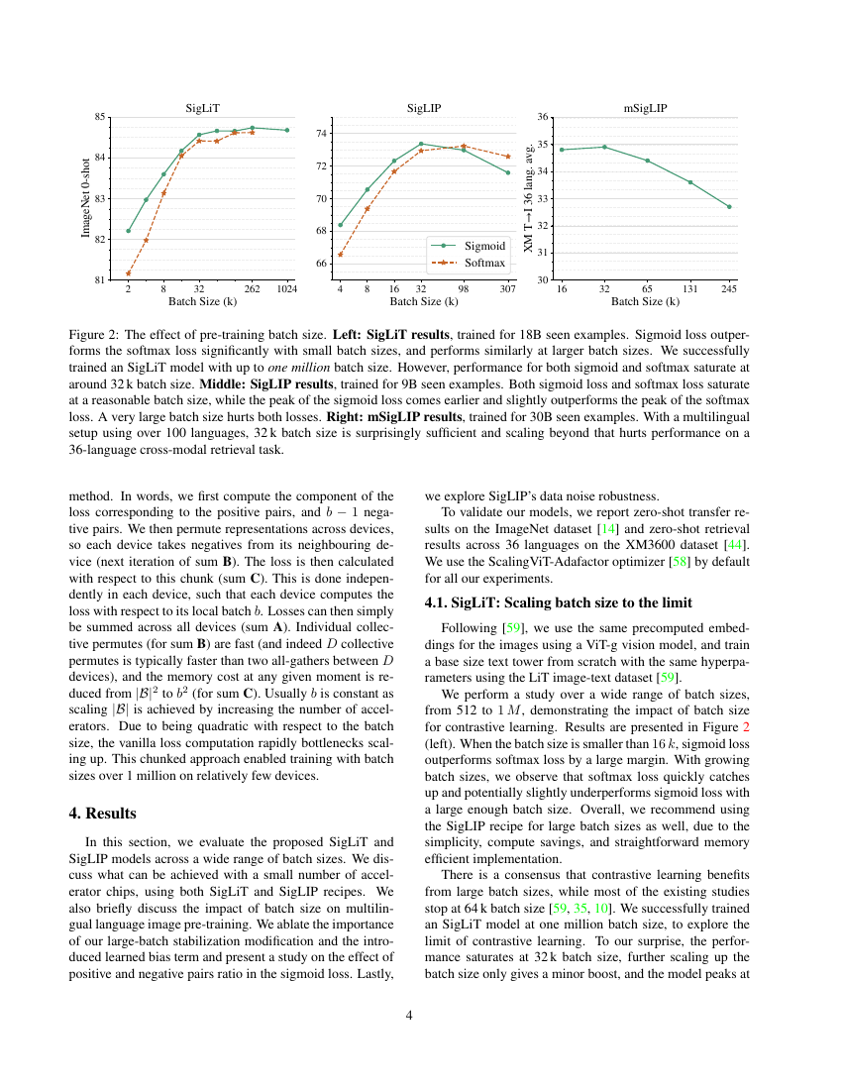
Target qualitative shape — Fig. 2 (not absolute INet %)
Empiricist · 11+3 · 4/10
Notes:
WHAT “MATCH Fig.2” MEANS
Show the paper figure. Your local curves won’t hit absolute % —
you want the qualitative shape: sigmoid above softmax at small BS.

Slide 5
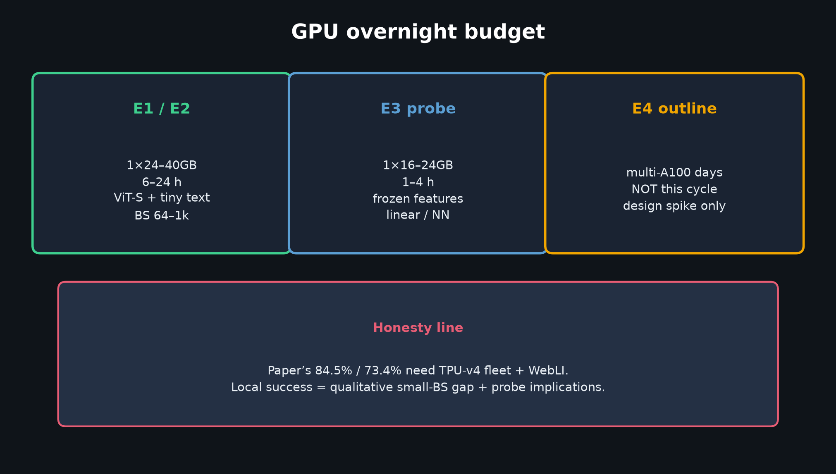
Empiricist · 11+3 · 5/10
Notes:
GPU OVERNIGHT BUDGET
E1/E2: 1×24–40GB, 6–24h
E3: cheap 1–4h
E4: multi-GPU days — outline only
Honesty: paper numbers need TPU fleet + WebLI.

Slide 6
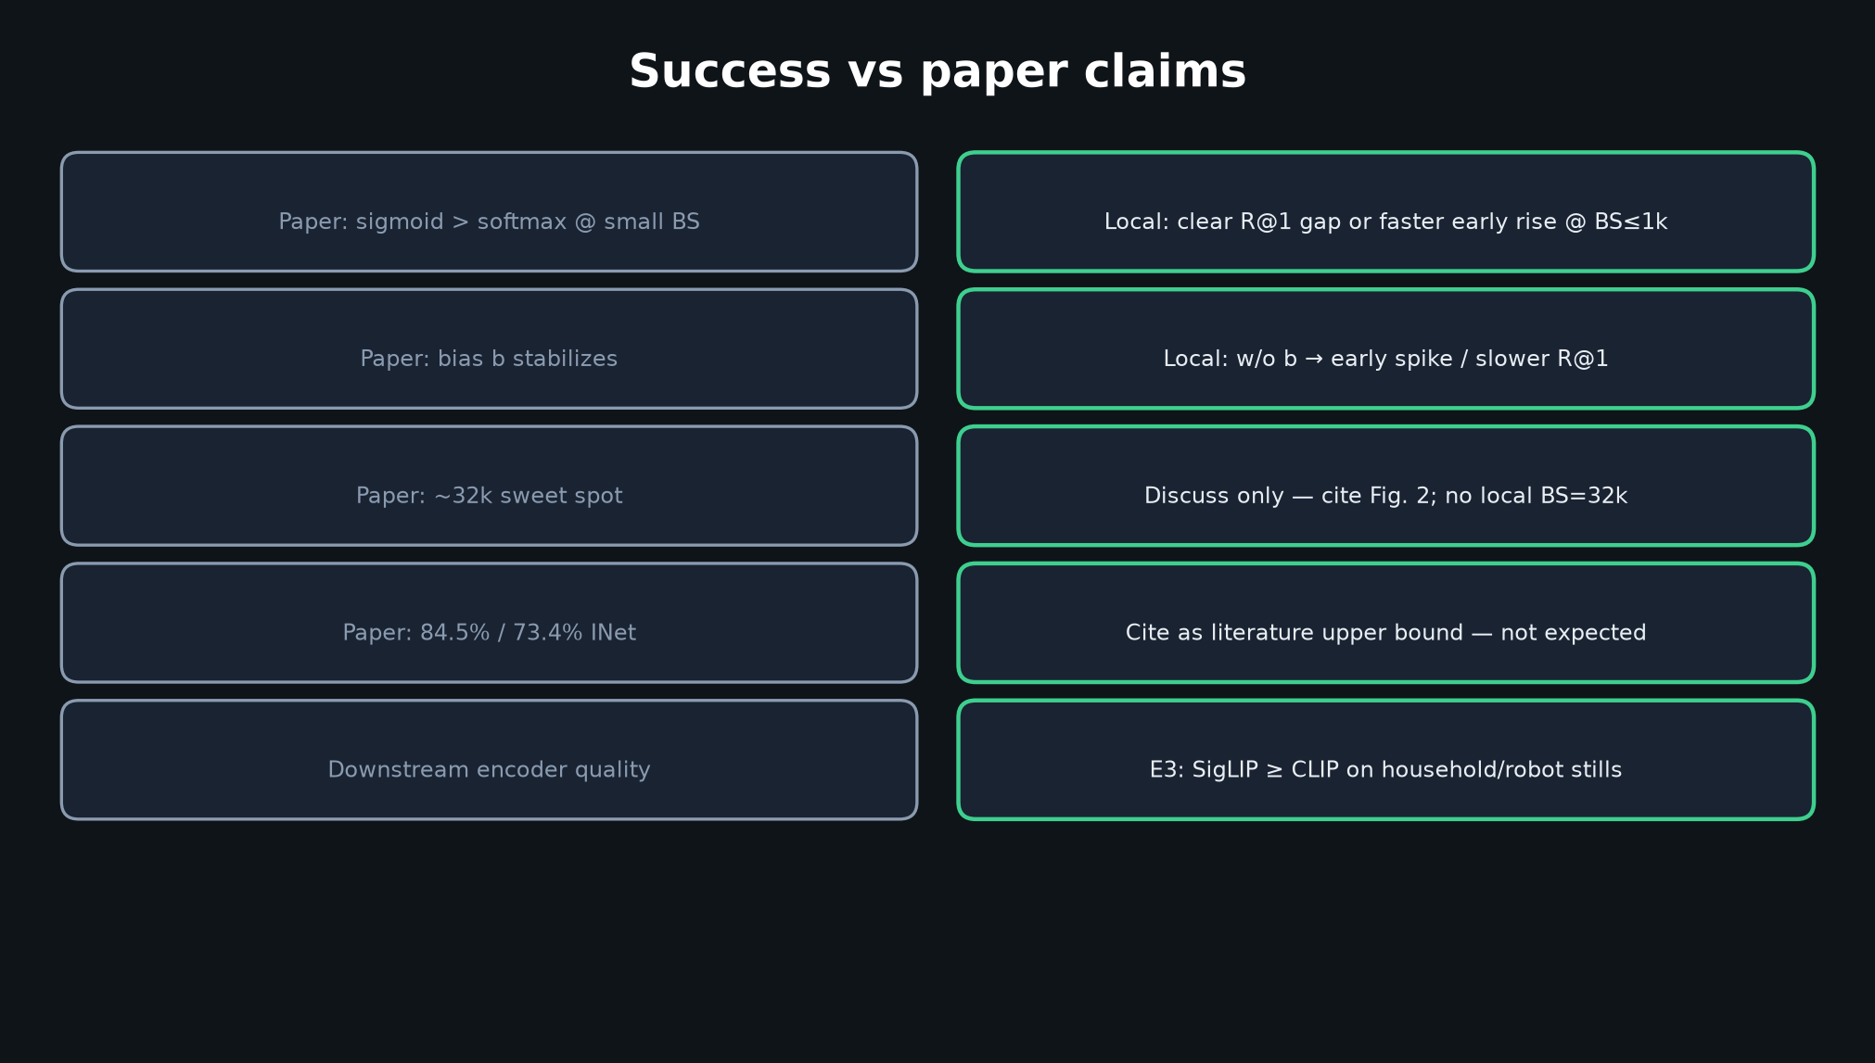
Empiricist · 11+3 · 6/10
Notes:
SUCCESS CRITERIA TABLE
Walk paper claim → local criterion.
Emphasize what is NOT expected (absolute INet %, BS=32k run).

Slide 7
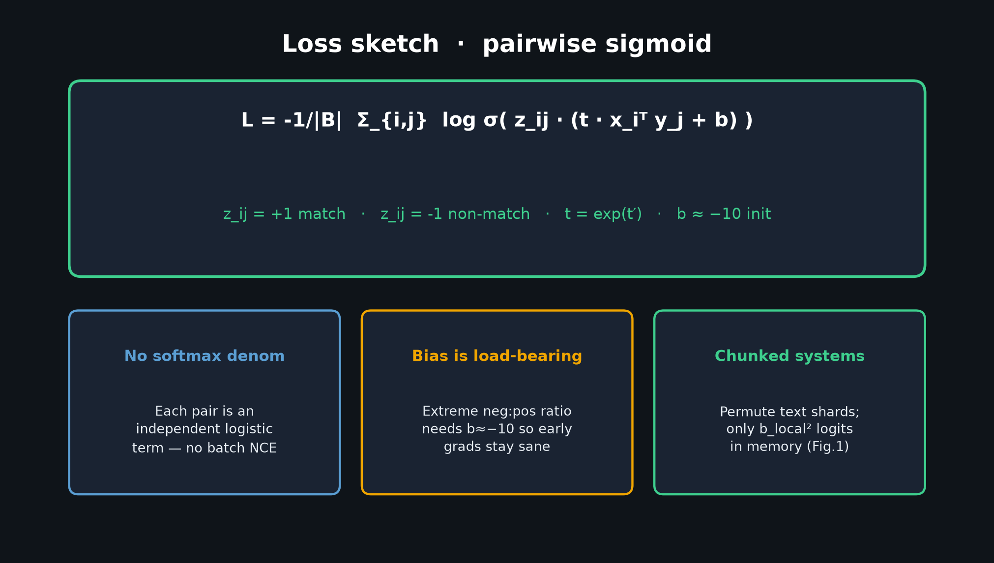
Empiricist · 11+3 · 7/10
Notes:
LOSS IMPLEMENTATION REMINDER
Unit-test sigmoid_loss vs softmax_clip_loss shapes; label matrix 2I−1;
finite grads at b=−10 init. Env stubs in /workspace/siglip-quiet/env_outline/.

Slide 8
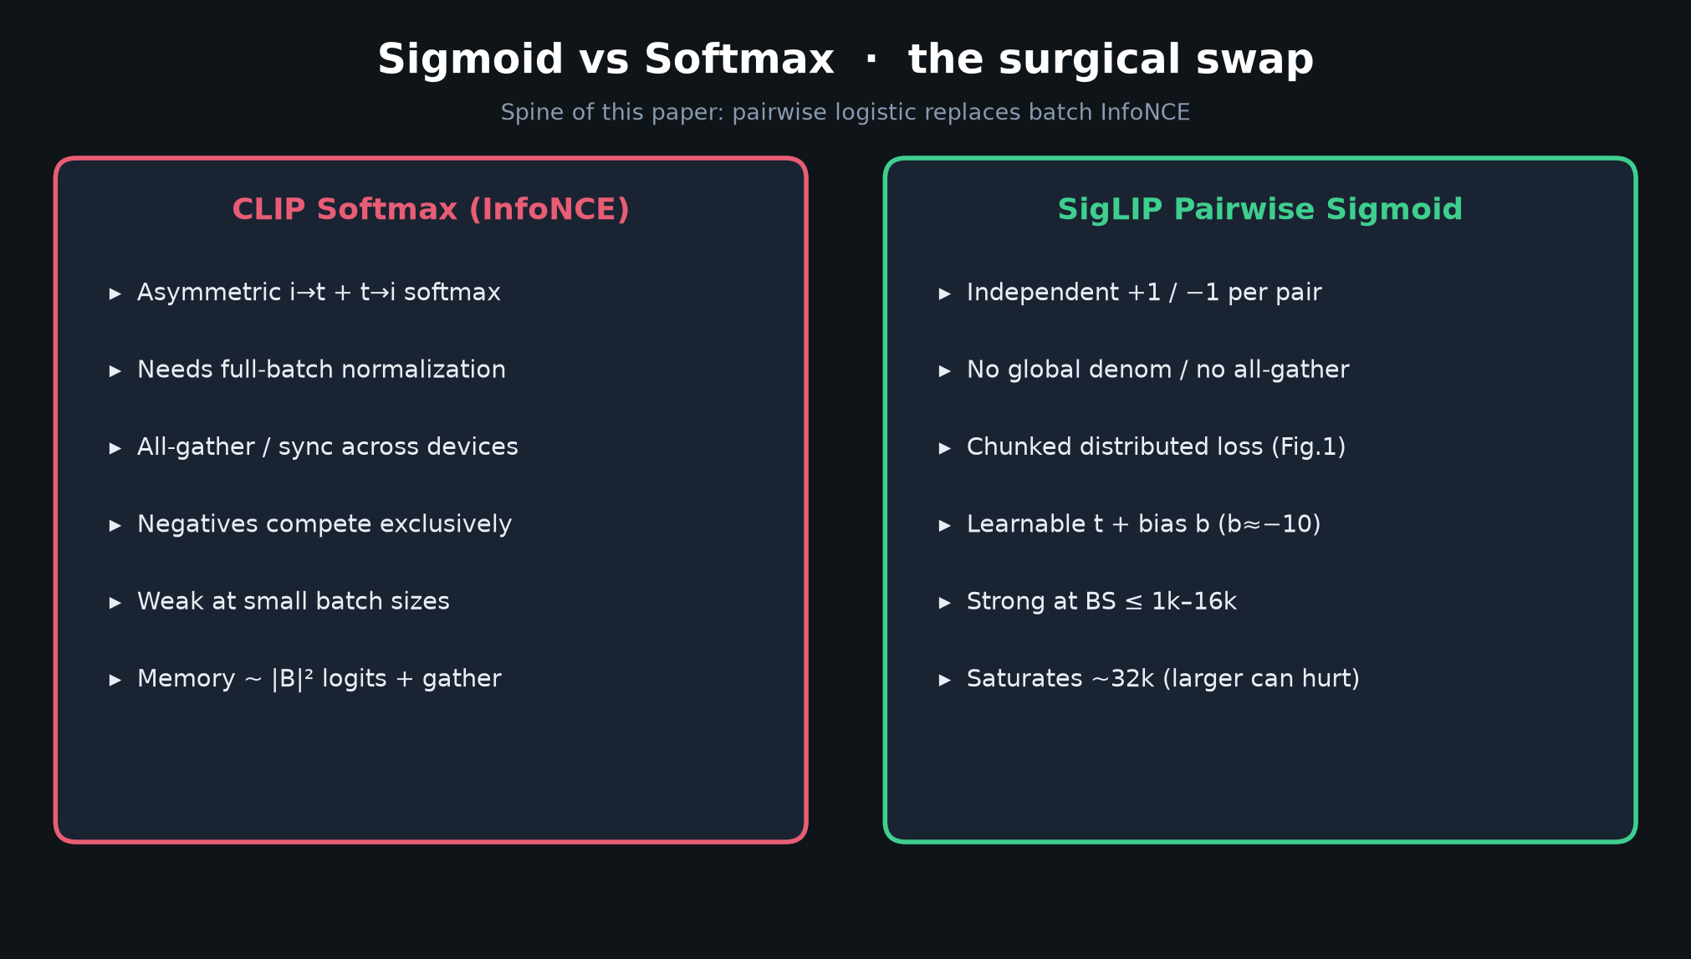
Empiricist · 11+3 · 8/10
Notes:
WHY SMALL-BS MATTERS FOR VLA
Robot / teleop batches are small. Sigmoid’s small-BS advantage is the club-relevant claim.
E3 asks whether pretraining still matches robot domain shift vs CLIP.

Slide 9
E4 outline only
OpenPI encoder-swap = design spike · not overnight Empiricist job
Empiricist · 11+3 · 9/10
Notes:
E4 OUTLINE ONLY
Encoder swap OpenPI π₀.₅ SigLIP → CLIP (or So400m → B/16) on tiny BEHAVIOR/Libero —
design spike for Visionary/systems, not this week’s overnight job.

Slide 10
Empiricist close
H @ BS≤1k · E1/E2/E3 · success = Fig.2 gap · skip WebLI
Empiricist · 11+3 · 10/10
Notes:
EMPIRICIST CLOSE
Restate H. Restate success = Fig.2 gap. Skip WebLI. Hand GPU plan to whoever runs cluster.

