Slide 1
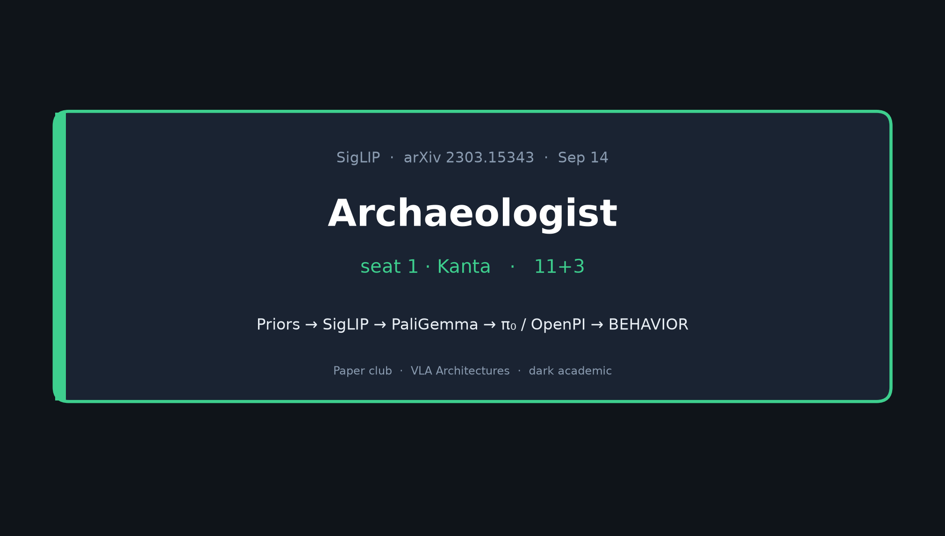
Archaeologist · 11+3 · 1/11
Notes:
ARCHAEOLOGIST OPENING — seat 1 = Kanta — 11 min + 3 Q&A
You OWN lineage. No Stakeholder motivation tour.
Job tonight:
1) Prior table — what SigLIP inherits and surgically replaces
2) Subsequent timeline — PaLI-3 → PaliGemma → π₀ → OpenPI → SigLIP 2 → BEHAVIOR’25 → HF
3) One-sentence lineage (memorize it)
4) Honest hedges — freeze/unlock not always documented; “uses SigLIP” ≠ isolating loss
Spine reminder: sigmoid vs softmax + So400M → PaliGemma → OpenPI/π₀ → BEHAVIOR’25
SigLIP is PERCEPTION backbone, not classical motion planner.

Slide 2
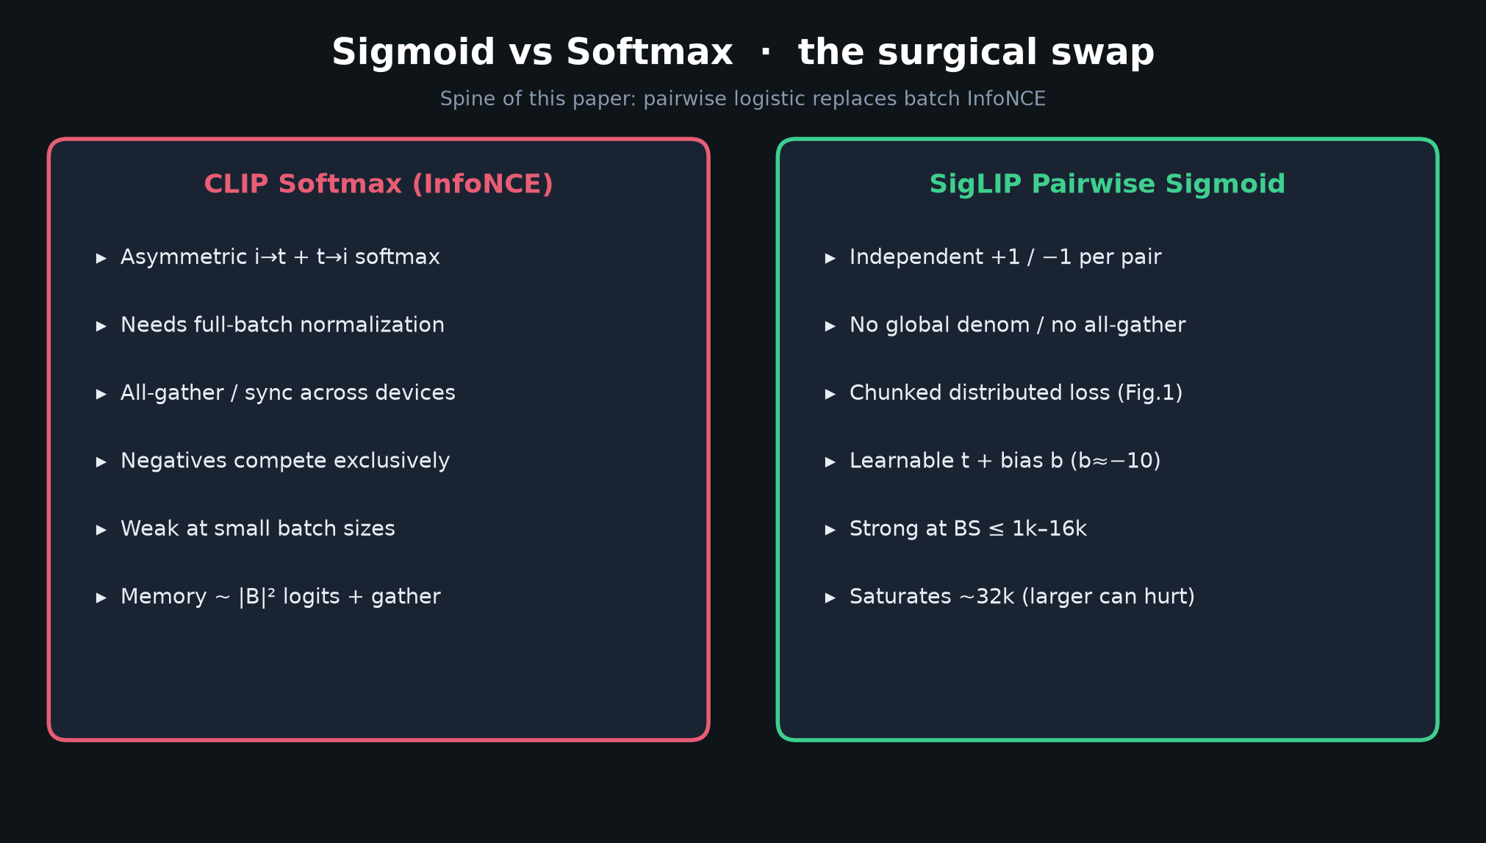
Archaeologist · 11+3 · 2/11
Notes:
OPTIONAL ORIENTATION (30–45s max)
Pairwise sigmoid replaces batch softmax InfoNCE.
Learnable temperature t + bias b (b≈−10).
No global batch normalization → chunked distributed training.
Do NOT linger — this is Archaeologist, not Stakeholder. Point at the swap, then move to priors.

Slide 3
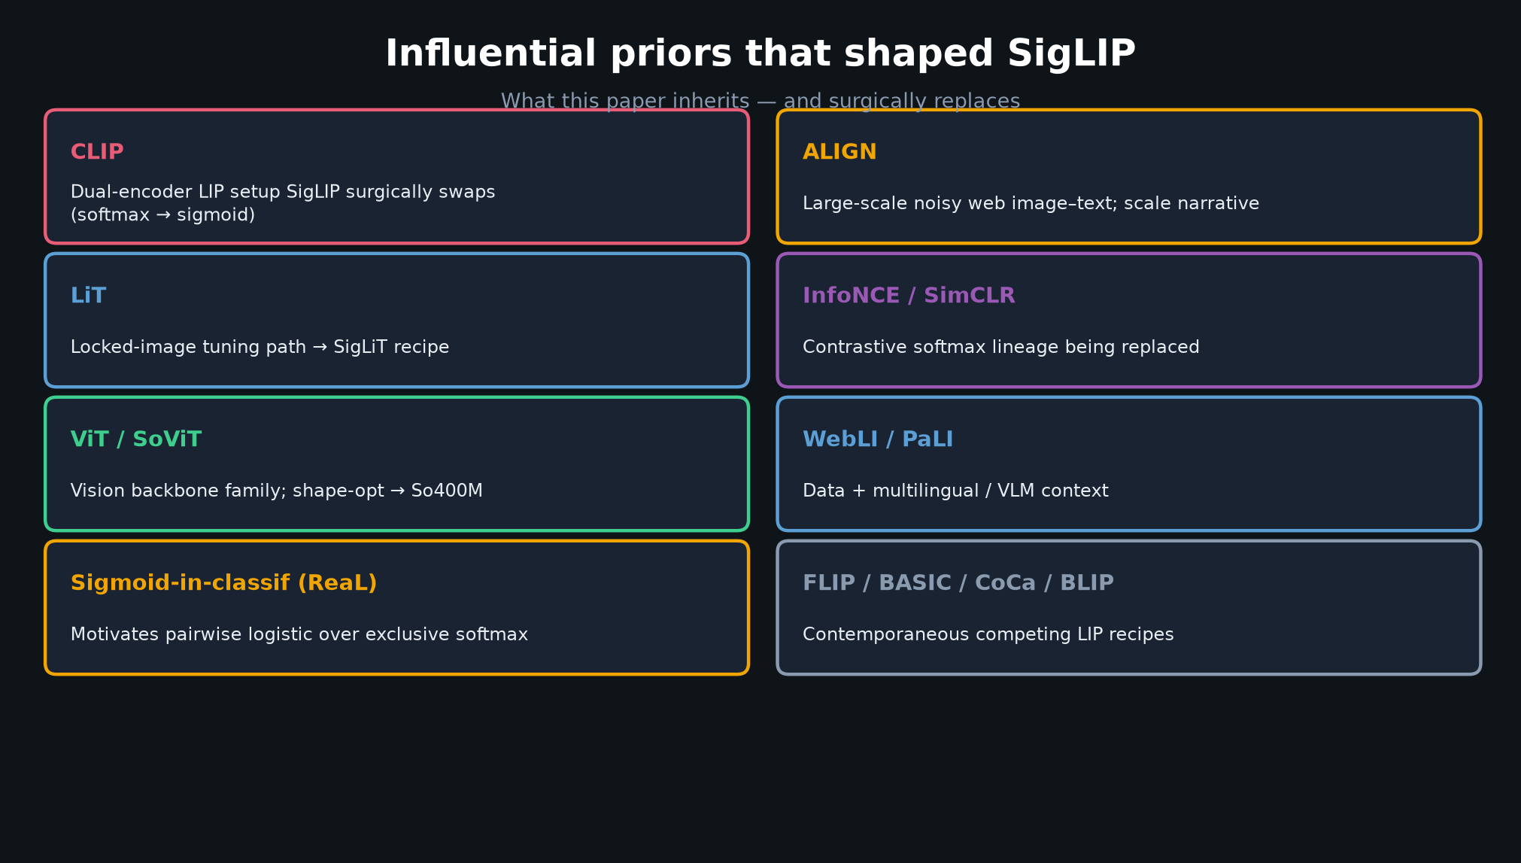
Archaeologist · 11+3 · 3/11
Notes:
INFLUENTIAL PRIORS — walk the table (this is your core visual #1)
CLIP (Radford): dual-encoder LIP setup SigLIP surgically replaces (softmax → sigmoid).
ALIGN: large-scale noisy web image–text; scale narrative.
LiT: locked-image tuning path → SigLiT.
InfoNCE / SimCLR: contrastive softmax lineage being replaced.
ViT / Scaling ViTs / SoViT: vision backbone family; shape-opt for So400M.
WebLI / PaLI: data + multilingual / VLM context.
Sigmoid-in-classification (e.g. ReaL): motivates pairwise logistic over exclusive softmax.
Contemporaneous: FLIP, BASIC, CoCa, BLIP — competing LIP recipes.
Spend ~3 min. Emphasize CLIP+LiT+WebLI as the immediate parents.

Slide 4
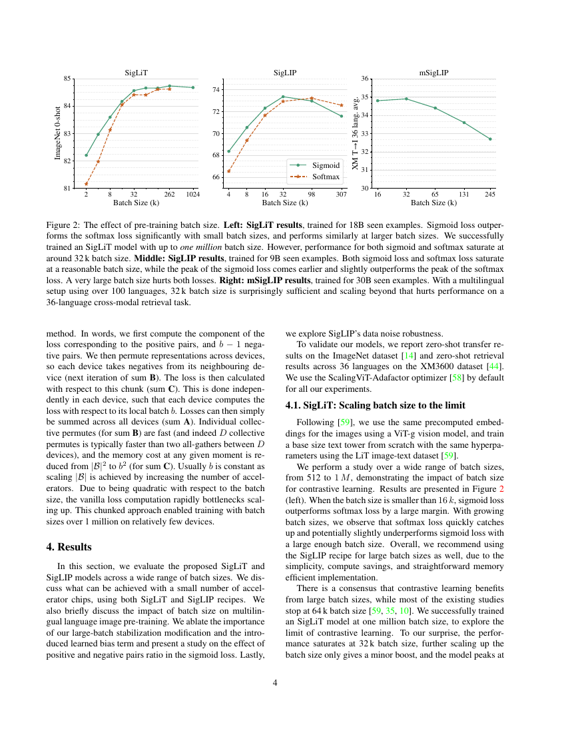
Paper Fig. 2 — batch-size effect (sigmoid vs softmax)
Archaeologist · 11+3 · 4/11
Notes:
PAPER ARTIFACT — Fig. 2 batch-size story (from paper PDF page 4)
Left/middle: sigmoid outperforms softmax at small BS; gap closes as BS grows.
Both saturate near ~32k; very large BS (e.g. 307k) can hurt.
Cite, don’t re-derive. This is the empirical signature later work inherits when they pick SigLIP weights.

Slide 5
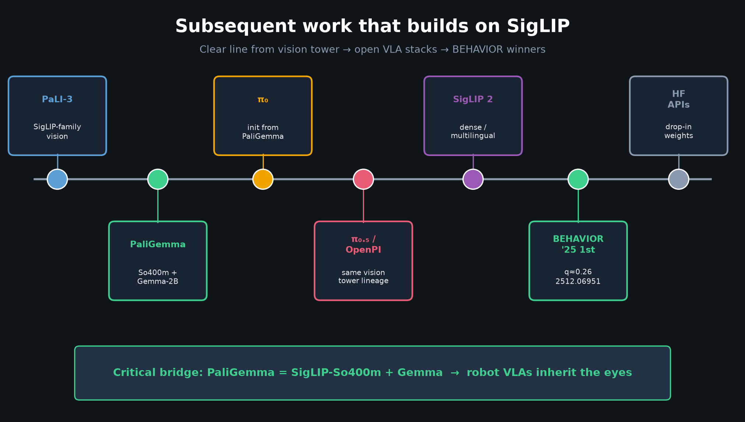
Archaeologist · 11+3 · 5/11
Notes:
SUBSEQUENT TIMELINE — core visual #2 (~3–4 min)
PaLI-3: continues Google VLM stack with SigLIP-family vision.
PaliGemma (2407.07726): SigLIP-So400m + Gemma-2B — THE CRITICAL BRIDGE.
π₀ (2410.24164): initializes from PaliGemma → robot VLA.
π₀.₅ / OpenPI: same vision tower lineage in open robot stacks.
SigLIP 2 (2502.14786): next-gen dense/multilingual improvements.
BEHAVIOR’25 1st place (2512.06951): diagram SigLIP → PaliGemma → Action Expert; q≈0.26.
HF Transformers SigLIP APIs: mass adoption / drop-in weights.
Point: the paper’s public So400M checkpoint became the default open eyes.

Slide 6
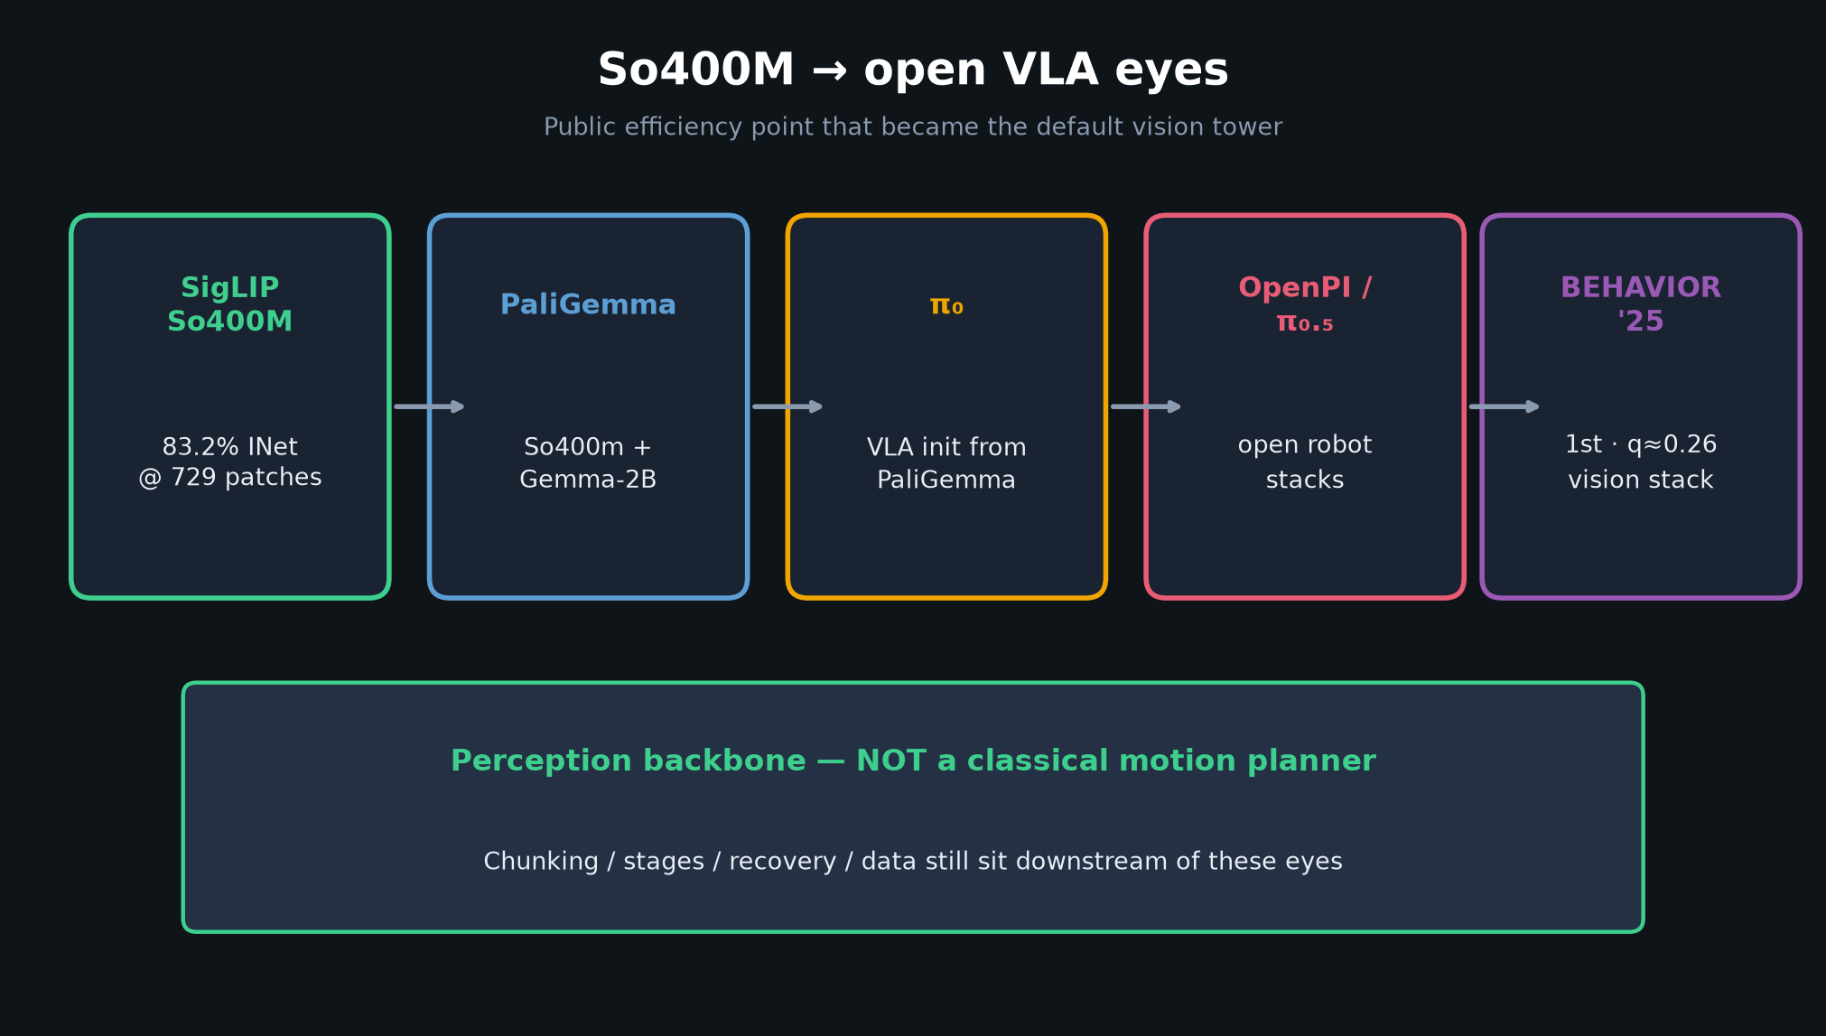
Archaeologist · 11+3 · 6/11
Notes:
SO400M CHAIN — zoom the bridge
Public SigLIP So400M @ 729 patches → 83.2% ImageNet.
That efficiency point → PaliGemma vision tower → π₀ init → OpenPI/π₀.₅ → BEHAVIOR winners’ vision stack.
Say out loud: perception backbone, NOT classical motion planner.
Club failures more often sit in chunking / stages / recovery / data — but these are the eyes those controllers see through.

Slide 7
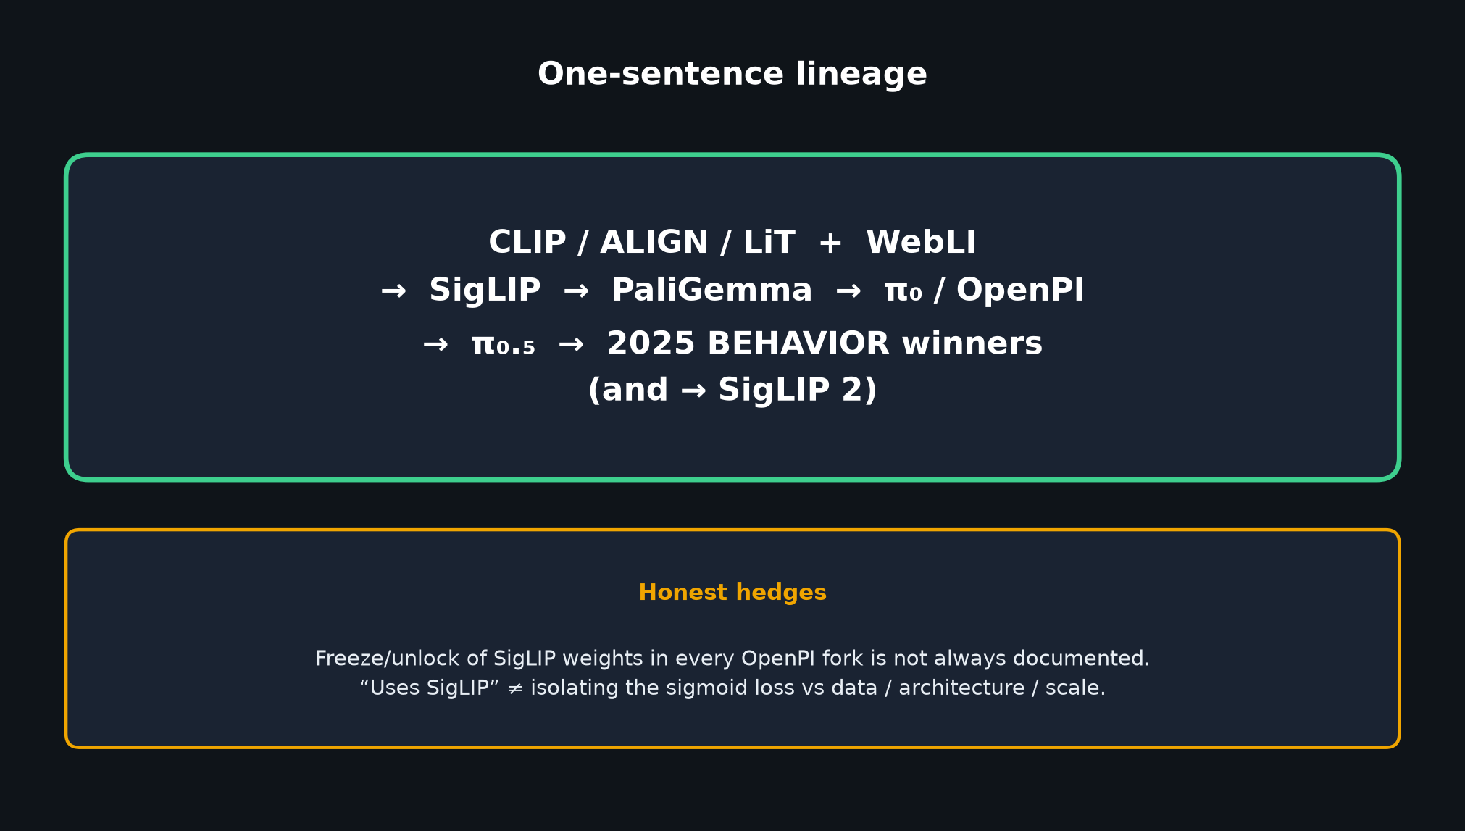
Archaeologist · 11+3 · 7/11
Notes:
ONE-SENTENCE LINEAGE — memorize and deliver slowly
“CLIP/ALIGN/LiT + WebLI → SigLIP → PaliGemma → π₀/OpenPI → π₀.₅ → 2025 BEHAVIOR winners (and → SigLIP 2).”
HONEST HEDGES (say these):
• Exact OpenPI freeze-vs-unlock of SigLIP weights in every fork is not always documented.
• Many “uses SigLIP” papers inherit weights WITHOUT isolating loss vs data/architecture.
• Downstream robot success ≠ validation of the sigmoid loss paper by itself.

Slide 8
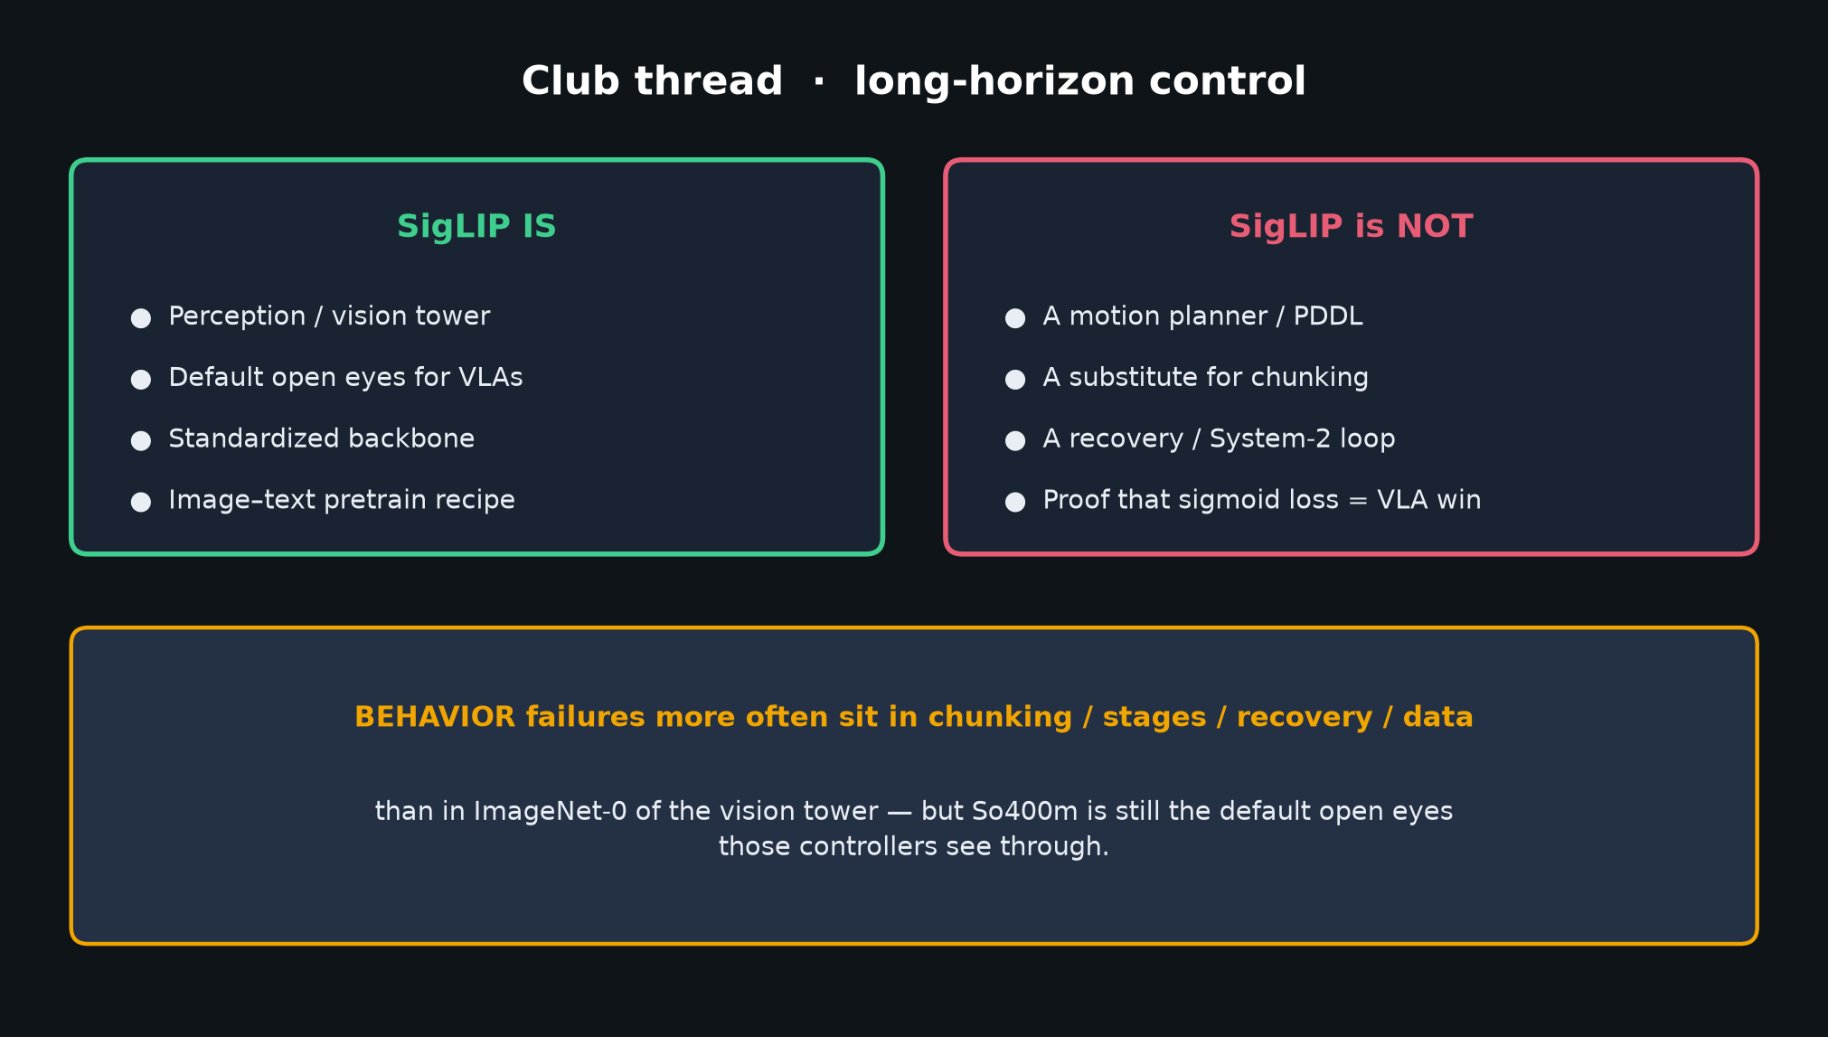
Archaeologist · 11+3 · 8/11
Notes:
PERCEPTION VS PLANNER — club thread
DO connect: OpenPI/π₀/π₀.₅ vision front-end is SigLIP-family; BEHAVIOR stacks encode multi-view RGB with SigLIP.
DO NOT force: classical PDDL/Task Network; claim that sigmoid during policy training equals SigLIP pretraining; claim SigLIP “solves” long-horizon motion.
Hand to Visionary: encoder-swap experiments live on this spine.

Slide 9
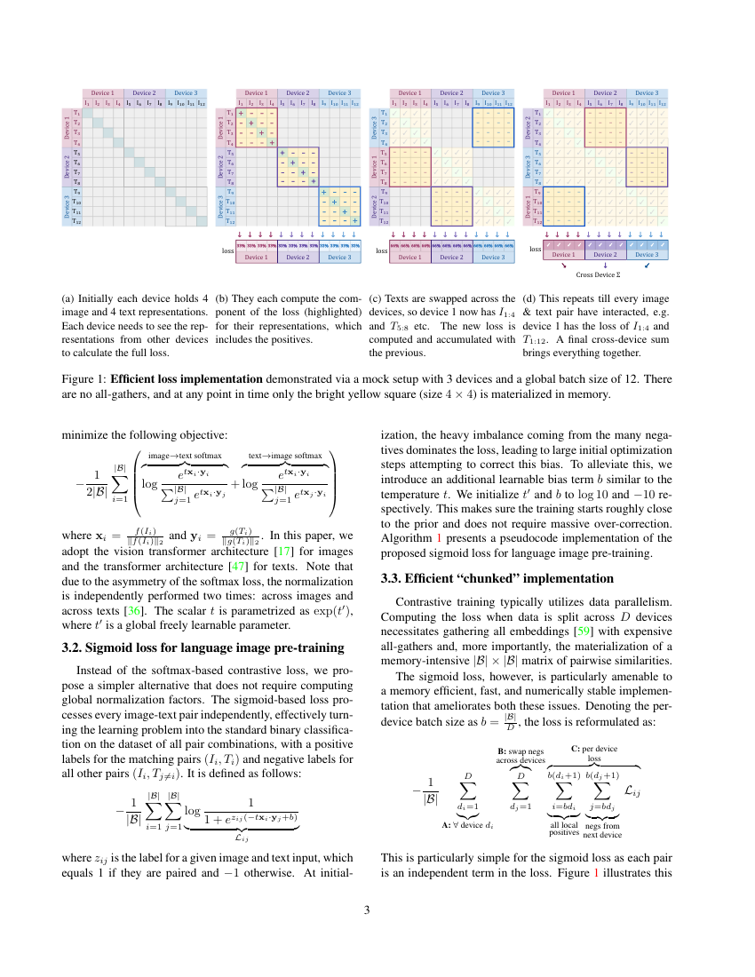
Paper Fig. 1 / Algorithm 1 — chunked sigmoid loss
Archaeologist · 11+3 · 9/11
Notes:
OPTIONAL DEEP DIVE — Algorithm 1 / Fig. 1 systems (paper page 3)
If Q&A asks “how does no-all-gather work?”: chunked permute of text embeddings; only b_local × b_local logits in memory.
Don’t steal Empiricist’s small-BS experiment plan — just show the paper artifact.

Slide 10
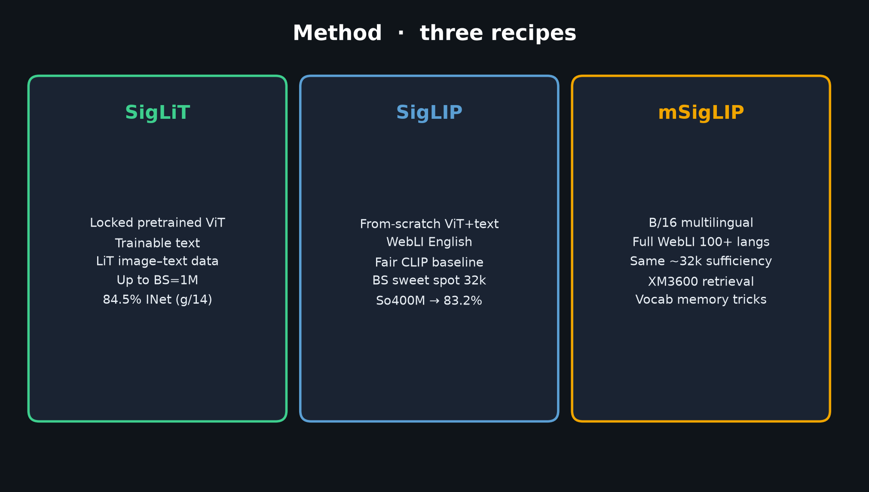
Archaeologist · 11+3 · 10/11
Notes:
METHOD RECIPES — naming clarity for the room
SigLiT = locked image (LiT-style) — extreme efficiency, up to 84.5%.
SigLIP = from-scratch on WebLI — fair CLIP baseline; So400M public.
mSigLIP = multilingual WebLI.
When people say “we use SigLIP in OpenPI,” they usually mean the pretrained So400m-class vision tower weights, not that they retrain with sigmoid loss.

Slide 11
Archaeologist close
Priors → SigLIP → PaliGemma → π₀/OpenPI → BEHAVIOR · hedges intact
Archaeologist · 11+3 · 11/11
Notes:
ARCHAEOLOGIST CLOSE / Q&A (3 min)
Restate one sentence. Restate hedges.
Invite questions on: which priors matter most; whether BEHAVIOR wins isolate the encoder; freeze/unlock documentation gaps.
Do NOT redo Stakeholder takeaways. Hand to next role / facilitator.

