Slide 1
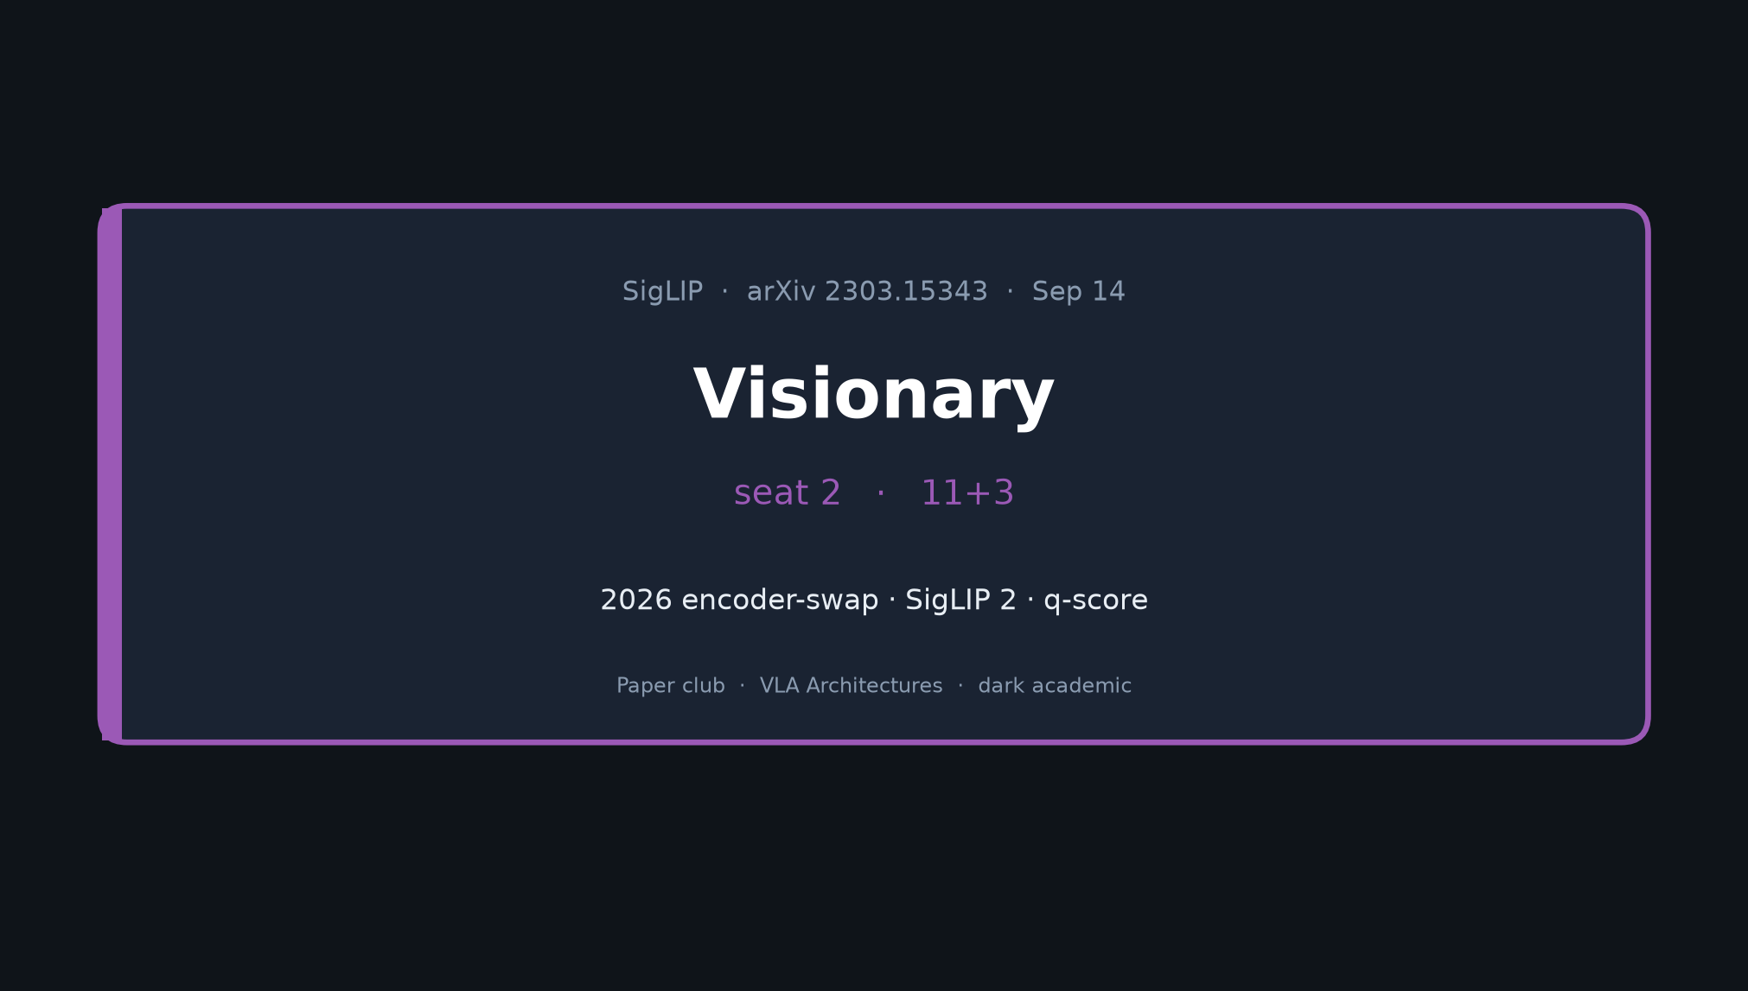
Visionary · 11+3 · 1/9
Notes:
VISIONARY — seat 2 — 11+3
NO Discord/Drive logistics. No Stakeholder redo.
Frame: 2026 encoder-swap experiments on the SigLIP→PaliGemma→π₀.₅ spine.

Slide 2
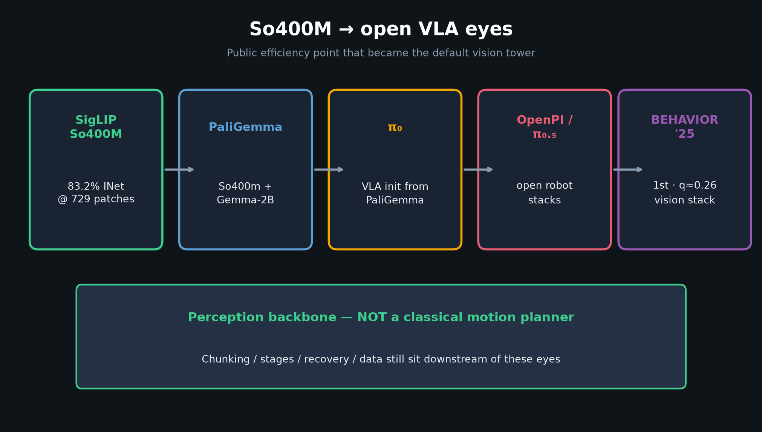
Visionary · 11+3 · 2/9
Notes:
DEFAULT OPEN EYES
Treat SigLIP→PaliGemma→π₀.₅ as default open eyes for 2026 BEHAVIOR.
Differentiate on action / data / System-2 / control — unless you have a measured encoder reason.

Slide 3
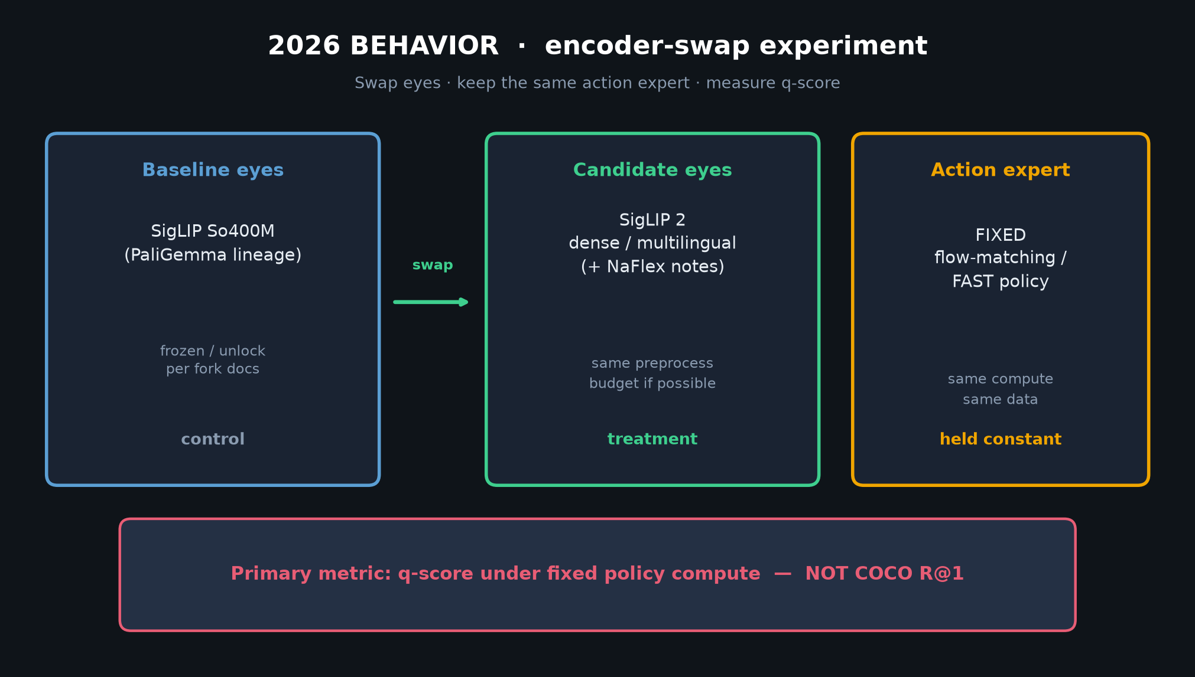
Visionary · 11+3 · 3/9
Notes:
THE EXPERIMENT — encoder swap
Put SigLIP 2 (dense/multilingual) behind the SAME action expert.
Measure q-score under fixed policy compute — NOT COCO R@1.

Slide 4
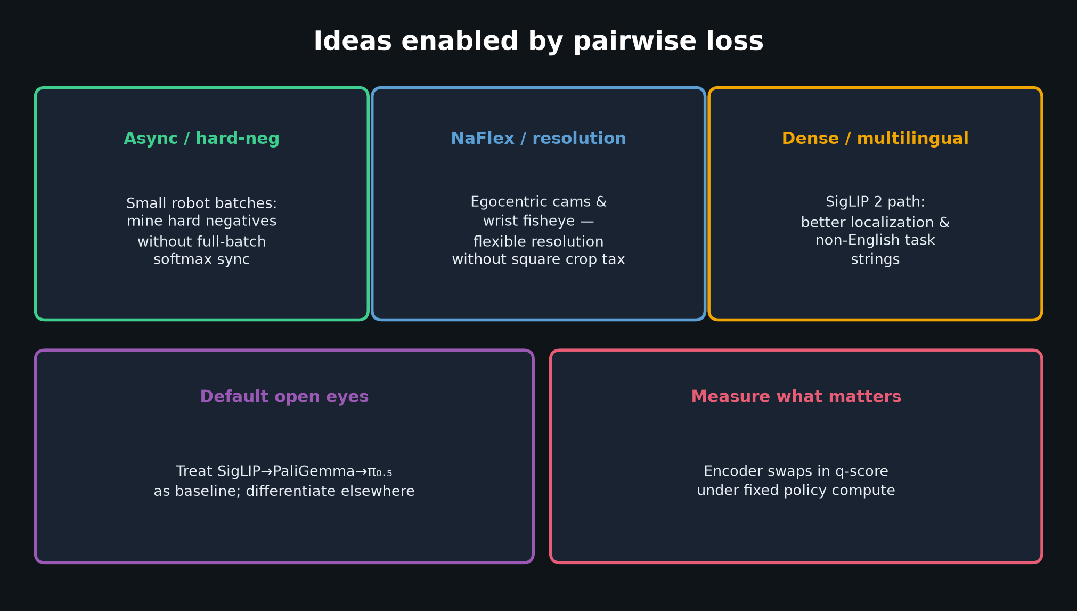
Visionary · 11+3 · 4/9
Notes:
IDEAS ENABLED BY PAIRWISE LOSS
Async / hard-negatives for small robot batches.
NaFlex / resolution tricks for egocentric + wrist cams.
Dense/multilingual path via SigLIP 2.

Slide 5
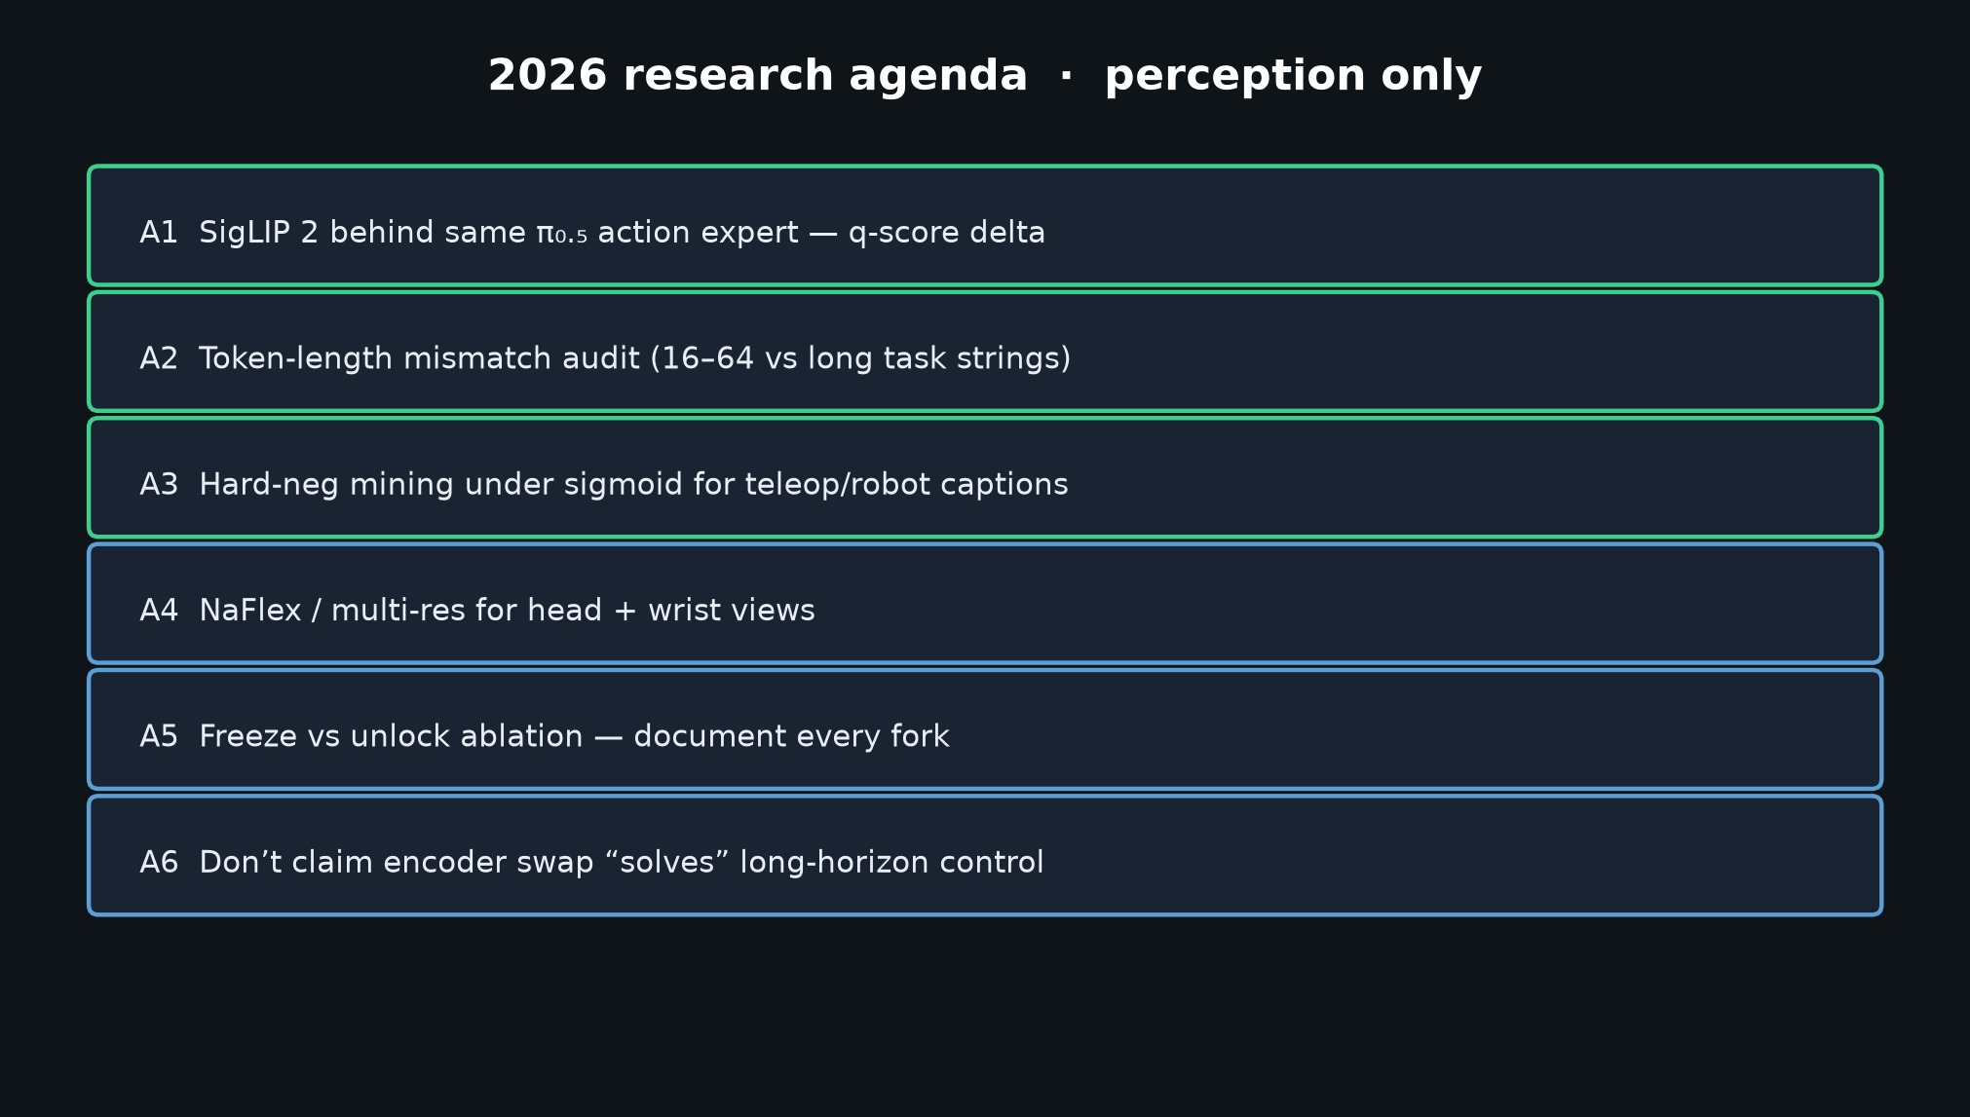
Visionary · 11+3 · 5/9
Notes:
2026 AGENDA CHECKLIST
A1 SigLIP 2 swap → q-score
A2 Token-length mismatch audit
A3 Hard-neg mining under sigmoid
A4 NaFlex multi-res head/wrist
A5 Document freeze vs unlock every fork
A6 Don’t claim encoder swap solves long-horizon control

Slide 6
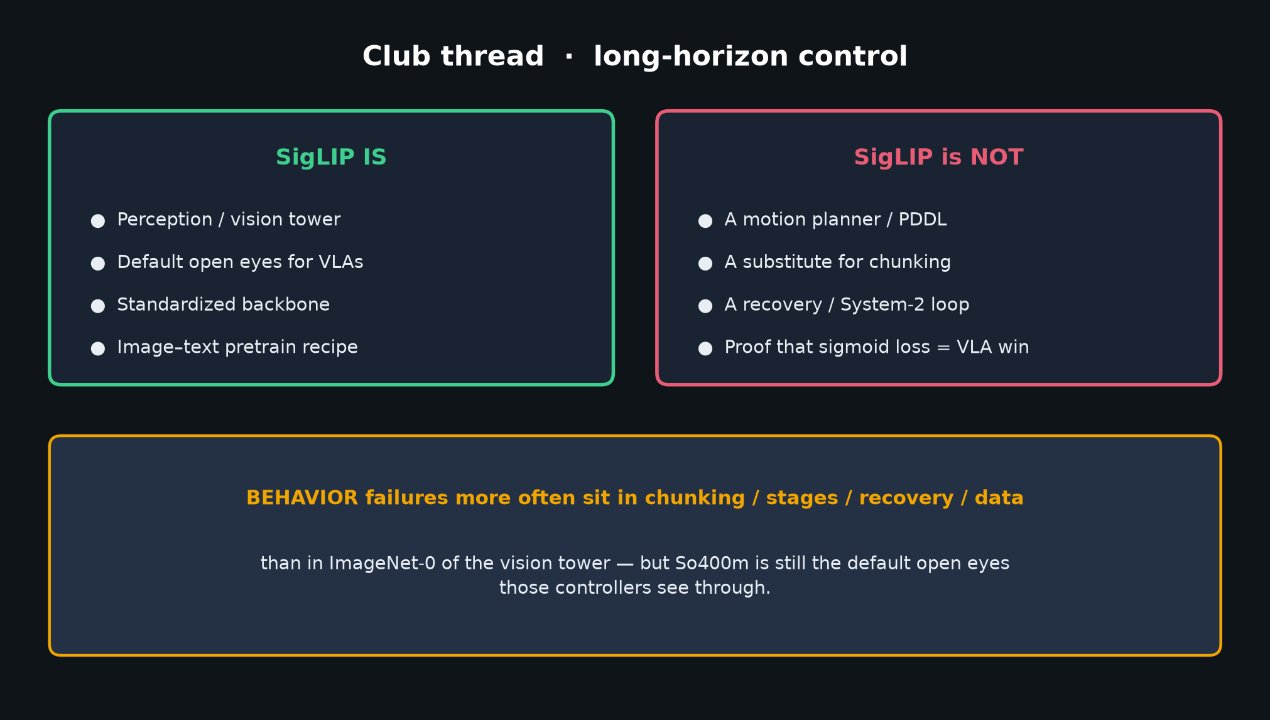
Visionary · 11+3 · 6/9
Notes:
PERCEPTION BOUNDARY
SigLIP standardized the backbone. Chunking/stages/recovery still own most BEHAVIOR failures.
Visionary ask: measure encoder contribution in q-score with policy held fixed.

Slide 7
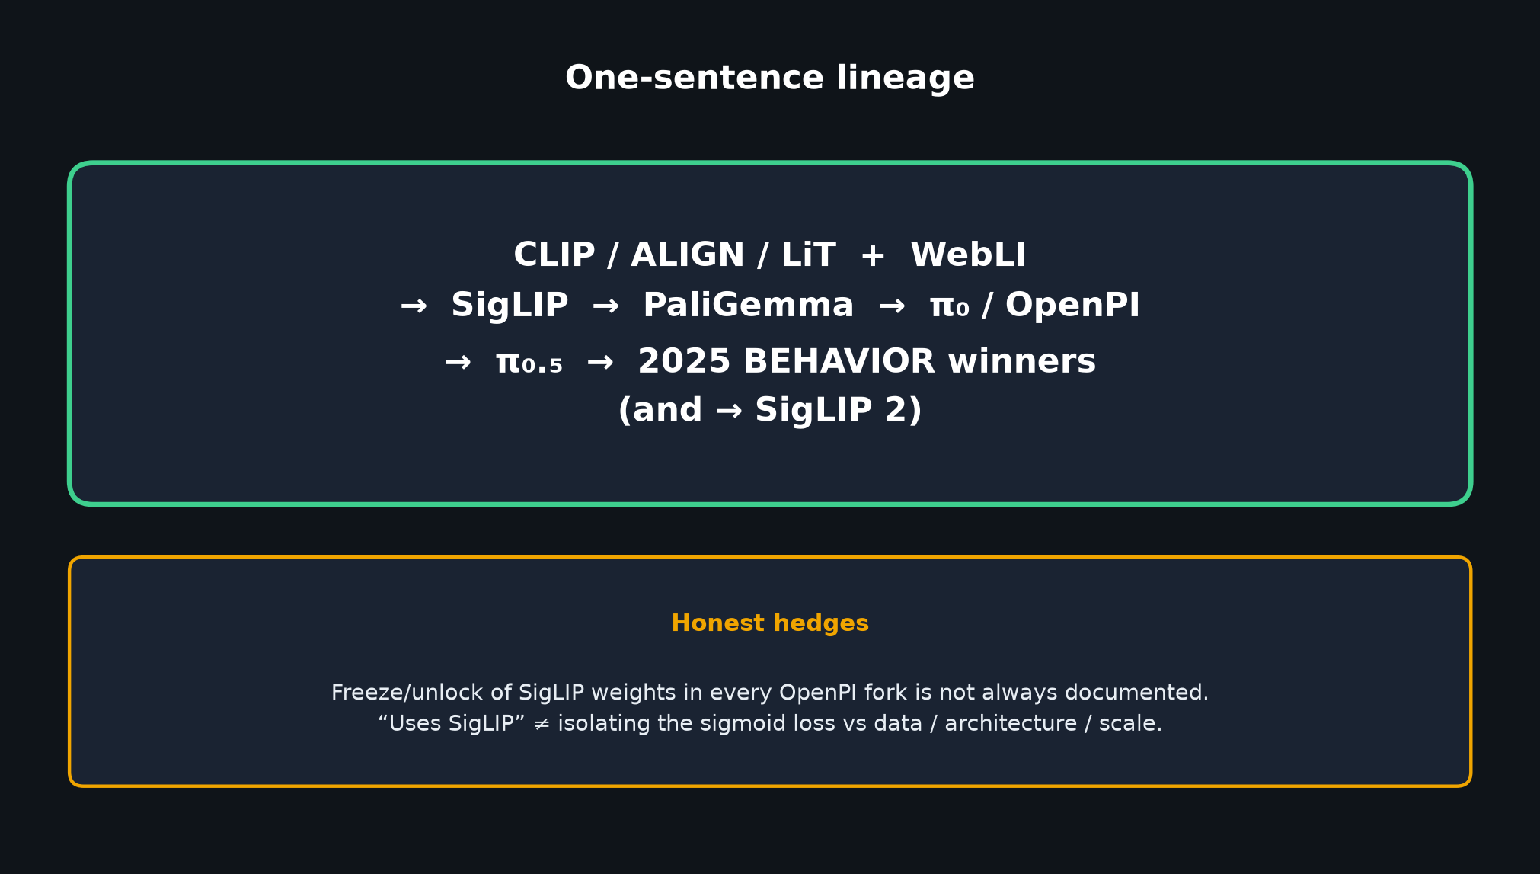
Visionary · 11+3 · 7/9
Notes:
LINEAGE REMINDER (one breath)
CLIP/ALIGN/LiT+WebLI → SigLIP → PaliGemma → π₀/OpenPI → π₀.₅ → BEHAVIOR winners (+ SigLIP 2).
Hedge: “uses SigLIP” ≠ isolating loss.

Slide 8
Don’t overclaim
Encoder swap is a measured bet · not a solved household robot
Visionary · 11+3 · 8/9
Notes:
DON’T OVERCLAIM
Encoder quality ≠ solved household robot.
q≈0.26 is still a low bar; perception helps wrong-object errors, not impedance/IK/safety.
No Discord/Drive.

Slide 9
Visionary close
SigLIP 2 swap · q-score · async/hard-neg · NaFlex
Visionary · 11+3 · 9/9
Notes:
VISIONARY CLOSE / Q&A
Invite discussion on SigLIP 2 swaps, hard-neg for teleop captions, NaFlex for fisheye.
No logistics. Hand back to facilitator.

