Slide 1
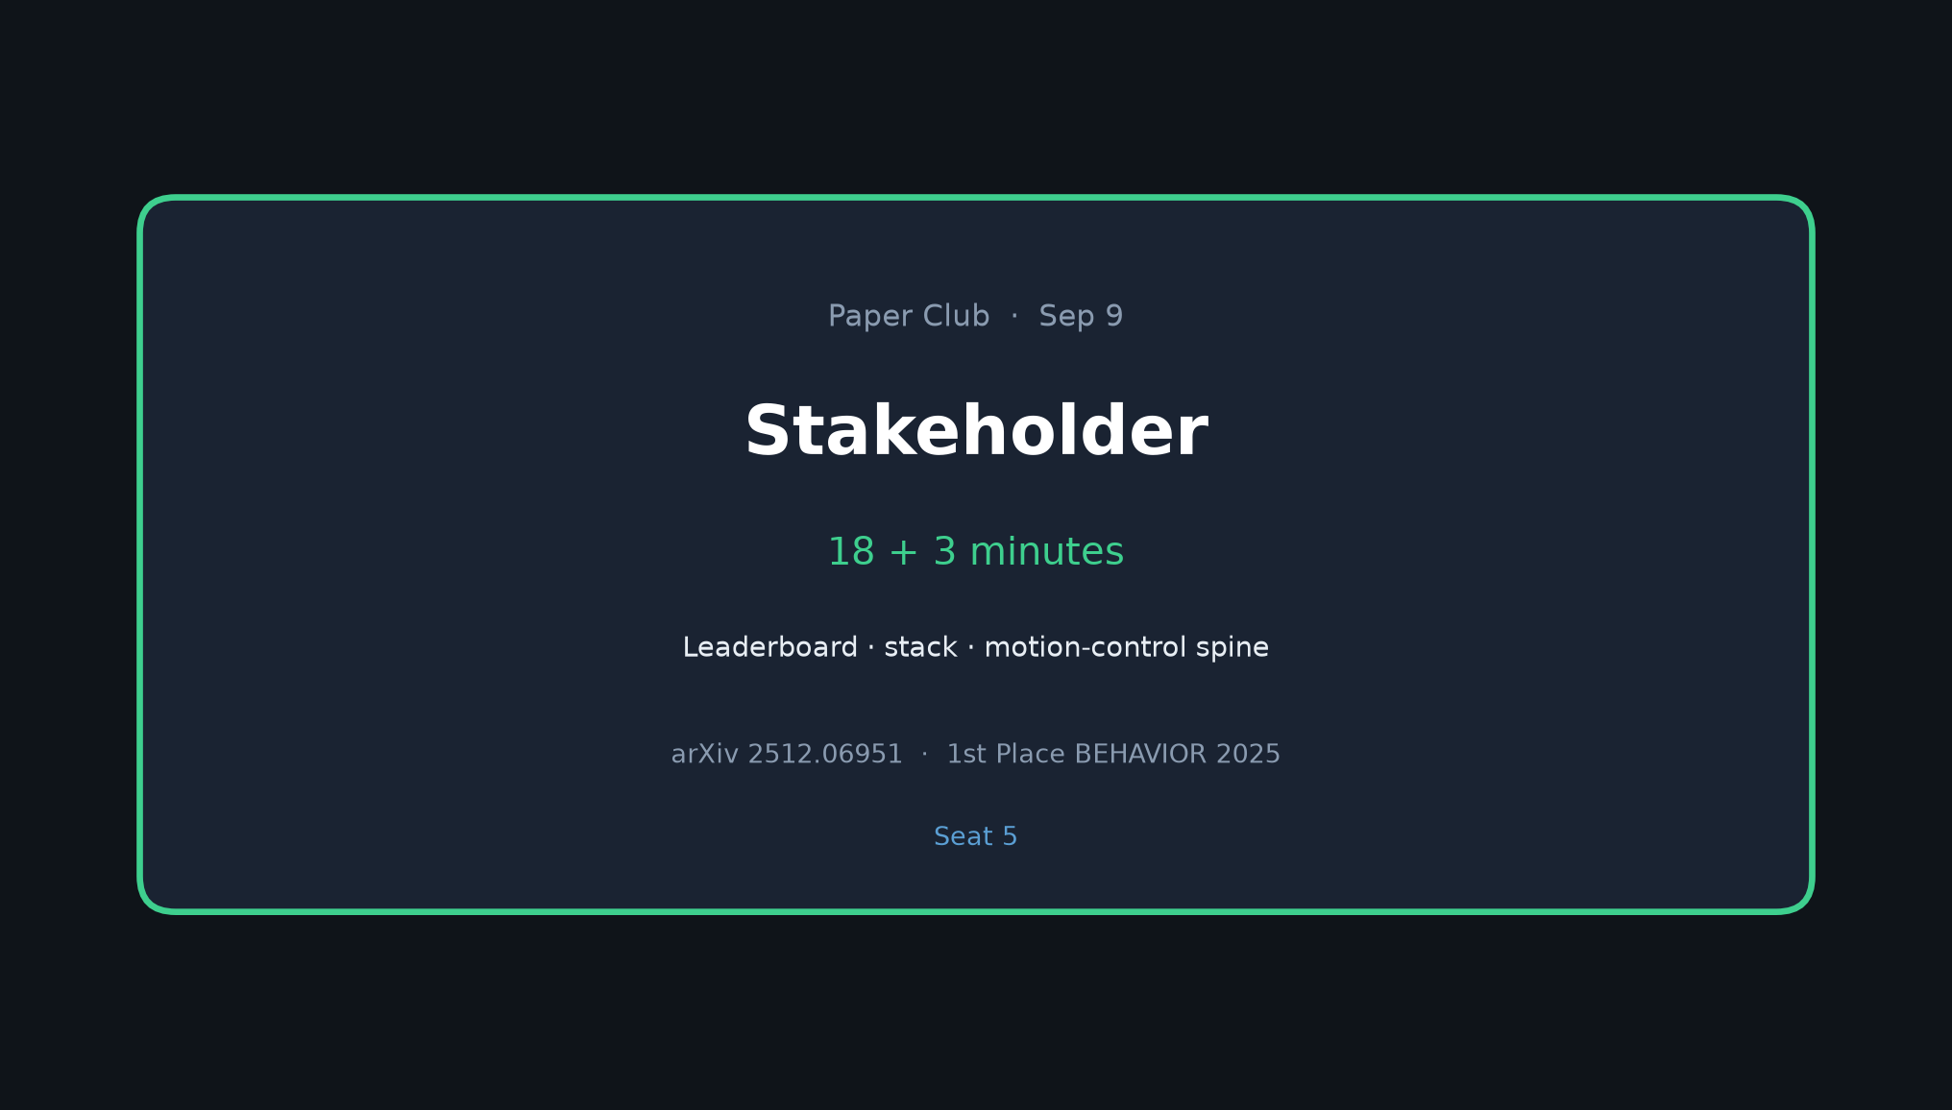
Stakeholder · 18+3 · 1/10
Notes:
STAKEHOLDER (seat 5) — 18 min + 3 Q&A
Set the room: why this paper, what they achieved, how the stack works at a high level.
Motivation: multi-minute bimanual + mobile household chores still unsolved.
Problem: 50 tasks; rank by partial-progress q_score on held-out instances.
Keep energy high; leave Empiricist to own ablations.

Slide 2
Why this matters
50 long-horizon household tasks · partial-progress q_score
Stakeholder · 18+3 · 2/10
Notes:
MOTIVATION / PROBLEM (brief)
BEHAVIOR Challenge: 50 long-horizon household tasks in OmniGibson.
Episodes avg ~6.6 min, longest ~14 min. Bimanual + mobile base.
Ranking metric = q_score (average partial goal fraction), not only binary success.
Binary success alone understates progress — partial ≈ half of q-score for this entry.

Slide 3
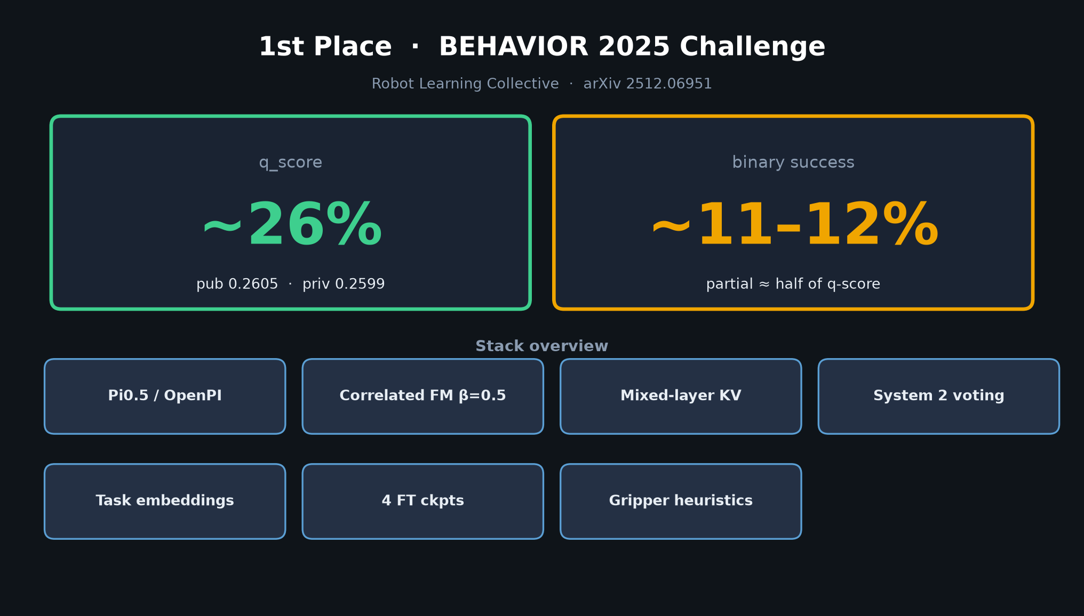
Stakeholder · 18+3 · 3/10
Notes:
LEADERBOARD
1st place — Robot Learning Collective.
q_score ~26% (public 0.2605 / private 0.2599) — tight pub≈priv.
Binary success only ~11–12%.
Peers in Table 1: Comet (NVIDIA), SimpleAI, Huawei North Star, Embodied Intelligence — not architectural apples-to-apples.
Authors: competition report, not rigorous science (§1.4, §9.3, §10).

Slide 4
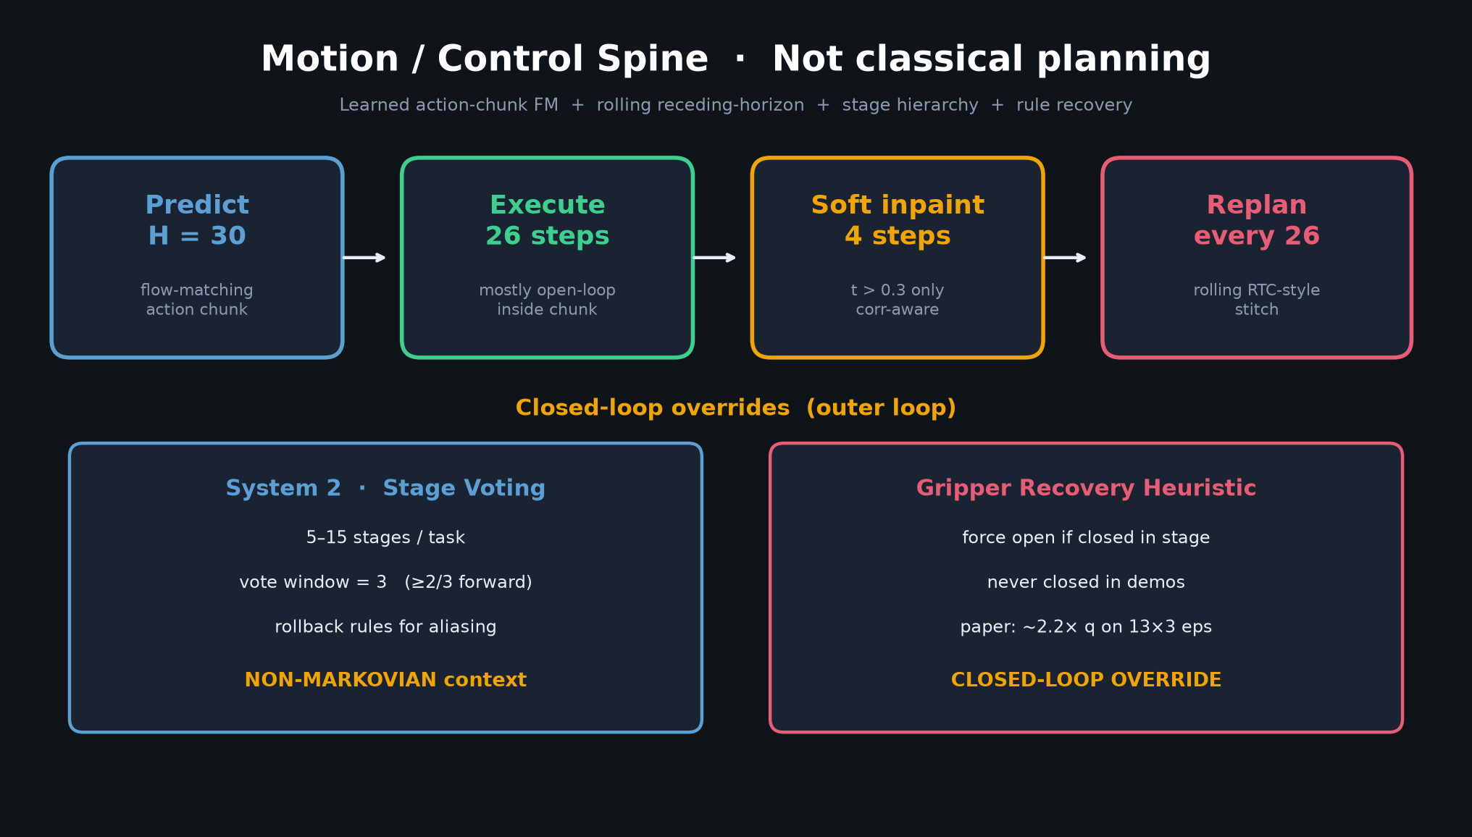
Stakeholder · 18+3 · 4/10
Notes:
MOTION-CONTROL SPINE (Stakeholder visual — critical)
Walk this diagram slowly — it is the shared spine for the whole club.
H=30 predict → execute 26 → soft inpaint 4 (t>0.3) → replan every 26.
Mostly open-loop inside chunk; closed-loop via System 2 vote + gripper rules.
Cubic 1.3× compression (26→20 @ 30 Hz); disable on gripper change.
Stages 5–15/task — implicit skill chaining, NO separate skill library / planner passes (simpler than Hi Robot CoT).
Absent: classical MP, MPC, ACT temporal ensemble, skill graphs.

Slide 5
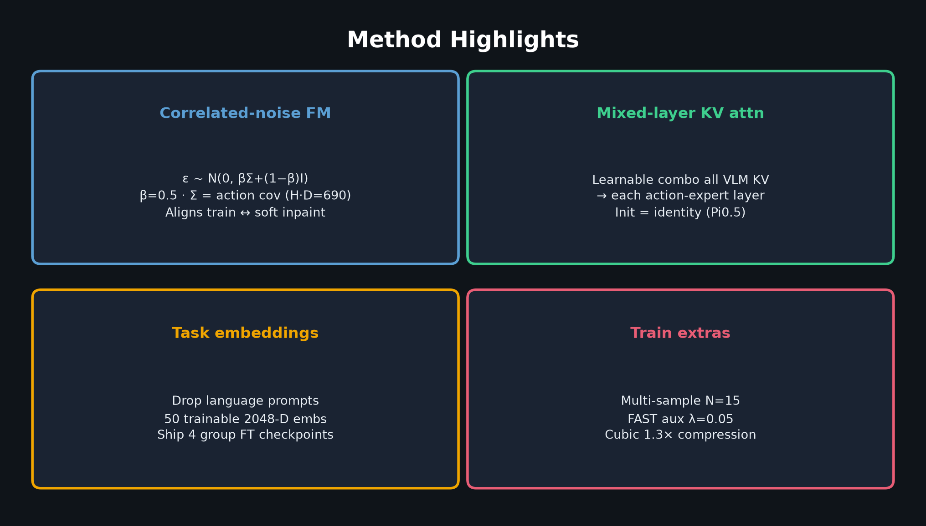
Stakeholder · 18+3 · 5/10
Notes:
METHOD HIGHLIGHTS
Pi0.5 / OpenPI backbone (SigLIP frozen, PaliGemma + ~311M action expert).
Correlated-noise flow matching β=0.5 — aligns train distribution with structured trajectories used at inpaint.
Learnable mixed-layer KV attention (init identity).
Language dropped → 50 trainable task embeddings; ship 4 group fine-tuned checkpoints.
Multi-sample FM (N=15), FAST aux λ=0.05.

Slide 6
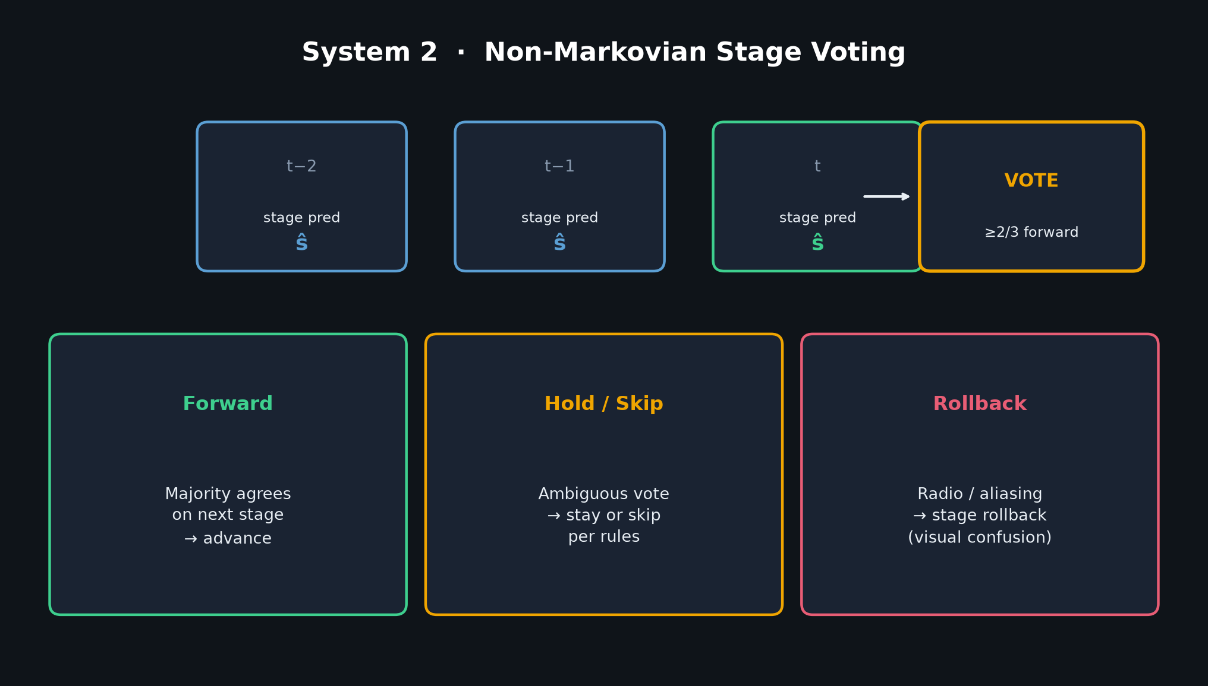
Stakeholder · 18+3 · 6/10
Notes:
SYSTEM 2 (brief for Stakeholder — Empiricist will go deeper)
Non-Markovian stage tracking + 3-frame majority vote.
Handles visual aliasing (radio/microwave Fig. 2).
Fused into task tokens for the action expert.
This is outer-loop control context, not a geometric planner.

Slide 7
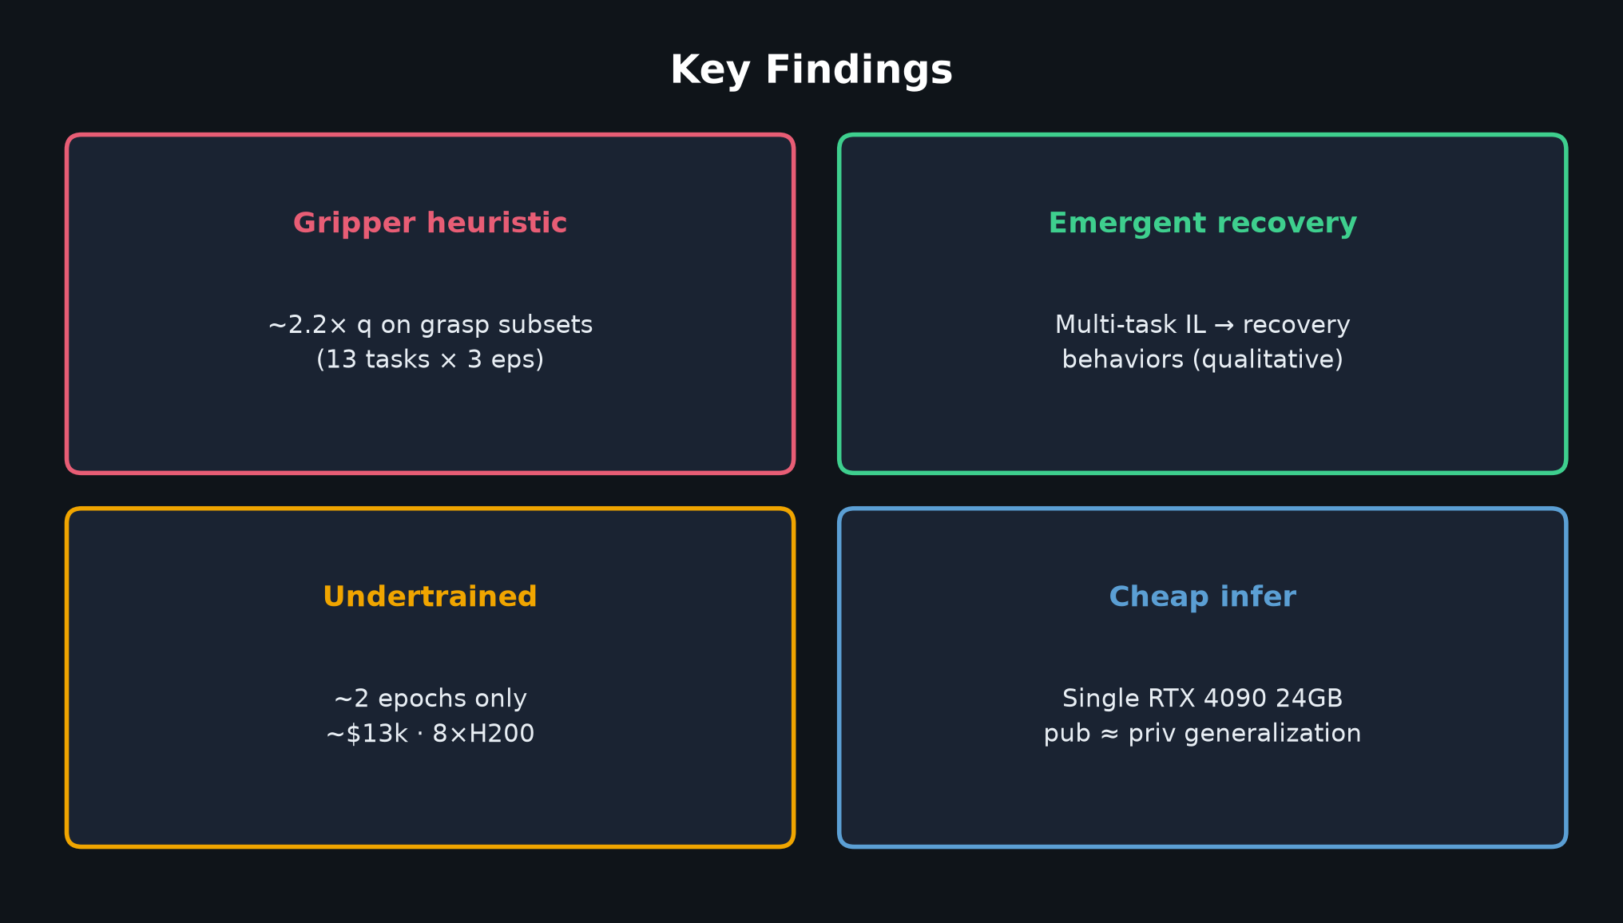
Stakeholder · 18+3 · 7/10
Notes:
KEY FINDINGS
• Gripper heuristic huge on grasp subsets (~2.2× q on 13×3 eps) — Empiricist will stress-test this
• Multi-task IL → emergent recovery (qualitative vs single-task)
• Undertrained: only ~2 epochs; ~$13k train budget on 8×H200 (~15 days multi-task + ~1 week/group FT)
• Inference: single RTX 4090 24GB; pub≈priv suggests decent generalization to private instances
• Intermediate 50-task ckpt guessed ~15–20% q (authors; not full eval)

Slide 8
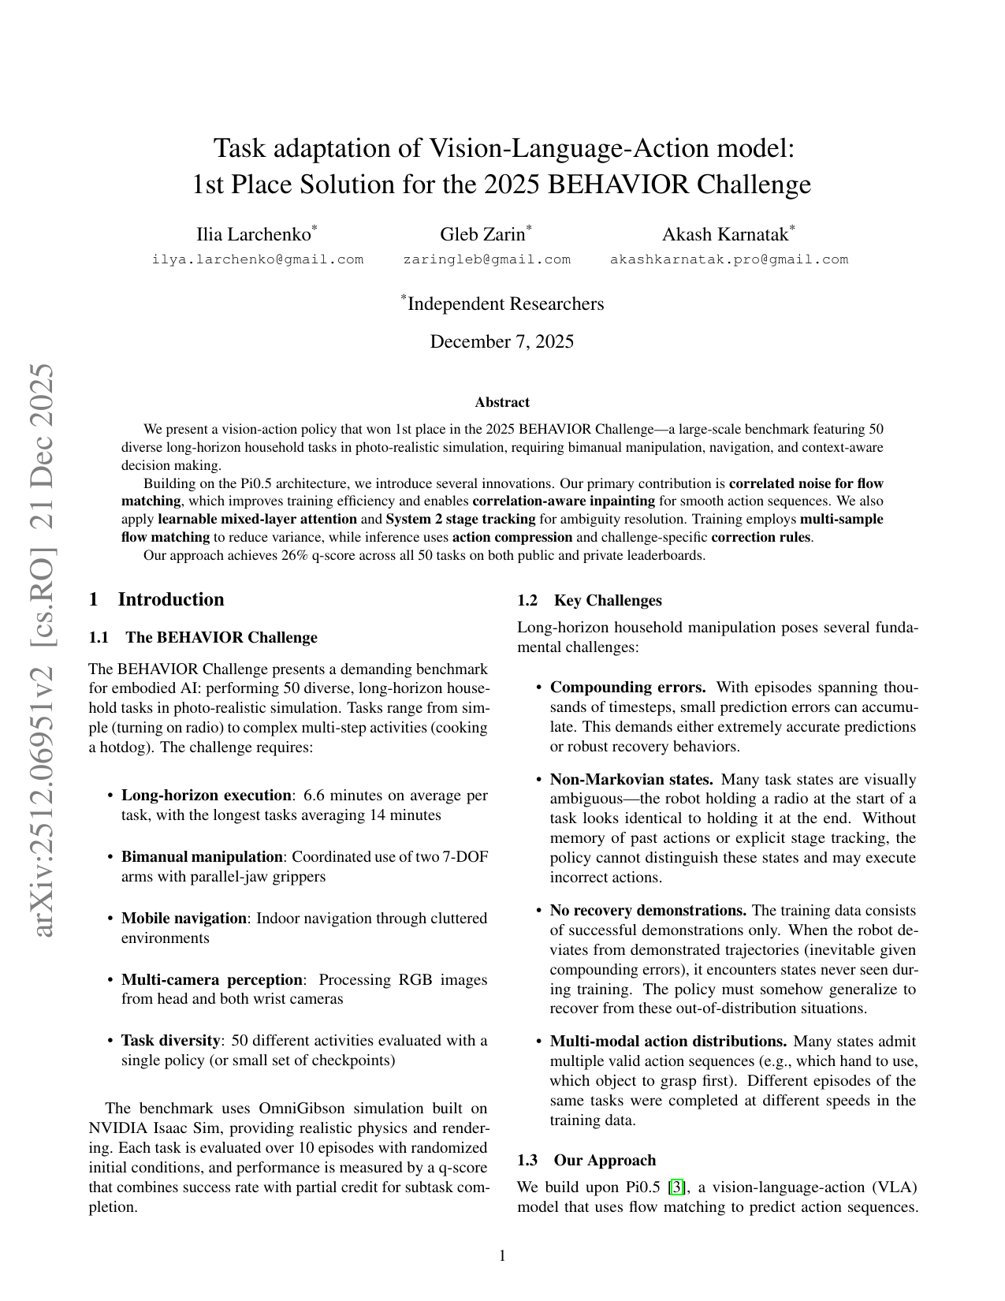
Paper title page · arXiv 2512.06951
Stakeholder · 18+3 · 8/10
Notes:
PAPER FIGURE CONTEXT (optional visual from PDF page)
Point at architecture / results figures if helpful for the room.
Code: github.com/IliaLarchenko/behavior-1k-solution
HF: IliaLarchenko/behavior_submission (4 ckpts)
Don’t steal Empiricist’s factorial thunder — hand off cleanly.

Slide 9
Cost & handoff
~$13k train · 4090 infer · Reviewer next, Empiricist owns ablations
Stakeholder · 18+3 · 9/10
Notes:
TRAIN COST CARD (verbal if no extra slide needed — this is wrap)
8×H200 FSDP; ~15 days multi-task + ~1 week per group FT; ~2 epochs; ~$13k.
Infer: 4090 24GB. Full 500-ep eval ~10 days single box; <2 days with parallelism.
Hand off to Scientific Reviewer for critique, Empiricist for ablations.

Slide 10
Questions?
Leaderboard · deploy · cost — ablations → Empiricist
Stakeholder · 18+3 · 10/10
Notes:
CLOSING / Q&A buffer for Stakeholder
Restate: 1st place ~26% q / ~11–12% binary; control spine is chunking + System2 + gripper; authors invite ablations.
Invite questions on leaderboard, deploy stack, or train cost — park ablation design for Empiricist.

