Slide 1
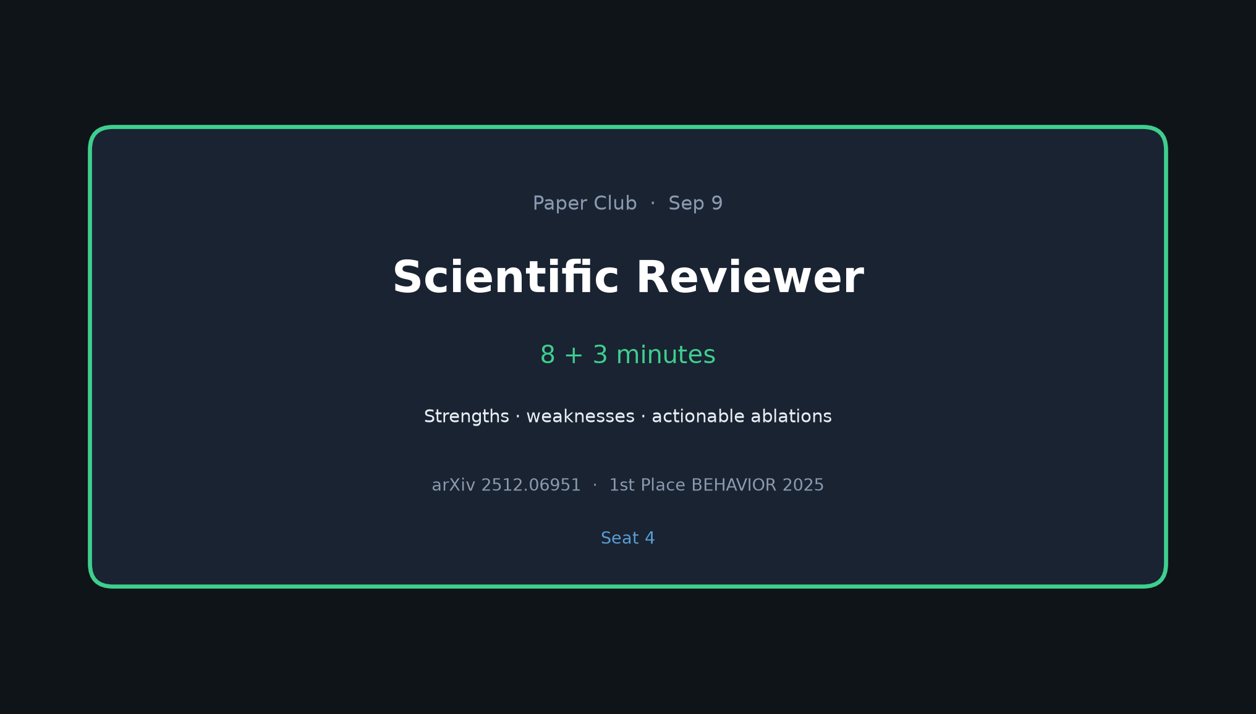
Scientific Reviewer · 8+3 · 1/6
Notes:
SCIENTIFIC REVIEWER (seat 4) — 8 min + 3 Q&A
No motivation tour. Jump straight to strengths / weaknesses / actionable list.
Tone: fair but sharp. Authors already admit gaps — use that.

Slide 2
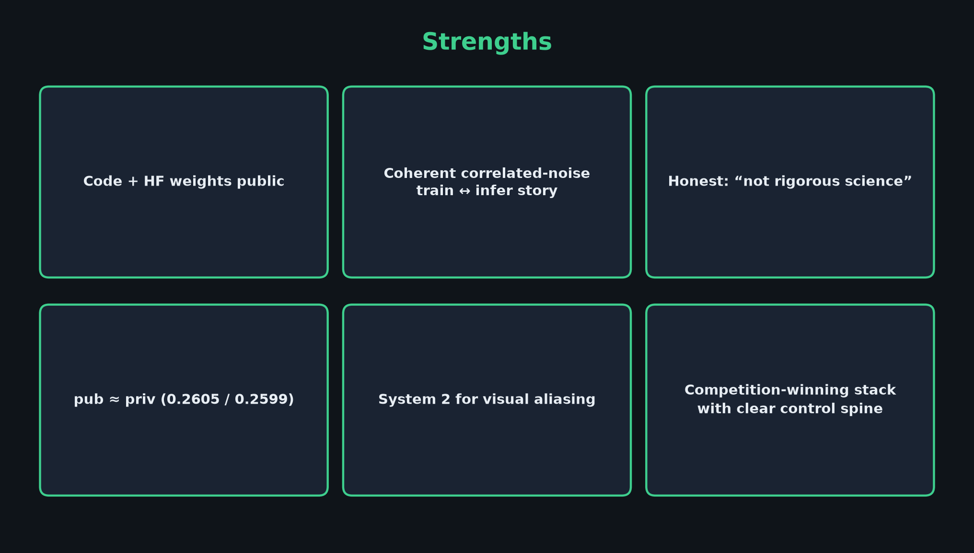
Scientific Reviewer · 8+3 · 2/6
Notes:
STRENGTHS
• Code + HF weights public — rare for competition winners
• Coherent correlated-noise train↔infer story (βΣ + soft inpaint)
• Honest framing: “not rigorous science” / competition report
• pub≈priv (0.2605 / 0.2599) — not a public-overfit story
• System 2 addresses a real failure mode (visual aliasing)
• Clear control spine others can build on

Slide 3
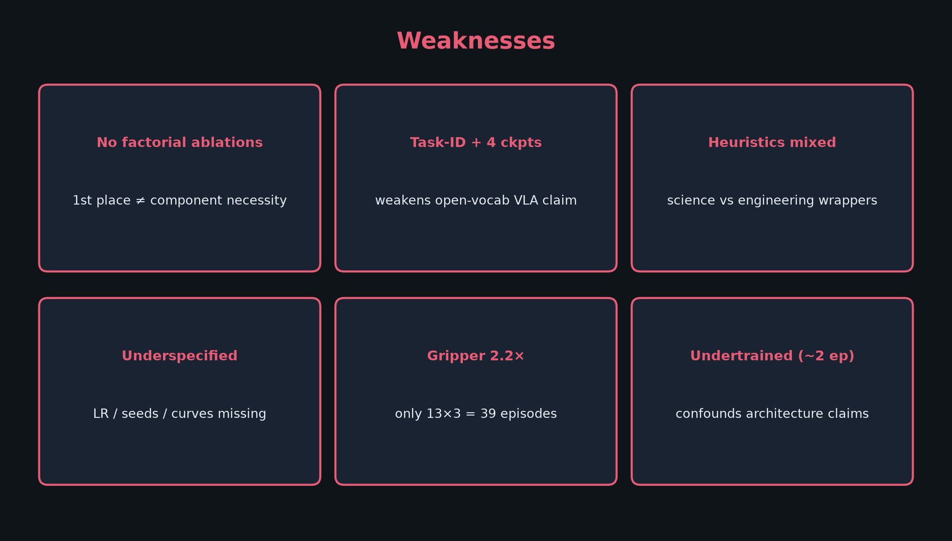
Scientific Reviewer · 8+3 · 3/6
Notes:
WEAKNESSES (pace these)
1. No factorial ablations — 1st place ≠ component necessity (§1.4 admitted)
2. Task-ID embeddings + 4 ckpts weaken open-vocab VLA claim
3. Heuristics mixed with science — gripper rule may inflate leaderboard
4. Underspecified LR / seeds / learning curves
5. Gripper 2.2× claim on only 13×3 = 39 episodes — small-N
6. Undertrained (~2 epochs) confounds architecture conclusions
Also: train demos biased easier than eval instances (§8.1.2); idealized teleop manifold.

Slide 4
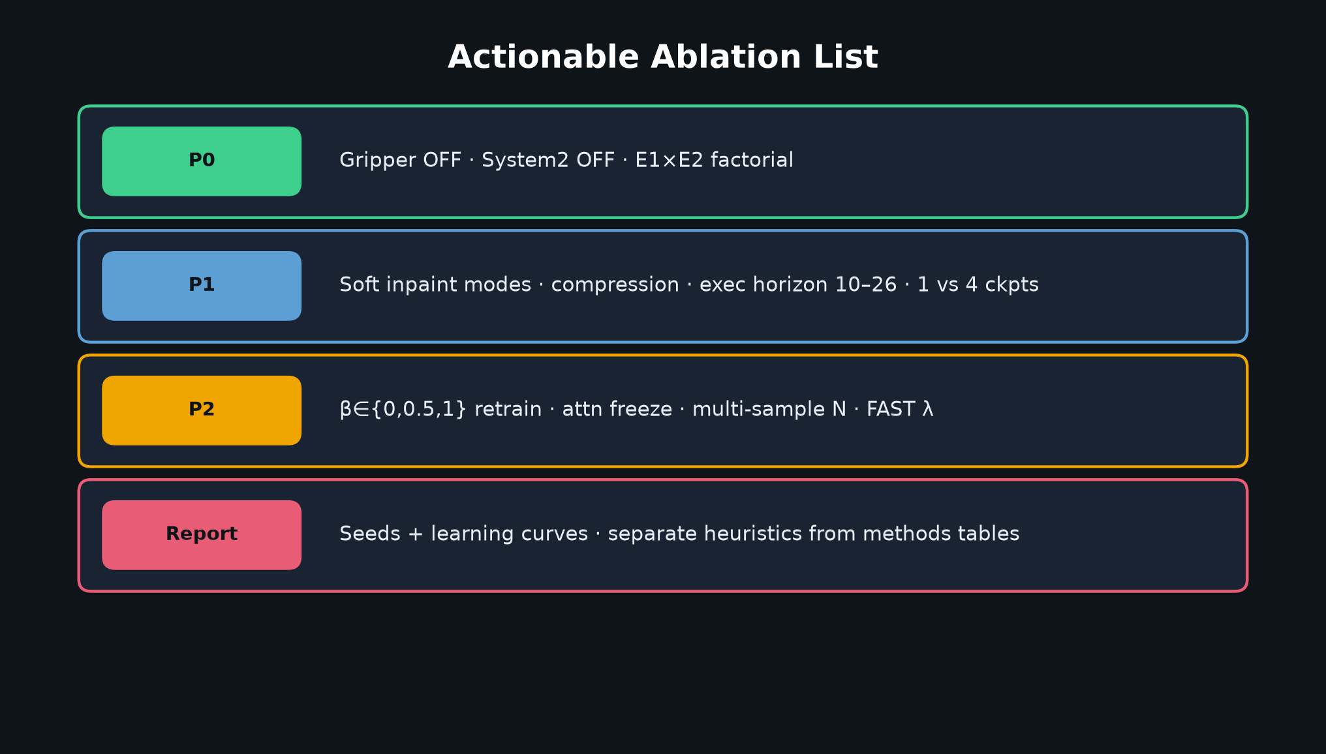
Scientific Reviewer · 8+3 · 4/6
Notes:
ACTIONABLE ABLATION LIST — gift to Empiricist
P0: Gripper OFF, System2 OFF, E1×E2 factorial
P1: Soft inpaint modes, compression, exec horizon 10–26, 1 vs 4 ckpts
P2: β∈{0,0.5,1} retrain, attn freeze, multi-sample N, FAST λ
Reporting: seeds + curves; separate competition heuristics from methods tables
Challenge design ask: scientific prize track with mandatory component ablations on fixed public subset.

Slide 5
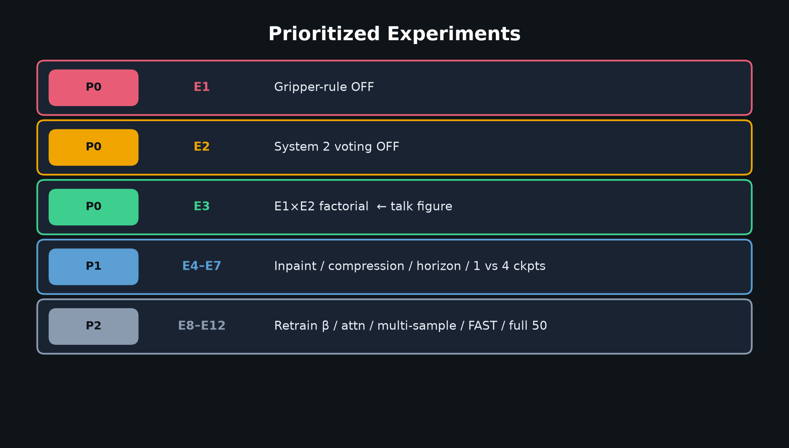
Scientific Reviewer · 8+3 · 5/6
Notes:
PRIORITY TABLE (quick visual)
Emphasize P0 is inference-only and Sep-9 feasible; P2 is not.
Hand to Empiricist cleanly: “Kanta will show the factorial design.”

Slide 6
Reviewer close
Strengths real · science incomplete without factorials
Scientific Reviewer · 8+3 · 6/6
Notes:
REVIEWER CLOSE
Restate: strengths real; science incomplete without factorials; heuristics need with/without reporting.
Q&A on critique only — don’t steal Empiricist experiment plan.

