Slide 1
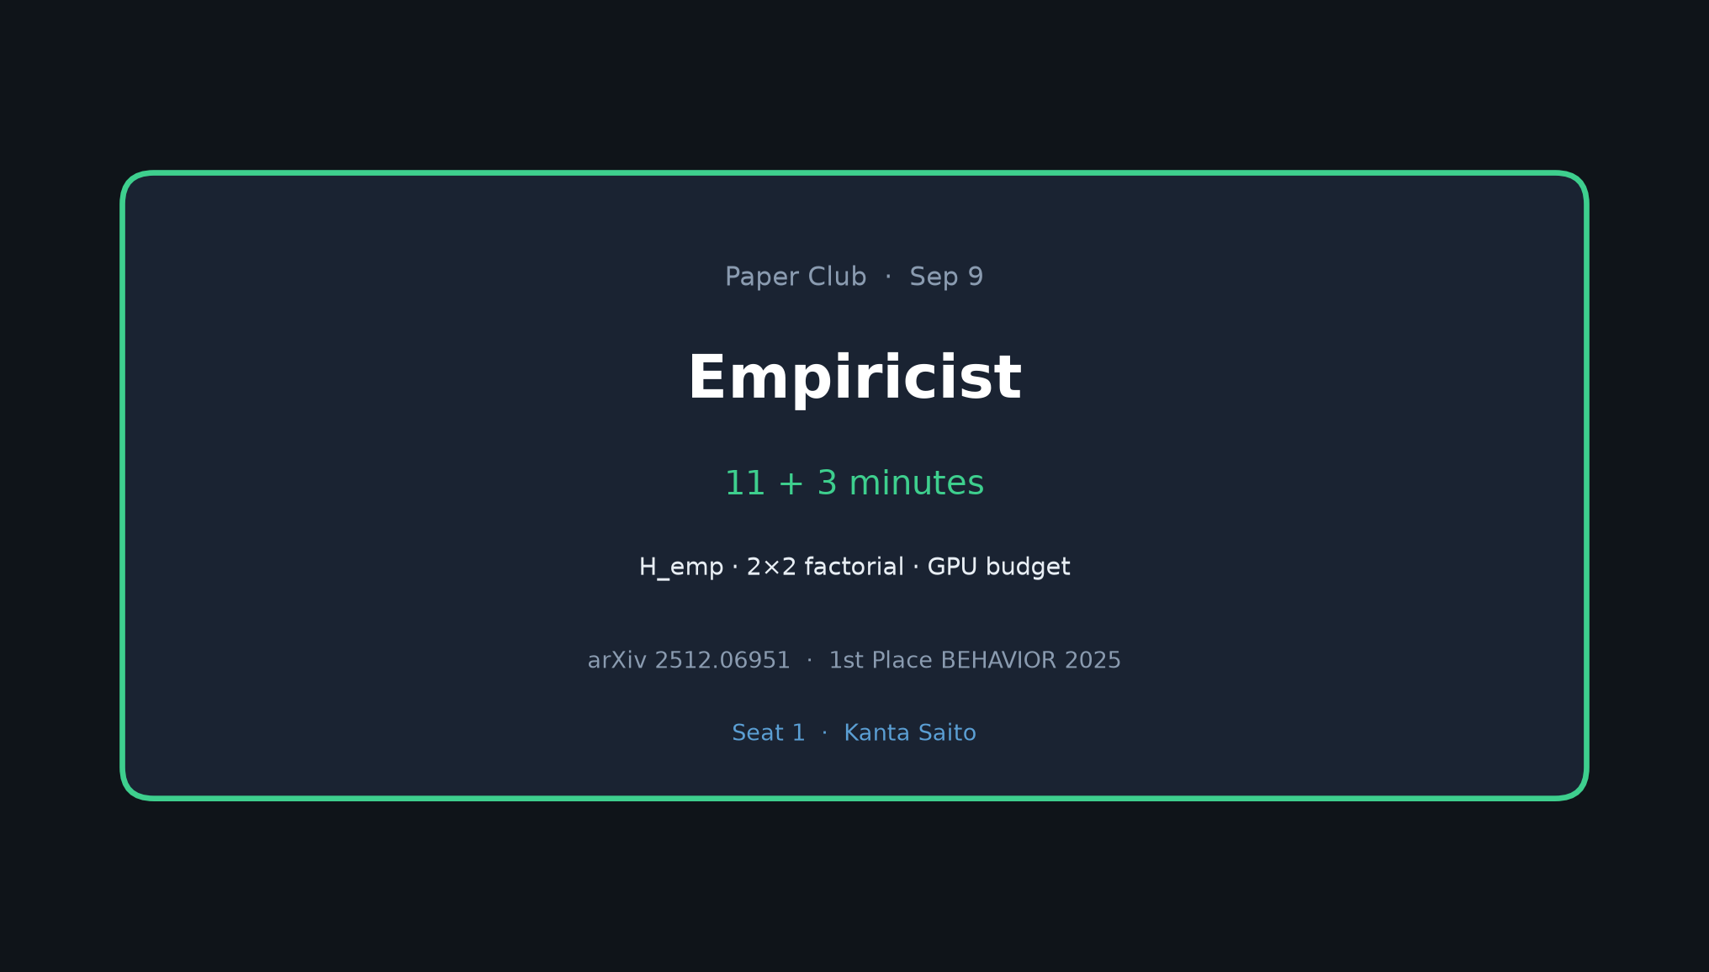
Empiricist · 11+3 · 1/9
Notes:
EMPIRICIST OPENING (seat 1 = Kanta)
Timing: 11 min talk + 3 Q&A.
You own the experimental critique. Authors admit this is a competition report, not a full ablation paper — that is your opening.
Headline: What fraction of “1st place VLA” is actually outer-loop control (gripper recovery + System 2), not train-time architecture?
Walk the room through H_emp → motion/control spine → 2×2 factorial → env/GPU → success criteria.
Do NOT redo Stakeholder motivation tour. Dive straight into the hypothesis.

Slide 2
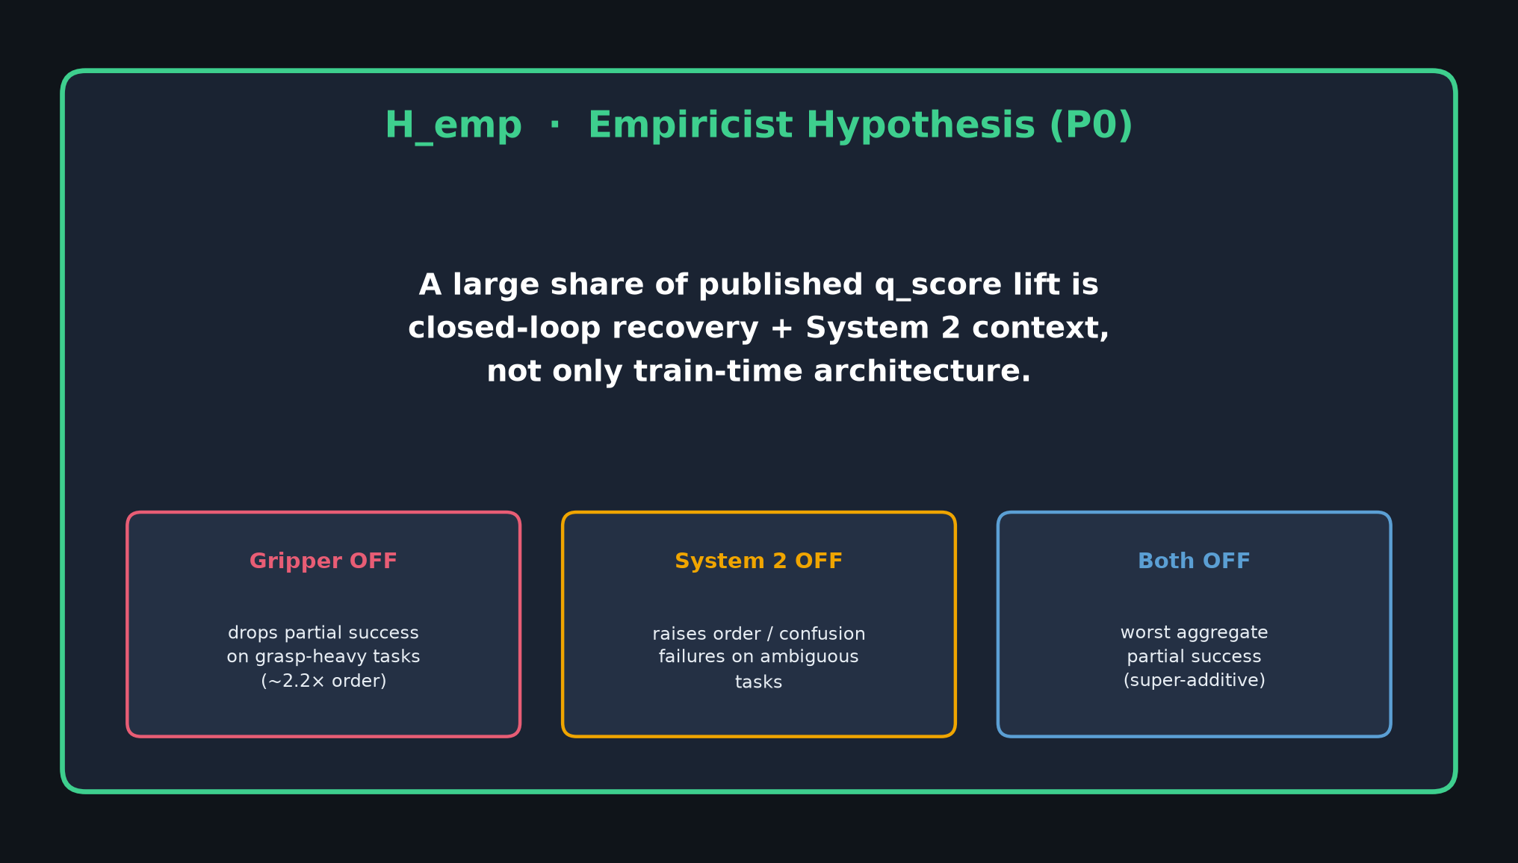
Empiricist · 11+3 · 2/9
Notes:
H_emp (read slowly, then unpack):
“A large share of published q_score lift is closed-loop recovery + non-Markovian stage context, not only train-time architecture.”
Three directional predictions:
1) Gripper OFF → drop on grasp-heavy (order-compatible with paper’s ~2.2× on 13×3 eps).
2) System 2 OFF → raise order/confusion failures on visually ambiguous tasks (radio, microwave).
3) Both OFF → worst / super-additive damage.
Why Sep-9 feasible: inference-only on HF submission ckpts — no 8×H200 month.
Success criteria later: directional effects, NOT global q=0.26.

Slide 3
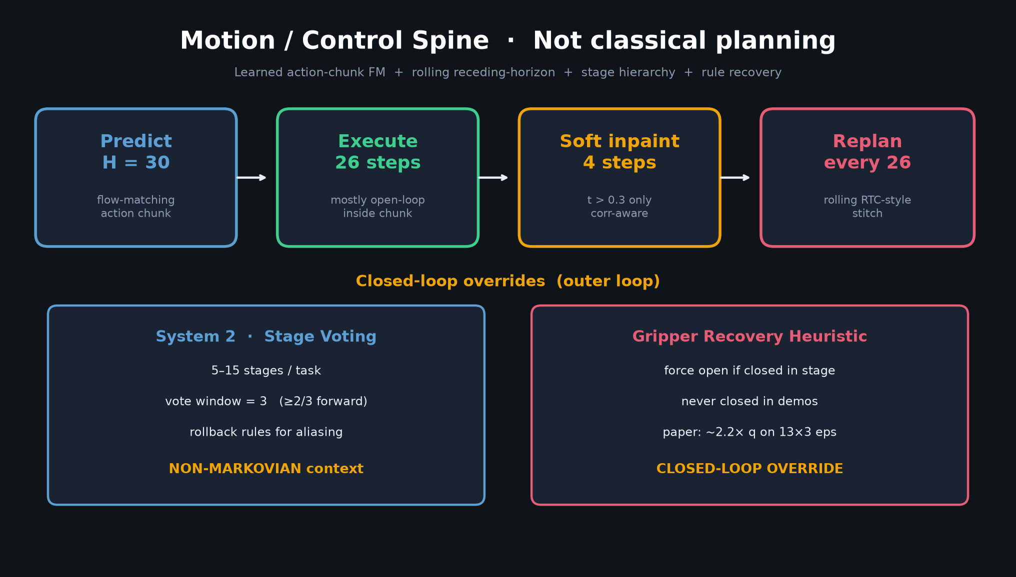
Empiricist · 11+3 · 3/9
Notes:
MOTION / CONTROL SPINE — center this narrative.
NOT classical RRT/MPC. Stack =
• Predict H=30 action chunk (flow matching)
• Execute 26 steps (mostly open-loop INSIDE chunk)
• Soft inpaint 4 overlap steps (correlation-aware, only while flow time t>0.3)
• Replan every 26 (rolling RTC-style stitch)
CLOSED-LOOP OVERRIDES (outer loop):
• System 2 stage voting (non-Markovian) — vote window 3, ≥2/3 forward, rollback rules
• Gripper recovery heuristic — force open if closed in a stage never closed in demos
Empiricist angle: E1–E6 probe which closed-loop outer pieces carry q_score vs expensive train-time correlated-noise story (P2, not this week).

Slide 4
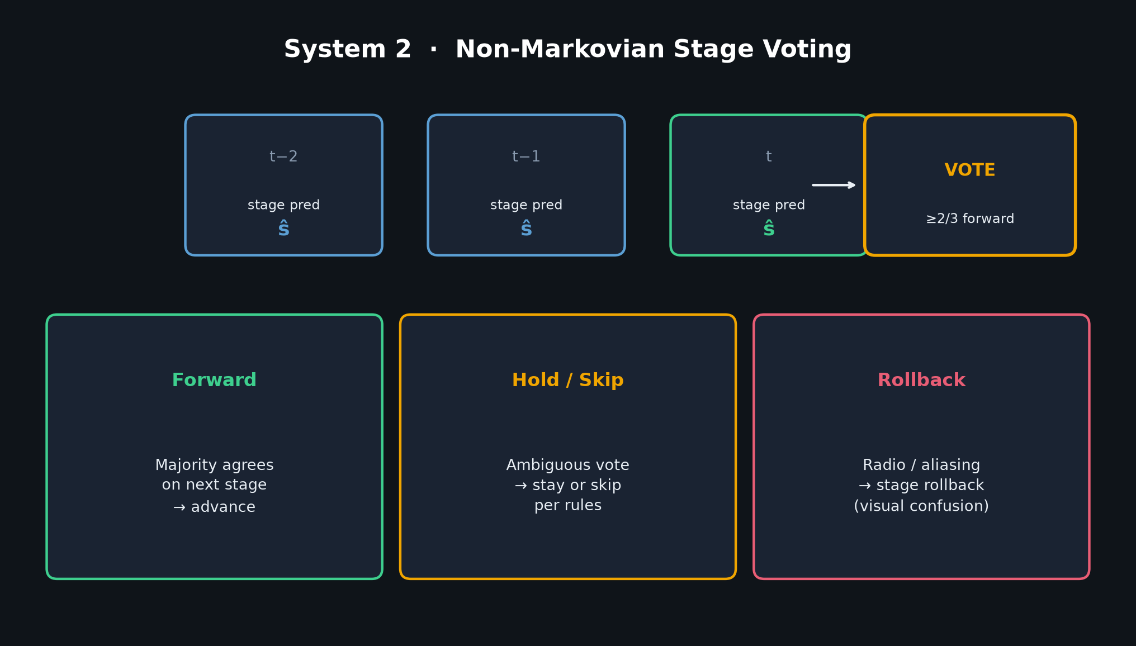
Empiricist · 11+3 · 4/9
Notes:
SYSTEM 2 DETAIL (optional deep-dive if time):
Stages 5–15 per task. Classifier fused into 5 task-related tokens.
Majority vote over last 3 predictions. Forward / hold / rollback.
Addresses visual aliasing (Fig. 2 radio/microwave) — semantic stage machine, not geometry.
When you disable voting (E2), expect failure-mode SHIFT toward order/confusion even if dexterity still works.
Log failure tags: {dexterity, order, confusion, OOD, other} à la §9.2.2.

Slide 5
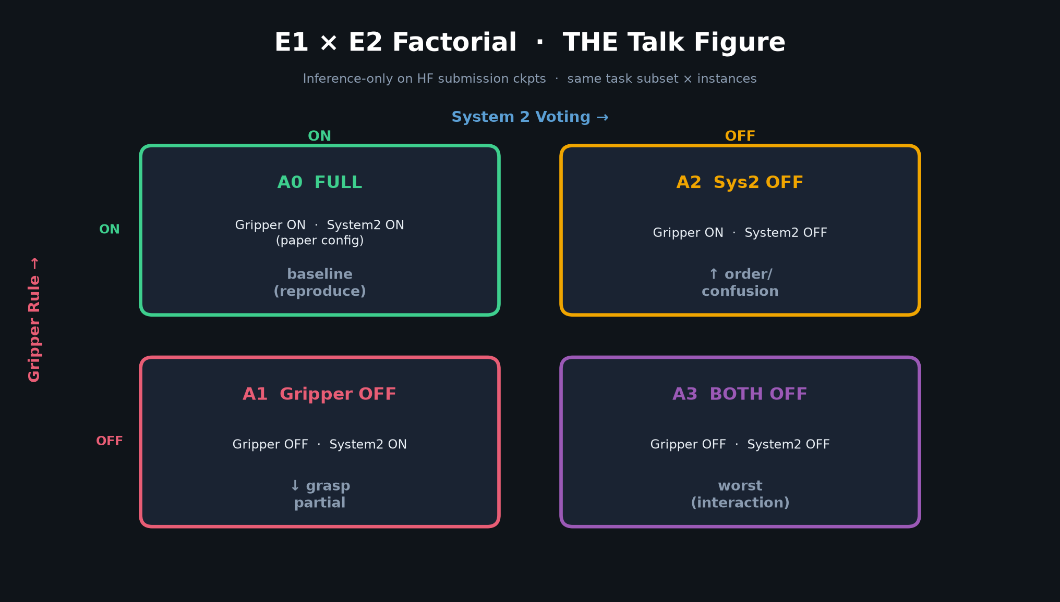
Empiricist · 11+3 · 5/9
Notes:
THE TALK FIGURE — E1 × E2 factorial.
Four conditions on SAME task subset × instances:
• A0 FULL — gripper ON, System2 ON (paper config) — sanity baseline
• A1 Gripper OFF — expect ↓ grasp partial
• A2 System2 OFF — expect ↑ order/confusion
• A3 Both OFF — expect worst; A3 ≤ min(A1,A2)
Suggested: ~8–12 tasks (grasp-heavy + aliasing) × 3–5 public instance IDs × 4 conditions.
Paired per-(task,instance) deltas vs A0; mean±CI.
Optional cheap negative control: compression OFF (E5) should NOT dwarf E1/E2.
If A1≈A0: report that as finding (rule inactive in serve path / subset too easy / 2.2× subset-specific).

Slide 6
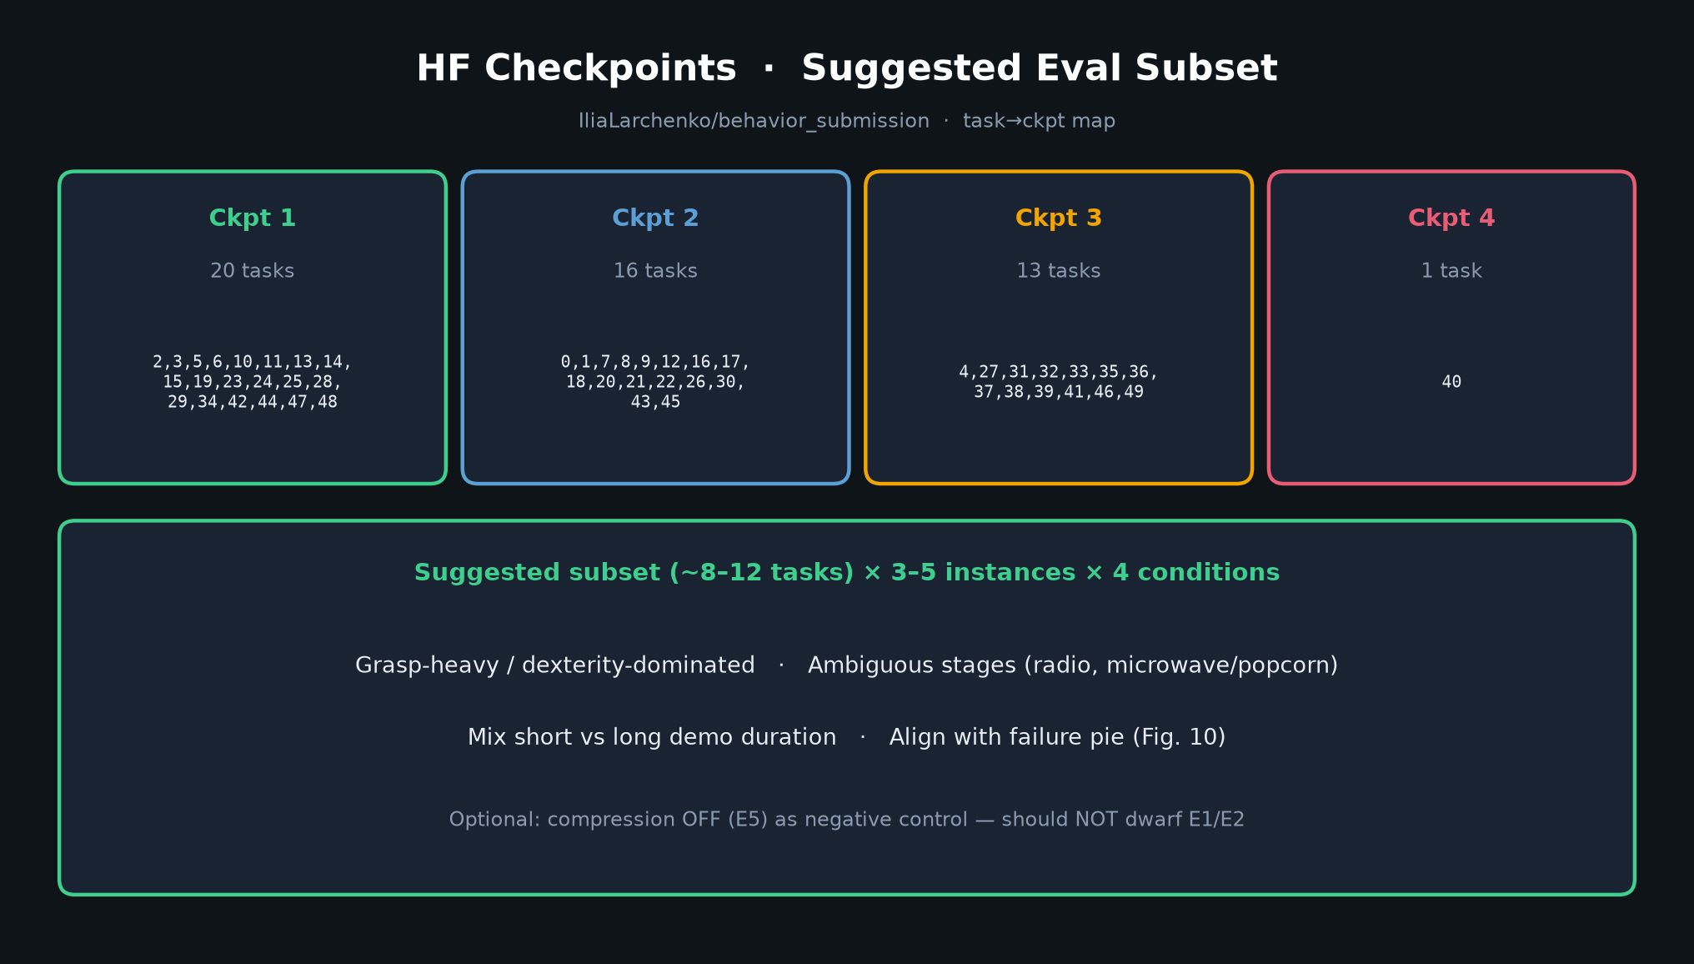
Empiricist · 11+3 · 6/9
Notes:
PRIORITY + HF CKPT MAP
P0: E1 gripper OFF, E2 System2 OFF, E3 factorial — YOUR talk.
P1: inpaint / compression / exec horizon 10–26 / 1 multi-task ckpt vs 4.
P2 / NOT Sep 9: correlated noise retrain, attn freeze, multi-sample, FAST λ, full 50-task.
HF submission splits (4 group FT ckpts):
Ckpt1 (20), Ckpt2 (16), Ckpt3 (13), Ckpt4 (1=task 40).
Prefer these for P0; skip 2TB demos / 260GB RGB unless training.
Also available: behavior_50t_checkpoint (authors guess ~15–20% q).

Slide 7
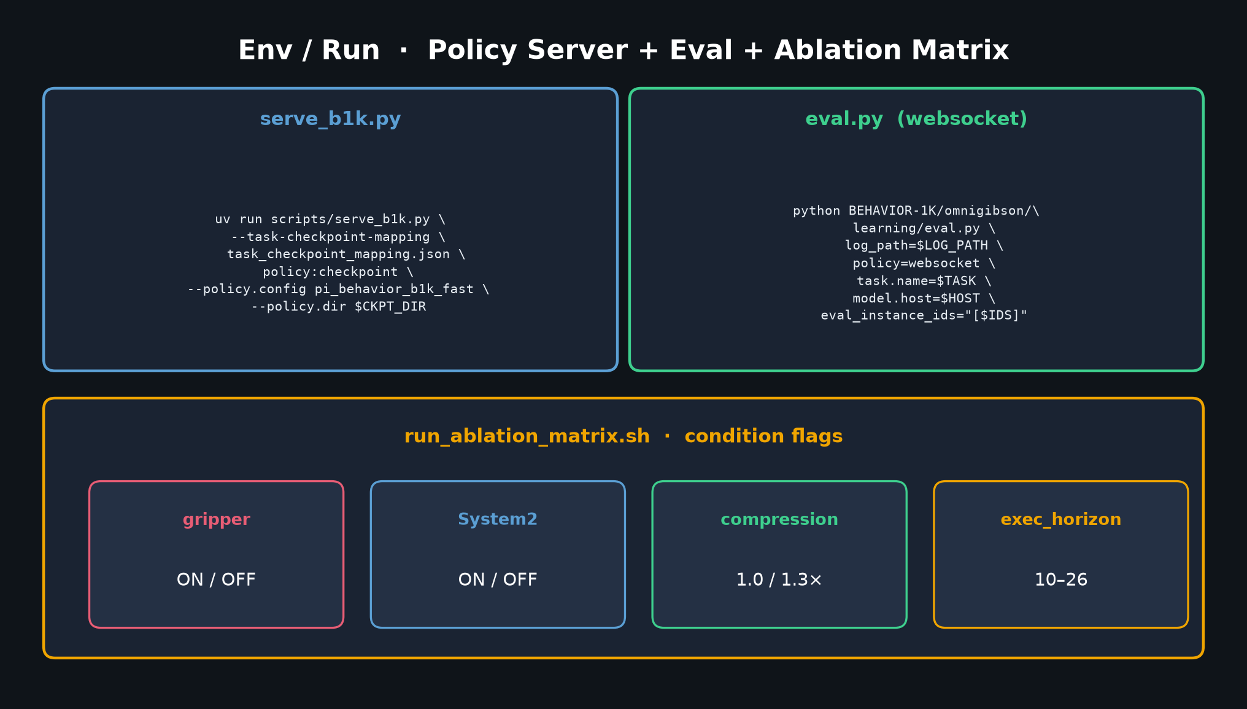
Empiricist · 11+3 · 7/9
Notes:
ENV / RUN ONE-PAGER
Outlines on box: /workspace/vla-task-adapt-behavior/env_outline/
(mamba env + uv for JAX serve; sbatch_policy_server / sbatch_eval_array / run_ablation_matrix)
Policy server: uv run scripts/serve_b1k.py with task_checkpoint_mapping.json
Eval: BEHAVIOR-1K omnigibson/learning/eval.py policy=websocket
Drive conditions via run_ablation_matrix.sh flags: gripper, System2, compression, exec_horizon.
Prefer Slurm array over one mega-job (paper: memory leaks / high RAM).
Main ops blocker = simulator bring-up, not ablation logic.

Slide 8
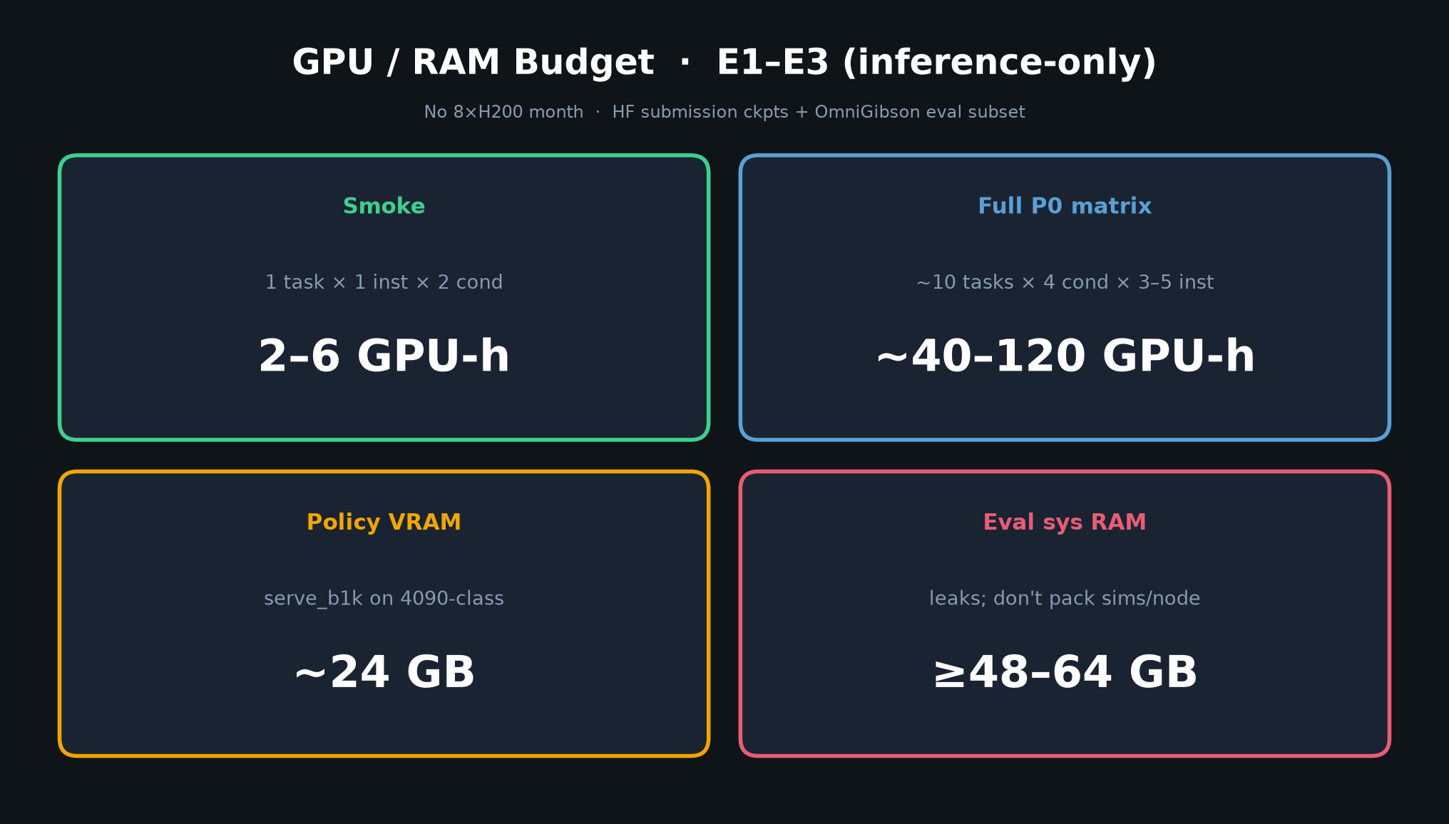
Empiricist · 11+3 · 8/9
Notes:
GPU BUDGET ONE-PAGER
Smoke (1 task × 1 inst × 2 cond): 2–6 GPU-h
Full P0 matrix (~10×4×3–5 eps ≈ 120–200 eps): ~40–120 GPU-h
Policy VRAM: ~24 GB (4090-class OK per paper App. B)
Eval node sys RAM: ≥48–64 GB (leaks; don’t pack many sims/node)
Wall @ 8 parallel eval GPUs: ~1–2 days (paper: 500 eps ~10 days single box)
NOT included: any E8–E12 training. Full recipe ~3000+ GPU-h / ~$13k — explicitly non-feasible for Sep 9.

Slide 9
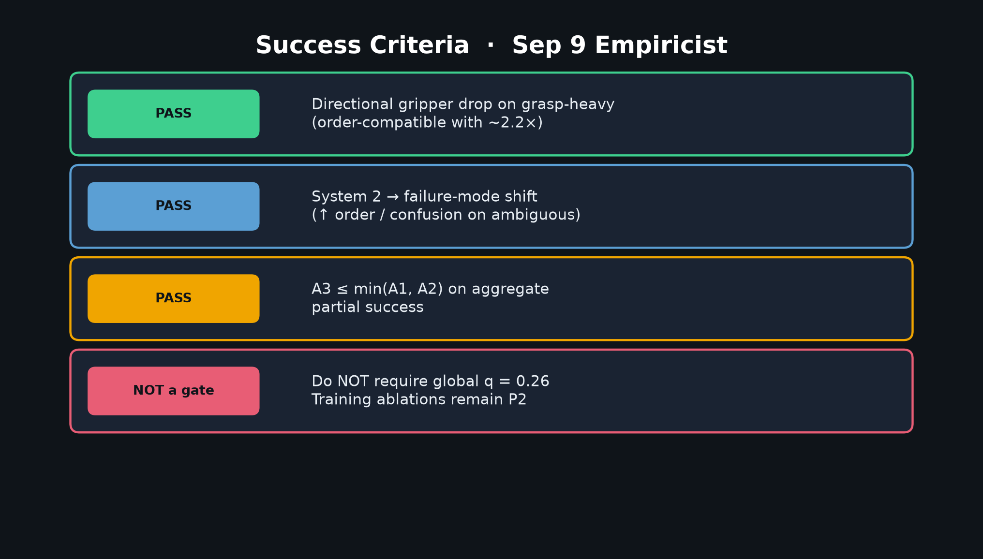
Empiricist · 11+3 · 9/9
Notes:
SUCCESS CRITERIA — close cleanly
PASS bars:
• Directional gripper drop on grasp-heavy (order-compatible with ~2.2×)
• System2 failure-mode shift (↑ order/confusion on ambiguous)
• Interaction: A3 ≤ min(A1,A2) on aggregate partial
NOT a gate: global q=0.26. Training innovations (correlated noise, mixed attn) remain UNABLATED at scale — say that explicitly; future work / P2.
Honesty: claim partial-success / failure-mode deltas, not “reproduce 26%.”
Invite Q&A on subset choice, failure tagging, and whether heuristics should be in methods tables.

