Slide 1

Archaeologist · 11+3 · 1/7
Notes:
ARCHAEOLOGIST (seat 2) — 11 + 3
NO Stakeholder redo. Map lineage: what this paper inherits and foil-contrasts.
Subsequent work: Dec 2025 — too new; repo/blog/video only.

Slide 2
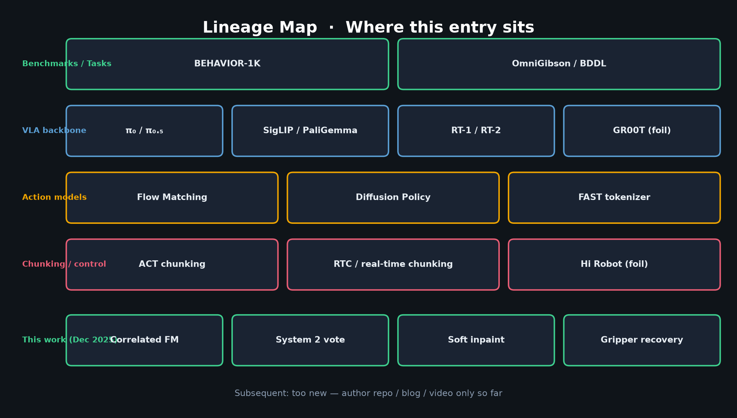
Archaeologist · 11+3 · 2/7
Notes:
LINEAGE MAP — walk top to bottom
Benchmarks: BEHAVIOR-1K, OmniGibson/BDDL
VLA backbone: π₀/π₀.₅, SigLIP/PaliGemma, RT-1/2, GR00T as foil (last-layer XAttn contrast to mixed-layer)
Action models: Flow Matching, Diffusion Policy, FAST
Chunking/control: ACT chunking, RTC / real-time chunking, Hi Robot as foil (CoT skill library — this work is simpler stage voting)
This work: correlated FM + System2 vote + soft inpaint + gripper recovery

Slide 3
π₀ / π₀.₅ lineage
OpenPI flow-matching VLA → task-adapted contest entry
Archaeologist · 11+3 · 3/7
Notes:
π₀ / π₀.₅ / OpenPI
Physical Intelligence lineage. Flow-matching VLA. This entry adapts openpi for fixed 50-task contest.
Key adaptation: drop language → task embeddings; correlated noise; mixed-layer attn; System 2.
Action expert ~311M; frozen SigLIP-So400m/14 @ 224.

Slide 4
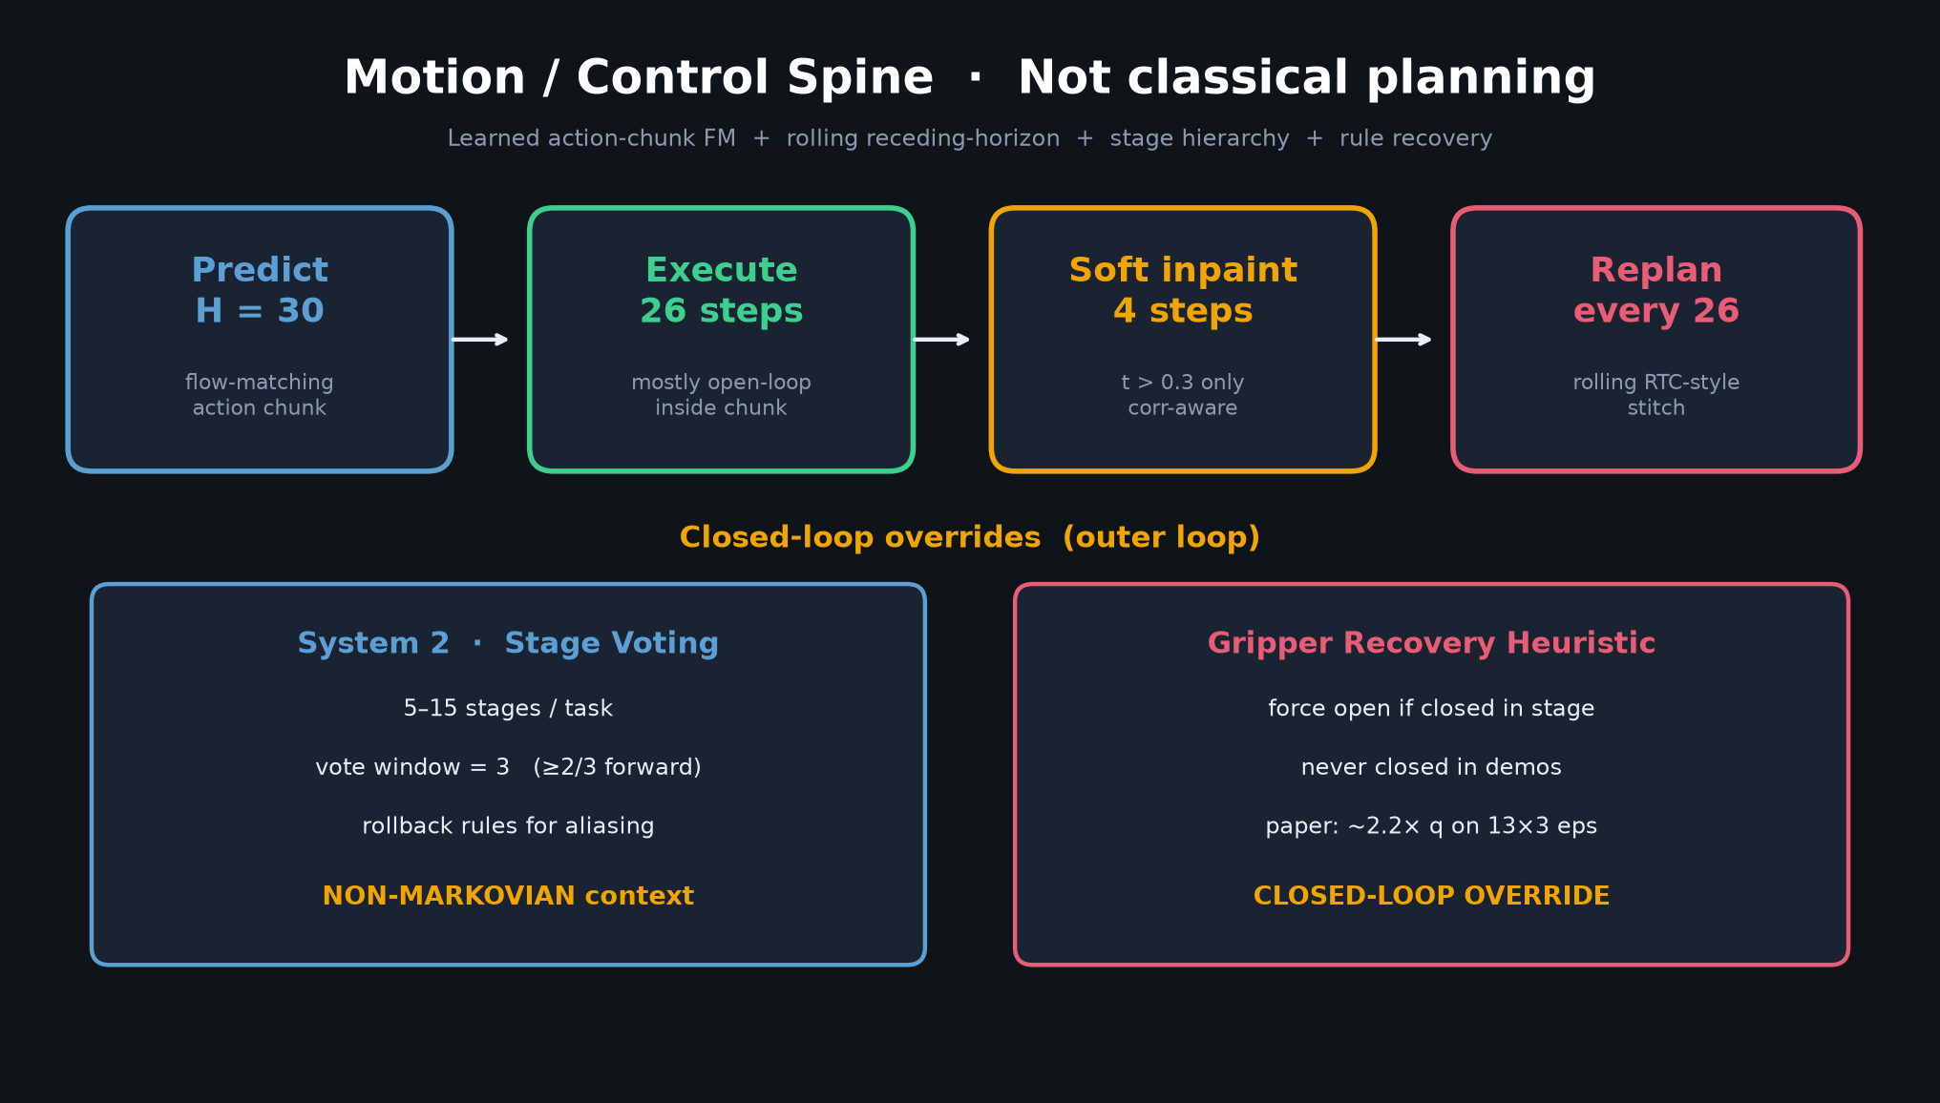
Archaeologist · 11+3 · 4/7
Notes:
CHUNKING LINEAGE: ACT → RTC → this work
ACT: action chunking + temporal ensemble (NOT used here).
RTC / real-time chunking: rolling stitch inspiration — soft correlation-aware inpaint (exec 26 / keep 4, t>0.3).
Hi Robot foil: explicit CoT / skill library — this paper uses implicit stages + vote, no skill graph.
Compression 1.3× cubic spline is an inference-time control trick, not classical planning.

Slide 5
Foils & contrasts
GR00T · Hi Robot · Diffusion Policy · RT-1/2
Archaeologist · 11+3 · 5/7
Notes:
FOILS
GR00T: last-layer cross-attn foil vs learnable mixed-layer KV combo.
Hi Robot: heavier hierarchical CoT vs lightweight System 2 stage machine.
Diffusion Policy / FM: continuous action generation family; correlated noise is the twist.
RT-1/2: earlier VLA milestones; language-conditioned — this contest drops L for task IDs.

Slide 6
Subsequent work
Dec 2025 · repo / blog / video only so far
Archaeologist · 11+3 · 6/7
Notes:
SUBSEQUENT WORK
Paper Dec 2025 (v2). Too new for rich citation graph.
So far: author GitHub (behavior-1k-solution), HF weights, blog/video only.
Watch for: with/without-heuristics replications; RTC comparisons on real robots; BEHAVIOR 2026 entries that cite this control spine.

Slide 7
Takeaway
π₀.₅ + correlated FM + RTC-style chunking + stage vote + heuristics
Archaeologist · 11+3 · 7/7
Notes:
ARCHAEOLOGIST CLOSE
One slide takeaway: this is π₀.₅ + correlated FM + RTC-style chunking + stage vote + light heuristics on BEHAVIOR-1K — not a classical planner paper.
Hand to Visionary for 2026 agenda.

