Slide 1
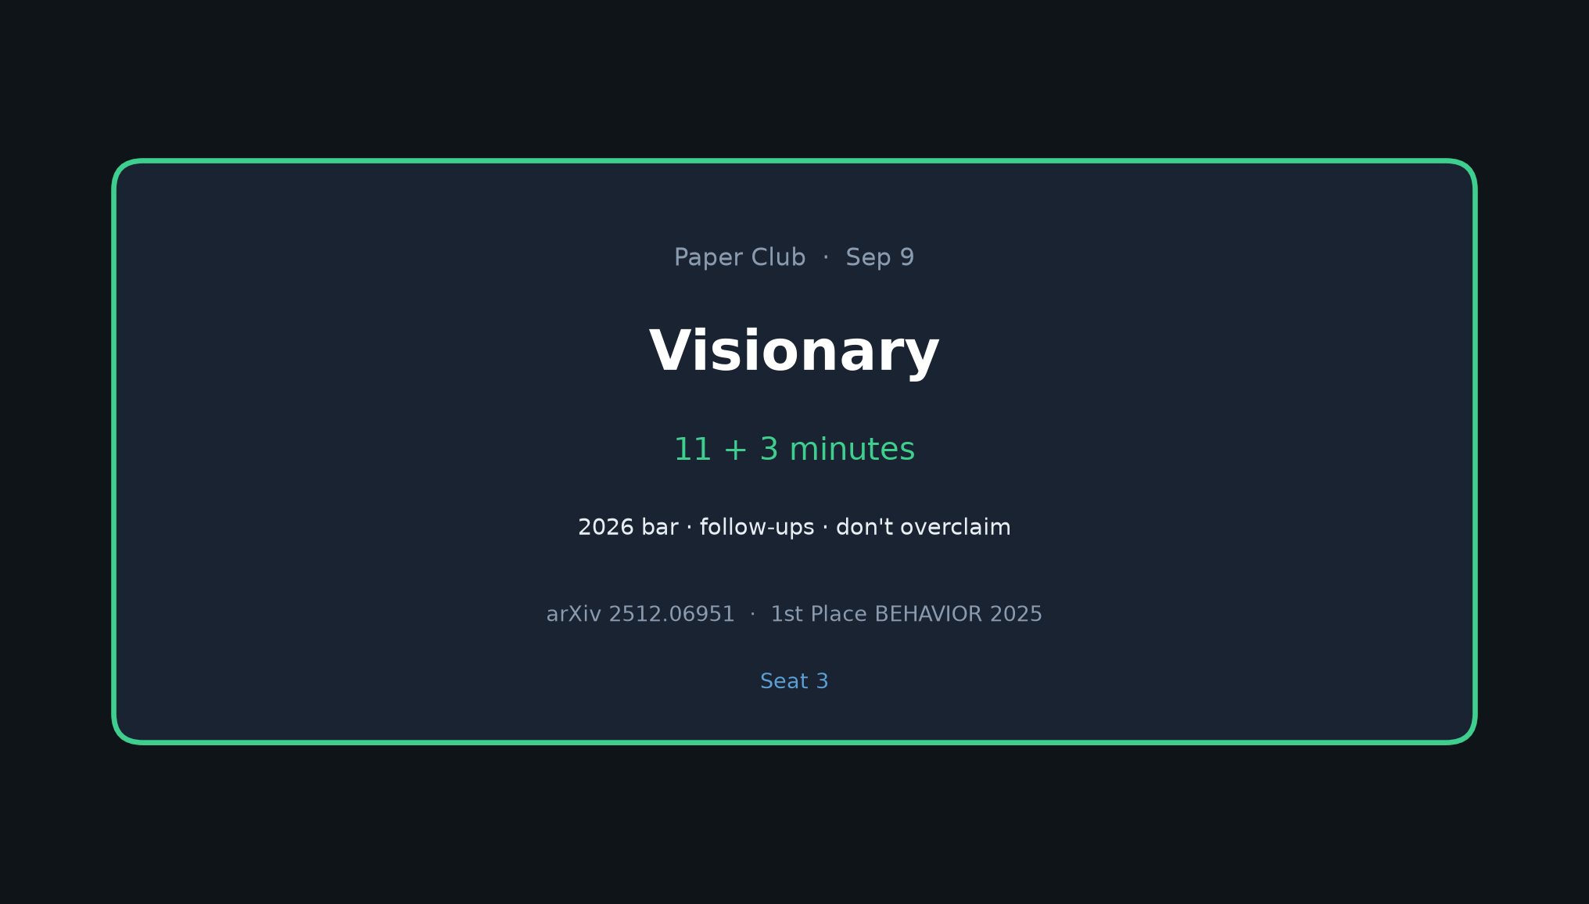
Visionary · 11+3 · 1/7
Notes:
VISIONARY (seat 3) — 11 + 3
NO Discord/Drive logistics. Don't overclaim.
Frame: 2026 bar still ~26% partial — what research moves the frontier?

Slide 2
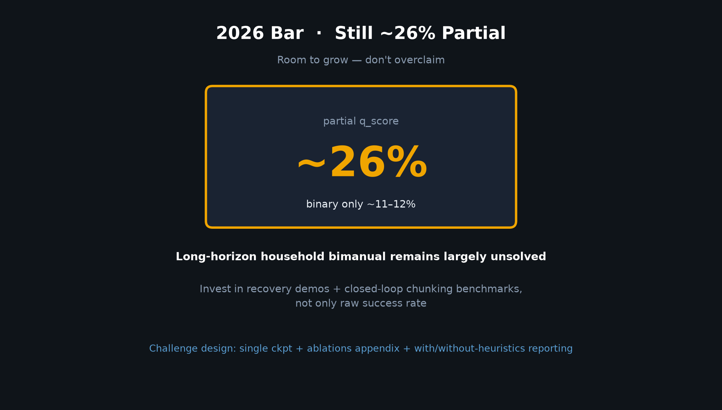
Visionary · 11+3 · 2/7
Notes:
2026 BAR
Still ~26% average partial q_score; binary ~11–12%.
Long-horizon household bimanual + mobile remains largely unsolved.
Invest in recovery demos + closed-loop chunking benchmarks, not only raw SR.
Challenge design: require single checkpoint + ablations appendix; report q with/without heuristics.

Slide 3
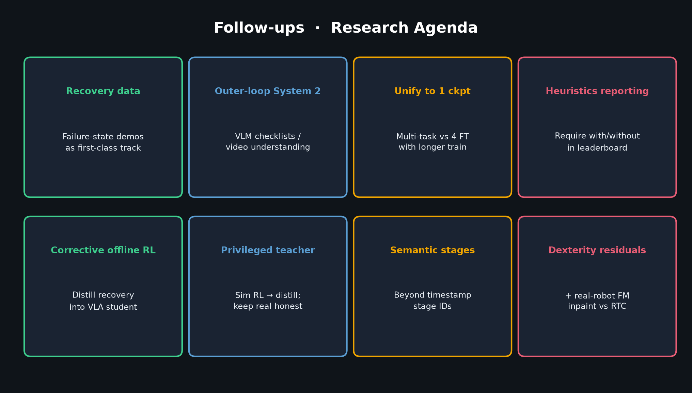
Visionary · 11+3 · 3/7
Notes:
FOLLOW-UPS (walk the grid)
1. Recovery / failure-state data as first-class track (§10.1) — biggest robustness lever
2. Outer-loop System 2 → VLM checklists / video understanding APIs
3. Unify to 1 multi-task ckpt (authors themselves question 4)
4. Require with/without-heuristics reporting on leaderboard
5. Corrective offline RL / distill recovery into VLA student
6. Privileged sim RL teacher → distill; keep real-world constraints honest
7. Semantic stages beyond timestamp IDs
8. Dexterity residual policies; real-robot correlated FM + soft inpaint vs RTC

Slide 4
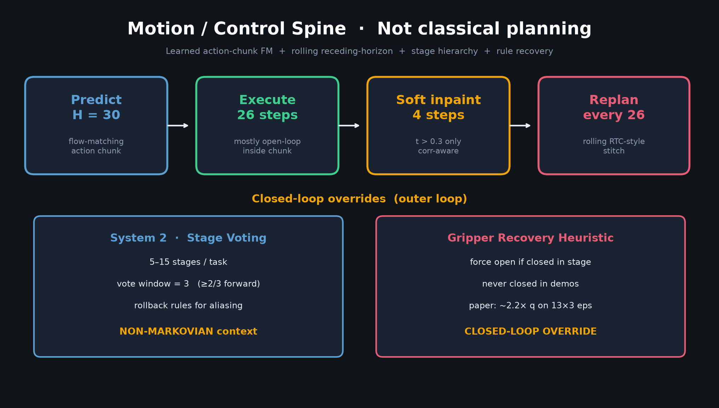
Visionary · 11+3 · 4/7
Notes:
CONTROL RESEARCH AGENDA
The motion spine is the gift: H=30→26→inpaint4 + System2 + gripper.
2026 questions:
• Soft inpaint vs hard RTC on real robots?
• Learned recovery policies vs brittle rules?
• Stage machines from VLM vs fixed timestamps?
Don't claim this paper solved long-horizon control — it showed a winning competition stack with a clear outer loop.

Slide 5
Challenge design asks
Ablations appendix · single ckpt track · with/without heuristics
Visionary · 11+3 · 5/7
Notes:
CHALLENGE DESIGN ASKS
• Scientific prize track: mandatory component ablations on fixed public subset
• Single-checkpoint track vs multi-model submissions
• Limit brittle task-specific rules OR require them in a separate “engineering” score
• Safety envelope against falls / stuck base (Fig. 10 failure modes)
• Sensing: fisheye / rear camera for coverage holes

Slide 6
Don't overclaim
Winning stack ≠ settled science · push concrete follow-ups
Visionary · 11+3 · 6/7
Notes:
DON'T OVERCLAIM
This is a strong competition entry with public code/weights — not a settled science paper on which components matter.
Training innovations (correlated noise, mixed attn) remain largely unablated at scale.
Binary success still ~11–12%; partial progress is real but far from reliable household robots.
Park hype; push concrete follow-ups.

Slide 7
Visionary close
Recovery data · VLM outer loops · real-robot RTC
Visionary · 11+3 · 7/7
Notes:
VISIONARY CLOSE / Q&A
Invite discussion on recovery data collection, VLM outer loops, and real-robot RTC comparisons.
No Discord/Drive. Hand back to facilitator.

