Slide 1
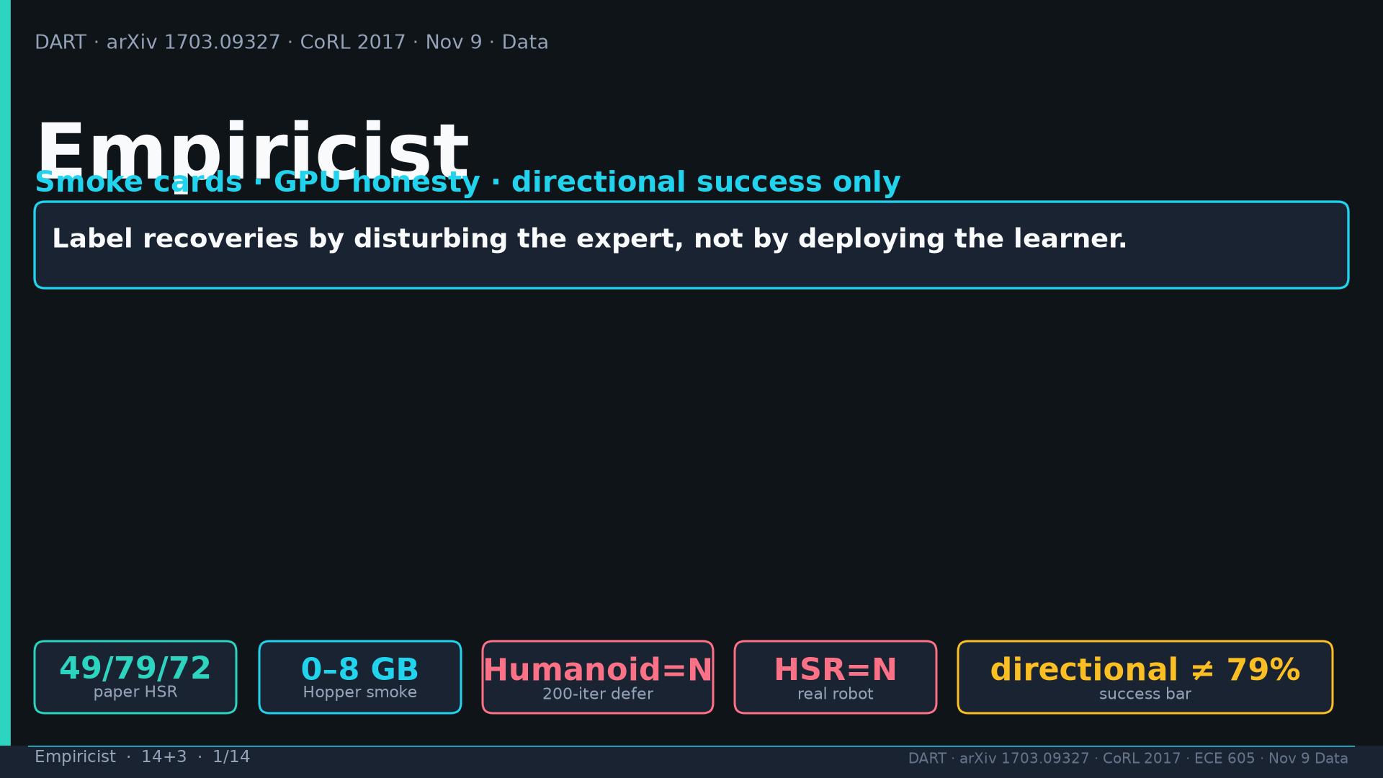
Notes:
Title. Smoke cards; GPU honesty; directional ≠ paper parity. Humanoid-200=N; real HSR=N.

Slide 2
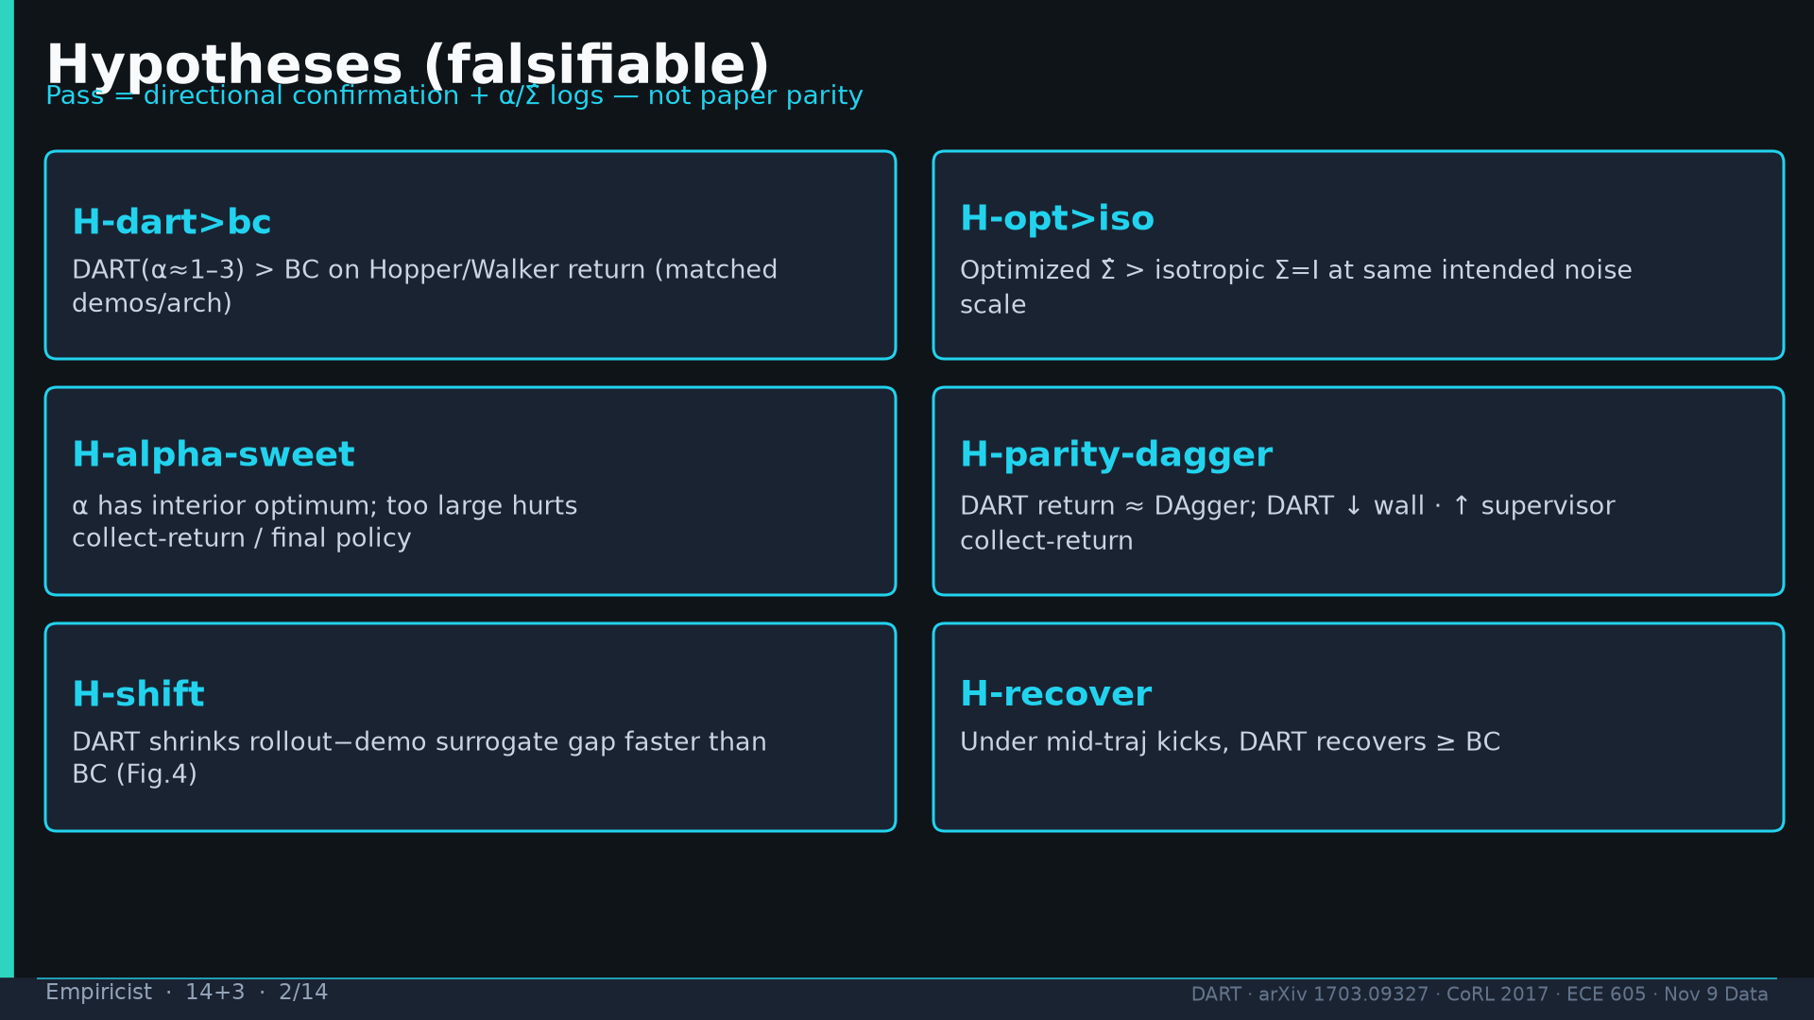
Notes:
Hypotheses H-dart>bc / H-opt>iso / H-alpha-sweet / H-parity-dagger / H-shift / H-recover.

Slide 3
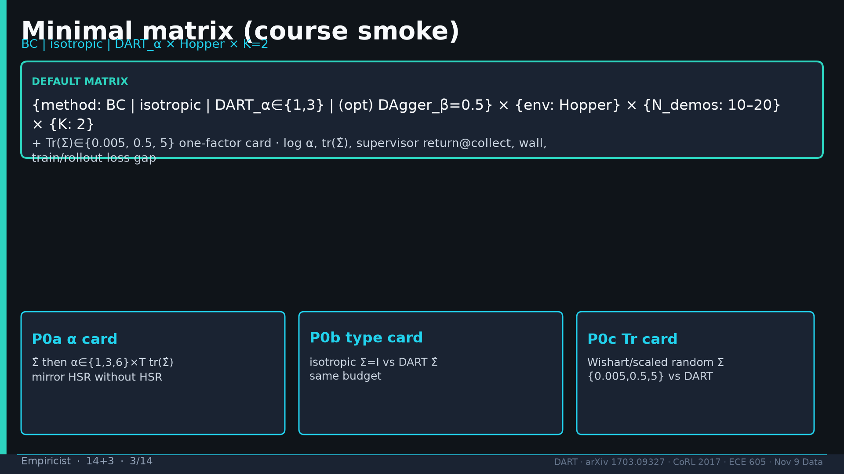
Notes:
Minimal matrix BC|isotropic|DART_α×Hopper×K=2 + Tr(Σ) card.

Slide 4
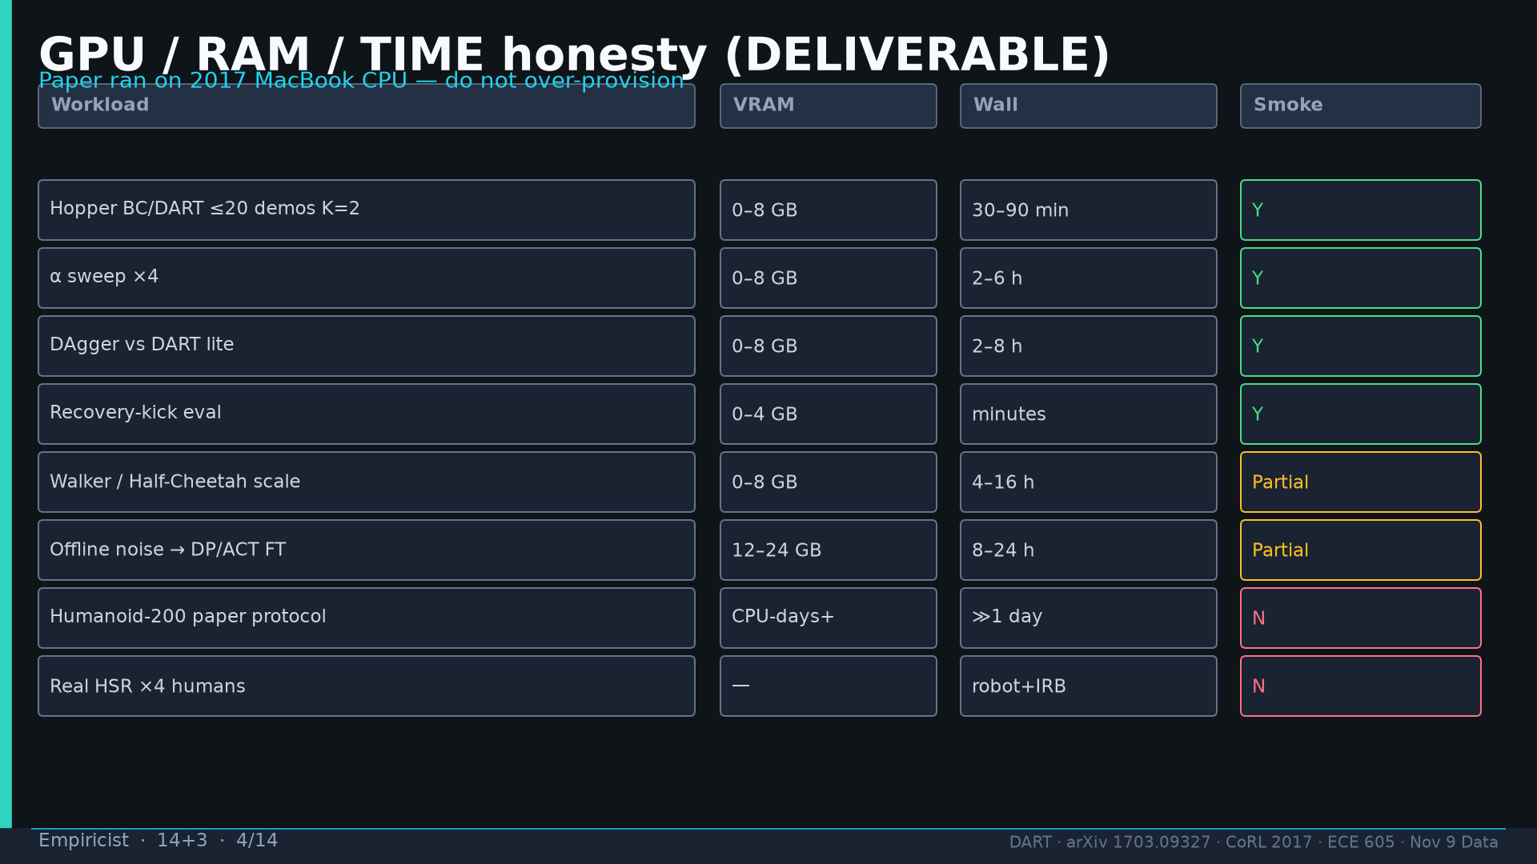
Notes:
GPU table from DELIVERABLE: Hopper 0–8GB Y; Humanoid/HSR N.

Slide 5
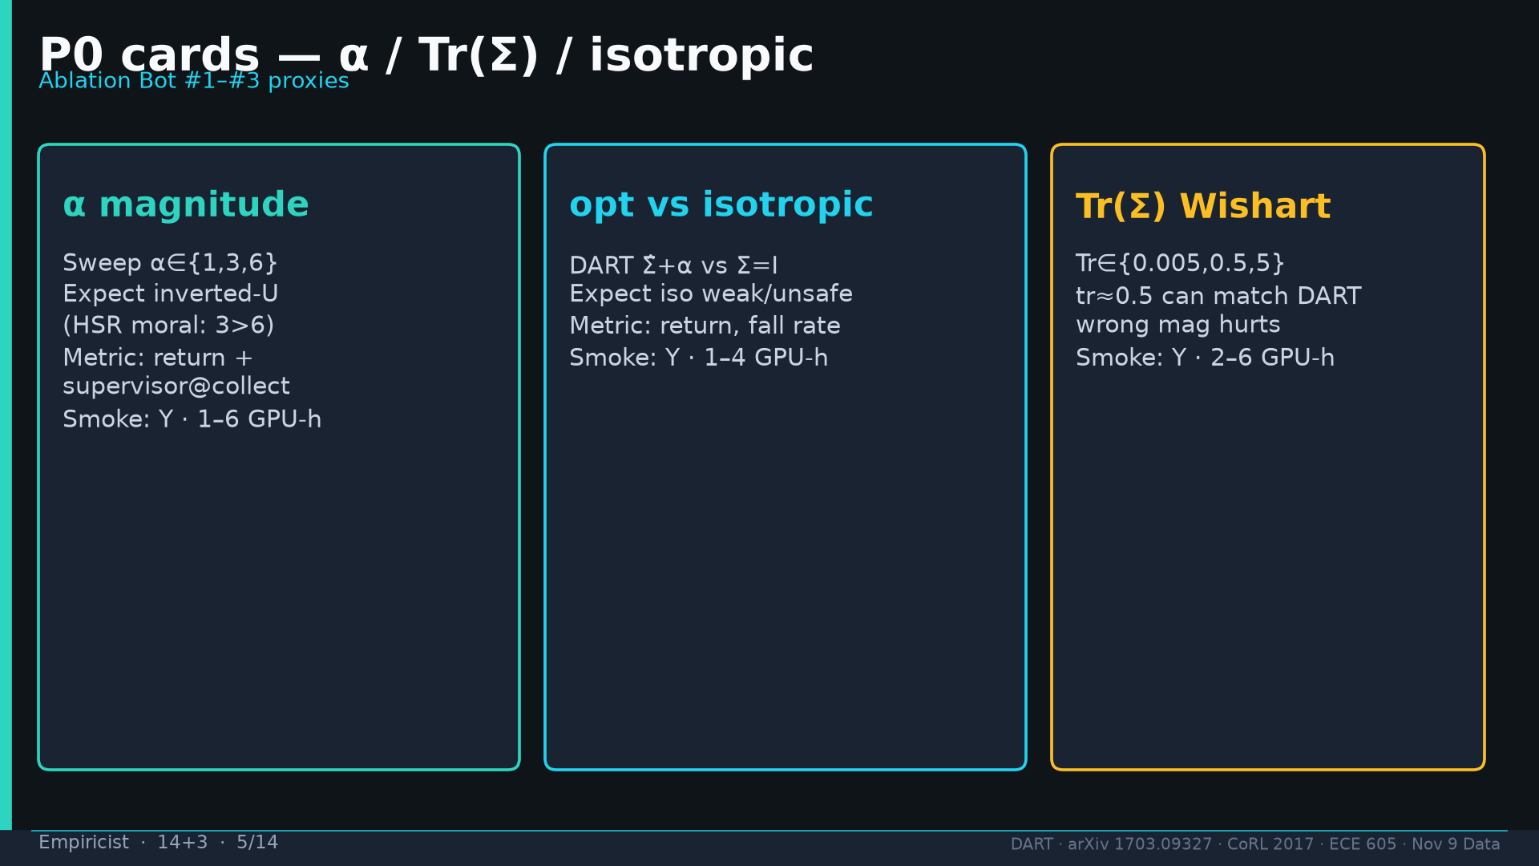
Notes:
P0 α / type / Tr cards — Ablation Bot #1–#3 proxies.

Slide 6
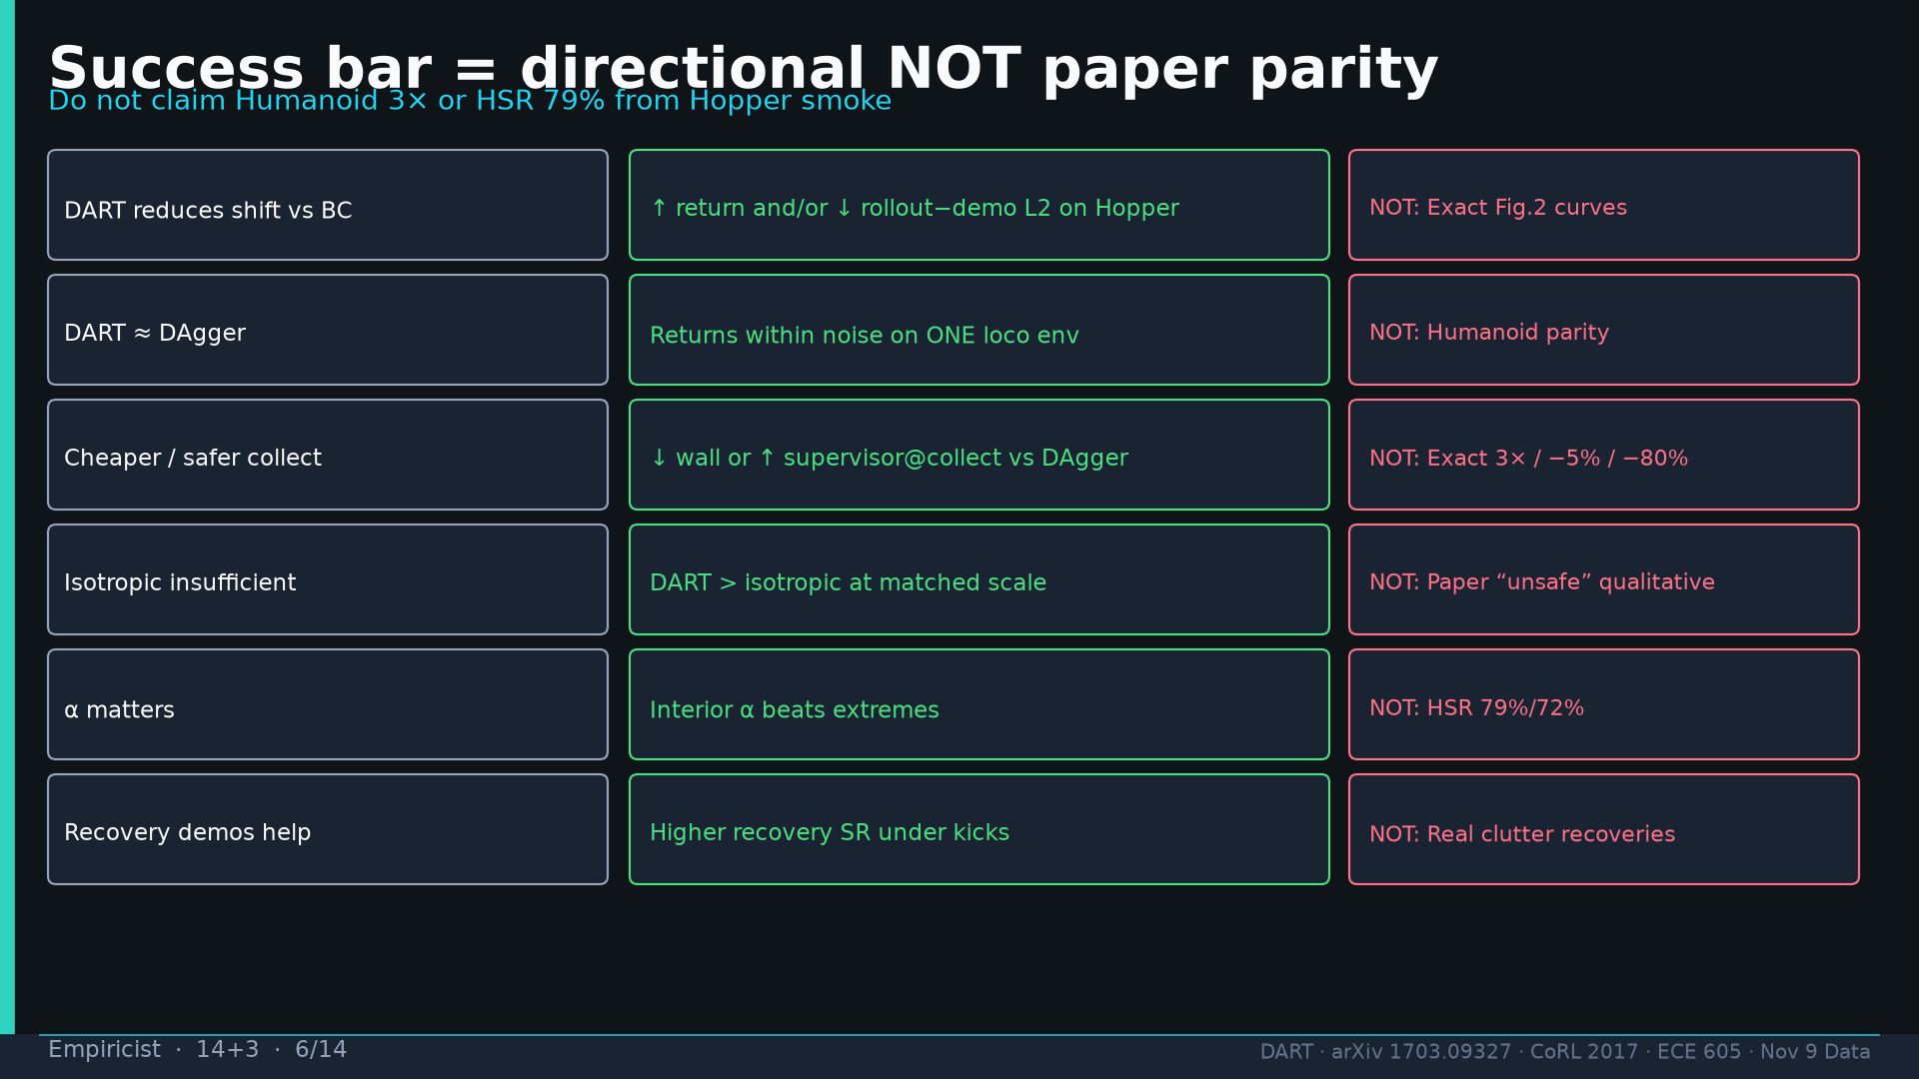
Notes:
Success bar table: feasible vs NOT required (no 3×/79% from smoke).

Slide 7
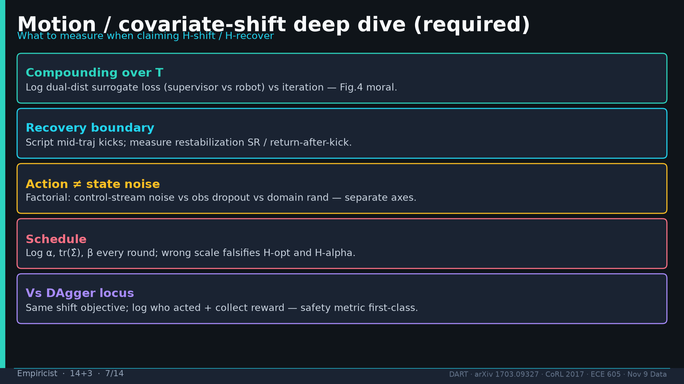
Notes:
Motion deep dive: dual-dist loss, kicks, action≠state, log α/tr, collect reward.

Slide 8
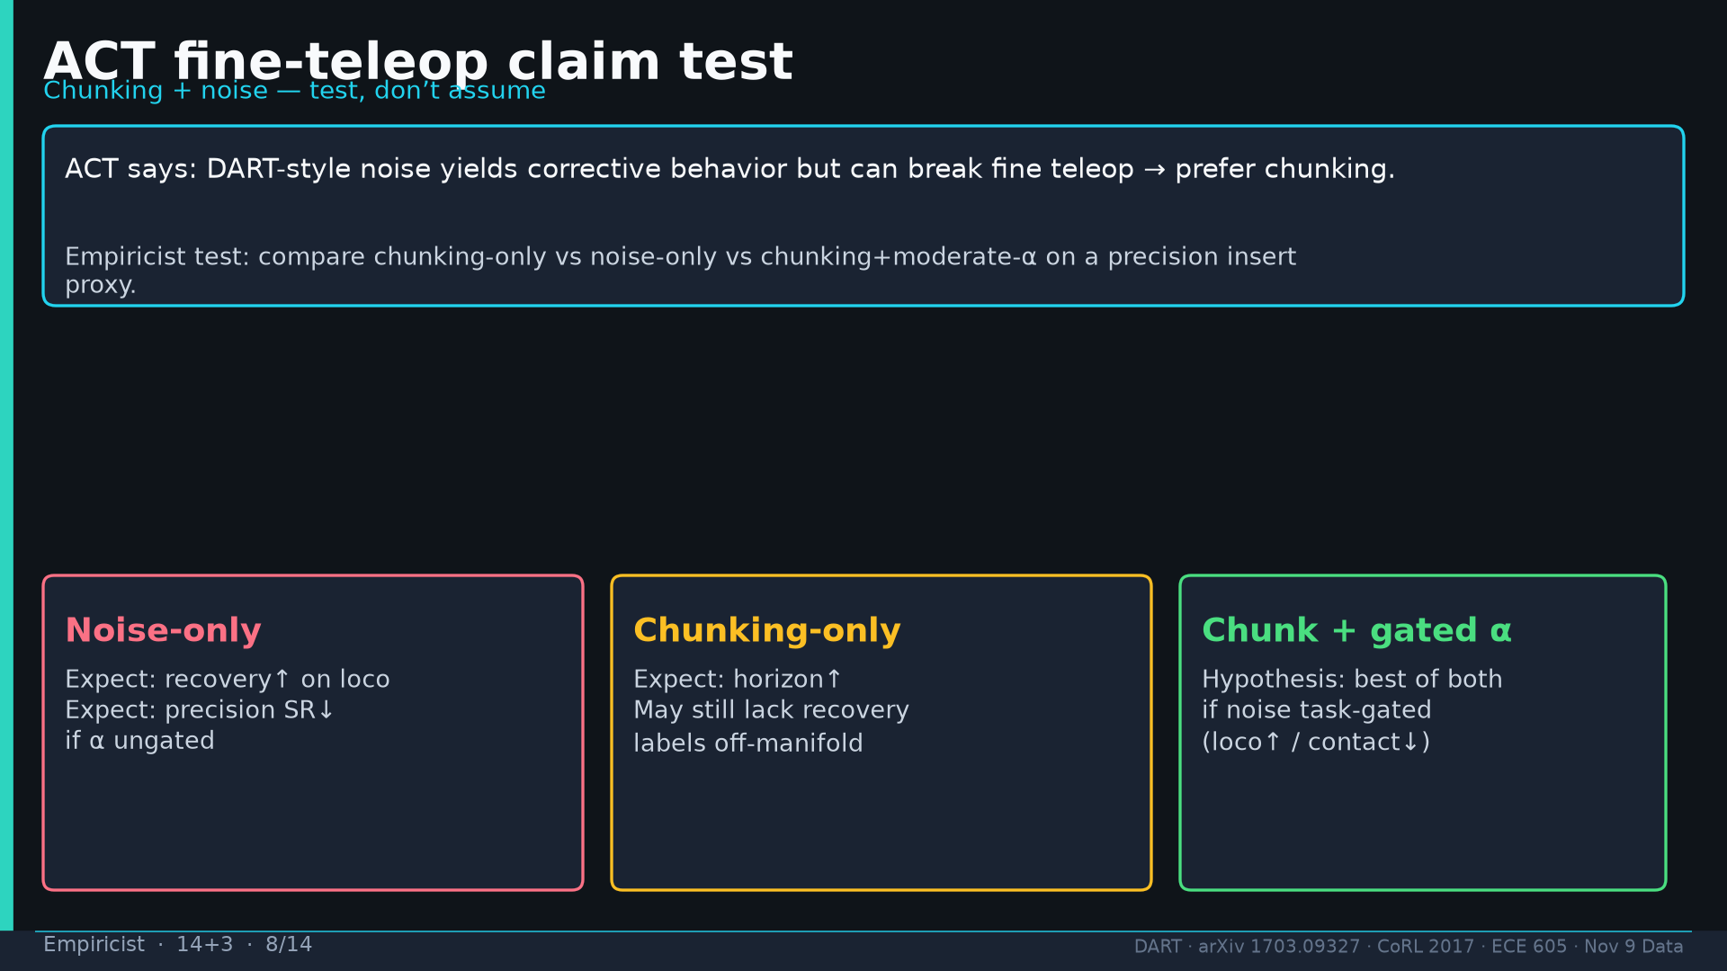
Notes:
ACT claim test: noise-only vs chunking-only vs chunk+gated α.

Slide 9
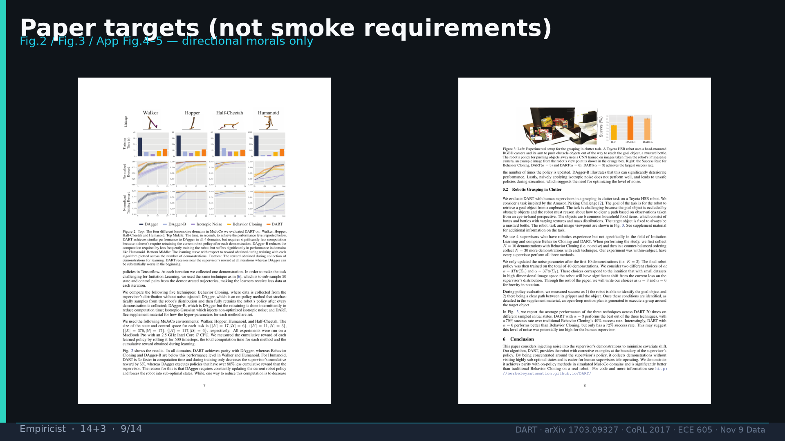
Notes:
Paper Fig.2/3 targets — morals only.

Slide 10
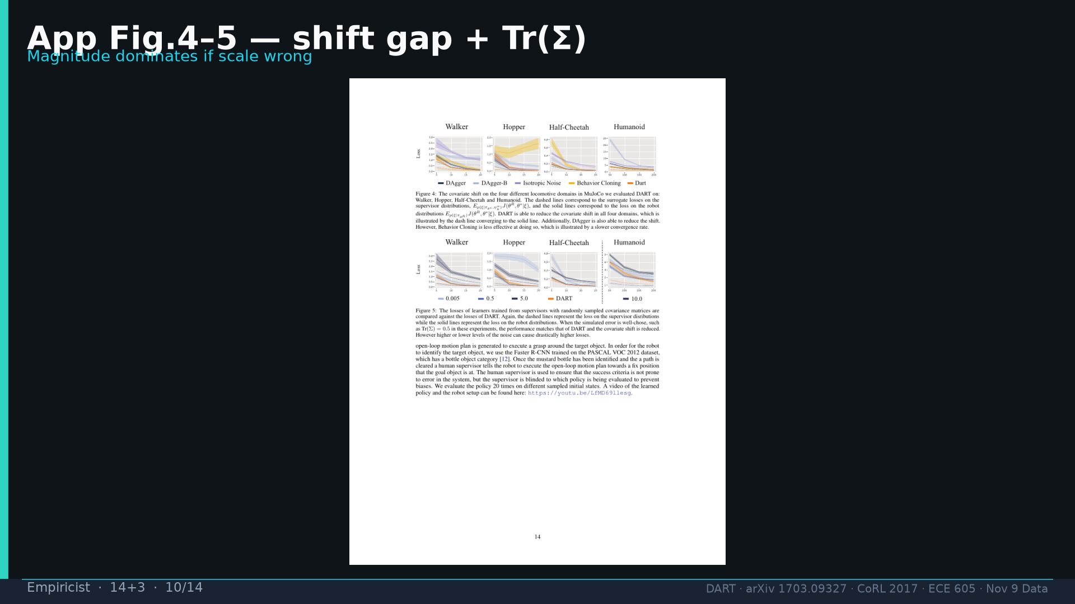
Notes:
App Fig.4–5 shift + Wishart.

Slide 11
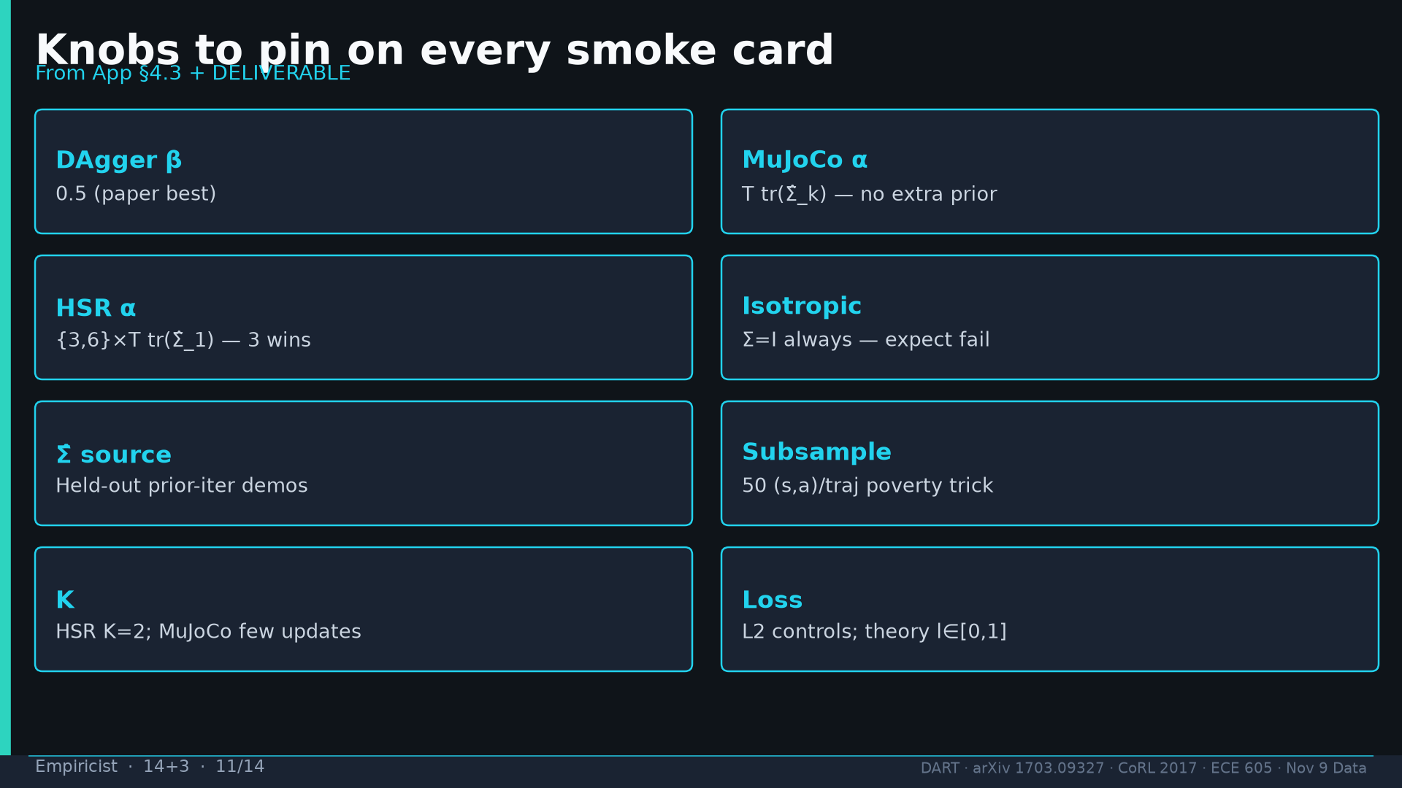
Notes:
Knobs: β=0.5, α defaults, held-out Σ̂, 50 subsample, K=2, L2.

Slide 12
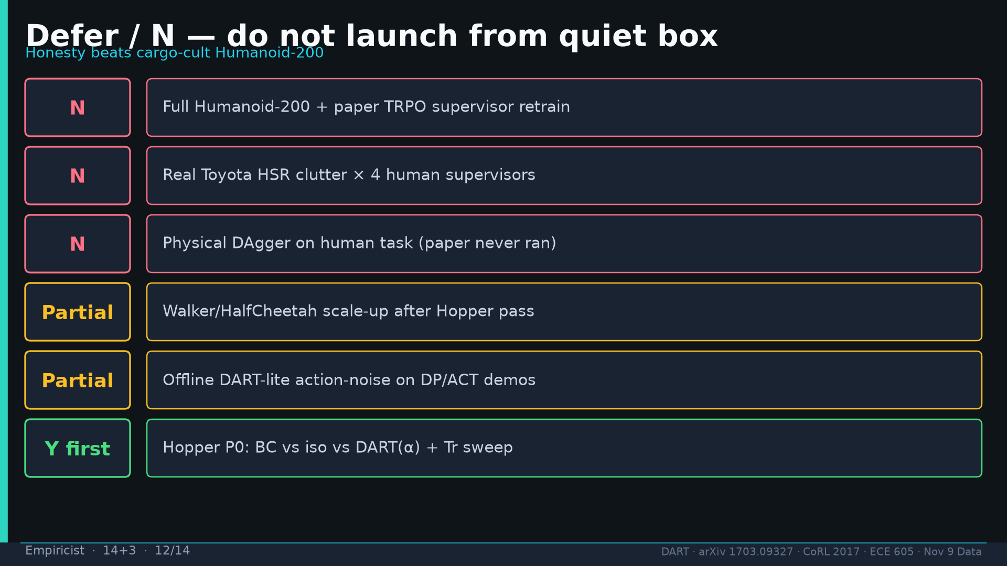
Notes:
Defer N list; Y-first Hopper P0.

Slide 13
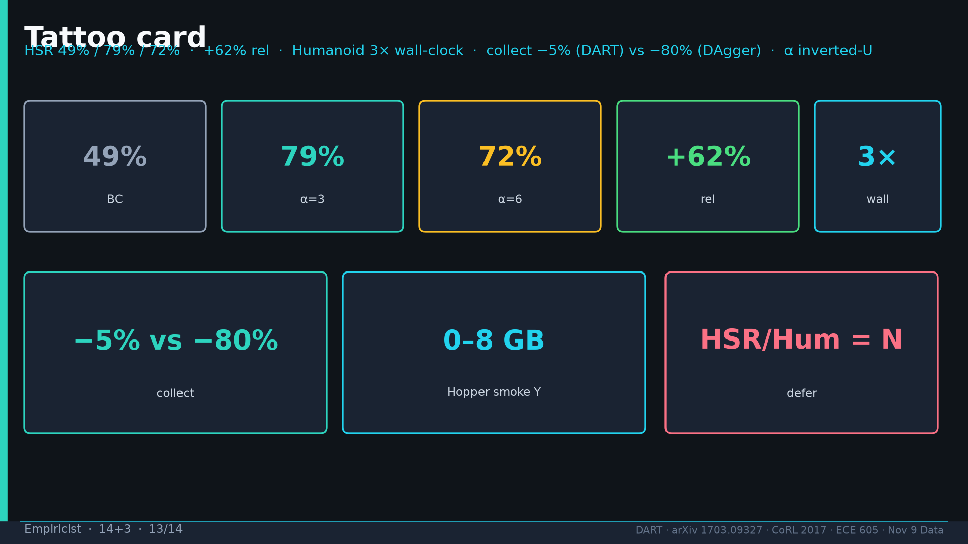
Notes:
Tattoo.

Slide 14
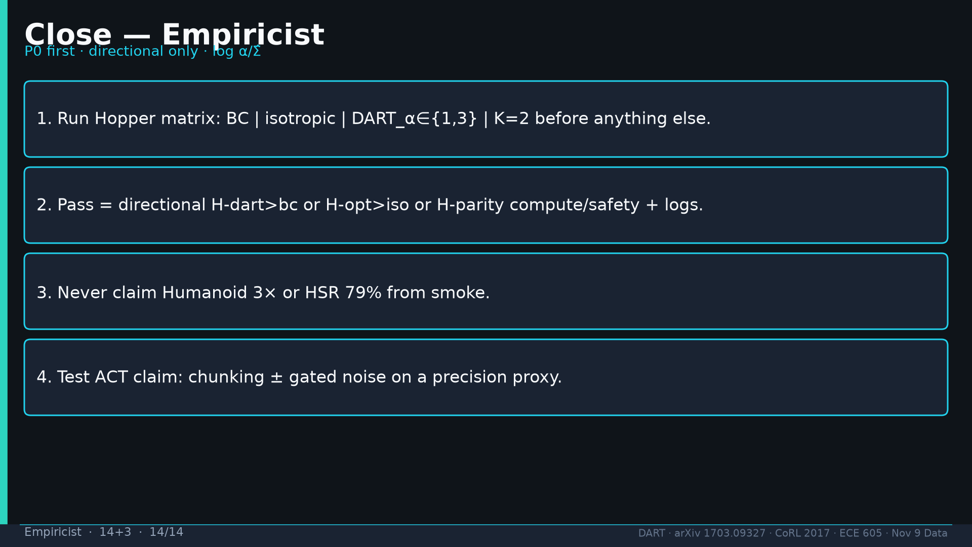
Notes:
Close: P0 first; directional; never claim paper parity; test ACT.

