Slide 1
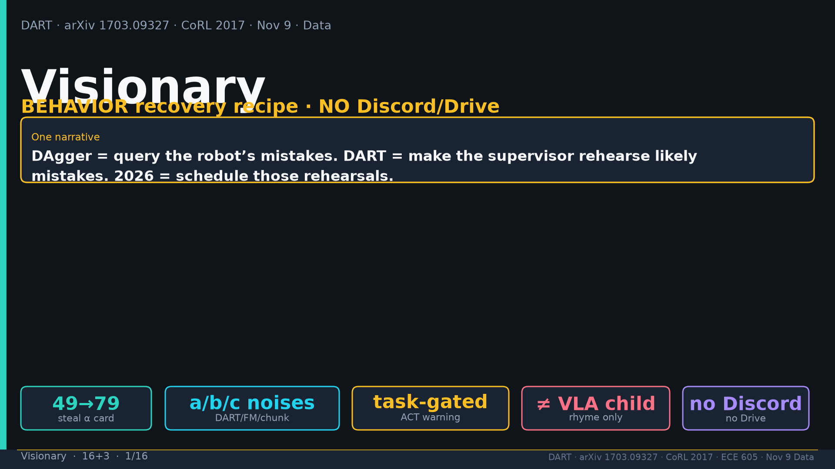
Notes:
Title. NO Discord/Drive. Narrative: DAgger query mistakes; DART rehearse; 2026 schedule.

Slide 2
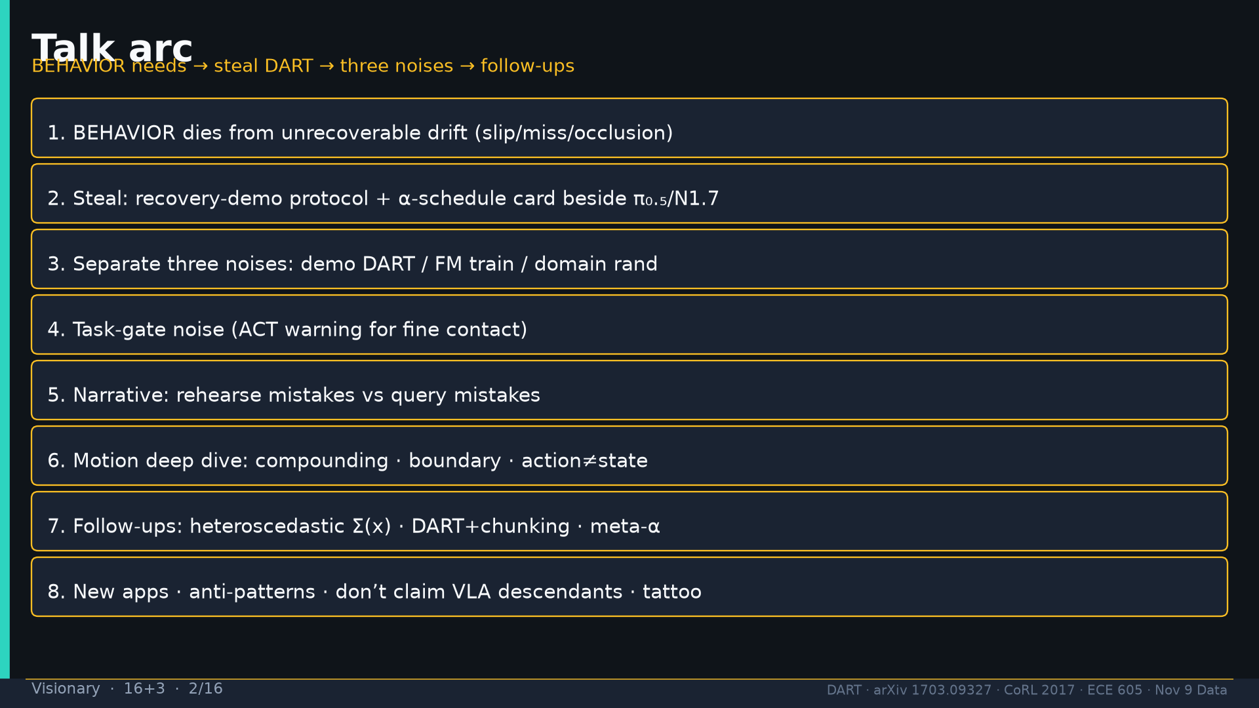
Notes:
Talk arc overview.

Slide 3
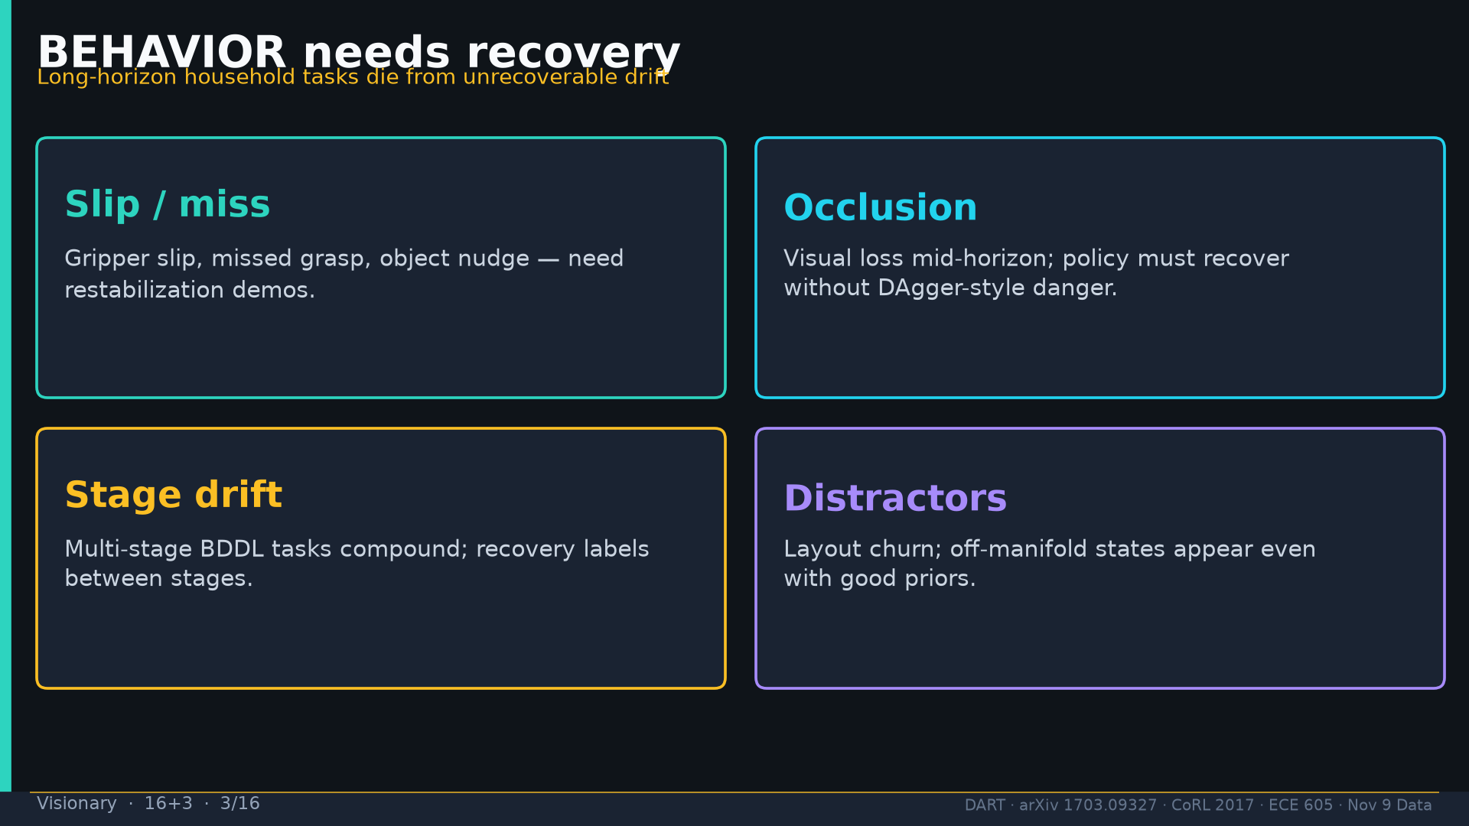
Notes:
BEHAVIOR needs: slip/miss, occlusion, stage drift, distractors.

Slide 4
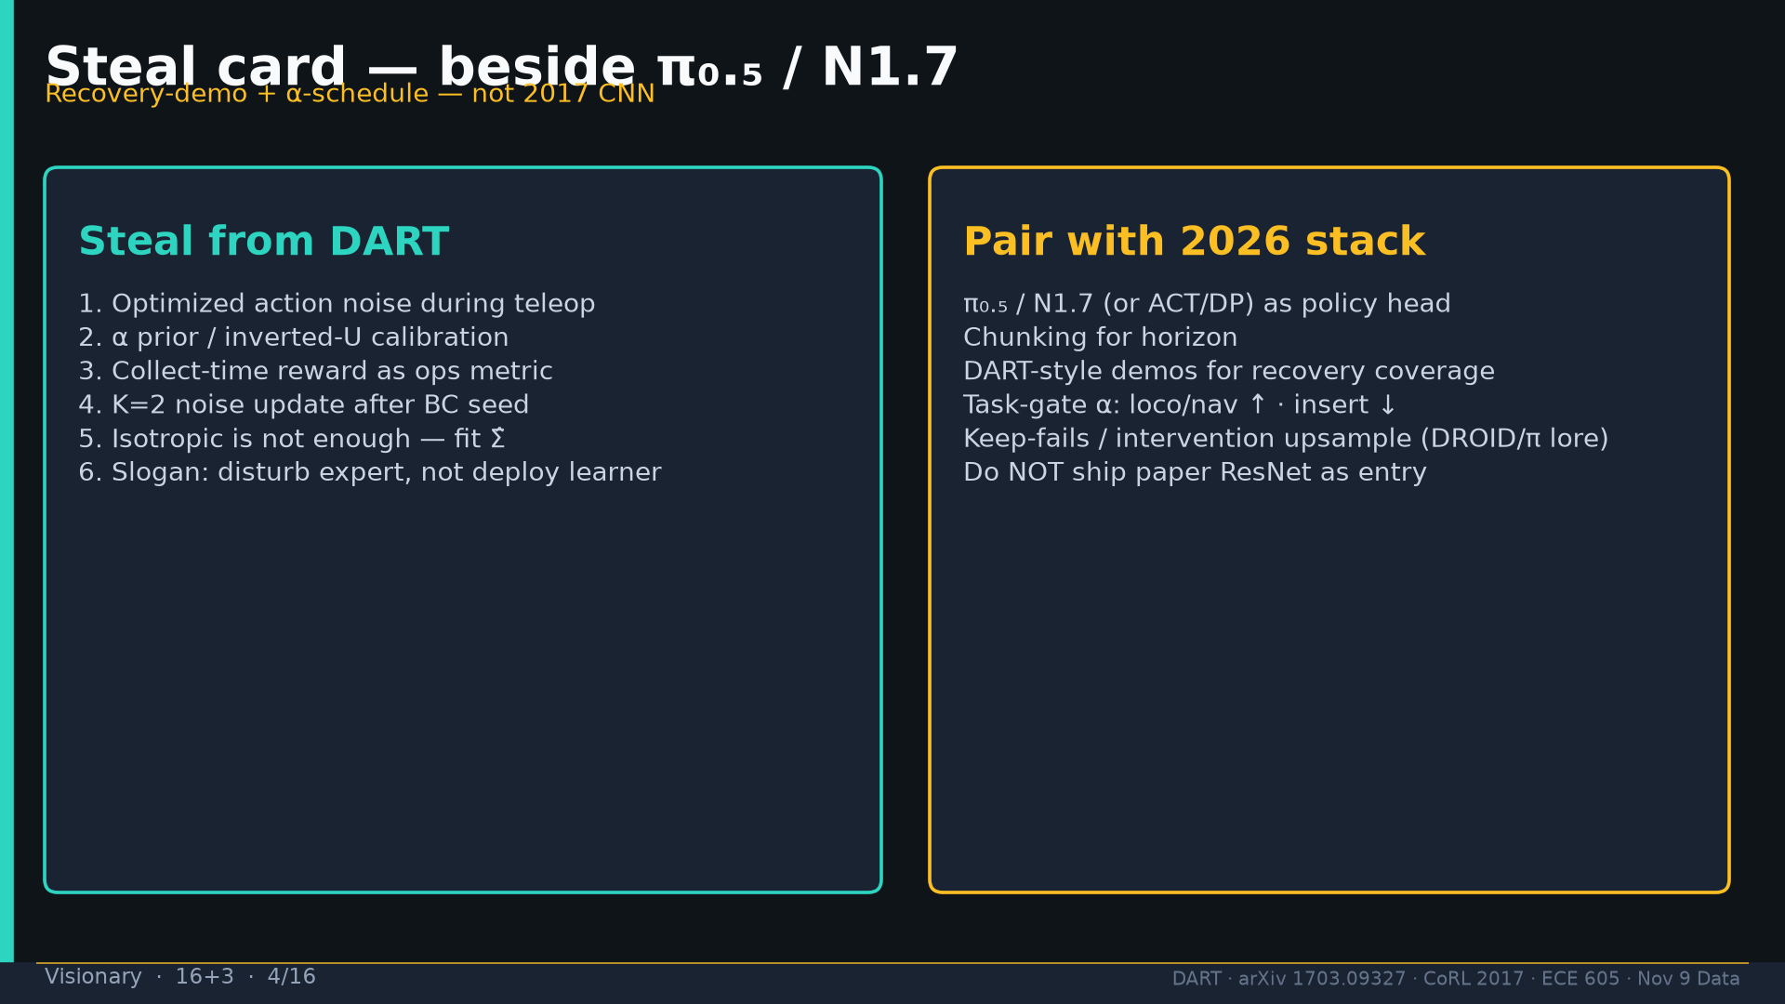
Notes:
Steal recovery-demo+α beside π₀.₅/N1.7; pair with modern head.

Slide 5
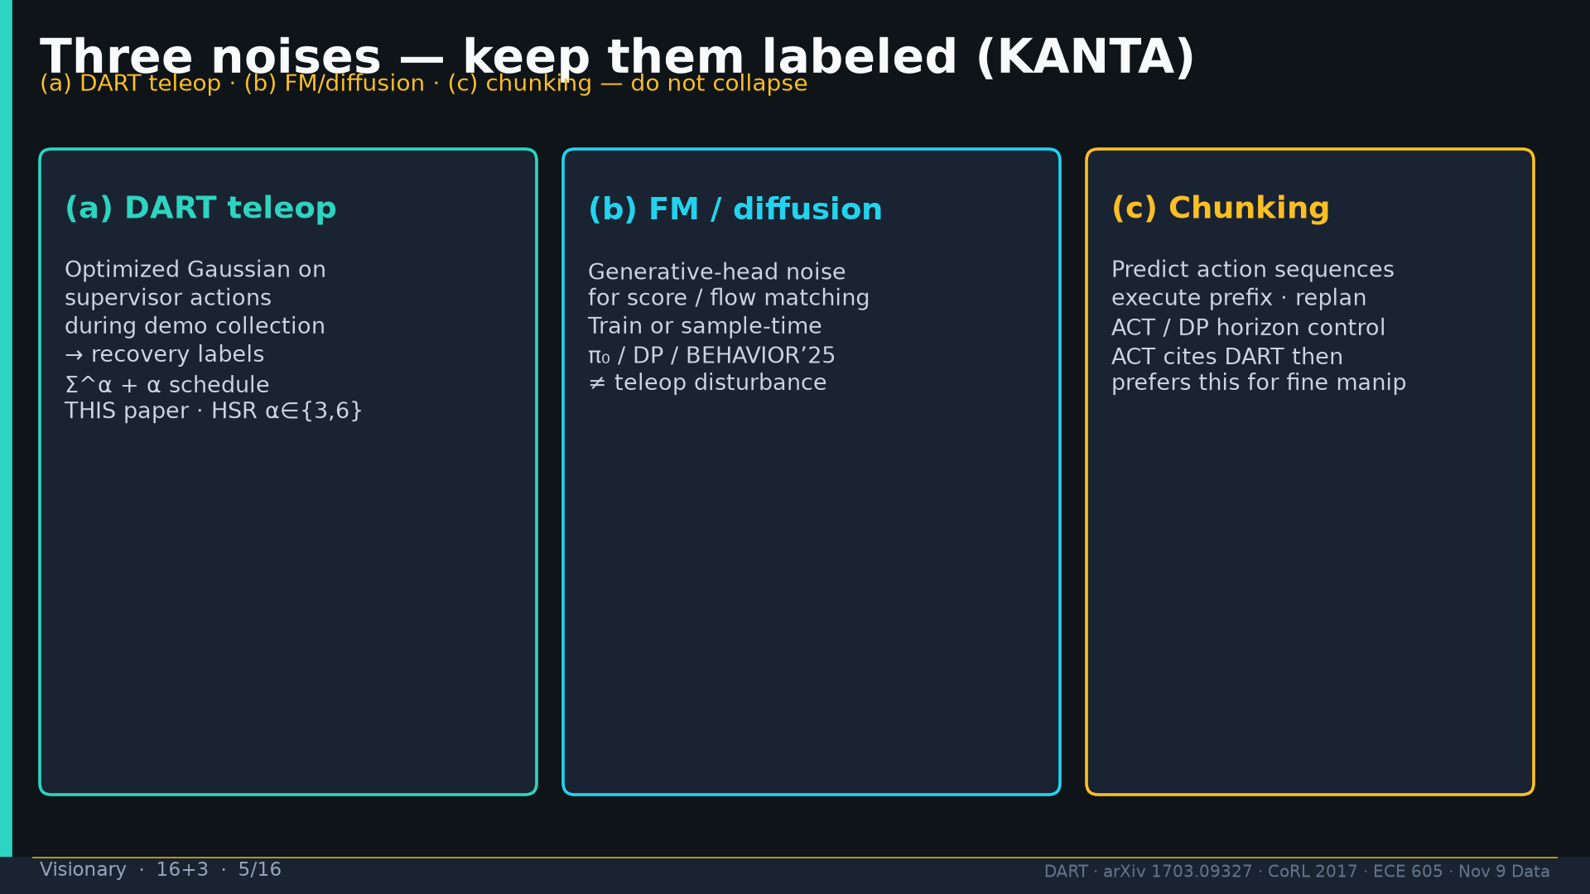
Notes:
Three noises: demo DART / FM train / domain rand — separate.

Slide 6
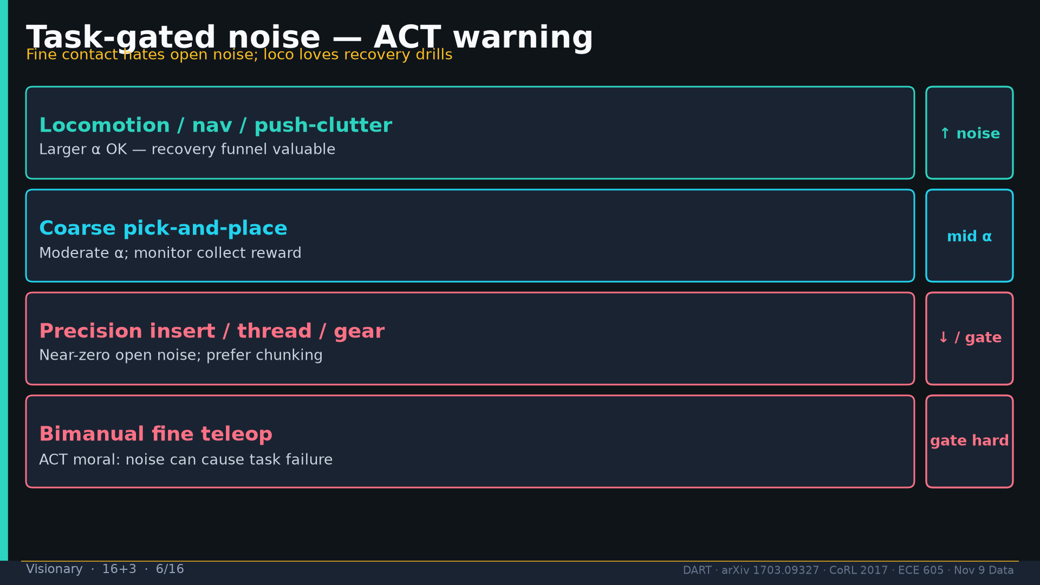
Notes:
Task-gated noise table; ACT warning for fine contact.

Slide 7
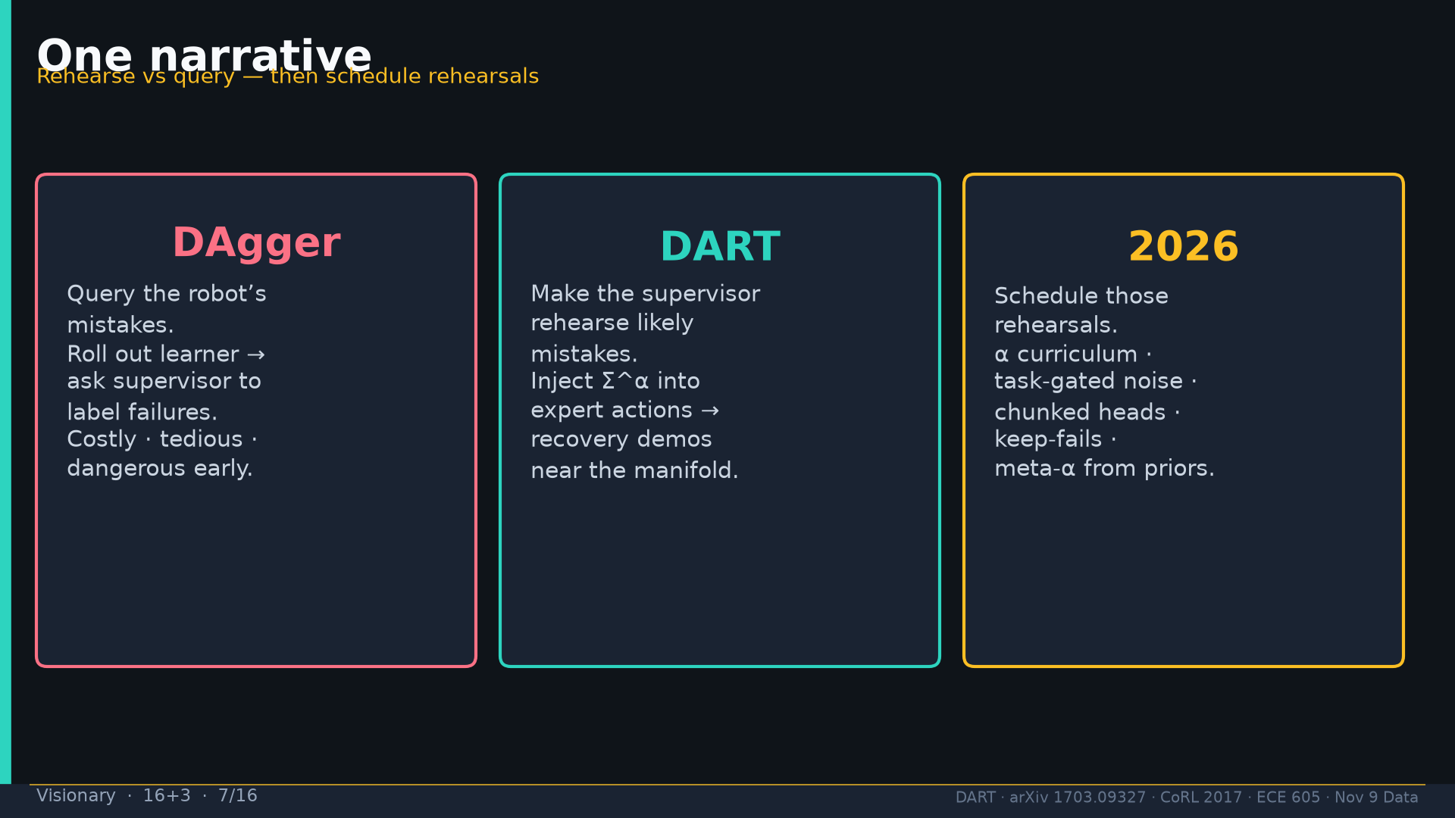
Notes:
One narrative three columns.

Slide 8
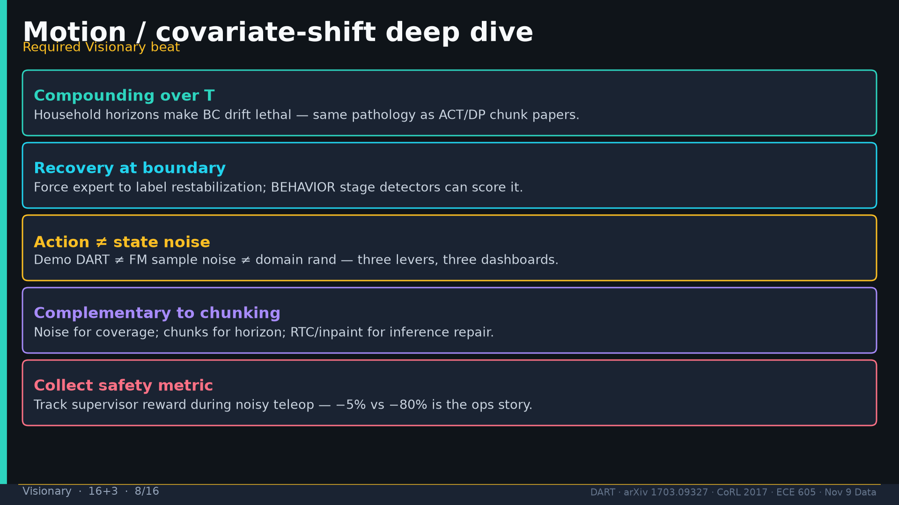
Notes:
Motion deep dive required.

Slide 9
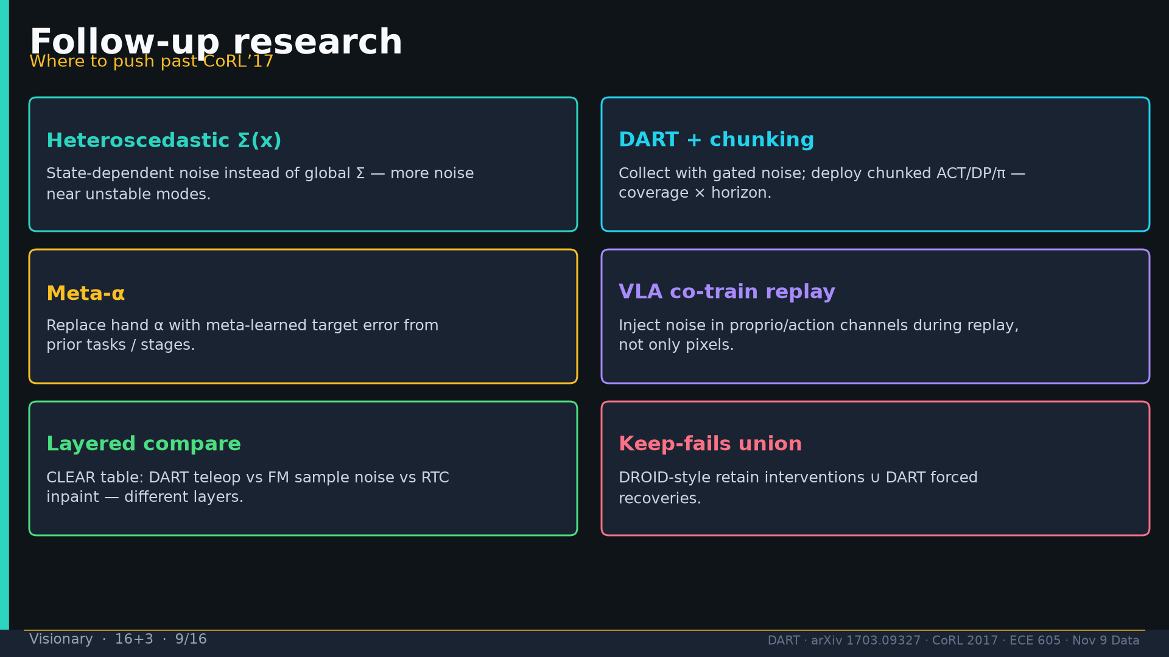
Notes:
Follow-ups: Σ(x), DART+chunking, meta-α, VLA replay, layered compare, keep-fails.

Slide 10
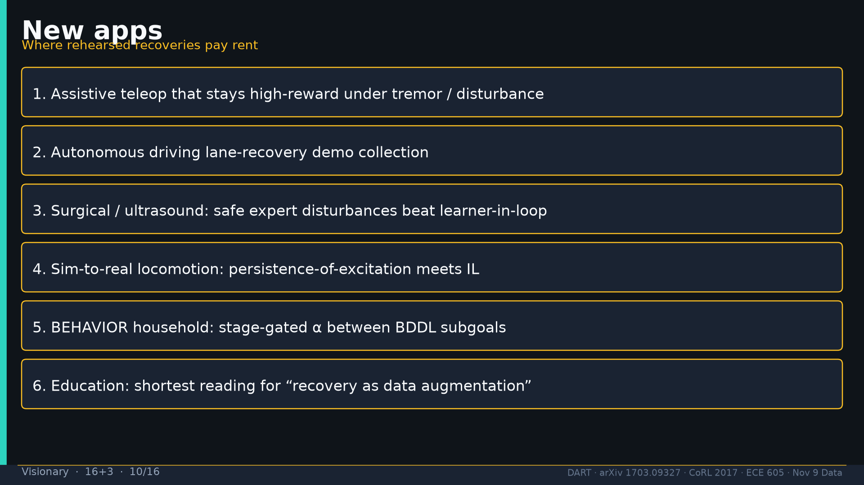
Notes:
New apps list.

Slide 11
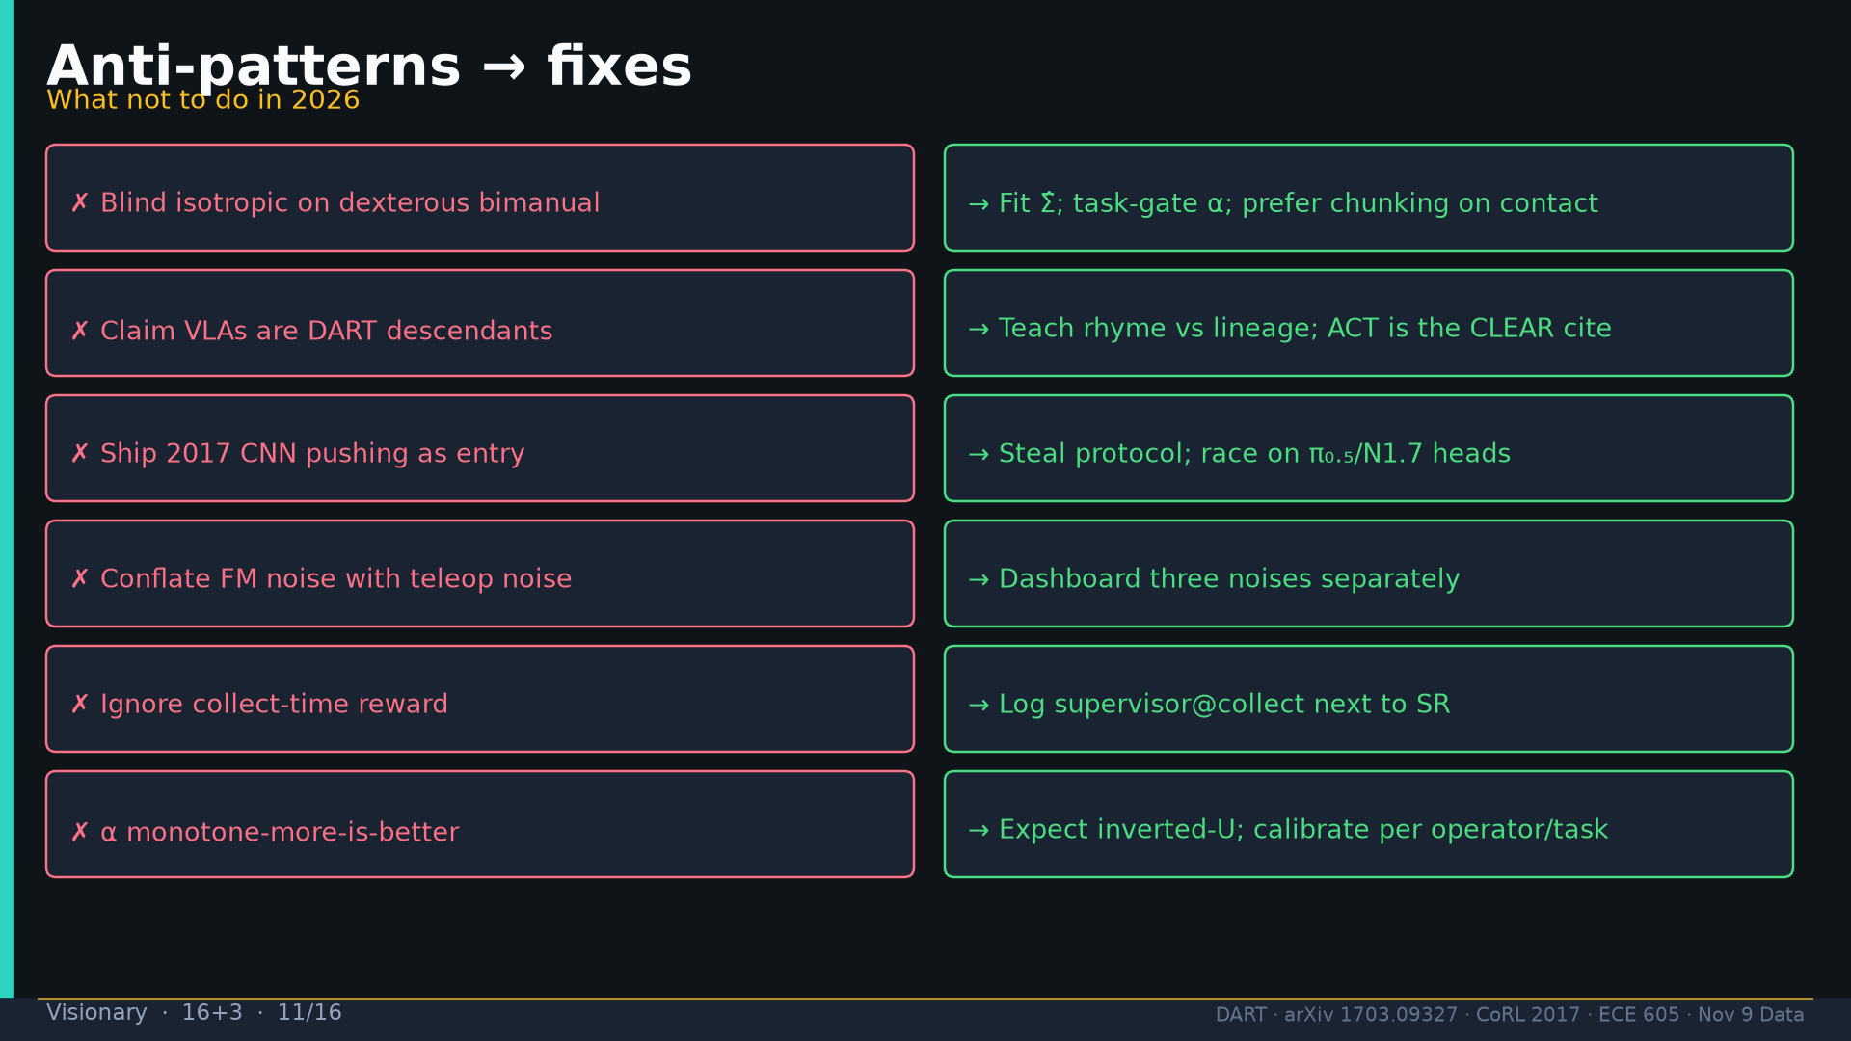
Notes:
Anti-patterns → fixes.

Slide 12
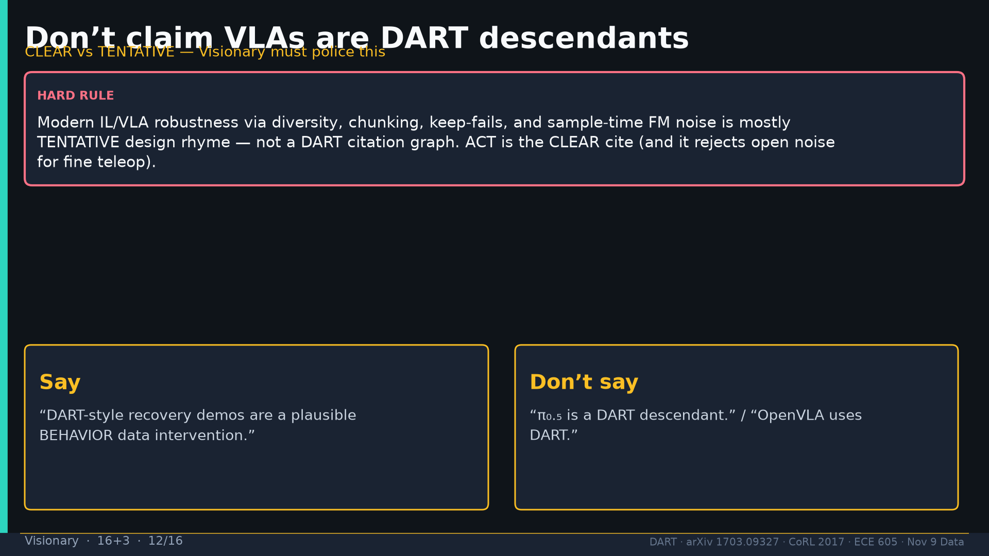
Notes:
Don’t claim VLA descendants; CLEAR vs TENTATIVE police.

Slide 13
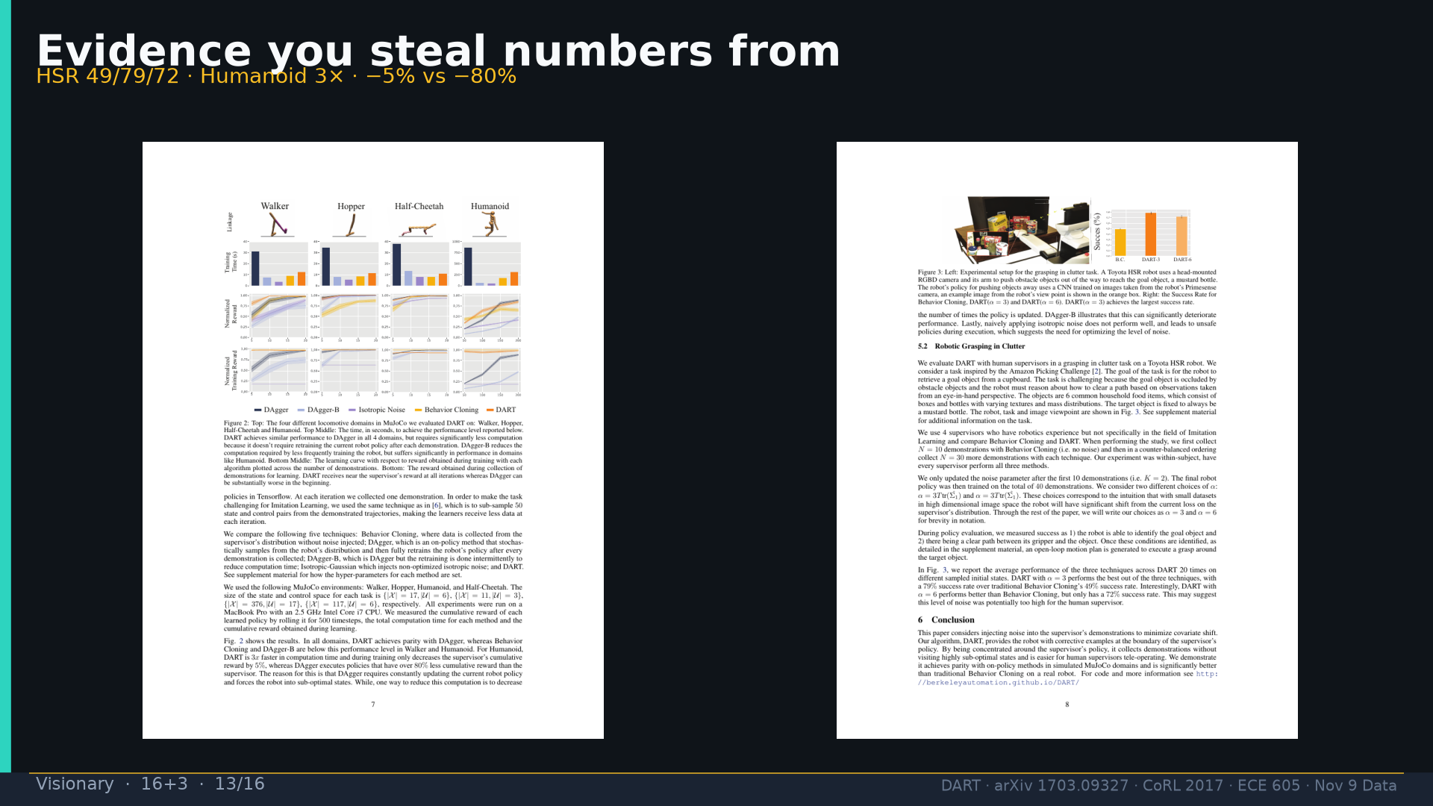
Notes:
Evidence Fig.2+3.

Slide 14
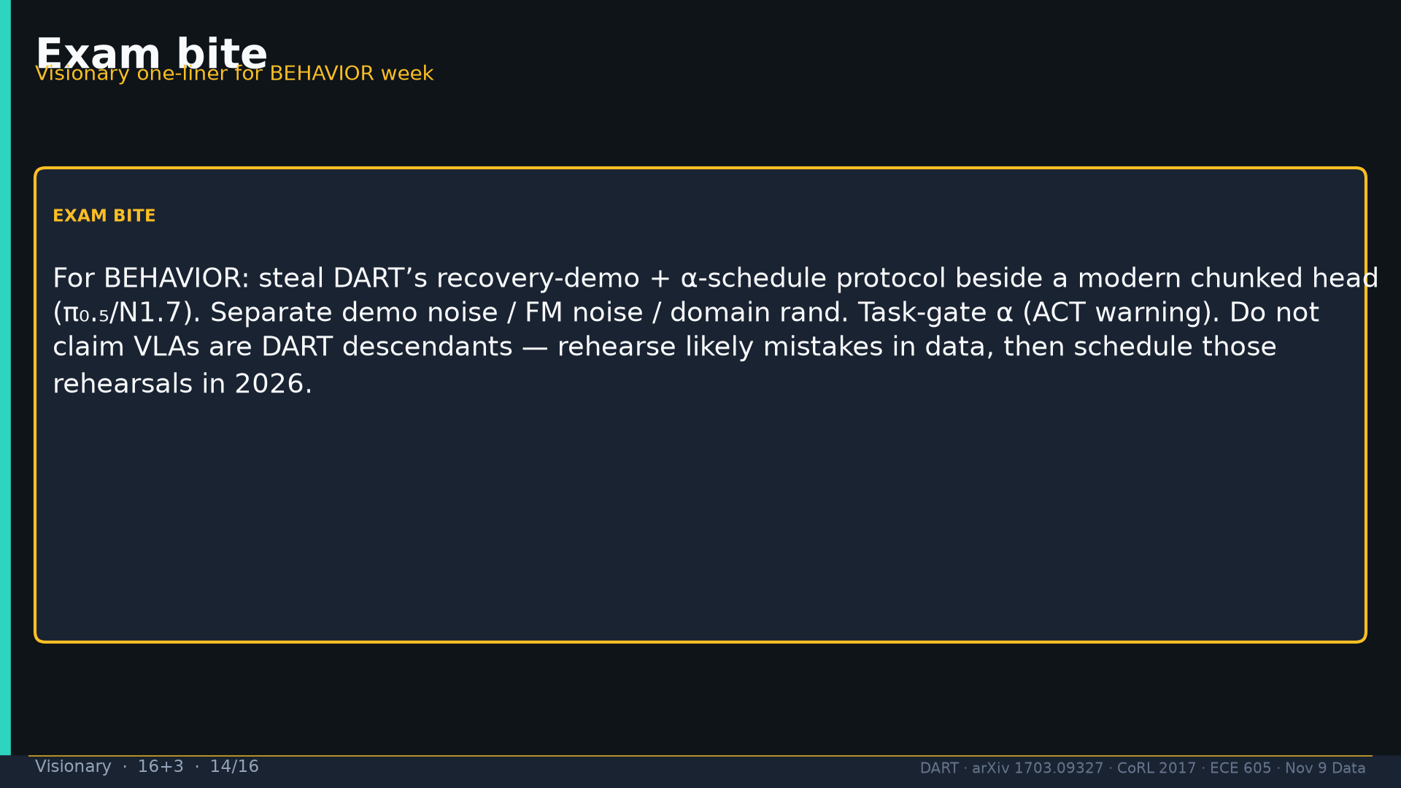
Notes:
Exam bite BEHAVIOR week.

Slide 15
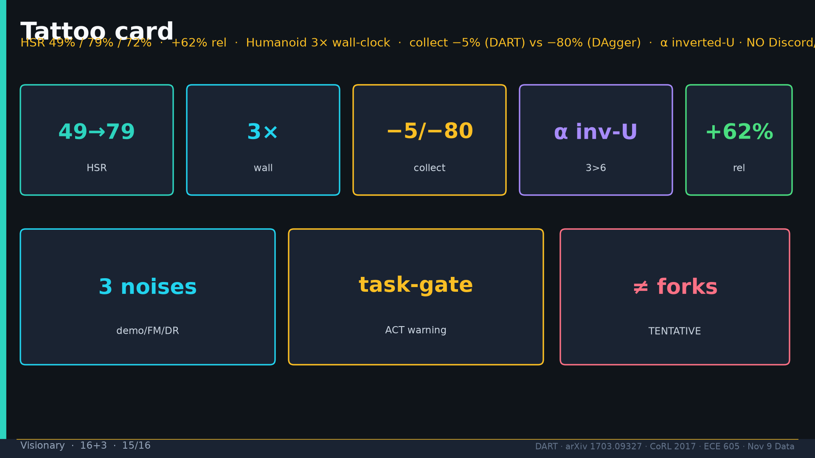
Notes:
Tattoo + no Discord/Drive.

Slide 16
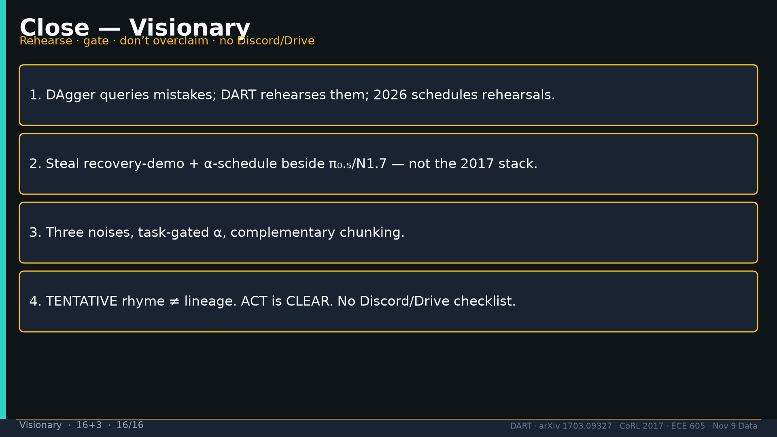
Notes:
Close four takes.

