Slide 1
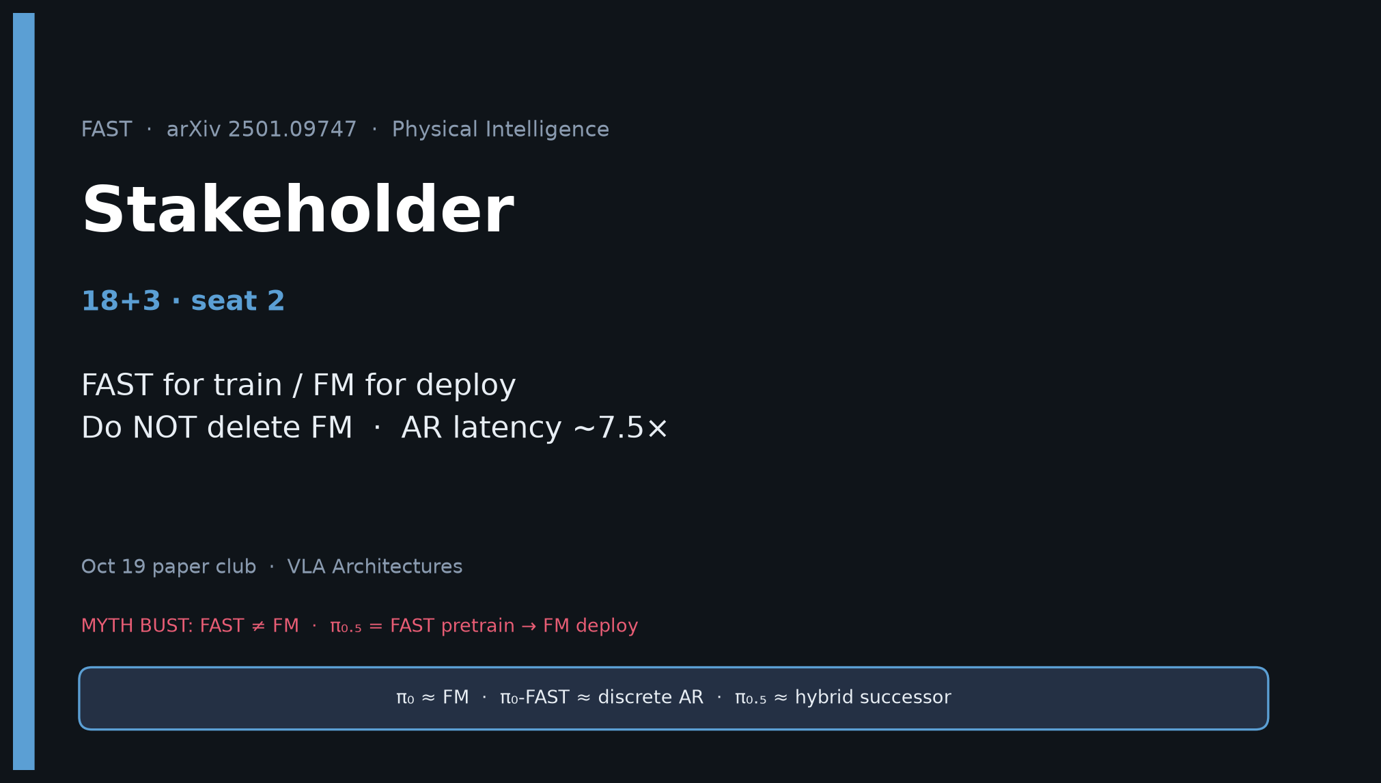
Stakeholder · 18+3 · 1/18
Notes:
STAKEHOLDER — seat 2 · 18+3.
You own: buy/build decision. FAST for train / FM for deploy. Do NOT delete FM.
No Stakeholder redo later — this is the durable briefing.
Open with myth bust.

Slide 2
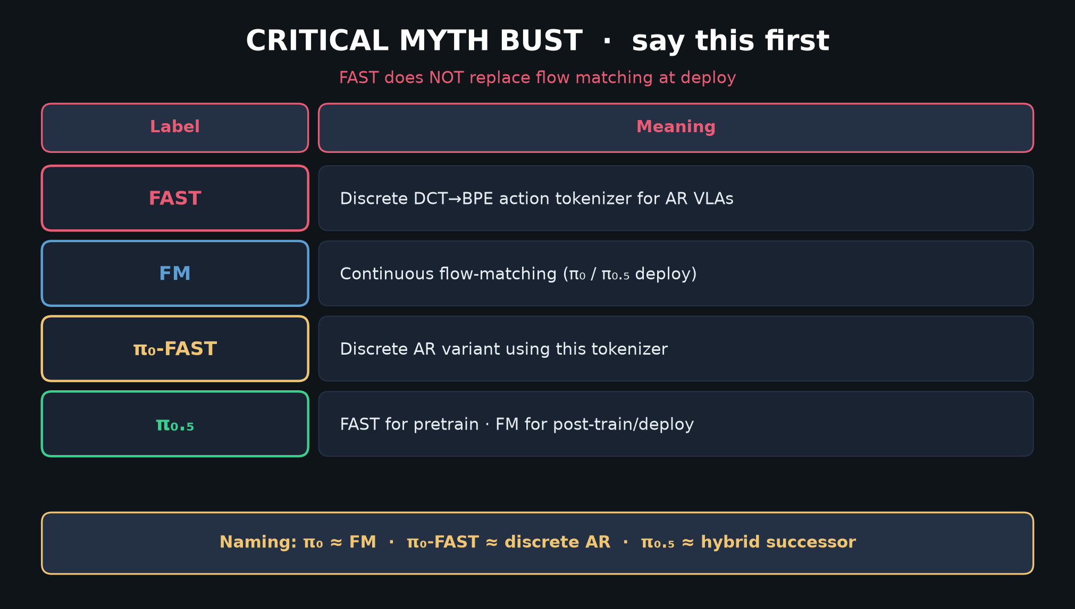
Stakeholder · 18+3 · 2/18
Notes:
MYTH BUST — leadership version of the club spine.
FAST ≠ FM. π₀.₅ keeps FM at deploy. Say it before any product pitch.

Slide 3
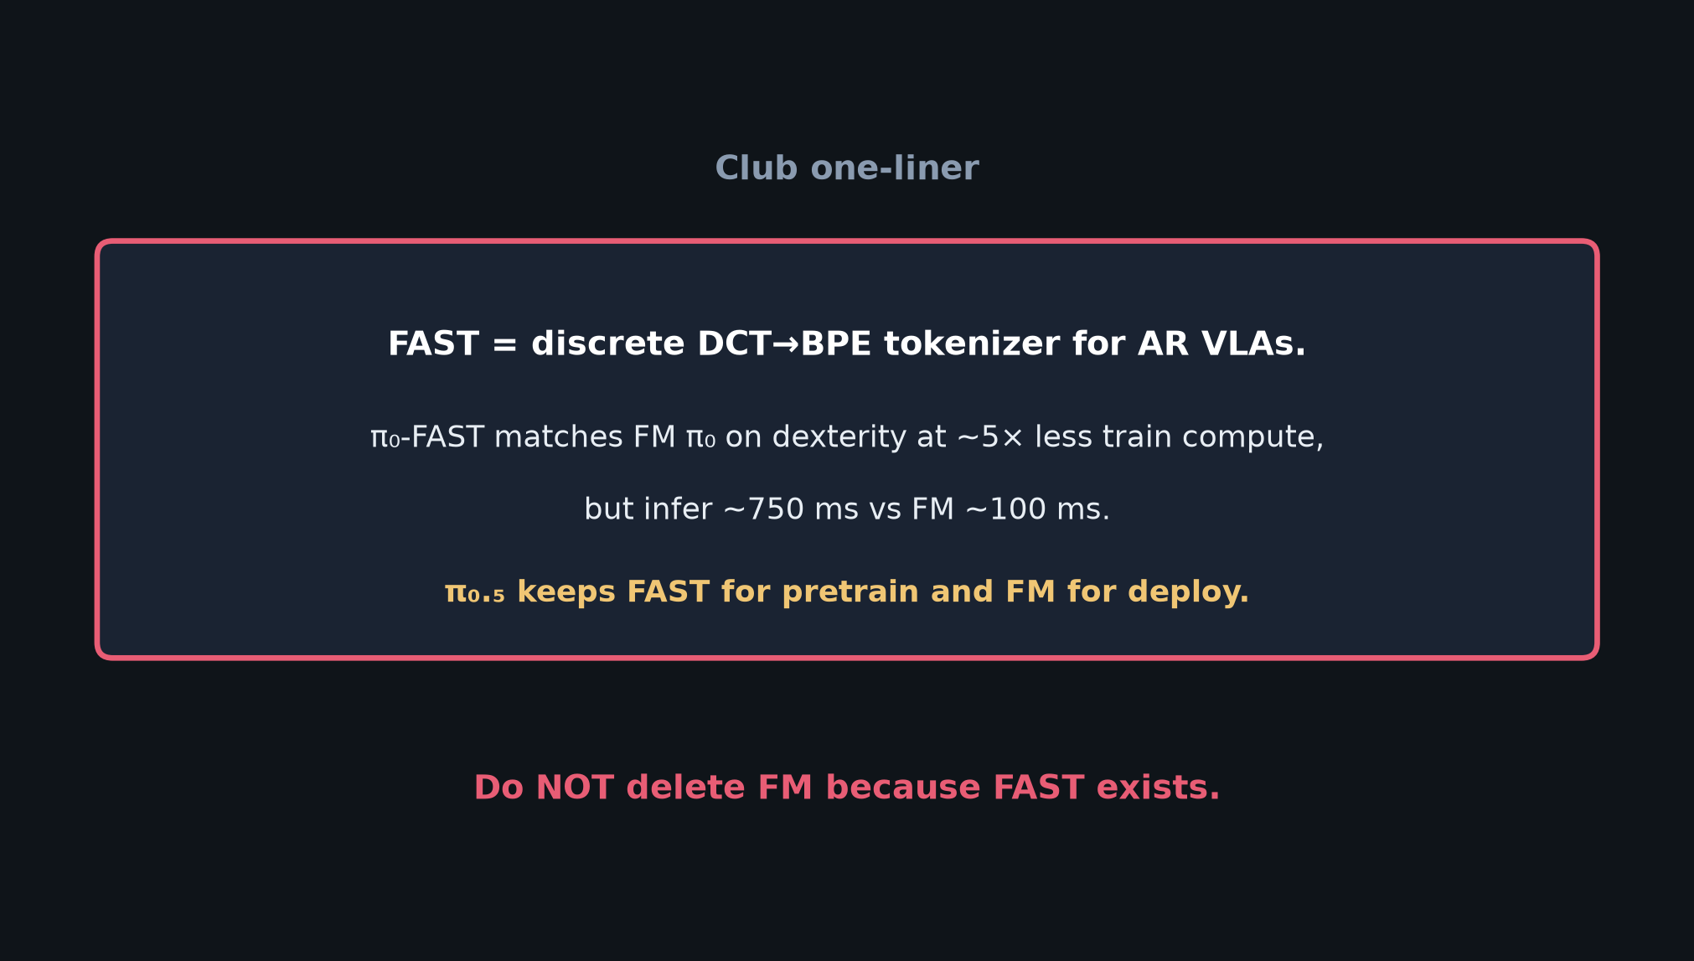
Stakeholder · 18+3 · 3/18
Notes:
ONE-LINER — what the room should remember in one breath.

Slide 4
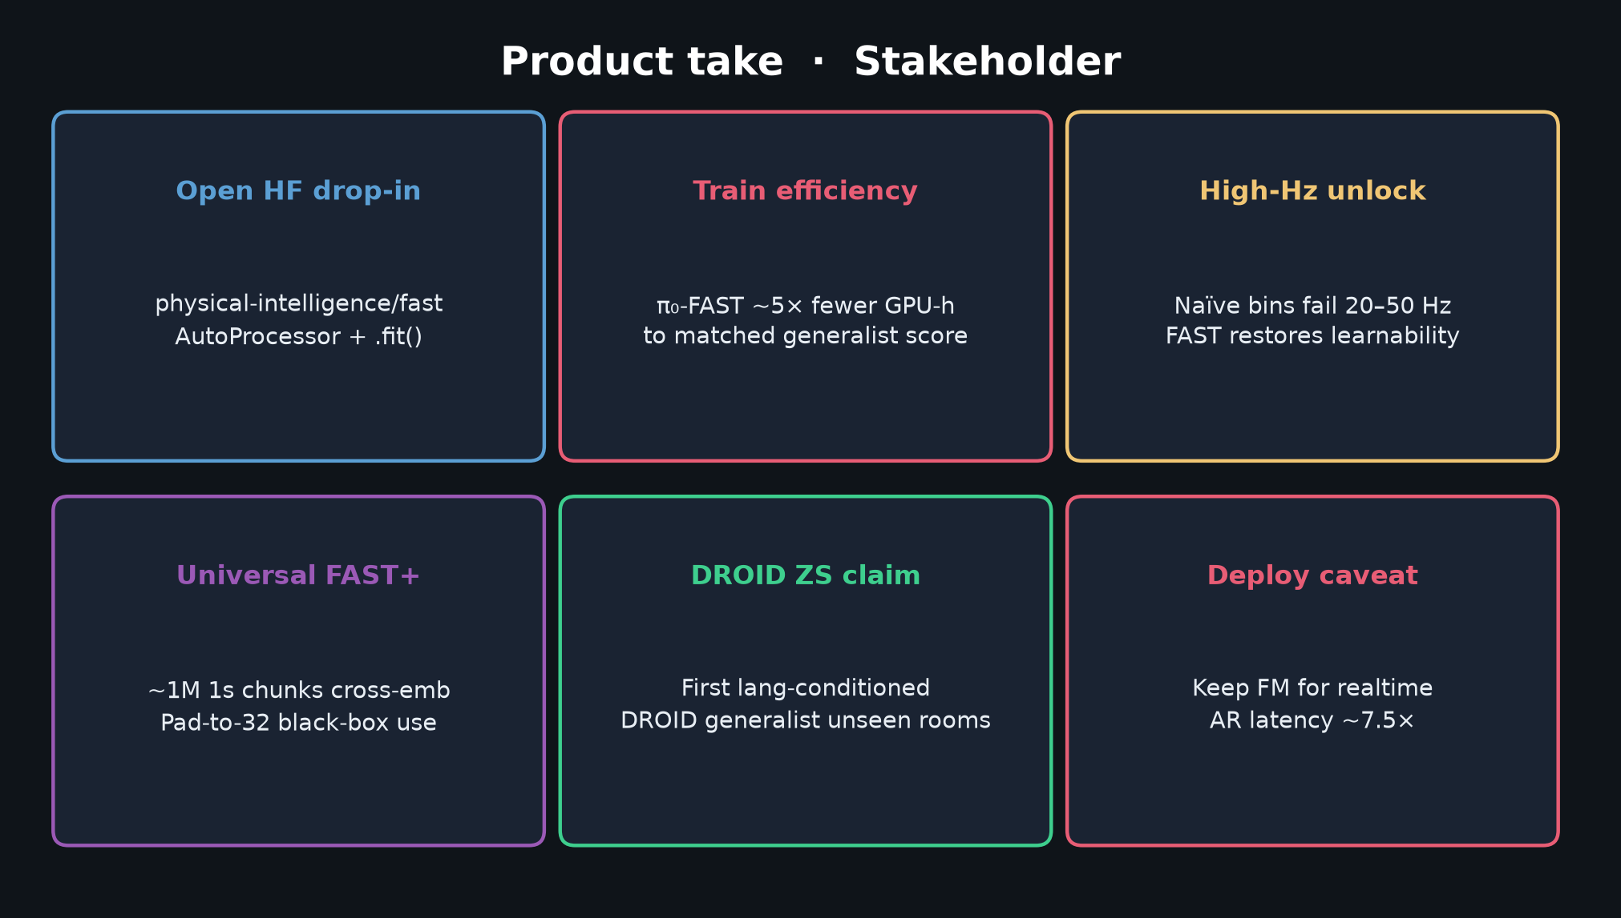
Stakeholder · 18+3 · 4/18
Notes:
VALUE CARDS — open HF, 5× train, high-Hz unlock, FAST+, DROID ZS, deploy caveat.

Slide 5
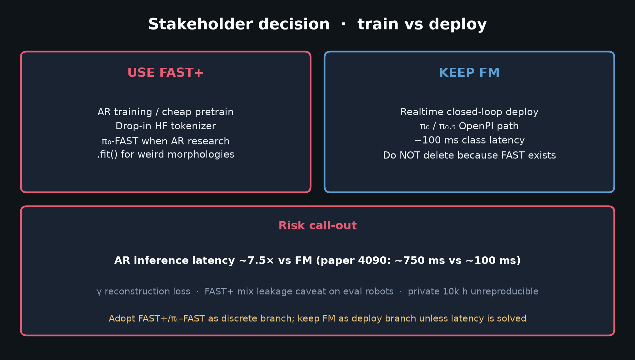
Stakeholder · 18+3 · 5/18
Notes:
DECISION — USE FAST+ for AR train/pretrain; KEEP FM for realtime.
Risk: AR latency ~7.5×. Do not budget “delete FM because FAST exists.”

Slide 6
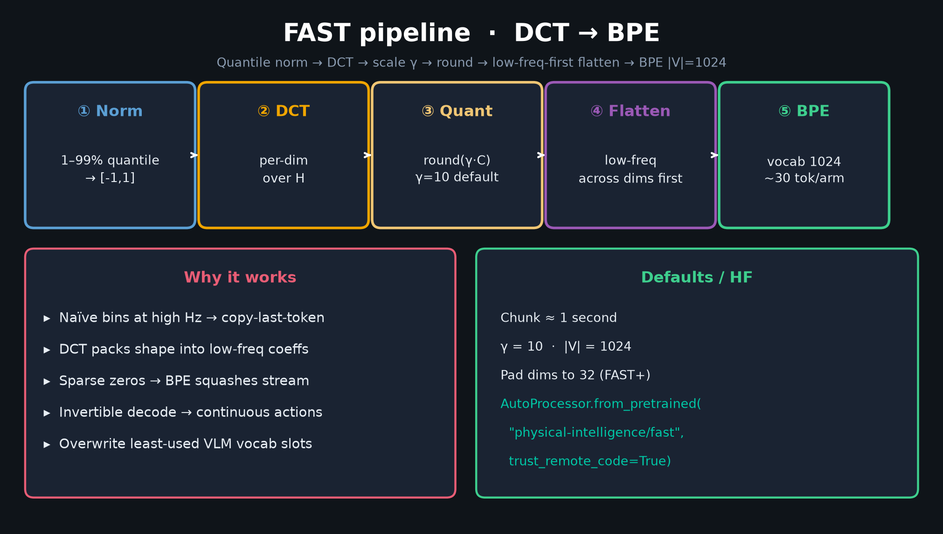
Stakeholder · 18+3 · 6/18
Notes:
PIPELINE glance — enough method for non-specialists without Empiricist depth.

Slide 7
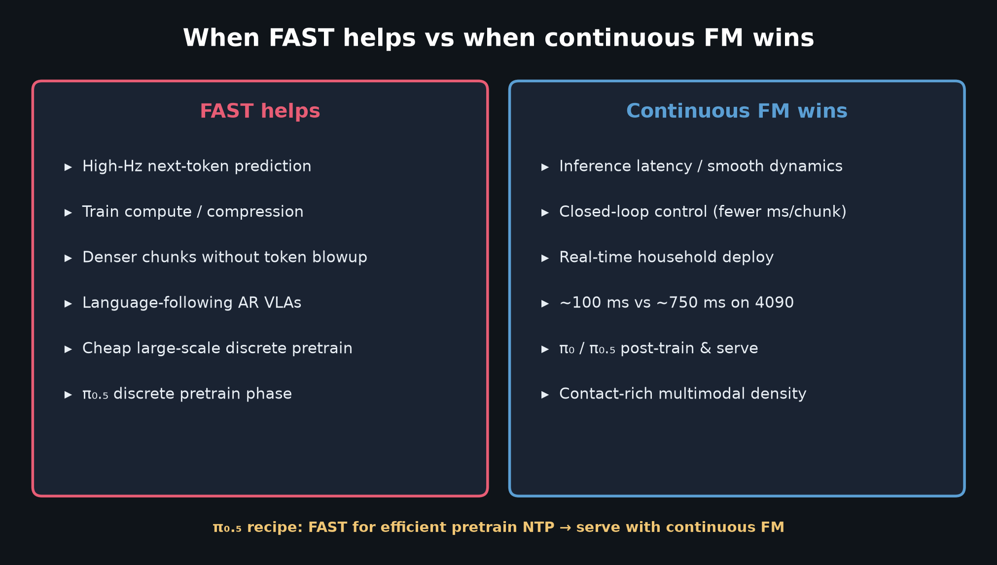
Stakeholder · 18+3 · 7/18
Notes:
WHEN HELPS — cheat sheet for resource allocation.

Slide 8
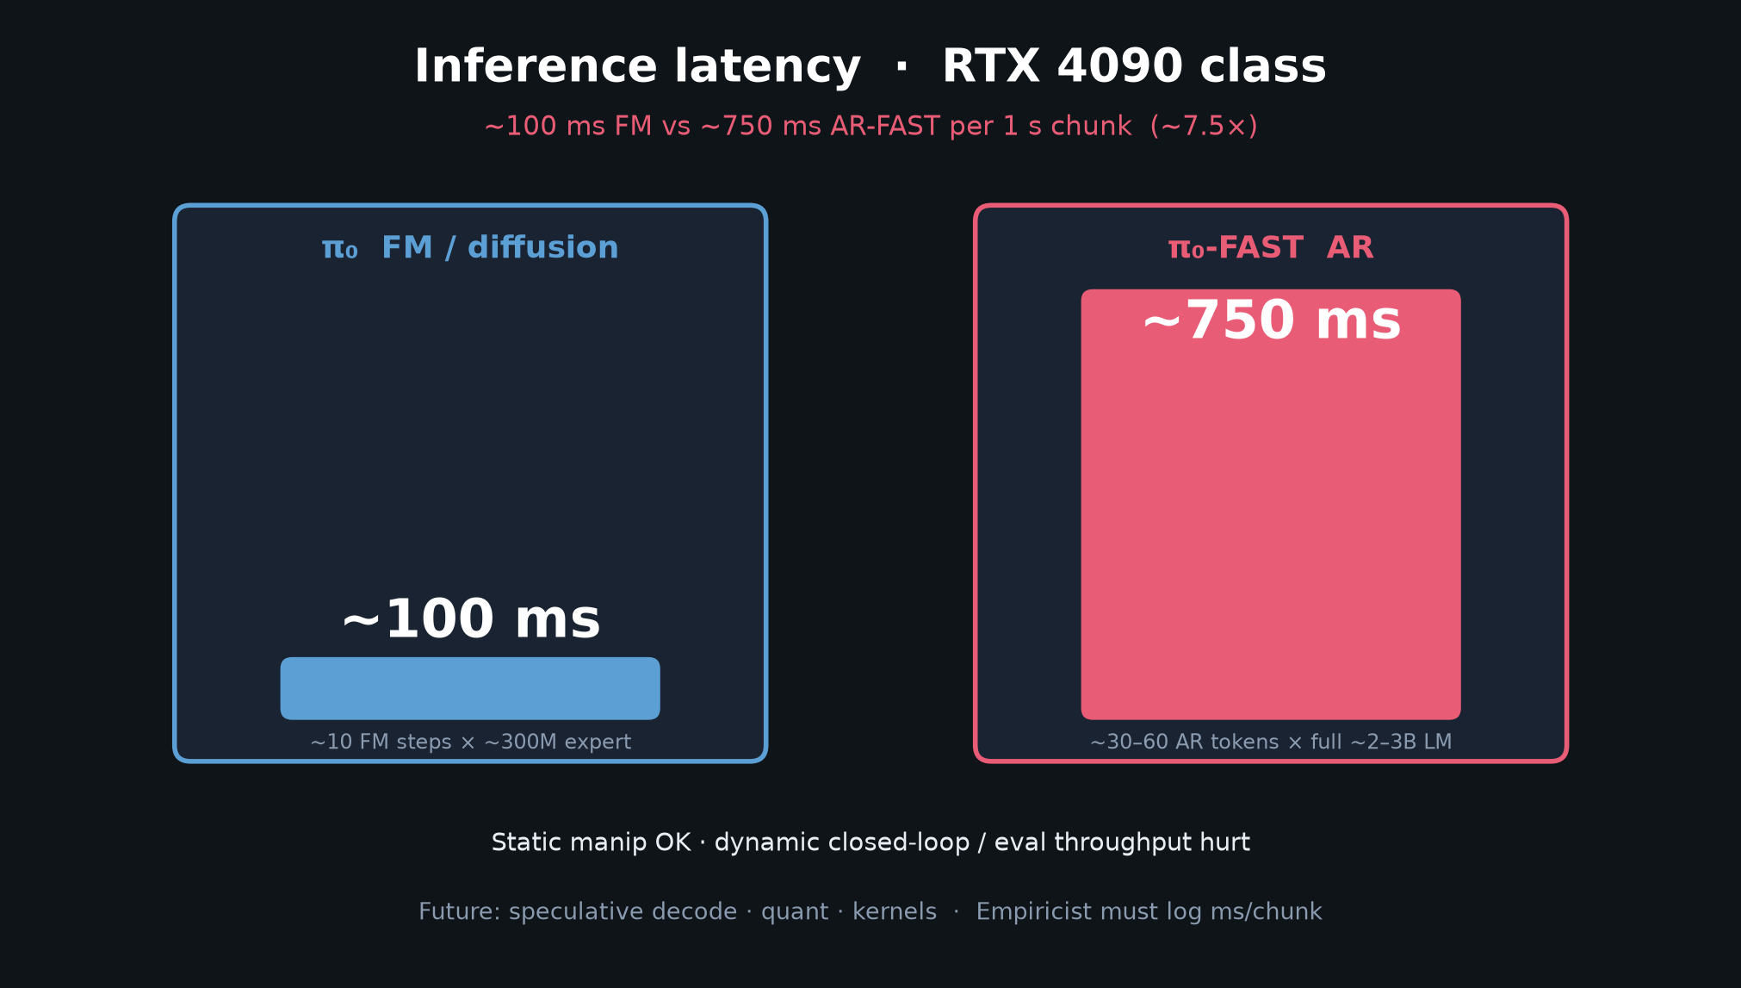
Stakeholder · 18+3 · 8/18
Notes:
LATENCY RISK — the number leadership must hear: ~750 vs ~100 ms.

Slide 9
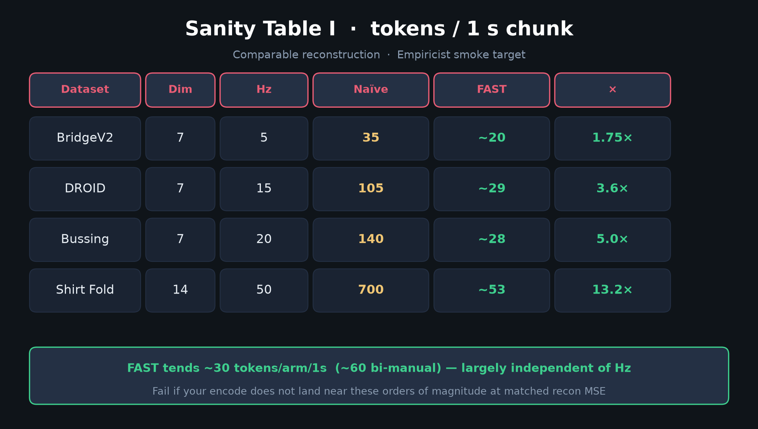
Stakeholder · 18+3 · 9/18
Notes:
TABLE I — compression = why train gets cheaper / denser.

Slide 10
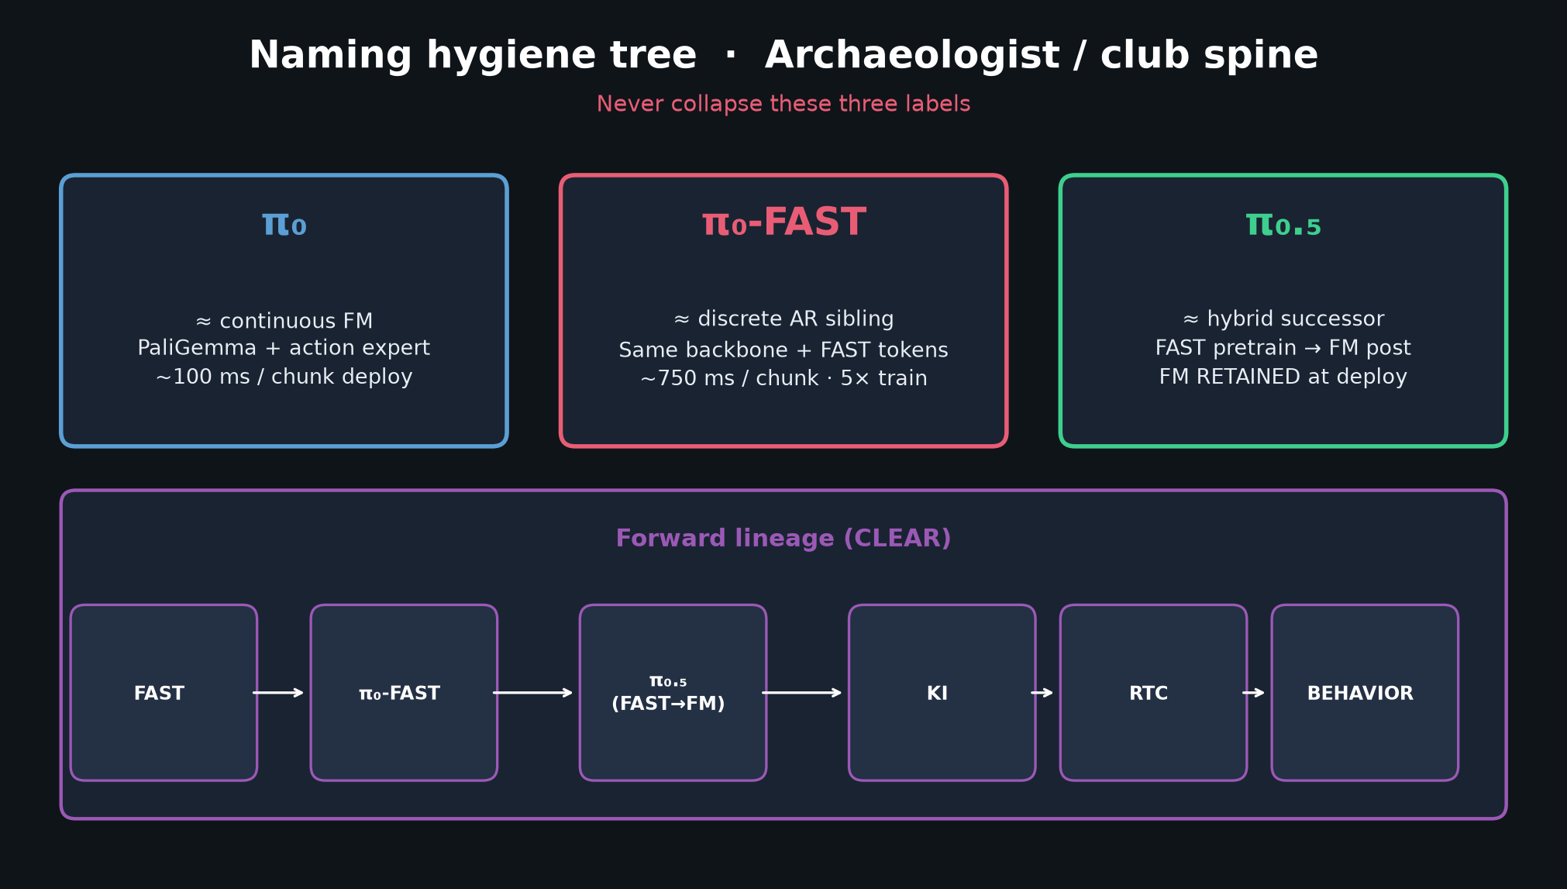
Stakeholder · 18+3 · 10/18
Notes:
NAMING — so roadmap slides never confuse π₀ / π₀-FAST / π₀.₅.

Slide 11
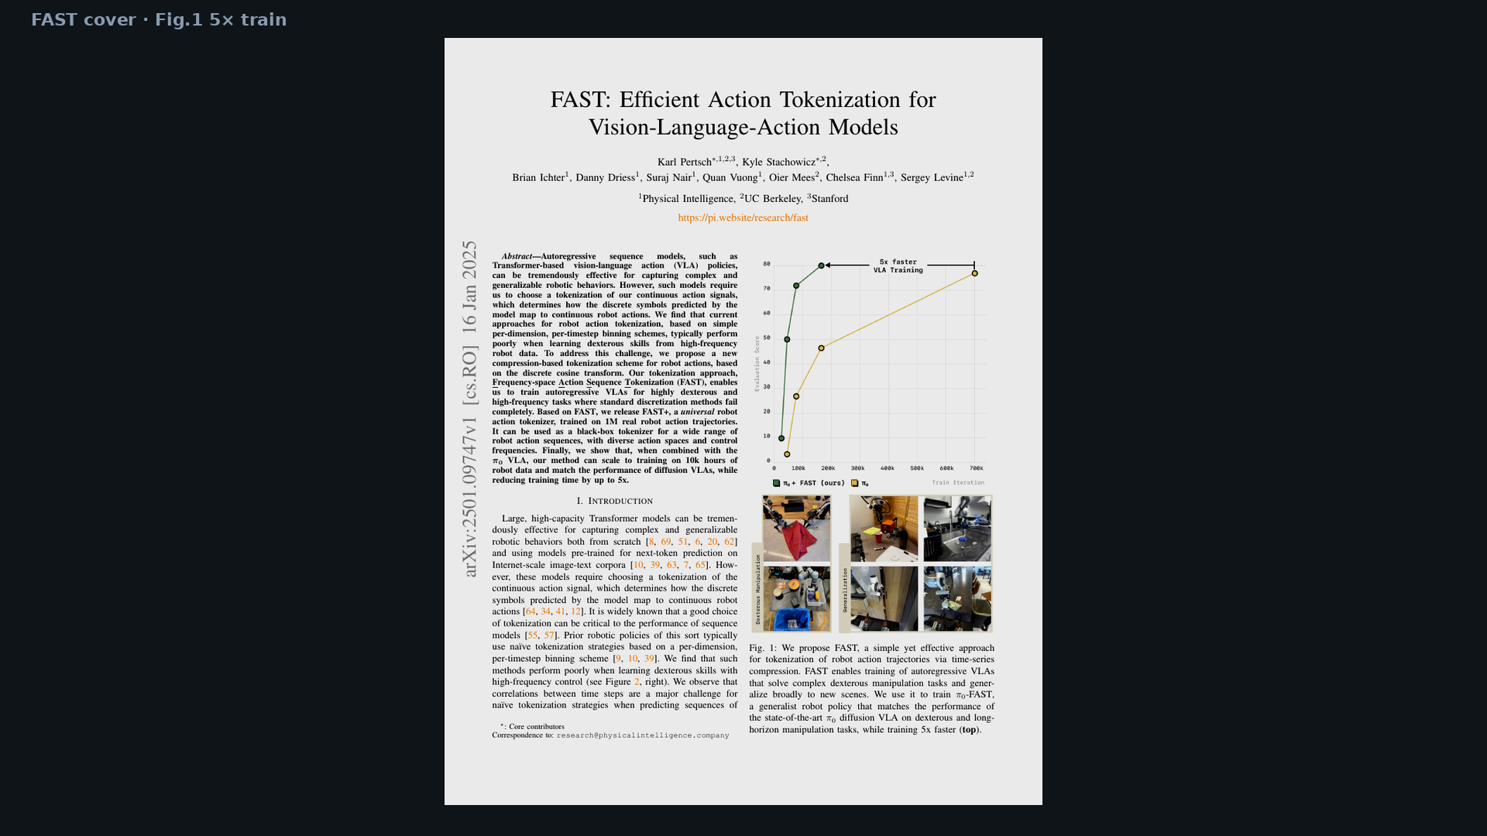
Stakeholder · 18+3 · 11/18
Notes:
PAPER COVER / Fig.1 — 5× train curve + dexterity photos. Existence proof.

Slide 12
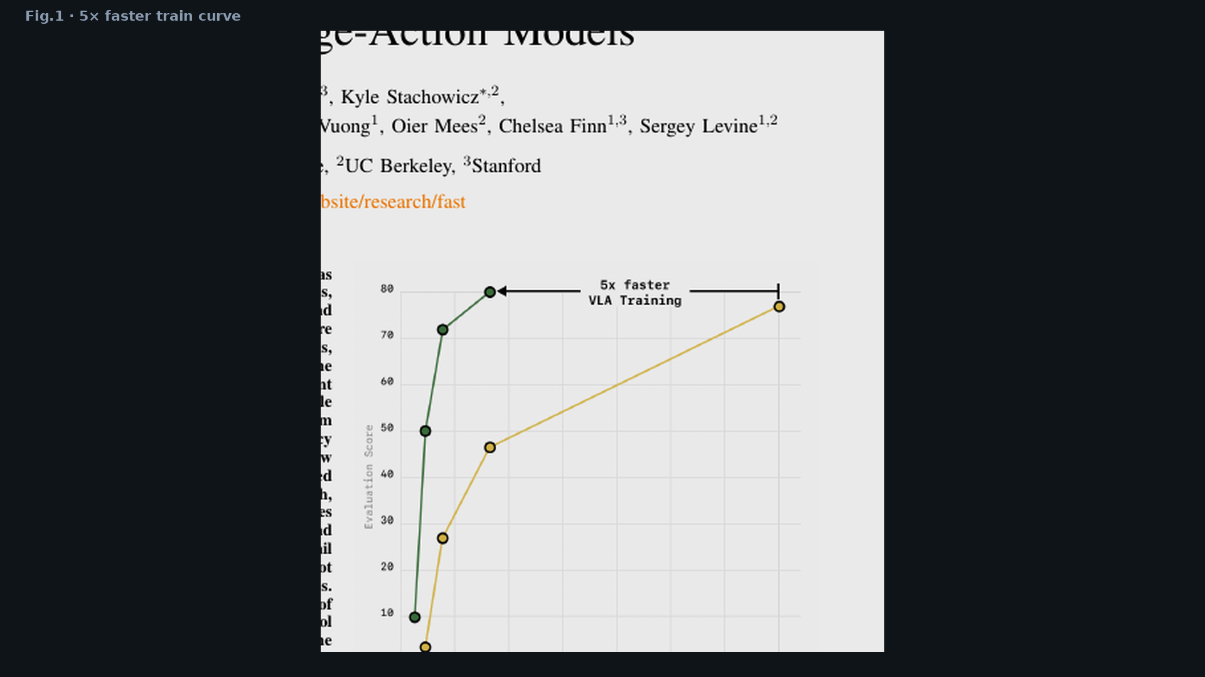
Stakeholder · 18+3 · 12/18
Notes:
Fig.1 curve crop — point at 180k vs 700k iters.

Slide 13
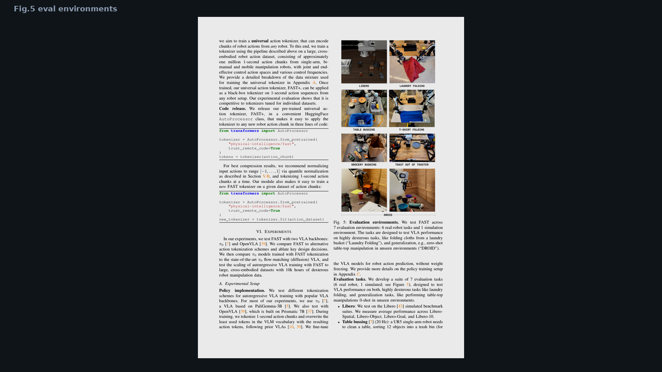
Stakeholder · 18+3 · 13/18
Notes:
Fig.5 environments — laundry, bussing, shirt, DROID breadth for product story.

Slide 14
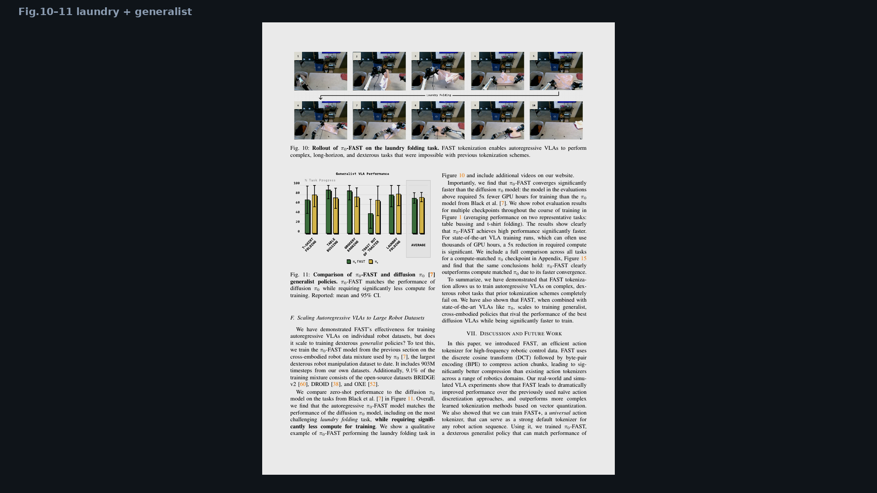
Stakeholder · 18+3 · 14/18
Notes:
Fig.10–11 — laundry + generalist match to diffusion π₀.

Slide 15
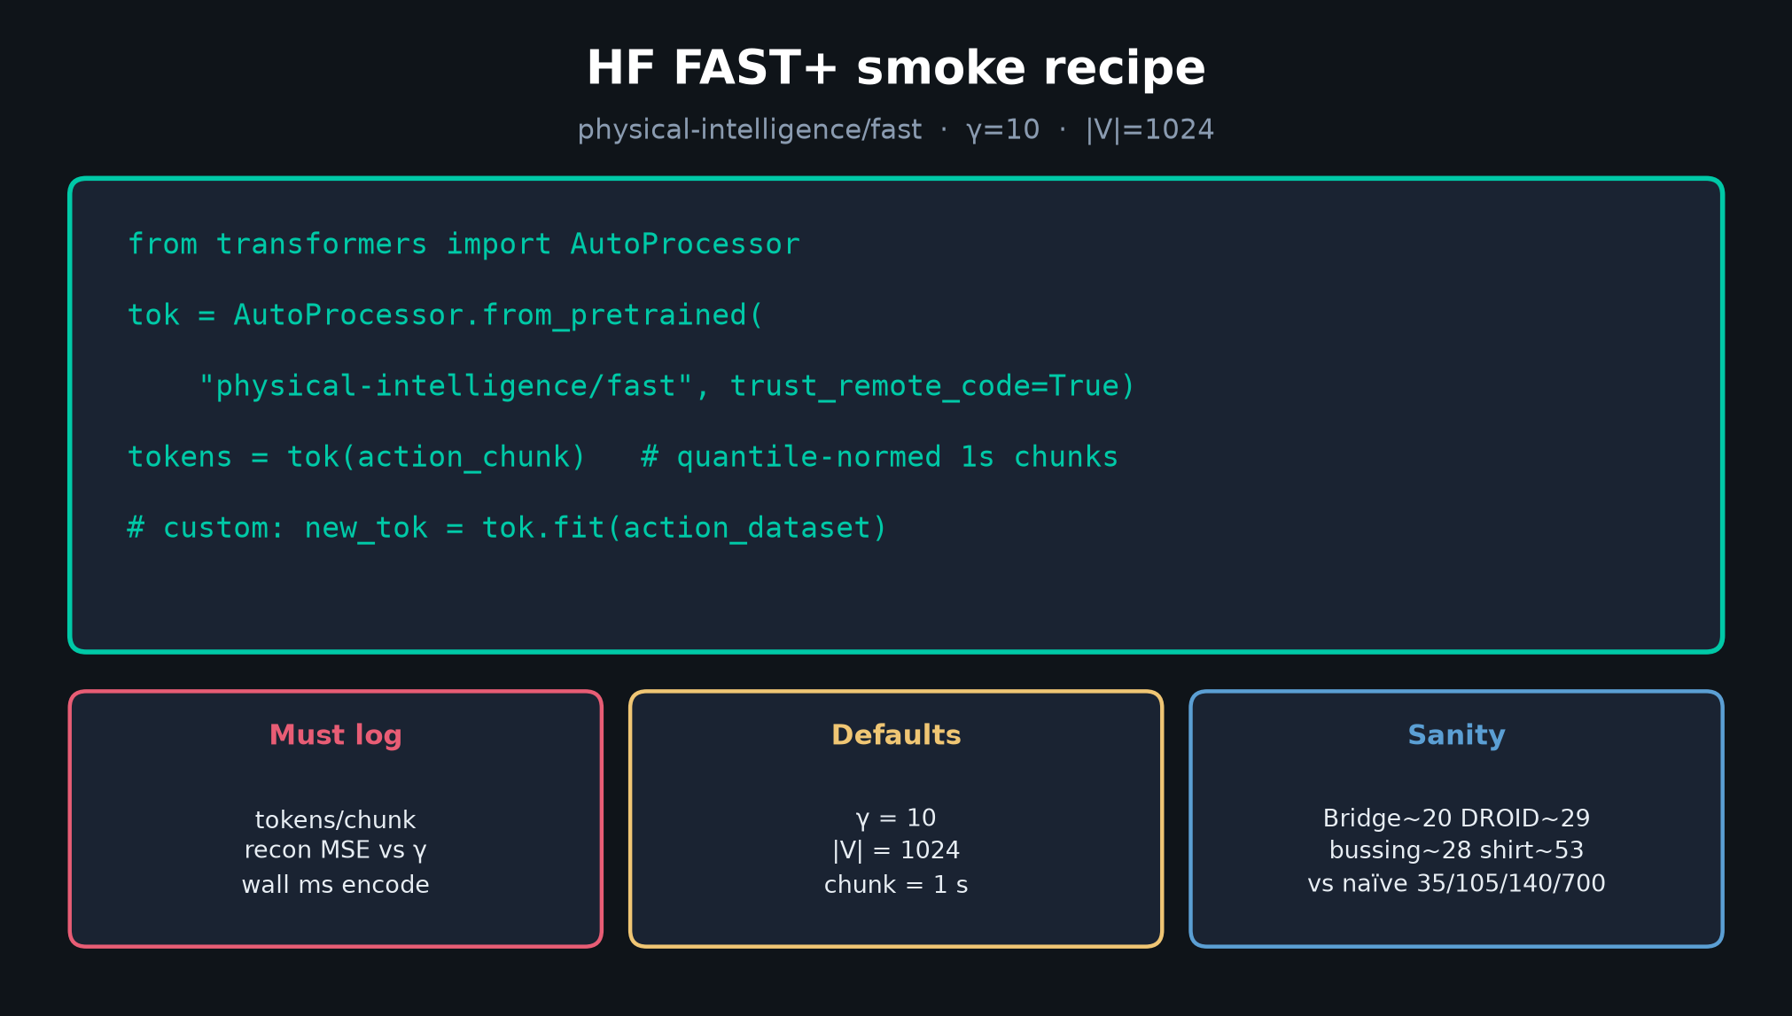
Stakeholder · 18+3 · 15/18
Notes:
HF recipe — what eng actually installs tomorrow.

Slide 16
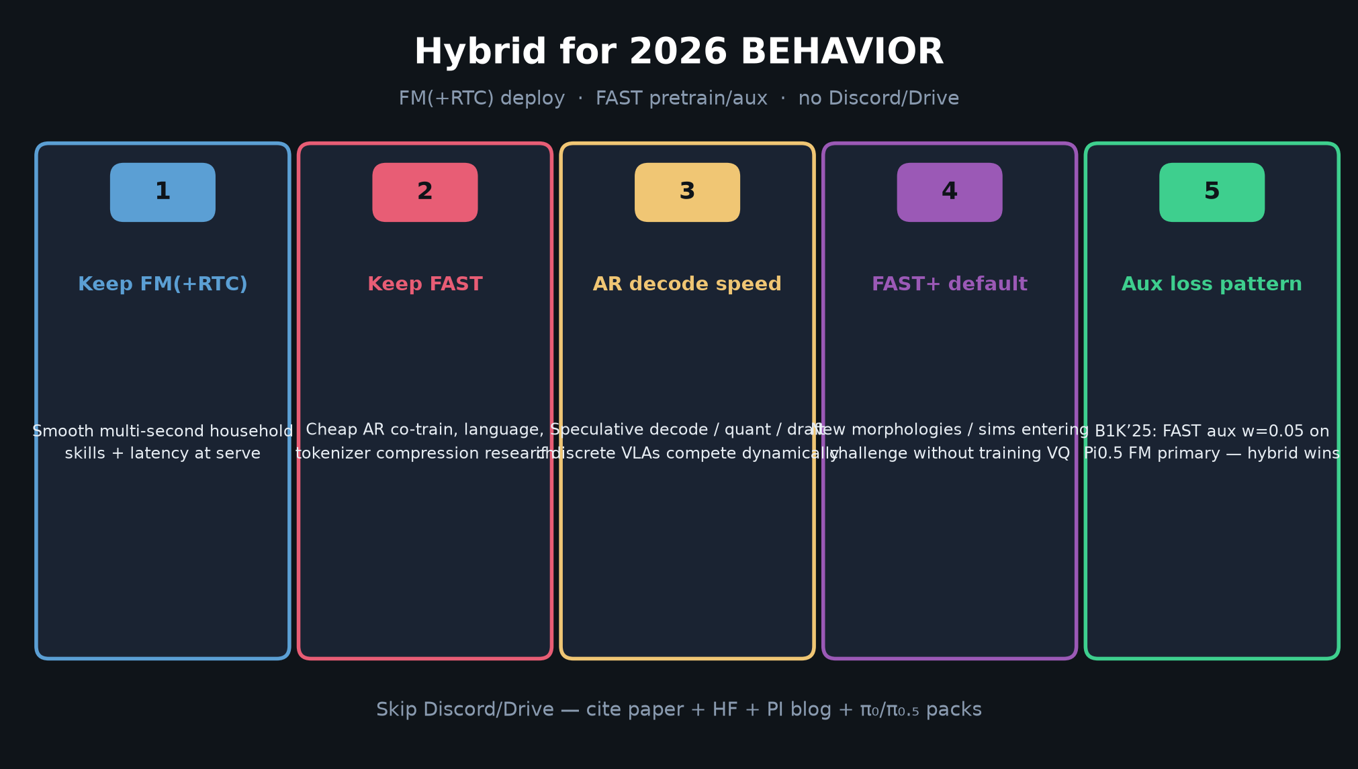
Stakeholder · 18+3 · 16/18
Notes:
VISIONARY bridge — 2026 hybrid bet without owning that seat.

Slide 17
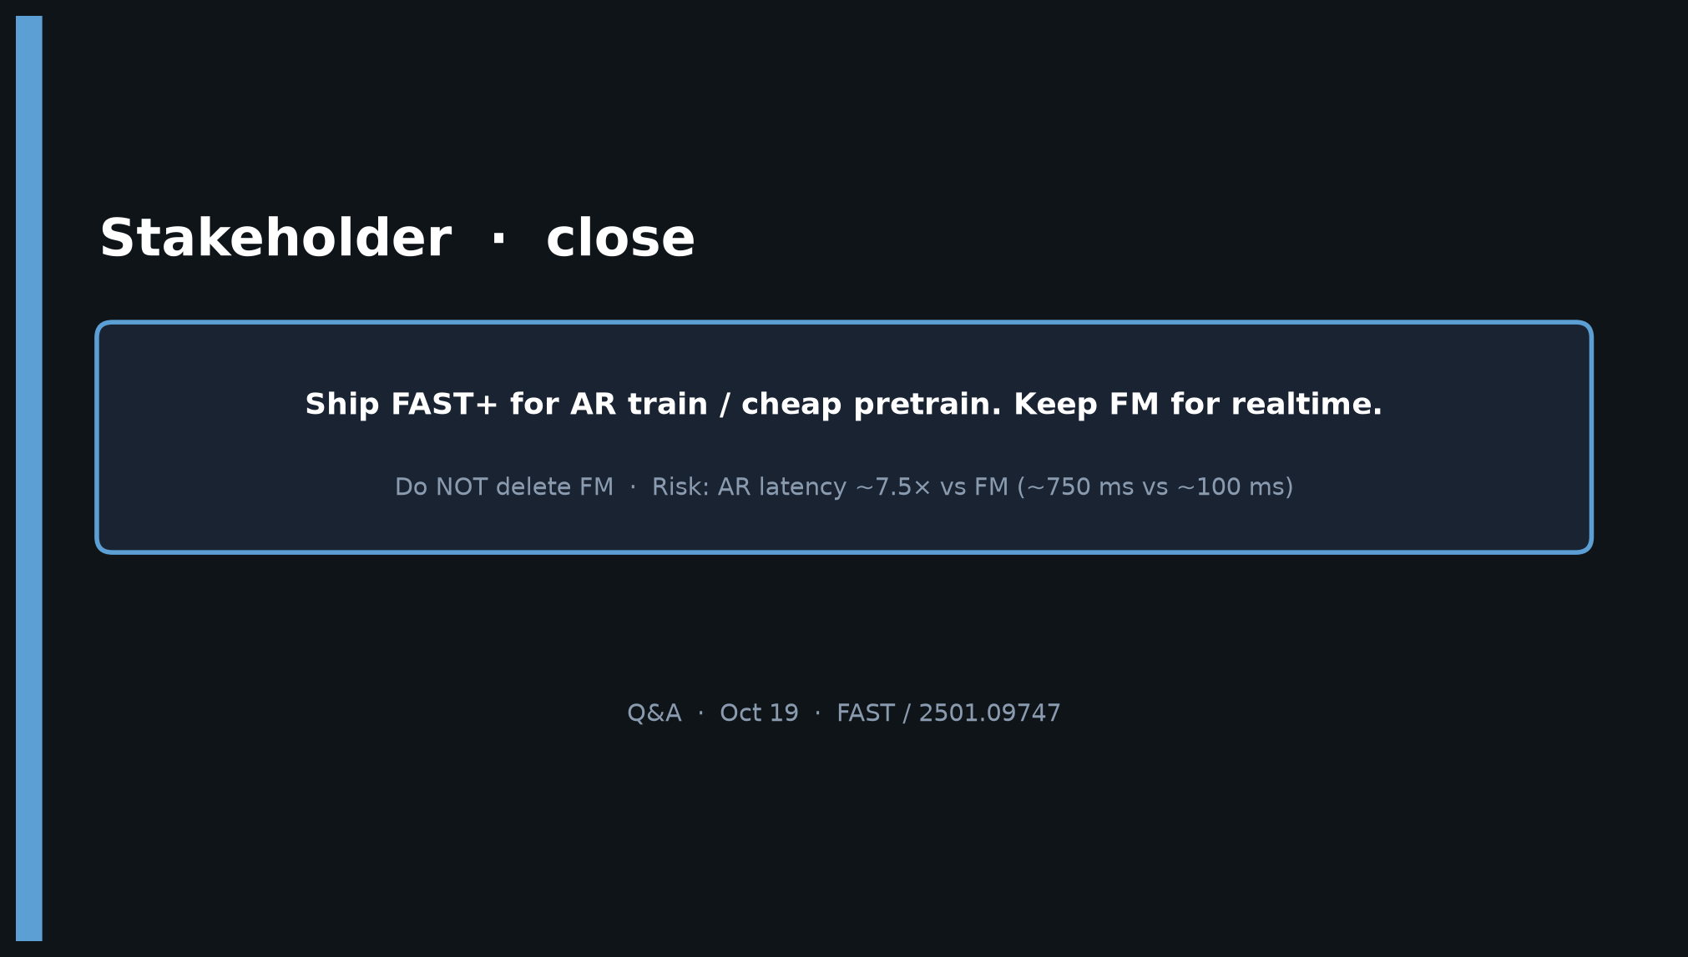
Stakeholder · 18+3 · 17/18
Notes:
CLOSE — Ship FAST+ for AR train; keep FM for realtime; risk AR ~7.5× latency.
Hand Empiricist the smoke matrix; hand Reviewer the caveats.

Slide 18
Stakeholder · 18+3 · 18/18
Notes:
BACKUP — decision slide again for Q&A.

