Slide 1

Scientific Reviewer · 8+3 · 1/11
Notes:
SCIENTIFIC REVIEWER — 8+3. Short talk.
Strengths → weaknesses → verdict.
Cite as discrete tokenizer unlock / π₀-FAST — NOT as FM retirement.
Open with myth bust so citation hygiene is visible.

Slide 2
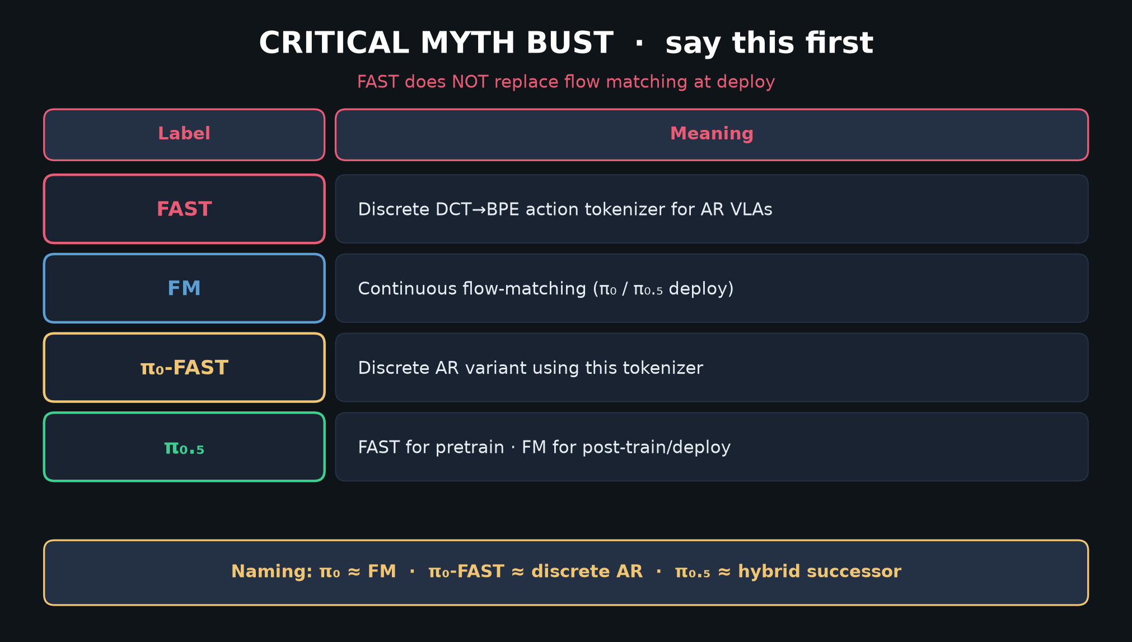
Scientific Reviewer · 8+3 · 2/11
Notes:
MYTH BUST — citation hygiene starts here.
If the room cites FAST as retiring FM, that is a mis-cite.

Slide 3
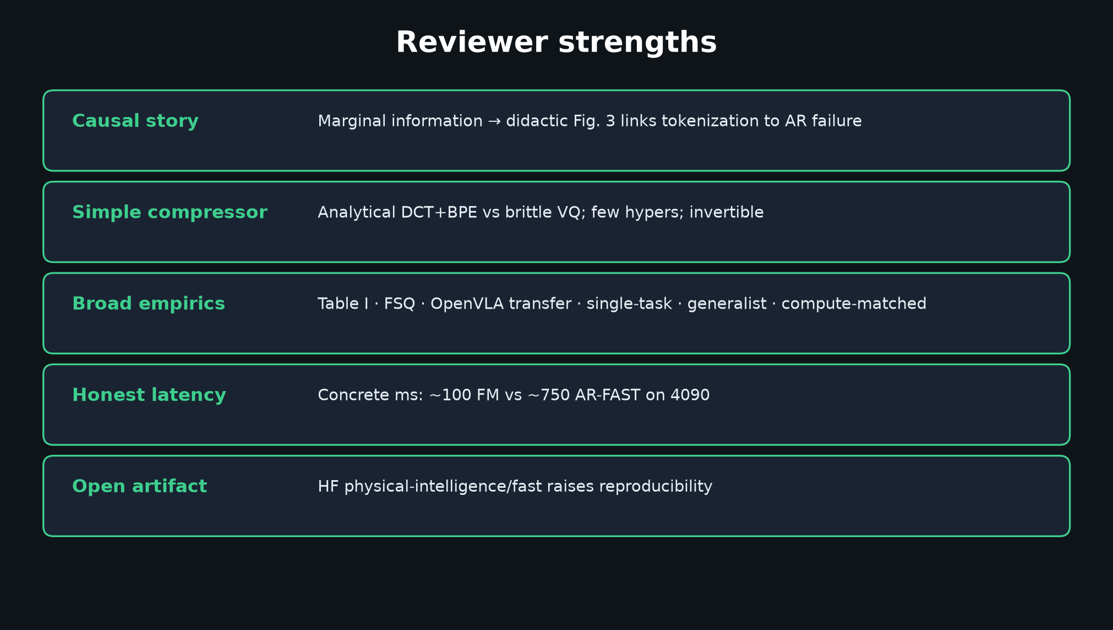
Scientific Reviewer · 8+3 · 3/11
Notes:
STRENGTHS — causal Fig.3; simple invertible compressor; broad empirics; honest ms; open HF.

Slide 4
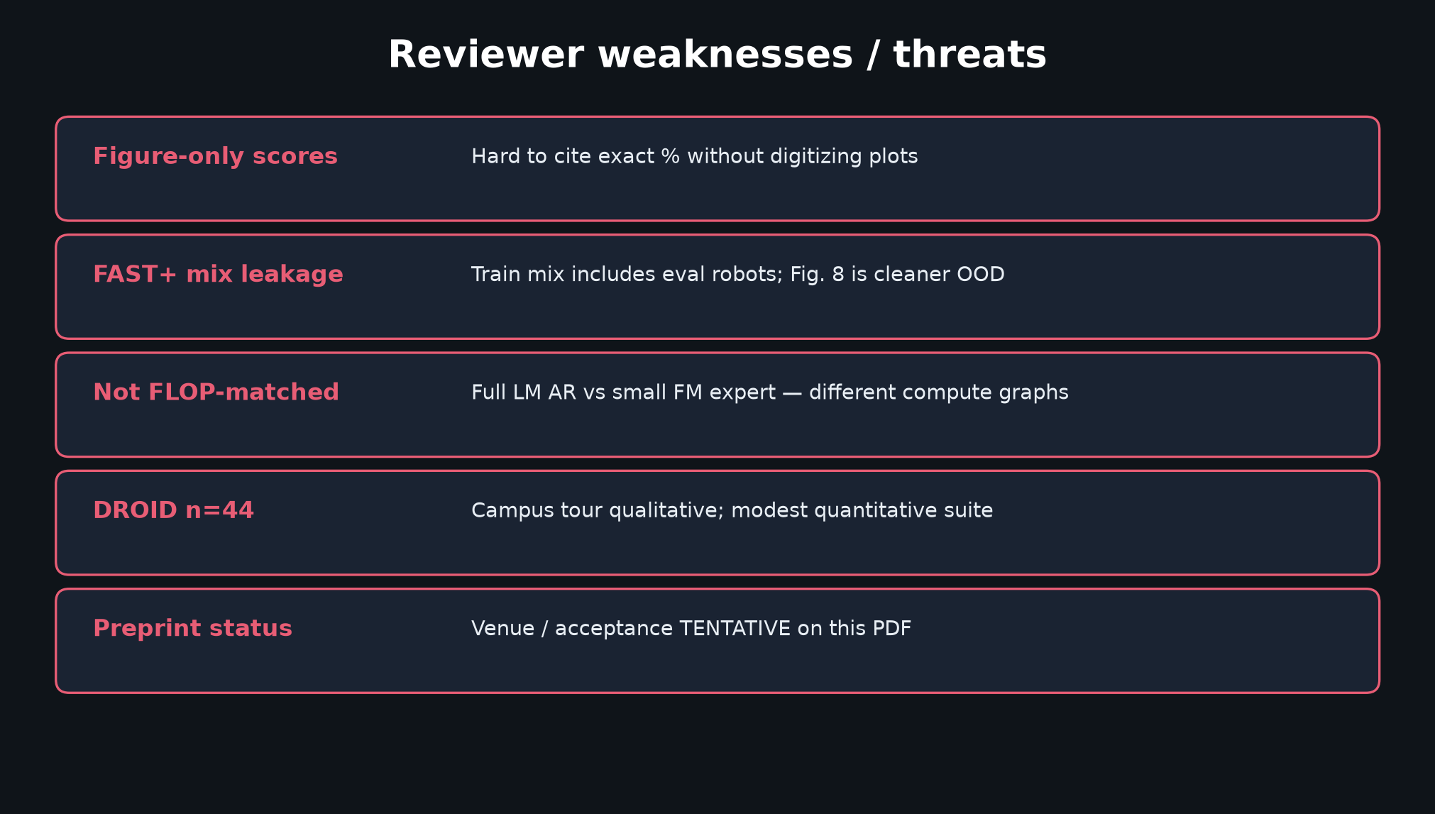
Scientific Reviewer · 8+3 · 4/11
Notes:
WEAKNESSES — figure-only; FAST+ leakage; not FLOP-matched AR vs FM; DROID n=44; preprint.

Slide 5
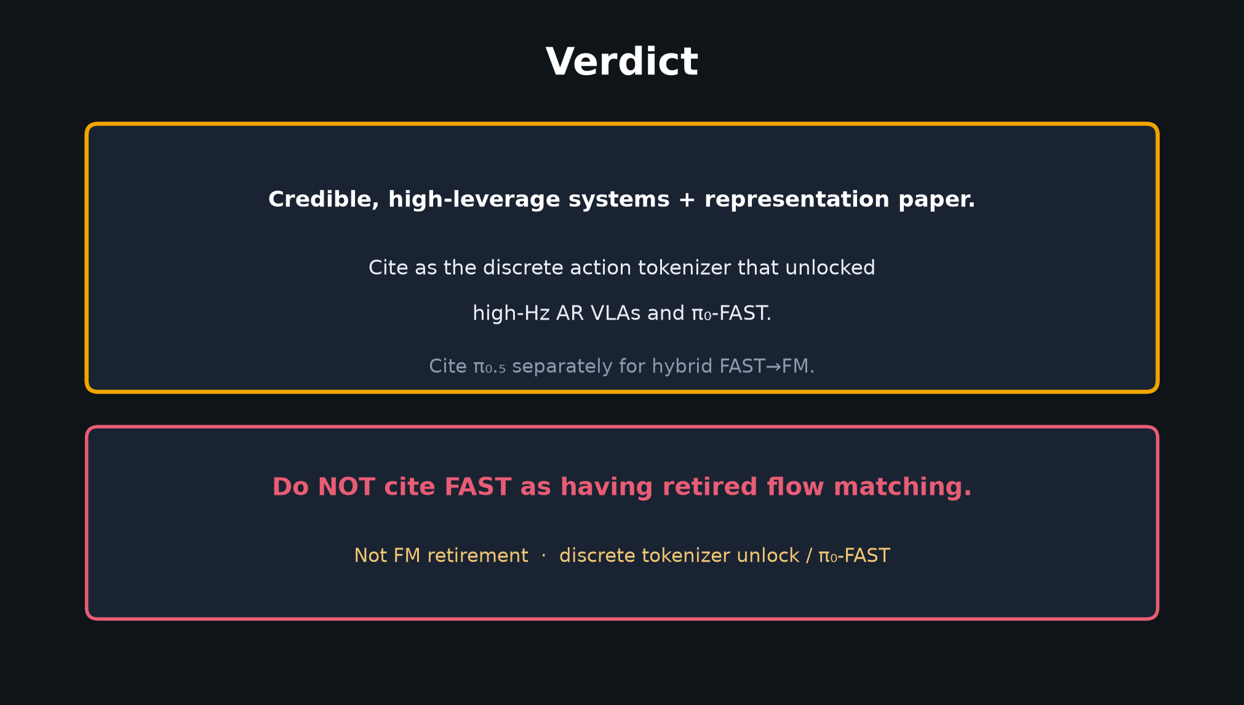
Scientific Reviewer · 8+3 · 5/11
Notes:
VERDICT — credible unlock paper. Cite tokenizer / π₀-FAST. Do NOT cite as FM retirement.

Slide 6
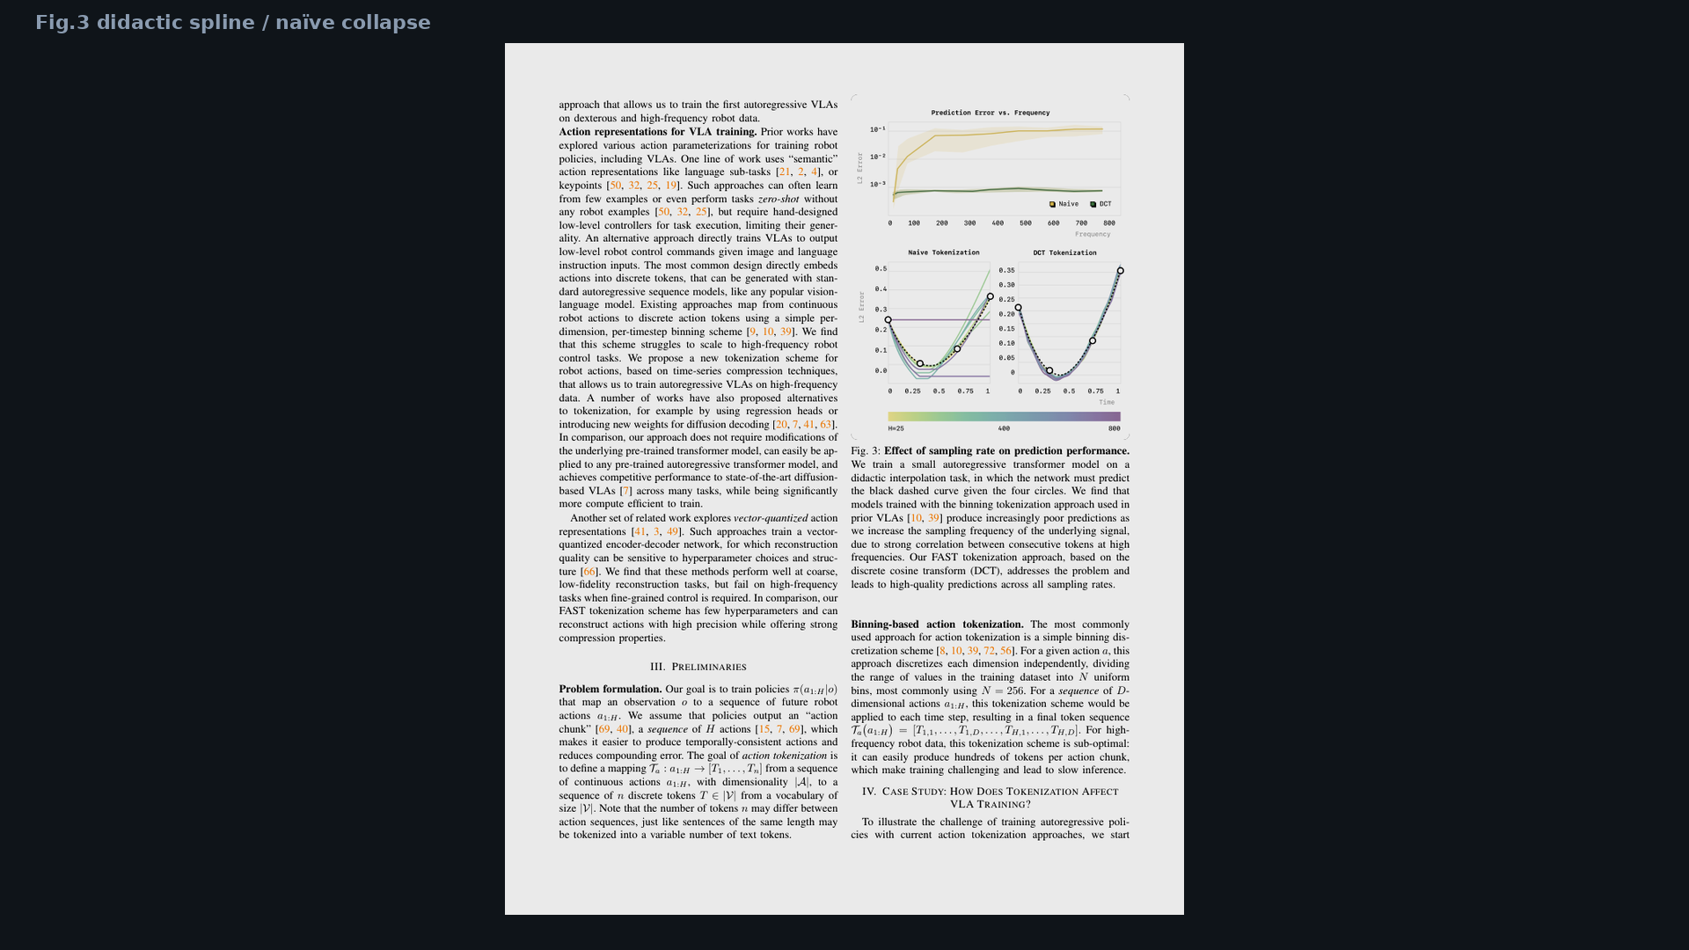
Scientific Reviewer · 8+3 · 6/11
Notes:
Fig.3 evidence — causal story you can defend.

Slide 7
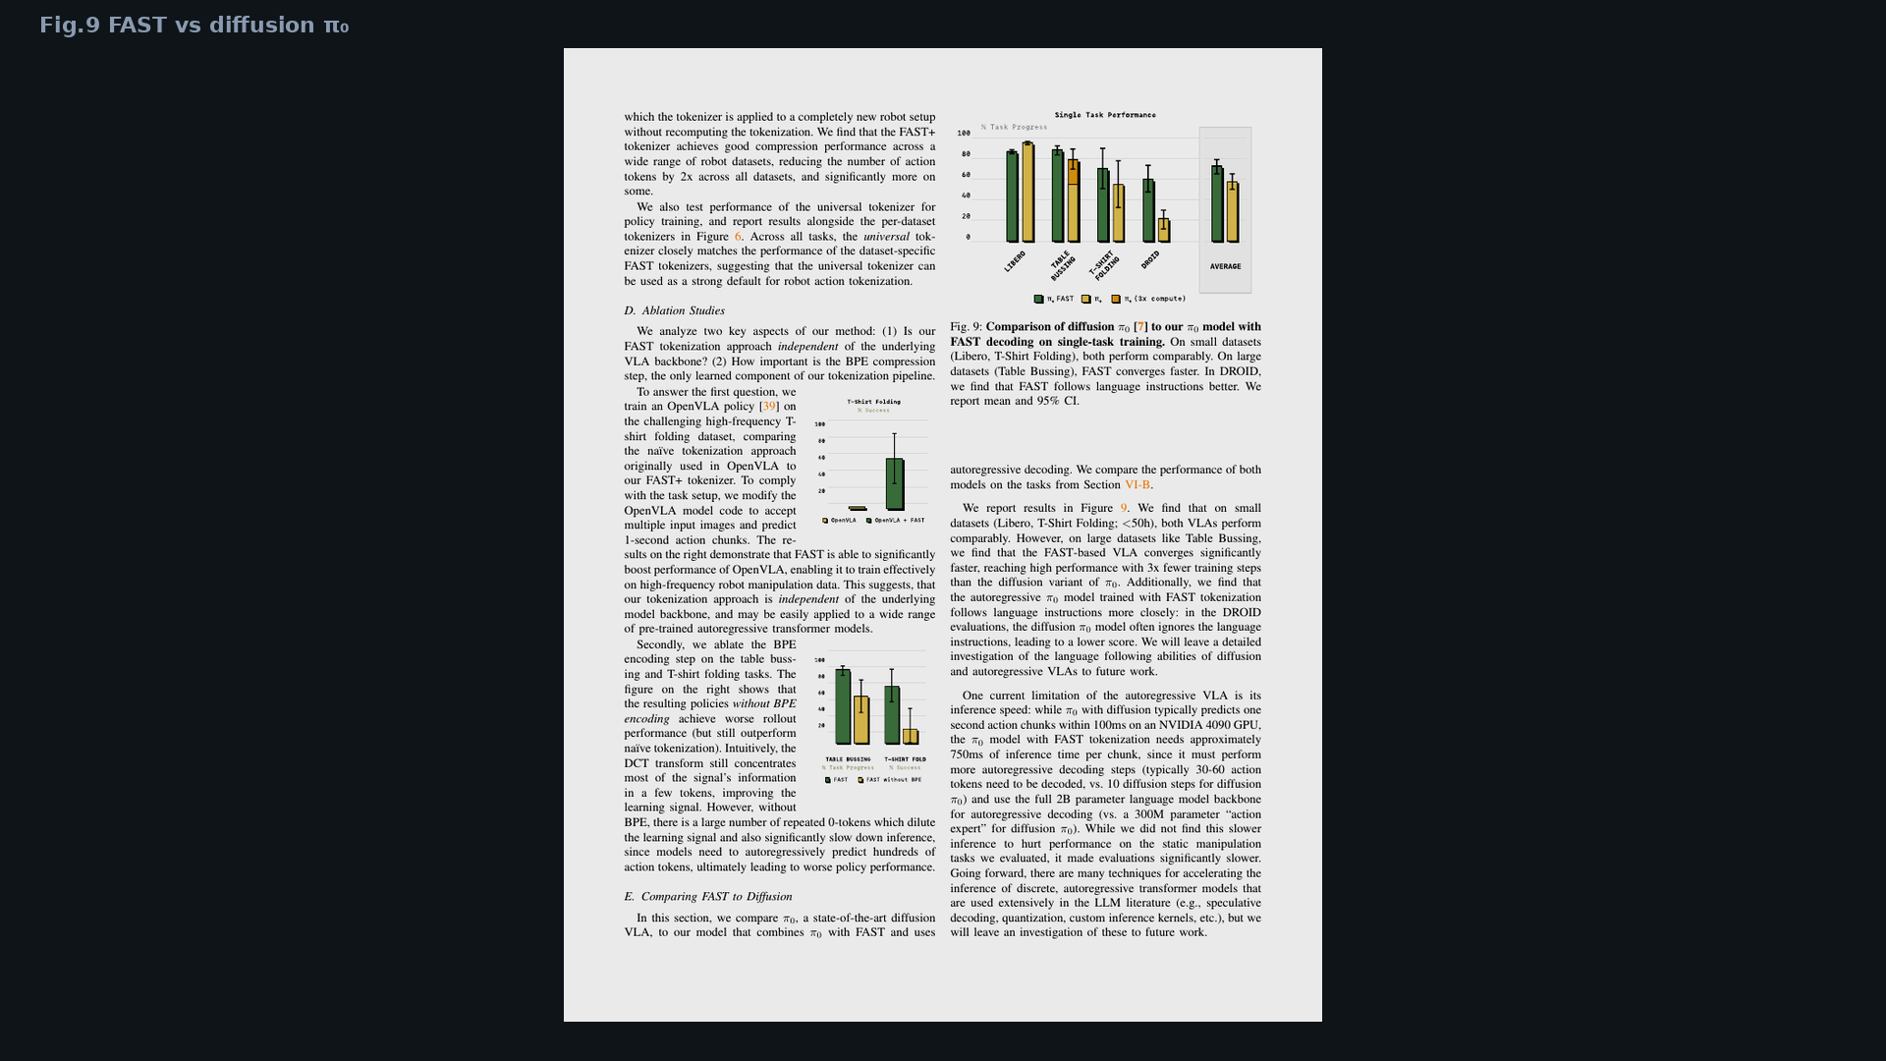
Scientific Reviewer · 8+3 · 7/11
Notes:
Fig.9 — when discussing vs FM, note different compute graphs.

Slide 8
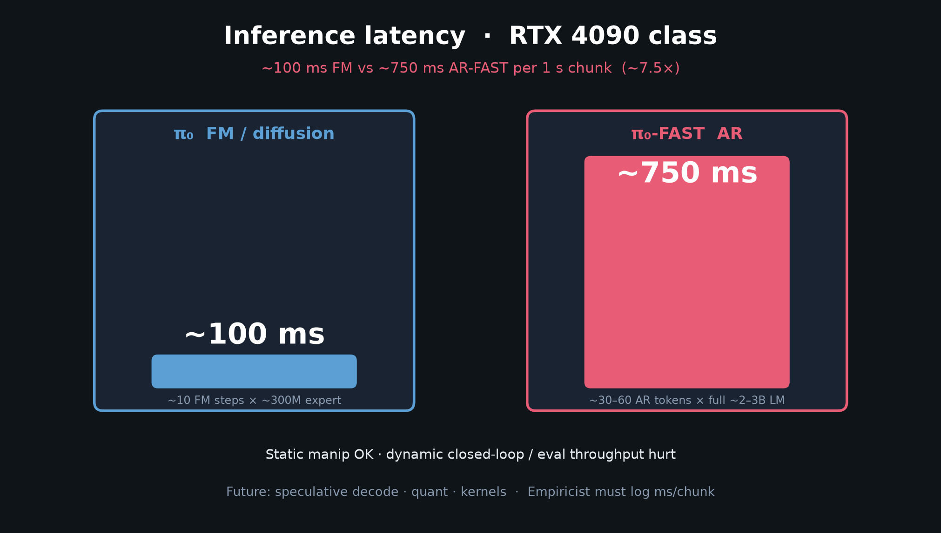
Scientific Reviewer · 8+3 · 8/11
Notes:
Latency honesty — paper’s own limitation, use it.

Slide 9
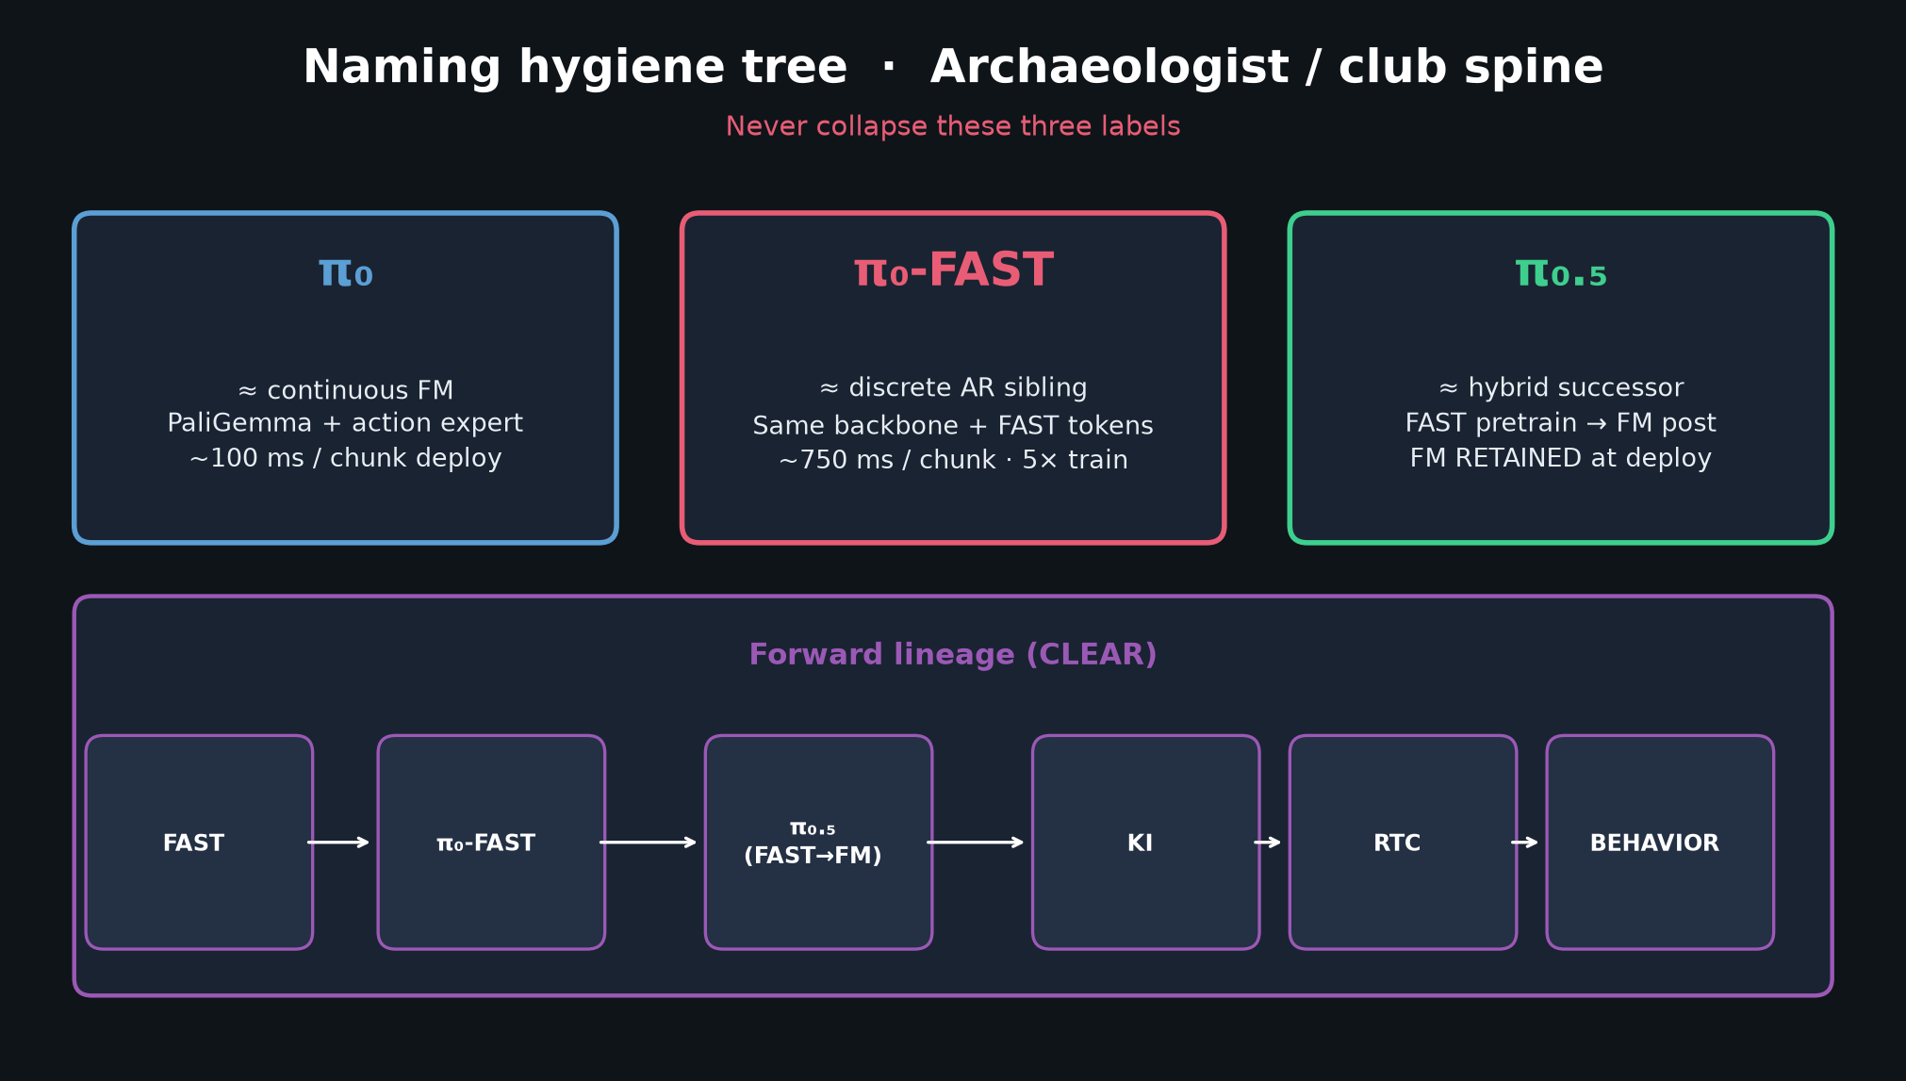
Scientific Reviewer · 8+3 · 9/11
Notes:
Naming — π₀ / π₀-FAST / π₀.₅ must stay distinct in citations.

Slide 10
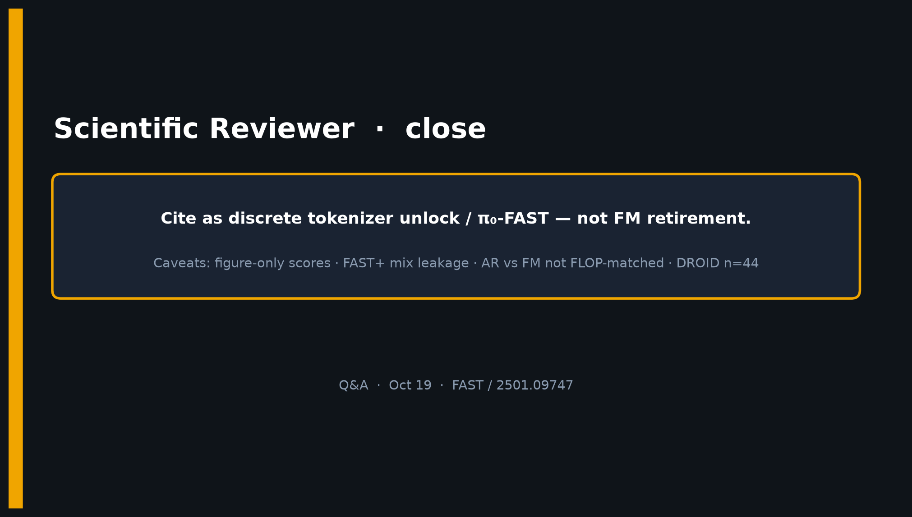
Scientific Reviewer · 8+3 · 10/11
Notes:
CLOSE — Cite unlock / π₀-FAST; caveats figure-only / leakage / FLOP / n=44.

Slide 11
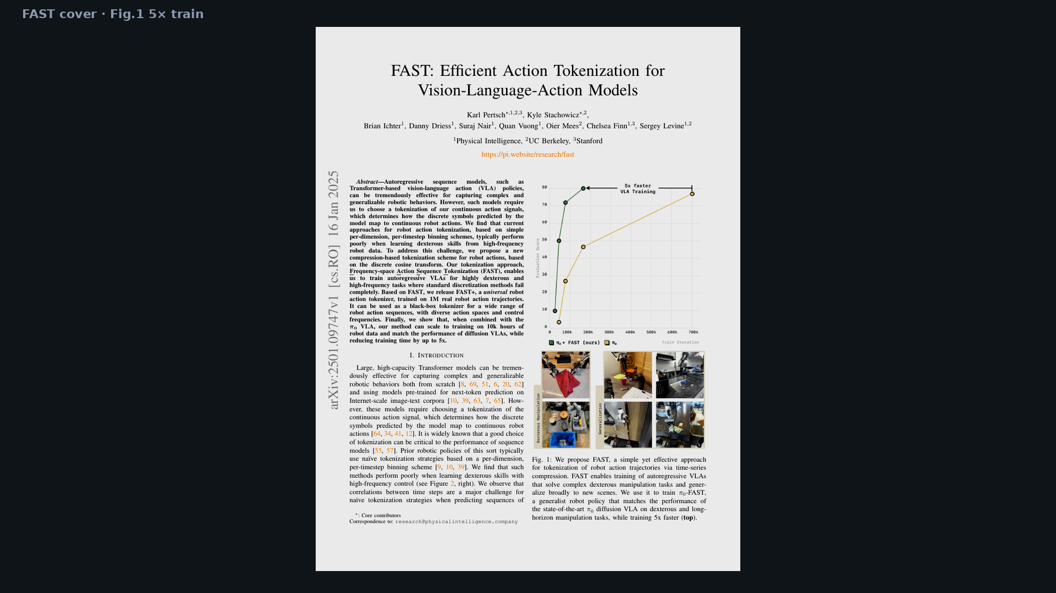
Scientific Reviewer · 8+3 · 11/11
Notes:
BACKUP cover.

