Slide 1
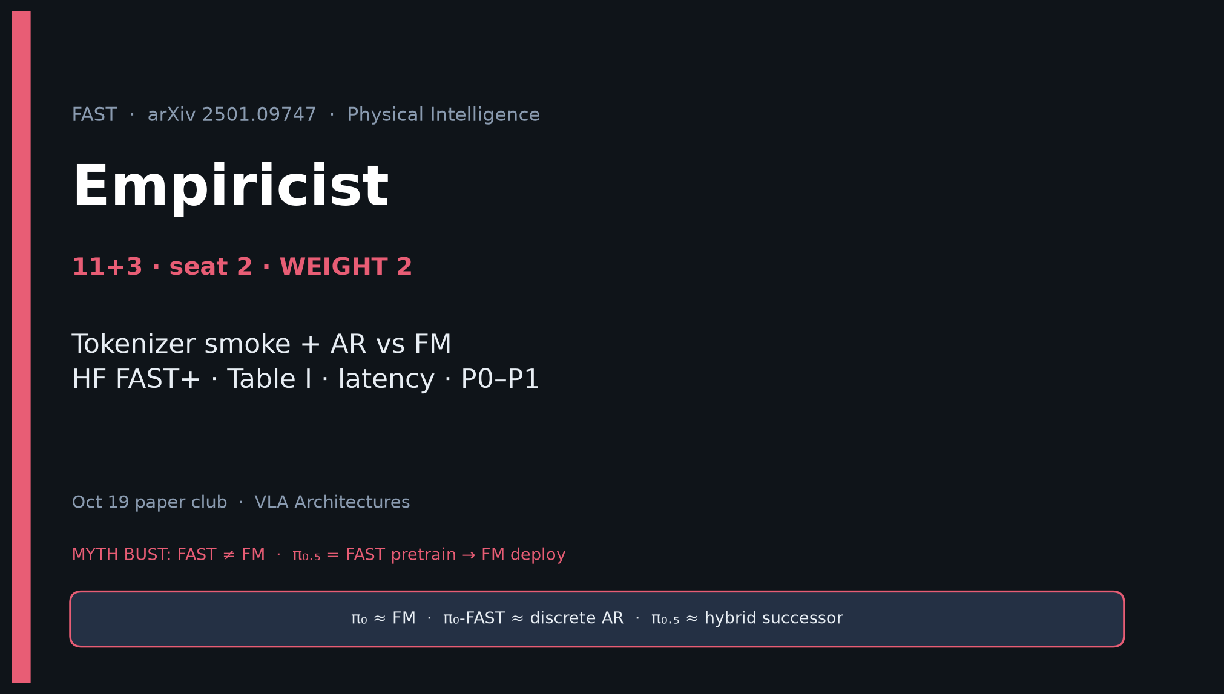
Empiricist · 11+3 · 1/16
Notes:
EMPIRICIST OPENING — seat 2 · WEIGHT 2 · Timing 11+3. DENSEST DECK. BUILD FIRST.
You own: tokenizer smoke, compression sanity, AR-FAST vs continuous FM honesty.
ONE SENTENCE:
FAST is a DCT→BPE action tokenizer that makes high-Hz AR VLAs trainable; measure tokens, recon MSE, and ms/chunk — do not confuse train speed with deploy latency.
MUST OPEN WITH MYTH BUST:
| FAST | Discrete DCT→BPE tokenizer for AR VLAs |
| FM | Continuous flow-matching (π₀ / π₀.₅ deploy) |
| π₀-FAST | Discrete AR variant using this tokenizer |
| π₀.₅ | FAST pretrain → FM post-train/deploy — FAST does NOT replace FM |
GitHub title cue: [ECE 605] - FAST Making Empiricist

Slide 2
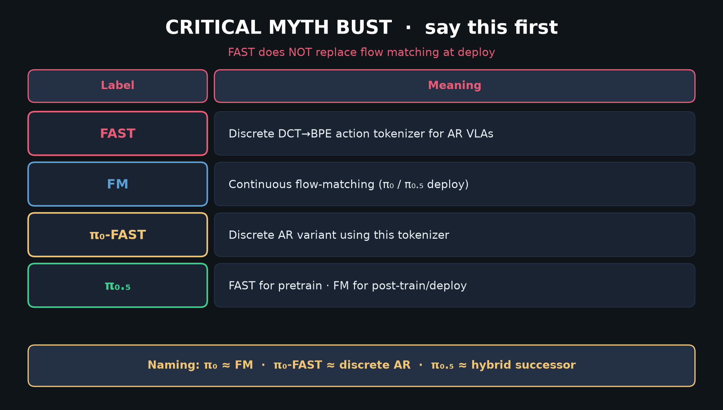
Empiricist · 11+3 · 2/16
Notes:
MYTH TABLE — SAY ALOUD first 60–90s. Club spine for every seat.
π₀ ≈ FM; π₀-FAST ≈ discrete AR; π₀.₅ ≈ hybrid successor.
If someone says “FAST replaced FM,” correct immediately.

Slide 3
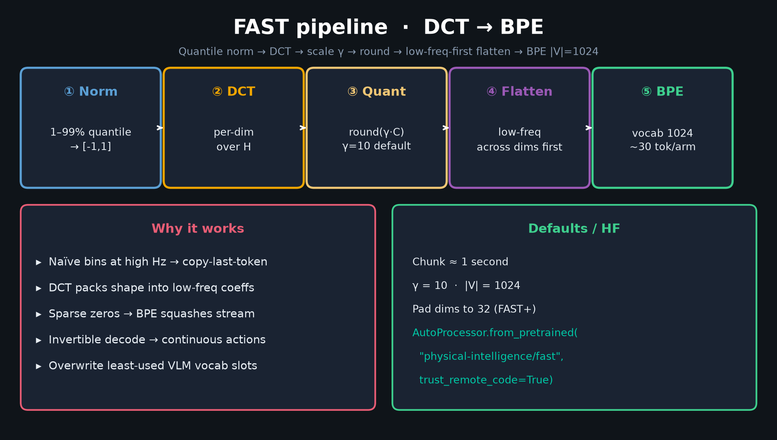
Empiricist · 11+3 · 3/16
Notes:
DCT→BPE PIPELINE — Algorithm 1 / Fig.4 spirit.
1 Quantile norm 1–99% → [-1,1]
2 Per-dim DCT over chunk H
3 round(γ·C); default γ=10
4 Flatten low-frequency-across-dims first (critical for AR)
5 BPE vocab 1024 → overwrite least-used VLM tokens
Invertible decode.
Spend 60s walking the five boxes.

Slide 4
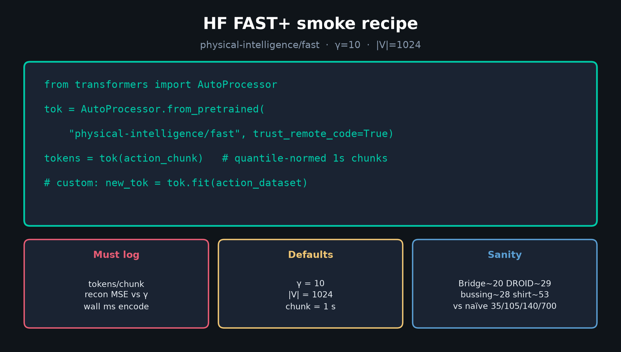
Empiricist · 11+3 · 4/16
Notes:
HF FAST+ SMOKE RECIPE — P0 Y.
AutoProcessor.from_pretrained("physical-intelligence/fast", trust_remote_code=True)
γ=10; |V|=1024; 1s chunks; pad-to-32 for universal.
Log tokens/chunk, recon MSE vs γ, wall ms.
.fit(action_dataset) for custom morphologies.

Slide 5
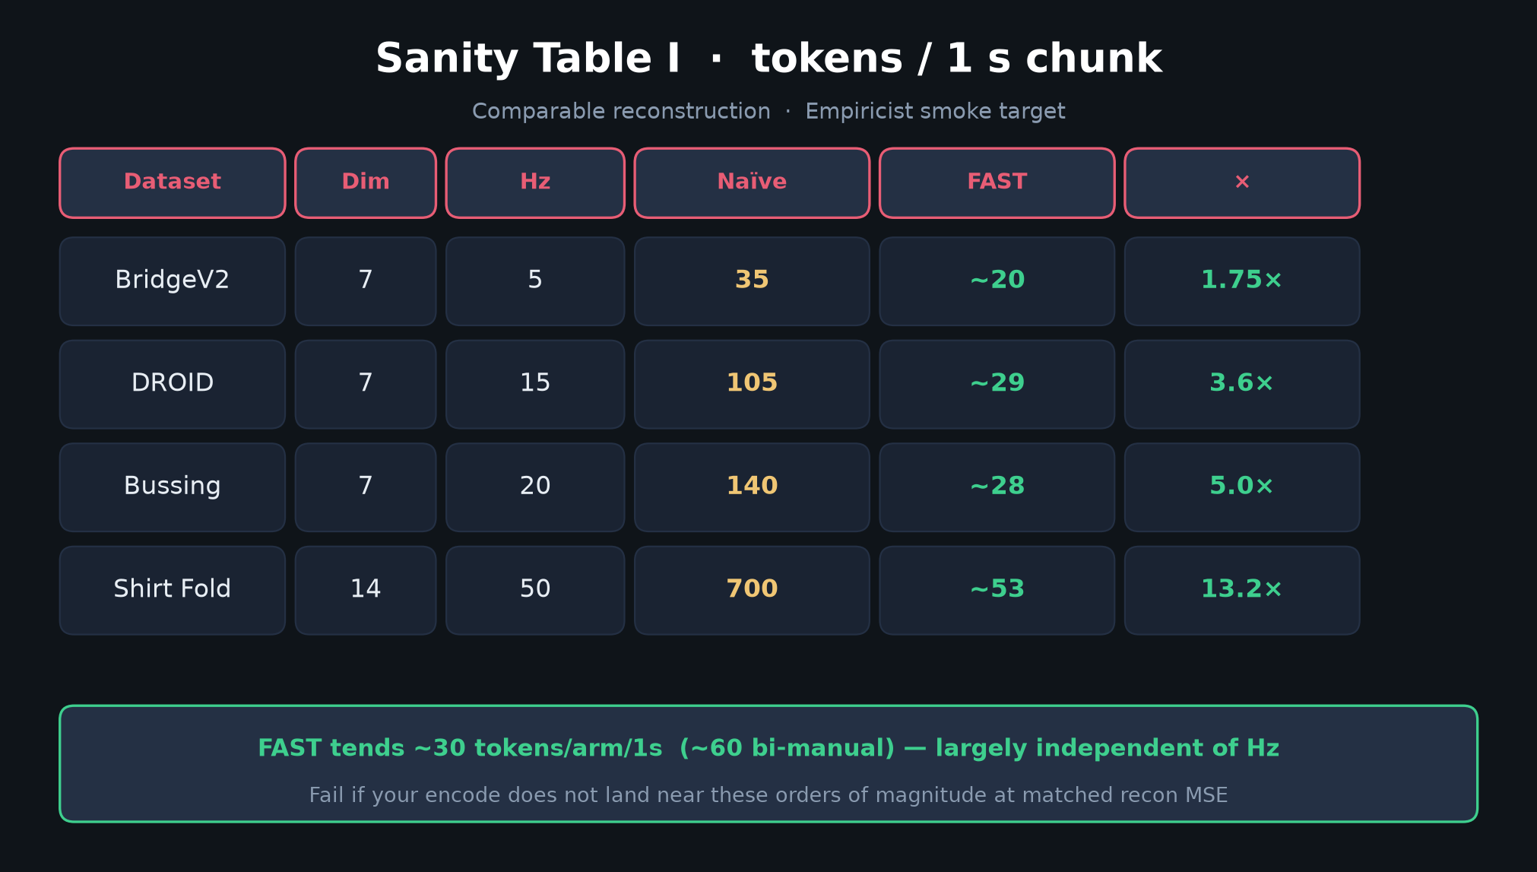
Empiricist · 11+3 · 5/16
Notes:
SANITY TABLE I — reproduce orders of magnitude.
Bridge~20, DROID~29, bussing~28, shirt~53 FAST tokens
vs naïve 35 / 105 / 140 / 700.
~30 tok/arm/1s largely independent of Hz.
Fail the smoke if you are nowhere near these at matched recon MSE.

Slide 6
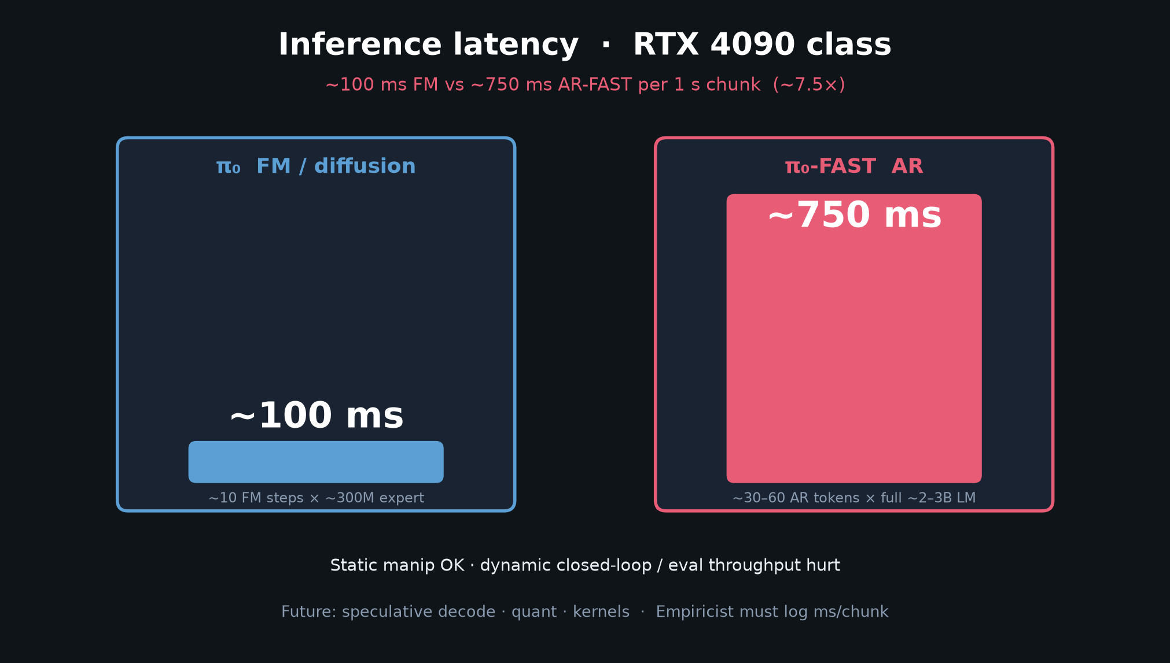
Empiricist · 11+3 · 6/16
Notes:
LATENCY BARS — H5 / deploy honesty.
~100 ms FM (10 steps × ~300M expert) vs ~750 ms AR-FAST (30–60 tokens × full LM) on 4090.
~7.5×. Static OK; dynamic closed-loop hurt.
Every success number needs (H, Hz, tokens or NFE, ms, GPU).

Slide 7
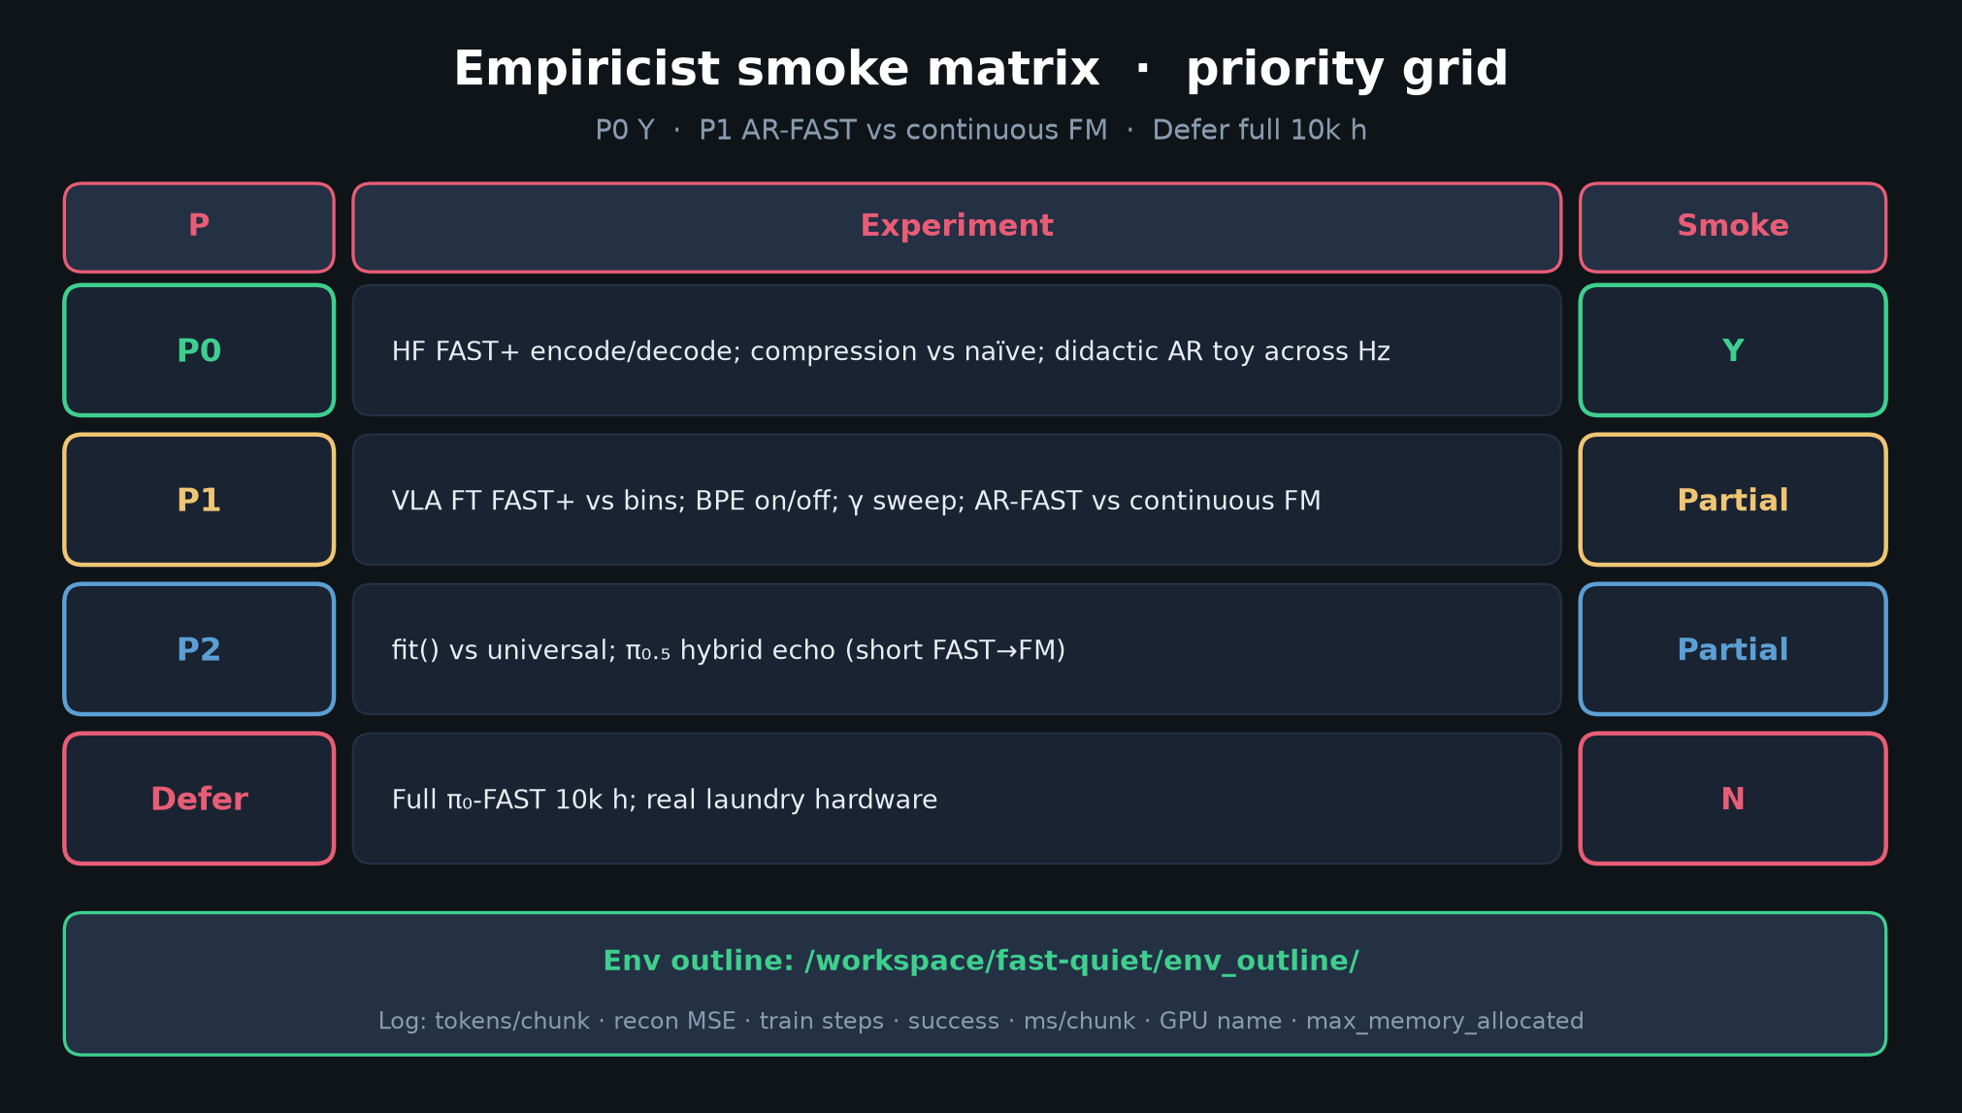
Empiricist · 11+3 · 7/16
Notes:
PRIORITY GRID — P0 Y / P1 AR-FAST vs FM / Defer 10k h.
P0: HF encode/decode; compression vs naïve; didactic AR toy across Hz — Y
P1: VLA FT FAST vs bins; BPE on/off; γ; AR-FAST vs continuous FM — Partial
P2: fit() vs universal; π₀.₅ hybrid echo — Partial
Defer: full π₀-FAST 10k h; laundry hardware — N
Env: /workspace/fast-quiet/env_outline/

Slide 8
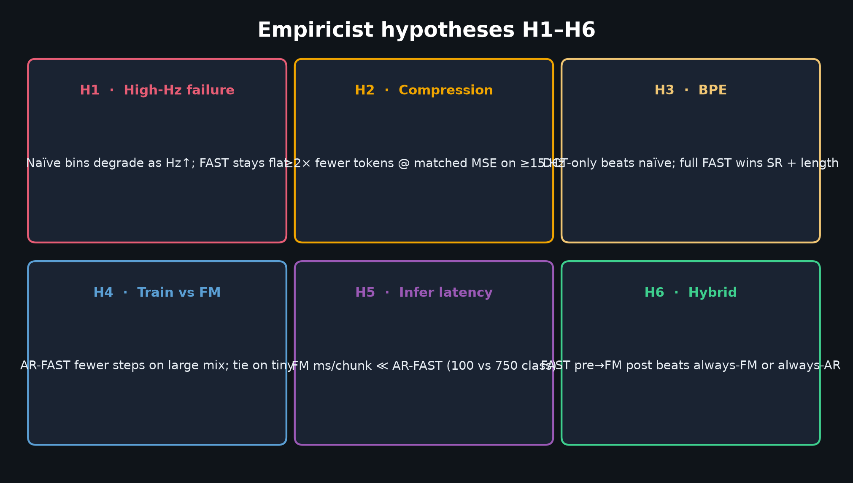
Empiricist · 11+3 · 8/16
Notes:
HYPOTHESES H1–H6 — what you are testing.
H1 high-Hz naïve collapse; H2 ≥2× compression; H3 BPE helps;
H4 train efficiency vs FM on large mix; H5 FM faster at infer; H6 hybrid echo.
Falsifiers listed in DELIVERABLE §3.

Slide 9
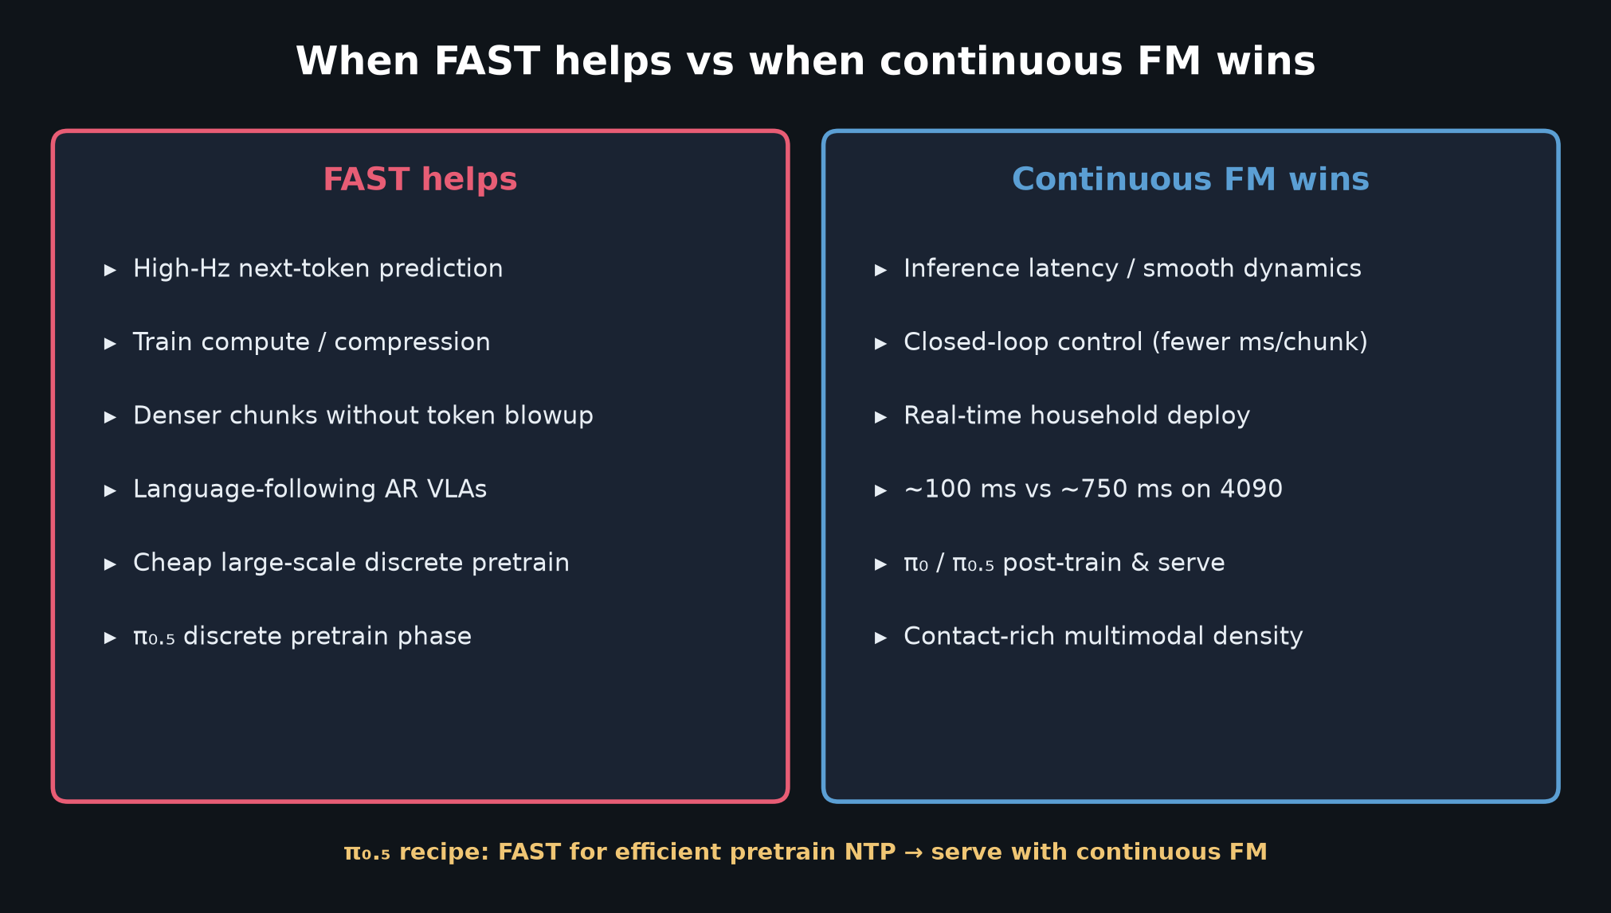
Empiricist · 11+3 · 9/16
Notes:
WHEN FAST HELPS vs FM WINS — operator cheat-sheet.
FAST: high-Hz NTP, train compute, denser chunks, language AR.
FM: latency, closed-loop, realtime household, π₀.₅ serve.
π₀.₅: FAST pretrain → FM deploy.

Slide 10
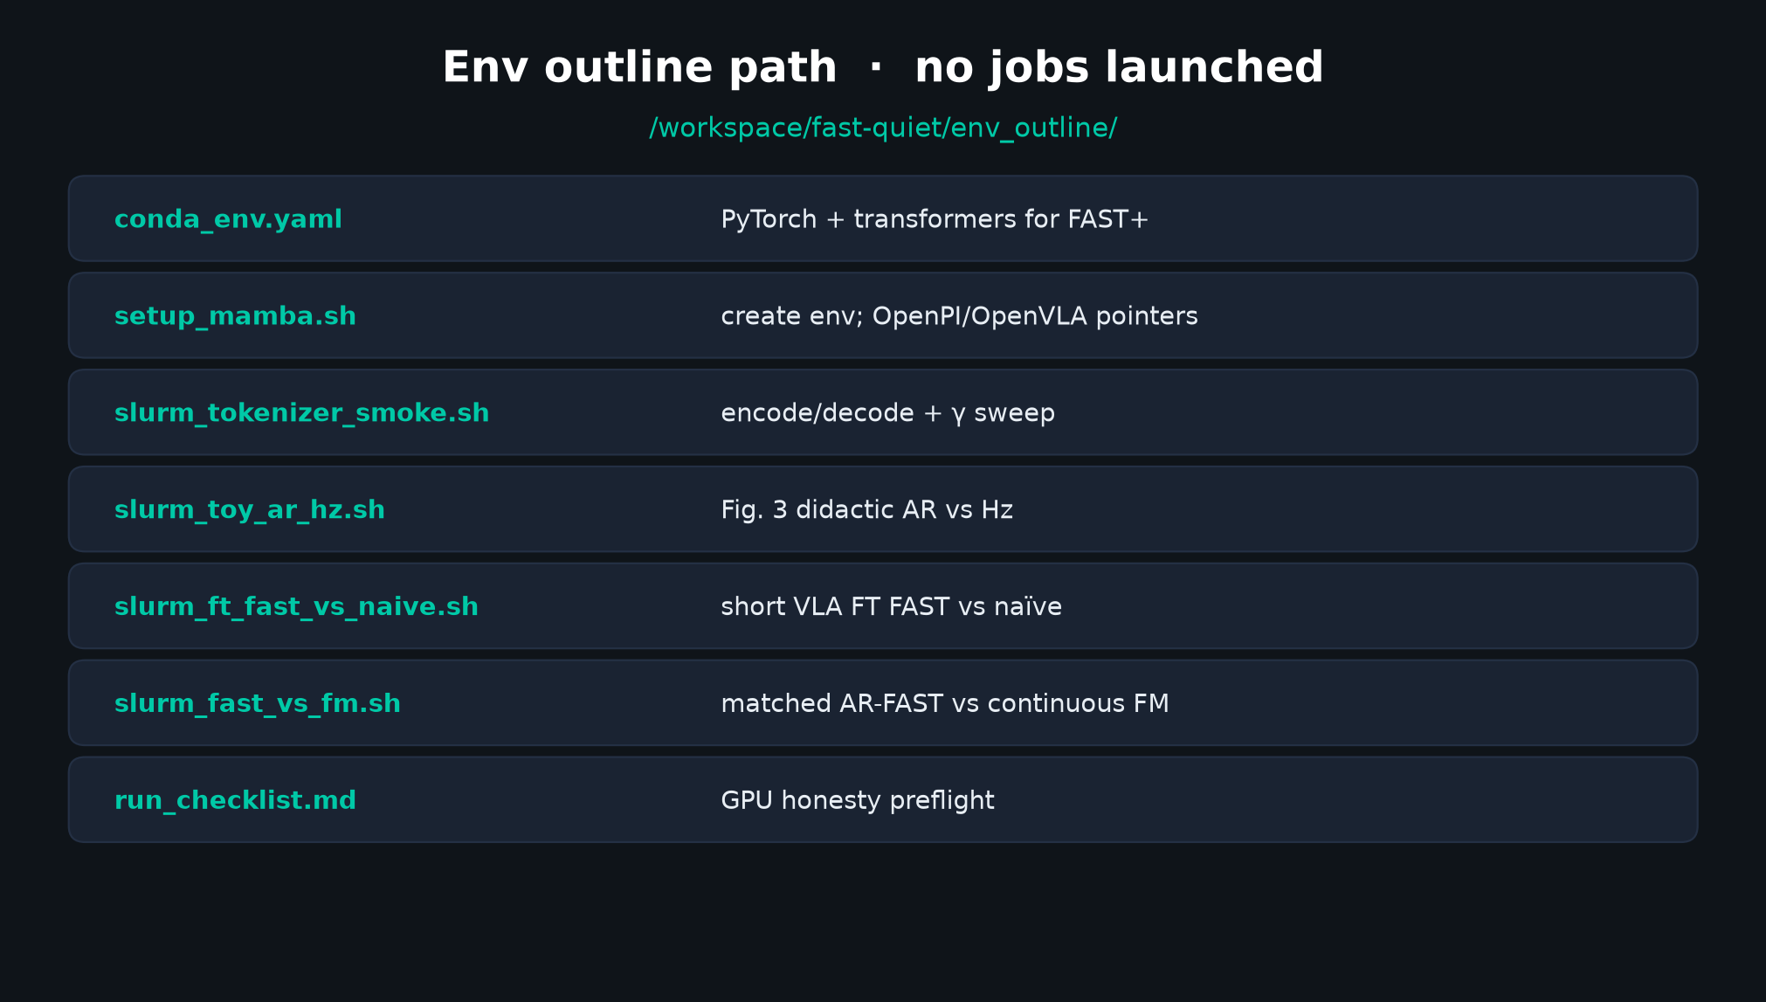
Empiricist · 11+3 · 10/16
Notes:
ENV OUTLINE — quiet mode: outlines only, no Slurm jobs launched.
Point to conda_env.yaml, slurm_tokenizer_smoke.sh, slurm_toy_ar_hz.sh,
slurm_ft_fast_vs_naive.sh, slurm_fast_vs_fm.sh, run_checklist.md.
GPU honesty: exit nonzero if CUDA claimed but unavailable.

Slide 11
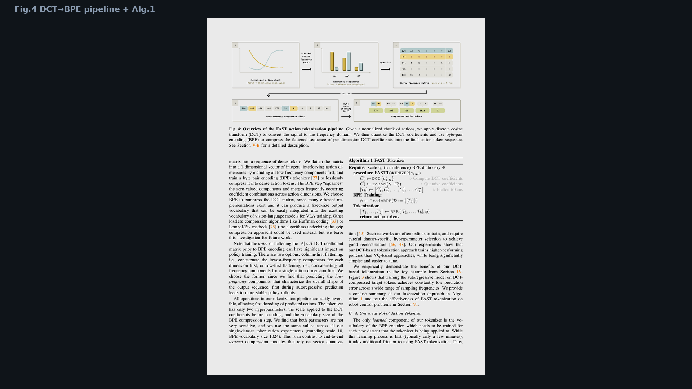
Empiricist · 11+3 · 11/16
Notes:
PAPER FIG.4 — visual of DCT→BPE + Algorithm 1.
Point to flatten order and γ / |V| defaults in the text.

Slide 12
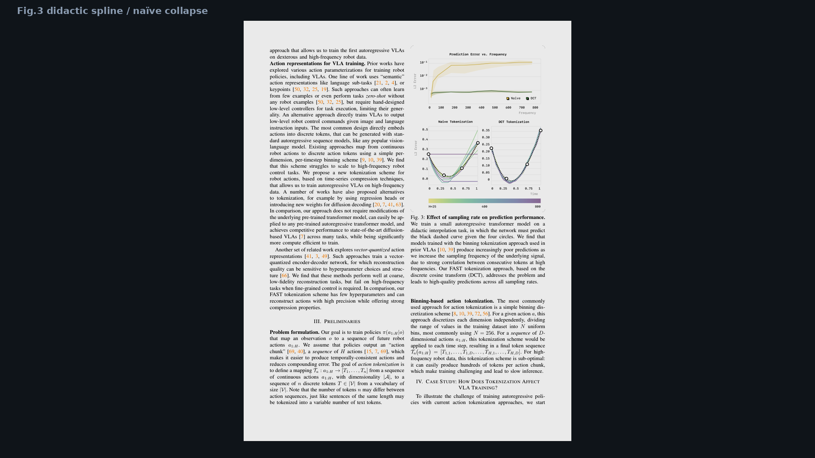
Empiricist · 11+3 · 12/16
Notes:
PAPER FIG.3 — didactic spline: naïve MSE explodes with sampling rate; FAST stays low.
This is the causal story Empiricist owns — not just “DCT is cool.”

Slide 13
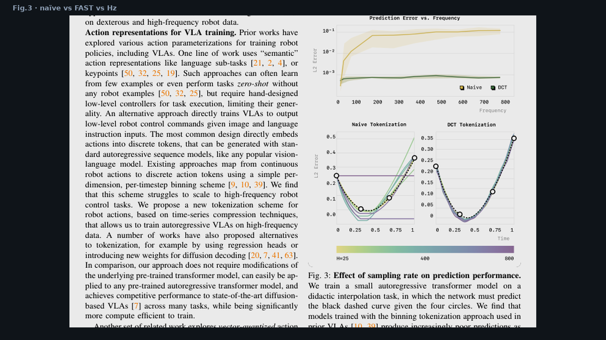
Empiricist · 11+3 · 13/16
Notes:
CROP Fig.3 detail — use if room needs a zoom on the Hz failure mode.

Slide 14
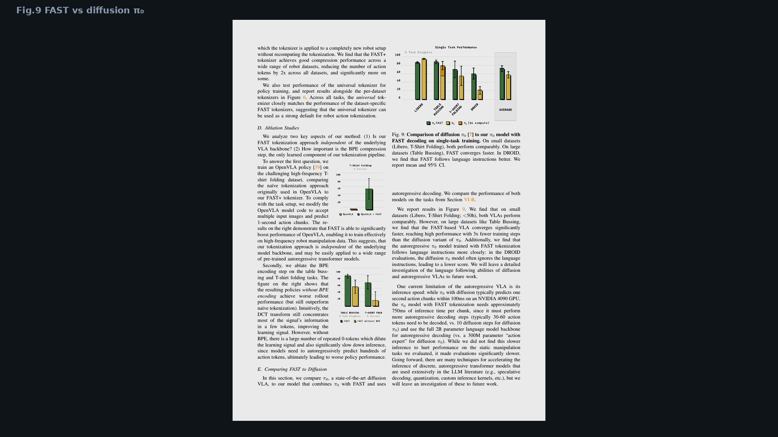
Empiricist · 11+3 · 14/16
Notes:
PAPER FIG.9 — FAST vs diffusion π₀ single-task.
Large-data bussing: FAST ~3× fewer steps; DROID language following edge for AR.

Slide 15
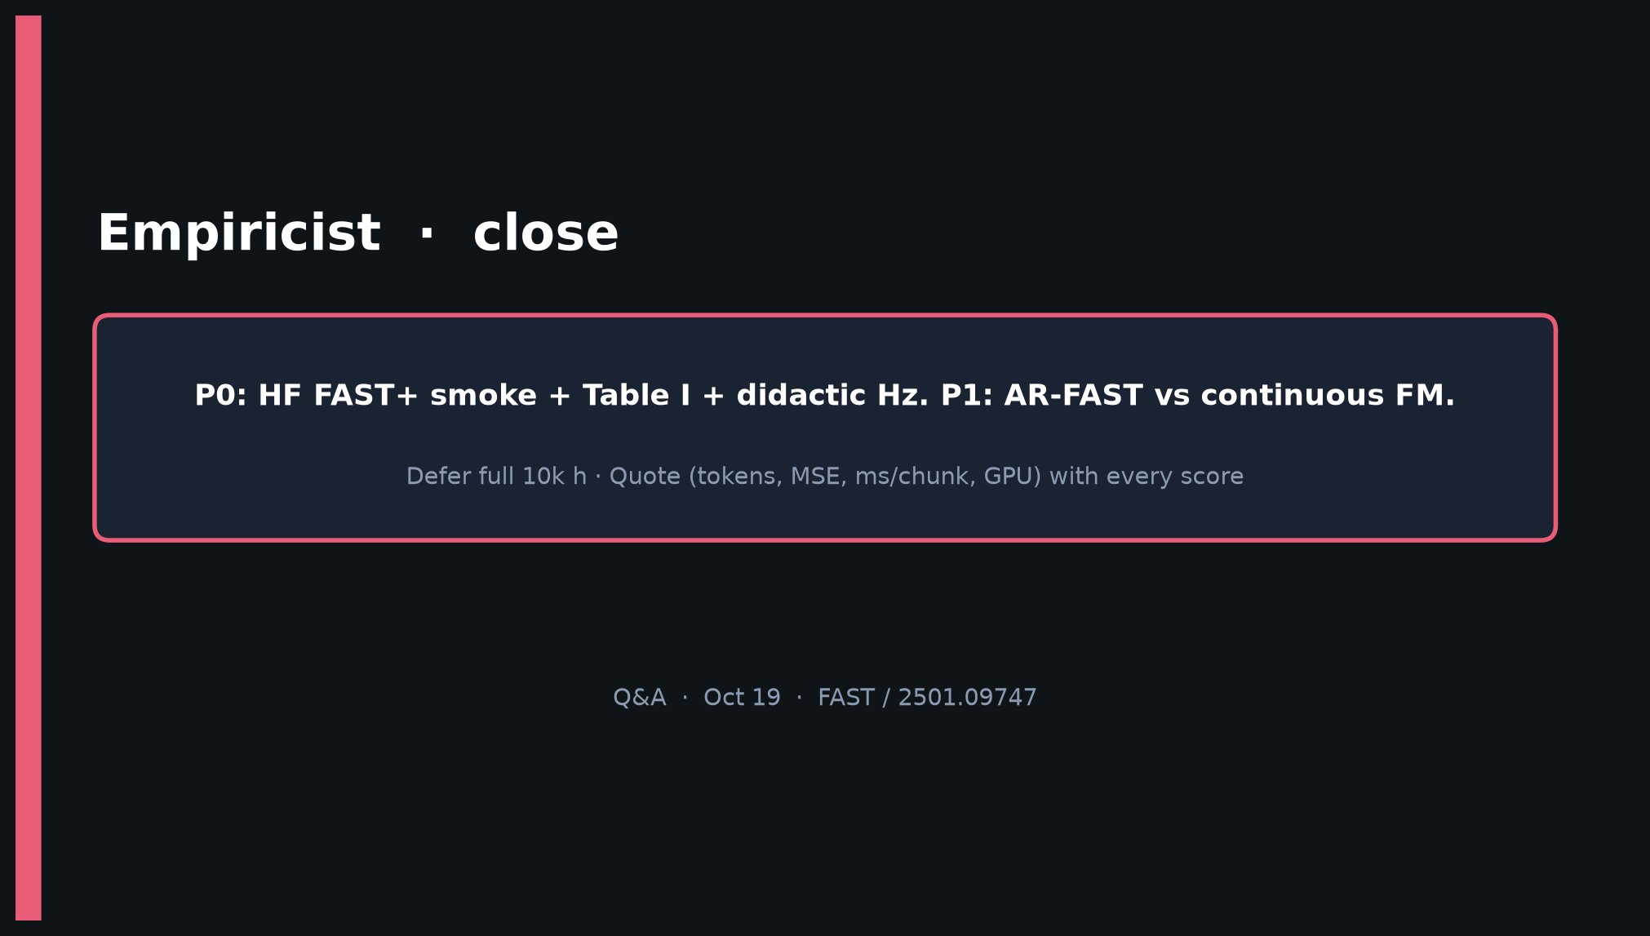
Empiricist · 11+3 · 15/16
Notes:
CLOSE — P0 smoke + Table I + latency log is the bar for “reproduced spirit.”
Defer absolute laundry / 10k h. Hand FM-deploy story to Stakeholder/Visionary.

Slide 16
Empiricist · 11+3 · 16/16
Notes:
BACKUP — Table I again if someone challenges compression numbers mid-Q&A.

