Slide 1
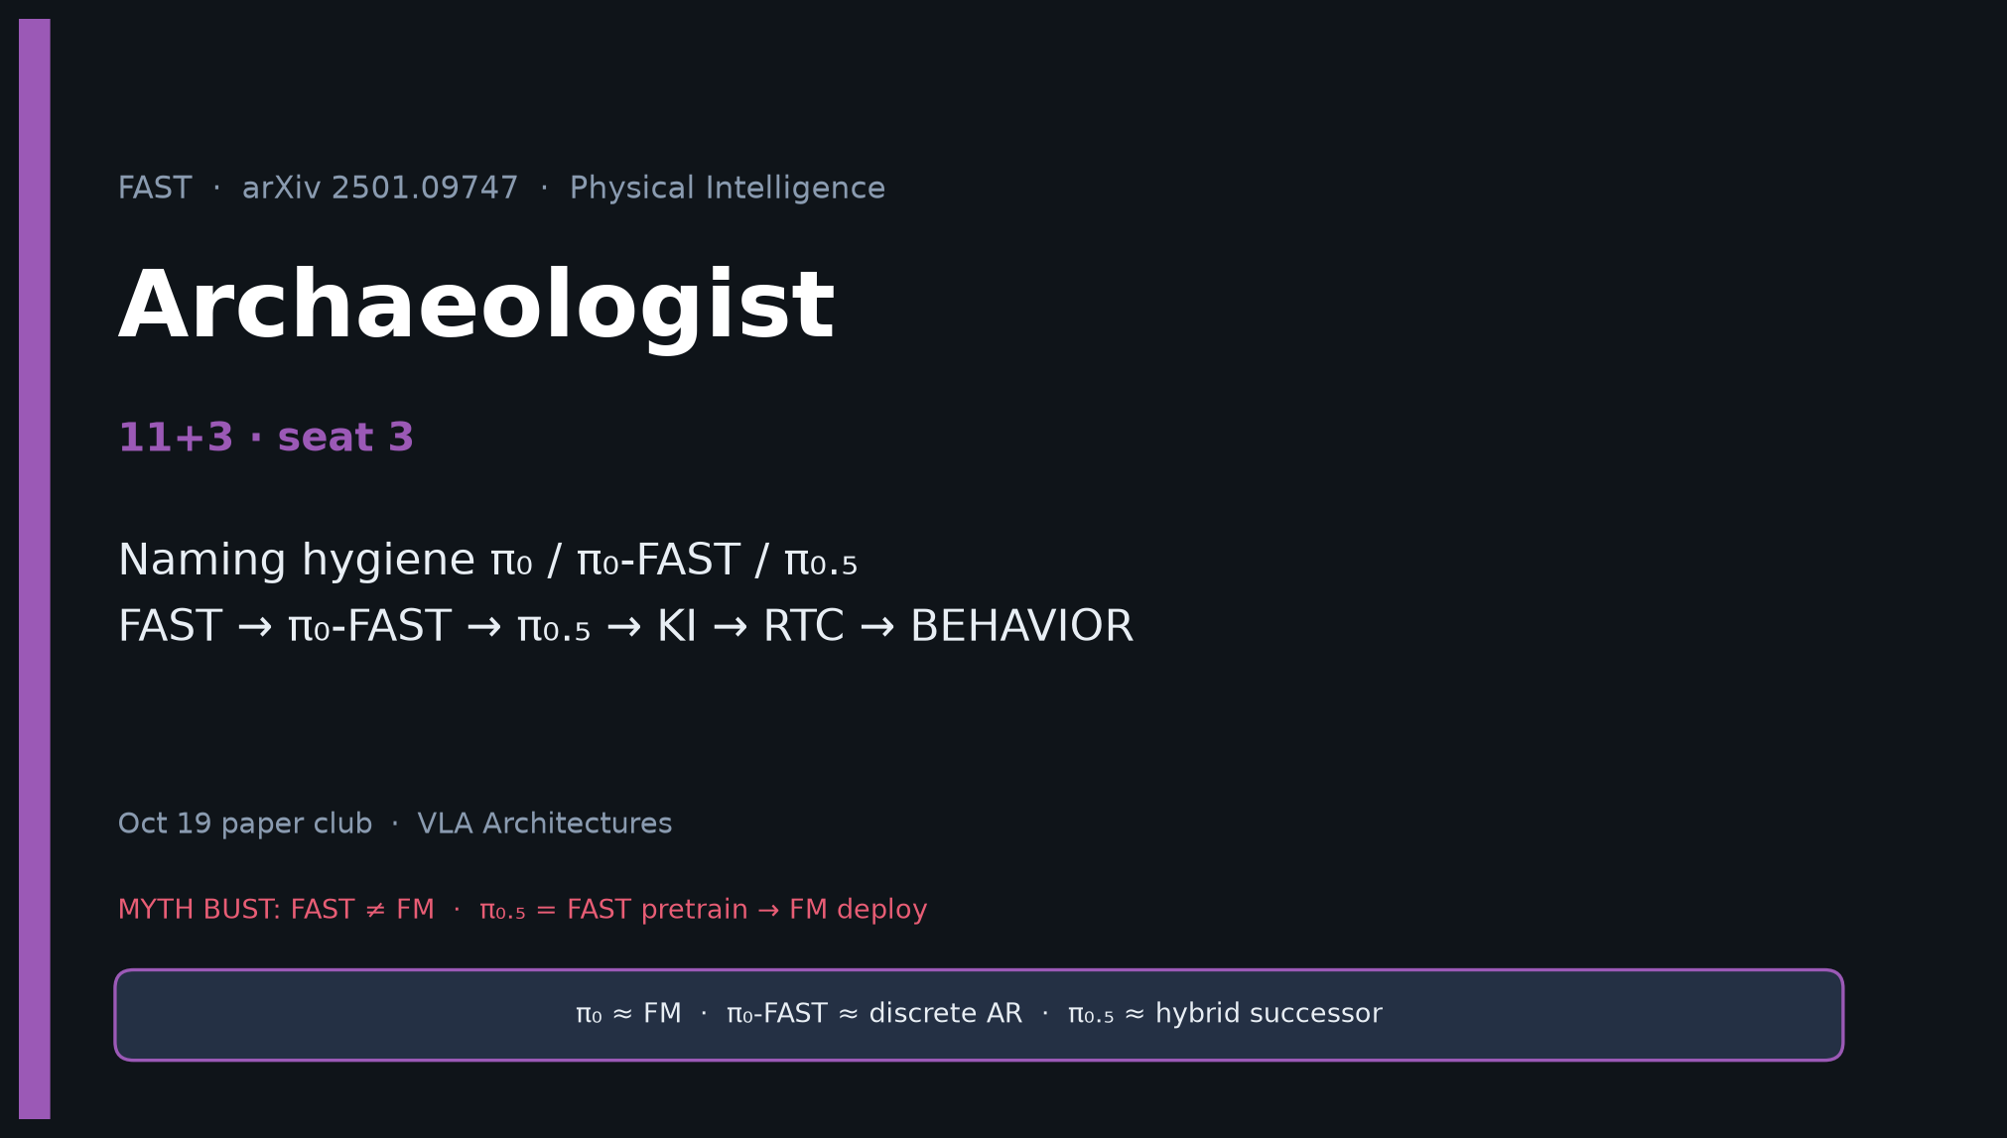
Archaeologist · 11+3 · 1/14
Notes:
ARCHAEOLOGIST — 11+3.
You own naming hygiene and genealogy.
FAST → π₀-FAST → π₀.₅ (FAST pre→FM) → KI → RTC → BEHAVIOR.
Never collapse π₀ / π₀-FAST / π₀.₅.

Slide 2
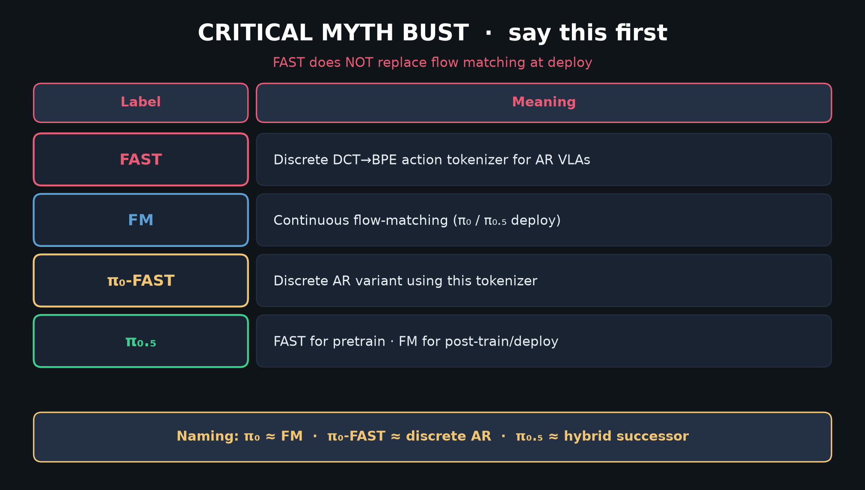
Archaeologist · 11+3 · 2/14
Notes:
MYTH BUST / naming table — primary Archaeologist deliverable early.

Slide 3
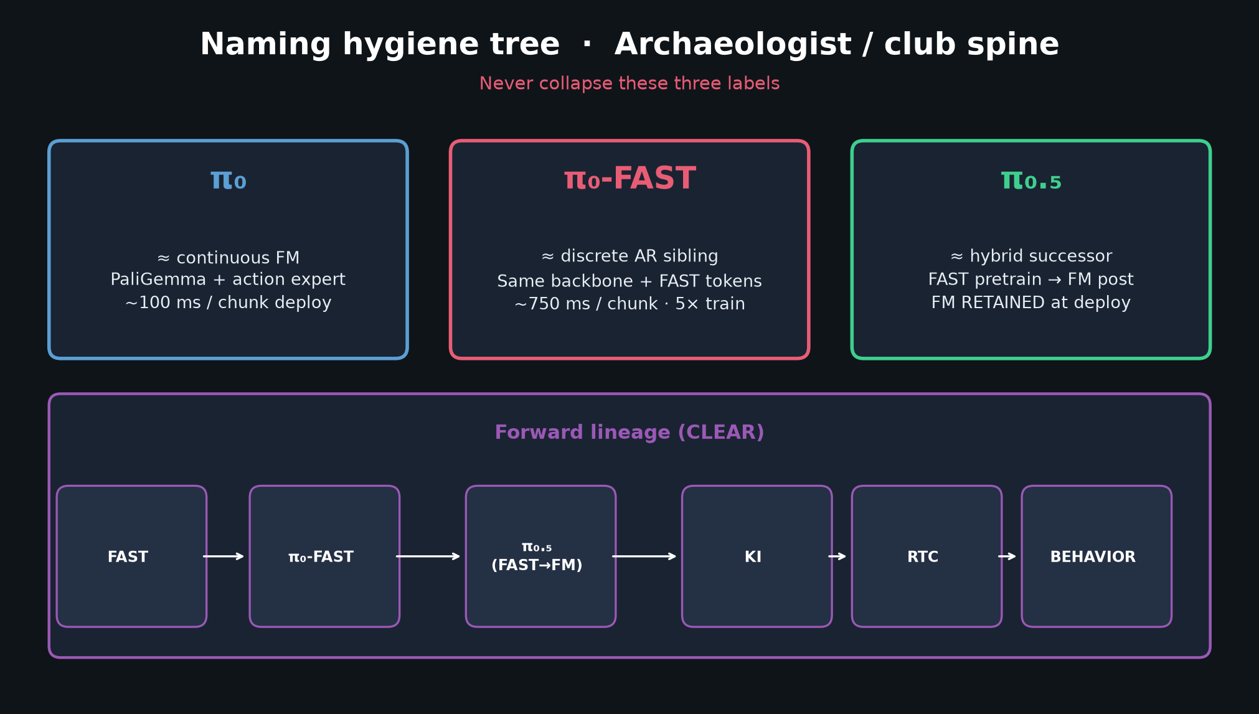
Archaeologist · 11+3 · 3/14
Notes:
NAMING TREE — three boxes + forward lineage strip. Spend 90s.

Slide 4
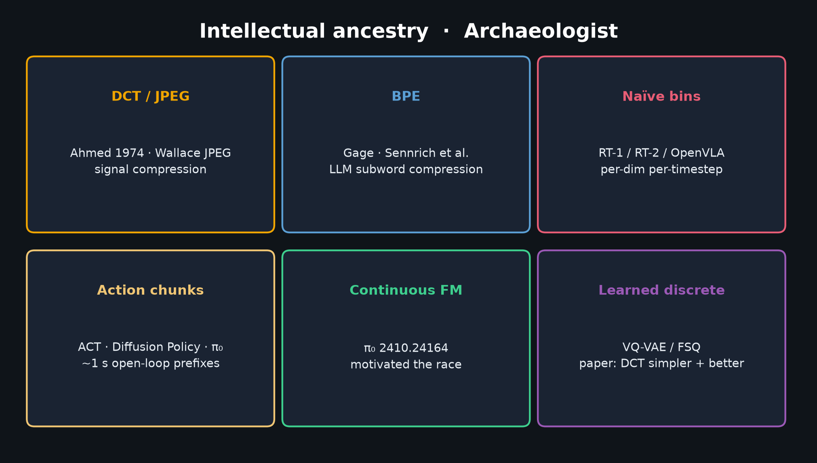
Archaeologist · 11+3 · 4/14
Notes:
PRIORS — DCT/JPEG, BPE, naïve bins RT-2/OpenVLA, ACT/DP/π₀ chunks, π₀ FM, VQ/FSQ.

Slide 5
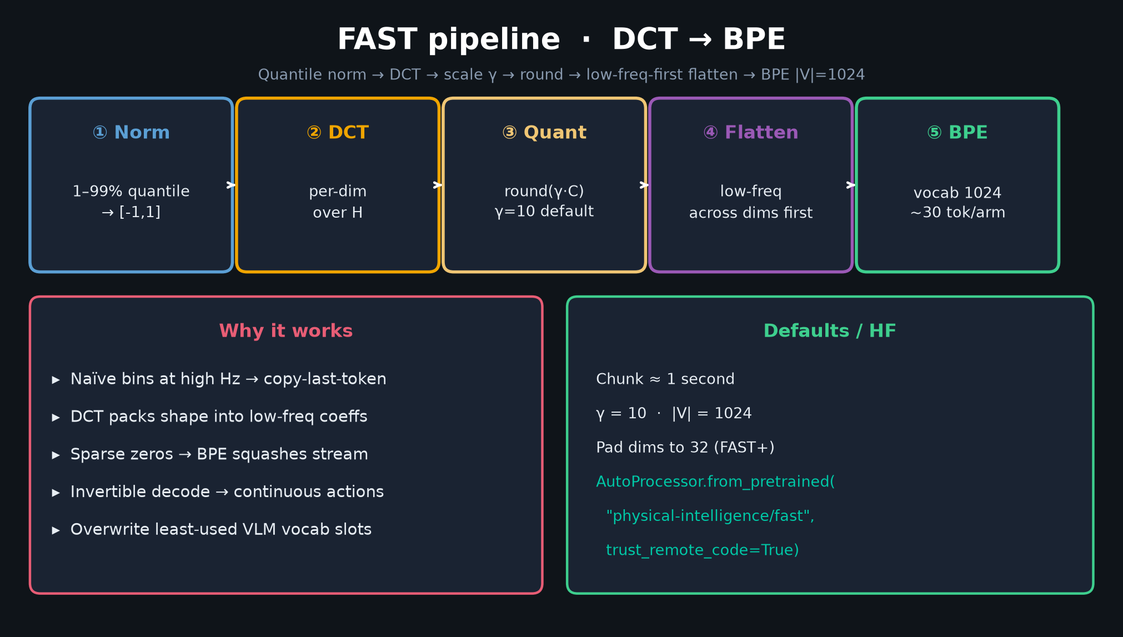
Archaeologist · 11+3 · 5/14
Notes:
PIPELINE — method as historical fix to naïve binning failure mode.

Slide 6
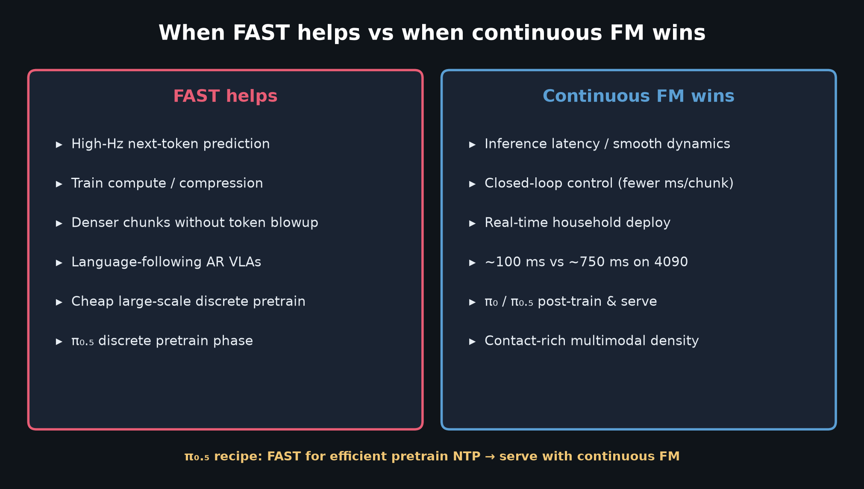
Archaeologist · 11+3 · 6/14
Notes:
WHEN HELPS — situates FAST vs continuous FM historically and operationally.

Slide 7
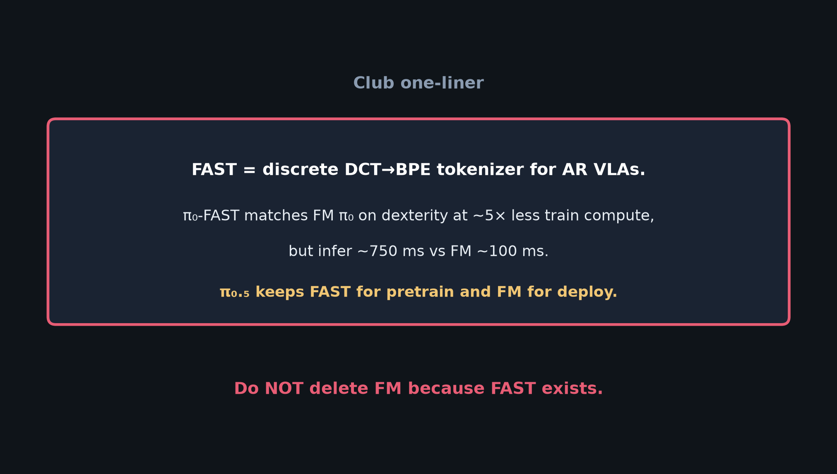
Archaeologist · 11+3 · 7/14
Notes:
ONE-LINER — compressed claim for the room.

Slide 8
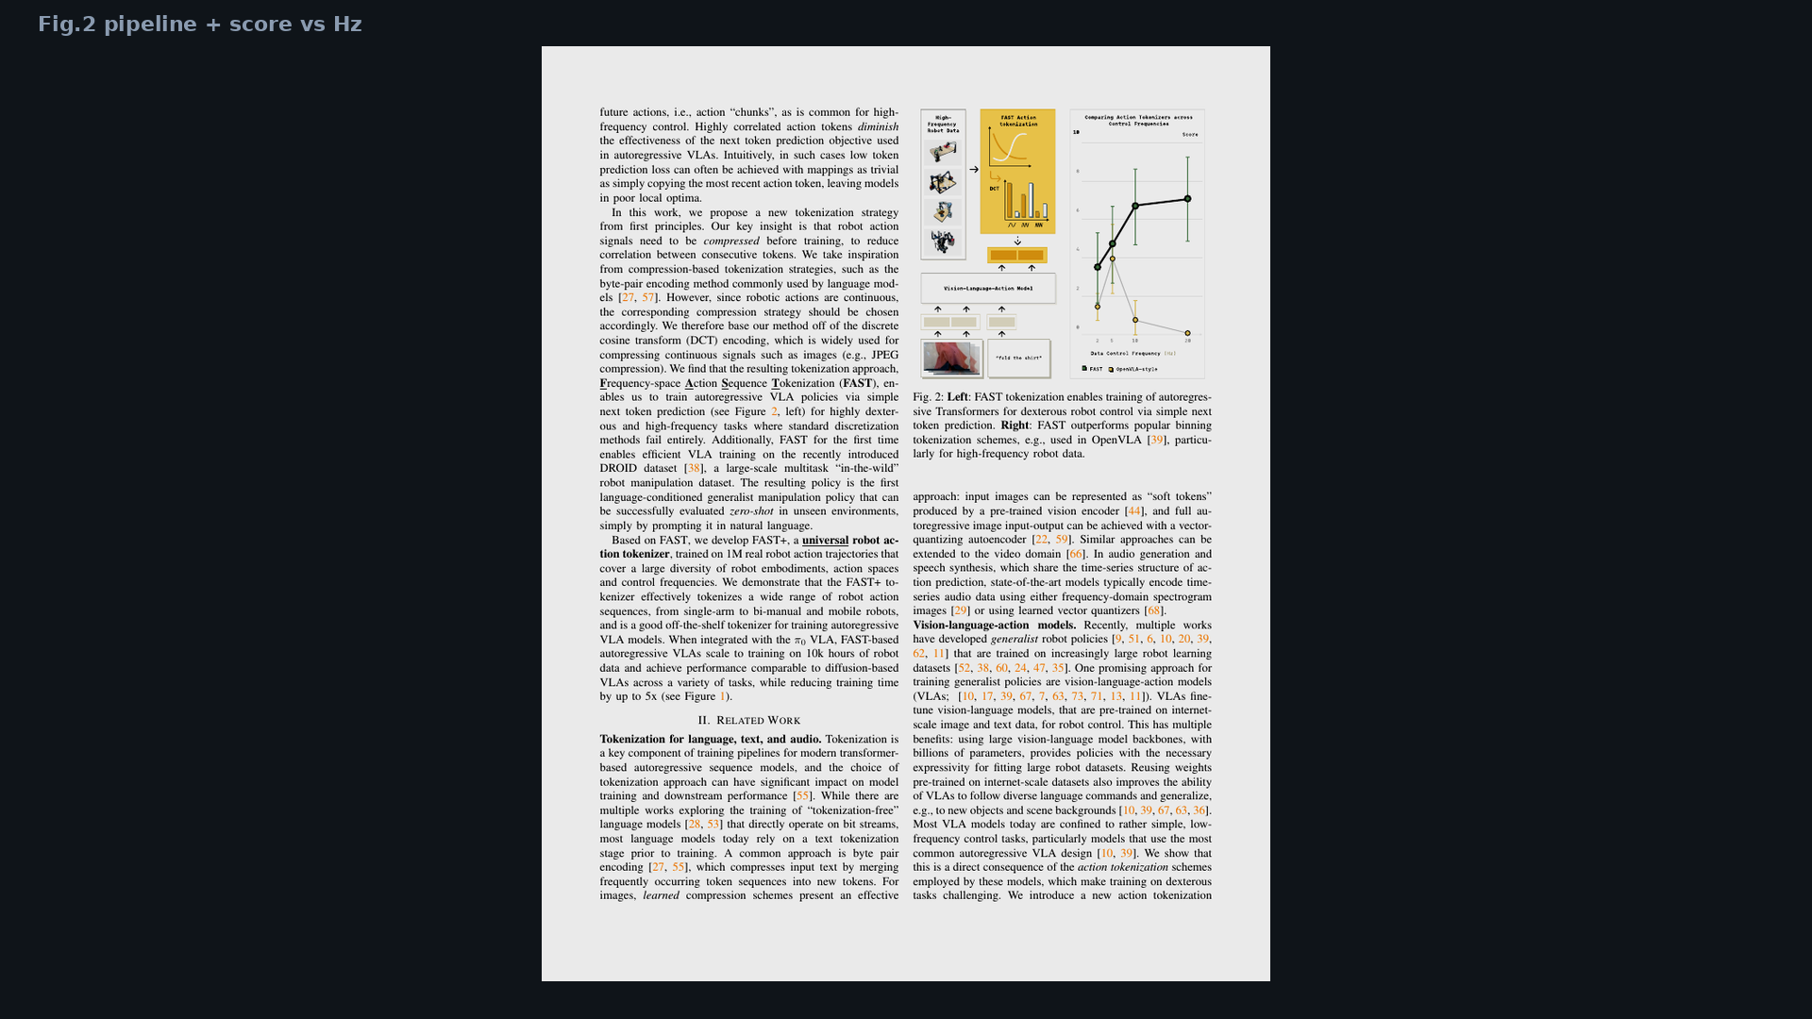
Archaeologist · 11+3 · 8/14
Notes:
Fig.2 — score vs Hz shows why naïve era ended for dexterous AR.

Slide 9
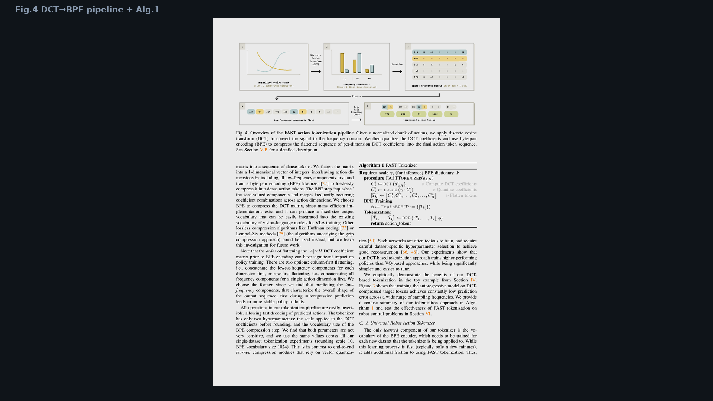
Archaeologist · 11+3 · 9/14
Notes:
Fig.4 — the JPEG-like moment for robot actions.

Slide 10
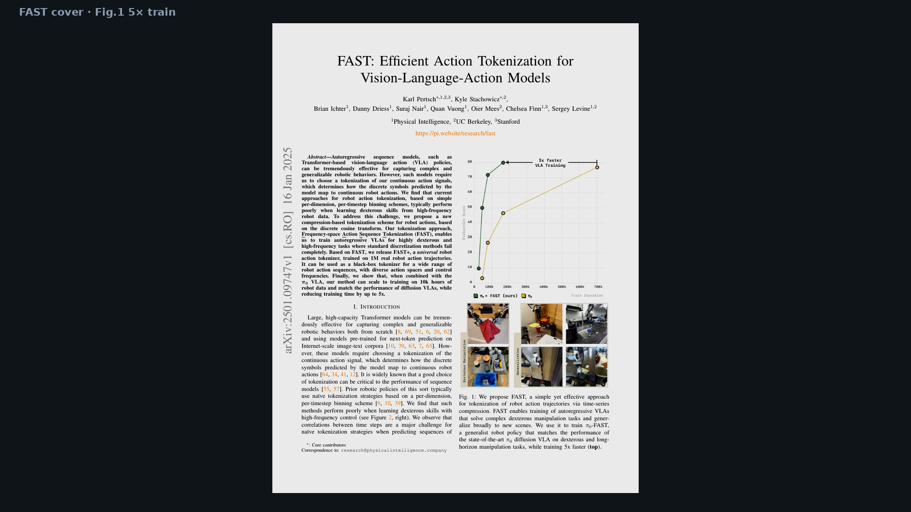
Archaeologist · 11+3 · 10/14
Notes:
Fig.1 cover — π₀-FAST enters the PI stack narrative.

Slide 11
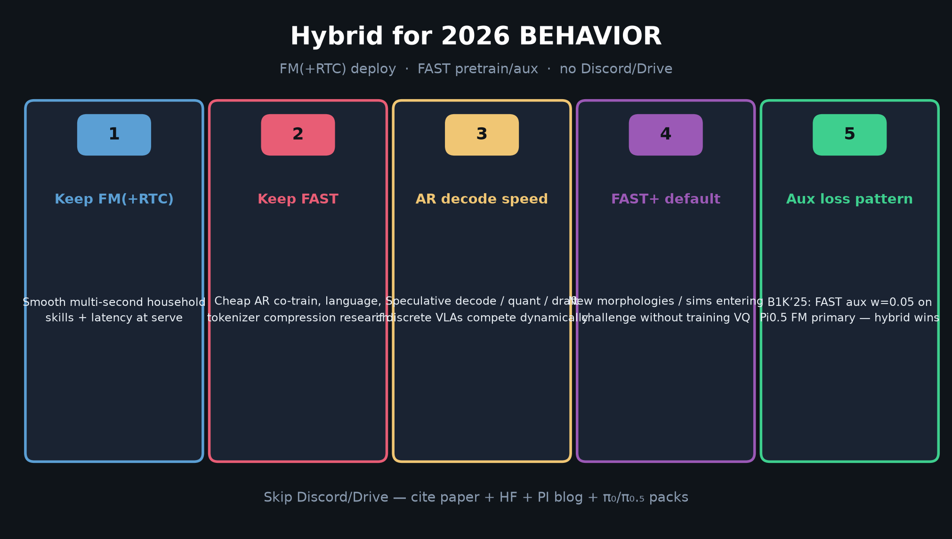
Archaeologist · 11+3 · 11/14
Notes:
2026 bridge — where BEHAVIOR sits relative to this tokenizer paper.

Slide 12
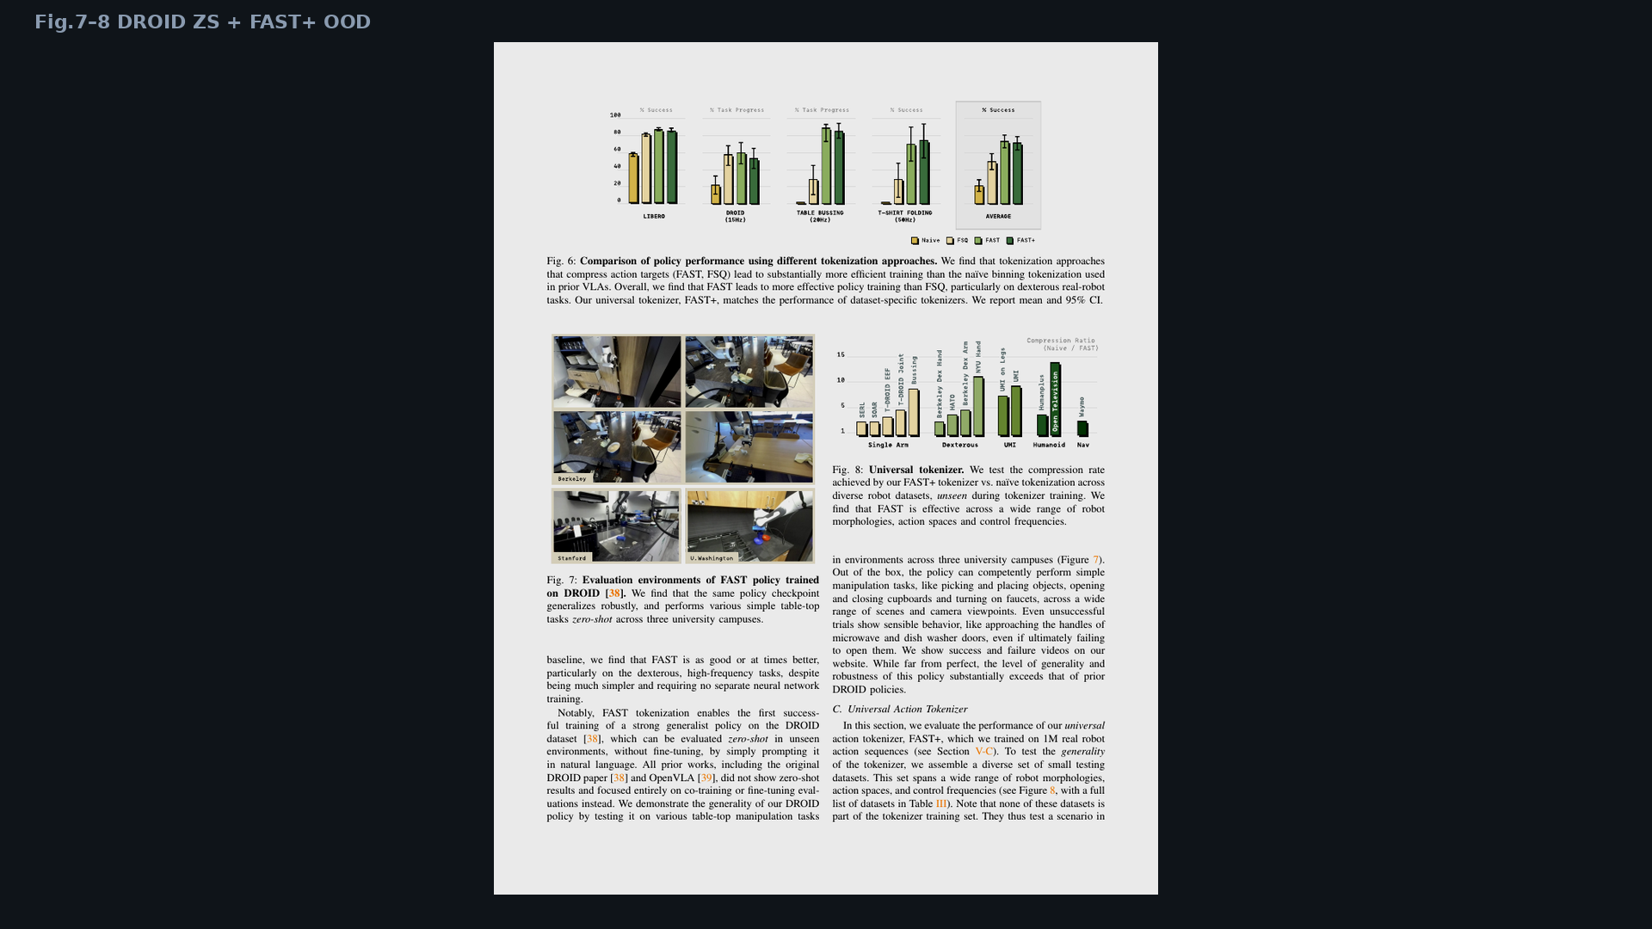
Archaeologist · 11+3 · 12/14
Notes:
Fig.7–8 — DROID ZS + FAST+ OOD morphologies in the data archaeology.

Slide 13
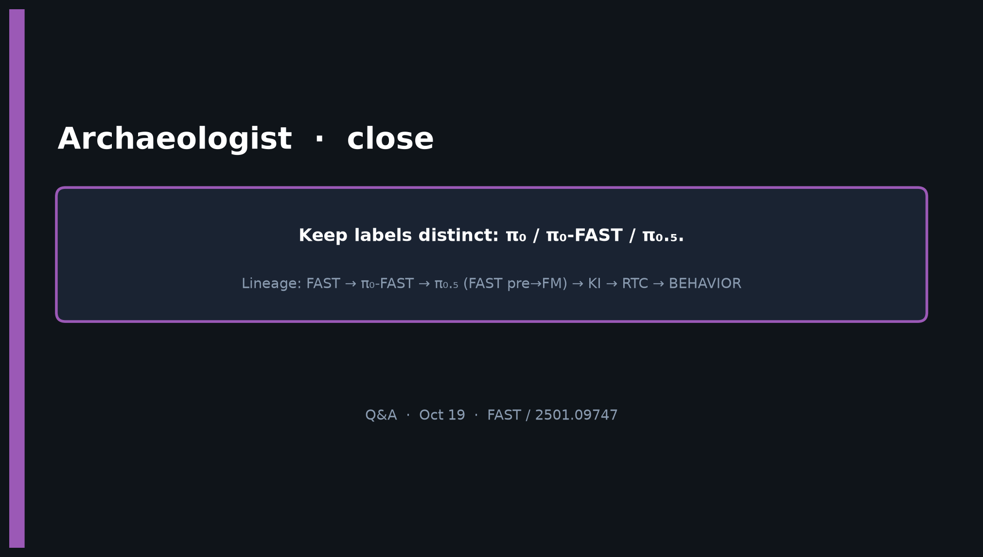
Archaeologist · 11+3 · 13/14
Notes:
CLOSE — Keep labels distinct. Lineage FAST→π₀-FAST→π₀.₅→KI→RTC→BEHAVIOR.

Slide 14
Archaeologist · 11+3 · 14/14
Notes:
BACKUP naming tree.

