Slide 1
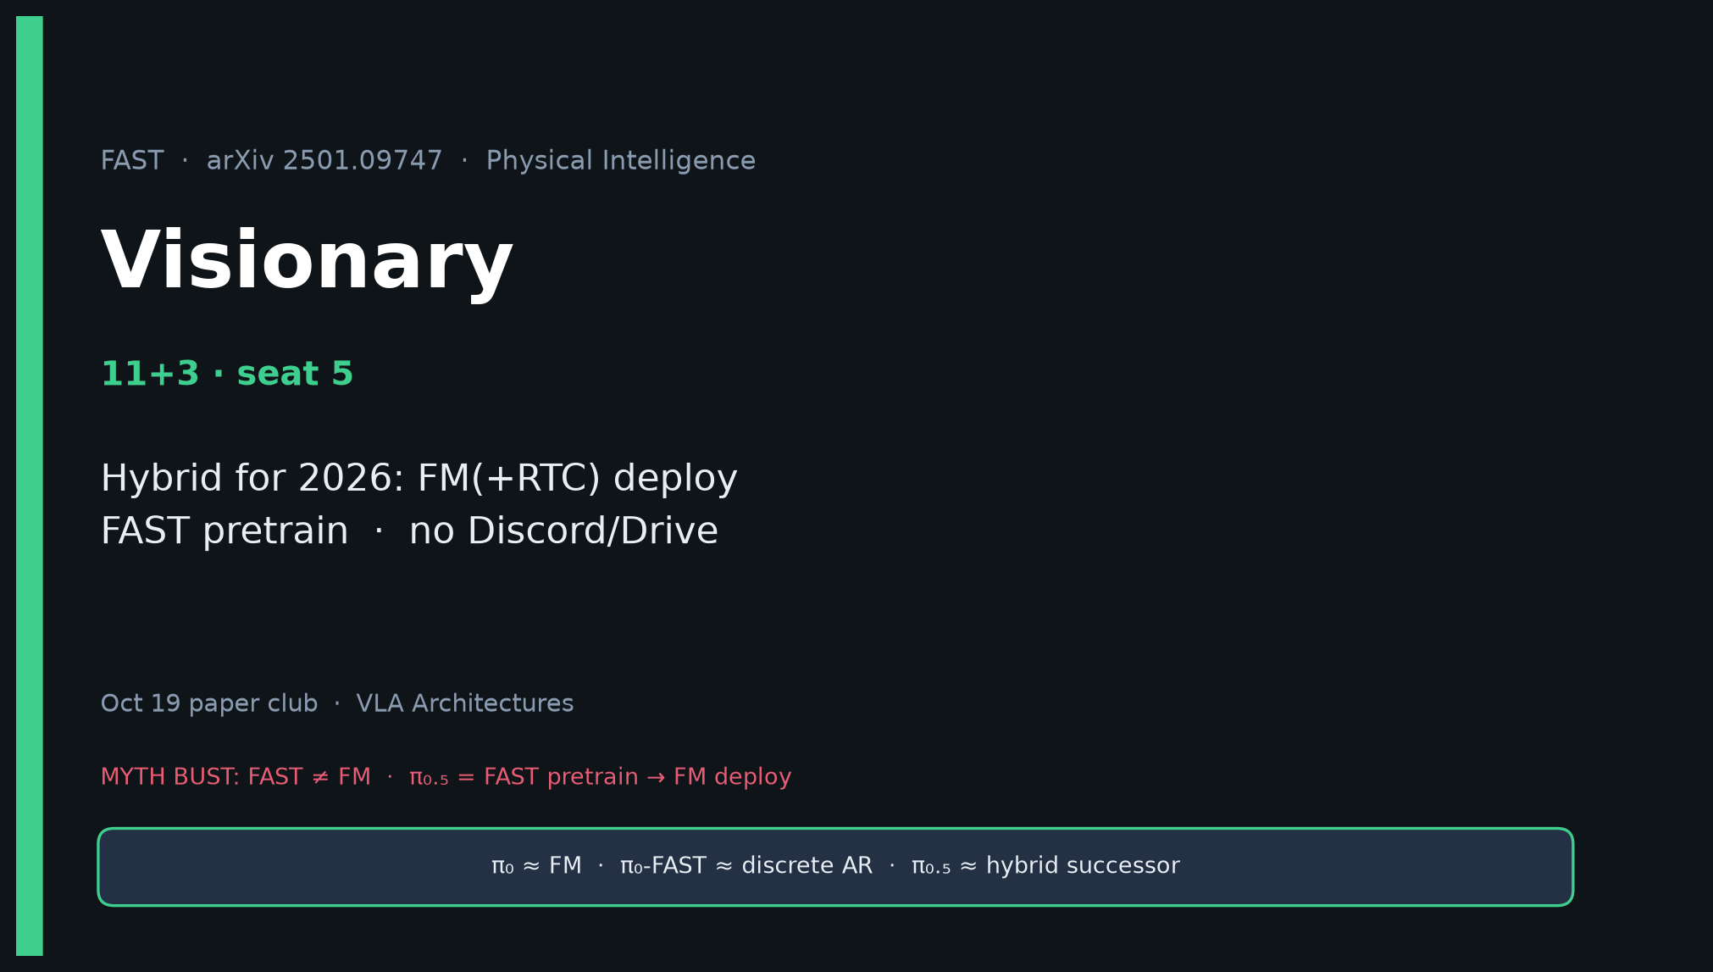
Visionary · 11+3 · 1/14
Notes:
VISIONARY — 11+3.
Hybrid for 2026: FM(+RTC) deploy; FAST for pretrain/aux.
Skip Discord/Drive entirely.
Open with myth bust so strategy never deletes FM.

Slide 2
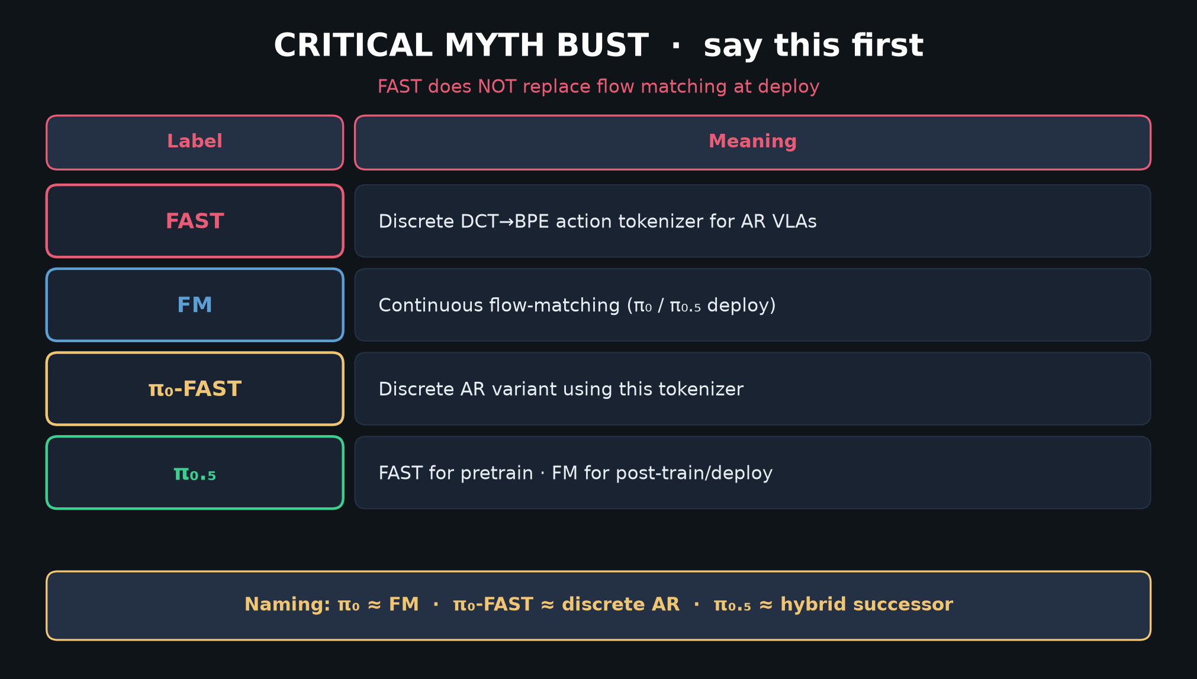
Visionary · 11+3 · 2/14
Notes:
MYTH BUST — strategy foundation. FAST does not replace FM.

Slide 3
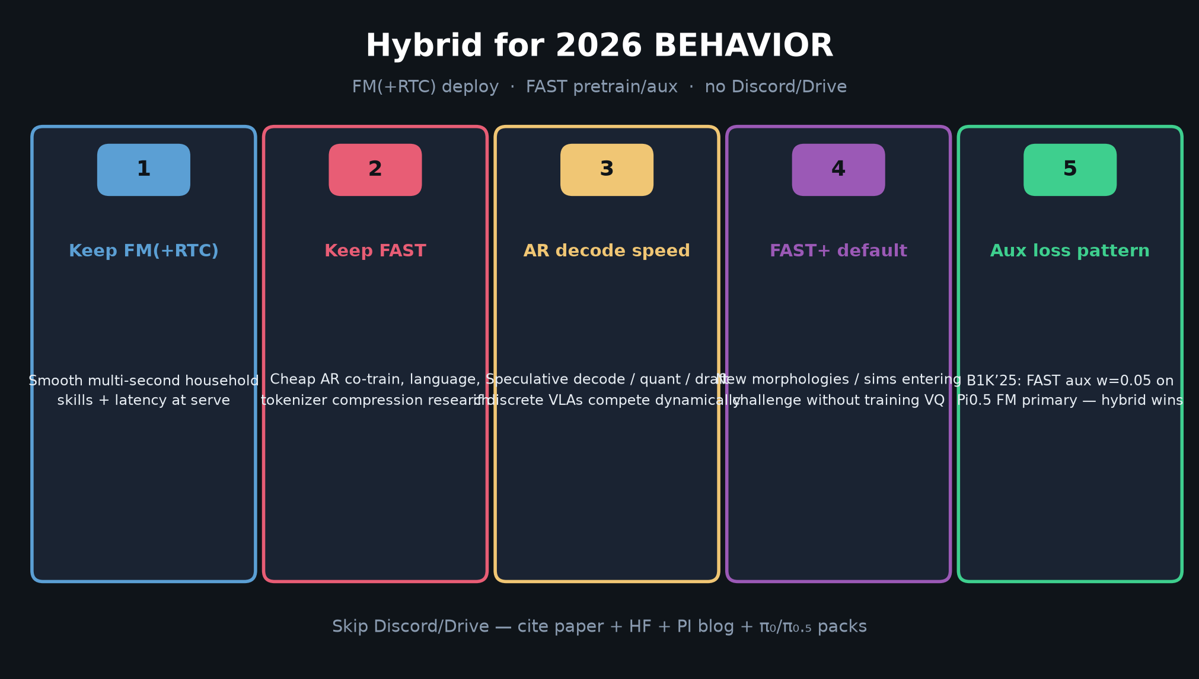
Visionary · 11+3 · 3/14
Notes:
2026 BETS 1–5 — Keep FM(+RTC); Keep FAST; AR decode speed; FAST+ default; aux loss pattern.
B1K’25 already used FAST aux 0.05 on Pi0.5 FM — validates hybrid.

Slide 4
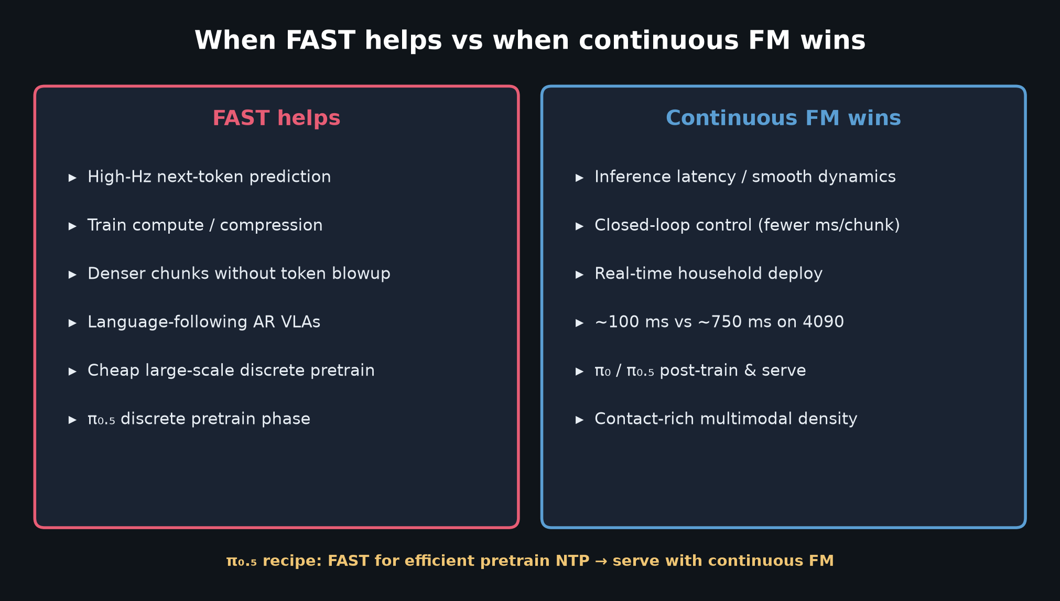
Visionary · 11+3 · 4/14
Notes:
WHEN HELPS — maps bets to regimes.

Slide 5
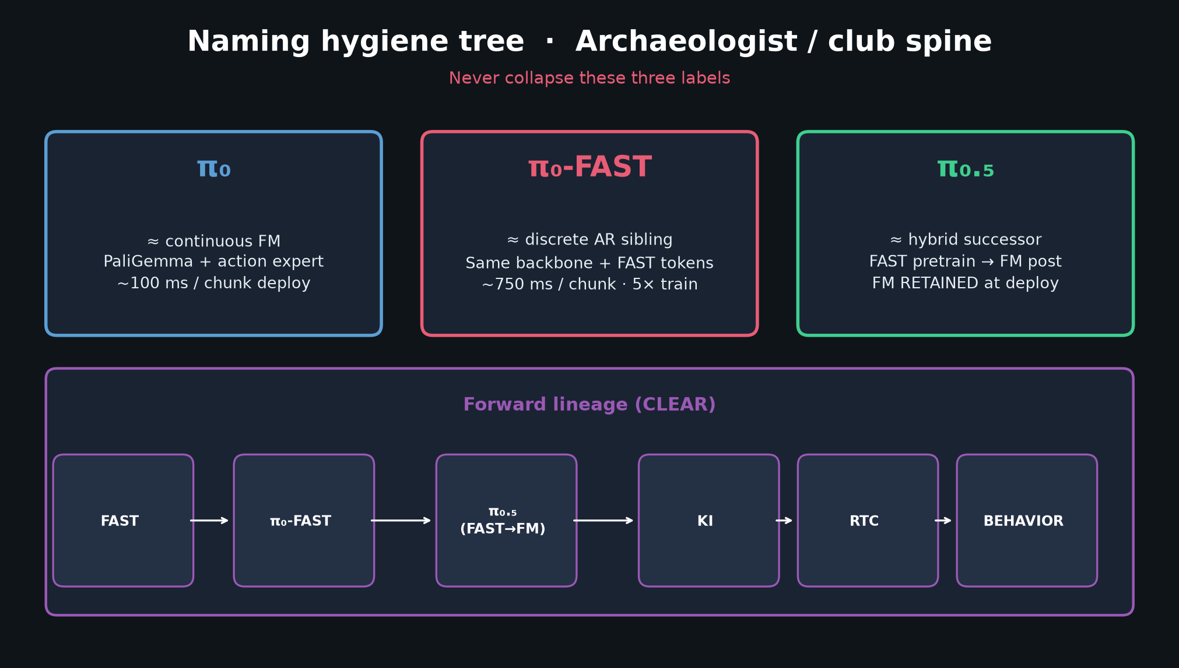
Visionary · 11+3 · 5/14
Notes:
NAMING / LINEAGE — so Oct proposals don’t mislabel stacks.

Slide 6
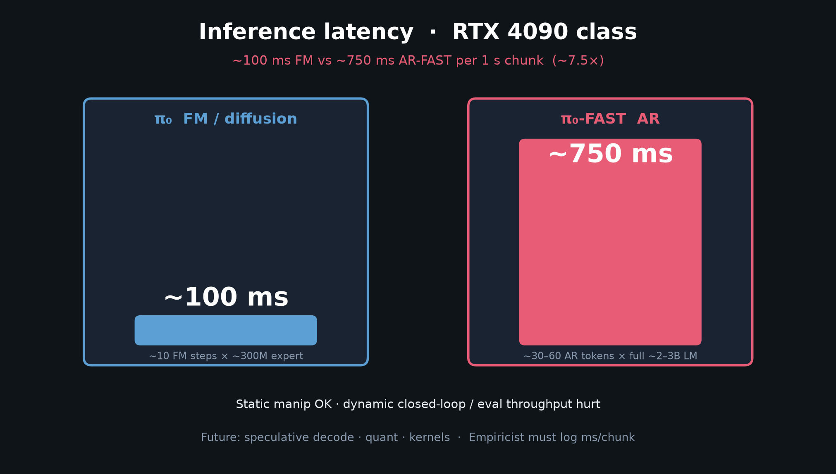
Visionary · 11+3 · 6/14
Notes:
LATENCY — why deploy stays FM(+RTC).

Slide 7
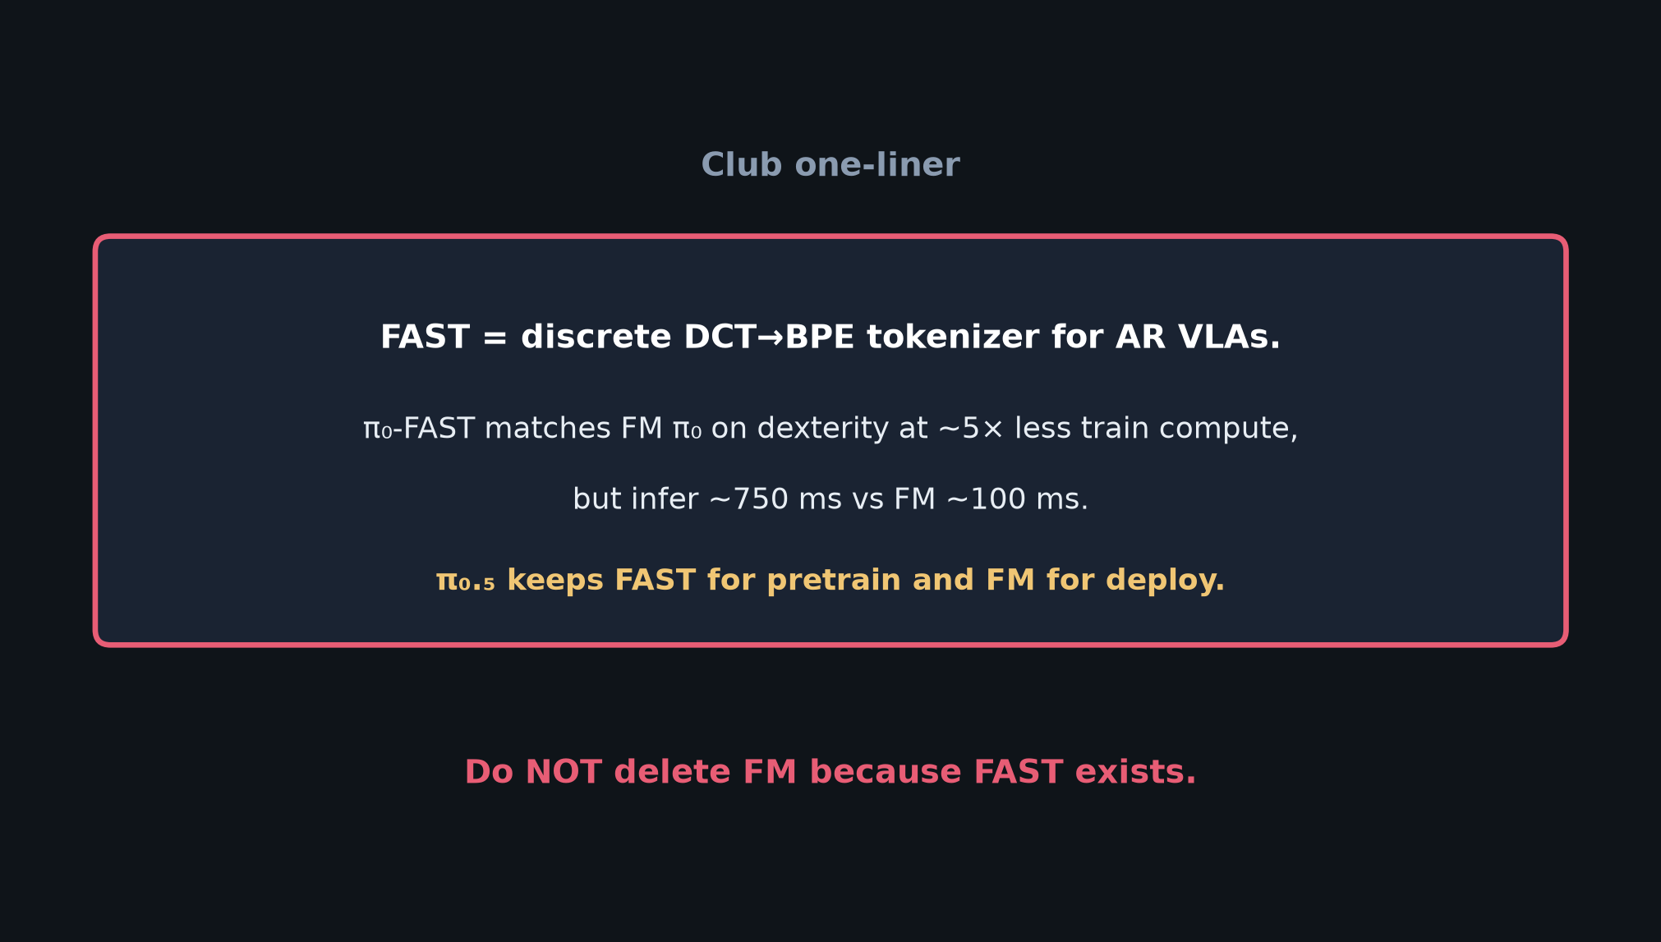
Visionary · 11+3 · 7/14
Notes:
ONE-LINER — strategy sentence.

Slide 8
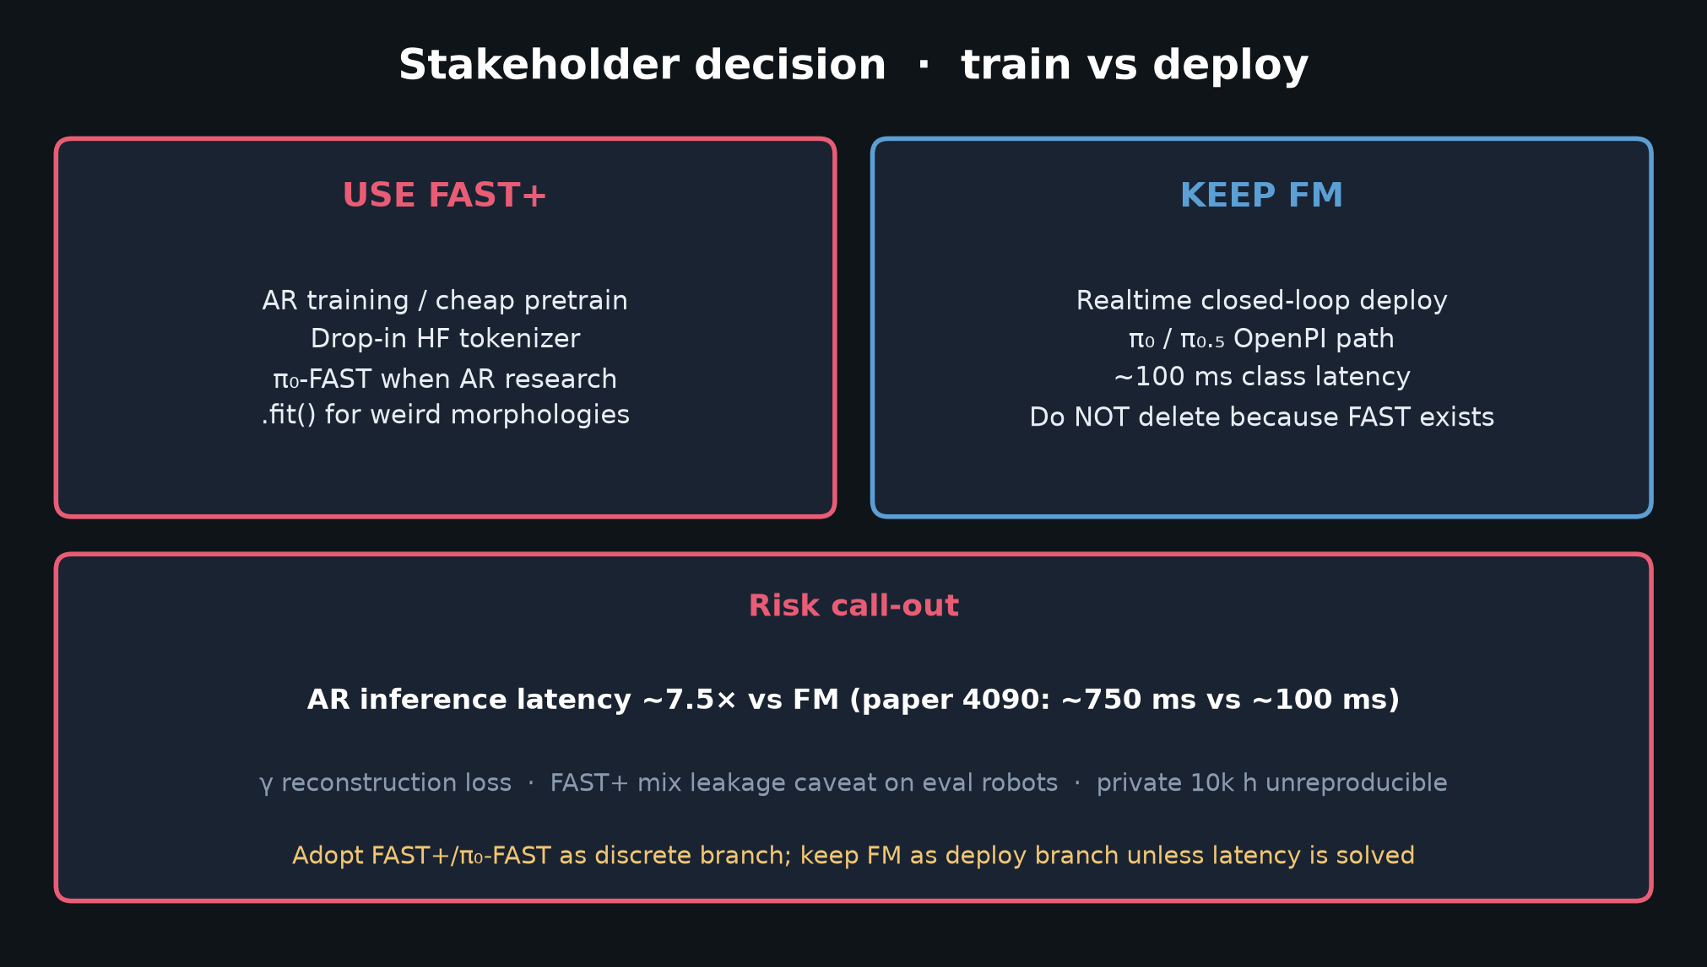
Visionary · 11+3 · 8/14
Notes:
STAKEHOLDER DECISION — align Visionary with durable buy/build.

Slide 9
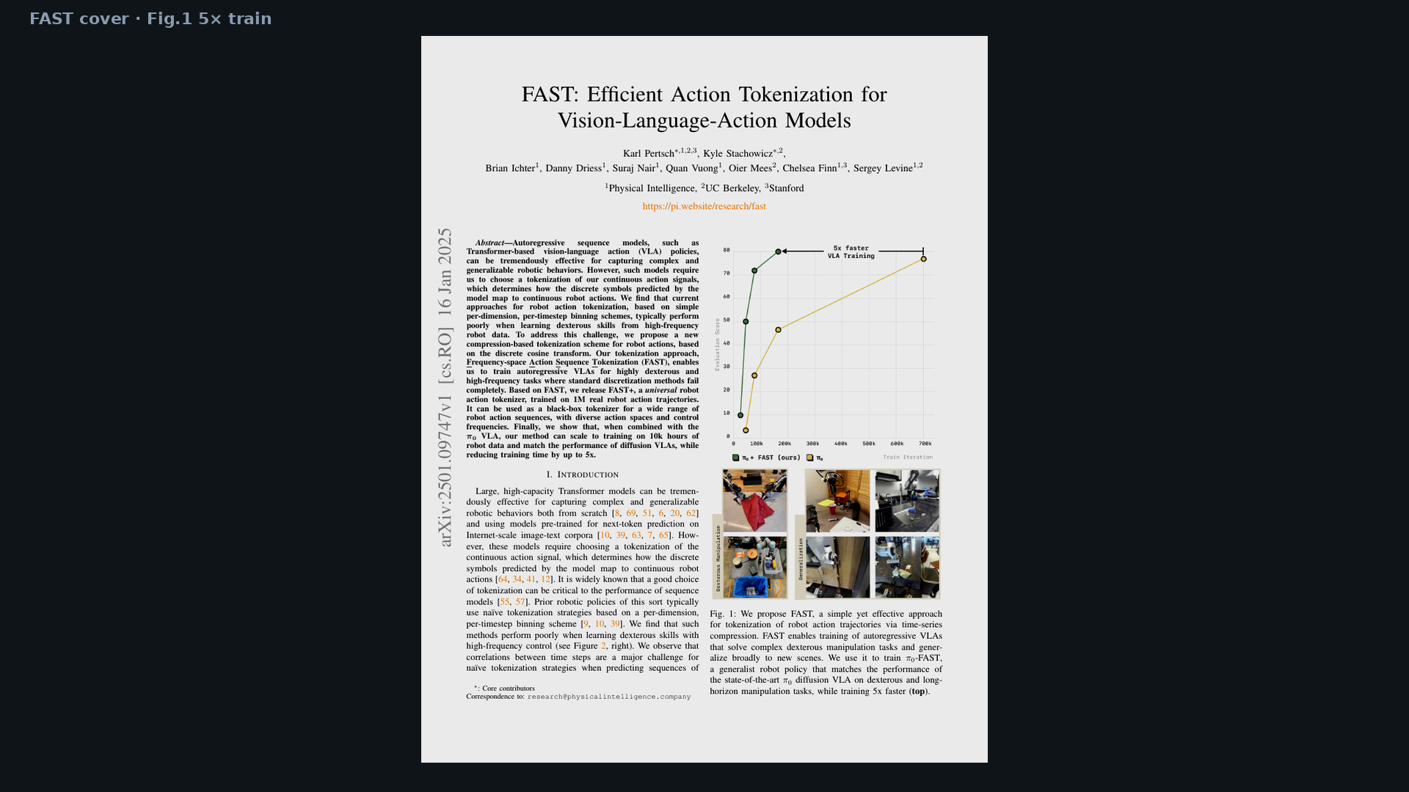
Visionary · 11+3 · 9/14
Notes:
Fig.1 — 5× train is why FAST stays in the pretrain story.

Slide 10
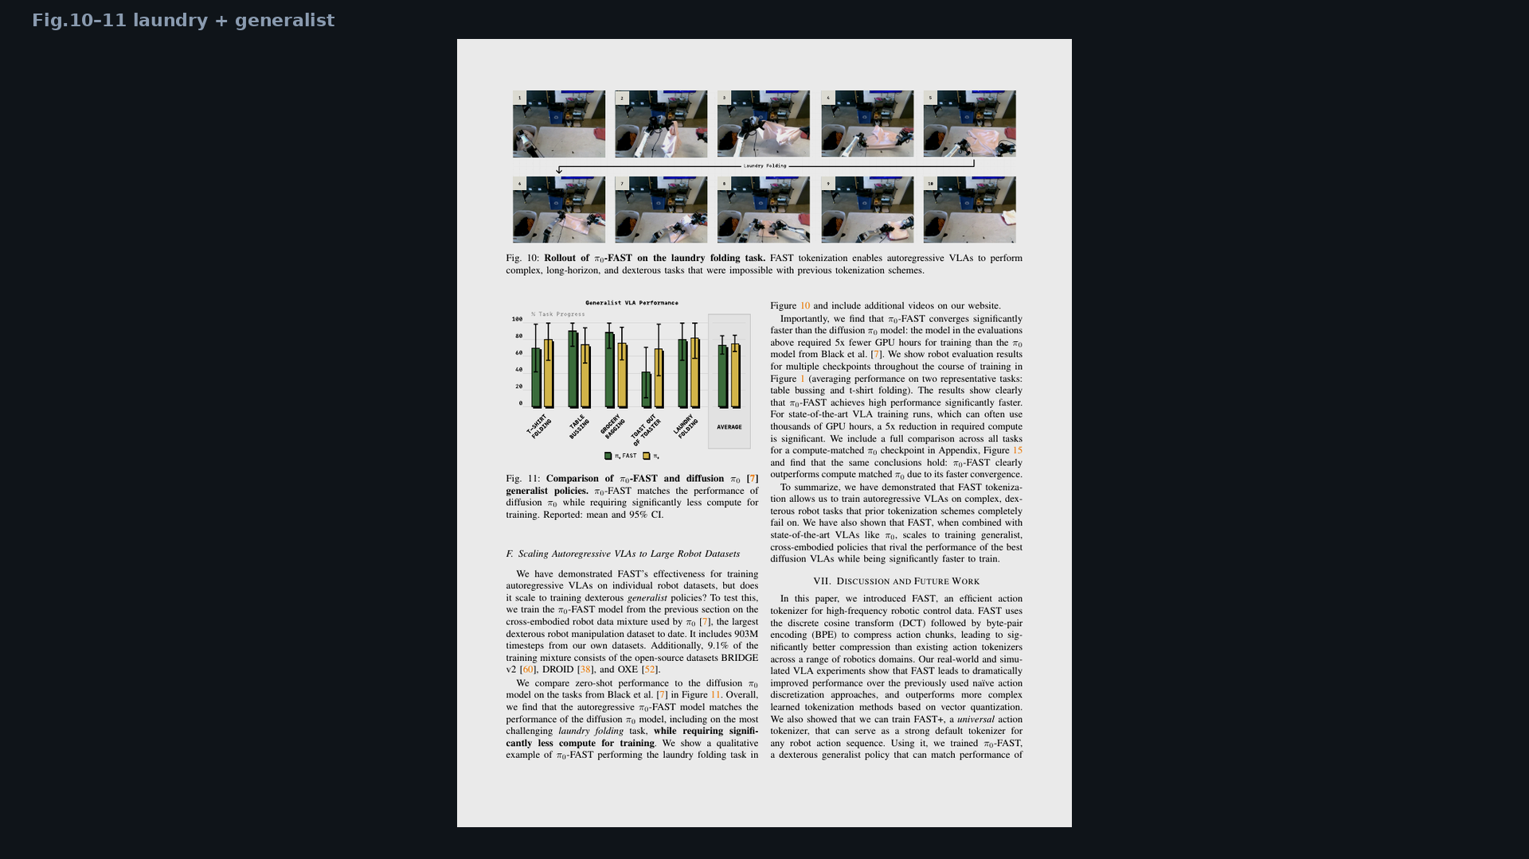
Visionary · 11+3 · 10/14
Notes:
Fig.10–11 — dexterity proof without claiming FM retirement.

Slide 11
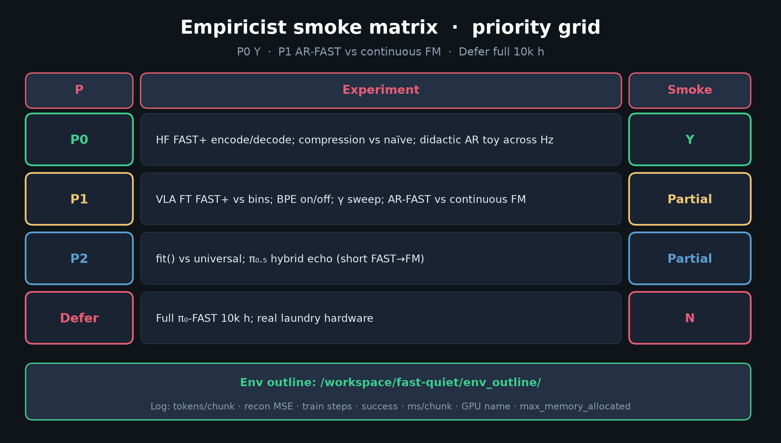
Visionary · 11+3 · 11/14
Notes:
EMPIRICIST SMOKE — what Visionary asks Empiricist to measure for ’26 transfer
(aux CE, γ/H schedules, honest ms/chunk).

Slide 12
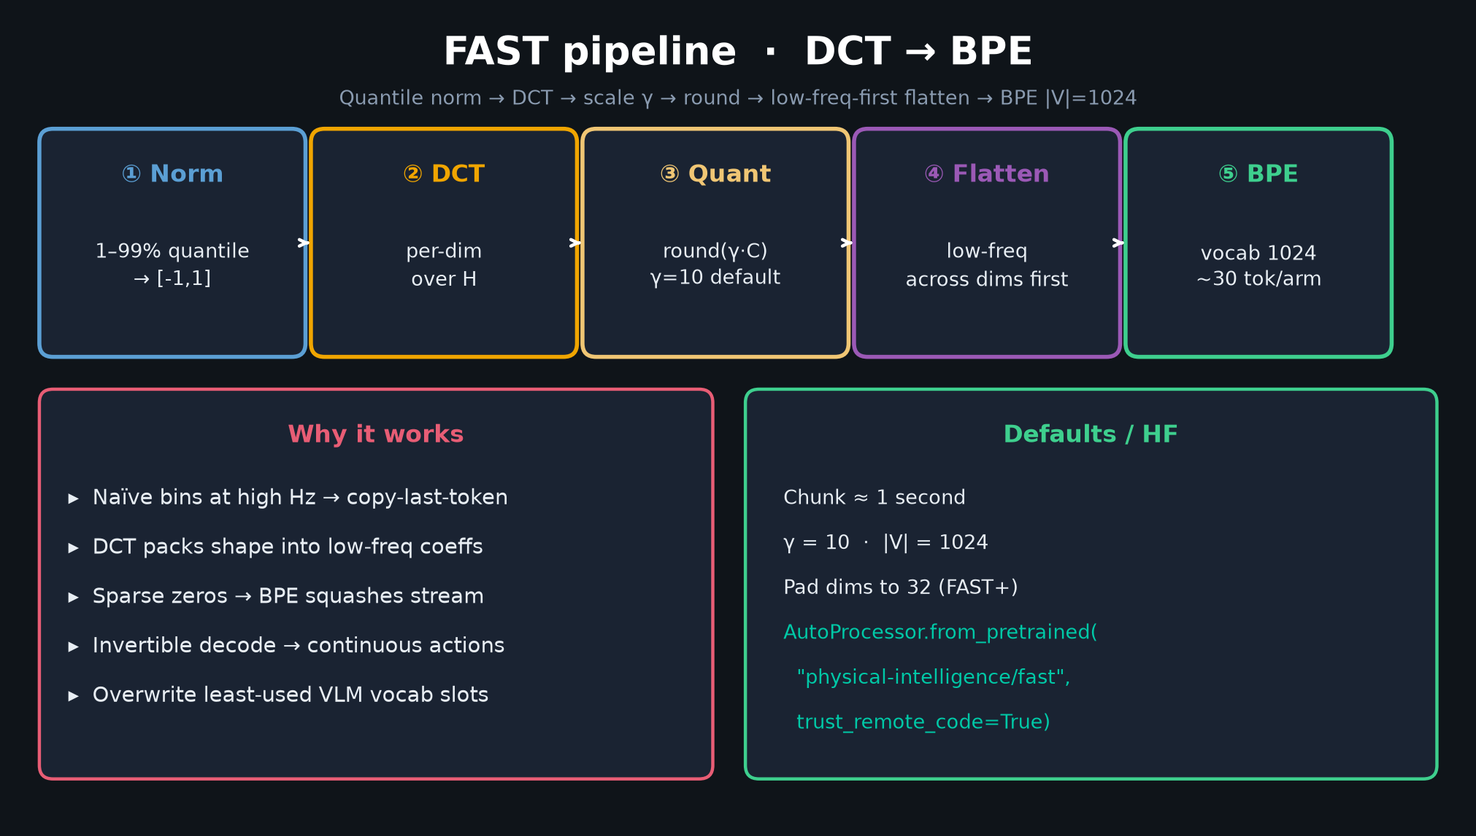
Visionary · 11+3 · 12/14
Notes:
PIPELINE — compression prior that Visionary links from pi05 / openpi-comet / behavior packs.

Slide 13
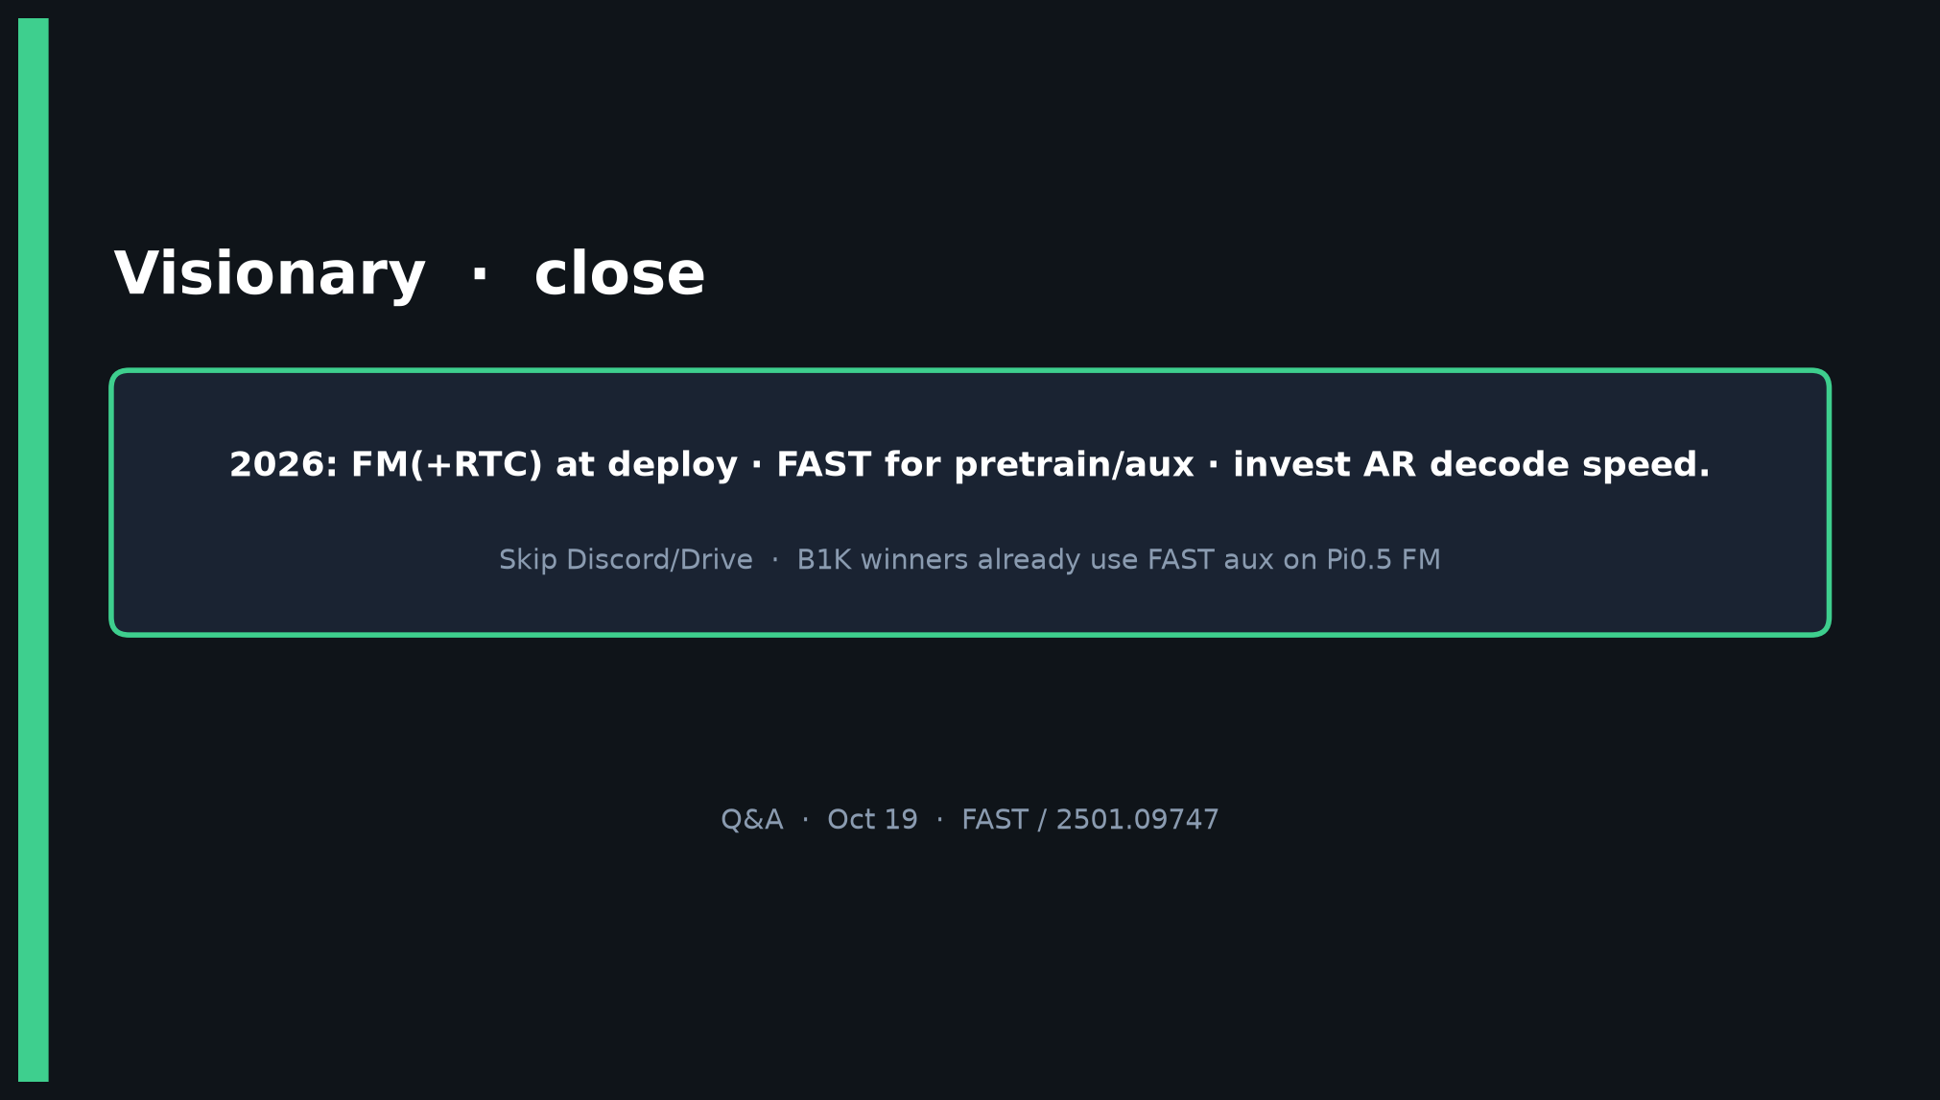
Visionary · 11+3 · 13/14
Notes:
CLOSE — FM(+RTC) deploy; FAST pretrain; invest AR decode if competing; skip Discord/Drive.

Slide 14
Visionary · 11+3 · 14/14
Notes:
BACKUP 2026 bets.

