Slide 1
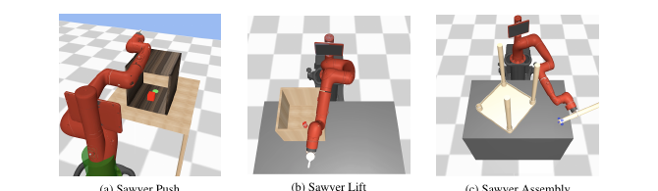
DEC 9 · ALTERNATIVE APPROACHES · STAKEHOLDER
Buy the pattern,
not the checkpoint.
MoPA-PD turns a privileged motion planner into a visual policy you can ship without it. Liu*, Uppal*, Sukhatme, Lim, Englert, Lee — CoRL 2021.
Push 100 / 32.0 / 110.8
Assembly 0 → 100
DR ≥ 96.7 sim-to-sim
Sim has geometry. Deploy is vision. Clutter is the hard part. That is the buy. The 2021 Sawyer 32×32 checkpoint is not.
MoPA-PD · arXiv 2111.06383 · CoRL 2021 · Alternative approaches · Dec 9
Stakeholder 1 / 13
Notes:
Stakeholder open.
• Paper: Distilling Motion Planner Augmented Policies into Visual Control Policies. MoPA-PD. arXiv 2111.06383. CoRL 2021. Code: clvrai.com/mopa-pd.
• Authors, equal first: I-Chun Arthur Liu* and Shagun Uppal*; Sukhatme, Lim, Englert, Lee. USC CLVR + RESL.
• Seat: Dec 9, Alternative approaches. All seats empty — equal depth. Not a foundation-model prehistory talk.
• One-liner: lock the privileged-MP → vision-student alternative before pure VLA weeks. Buy the pattern, not the 2021 Sawyer checkpoint.
• Chips are Table 1 and Table 2, not estimates. Fig. 2 is Push, Lift, Assembly in MuJoCo — not a household robot.

Slide 2
SHARED SPINE · TATTOO ON EVERY DECK
Five facts that do not change with the seat
01
Train privilege
Classical MP (RRT-Connect) lives inside MoPA-RL (Yamada et al., CoRL 2020). Geometry and the planner are train-time infrastructure, not the shipped controller.
02
Distill, then smooth
Visual BC on direct-action rollouts removes the planner and smooths RRT jitter. MoPA-PD then runs asymmetric SAC: actor from BC, critic from MoPA-RL Q, Re:Rπ = 1:3, small α.
03
Deploy is planner-free pixels
Inference is a 32×32 image plus joints. No RRT-Connect, no object state, no motion planner. The critic’s state privilege ends when training ends.
04
Numbers you must be able to say
Push 100 / 32.0 / 110.8 (ASR / AEL / ADR). Assembly 0 without BC-smooth vs 100 with. DR ≥ 96.7 sim-to-sim (Lift Scenario 1 is worst). Expert Push AEL 111 vs Ours 32.
05
What this paper is not
Not an ancestor of ACT, Diffusion Policy, π₀, OpenVLA, or OXE — contrast poles only. Not a JEPA / LeWM / Cosmos child. Sim-only Sawyer. Do not launder DR into sim-to-real.
MoPA-PD · arXiv 2111.06383 · CoRL 2021 · Alternative approaches · Dec 9
Stakeholder 2 / 13
Notes:
Shared spine — say this before the role-specific argument.
• Privileged classical MP (RRT-Connect) at train inside MoPA-RL (Yamada 2020) → visual BC (smooths jitter, drops the planner) → MoPA-PD asymmetric SAC → planner-free pixels at deploy.
• Must-cites: Push 100 / 32.0 / 110.8 (ASR/AEL/ADR). Assembly 0 without BC smoothing vs 100 with. DR ≥ 96.7 sim-to-sim; Lift Scenario 1 is the worst cell. Expert Push AEL 111 vs Ours 32.
• NOT an ancestor of ACT, Diffusion Policy, or VLAs (π₀ / OpenVLA / OXE). CLEAR contrast poles only. NOT a JEPA / LeWM / Cosmos child.
• Sim-only Sawyer MuJoCo, 32×32 images. Real robot is future work in the conclusion. Refuse to launder domain randomization into sim-to-real.
• Preserve paper numbers only. Do not invent BEHAVIOR success rates or a real-robot SR.
• Stakeholder use: these five lines are the buying brief. The rest is when to buy, when to walk, and which risks you will not paper over.

Slide 3
WHY THIS SEAT EXISTS
Classical robotics is still a training superpower
Obstructed exploration
Productization, not the product
Sparse contact around boxes and furniture is where pure visual SAC dies. Table 1: Asym. SAC and MoPA-Asym. SAC are 0. A planner that can see geometry is how the demos exist.
MoPA-RL already solves the tasks in state space. MoPA-PD’s job is to throw the planner and the mesh away at deploy, and to shorten the path while doing it.
Not a TAMP stack
The alternative to demo-only
A distillation recipe for obstructed visuomotor control. Not a hierarchical planner library and not a BEHAVIOR skill API. Teach the pattern; do not assign the repo as the platform.
When teleop and OXE-scale data are thin and sim geometry is honest, privileged exploration beats waiting for more human demos. That is the Alternative-approaches argument.
MoPA-PD · arXiv 2111.06383 · CoRL 2021 · Alternative approaches · Dec 9
Stakeholder 3 / 13
Notes:
Why schedule MoPA-PD under Alternative approaches.
• Clean story for “why not only VLA-from-demo?”: in heavily obstructed sim, privileged MP exploration makes the demos. Distillation is the productization step.
• HIGH motion-planning / obstruction hook without a full TAMP stack. Do not overclaim hierarchy.
• Asym. SAC is 0/0/0 (Assembly ADR 3.4 only). MoPA-Asym. SAC is 0/0/0. Putting the planner inside a visual loop is not enough.
• MoPA-RL state expert ASR is already 98.2 / 95.0 / 99.8. The extra claim is a visual policy with better path length.

Slide 4
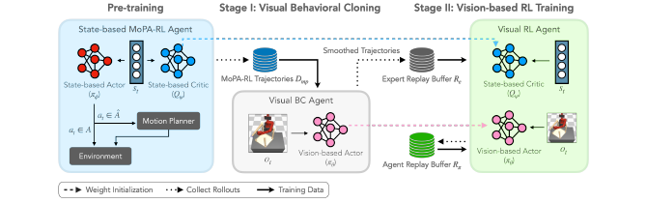
FIG. 1 · THE FACTORY
Spend privilege in sim. Ship pixels.
Stage 0
Stage 1
Stage 2
MoPA-RL SAC. Small Δq is direct. Large Δq calls RRT-Connect. Full state.
Visual BC, MSE, 32×32. Drops the planner. Smoothed rollouts become the expert buffer Re.
Asymmetric SAC. Actor from pixels. Critic from state. Init, low α, 1:3 mix.
MoPA-PD · arXiv 2111.06383 · CoRL 2021 · Alternative approaches · Dec 9
Stakeholder 4 / 13
Notes:
Walk Fig. 1 left to right. Do not skip Stage 0.
• Stage 0: enlarged action Ã. Direct band is small joint deltas. Larger deltas invoke RRT-Connect (Kuffner & LaValle) for collision-free paths. State SAC.
• Stage 1: rollouts stored in direct action space. Visual BC by MSE. Side effect the paper insists on: BC smooths jitter, because the planner optimizes avoidance, not smoothness.
• BC still has covariate shift (Ross et al.). Stage 2 is required.
• Stage 2: deployed actor is image + joints. Critic sees full state only in sim. Init: actor ← BC, critic ← MoPA-RL Q, legal because MoPA-RL’s action space supersets direct actions.
• SAC samples Re and the agent buffer at 1:3. α starts lower than MoPA-RL’s final α so the visual agent exploits the prior.
• Re is BC trajectories, not raw planner data. Jitter in the replay is why Assembly dies.

Slide 5
BUY / WALK
Buy when geometry, vision deploy, and clutter line up
BUY THE PATTERN
WALK TO ANOTHER POLE
Sim collision geometry is real
An RRT, TAMP, or MoPA-style teacher can run offline. If the mesh is a lie, Stage 0 dies.
Deploy must be vision
No planner latency and no object-state sensor on the robot. That is the product constraint.
Clutter is the bottleneck
Reach into a box, lift out, insert among obstacles. Pure visual RL does not explore this.
Abundant teleop or OXE-scale data
Prefer ACT, Diffusion Policy, or a VLA. MoPA-PD is a sim recipe, not a replacement head.
No reliable collision model
Nothing privileged to distill. Do not invent a planner to justify the pipeline.
Cross-embodiment generality
One Sawyer in MuJoCo. Use the idea. Do not ship the checkpoint.
MoPA-PD · arXiv 2111.06383 · CoRL 2021 · Alternative approaches · Dec 9
Stakeholder 5 / 13
Notes:
Buy / walk. The left column is the only honest purchase.
• Buy: accurate sim geometry, vision-only deploy, clutter as the hard part. Pattern = MP or TAMP teacher → BC smooth → vision RL or IL.
• Walk: abundant teleop or OXE-scale language tasks → ACT / Diffusion Policy / VLA. Complementary, not a successor, not an ancestor.
• Walk: no collision geometry. Stage 0 cannot run.
• No cited chain into π₀ or OpenVLA. Do not brief one.

Slide 6
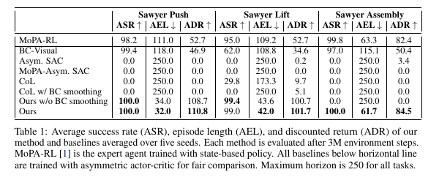
TABLE 1 · THE EFFICIENCY BUY
Same success. Much shorter paths than the expert.
PUSH AEL
111 → 32.0
Expert MoPA-RL vs MoPA-PD. Push ADR moves 52.7 → 110.8. The policy is not cloning the planner. It is shorter.
ASR is the wrong headline on Push and Assembly: BC-Visual is already 99.4 and 97.0. The buy is AEL / ADR, plus Lift (BC 62 → 99).
MoPA-PD · arXiv 2111.06383 · CoRL 2021 · Alternative approaches · Dec 9
Stakeholder 6 / 13
Notes:
Do not sell raw success on Push.
• Ours: Push 100.0/32.0/110.8. Lift 99.0/42.0/101.7. Assembly 100.0/61.7/84.5.
• MoPA-RL Push 98.2/111.0/52.7. About 3.5× longer. ADR 52.7 vs 110.8.
• BC-Visual: 99.4/118.0/46.9 · 62.0/108.8/34.6 · 97.0/115.1/50.4.
• Horizon 250 is why failures show AEL 250. Eval: 5 seeds × 100 episodes after 3M steps (teacher 1M + distill 2M). γ=0.99. Success < 0.05. Bonus +150.
• You are buying a shorter visual policy, not a higher scoreboard on an already-solved push.

Slide 7
RISKS YOU WILL OWN IF YOU BUY IT
Four costs the abstract does not waive
Sim-only. Tax unpaid.
32×32, one arm
The conclusion names real-world fine-tune and a vision critic as future work. Table 2 is sim-to-sim. Do not brief this as a robot result.
Sawyer 7-DoF, MuJoCo, three tasks, tiny RGB. Not wrist cameras, not multi-embodiment, not a household camera stack.
Stage 0 is engineering
The critic is still privileged
You need a working MoPA-RL or another MP teacher, plus collision checks. Frozen demos are the practical path. The planner is not free.
Asymmetric actor-critic (Pinto et al.) sees full state while learning. “Vision-only” is an inference claim, not a training claim.
MoPA-PD · arXiv 2111.06383 · CoRL 2021 · Alternative approaches · Dec 9
Stakeholder 7 / 13
Notes:
Read all four risks. Do not soften the first.
• §5: fine-tuning in the real world with a vision critic, or sim-to-real techniques, is “definite future work.”
• DR randomizes texture, color, lighting. Test scenes add distractors, walls, furniture, table size. Still MuJoCo. Still Sawyer.
• Visual actor: 3-layer CNN, 3× FC-256, LeakyReLU, 32×32. Transfer the recipe, not the representation.
• Do not propose “just run SAC on the robot.” The critic story does not survive that sentence.
• Pitch: clutter-exploration prior. Not a competitor to π₀-scale generalists.

Slide 8
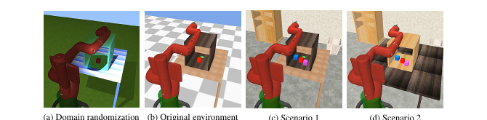
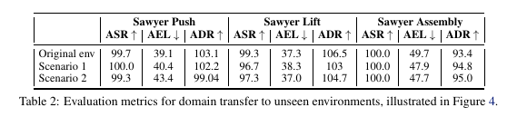
FIG. 4 + TABLE 2
Robust in sim. Not a sim-to-real receipt.
DO NOT LAUNDER
Worst cell is Lift, Scenario 1: ASR 96.7. The paper’s claim is >96% on three unseen sim scenarios. Appearance shift is not a real robot.
MoPA-PD · arXiv 2111.06383 · CoRL 2021 · Alternative approaches · Dec 9
Stakeholder 8 / 13
Notes:
The picture is the whole argument: textures and distractors inside MuJoCo.
• Table 2 ASR Push/Lift/Assembly. Original 99.7/99.3/100.0. Scenario 1: 100.0/96.7/100.0. Scenario 2: 99.3/97.3/100.0.
• Push Scenario 2 ADR is printed 99.04. Quote that precision if you read the cell.
• No non-DR control column. Do not invent a “without DR” delta.
• Sentence: we bought appearance robustness in simulation. We did not buy sim-to-real.

Slide 9
CONTRAST POLES · NOT A FAMILY TREE
Where modern stacks win, say so
ACT / ALOHA
Diffusion Policy
Chunked CVAE cloning from human teleop. Different data, different action interface. Use it when demonstrations are what you actually have.
Generative action chunks from demos. Not a privileged-planner distill. Table 1 does not beat it — that baseline did not exist here.
π₀ / OpenVLA / OXE
DART, separately
Large multi-task vision-language-action. MoPA-PD is single-task sim distillation. No cited ancestry. Do not brief one.
DART labels recoveries by disturbing the expert. MoPA-PD amortizes a planner. Shared covariate-shift vocabulary. Not the same product.
MoPA-PD · arXiv 2111.06383 · CoRL 2021 · Alternative approaches · Dec 9
Stakeholder 9 / 13
Notes:
Contrast only. Do not invent descent.
• ACT and Diffusion Policy: human/teleop demos. MoPA-PD demos come from a privileged MP-RL teacher.
• π₀, OpenVLA, Open X-Embodiment: no cited chain. “Ancestor” is a false claim.
• LeWM / JEPA / Cosmos are world-model poles. Mention only to refuse the filing. Do not build the talk on them.
• RoboGen keeps MP primitives in the loop. MoPA-PD’s deploy story is the opposite: the planner leaves. Parallel, not a child.
• Ross, Gordon, Bagnell 2011 is the shared covariate-shift citation with the DAgger family. Methods differ.

Slide 10
WHAT THE PURCHASE ORDER SAYS
Pattern in. Checkpoint out.
In
Out
An MP or TAMP teacher when sim geometry is trustworthy. BC smoothing before any RL buffer. A vision actor at deploy. Path length, not just success.
2021 32×32 weights. Online RRT on the robot. A claim that DR solved reality. Any sentence that starts “this is why VLAs work.”
Budget shape
Decision
Paper protocol: 3M steps × 5 seeds × 3 tasks, after a 1M-step teacher. The only printed times are BC (Table 8): 30 / 39 / 120 min. Full RL GPU time is unstated.
Fund the pattern on the next cluttered sim task that already has a mesh. Do not fund a Sawyer reproduction as a product milestone.
MoPA-PD · arXiv 2111.06383 · CoRL 2021 · Alternative approaches · Dec 9
Stakeholder 10 / 13
Notes:
Close the buy.
• Product line: a sim distillation factory. Spend privileged MP + state to mint visual policies that no longer carry planner latency or state sensors.
• Table 8: Push 12 epochs / 30 min; Lift 13 / 39; Assembly 24 / 120. Selection is first epoch at 100% validation success, not lowest test MSE (Fig. 9).
• Do not quote a GPU-hour number for the full paper. It is not in the PDF.
• “Does this replace our VLA?” No. “Can a planner in sim teach a vision policy for clutter?” Inside MuJoCo, this paper’s yes.

Slide 11
FIG. 2 · THE ONLY PRODUCT SURFACE
Three obstructed Sawyer tasks. Nothing else was scored.
Push
Lift
Assembly
Reach into a box. Push the red cube onto the green goal. ASR is easy for BC. Path length is not.
Reach, grasp, lift a can out without collisions. BC-Visual ASR falls to 62. Stage 2 earns its place.
Insert the fourth table leg among the other three. IKEA furniture env. Dies without BC smoothing.
MoPA-PD · arXiv 2111.06383 · CoRL 2021 · Alternative approaches · Dec 9
Stakeholder 11 / 13
Notes:
Fig. 2, Yamada et al. tasks, re-used. MuJoCo, Sawyer 7-DoF, 32×32, horizon 250.
• Do not generalize the picture into a kitchen. It is a box, a can, and a table.
• Assembly is Lee, Hu, Lim, ICRA 2021 furniture assembly — one insert, not a BEHAVIOR activity.
• Stakeholder use: name which task matches the buyer’s clutter. If none do, you are selling an analogy, and you should say so.

Slide 12
LANGUAGE FOR THE BRIEFING
Sentences that survive contact with the PDF
Say
Say
Say
“Train-time RRT-Connect inside MoPA-RL, distilled to a visual policy.”
“Push episodes went from 111 steps to 32, at full success.”
“Domain randomization held up in unseen sim scenes, worst cell 96.7.”
Don’t say
Don’t say
Don’t say
“We have a sim-to-real manipulation system.”
“This is an early VLA / ACT / diffusion policy.”
“It works on BEHAVIOR.” Nothing in the paper ran that benchmark.
MoPA-PD · arXiv 2111.06383 · CoRL 2021 · Alternative approaches · Dec 9
Stakeholder 12 / 13
Notes:
Briefing language. Read the don’t column last so it sticks.
• The three say-lines are Table 1 and Table 2, scoped.
• If a stakeholder asks for a robot video, the honest answer is: the authors list real fine-tuning as future work. The project page is clvrai.com/mopa-pd; do not promise it contains a real-robot result you have not watched.

Slide 13
STAKEHOLDER CLOSE
Say this, then stop
ONE-LINER
Lock the privileged-planner → vision-student alternative before the pure VLA weeks. Buy the pattern. Do not buy the 2021 Sawyer checkpoint.
Remember
Refuse
Push 100 / 32.0 / 110.8. Assembly dies at 0 without BC smoothing.
Sim-to-sim DR is not sim-to-real. No invented robot success rate.
MoPA-PD · arXiv 2111.06383 · CoRL 2021 · Alternative approaches · Dec 9
Stakeholder 13 / 13
Notes:
Stop on the one-liner. Do not add a roadmap.
• Follow-up experiments belong to the Empiricist seat: a smoke is not Table 1.
• “Is this how π₀ was trained?” No.
• Project page, from the abstract: https://clvrai.com/mopa-pd

