Slide 1
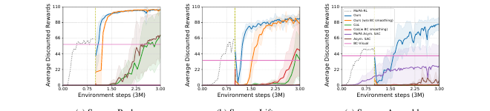
DEC 9 · ALTERNATIVE APPROACHES · SCIENTIFIC REVIEWER
Crisp mechanism.
Not foundation-model prehistory.
Grade MoPA-PD as an Alternative-approaches classic: privileged teacher, causal ablations, sim-to-sim DR. Do not upgrade the claim.
MoPA-PD · arXiv 2111.06383 · CoRL 2021 · Alternative approaches · Dec 9
Scientific Reviewer 1 / 13
Notes:
Reviewer open. Fig. 3: discounted return over 3M steps. Ours rises fastest. Assembly without BC smoothing does not.
• Claims: (1) distill removes MP and state at deploy; (2) BC smoothing is necessary, especially Assembly; (3) init + expert buffer + small α vs Asym. SAC / CoL / MoPA-Asym. SAC; (4) DR zero-shot >96% ASR; (5) visual policy can beat expert path quality.
• Verdict preview: accept the mechanism. Do not accept “solved real clutter” or “ancestor of modern VLAs.”

Slide 2
SHARED SPINE · TATTOO ON EVERY DECK
Five facts that do not change with the seat
01
Train privilege
Classical MP (RRT-Connect) lives inside MoPA-RL (Yamada et al., CoRL 2020). Geometry and the planner are train-time infrastructure, not the shipped controller.
02
Distill, then smooth
Visual BC on direct-action rollouts removes the planner and smooths RRT jitter. MoPA-PD then runs asymmetric SAC: actor from BC, critic from MoPA-RL Q, Re:Rπ = 1:3, small α.
03
Deploy is planner-free pixels
Inference is a 32×32 image plus joints. No RRT-Connect, no object state, no motion planner. The critic’s state privilege ends when training ends.
04
Numbers you must be able to say
Push 100 / 32.0 / 110.8 (ASR / AEL / ADR). Assembly 0 without BC-smooth vs 100 with. DR ≥ 96.7 sim-to-sim (Lift Scenario 1 is worst). Expert Push AEL 111 vs Ours 32.
05
What this paper is not
Not an ancestor of ACT, Diffusion Policy, π₀, OpenVLA, or OXE — contrast poles only. Not a JEPA / LeWM / Cosmos child. Sim-only Sawyer. Do not launder DR into sim-to-real.
MoPA-PD · arXiv 2111.06383 · CoRL 2021 · Alternative approaches · Dec 9
Scientific Reviewer 2 / 13
Notes:
Shared spine — say this before the role-specific argument.
• Privileged classical MP (RRT-Connect) at train inside MoPA-RL (Yamada 2020) → visual BC (smooths jitter, drops the planner) → MoPA-PD asymmetric SAC → planner-free pixels at deploy.
• Must-cites: Push 100 / 32.0 / 110.8 (ASR/AEL/ADR). Assembly 0 without BC smoothing vs 100 with. DR ≥ 96.7 sim-to-sim; Lift Scenario 1 is the worst cell. Expert Push AEL 111 vs Ours 32.
• NOT an ancestor of ACT, Diffusion Policy, or VLAs (π₀ / OpenVLA / OXE). CLEAR contrast poles only. NOT a JEPA / LeWM / Cosmos child.
• Sim-only Sawyer MuJoCo, 32×32 images. Real robot is future work in the conclusion. Refuse to launder domain randomization into sim-to-real.
• Preserve paper numbers only. Do not invent BEHAVIOR success rates or a real-robot SR.
• Reviewer use: hold every later claim against the numbers and the non-claims. If a sentence needs a number the PDF does not contain, cut it.

Slide 3
CLAIMS, AS THE PAPER STATES THEM
Five claims. Only some are equally hard.
1
Deploy without the planner
Distilling MP-augmented state RL via BC and guided vision RL removes the planner and full state at inference.
2
Smoothing is load-bearing
Expert buffer Re holds BC trajectories, not raw MoPA-RL jitter. Assembly is the test.
3
The efficiency stack
Weight init, expert buffer at 1:3, and a small entropy α — versus Asym. SAC, MoPA-Asym. SAC, and CoL.
4
DR transfers in sim
Texture, color, and lighting in training. Zero-shot distractors and appearance. Above 96% ASR.
5
Better paths than the teacher
Lower AEL and higher ADR than state MoPA-RL. Not merely a clone of the expert.
MoPA-PD · arXiv 2111.06383 · CoRL 2021 · Alternative approaches · Dec 9
Scientific Reviewer 3 / 13
Notes:
Map the five claims onto the evidence slides.
• Claim 1 → Table 1: MoPA-Asym. SAC is 0 while Ours is planner-off and near 100. Actor inputs are image + joints.
• Claim 2 → “Ours w/o BC smoothing” and Fig. 8.
• Claim 3 → Fig. 3, Fig. 7, Figs. 5–6. CoL is Goecks et al. 2020, not a 2024 IL method.
• Claim 4 → Table 2 only. Scope it as sim-to-sim.
• Claim 5 → AEL/ADR. Push 111 vs 32 is the cleanest single comparison.

Slide 4
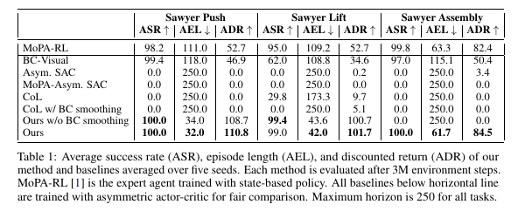
TABLE 1 IS THE DECISIVE EXHIBIT
Vision-from-scratch and “MP inside vision” both zero out
Read rows, not only the bold last line. MoPA-Asym. SAC keeps the planner and still scores 0. BC-Visual keeps ASR on Push and Assembly and loses the path. Without smoothing, Assembly is 0.
MoPA-PD · arXiv 2111.06383 · CoRL 2021 · Alternative approaches · Dec 9
Scientific Reviewer 4 / 13
Notes:
Spend time here. This table is the paper.
• MoPA-RL: 98.2/111.0/52.7 · 95.0/109.2/52.7 · 99.8/63.3/82.4.
• BC-Visual: 99.4/118.0/46.9 · 62.0/108.8/34.6 · 97.0/115.1/50.4.
• Asym. SAC: 0/250/0 · 0/250/0.2 · 0/250/3.4. MoPA-Asym. SAC: 0/250/0 on all three.
• CoL: 0/250/0 · 29.8/173.3/9.7 · 0/250/0. CoL with BC smoothing: 0/250/0 · 0/250/5.1 · 0/250/0.
• Ours w/o smoothing: 100/34.0/108.7 · 99.4/43.6/100.7 · 0/250/0.
• Ours: 100/32.0/110.8 · 99.0/42.0/101.7 · 100/61.7/84.5.
• All baselines under the rule use an asymmetric critic. Zeros are stark. They are not a win over 2024–26 imitation learning. CoL hyperparameters may be disadvantaged; say so, then still read the zeros.

Slide 5
WHAT HOLDS
Sample efficiency is visible, and it is not just ASR
Fig. 3
Discounted return, 0–3M. Ours on top. The handoff off the state teacher is the vertical mark.
Path quality
Push AEL 32.0 vs expert 111.0 and vs BC 118.0. ADR 110.8 vs 52.7 vs 46.9.
Lift needs Stage 2
BC-Visual ASR 62.0. Ours 99.0. Cloning is not enough when coverage is thin.
Related work
Neural motion planners that stay state-based are distinguished, not quietly absorbed. That honesty holds.
MoPA-PD · arXiv 2111.06383 · CoRL 2021 · Alternative approaches · Dec 9
Scientific Reviewer 5 / 13
Notes:
What a reviewer should concede.
• Fig. 3: MoPA-RL for 1M, then visual methods for 2M, total 3M. Ours has the highest average discounted return.
• ADR uses γ=0.99, so shorter success scores higher. AEL and ADR are coupled. Report both.
• “Outperforms SOTA” is this suite and these baselines. Not ACT. Not Diffusion Policy.
• Distinction vs Qureshi, MPNet, Strudel, Jurgenson & Tamar: they distill planners into networks. MoPA-PD distills a planner-using policy into vision. Keep that.

Slide 6
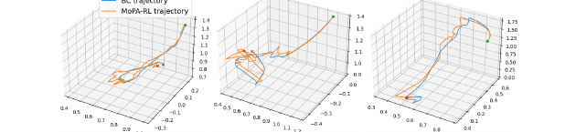
THE CAUSAL KNIFE · BC SMOOTHING
Assembly is 0 without it and 100 with it
WITHOUT BC SMOOTH
WITH BC SMOOTH
0
100
Assembly ASR
Assembly ASR
Fig. 8 — same start (green) and goal (red). Orange MoPA-RL paths jitter. Blue BC paths do not. Push and Lift still learn from raw replay, slower. Assembly does not.
Push still works
Why jitter hurts
100 / 34.0 / 108.7 without smoothing vs 100 / 32.0 / 110.8 with. The knife is not Push.
RRT prioritizes collision avoidance over smoothness. Raw paths in Re make RL difficult and, on Assembly, impossible.
MoPA-PD · arXiv 2111.06383 · CoRL 2021 · Alternative approaches · Dec 9
Scientific Reviewer 6 / 13
Notes:
Cleanest ablation. Do not bury it.
• Single factor: Re is BC-smoothed vs raw MoPA-RL.
• Without smoothing: Push 100/34.0/108.7; Lift 99.4/43.6/100.7; Assembly 0/250/0.
• §4.4: higher variance, slower on two tasks, fails entirely on Assembly.
• Fig. 8 is one rollout per task. Qualitative. The quantitative claim is Table 1 and Fig. 3.
• A reimplementation that dumps raw RRT into the buffer is not MoPA-PD.
• CoL with smoothing is still ~0. Smoothing is necessary inside this recipe. It is not a universal LfD patch.

Slide 7
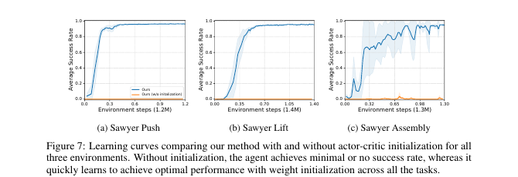
FIG. 7 · WEIGHT INITIALIZATION
Without init, success stays near zero past a million steps
With init
Actor ← BC. Critic ← MoPA-RL Q. Success ≈ 1.0 well before 1.0M steps, all three tasks.
Without init
“Minimal or no success” up till 1.2M steps. No successes observed until then.
Why init is legal
MoPA-RL actions superset the direct action space, so the critic transfer is defined.
Still privilege
That critic was trained with state. Init carries the privilege into the visual run.
MoPA-PD · arXiv 2111.06383 · CoRL 2021 · Alternative approaches · Dec 9
Scientific Reviewer 7 / 13
Notes:
Fig. 7, Appendix A.2. Curves, not a final-ASR table.
• Stay close to the prose: no episode success until 1.2M without init; ≈1.0 much earlier than 1.0M with init, all three tasks.
• Do not invent an exact first-success step beyond that prose.
• Supports sample efficiency more than “learning vision from scratch.” The actor is visual. The value function starts privileged. §5 asks for a vision critic before reality.

Slide 8
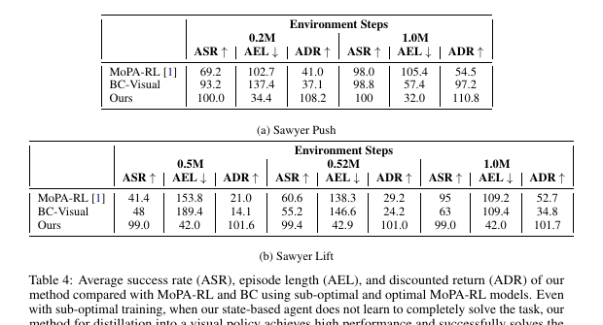
TABLE 4 · A WEAK EXPERT STILL DISTILLS
Not mere cloning. Also not a free lunch.
Push @ 0.2M
Expert ASR 69.2. Ours 100.0, AEL 34.4. BC-Visual is 93.2 / 137.4.
Lift @ 0.5M
Expert ASR 41.4. Ours 99.0, AEL 42.0. BC stays at 48.
Read carefully
The visual phase is still 2M steps. A weak teacher is not “no teacher.” Init still uses that critic.
Authors
Does not heavily depend on the state agent’s success. It does benefit from the initialization.
MoPA-PD · arXiv 2111.06383 · CoRL 2021 · Alternative approaches · Dec 9
Scientific Reviewer 8 / 13
Notes:
Appendix A.4. Answer to “do you need a perfect MoPA-RL?”
• Push 0.2M: MoPA-RL 69.2/102.7/41.0; BC 93.2/137.4/37.1; Ours 100.0/34.4/108.2.
• Push 1.0M: MoPA-RL 98.0/105.4/54.5; BC 98.8/57.4/97.2; Ours 100/32.0/110.8.
• Lift 0.5M: MoPA-RL 41.4/153.8/21.0; BC 48/189.4/14.1; Ours 99.0/42.0/101.6.
• Lift 0.52M: MoPA-RL 60.6, Ours 99.4. At 1.0M: MoPA-RL 95, BC 63, Ours 99.0/42.0/101.7.
• Quote the table you are pointing at. Lift Ours ADR is 101.6 in the 0.5M cell and 101.7 in Table 1. Do not average them.
• Low α assumes a useful prior. Table 4 softens “the teacher must be solved.” It is not an adversarial-teacher study.

Slide 9
WHAT IS SOFT
External validity stops at the simulator door
No real robot
One embodiment, three tasks
Transfer claims are sim-to-sim. §5 names a real fine-tune and a vision critic as future work. Writing “sim-to-real” rewrites the paper.
Sawyer only. Push, Lift, Assembly. The third uses the IKEA furniture env. Household generalization is not measured.
32×32 RGB
2021 baseline scope
Enough to prove the recipe. Not evidence about wrist cameras or multi-view stacks. That external validity is unknown.
CoL and asymmetric SAC are the foils. They zero out. That does not adjudicate ACT, Diffusion Policy, or any VLA.
MoPA-PD · arXiv 2111.06383 · CoRL 2021 · Alternative approaches · Dec 9
Scientific Reviewer 9 / 13
Notes:
None of these kill the mechanism. All of them kill an overclaim.
• MuJoCo, one arm, horizon 250, success when distance < 0.05. Reward ε is 0.1 on Push and 0.3 on Assembly; do not conflate ε with the success threshold.
• Reward scales: Push 0.8, Lift 0.5, Assembly 1.0. Lift shaping is reach / grasp / lift, SURREAL-style.
• DR does not vary kinematic layout in a household sense. Say appearance and local clutter.
• If the criterion is “no privilege at train,” this paper fails it on purpose. The critic is the privilege.

Slide 10
SMALLER KNIVES, STILL REAL
α is a knob. CoL is not saved by smoothing.
Entropy α
CoL is the LfD foil
Teacher final log α (Table 3): Push −0.63, Lift −2.7, Assembly −0.29. Visual stage uses smaller α. Sweep {0.5, 0, −3, −10, −20, −40}. Smaller is stabler. No per-α ASR table.
Best CoL cell is Lift ASR 29.8. BC smoothing does not rescue it (Lift ASR 0, ADR 5.1). Do not over-read a 2020 baseline as a 2025 one.
BC model selection
MoPA-Asym. SAC = 0
Fig. 9: low test MSE is not the best policy. They take the earliest epoch with 100% validation success. Min-MSE is a different method.
Keeping RRT in the visual action loop fails all three tasks. Distillation is not optional sugar. Collapsing the plan into a reactive policy is the result.
MoPA-PD · arXiv 2111.06383 · CoRL 2021 · Alternative approaches · Dec 9
Scientific Reviewer 10 / 13
Notes:
Secondary. Do not rebuild the talk around α.
• Figs. 5–6 are qualitative. Do not invent ASR per α.
• CoL partial rewards around 1.5–2M steps, slower than MoPA-PD. Still not a modern BC comparison.
• Selected BC epochs: 12 / 13 / 24. Appendix mentions training up to 140 epochs on the Assembly MSE plot.
• MP calls at inference are zero by architecture. The paper does not print that column. A reviewer may ask for the log.

Slide 11
VERDICT
Accept the recipe. Refuse the upgrade.
ALTERNATIVE APPROACHES CLASSIC
The privileged-teacher claim holds in obstructed simulation. The ablations that matter are in the paper. The generalizations people will want are not.
Accept
Do not accept
Planner removal. BC-smooth knife. Init effect. Path-length gain. Sim-to-sim DR above 96%.
Real clutter solved. Ancestor of π₀ or OpenVLA. Child of JEPA or Cosmos. A BEHAVIOR baseline.
MoPA-PD · arXiv 2111.06383 · CoRL 2021 · Alternative approaches · Dec 9
Scientific Reviewer 11 / 13
Notes:
This is the grade.
• Strong CoRL systems paper for privileged-teacher distillation in obstructed sim.
• One-liner: mechanism and ablations are crisp; sim-to-sim DR is real; real-world and modern-camera generalization remain open — Alternative approaches classic, not foundation-model prehistory.
• If discussion drifts to ACT: contrast data source and architecture. Not lineage.

Slide 12
QUESTIONS WORTH ASKING
Four probes that do not require new experiments
Where is the planner?
Whose success?
At inference, architecturally absent. Ask for a log of planner calls anyway. The PDF does not print that column.
Push ASR flatters BC. Make the authors (and yourself) answer in AEL and ADR, then look at Lift and Assembly.
Whose baseline?
Whose reality?
CoL and Asym. SAC are 2020-era foils. Ask what would change if the BC baseline were a chunked or generative policy. The paper cannot answer. That is fine. Pretending it did is not.
Table 2 changes textures and adds distractor cubes. Ask which sentence in §5 they want remembered. It is the future-work sentence.
MoPA-PD · arXiv 2111.06383 · CoRL 2021 · Alternative approaches · Dec 9
Scientific Reviewer 12 / 13
Notes:
Discussion prompts, not extra claims.
• Planner-call log is a fair request and an unanswered one.
• A modern BC baseline is out of scope for a 2021 paper. The reviewer’s job is to keep the scope visible, not to punish the authors for the calendar.
• §5 future work: vision critic or sim-to-real techniques. Quote that, don’t paraphrase it into a result.

Slide 13
REVIEWER CLOSE
The sentence to leave in the notes
Table 1 decides the mechanism. Assembly 0 vs 100 decides smoothing. Fig. 7 decides init. Table 4 says a weak expert can still teach. Nothing in the PDF decides reality.
Push 100 / 32.0 / 110.8. Expert AEL 111 vs 32. DR worst cell 96.7, sim-to-sim. Not an ancestor. Not a world model.
MoPA-PD · arXiv 2111.06383 · CoRL 2021 · Alternative approaches · Dec 9
Scientific Reviewer 13 / 13
Notes:
Stop. No speculative extensions in the reviewer seat.
• BEHAVIOR analogies, if any, belong to Visionary — and even there no success rate may be invented.
• A course smoke may not claim this table. That is the Empiricist’s rule.

