Slide 1
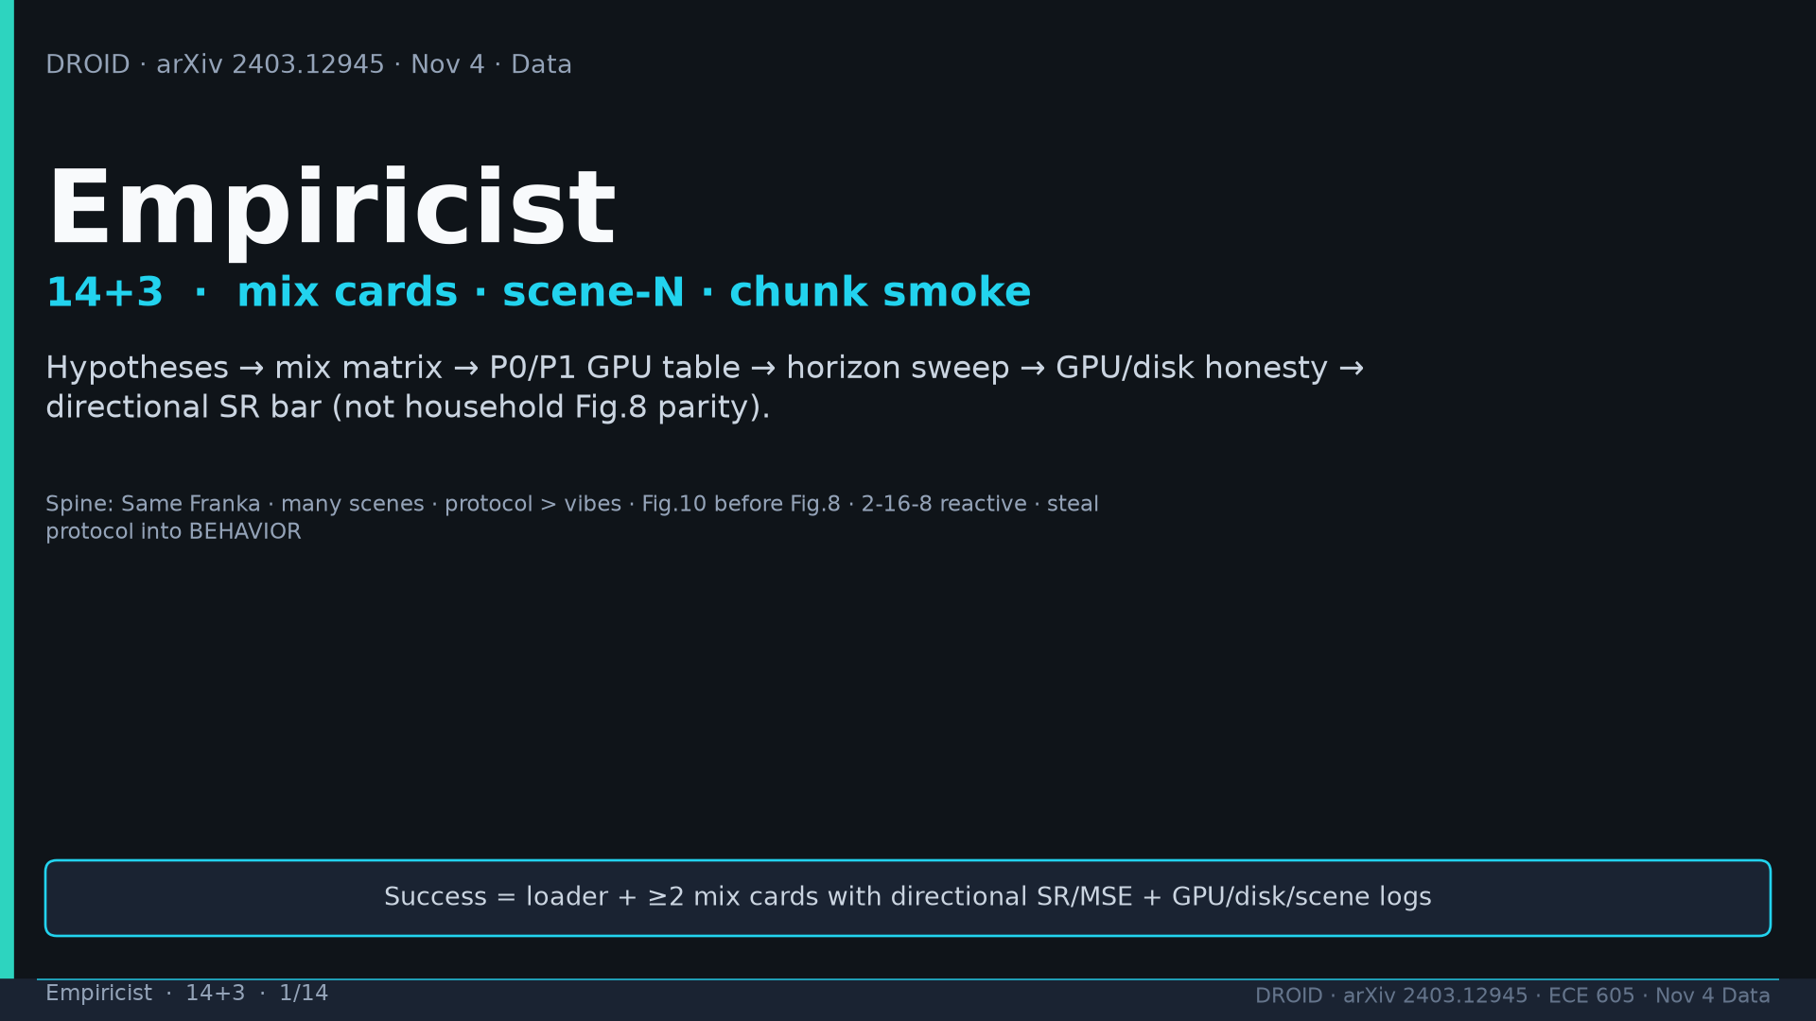
Notes:
Empiricist · 14+3 · 1/14
Title. Mix cards + scene-N + chunk smoke + GPU honesty. Success=directional SR not household parity.
Tattoo: 76k / 350h / 564 scenes / 86 tasks / 52 buildings / +22% ID / +17% OOD / obs2-pred16-action8 @15Hz / ~40k co-train ≠ 76k

Slide 2
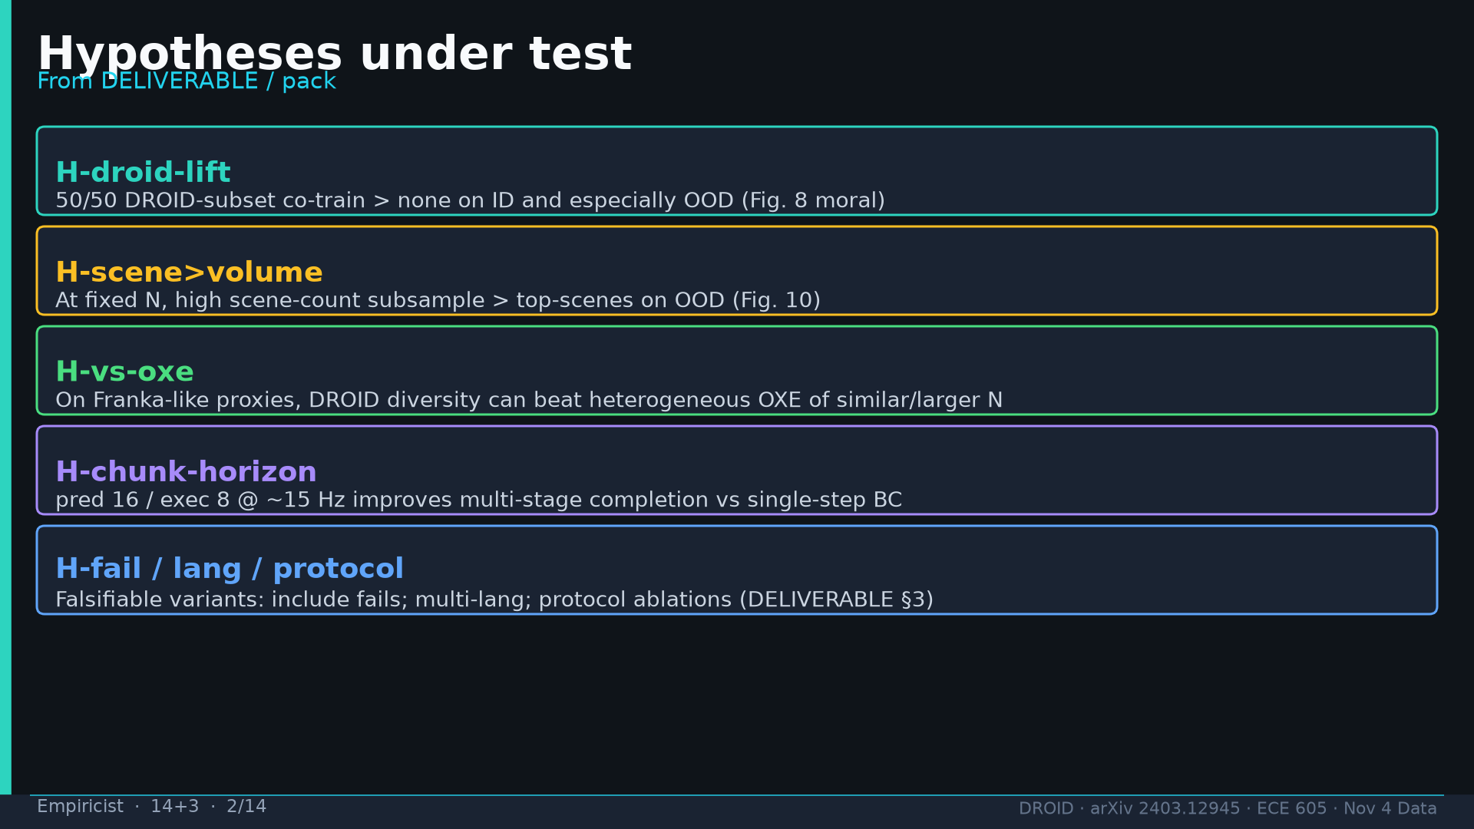
Notes:
Empiricist · 14+3 · 2/14
Hypotheses: H-droid-lift, H-scene>volume, H-vs-oxe, H-chunk-horizon, H-fail/lang/protocol.
Tattoo: 76k / 350h / 564 scenes / 86 tasks / 52 buildings / +22% ID / +17% OOD / obs2-pred16-action8 @15Hz / ~40k co-train ≠ 76k

Slide 3
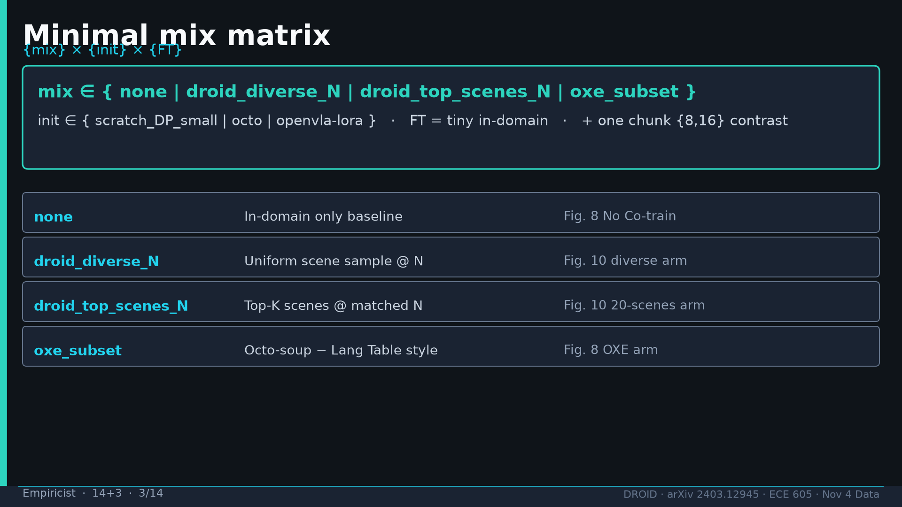
Notes:
Empiricist · 14+3 · 3/14
Minimal matrix: mix{none,droid_diverse_N,droid_top_scenes_N,oxe_subset} × init{scratch_DP,octo,openvla-lora} × tiny FT.
Tattoo: 76k / 350h / 564 scenes / 86 tasks / 52 buildings / +22% ID / +17% OOD / obs2-pred16-action8 @15Hz / ~40k co-train ≠ 76k

Slide 4
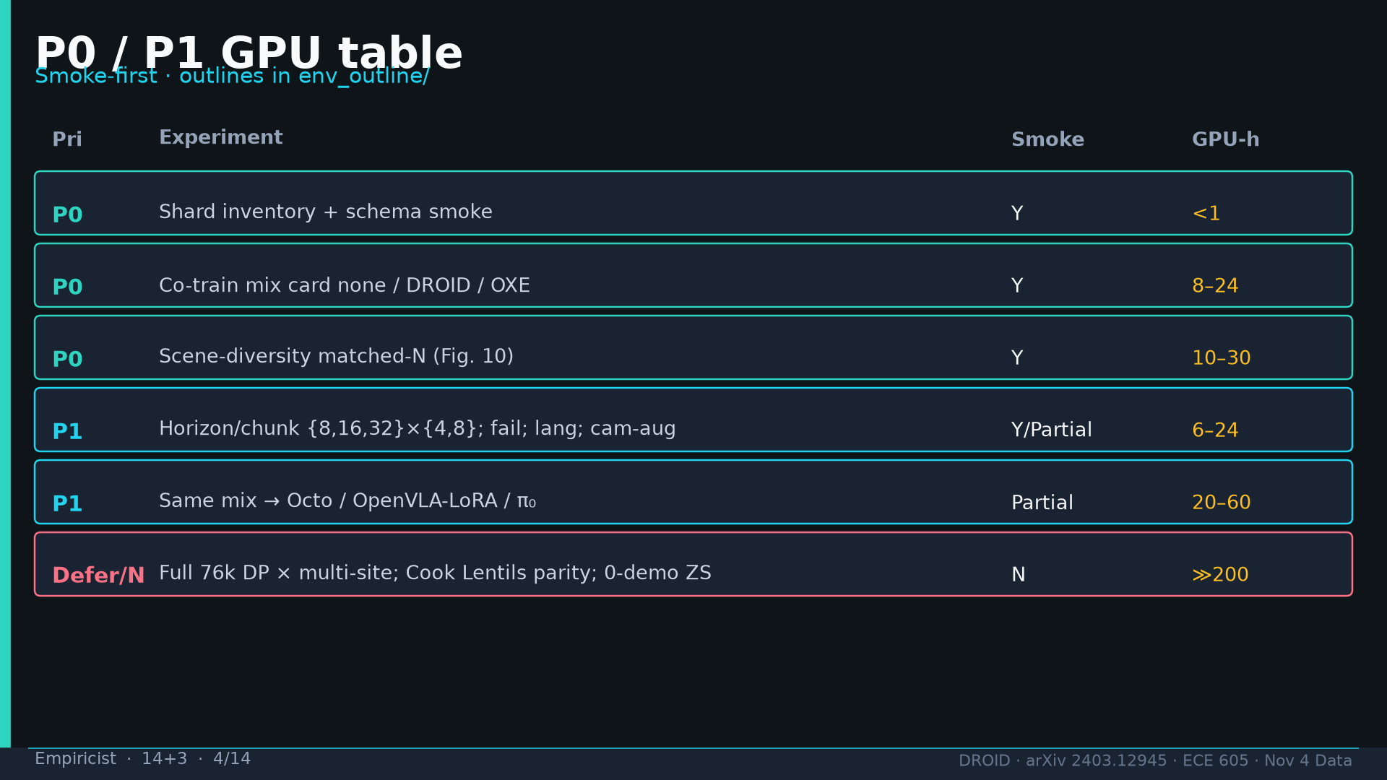
Notes:
Empiricist · 14+3 · 4/14
P0: schema smoke, mix card, matched-N. P1: horizon, cross-head. Defer: full 76k, household parity, 0-demo ZS.
Tattoo: 76k / 350h / 564 scenes / 86 tasks / 52 buildings / +22% ID / +17% OOD / obs2-pred16-action8 @15Hz / ~40k co-train ≠ 76k

Slide 5
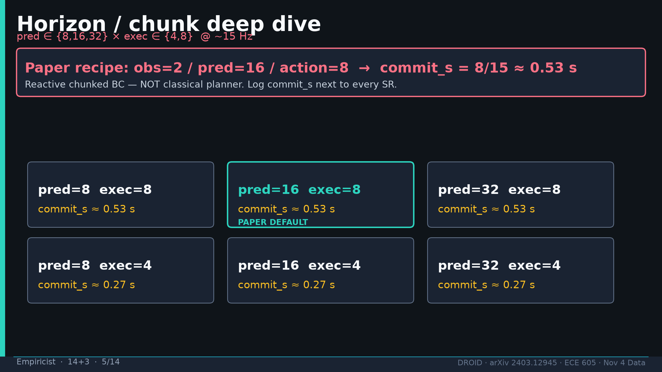
Notes:
Empiricist · 14+3 · 5/14
Horizon sweep pred∈{8,16,32}×exec∈{4,8}. Paper default 16/8 commit≈0.53s. Log commit_s next to SR.
Tattoo: 76k / 350h / 564 scenes / 86 tasks / 52 buildings / +22% ID / +17% OOD / obs2-pred16-action8 @15Hz / ~40k co-train ≠ 76k

Slide 6
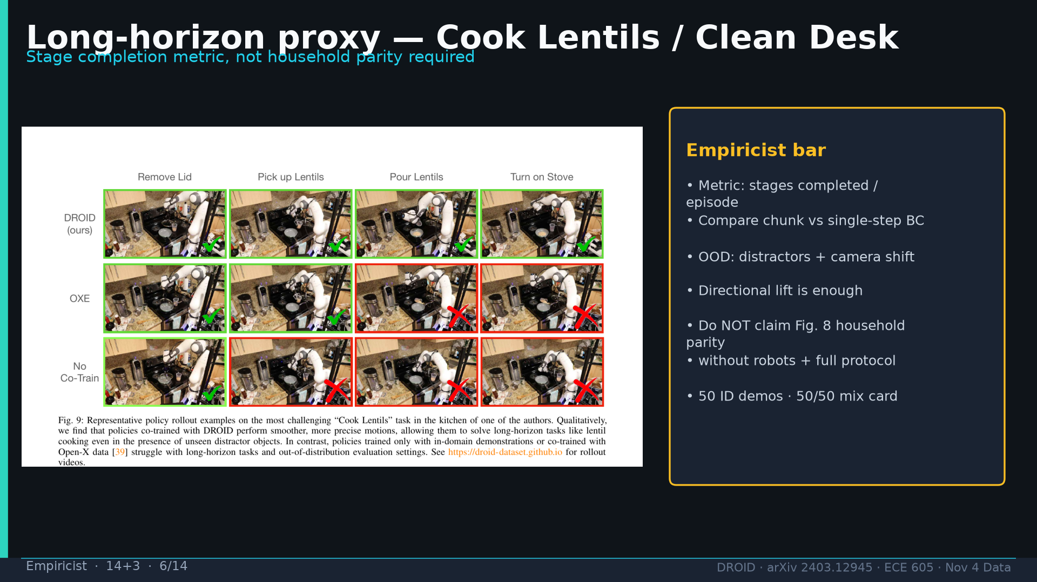
Notes:
Empiricist · 14+3 · 6/14
Cook Lentils / Clean Desk as multi-stage proxy. Metric=stages completed. Directional only.
Tattoo: 76k / 350h / 564 scenes / 86 tasks / 52 buildings / +22% ID / +17% OOD / obs2-pred16-action8 @15Hz / ~40k co-train ≠ 76k

Slide 7
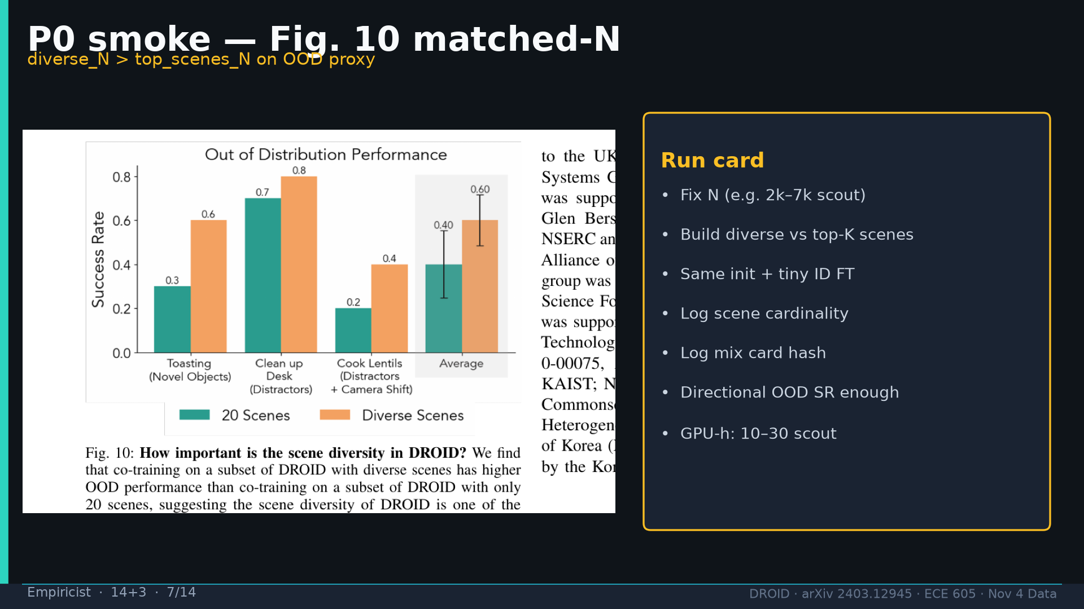
Notes:
Empiricist · 14+3 · 7/14
Fig10 P0 smoke: diverse_N > top_scenes_N. Log scene cardinality + mix hash. GPU 10-30h scout.
Tattoo: 76k / 350h / 564 scenes / 86 tasks / 52 buildings / +22% ID / +17% OOD / obs2-pred16-action8 @15Hz / ~40k co-train ≠ 76k

Slide 8
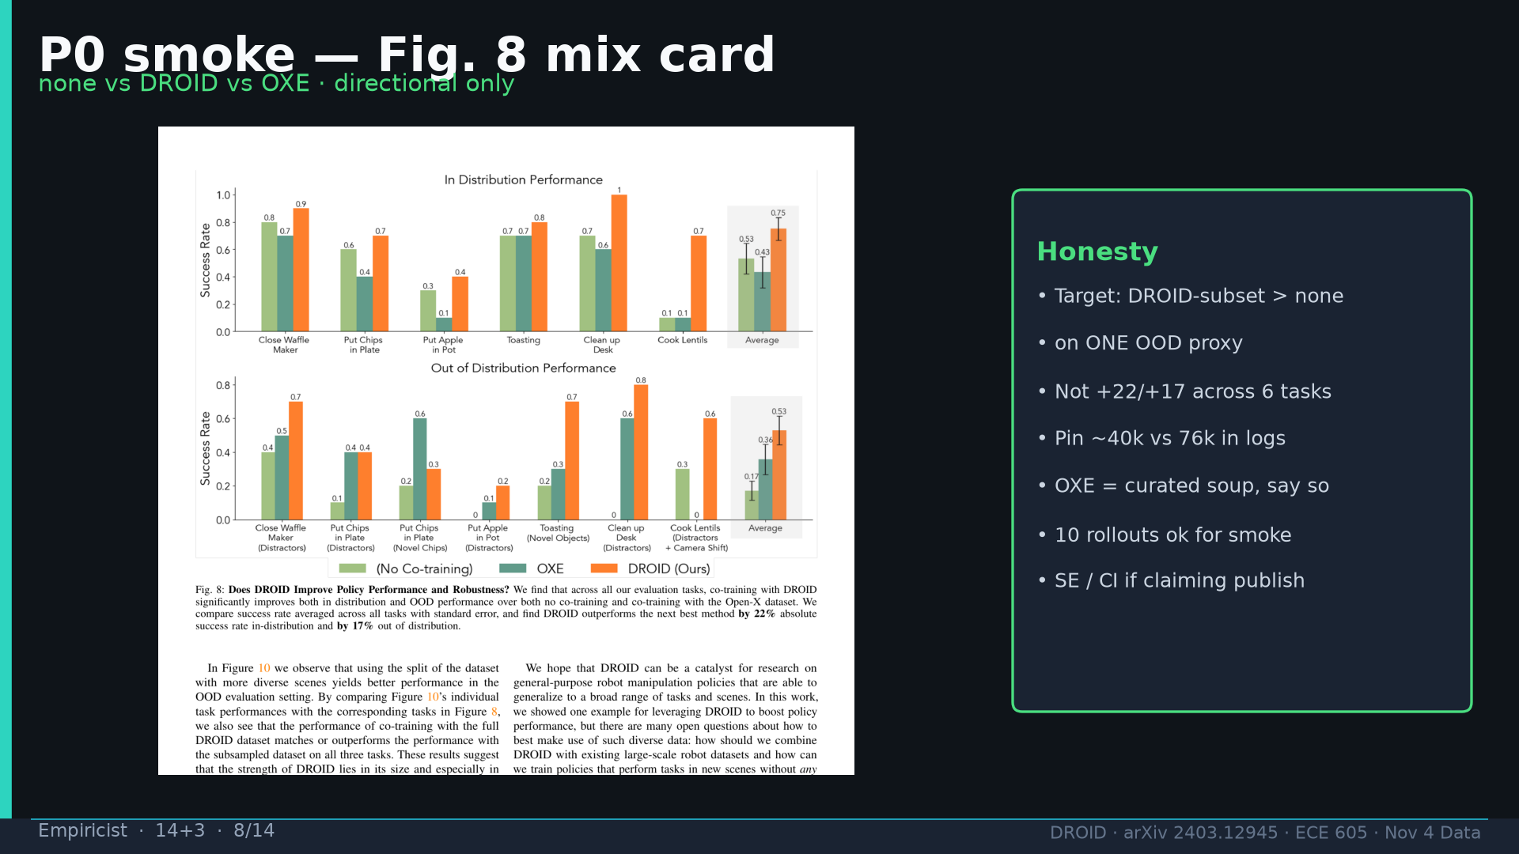
Notes:
Empiricist · 14+3 · 8/14
Fig8 P0 smoke: DROID-subset > none on one OOD proxy. Not +22/+17 across 6 tasks. Pin 40k≠76k.
Tattoo: 76k / 350h / 564 scenes / 86 tasks / 52 buildings / +22% ID / +17% OOD / obs2-pred16-action8 @15Hz / ~40k co-train ≠ 76k

Slide 9
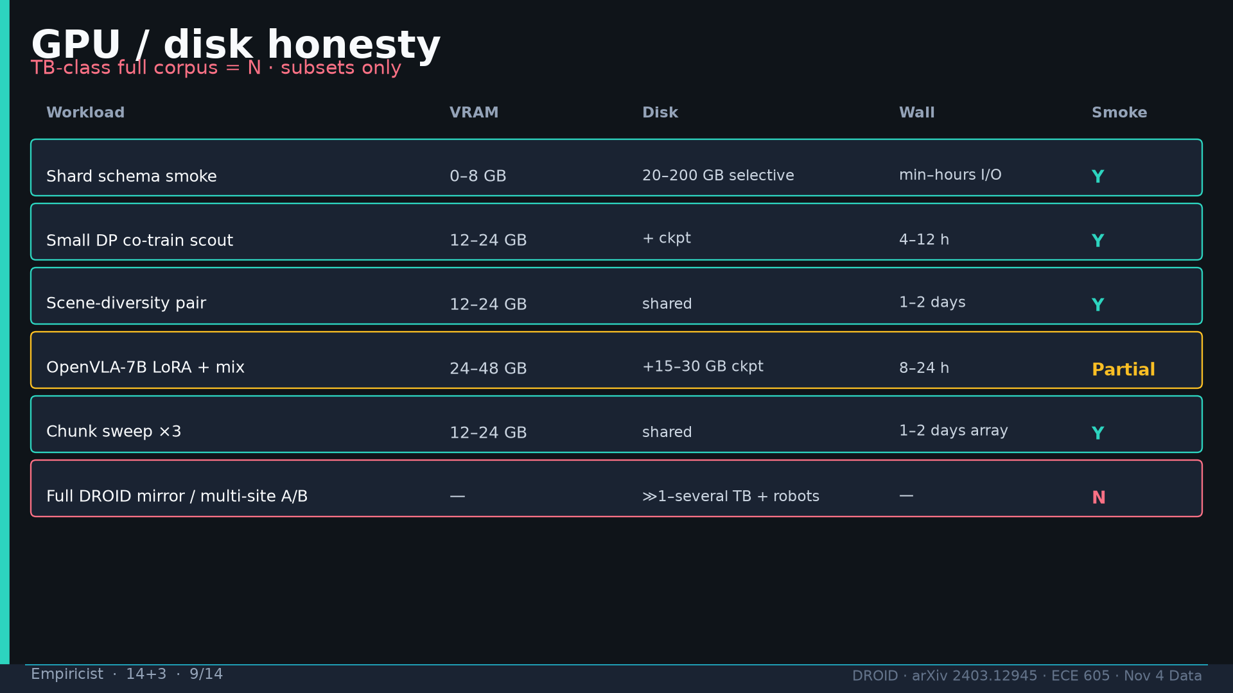
Notes:
Empiricist · 14+3 · 9/14
GPU/disk honesty: full corpus TB-class = N. Prefer HF resized mirrors. Fail job if no GPU when requested.
Tattoo: 76k / 350h / 564 scenes / 86 tasks / 52 buildings / +22% ID / +17% OOD / obs2-pred16-action8 @15Hz / ~40k co-train ≠ 76k

Slide 10
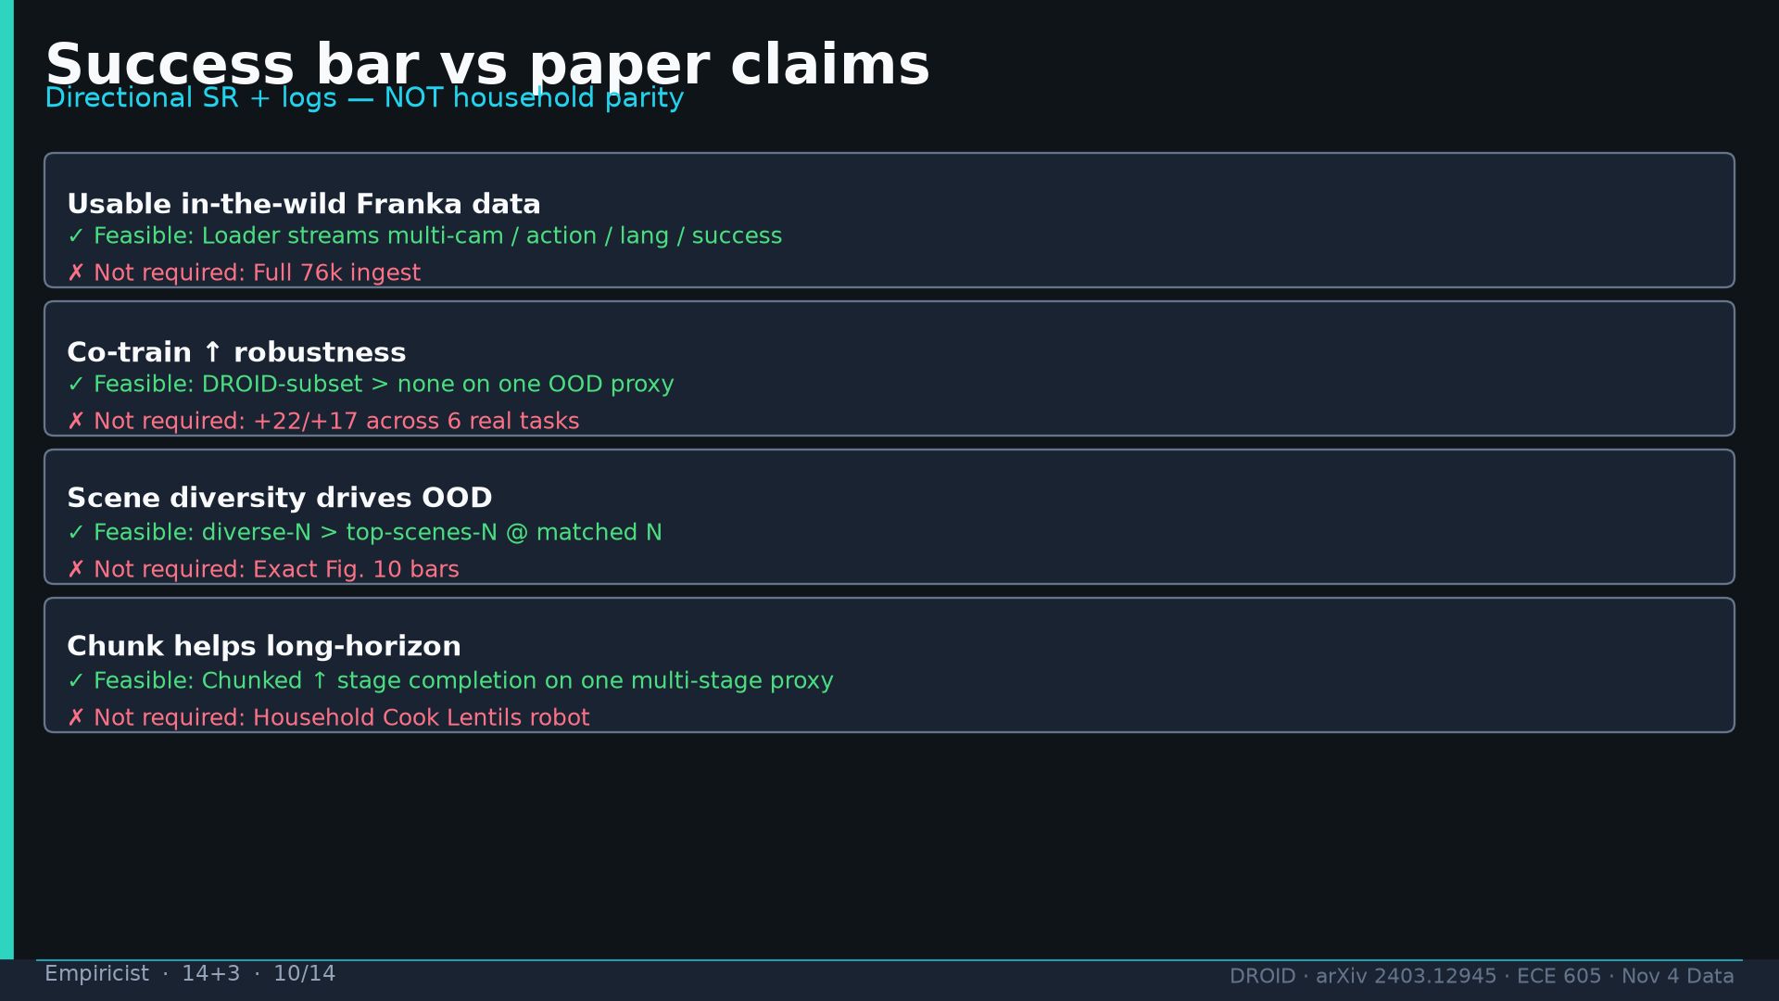
Notes:
Empiricist · 14+3 · 10/14
Success bar table: feasible vs not required. Pass=mix cards + ≥1 directional H. Fail=claim Fig8 household without robots.
Tattoo: 76k / 350h / 564 scenes / 86 tasks / 52 buildings / +22% ID / +17% OOD / obs2-pred16-action8 @15Hz / ~40k co-train ≠ 76k

Slide 11
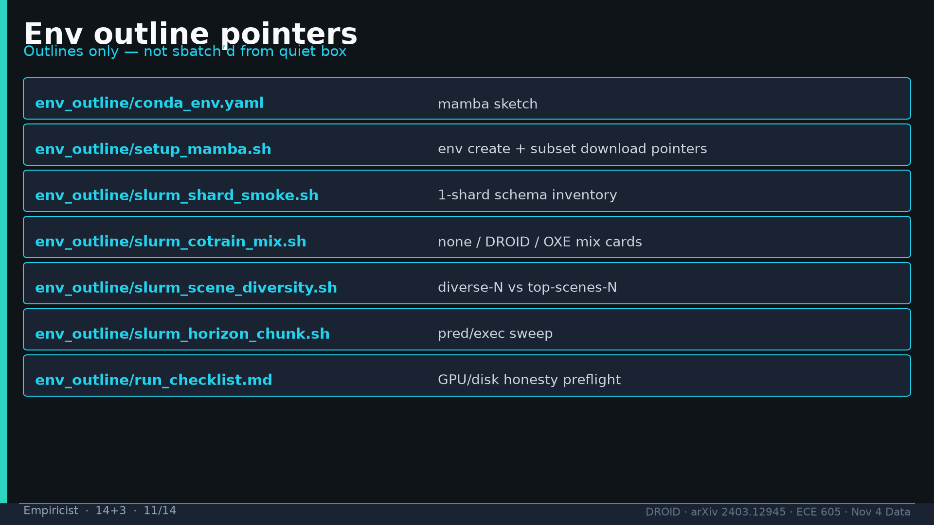
Notes:
Empiricist · 14+3 · 11/14
env_outline/ scripts: outlines only, not sbatch'd from quiet box.
Tattoo: 76k / 350h / 564 scenes / 86 tasks / 52 buildings / +22% ID / +17% OOD / obs2-pred16-action8 @15Hz / ~40k co-train ≠ 76k

Slide 12
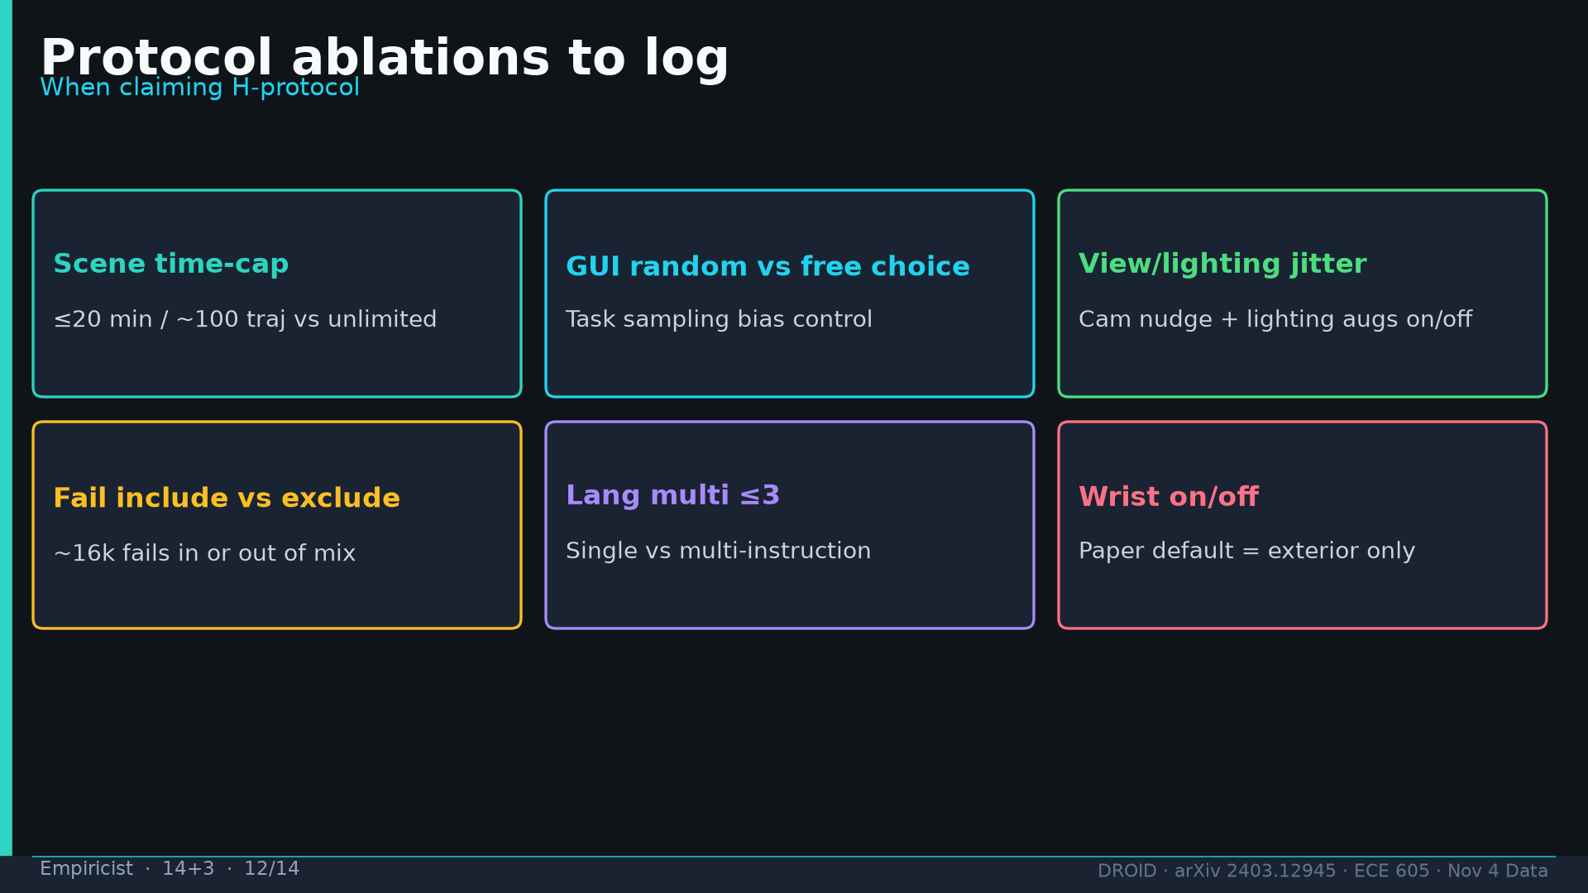
Notes:
Empiricist · 14+3 · 12/14
Protocol ablations to log when claiming H-protocol: time-cap, GUI random, jitter, fails, lang multi, wrist.
Tattoo: 76k / 350h / 564 scenes / 86 tasks / 52 buildings / +22% ID / +17% OOD / obs2-pred16-action8 @15Hz / ~40k co-train ≠ 76k

Slide 13
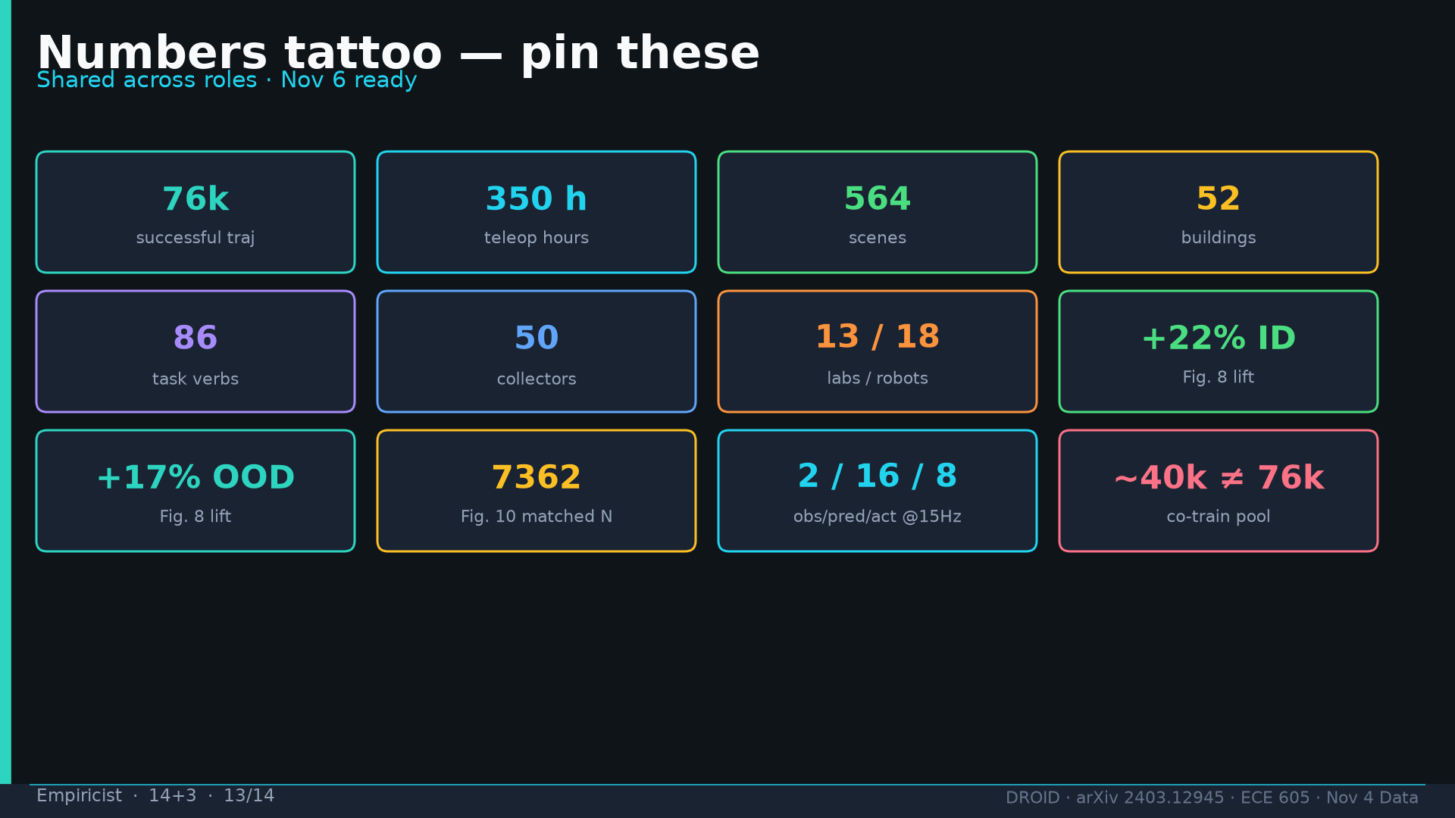
Notes:
Empiricist · 14+3 · 13/14
Tattoo card.
Tattoo: 76k / 350h / 564 scenes / 86 tasks / 52 buildings / +22% ID / +17% OOD / obs2-pred16-action8 @15Hz / ~40k co-train ≠ 76k

Slide 14
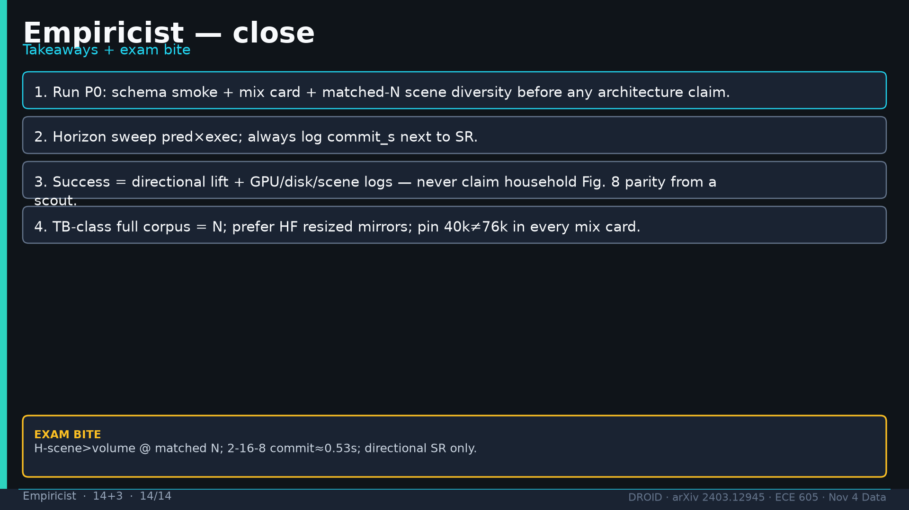
Notes:
Empiricist · 14+3 · 14/14
Close: P0 first; horizon+commit_s; directional only; TB=N.
Tattoo: 76k / 350h / 564 scenes / 86 tasks / 52 buildings / +22% ID / +17% OOD / obs2-pred16-action8 @15Hz / ~40k co-train ≠ 76k

