Slide 1
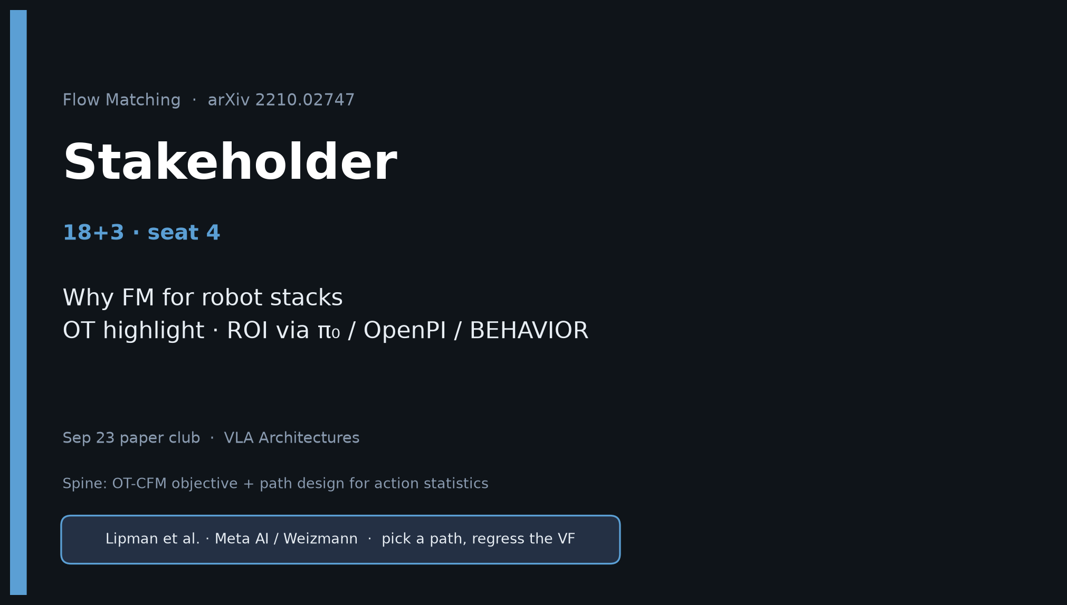
Stakeholder · 18+3 · 1/15
Notes:
STAKEHOLDER OPENING — seat 4. Timing 18+3.
You sell WHY this paper matters for robot stacks — not the ImageNet tables.
ROI is downstream: π₀ / OpenPI / BEHAVIOR. Required literacy for flow-head work; pair with DP + π₀.
One-liner: FM = pick a path, regress the VF; OT makes paths straighter/faster → DP showed generative chunks → π₀ puts OT-CFM in the VLM action head → BEHAVIOR fixes noise/inference for robot stats.

Slide 2
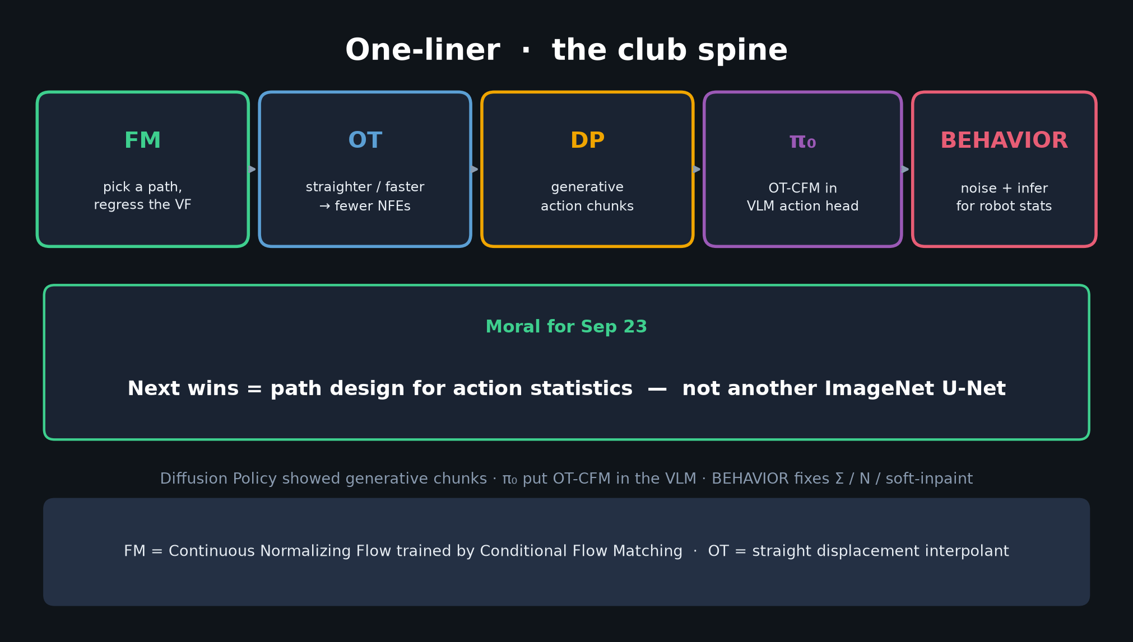
Stakeholder · 18+3 · 2/15
Notes:
ONE-LINER / SPINE — spend 60s. Make the room memorize the chain.
FM → OT → DP → π₀ → BEHAVIOR. Moral: path design for action statistics.

Slide 3
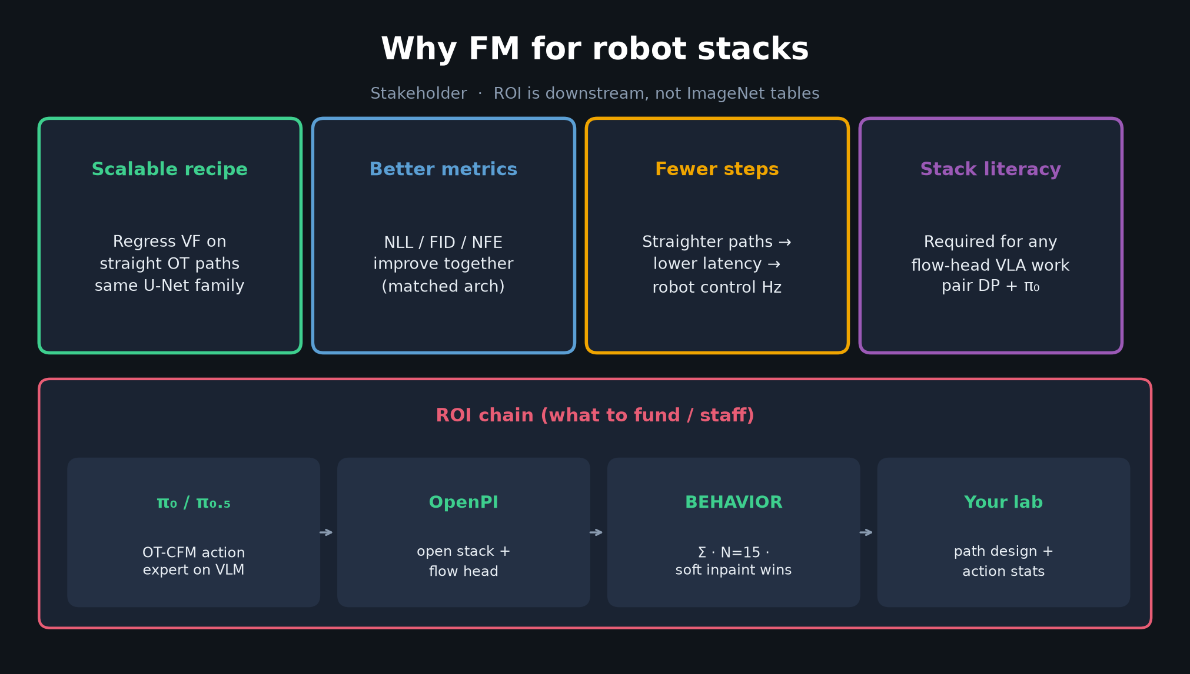
Stakeholder · 18+3 · 3/15
Notes:
WHY FM FOR ROBOT STACKS — four cards. Scalable recipe, better metrics, fewer steps (Hz), stack literacy.

Slide 4
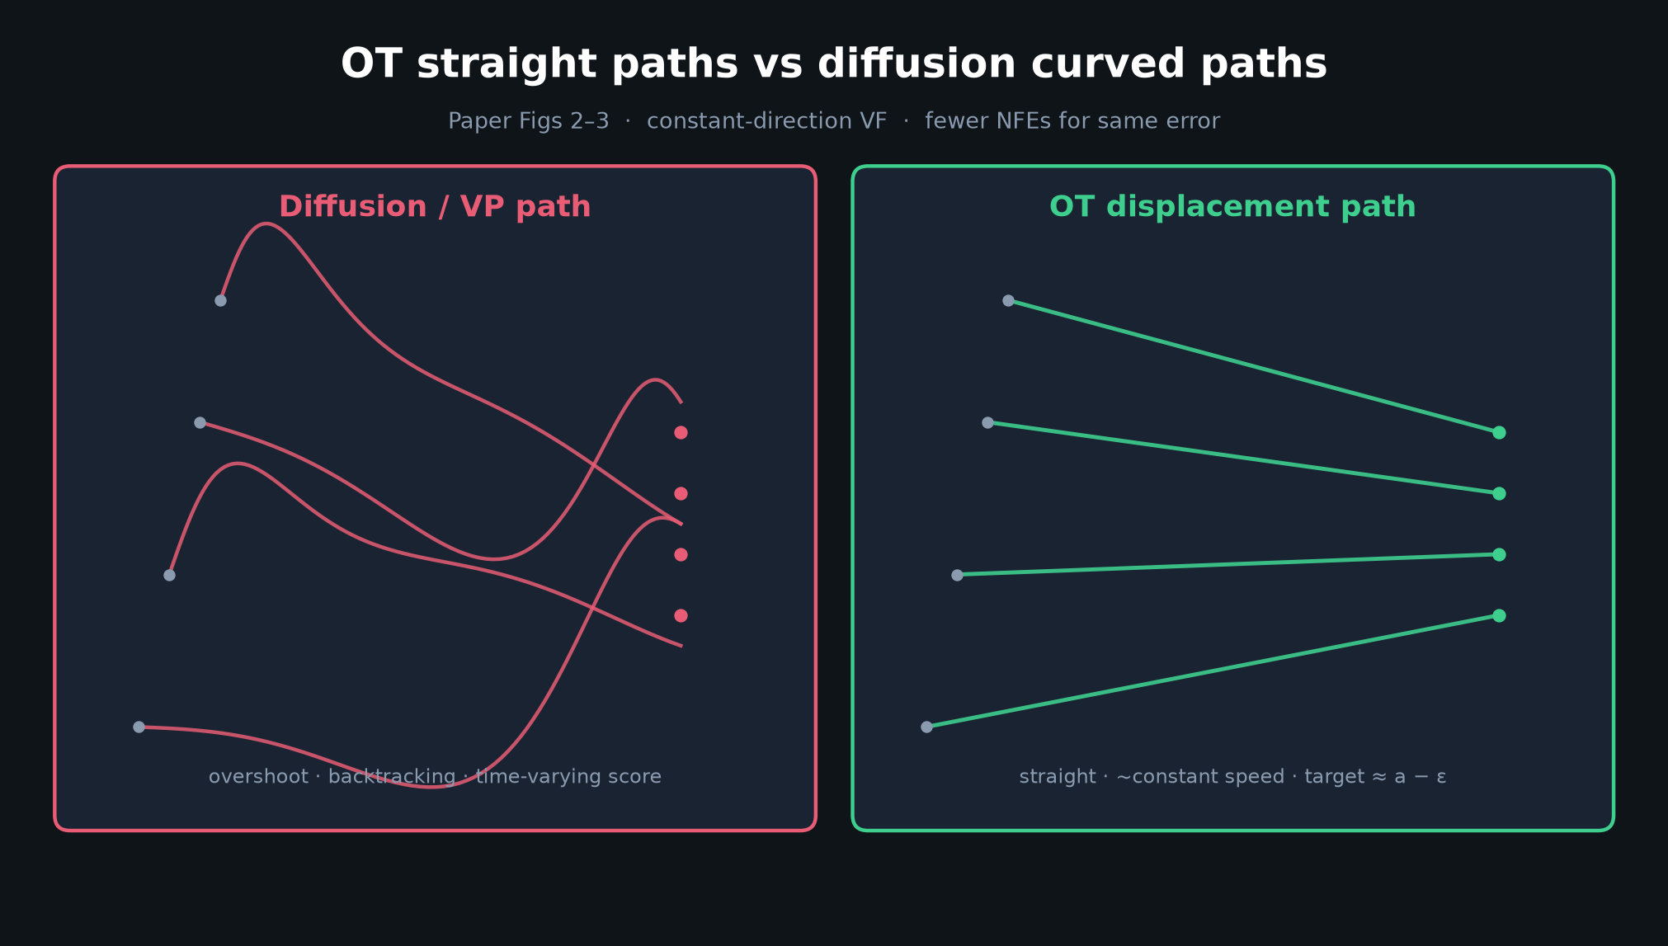
Stakeholder · 18+3 · 4/15
Notes:
OT HIGHLIGHT — straight vs curved. This is the business reason OT matters: latency / NFE.

Slide 5
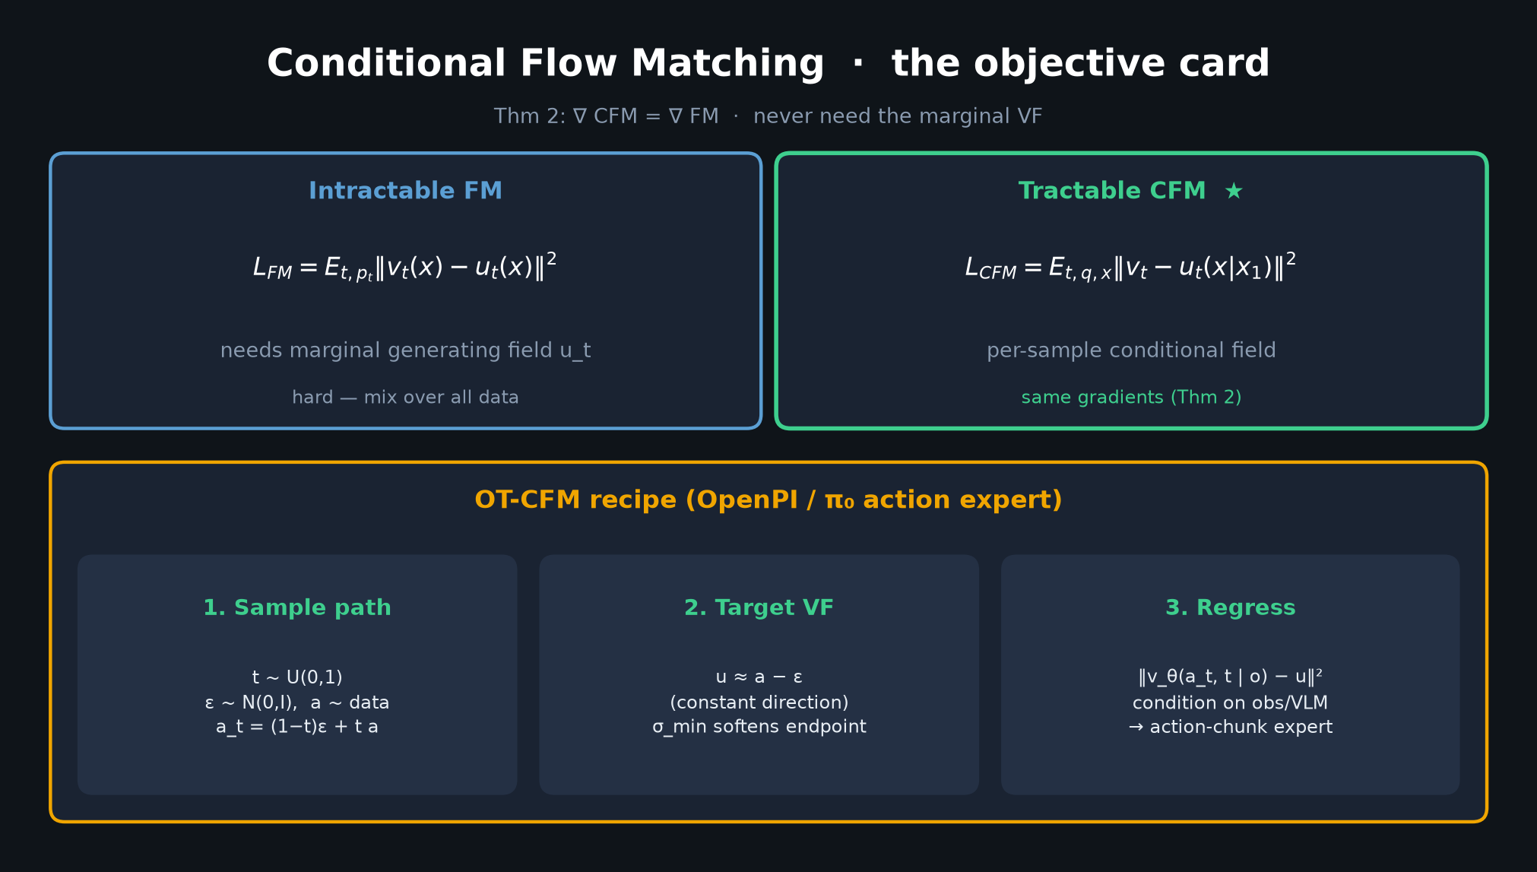
Stakeholder · 18+3 · 5/15
Notes:
CFM CARD — lightweight tech for stakeholders. “Regress a vector field on a chosen path; OT is the path we want.”

Slide 6
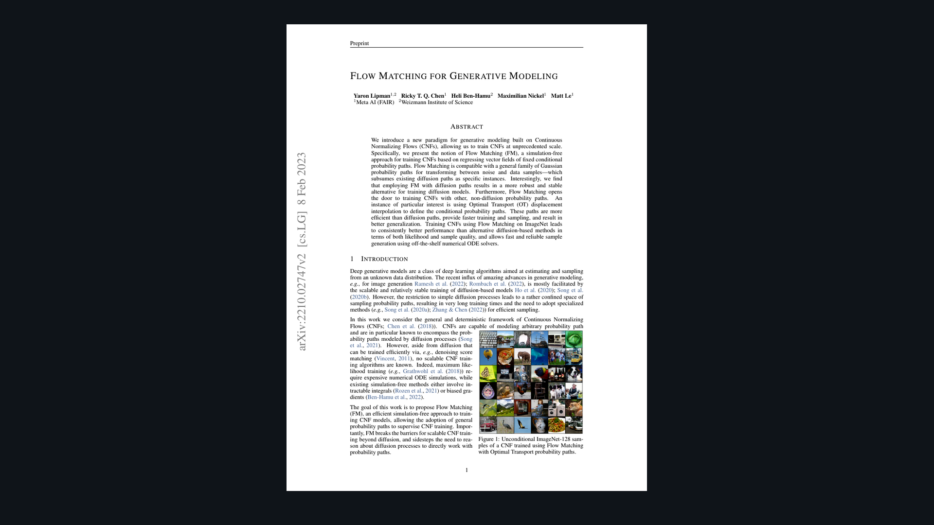
Stakeholder · 18+3 · 6/15
Notes:
PAPER COVER — ImageNet-128 samples. Prestige slide; don’t dwell on FID numbers. Transition: “the ROI for us is not this table — it’s the action head.”

Slide 7
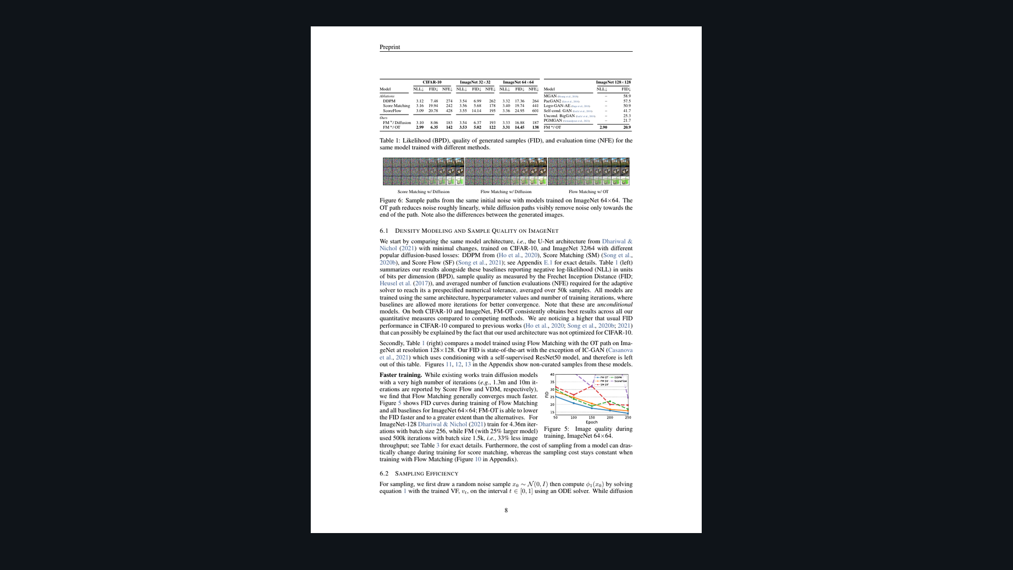
Stakeholder · 18+3 · 7/15
Notes:
TABLE 1 flavor — if present. Headline: FM-OT best NLL/FID/NFE under matched U-Nets. Caveat lightly (Reviewer owns hygiene).

Slide 8
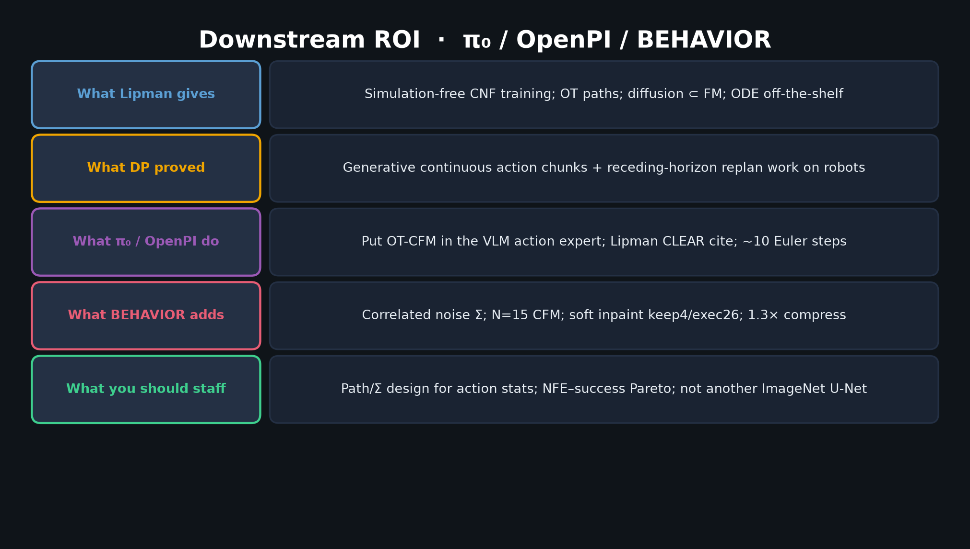
Stakeholder · 18+3 · 8/15
Notes:
DOWNSTREAM ROI CHAIN — densest Stakeholder slide. What Lipman gives → DP → π₀/OpenPI → BEHAVIOR → what you should staff.

Slide 9
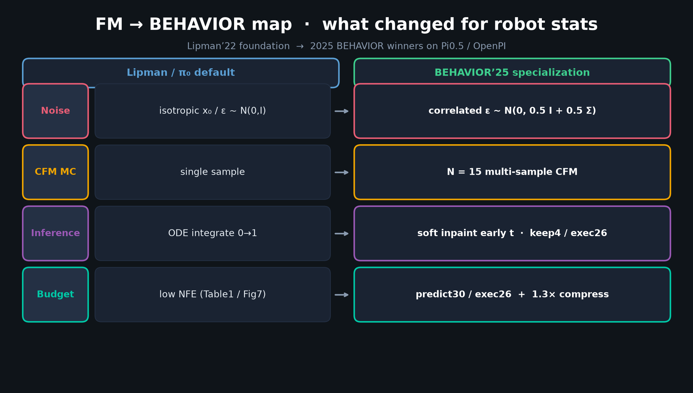
Stakeholder · 18+3 · 9/15
Notes:
FM→BEHAVIOR MAP — show Stakeholder how the foundation got specialized for robot stats without replacing FM.

Slide 10
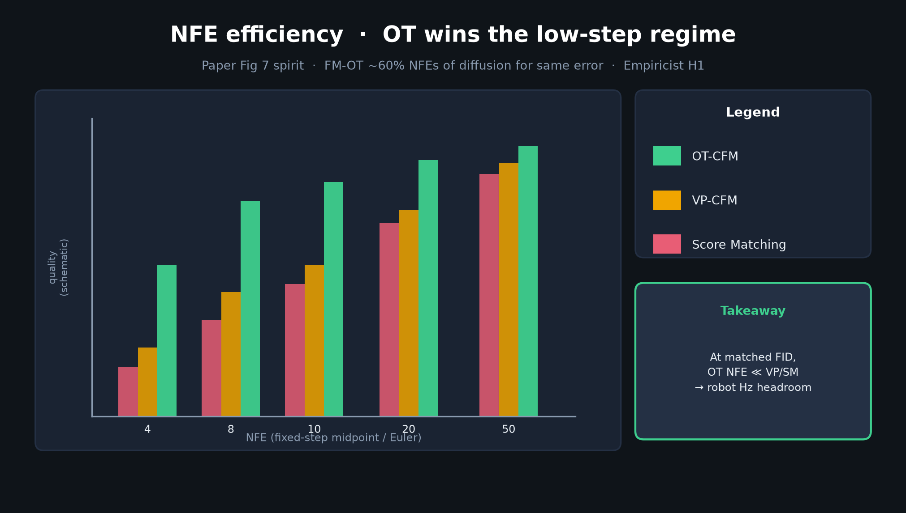
Stakeholder · 18+3 · 10/15
Notes:
NFE COMPARISON — latency = money on robots. OT wins low-step regime.

Slide 11
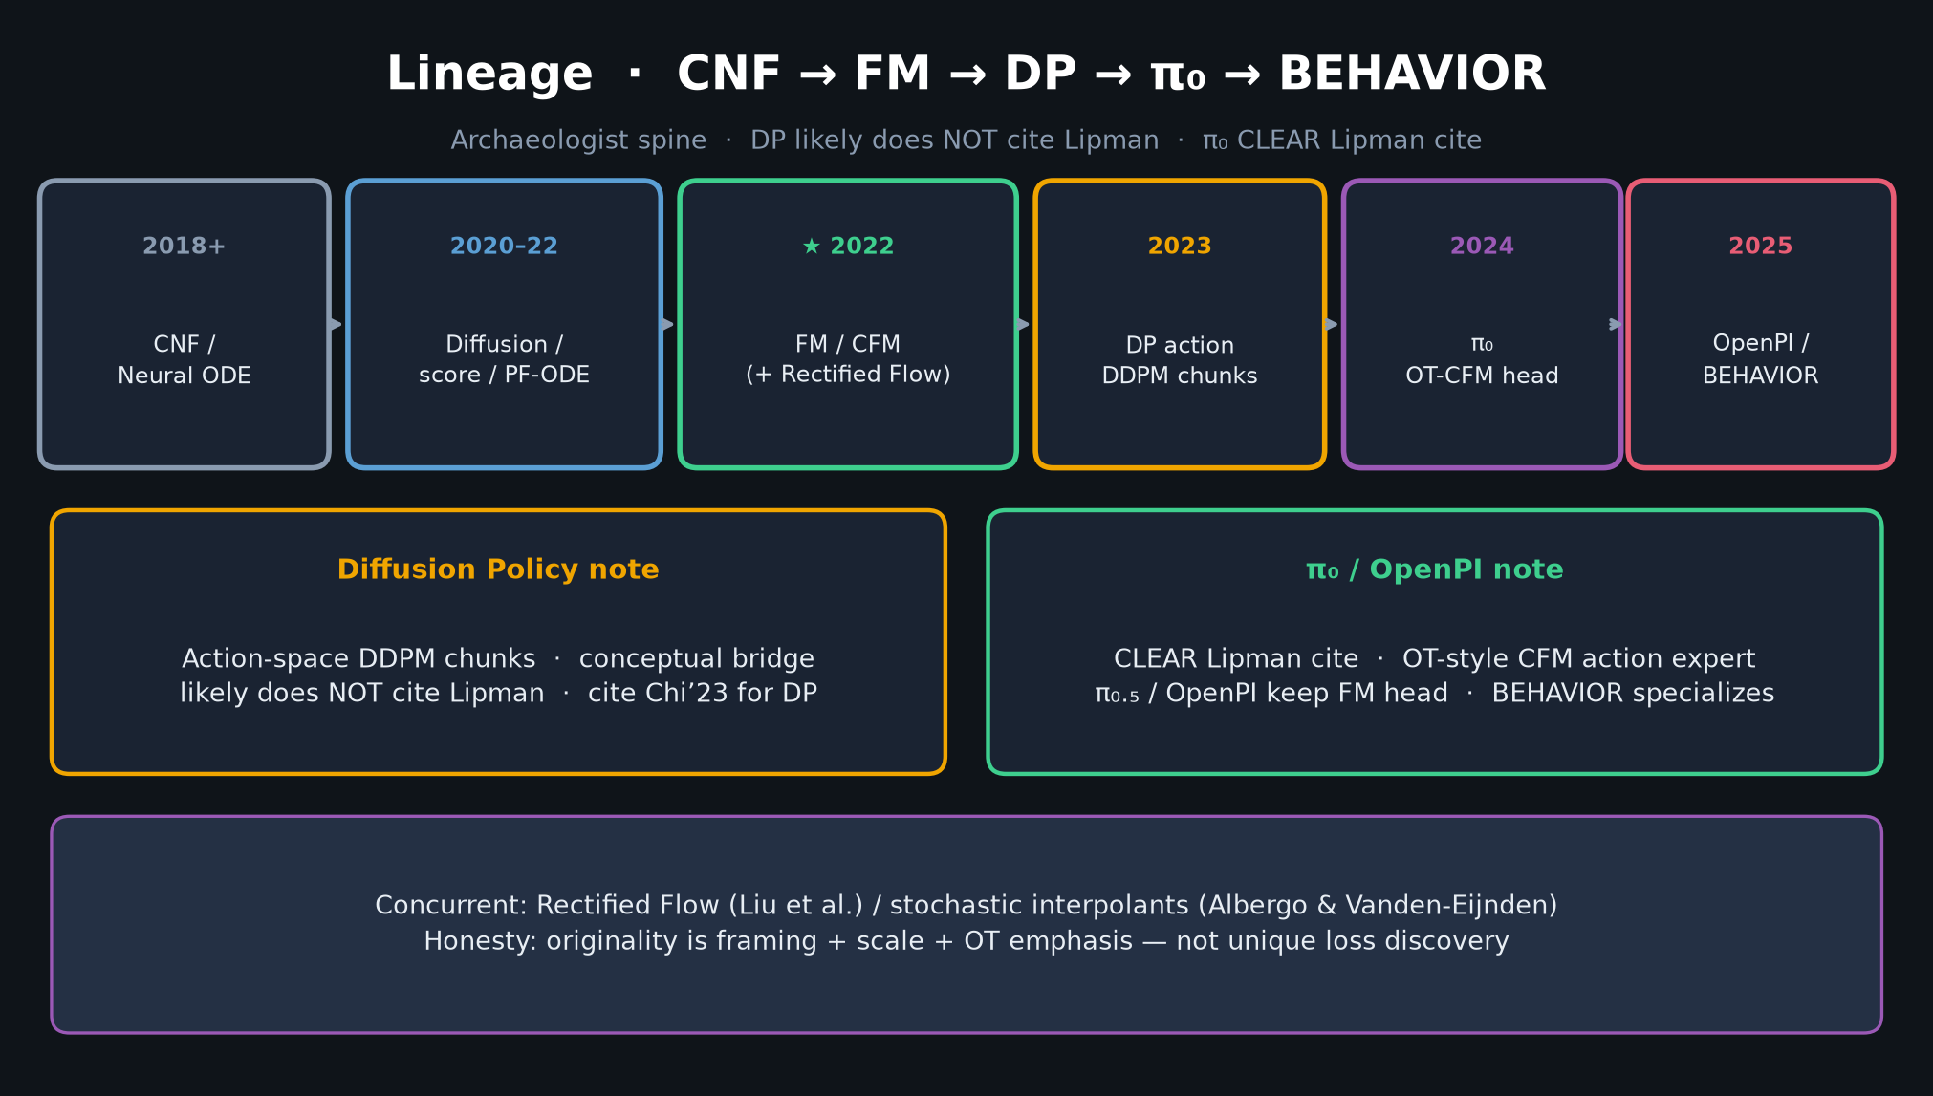
Stakeholder · 18+3 · 11/15
Notes:
LINEAGE — short. CNF→FM→DP→π₀→BEHAVIOR. Staffing implication: hire people who understand path design, not just U-Net tuning.

Slide 12
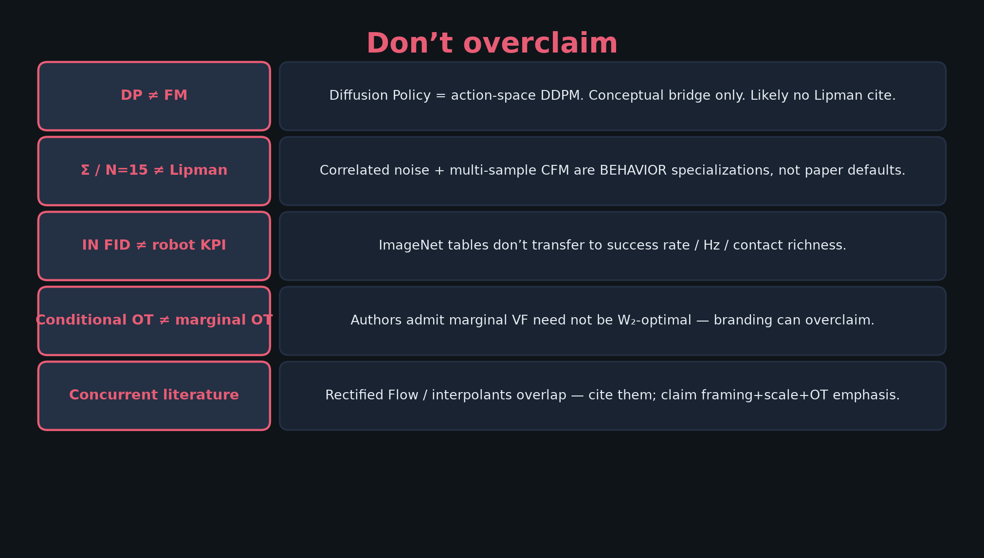
Stakeholder · 18+3 · 12/15
Notes:
DON’T OVERCLAIM — protect the ask. Don’t sell IN FID as robot KPI. Don’t equate BEHAVIOR tricks with Lipman.

Slide 13
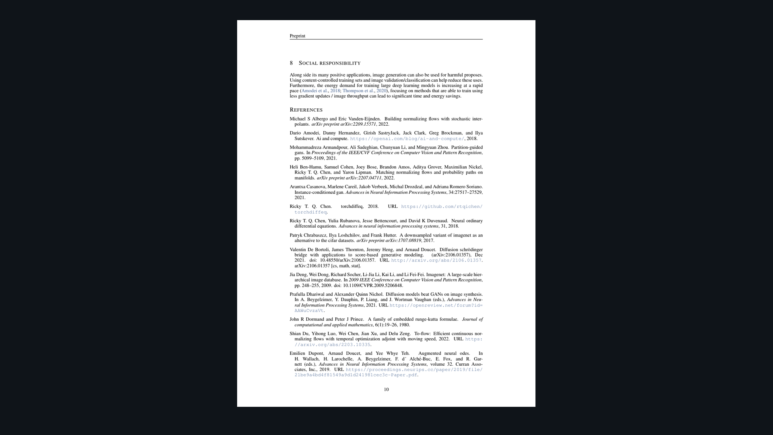
Stakeholder · 18+3 · 13/15
Notes:
PAPER FIG 7 area — sampling efficiency evidence for the low-NFE story.

Slide 14
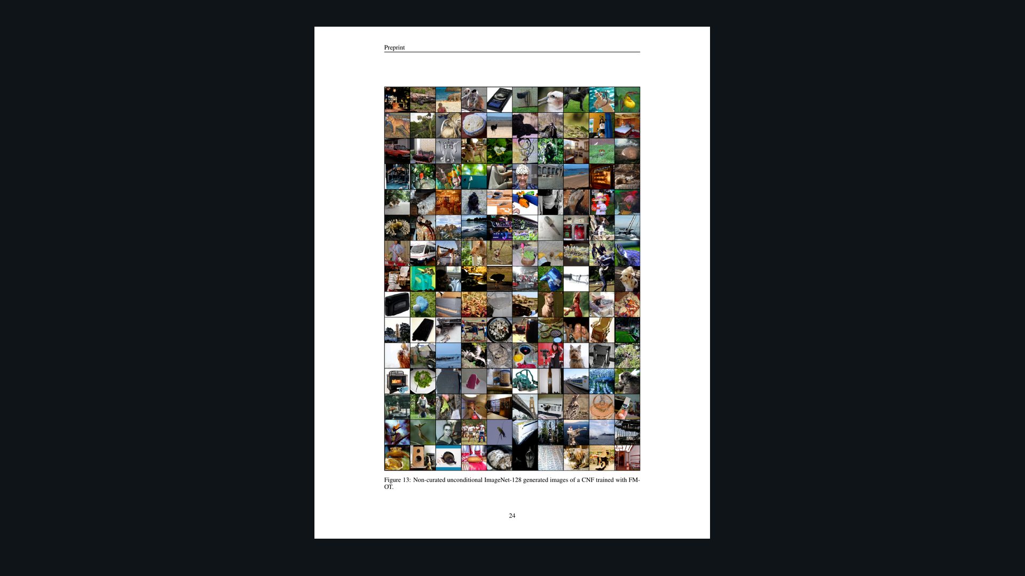
Stakeholder · 18+3 · 14/15
Notes:
SAMPLES backup — ImageNet-128 qualitative. Optional if time.

Slide 15
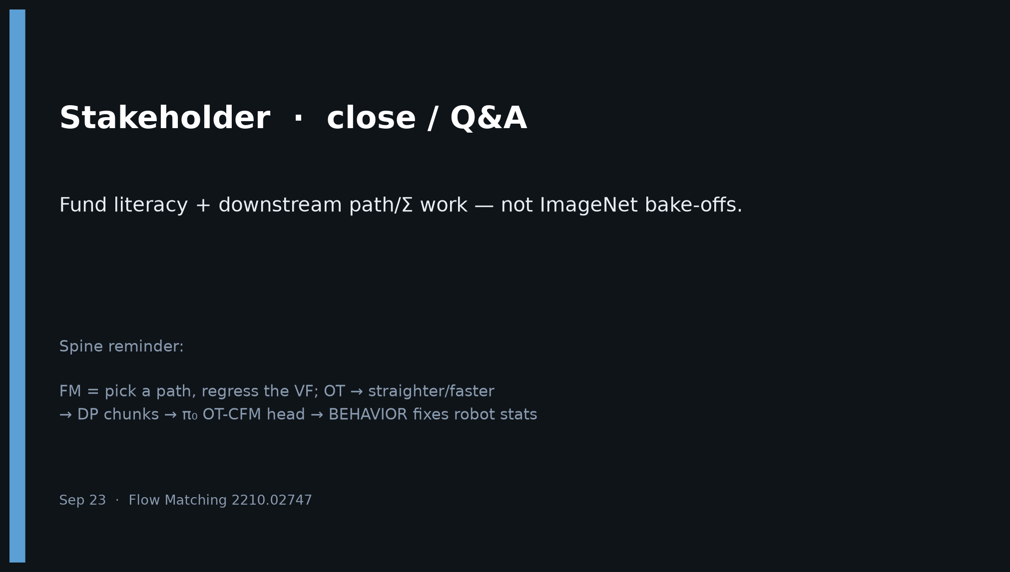
Stakeholder · 18+3 · 15/15
Notes:
CLOSE — Fund literacy + downstream path/Σ work — not ImageNet bake-offs. Pair reading: DP + π₀ + this paper.

