Slide 1

Scientific Reviewer · 8+3 · 1/10
Notes:
SCIENTIFIC REVIEWER OPENING — seat 3. Timing 8+3 (tight).
Job: strengths that hold + actionable cite hygiene. No robotics cheerleading without caveats.
Checklist: toy OT-CFM; confirm π₀ path=OT not VP; separate “FM>SM same U-Net” from “FM solves robot multimodality.”

Slide 2
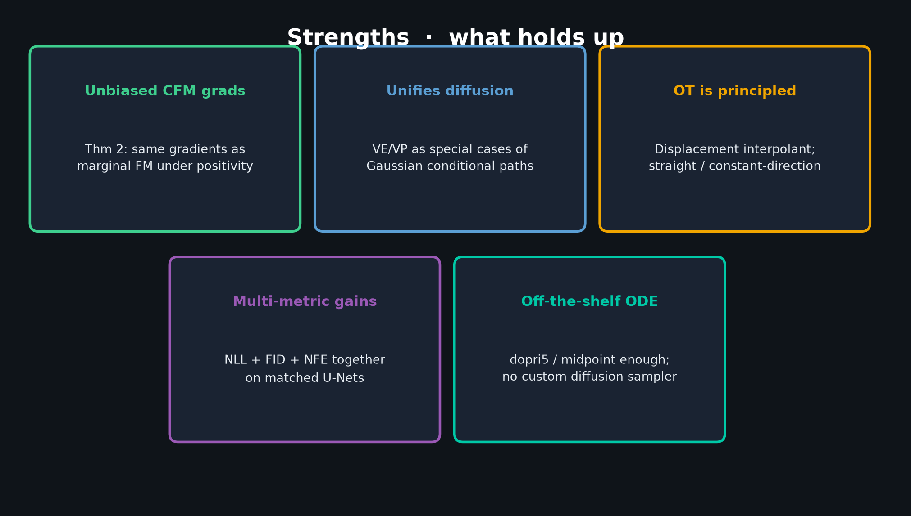
Scientific Reviewer · 8+3 · 2/10
Notes:
STRENGTHS — 60–75s. Unbiased CFM grads; unifies diffusion; OT principled; multi-metric gains; off-the-shelf ODE.

Slide 3
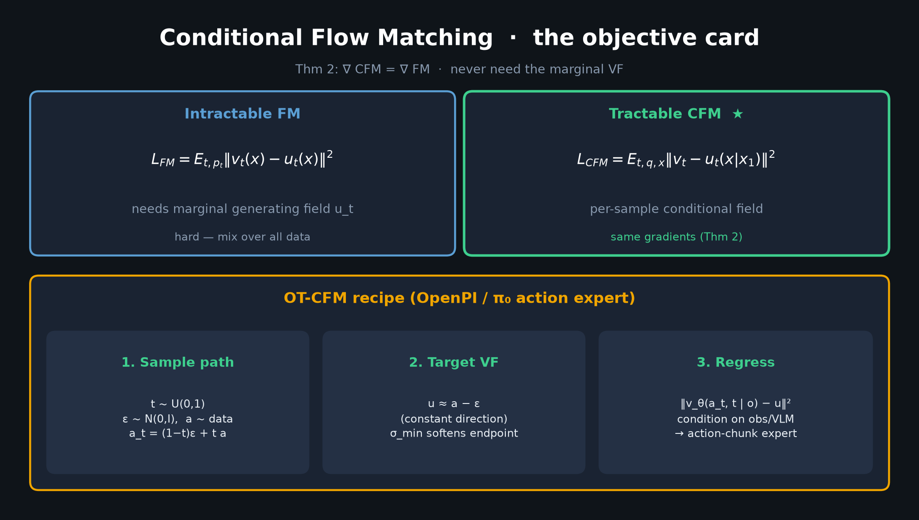
Scientific Reviewer · 8+3 · 3/10
Notes:
CFM CARD — point at Thm 2 as the theoretical backbone that makes the method scalable.

Slide 4
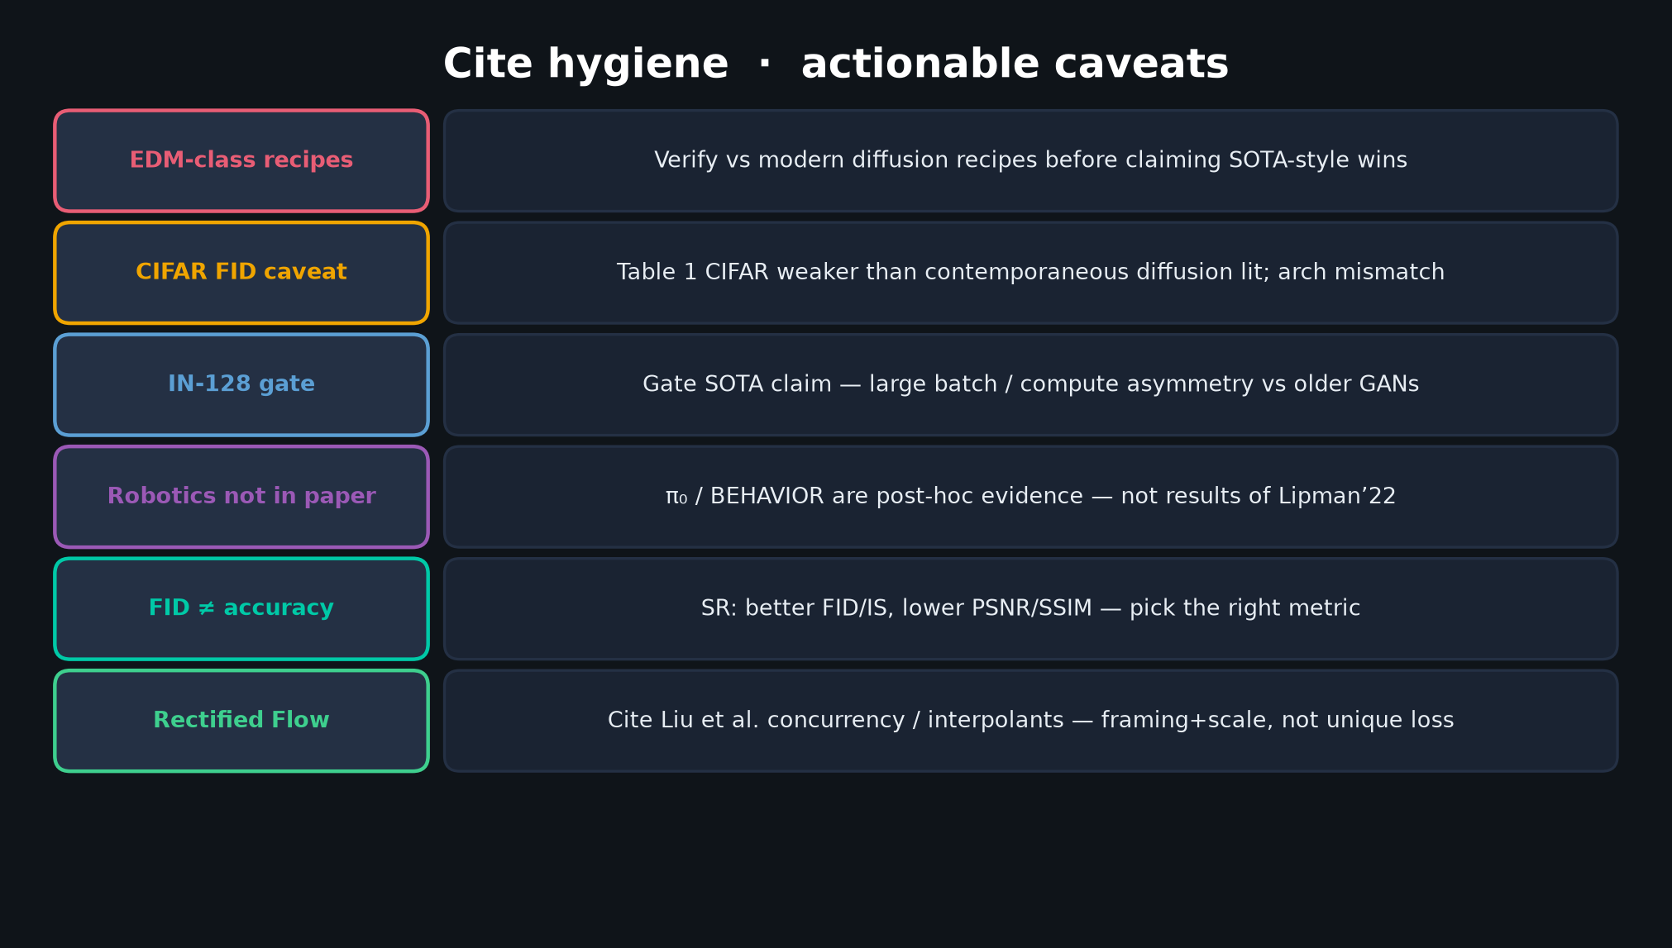
Scientific Reviewer · 8+3 · 4/10
Notes:
CITE HYGIENE — densest Reviewer slide. Hit all six: EDM, CIFAR FID, IN-128 gate, robotics not in paper, FID≠accuracy, Rectified Flow.

Slide 5
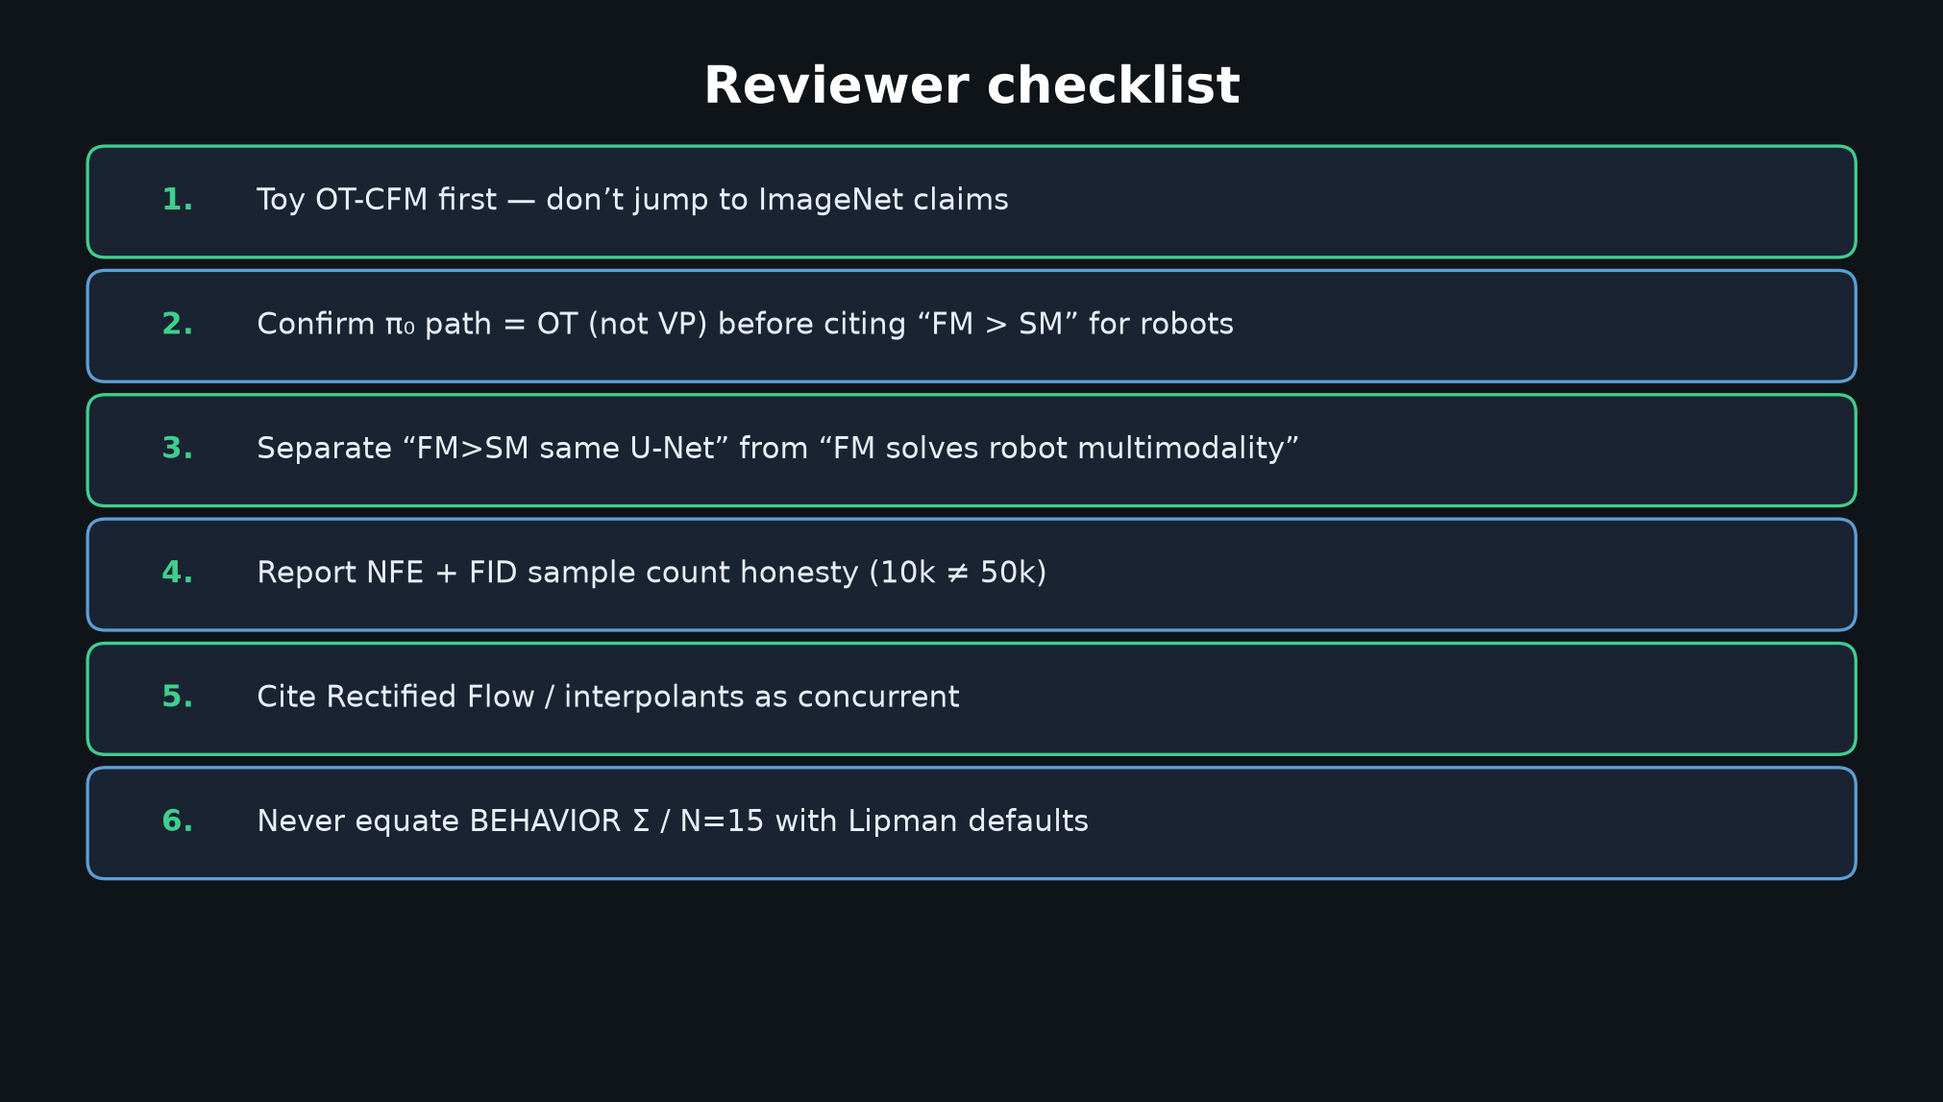
Scientific Reviewer · 8+3 · 5/10
Notes:
CHECKLIST — what the room must do before citing this paper for robotics claims.

Slide 6
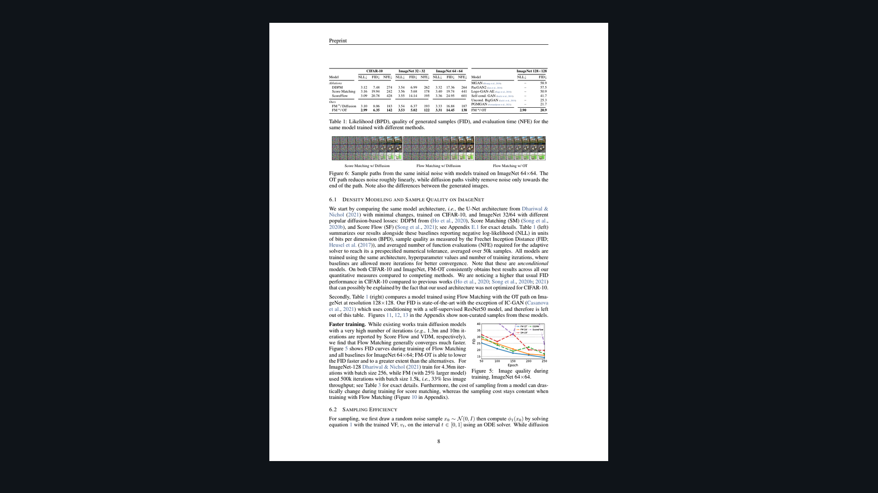
Scientific Reviewer · 8+3 · 6/10
Notes:
PAPER TABLE 1 — read carefully. FM-OT wins under matched U-Nets. Gate cross-paper SOTA brags (CIFAR arch not CIFAR-optimized; IN-128 compute asymmetry).

Slide 7
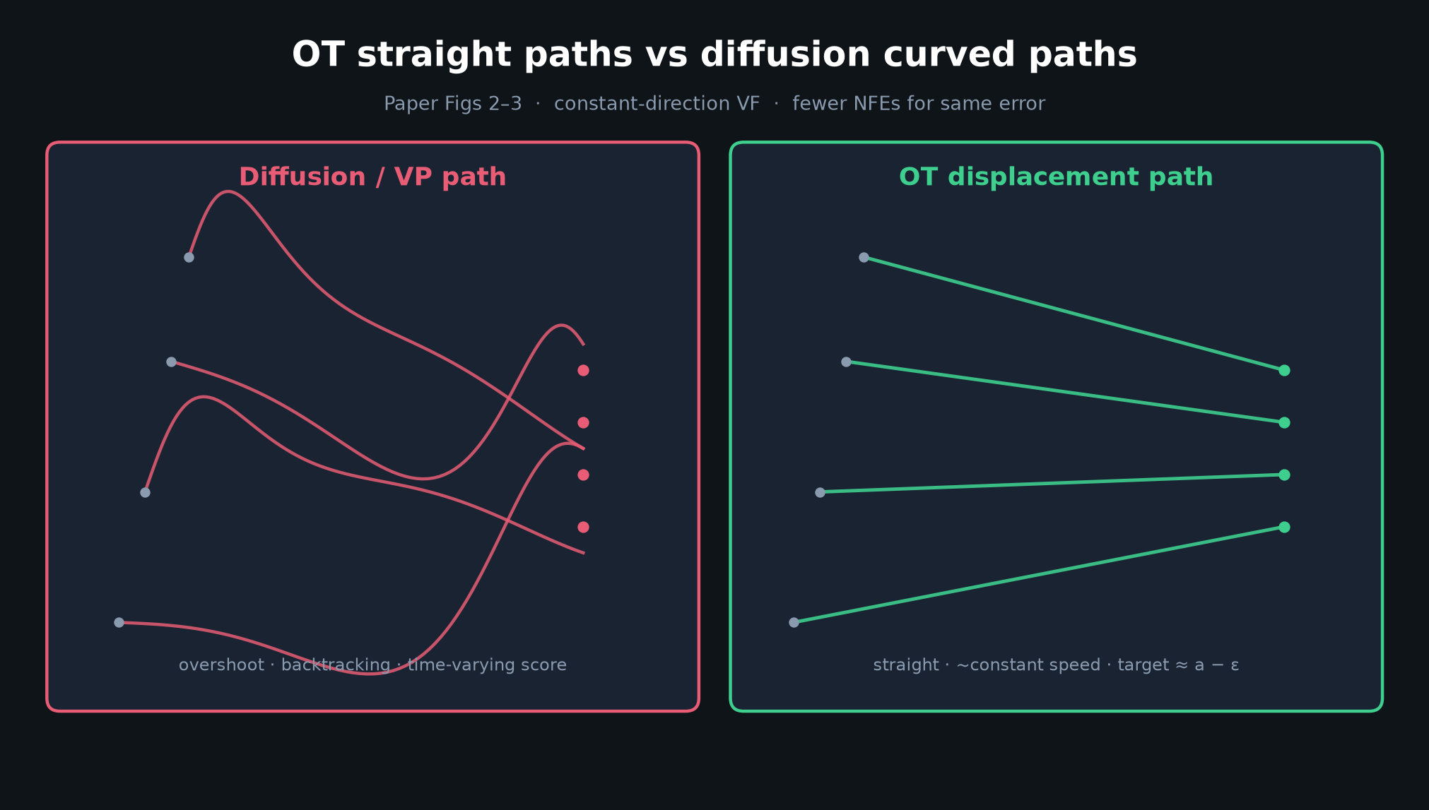
Scientific Reviewer · 8+3 · 7/10
Notes:
OT vs CURVED — principled, but remind: conditional OT ≠ claim that marginal VF is W₂-optimal (authors admit).

Slide 8
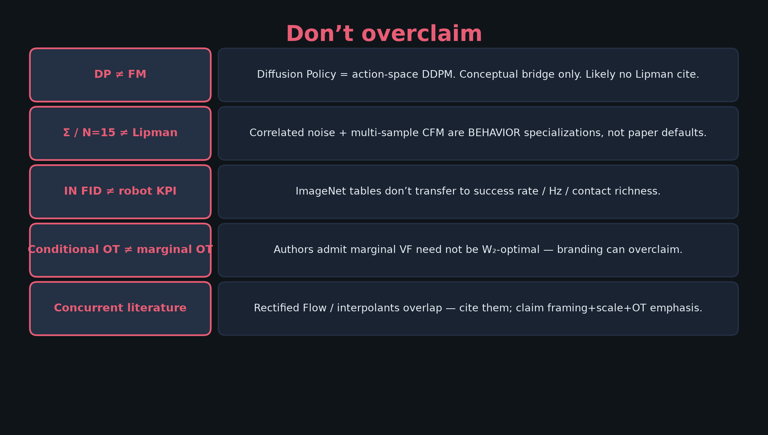
Scientific Reviewer · 8+3 · 8/10
Notes:
DON’T OVERCLAIM — robotics transfer is post-hoc. DP≠FM. Concurrent Rectified Flow.

Slide 9
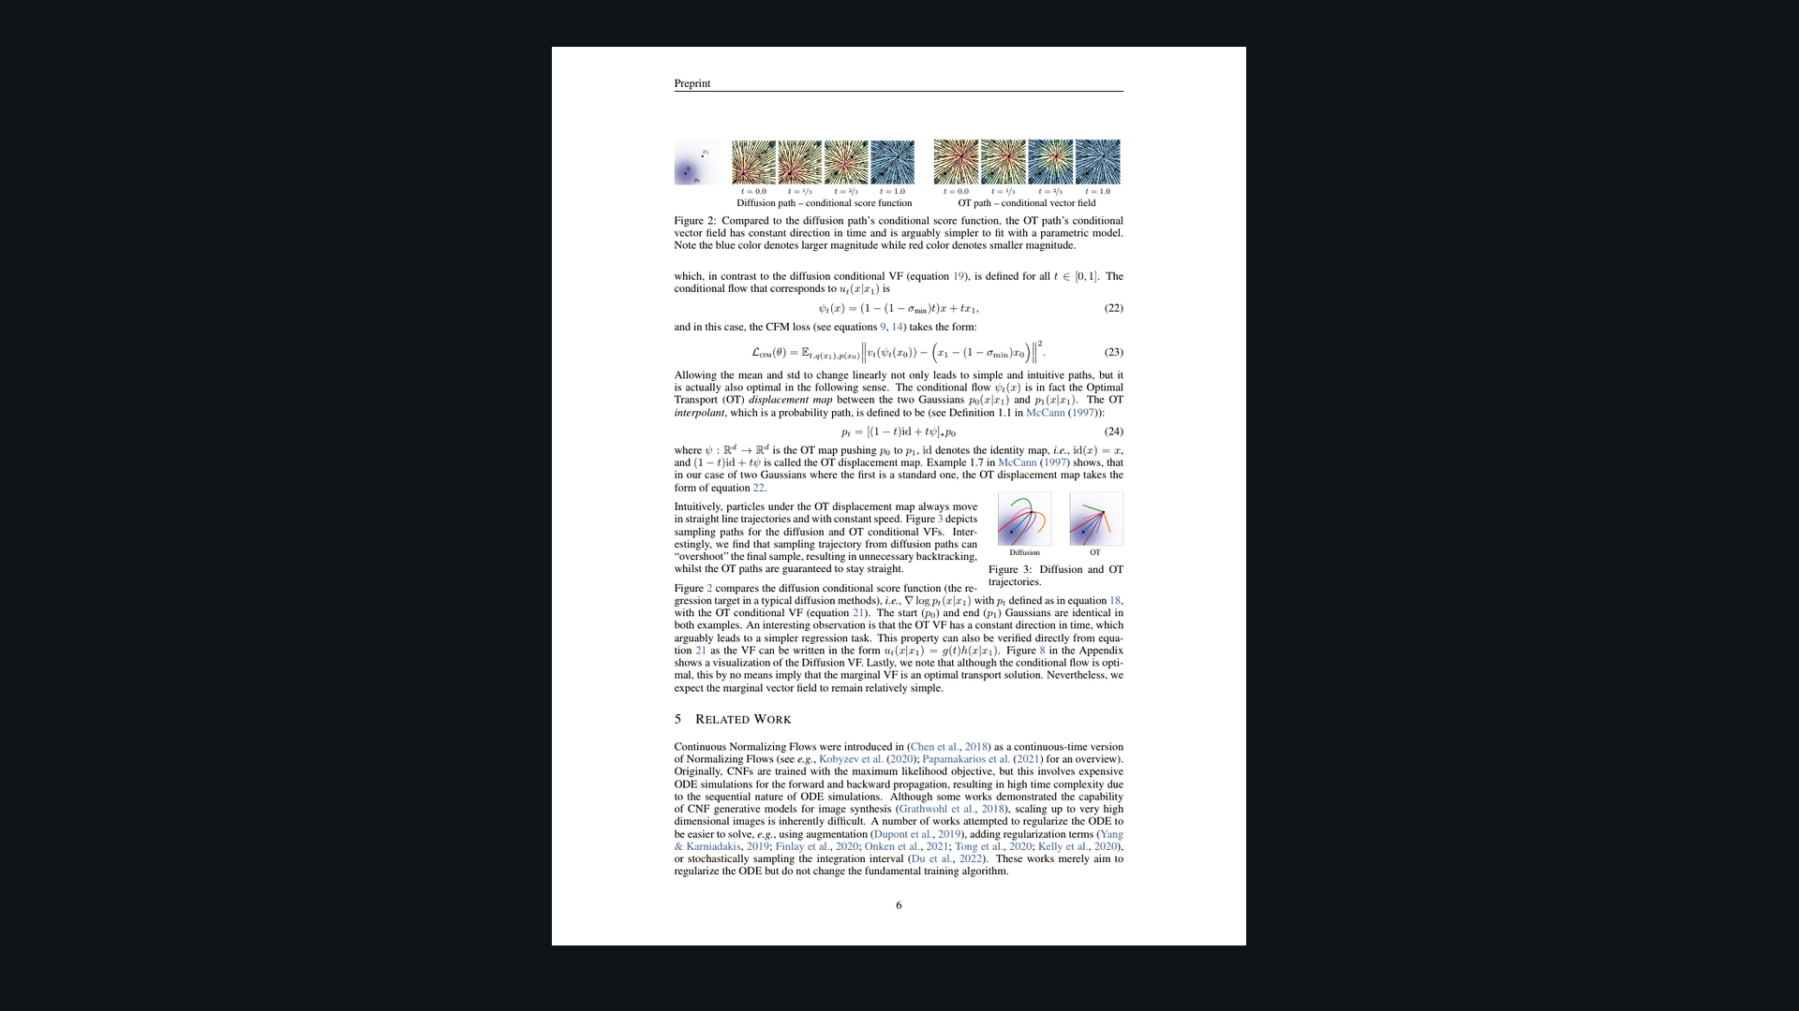
Scientific Reviewer · 8+3 · 9/10
Notes:
PAPER FIGS 2–3 — evidence quality is high for path geometry claims; keep ImageNet SOTA claims gated.

Slide 10
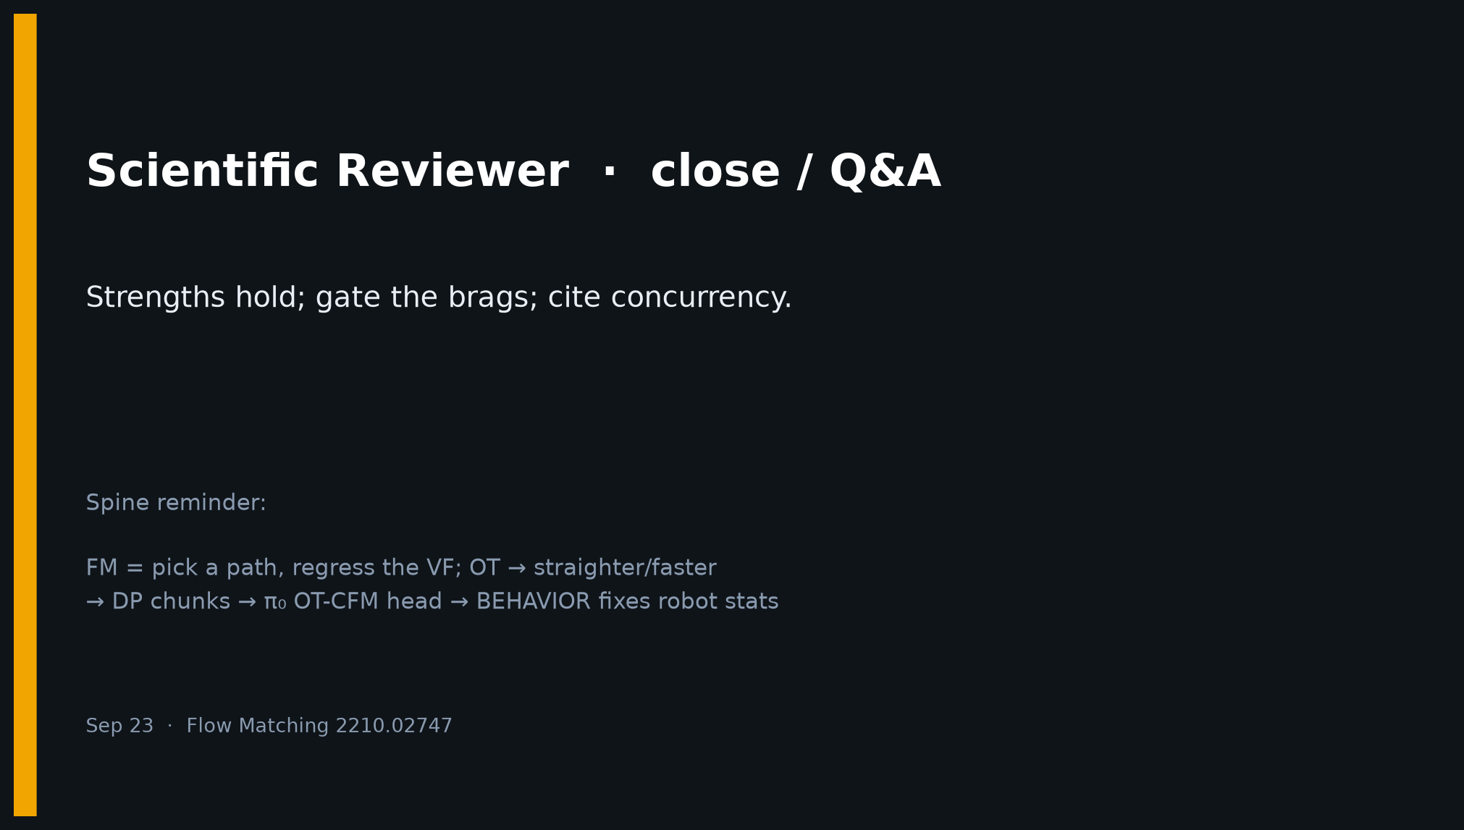
Scientific Reviewer · 8+3 · 10/10
Notes:
CLOSE — Strengths hold; gate the brags; cite concurrency. Leave checklist on screen if possible.

