Slide 1
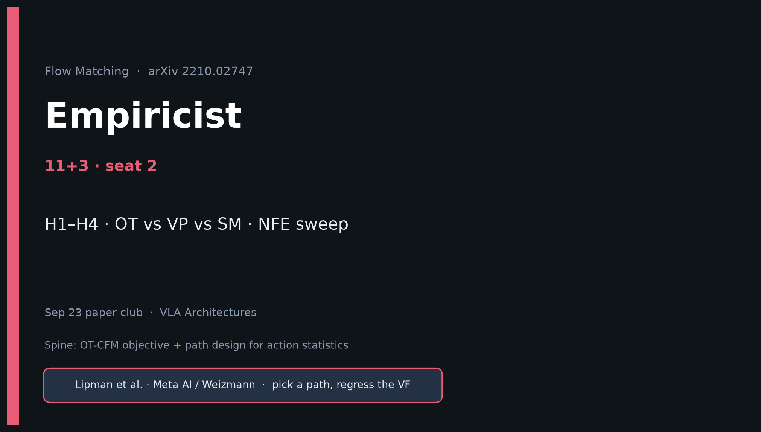
Empiricist · 11+3 · 1/12
Notes:
EMPIRICIST OPENING — seat 2. Timing 11+3.
You own H1–H4 and the P0 toy plan. Budget: 1×GPU hours–1 day for P0.
Env outline: /workspace/flow-matching-quiet/env_outline/
Do NOT attempt paper ImageNet-128.

Slide 2
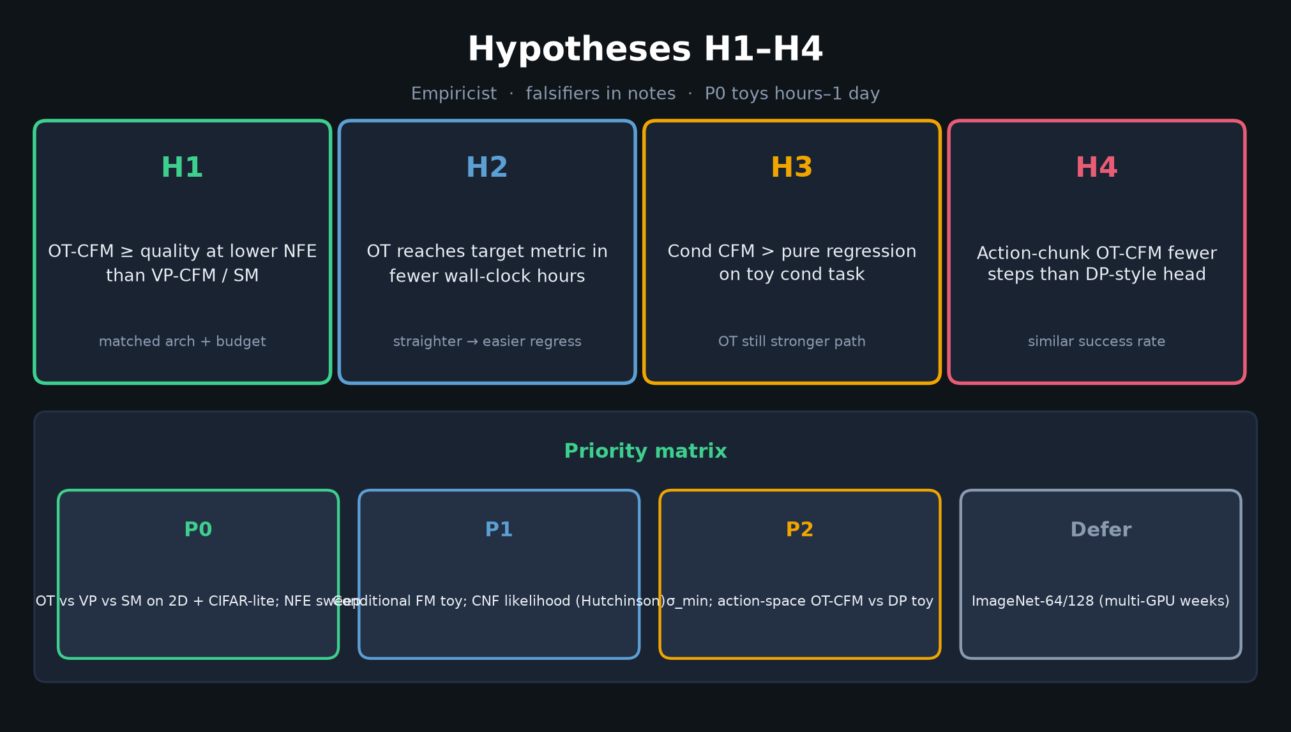
Empiricist · 11+3 · 2/12
Notes:
H1–H4 + priority matrix. Speak falsifiers from notes:
OT worse FID at high NFE; OT unstable near t→1 without σ_min; cond FM collapses vs regression.

Slide 3
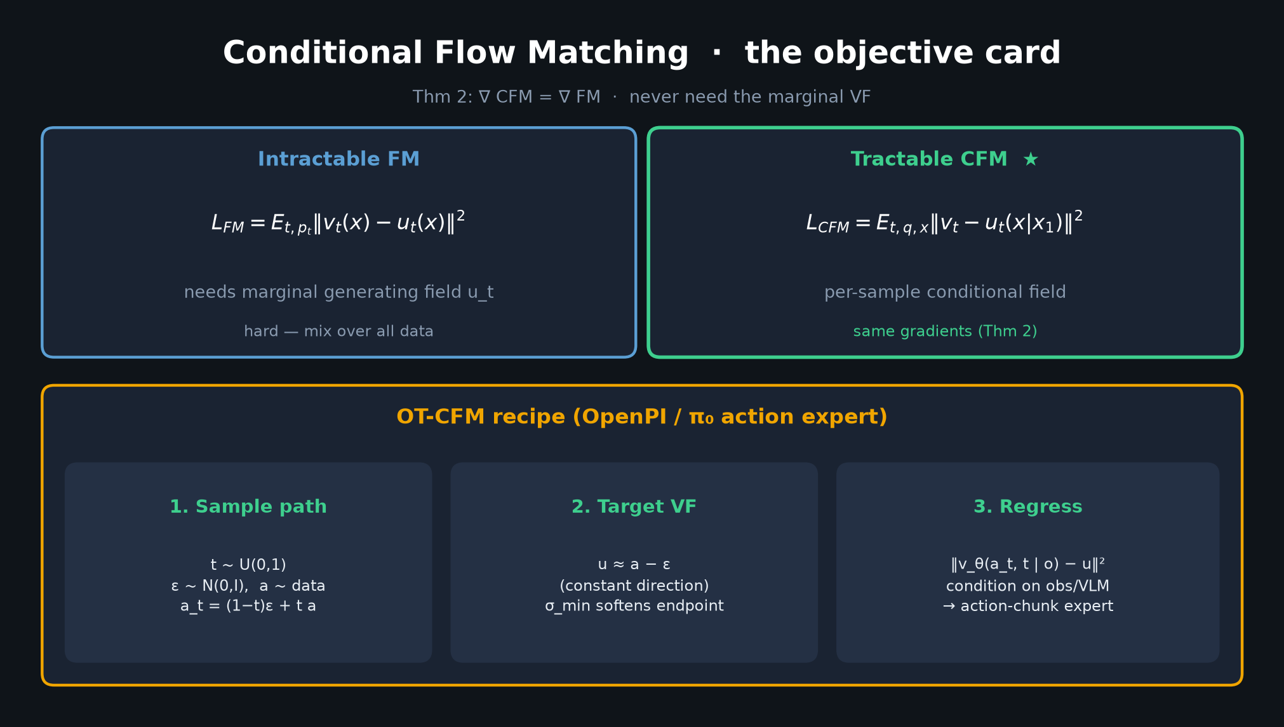
Empiricist · 11+3 · 3/12
Notes:
CFM OBJECTIVE — implement outline: sample_xt + target_ut for ot/vp; L=‖v−u‖²; SM baseline on VP.

Slide 4
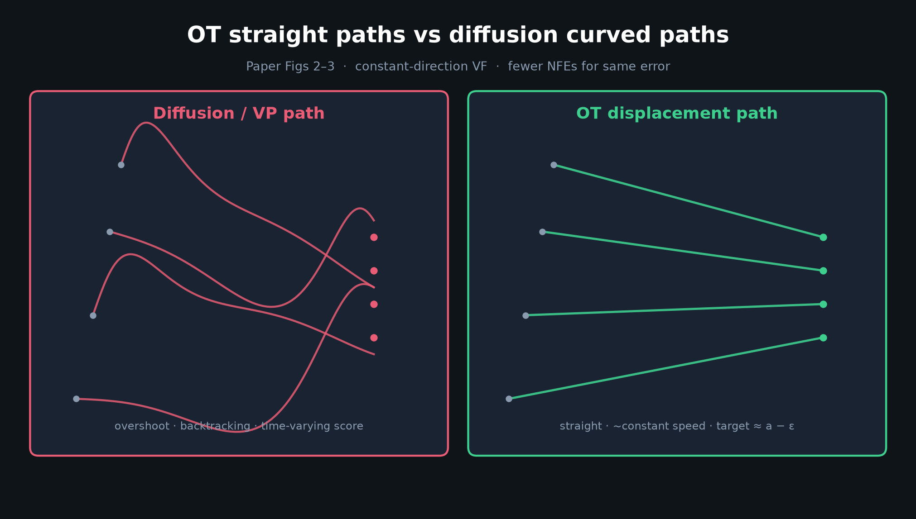
Empiricist · 11+3 · 4/12
Notes:
OT vs CURVED — what you expect to see in 2D trajectory plots (Fig 3 analogue).

Slide 5
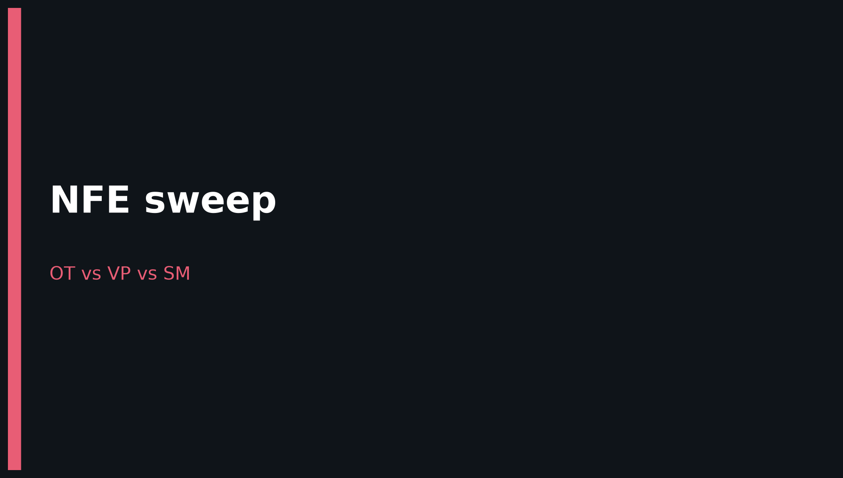
Empiricist · 11+3 · 5/12
Notes:
BANNER — NFE sweep is your key figure.

Slide 6
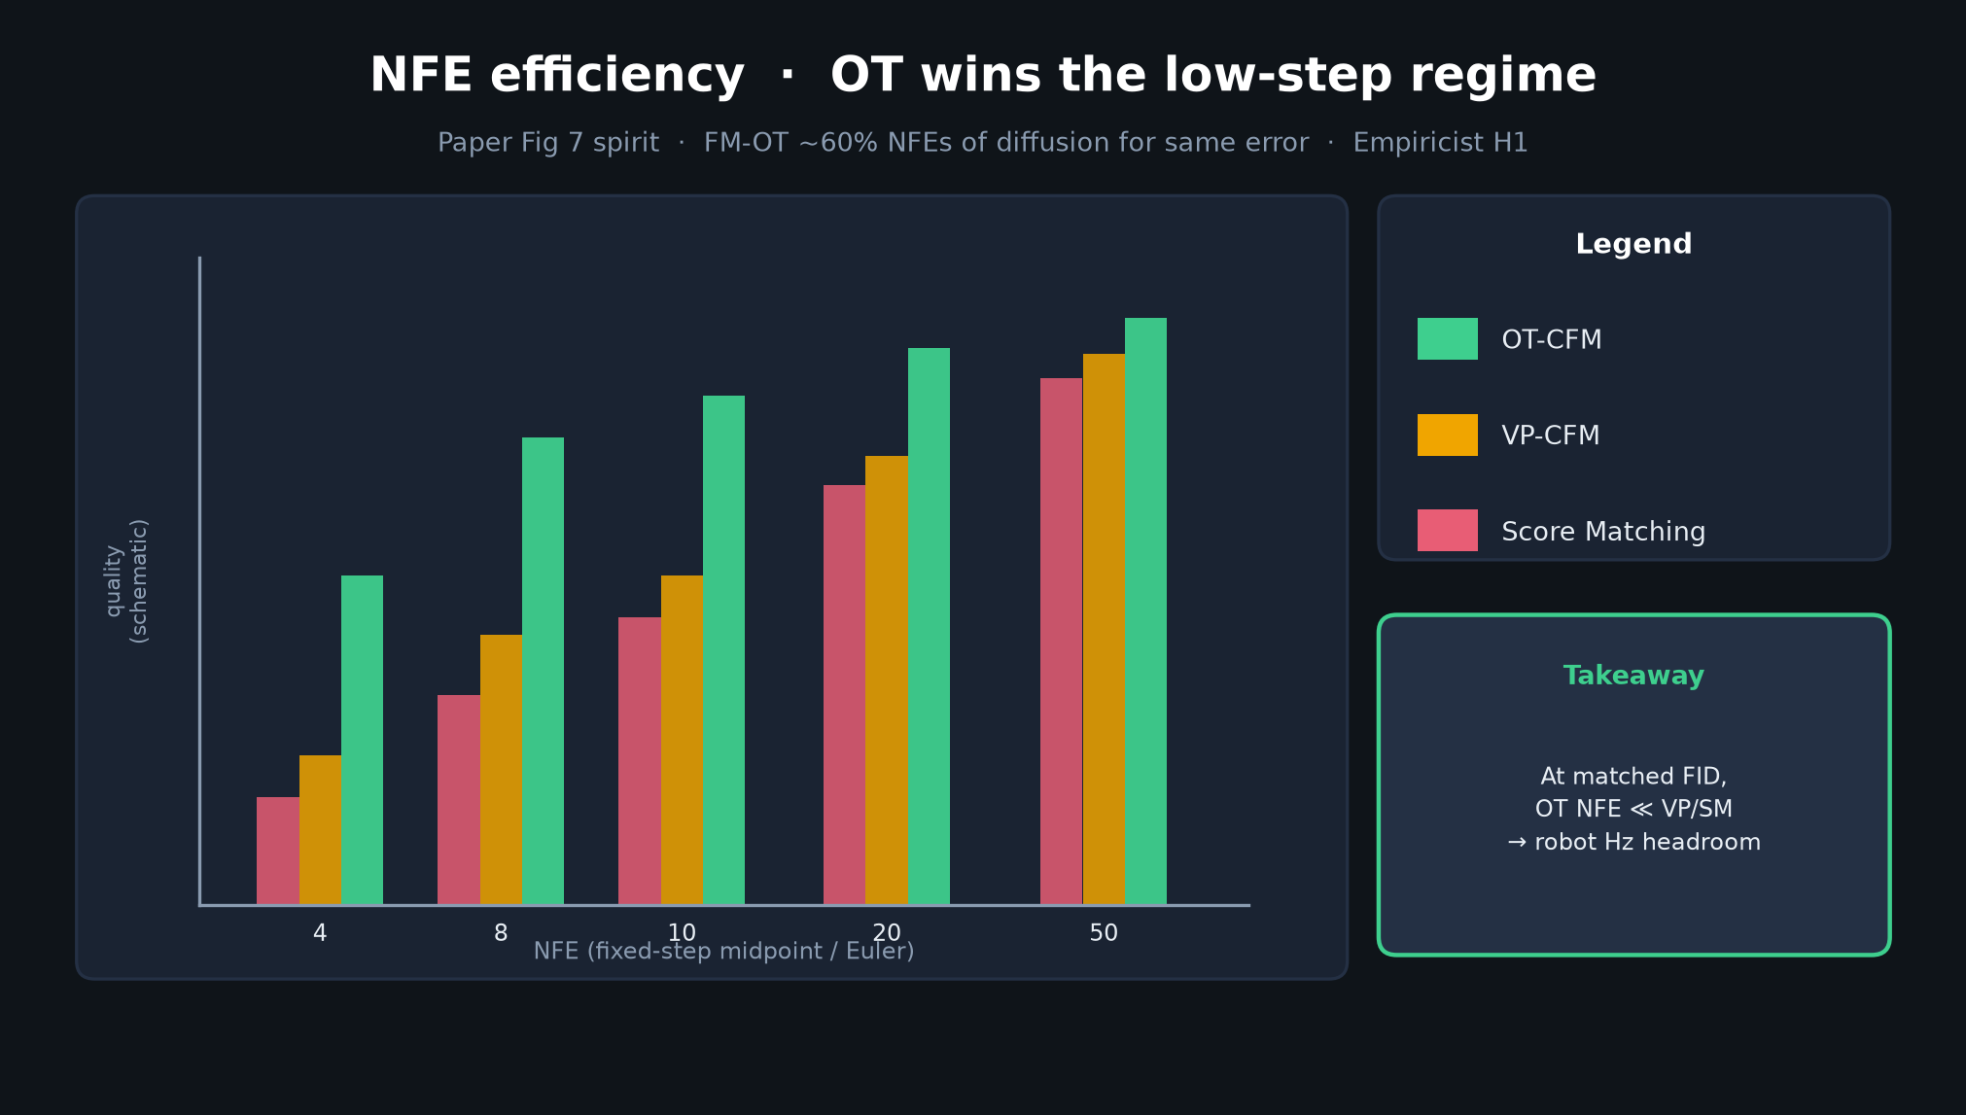
Empiricist · 11+3 · 6/12
Notes:
NFE COMPARISON FIGURE — schematic of H1. Report actual FID/MMD vs NFE ∈ {4…100} with Euler/midpoint/RK4.

Slide 7
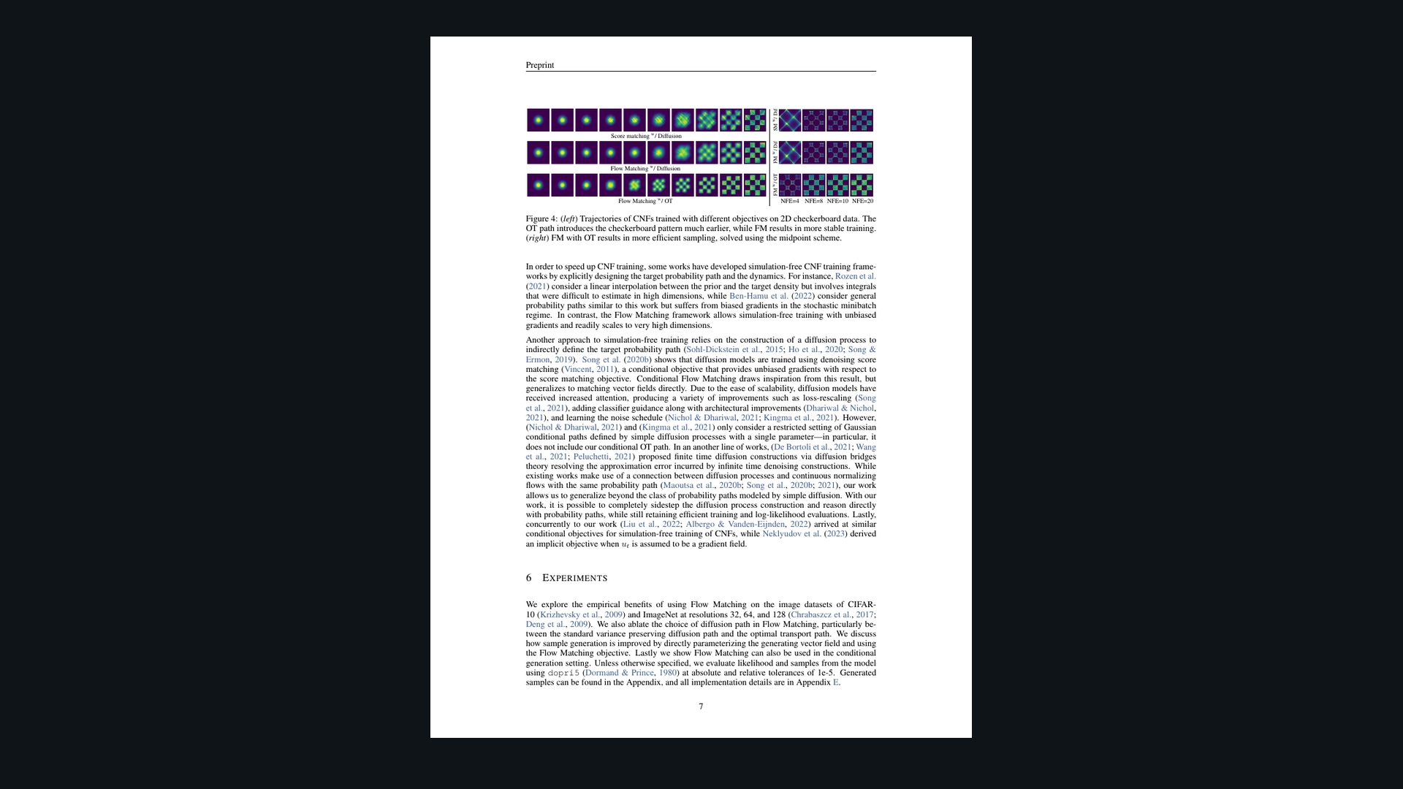
Empiricist · 11+3 · 7/12
Notes:
PAPER FIG 4 — gold-standard visual for OT vs VP vs SM on checkerboard + low NFE. Reproduce spirit at toy scale.

Slide 8
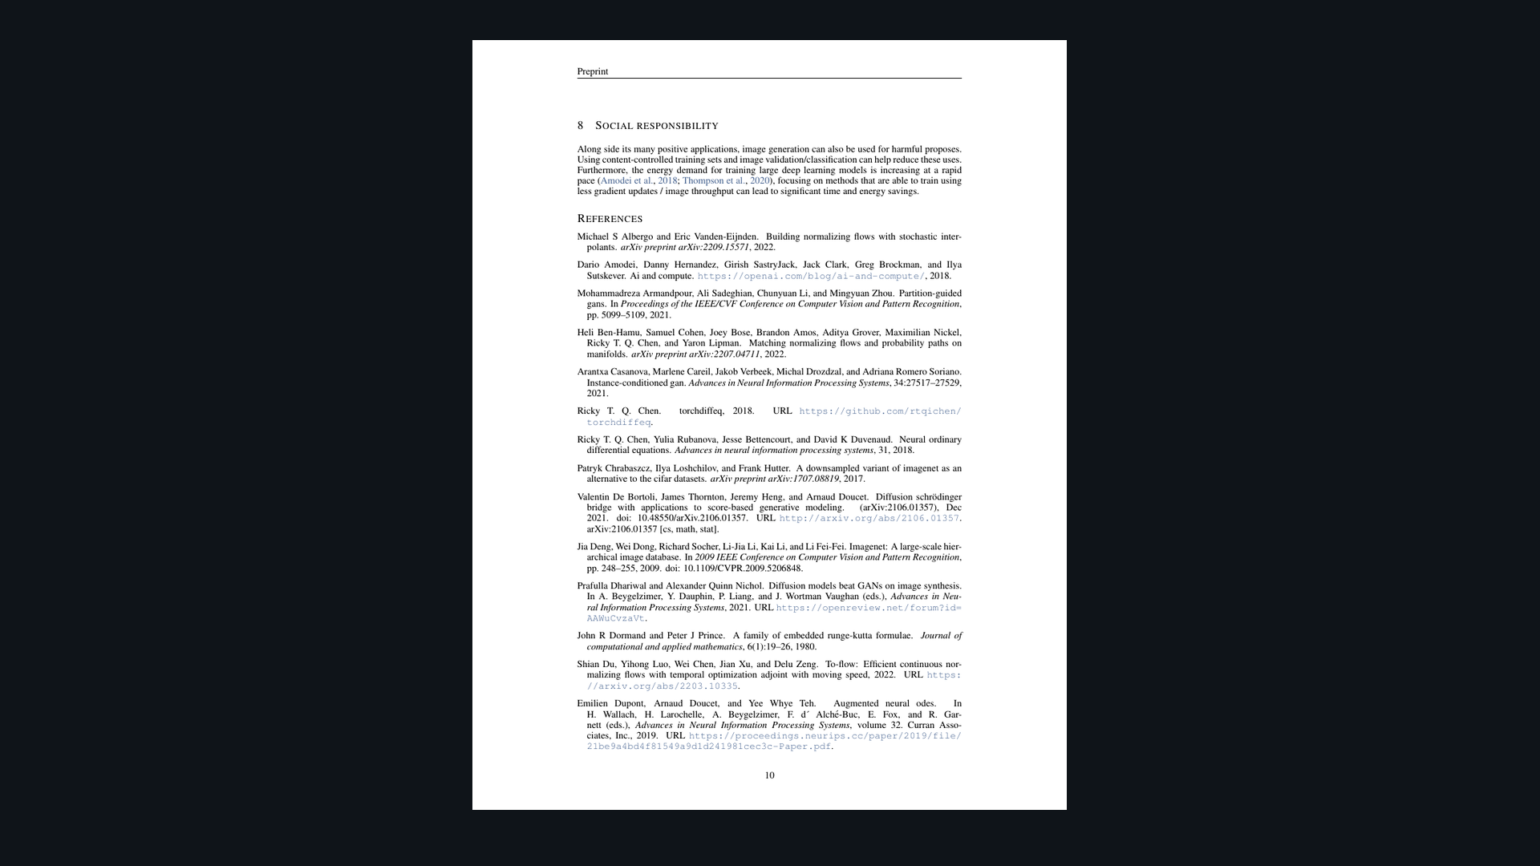
Empiricist · 11+3 · 8/12
Notes:
PAPER FIG 7 — MSE-to-high-NFE and FID vs cost. Target: OT needs ~60% NFEs of diffusion for same error.

Slide 9
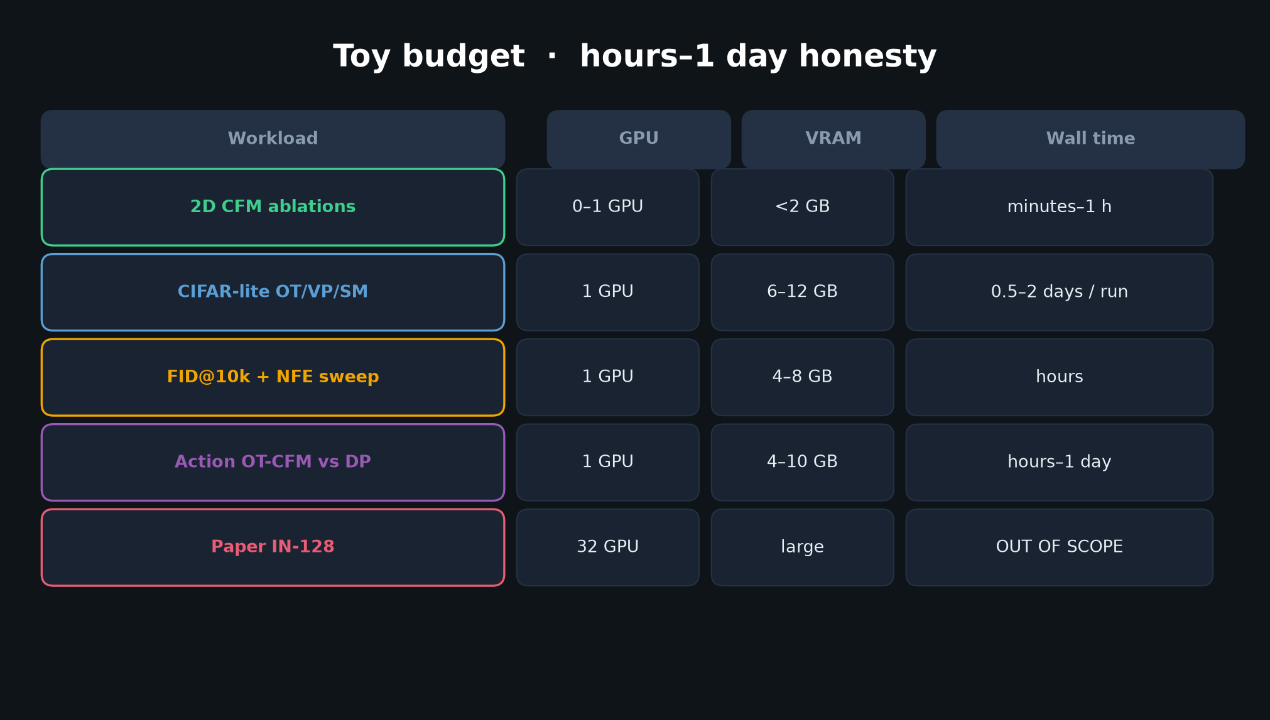
Empiricist · 11+3 · 9/12
Notes:
TOY BUDGET — honesty table. 2D minutes; CIFAR-lite 0.5–2 days; IN-128 OUT OF SCOPE. Log device + max_memory_allocated.

Slide 10
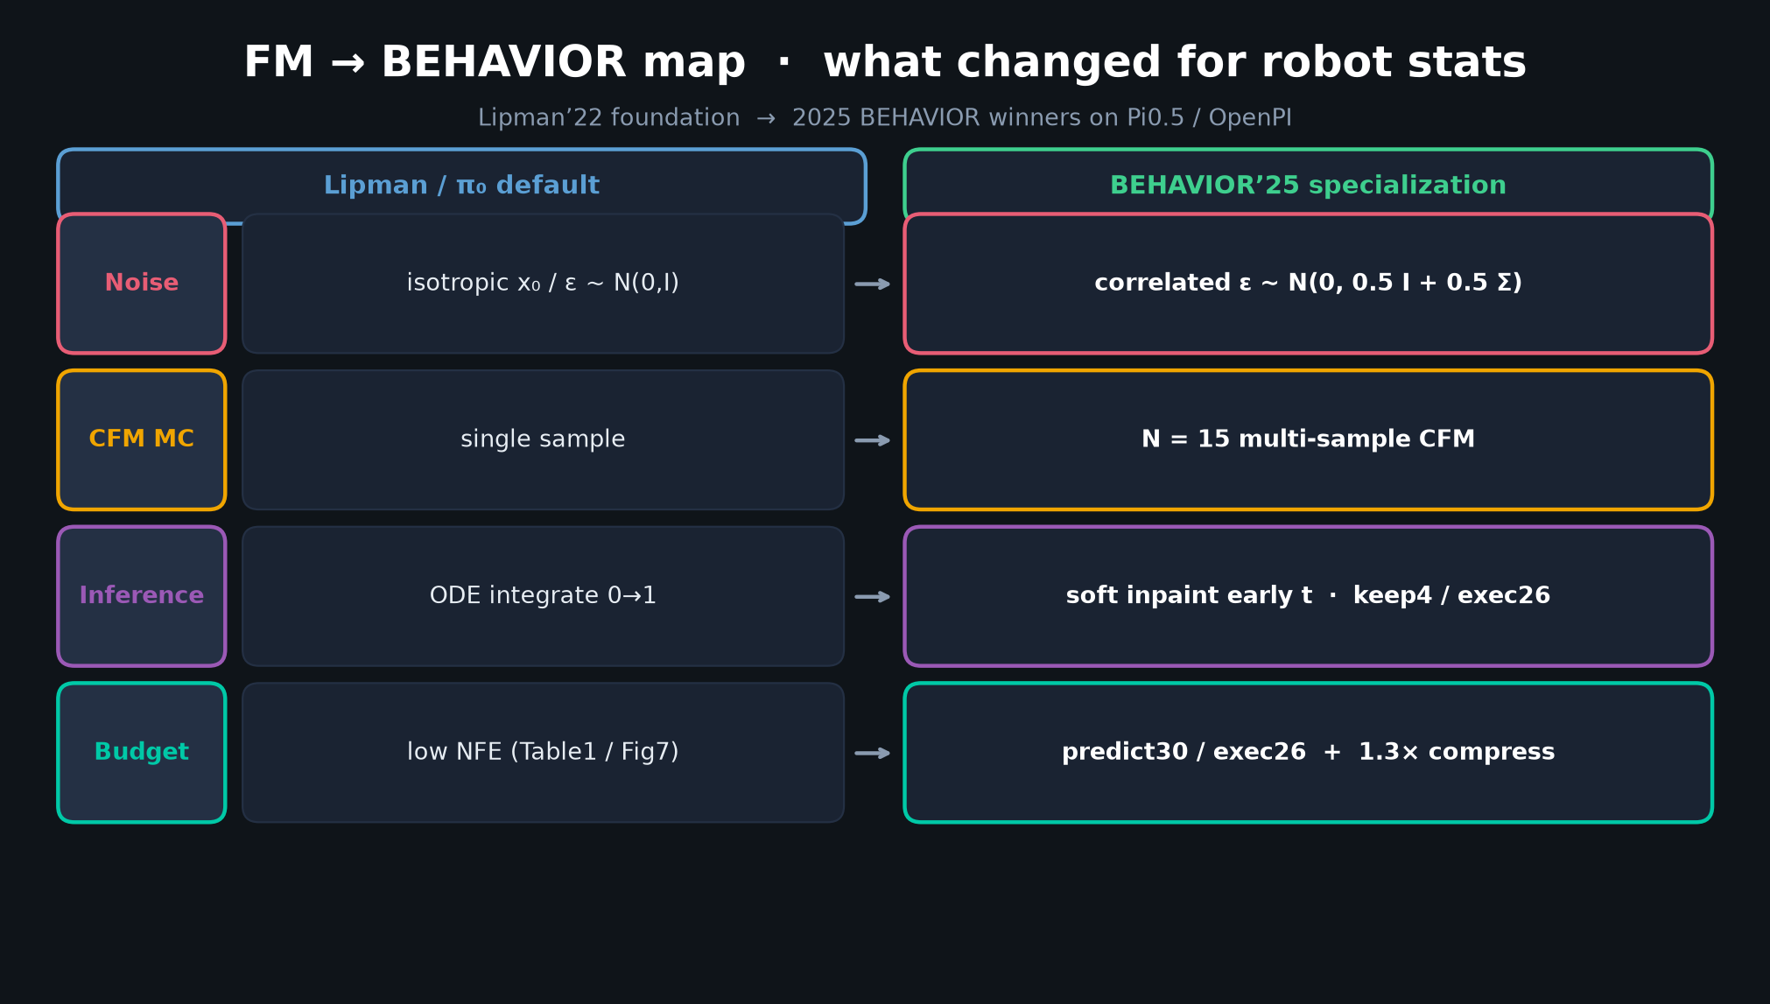
Empiricist · 11+3 · 10/12
Notes:
H4 bridge — action-chunk OT-CFM vs DP toy. Same backbone width; compare success vs steps. Full OpenPI fine-tunes out of quiet scope.

Slide 11
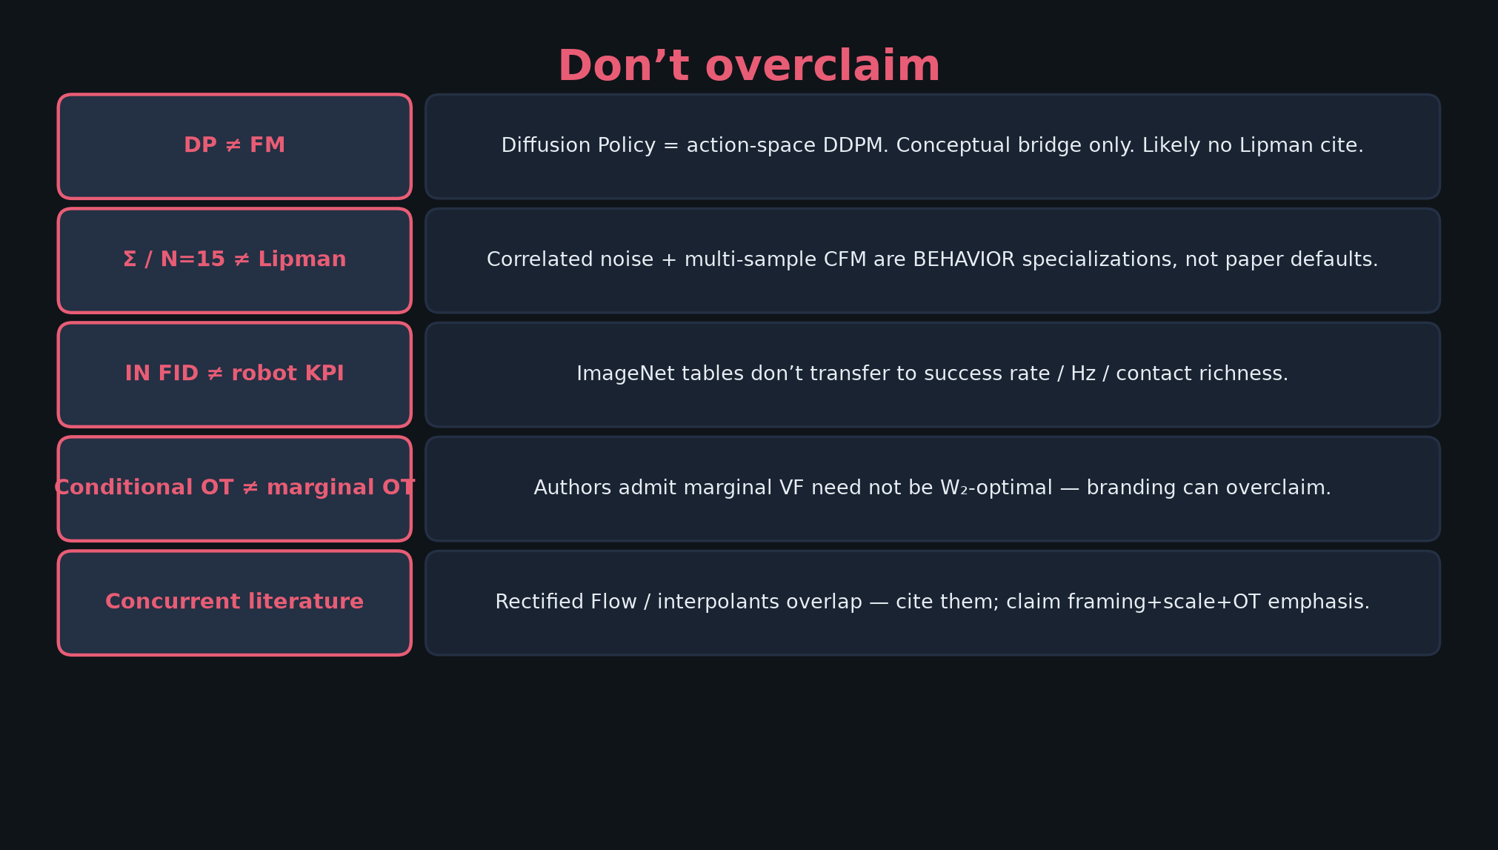
Empiricist · 11+3 · 11/12
Notes:
DON’T OVERCLAIM on results — FID sample count honesty; never “GPU run” for CPU fallback.

Slide 12
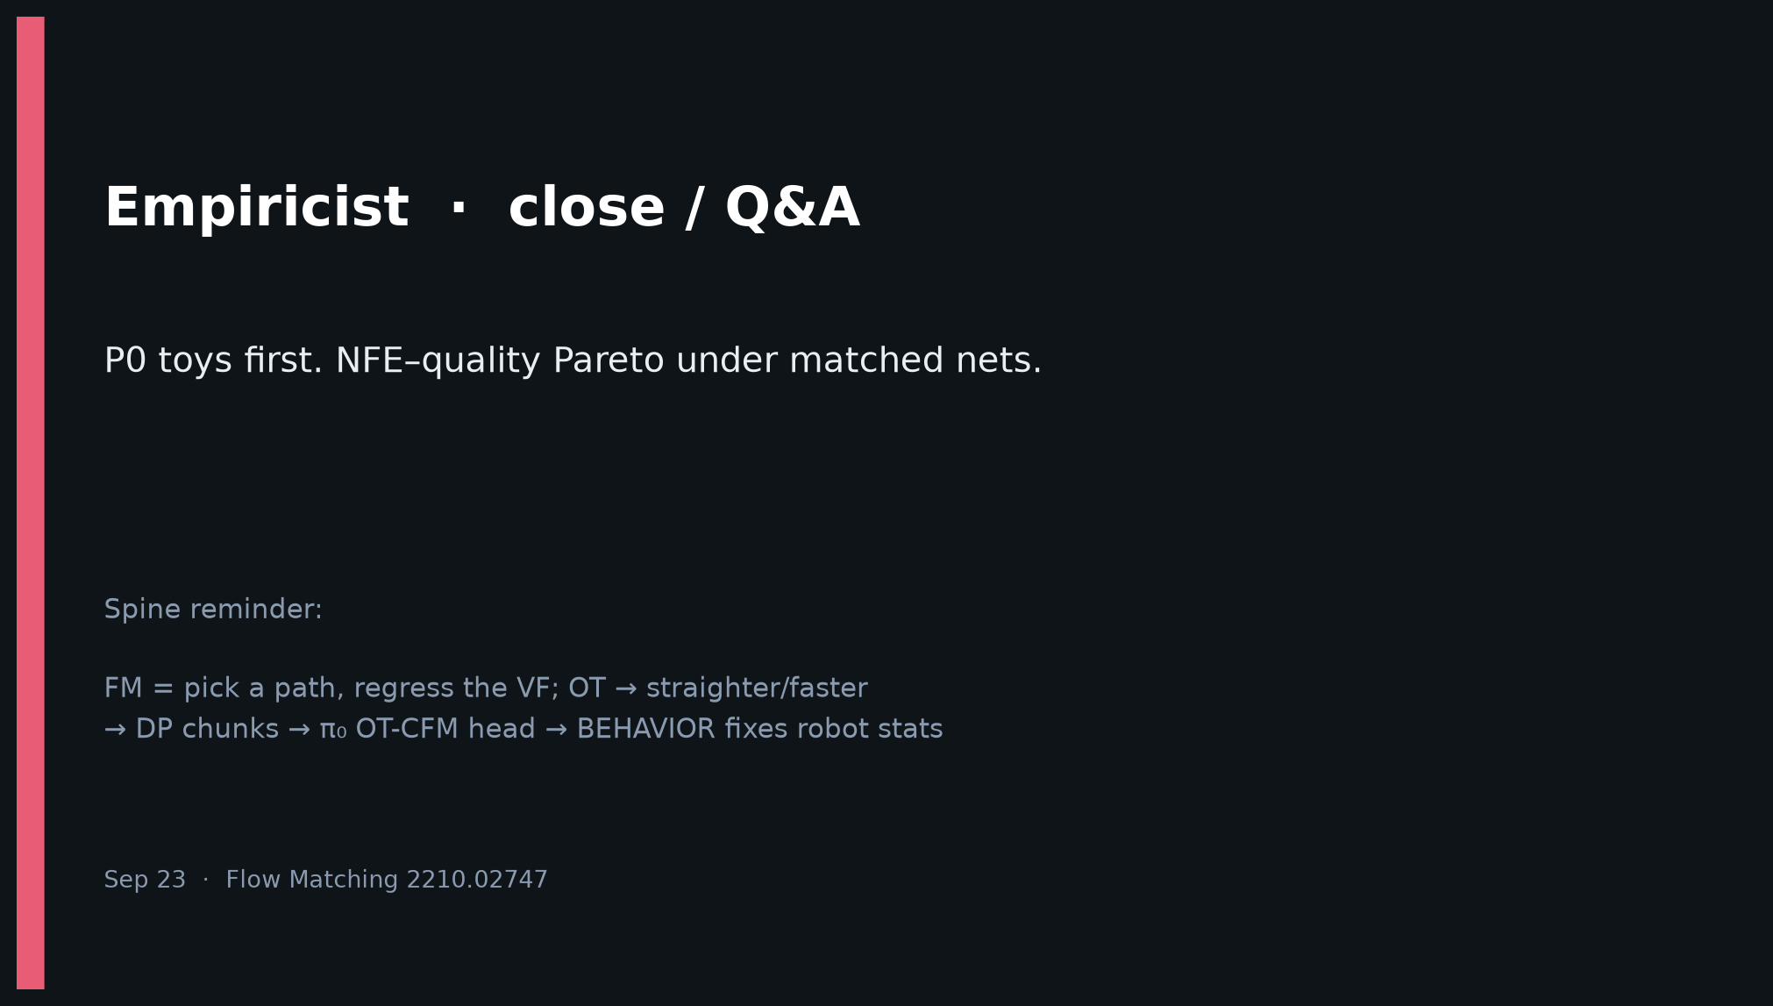
Empiricist · 11+3 · 12/12
Notes:
CLOSE — P0 toys first. NFE–quality Pareto under matched nets. Env outlines ready.

