Slide 1
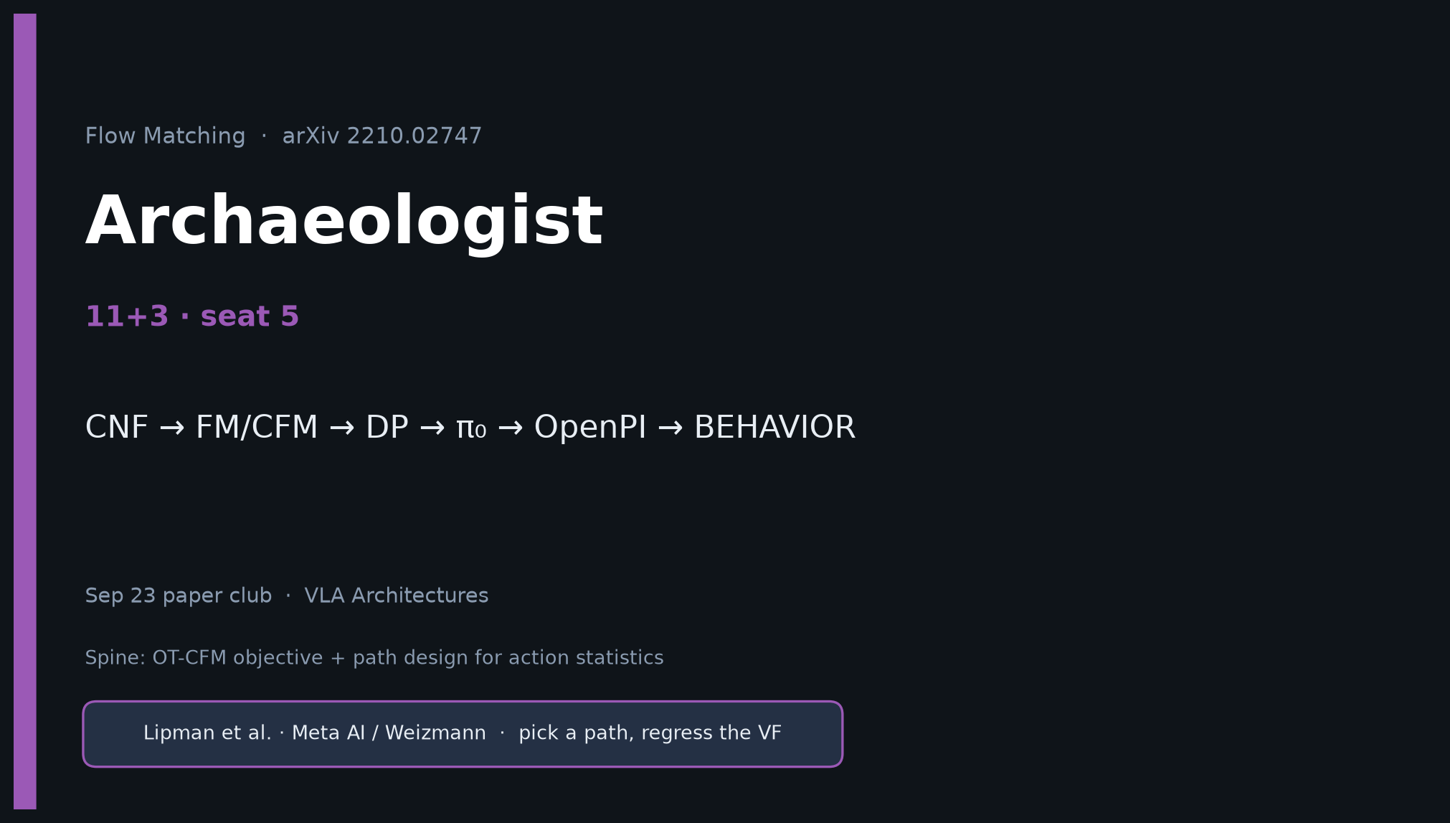
Archaeologist · 11+3 · 1/12
Notes:
ARCHAEOLOGIST OPENING — seat 5. Timing 11+3.
You own the intellectual history:
CNF/Neural ODE → sim-free attempts → diffusion/score → ★ FM/CFM (+ Rectified Flow) → DP action DDPM → π₀ (CLEAR Lipman cite) → OpenPI/π₀.₅ → BEHAVIOR correlated FM.
NOTE: DP likely does NOT cite Lipman. Say that aloud.

Slide 2

Archaeologist · 11+3 · 2/12
Notes:
BANNER — timeline is your densest figure.

Slide 3
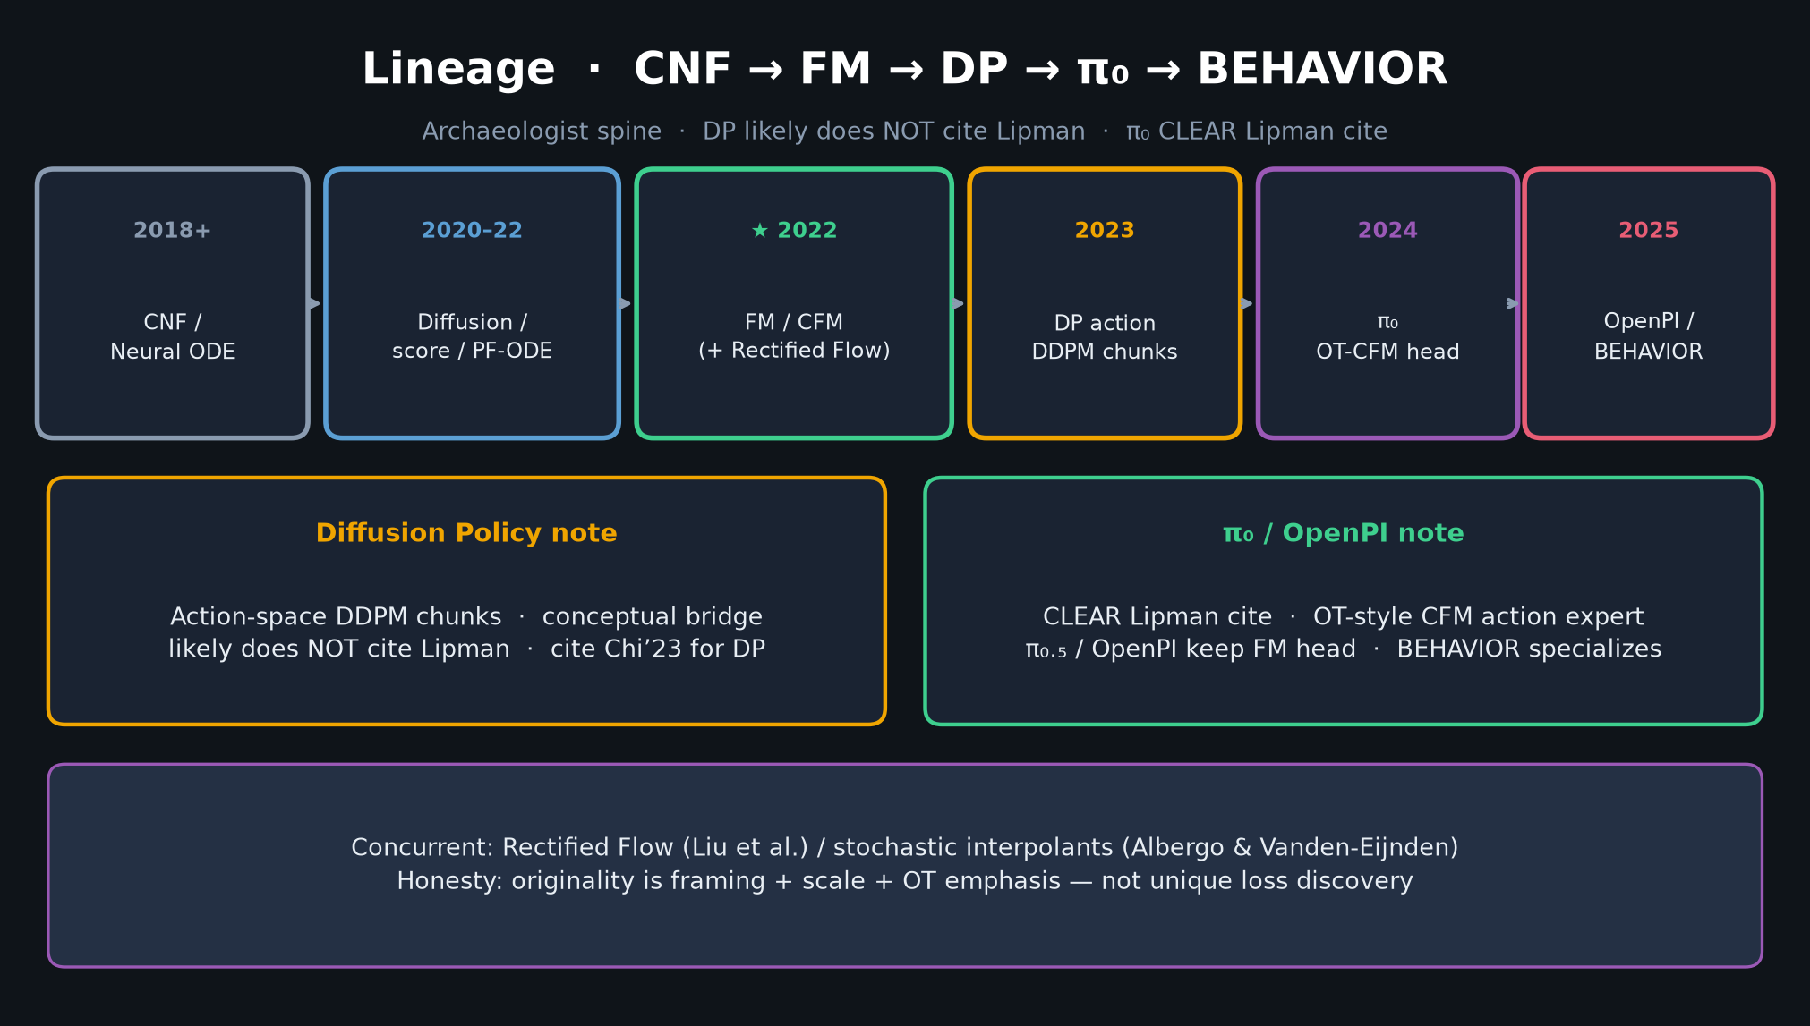
Archaeologist · 11+3 · 3/12
Notes:
LINEAGE TIMELINE — walk every node. Emphasize:
• FM/CFM ★ 2022 with concurrent Rectified Flow
• DP 2023 = action DDPM — likely NO Lipman cite
• π₀ CLEAR Lipman cite
• BEHAVIOR specializes FM (Σ, N=15, soft inpaint)

Slide 4
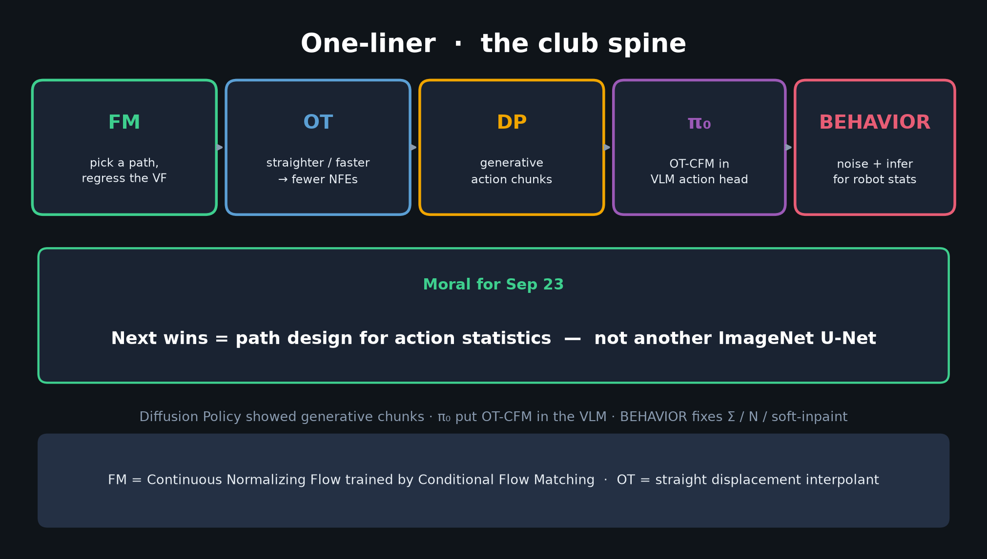
Archaeologist · 11+3 · 4/12
Notes:
ONE-LINER SPINE — how the club will remember the through-line.

Slide 5
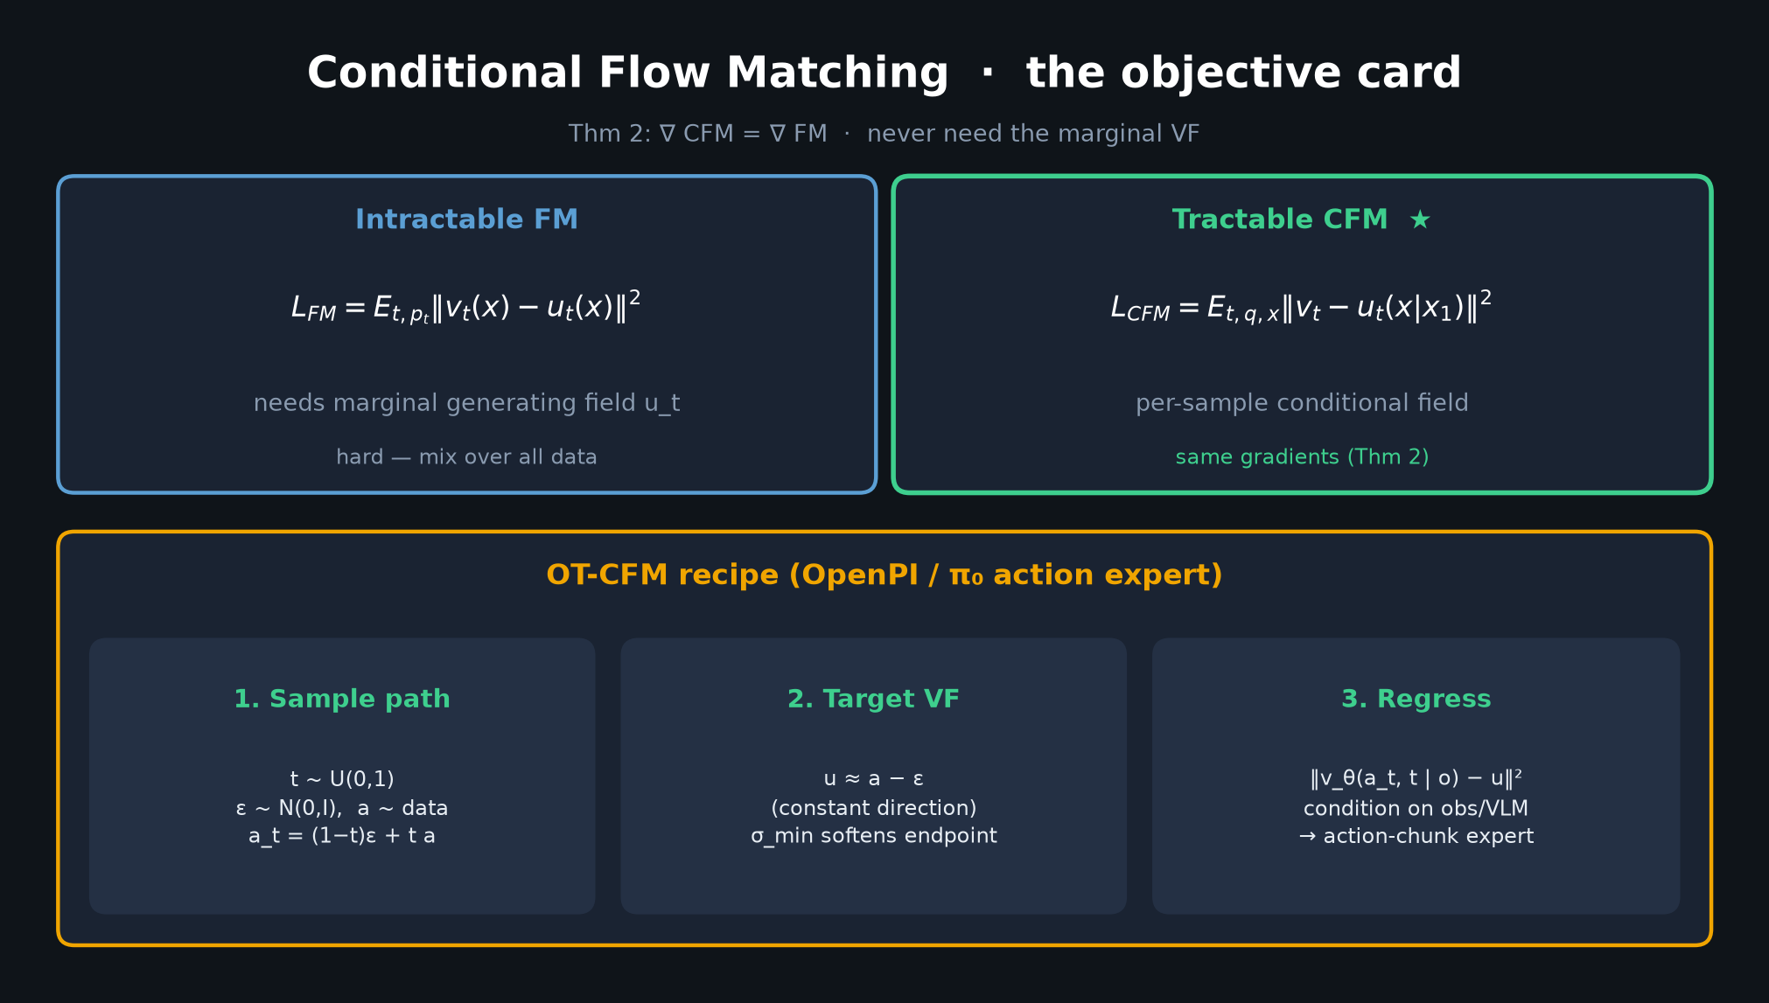
Archaeologist · 11+3 · 5/12
Notes:
CFM CARD — what FM contributed vs prior CNF simulation training.

Slide 6
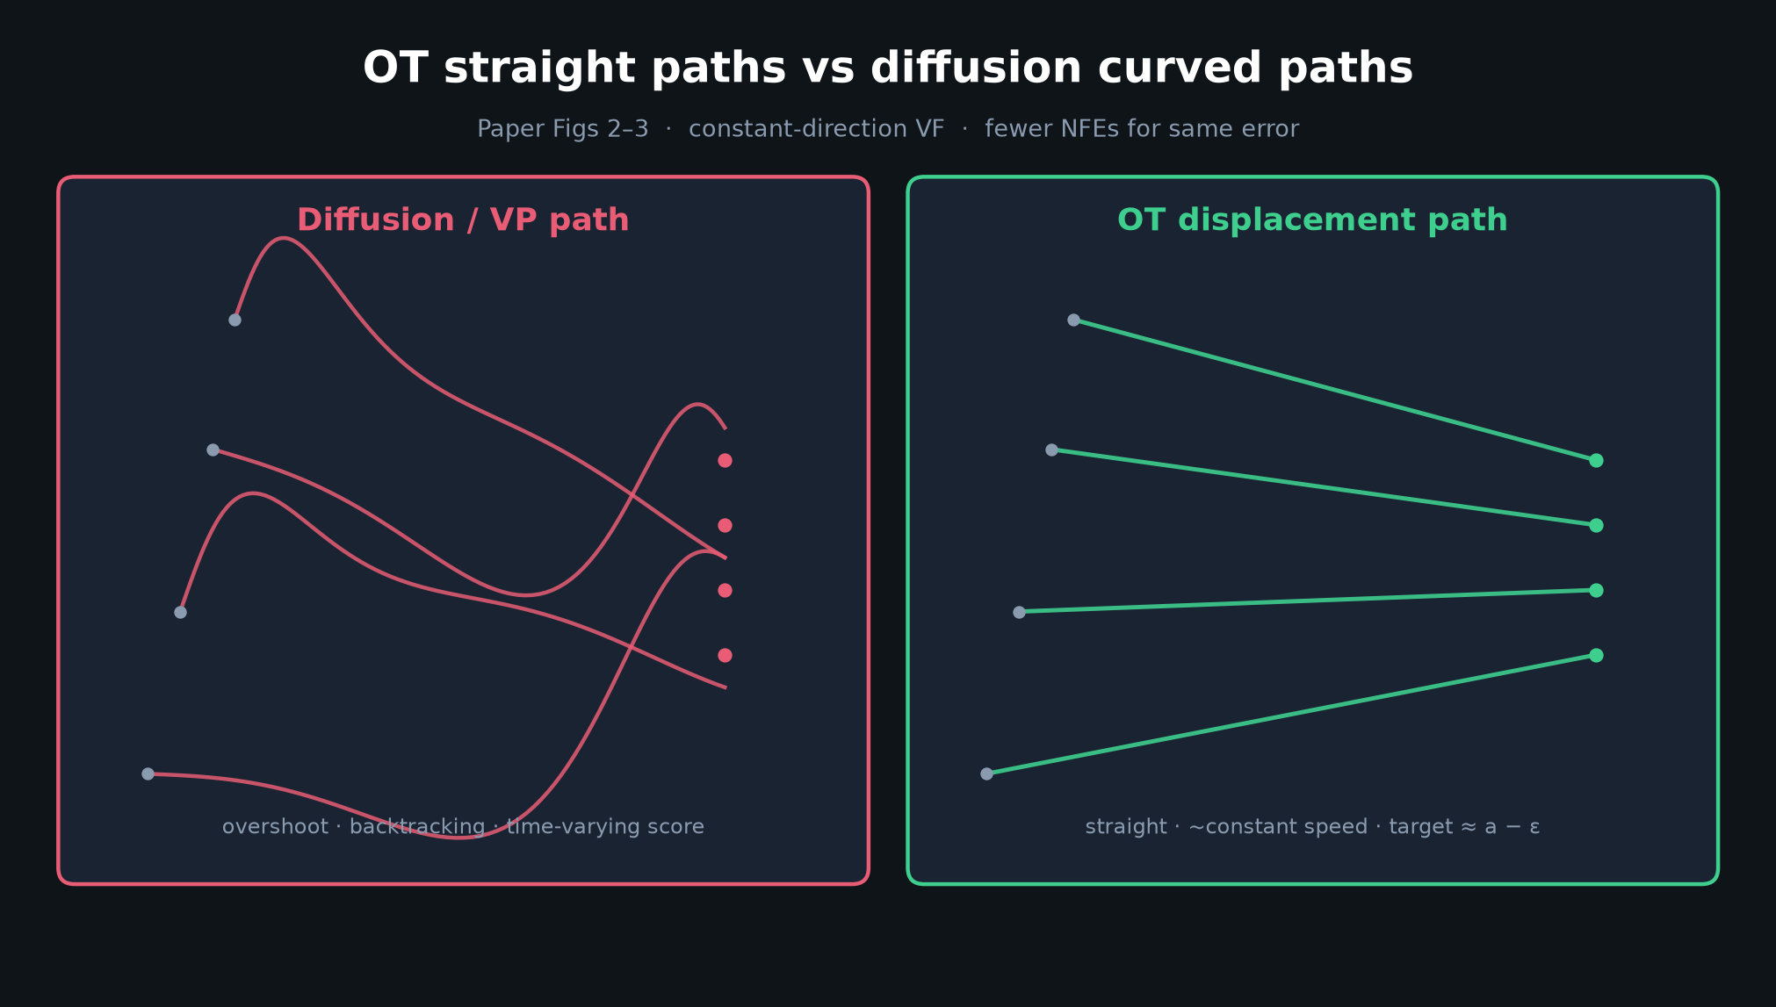
Archaeologist · 11+3 · 6/12
Notes:
OT vs CURVED — why OT path design became the default for action experts.

Slide 7
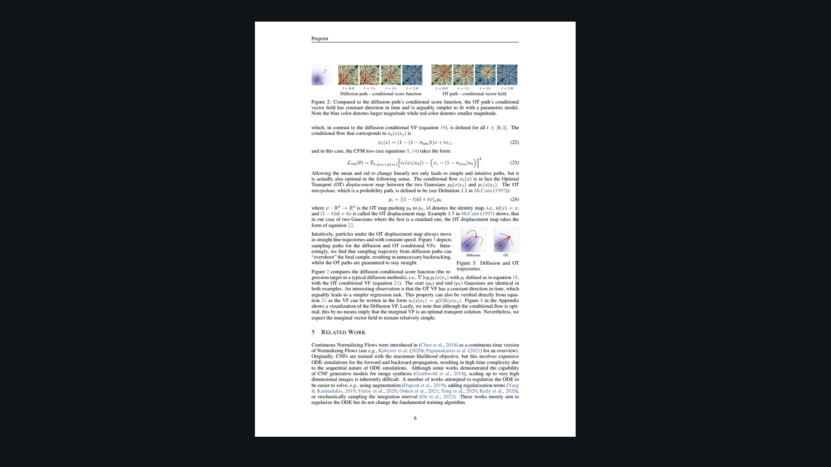
Archaeologist · 11+3 · 7/12
Notes:
PAPER FIGS 2–3 — primary historical evidence of the OT claim.

Slide 8
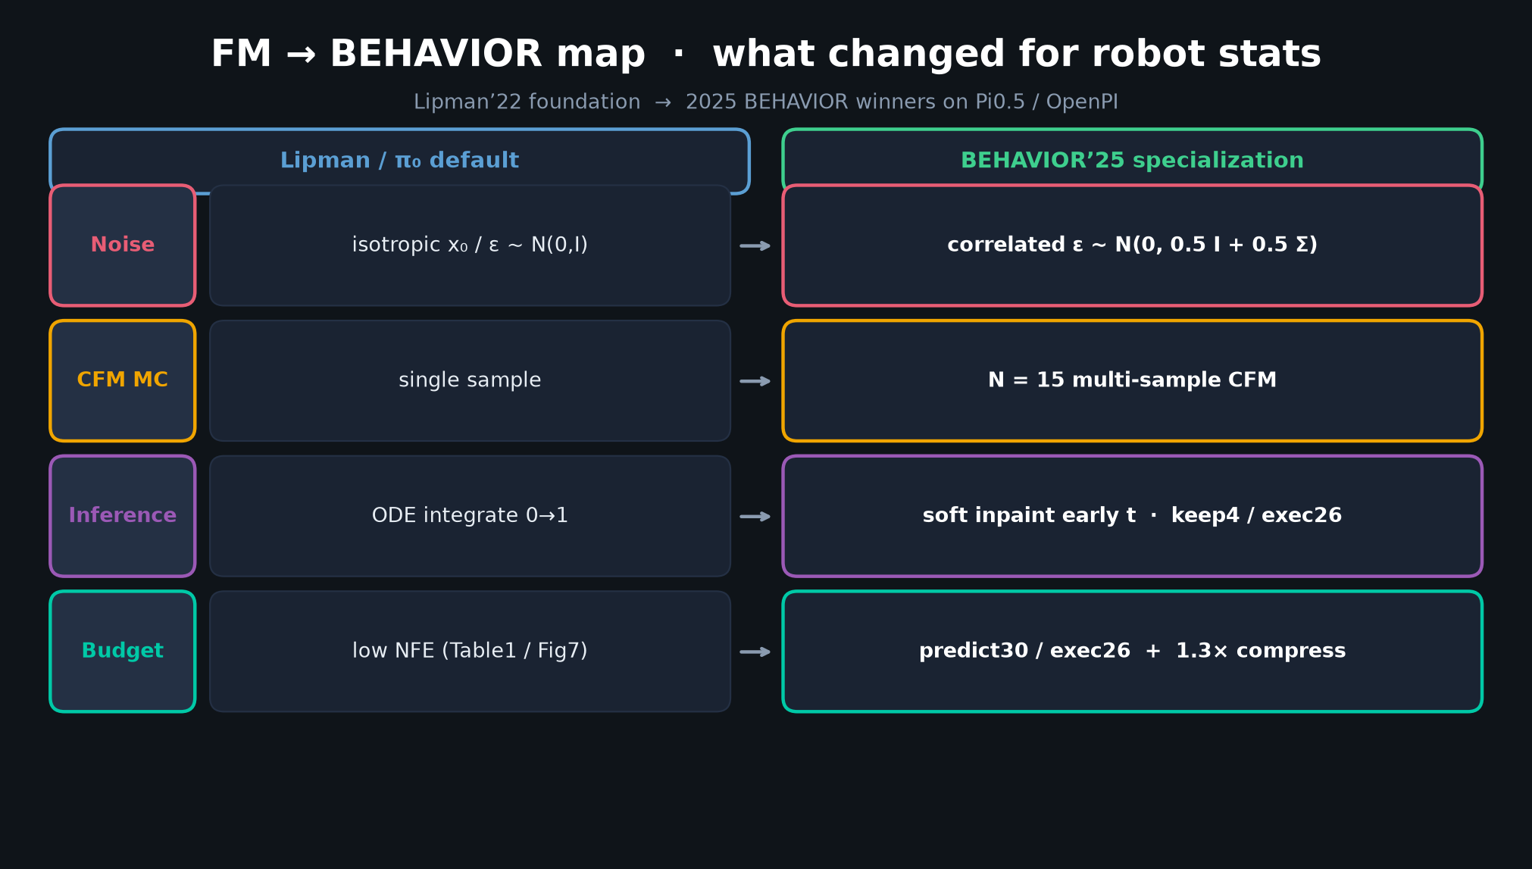
Archaeologist · 11+3 · 8/12
Notes:
FM→BEHAVIOR MAP — subsequent history: what changed after π₀ adopted FM.

Slide 9
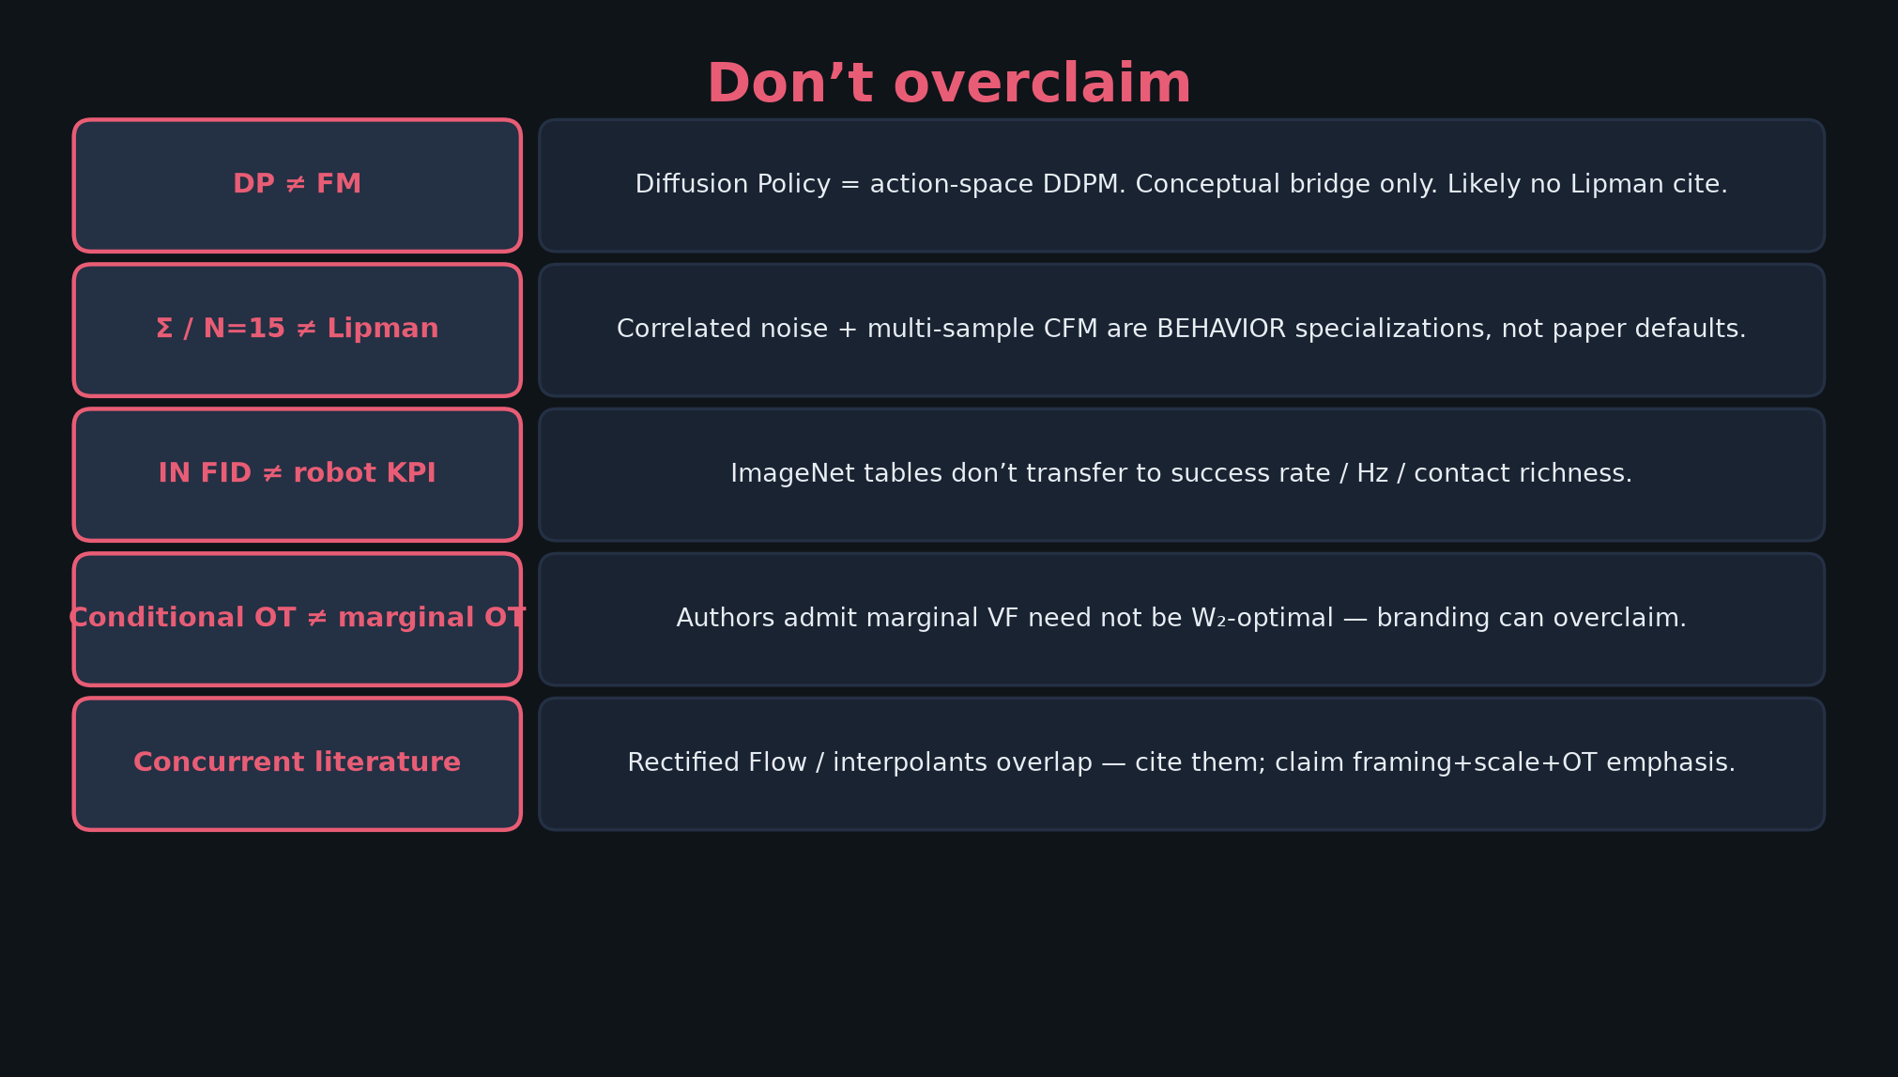
Archaeologist · 11+3 · 9/12
Notes:
DON’T OVERCLAIM on lineage — concurrent Rectified Flow; DP≠FM; BEHAVIOR tricks ≠ Lipman.

Slide 10
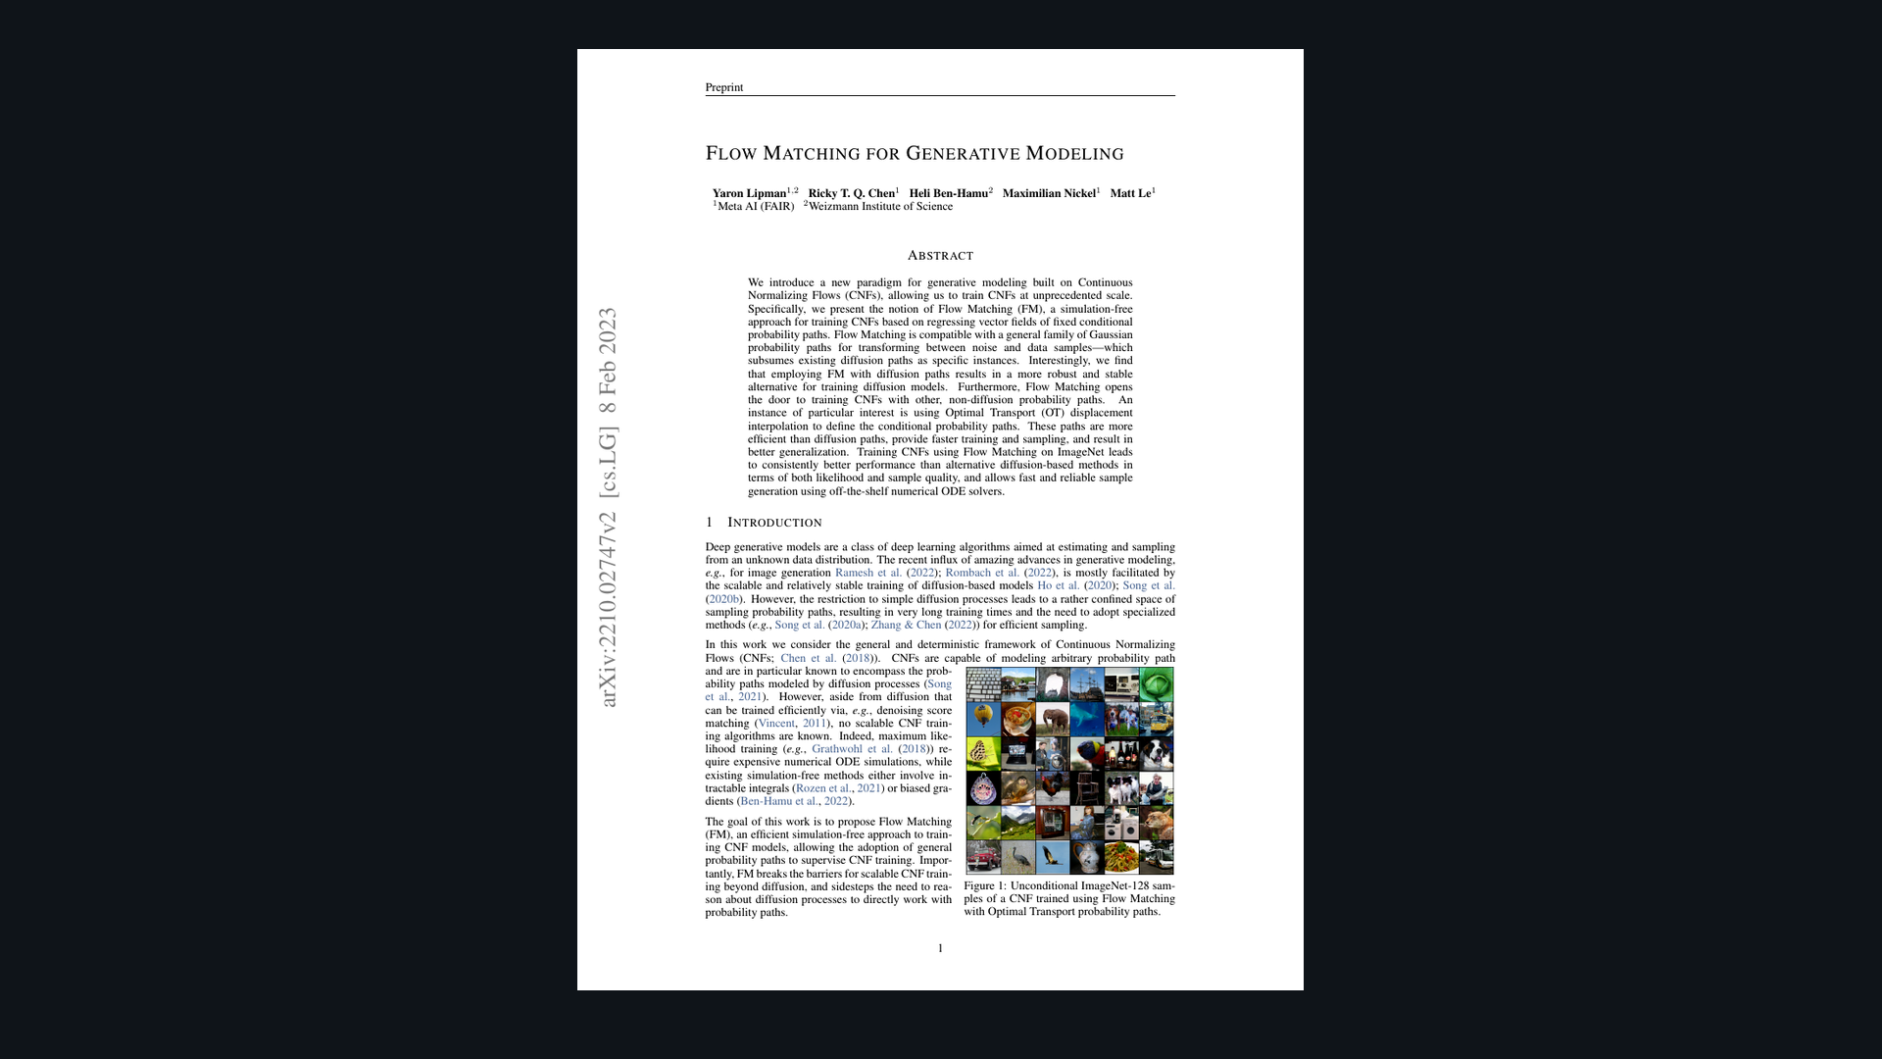
Archaeologist · 11+3 · 10/12
Notes:
PAPER COVER — origin artifact. Meta AI / Weizmann; arXiv Oct 2022 / v2 Feb 2023.

Slide 11
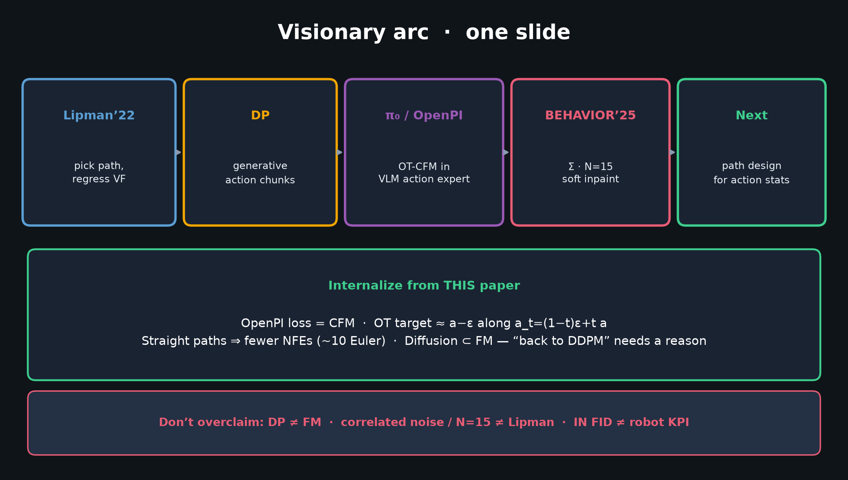
Archaeologist · 11+3 · 11/12
Notes:
VISIONARY ARC as history-forward — optional bridge to seat 1. Habit persisted (chunks); denoiser became flow.

Slide 12
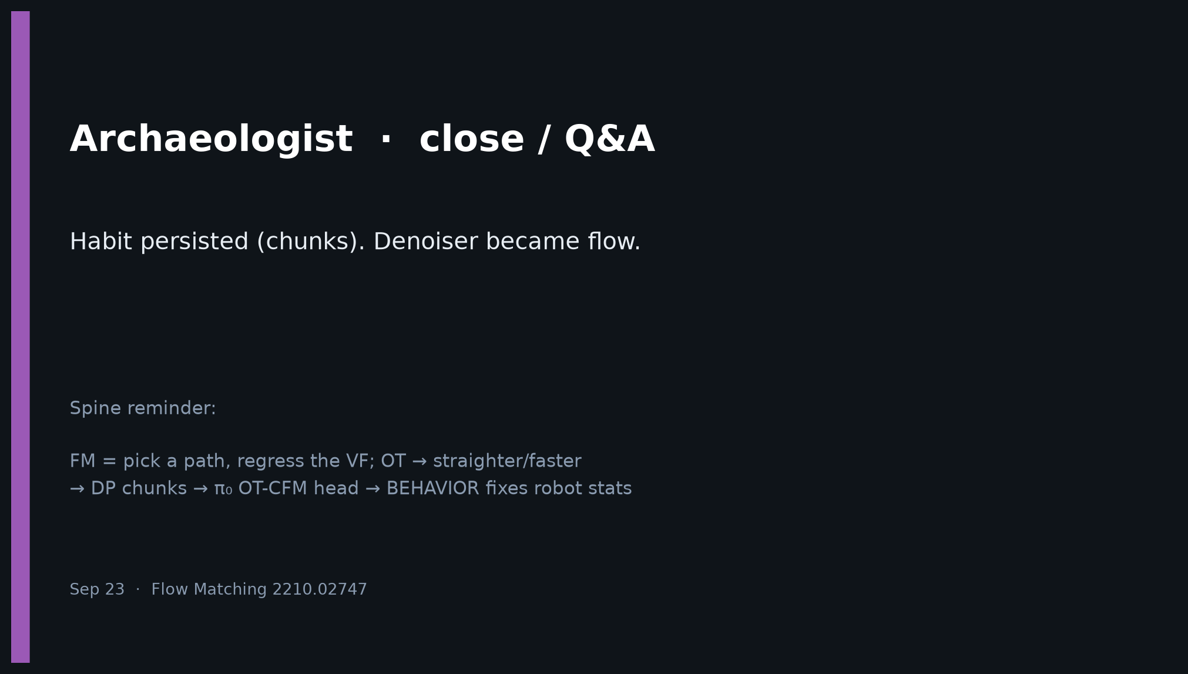
Archaeologist · 11+3 · 12/12
Notes:
CLOSE — Habit persisted (chunks). Denoiser became flow. Cite Lipman for FM; Chi for DP; don’t conflate.

