Slide 1
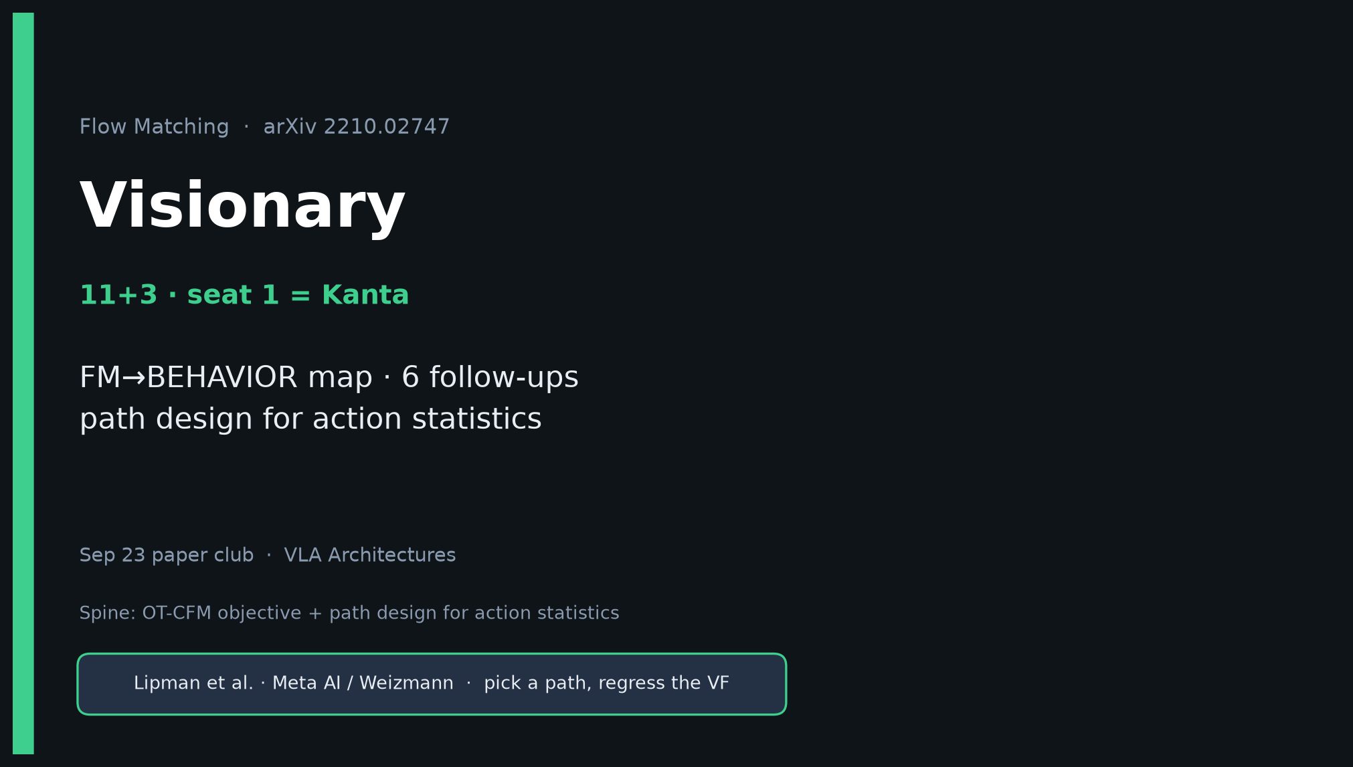
Visionary · 11+3 · 1/14
Notes:
VISIONARY OPENING — seat 1 = Kanta (YOU). Timing 11+3. HIGHEST PRIORITY deck.
You own the future-facing reading of Lipman’22 for robot stacks.
ONE SENTENCE for the room:
Lipman’22 = pick a path, regress the VF → DP showed generative action chunks → π₀/OpenPI put OT-CFM in the VLM action expert → BEHAVIOR’25 kept it and fixed correlated noise, multi-sample CFM, soft inpaint → next wins = path design for action statistics, not another ImageNet U-Net.
Skip Discord/Drive. No Stakeholder redo — this is your lane.
Must land: (1) Internalize four facts (2) FM→BEHAVIOR map (3) 6 follow-ups as THE talk figure.

Slide 2
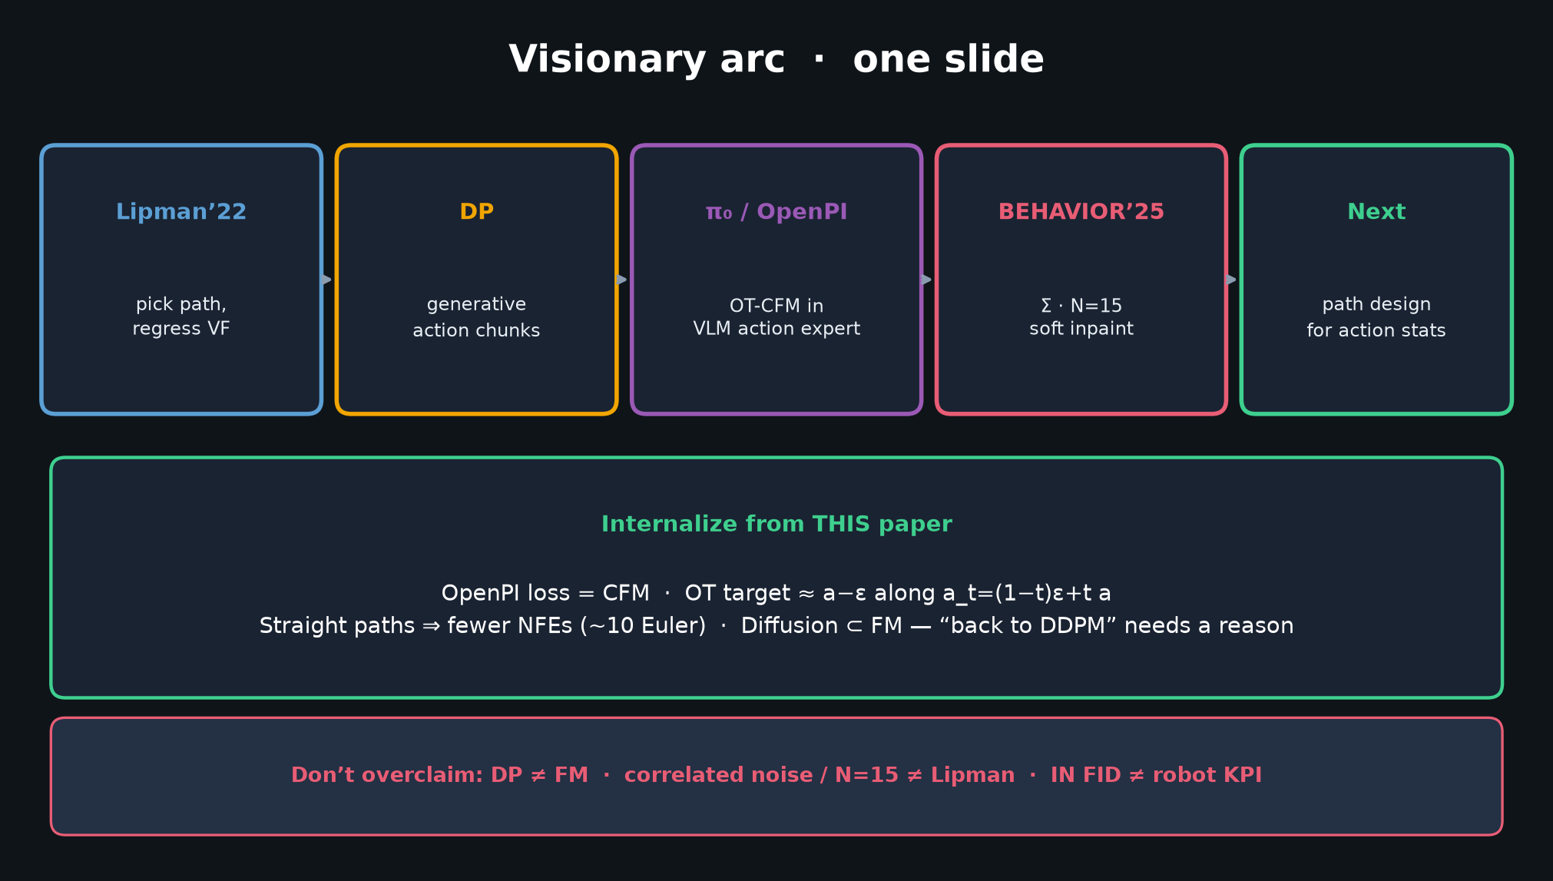
Visionary · 11+3 · 2/14
Notes:
VISIONARY ARC — deliver early (60–75s). This is the one-slide narrative from KANTA_PACK.
Walk left→right:
1) Lipman’22 pick path, regress VF
2) DP generative action chunks (conceptual bridge; likely NO Lipman cite)
3) π₀/OpenPI OT-CFM in VLM action expert (CLEAR Lipman cite)
4) BEHAVIOR’25 Σ · N=15 · soft inpaint
5) Next = path design for action stats
Internalize strip at bottom — say the four facts aloud if time is tight later.
Don’t-overclaim bar: DP≠FM; Σ/N=15≠Lipman; IN FID≠robot KPI.

Slide 3
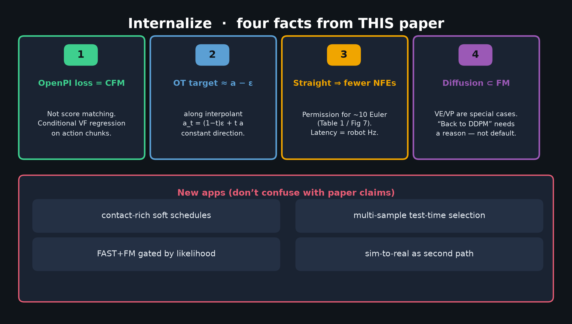
Visionary · 11+3 · 3/14
Notes:
INTERNALIZE — four facts from THIS paper. Spend ~90s. These are non-negotiable literacy for OpenPI work.
1) OpenPI loss = CFM, NOT score matching.
2) OT target ≈ a − ε along a_t = (1−t)ε + t a (constant direction).
3) Straight paths ⇒ fewer NFEs ≈ permission for ~10 Euler steps (Table 1 / Fig 7).
4) Diffusion ⊂ FM — VE/VP are special cases. “Back to DDPM” needs a reason.
Bottom: new apps are AFTER the paper — don’t confuse with Lipman claims.

Slide 4
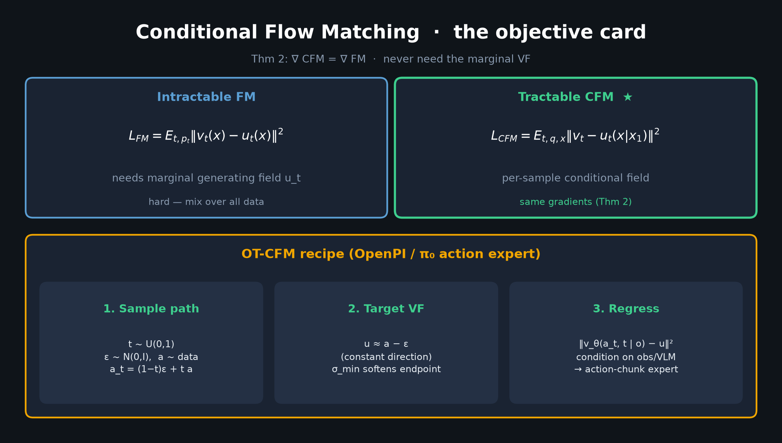
Visionary · 11+3 · 4/14
Notes:
CFM OBJECTIVE CARD — technical spine. 45–60s.
Left: intractable marginal FM.
Right: CFM — same gradients (Thm 2).
Bottom: OT-CFM recipe exactly as OpenPI / π₀ action experts use it.
Say: “We never need the marginal VF. We regress the conditional field. OT makes the target almost constant-direction.”

Slide 5
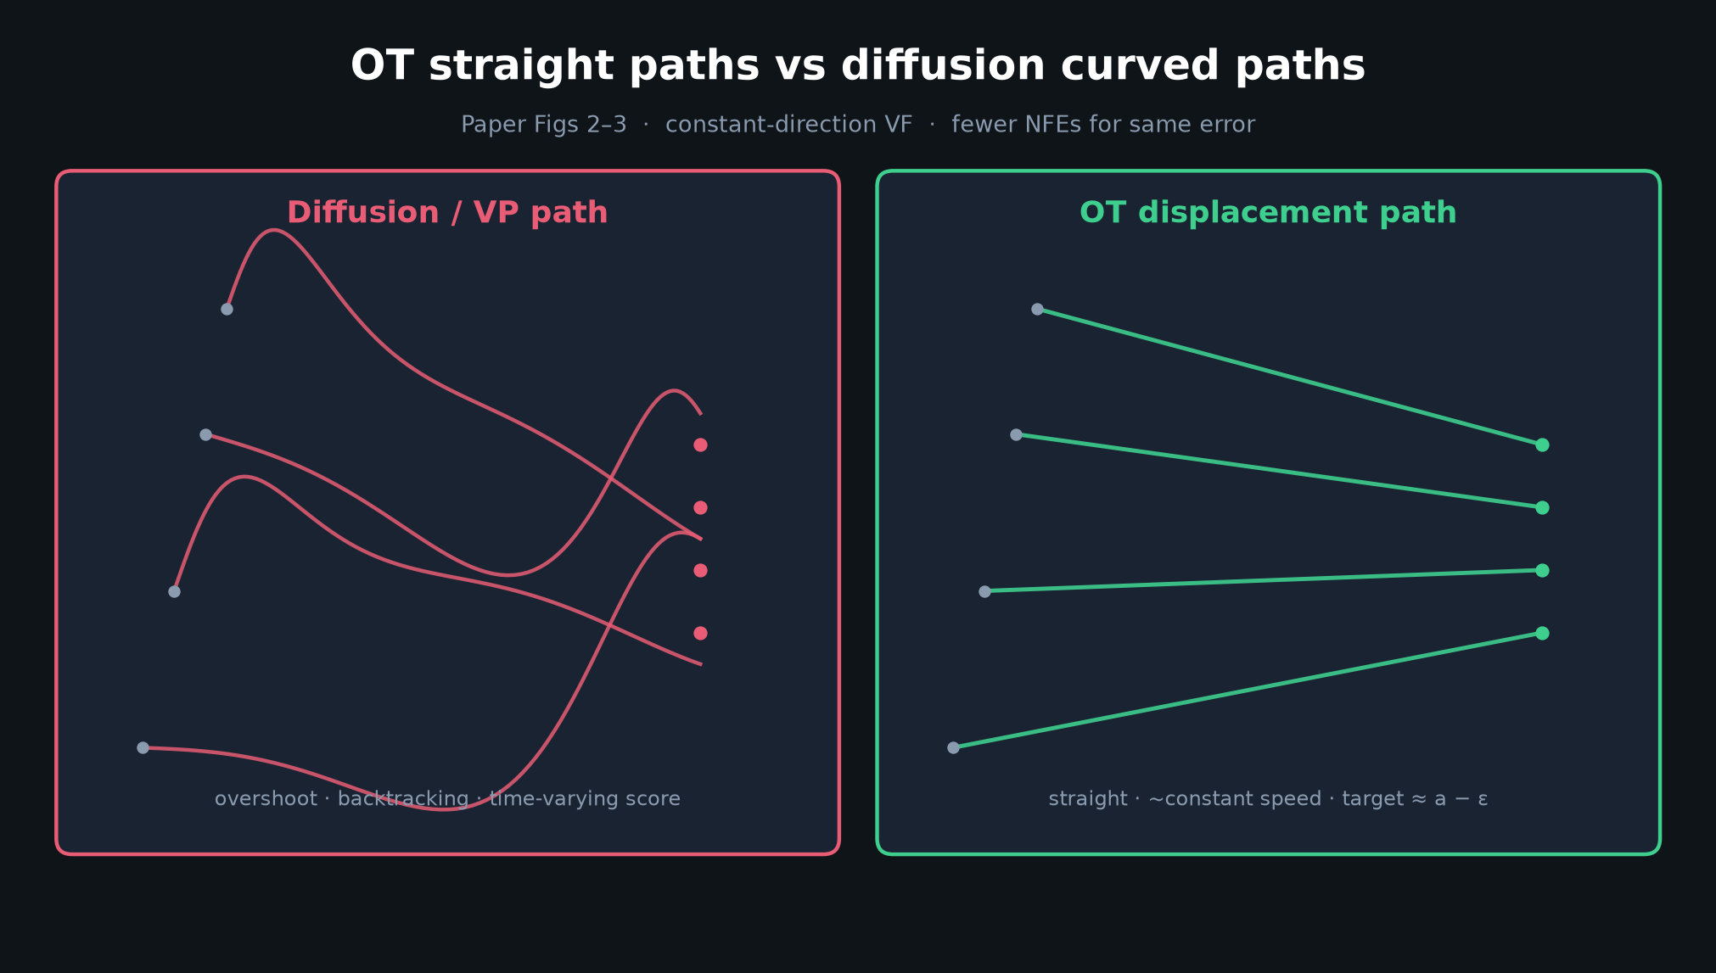
Visionary · 11+3 · 5/14
Notes:
OT vs CURVED — visual intuition for why NFE drops. Point at straight lines.
Diffusion: overshoot, backtracking, time-varying score.
OT: straight, ~constant speed, target ≈ a−ε.
Tie to robot Hz: every saved NFE is latency headroom in the action expert.

Slide 6
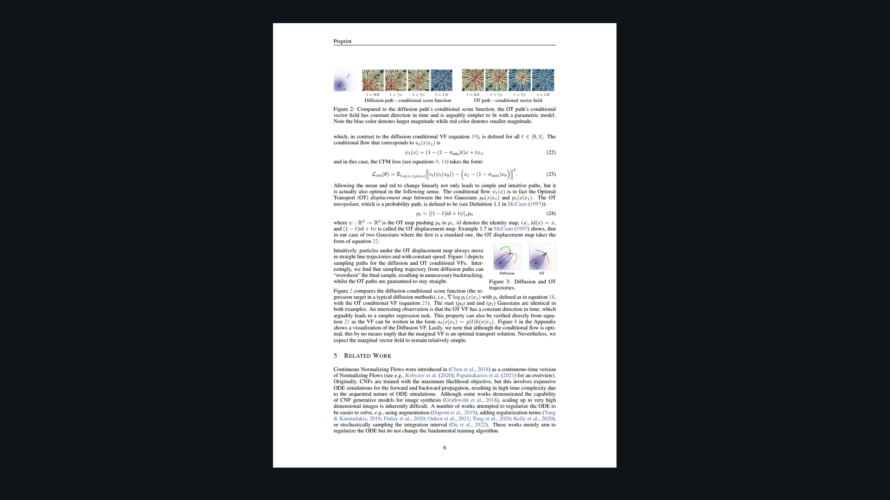
Visionary · 11+3 · 6/14
Notes:
PAPER FIGS 2–3 — primary evidence. Glance and point.
Fig 2: OT conditional VF has constant direction in time — easier to learn.
Fig 3: OT trajectories are straight; diffusion overshoots.
Eq 23 is the loss OpenPI implements (up to action-space conditioning).

Slide 7
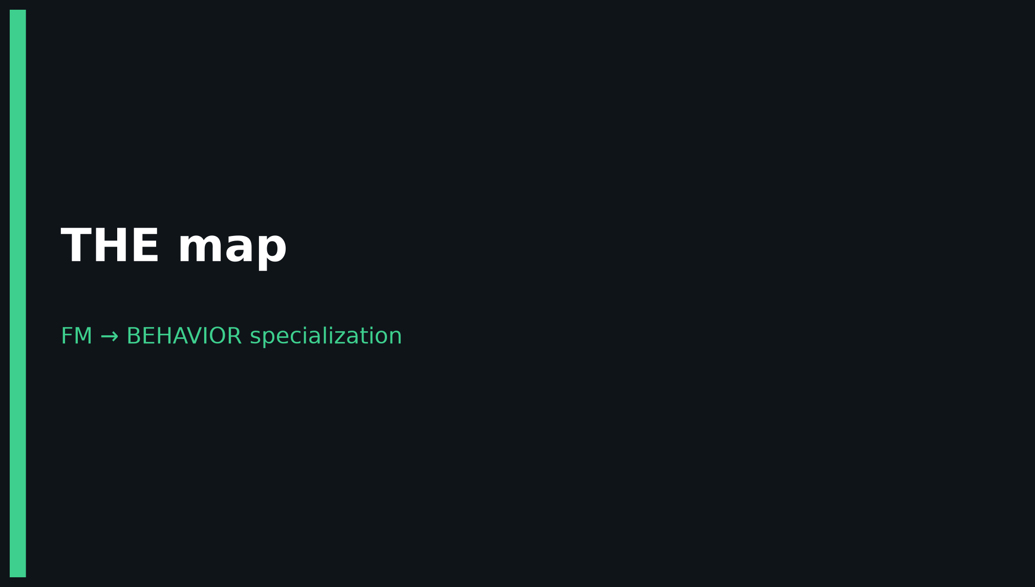
Visionary · 11+3 · 7/14
Notes:
BANNER — THE map is next. Signal to the room this is a must-photograph slide.

Slide 8
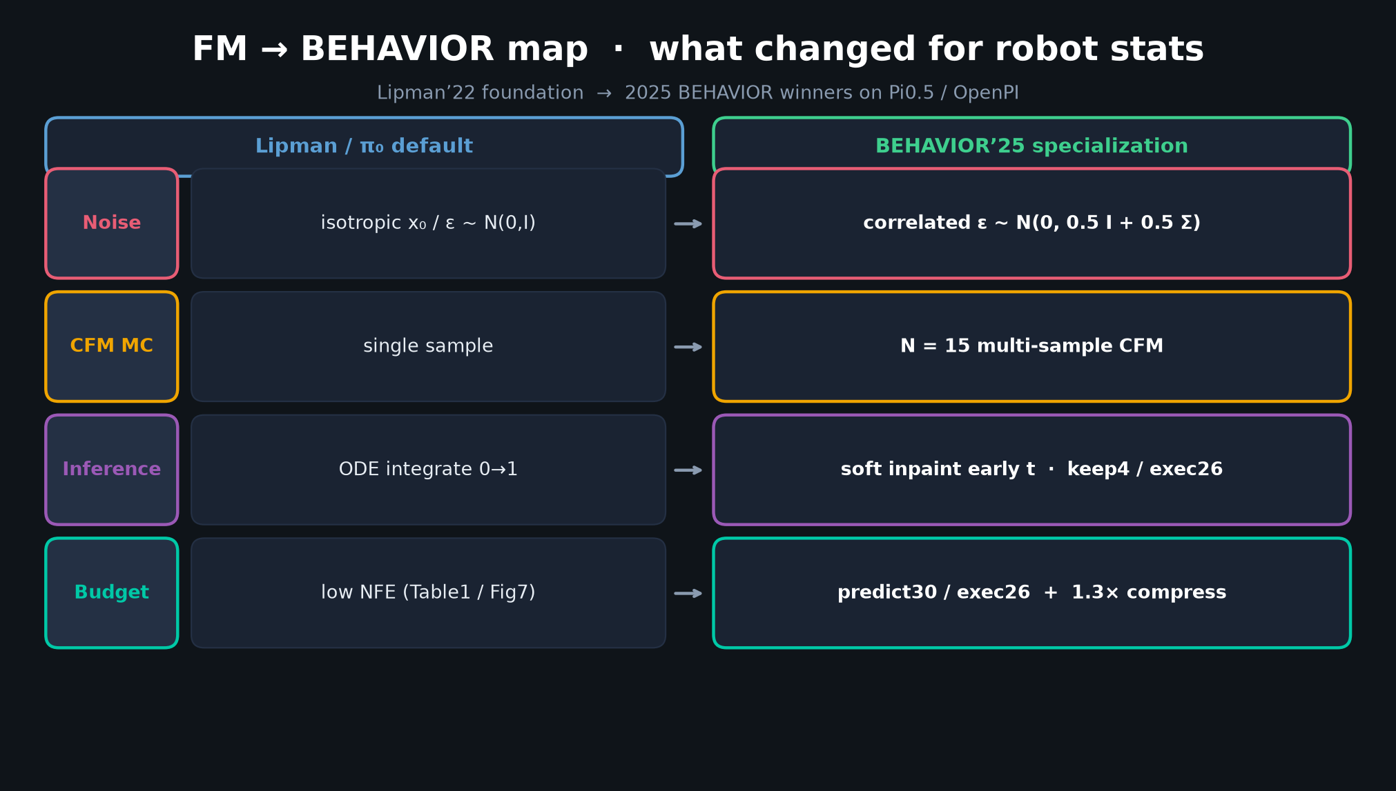
Visionary · 11+3 · 8/14
Notes:
FM → BEHAVIOR MAP — densest Visionary figure. Spend 2 minutes. Photograph-worthy.
Four rows Lipman/π₀ default → BEHAVIOR’25:
1) Noise: isotropic → correlated ε ~ N(0, 0.5 I + 0.5 Σ)
2) CFM MC: single → N=15
3) Inference: ODE 0→1 → soft inpaint early t (keep4 / exec26)
4) Budget: low NFE → predict30/exec26 + 1.3× compress
Say aloud: “BEHAVIOR did not replace FM. It specialized the path and the inference for robot action statistics.”

Slide 9
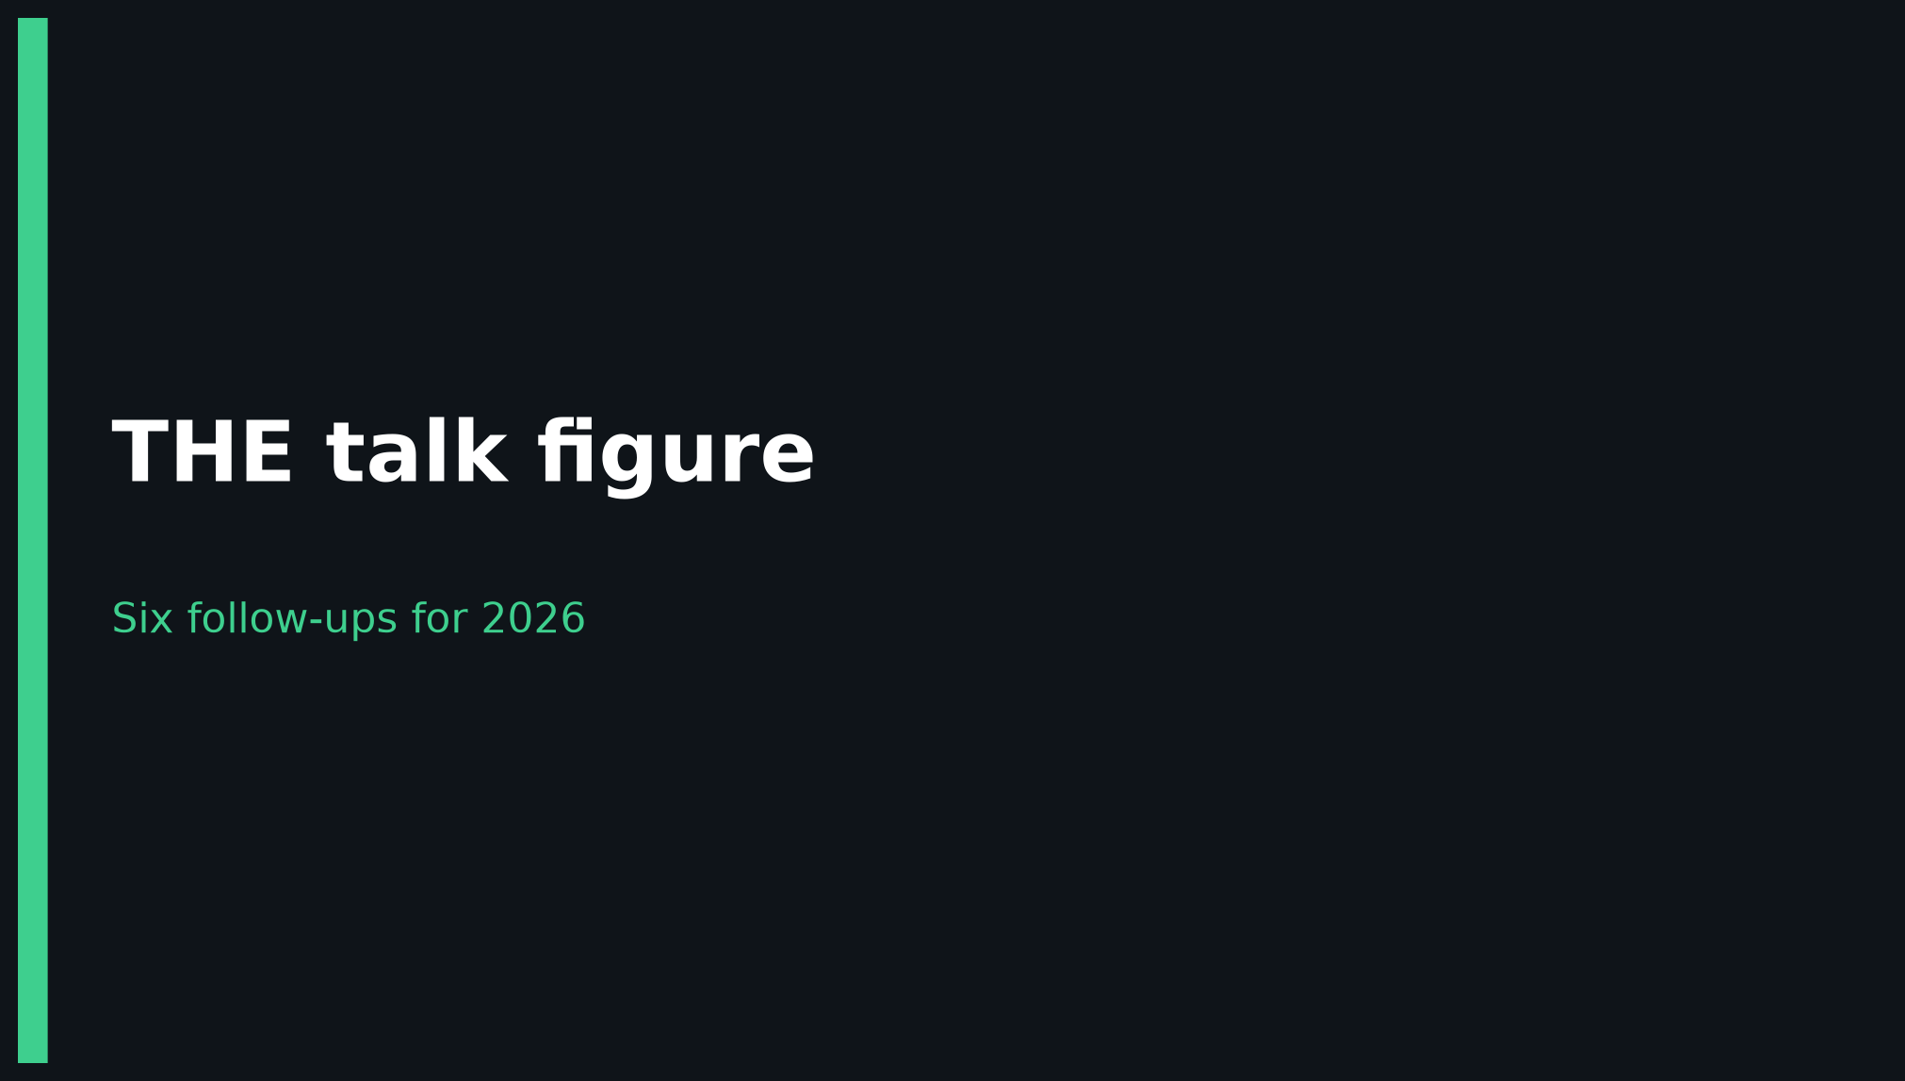
Visionary · 11+3 · 9/14
Notes:
BANNER — 6 follow-ups is THE talk figure.

Slide 10
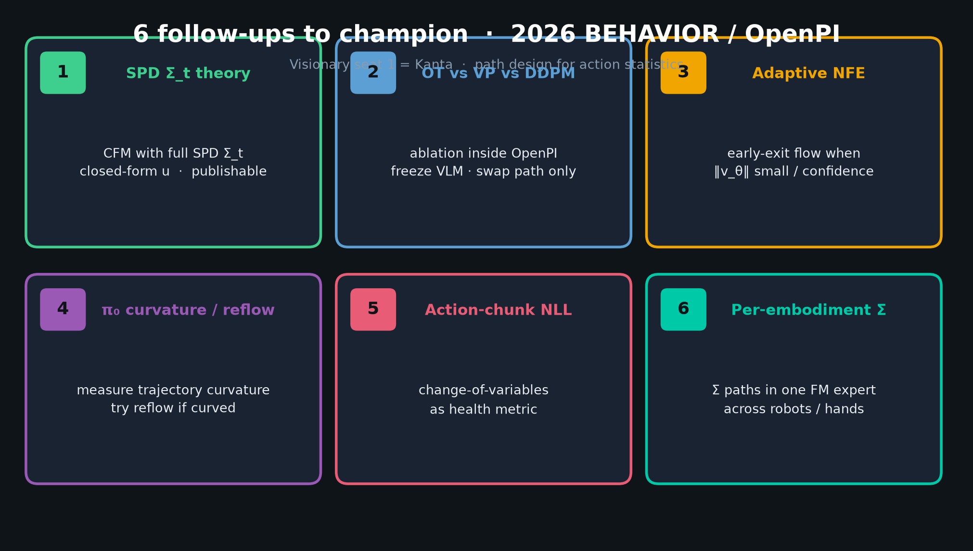
Visionary · 11+3 · 10/14
Notes:
SIX FOLLOW-UPS — THE talk figure for Visionary. Champion these for 2026 BEHAVIOR / OpenPI.
1. Theory: CFM with full SPD Σ_t (closed-form u) — publishable
2. OT vs VP vs DDPM ablation inside OpenPI (freeze VLM)
3. Adaptive NFE / early-exit flow
4. Measure π₀ trajectory curvature; try reflow if curved
5. Action-chunk NLL via change-of-variables as health metric
6. Per-embodiment Σ paths in one FM expert
Do NOT turn this into Discord/Drive logistics. Stay technical.

Slide 11
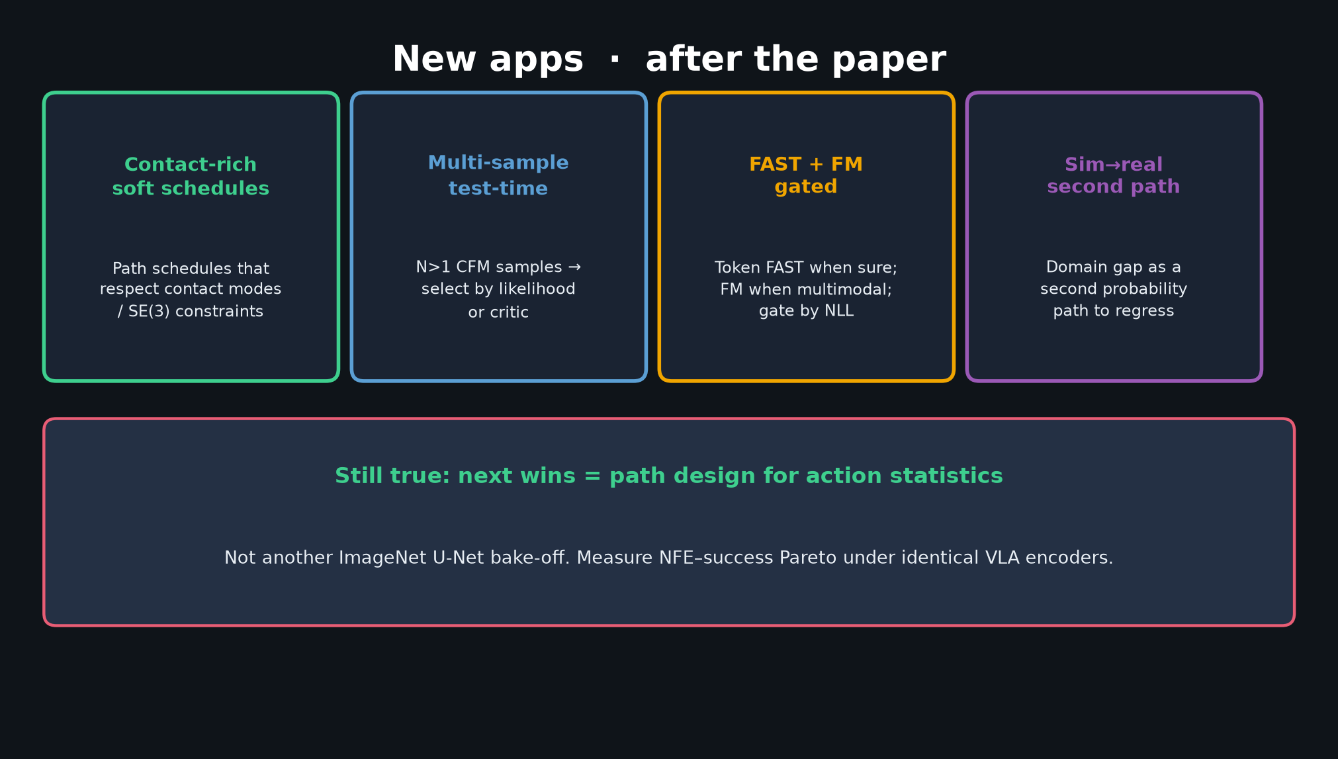
Visionary · 11+3 · 11/14
Notes:
NEW APPS — brief. Contact-rich soft schedules; multi-sample test-time; FAST+FM gated by likelihood; sim-to-real as second path.
Still true: next wins = path design for action statistics — not ImageNet U-Net bake-offs.
Measure NFE–success Pareto under identical VLA encoders.

Slide 12
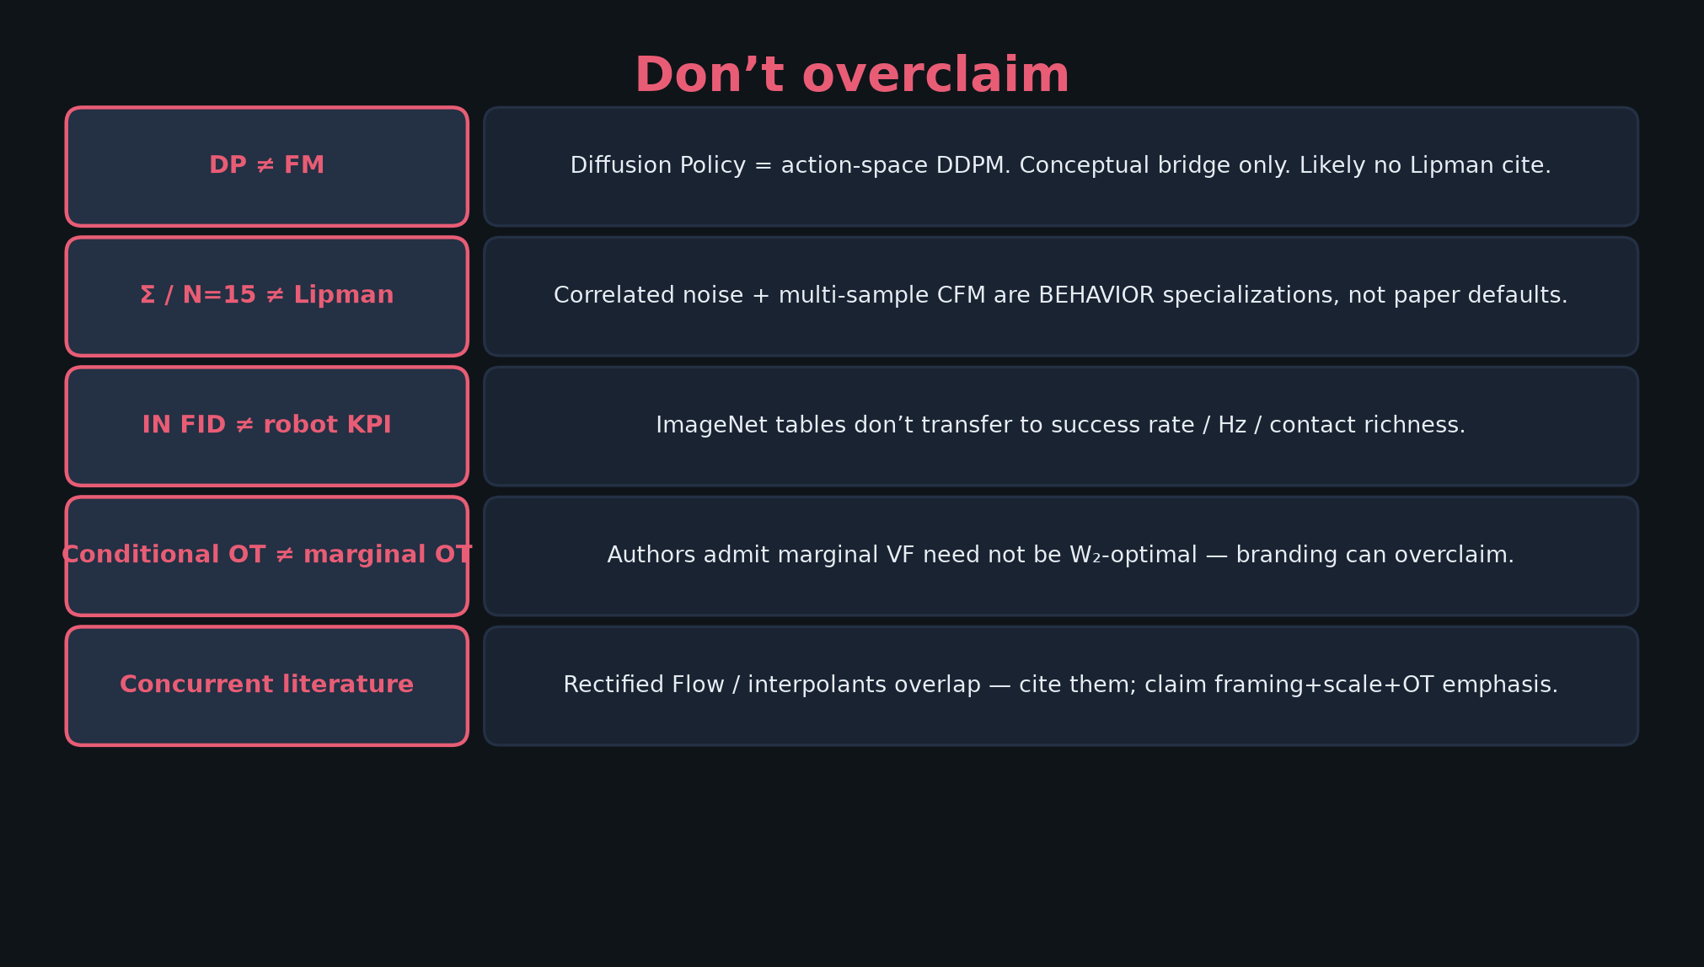
Visionary · 11+3 · 12/14
Notes:
DON’T OVERCLAIM — 45s. Protect credibility.
DP ≠ FM. Σ/N=15 ≠ Lipman. IN FID ≠ robot KPI. Conditional OT ≠ marginal W₂ OT. Cite Rectified Flow concurrency.
If someone conflates BEHAVIOR tricks with Lipman’22, correct gently with this slide.

Slide 13
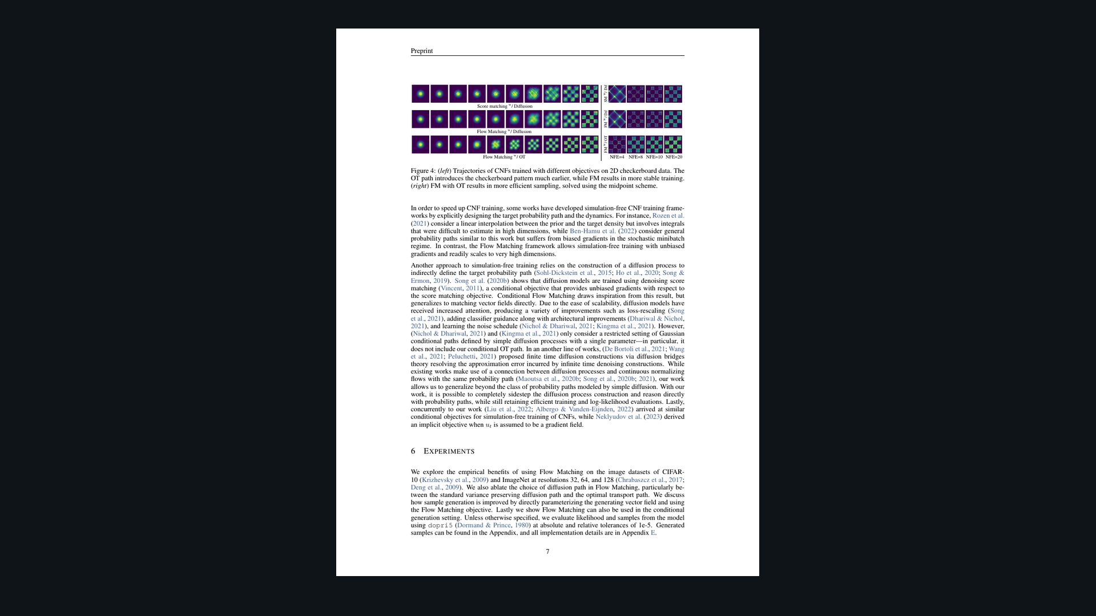
Visionary · 11+3 · 13/14
Notes:
PAPER FIG 4 — checkerboard + low-NFE evidence (Empiricist will go deeper). For Visionary: visual proof that OT introduces structure earlier and survives low NFE.
Optional if time-pressed — skip to close.

Slide 14
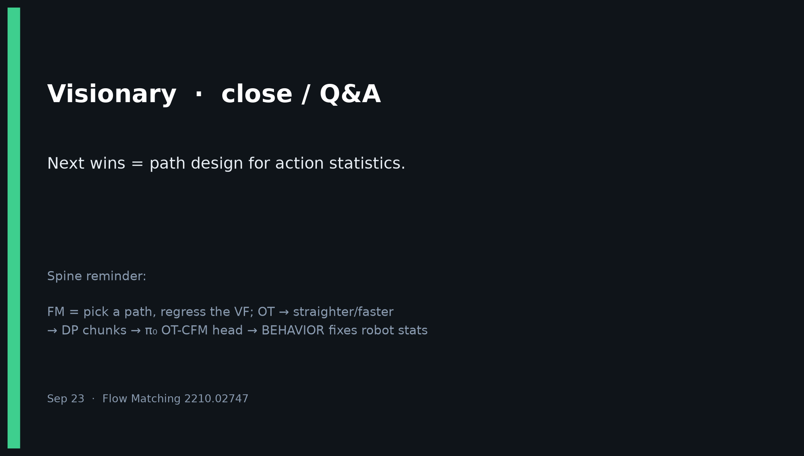
Visionary · 11+3 · 14/14
Notes:
CLOSE / Q&A — Visionary.
Leave them with: Next wins = path design for action statistics.
Offer the 6 follow-ups as a menu for lab projects.
No Discord/Drive. No Stakeholder redo.

