Slide 1
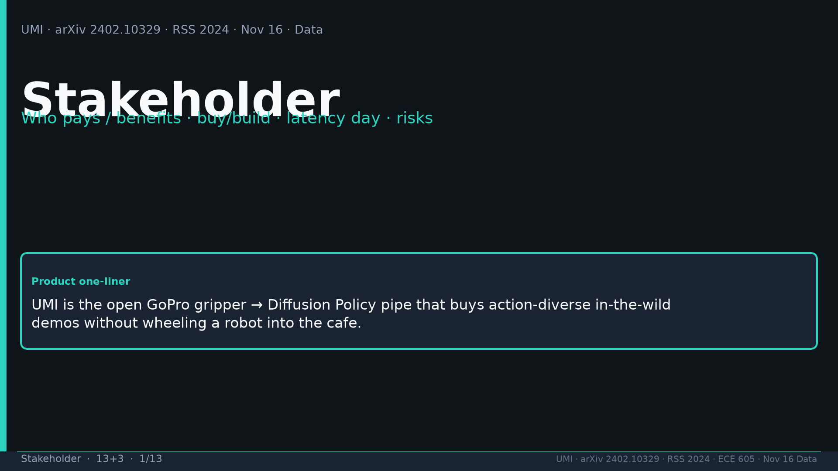
Notes:
Stakeholder · 13+3 · 1/13
Title. Product one-liner: GoPro gripper → DP pipe; action-diverse wild demos without robot-in-cafe. Spine: human logistics not robot logistics.
Tattoo: cup 100%/90% · toss 87.5% (no lat 57.5%) · wild 1400/30 → 71.7% vs narrow 0% · rel 100% vs abs 25% · fisheye vs 69° 55% · cloth 70%/30% · dish 70%/0% · Ta=6 @10Hz (20Hz toss)

Slide 2
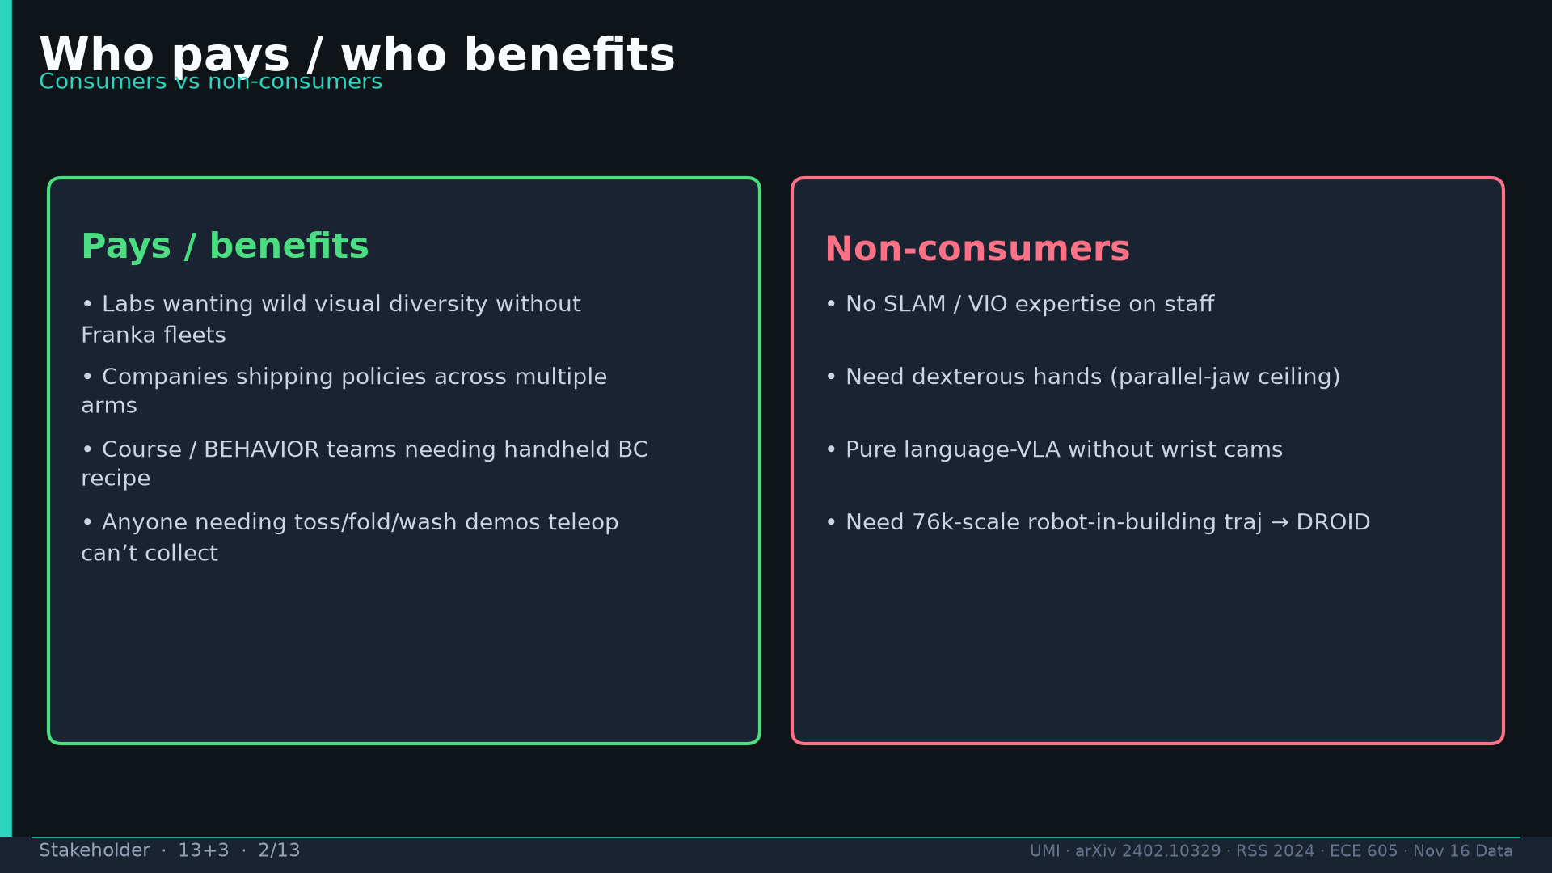
Notes:
Stakeholder · 13+3 · 2/13
Who pays: labs wanting wild diversity without Franka fleets; multi-arm companies; course/BEHAVIOR teams. Non-consumers: no SLAM, need dex hands, pure lang-VLA, need 76k Franka scale.
Tattoo: cup 100%/90% · toss 87.5% (no lat 57.5%) · wild 1400/30 → 71.7% vs narrow 0% · rel 100% vs abs 25% · fisheye vs 69° 55% · cloth 70%/30% · dish 70%/0% · Ta=6 @10Hz (20Hz toss)

Slide 3
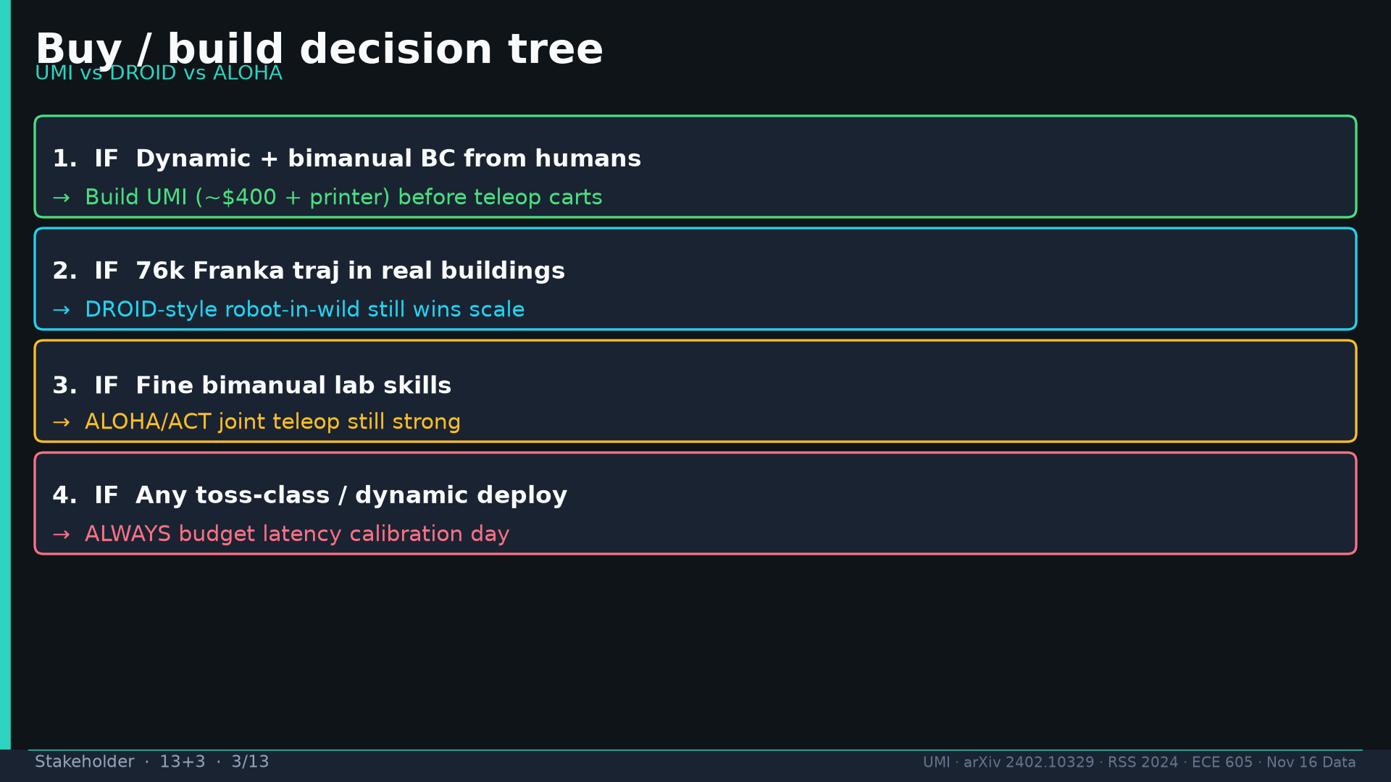
Notes:
Stakeholder · 13+3 · 3/13
Decision tree: (1) dynamic+bimanual from humans → UMI ~$400 (2) 76k Franka buildings → DROID (3) fine lab bimanual → ALOHA (4) ALWAYS latency calibration day.
Tattoo: cup 100%/90% · toss 87.5% (no lat 57.5%) · wild 1400/30 → 71.7% vs narrow 0% · rel 100% vs abs 25% · fisheye vs 69° 55% · cloth 70%/30% · dish 70%/0% · Ta=6 @10Hz (20Hz toss)

Slide 4
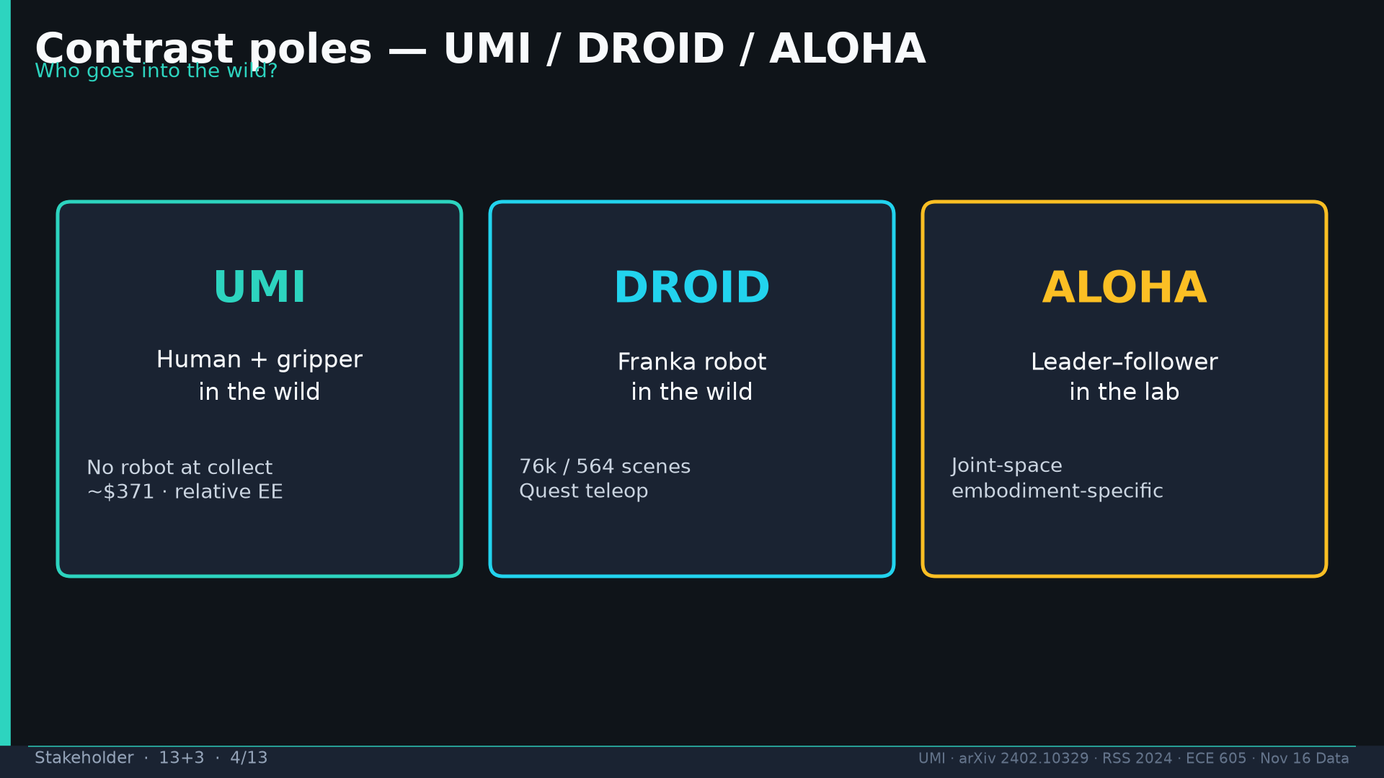
Notes:
Stakeholder · 13+3 · 4/13
Poles: UMI=human+gripper in wild; DROID=Franka in wild; ALOHA=lab leader–follower. Pick axis you can afford.
Tattoo: cup 100%/90% · toss 87.5% (no lat 57.5%) · wild 1400/30 → 71.7% vs narrow 0% · rel 100% vs abs 25% · fisheye vs 69° 55% · cloth 70%/30% · dish 70%/0% · Ta=6 @10Hz (20Hz toss)

Slide 5
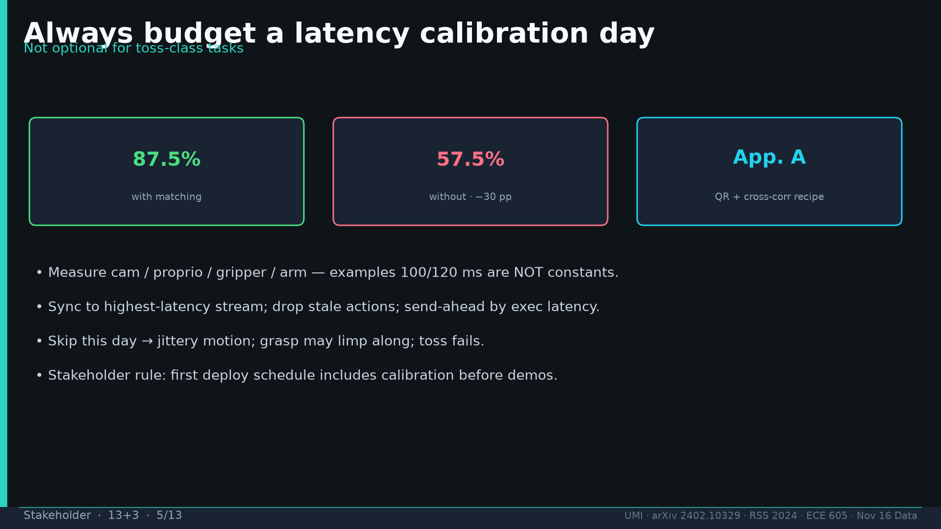
Notes:
Stakeholder · 13+3 · 5/13
Latency day: 87.5% vs 57.5% (−30 pp). App.A QR+cross-corr. 100/120 ms are EXAMPLES. First-deploy schedule includes calibration.
Tattoo: cup 100%/90% · toss 87.5% (no lat 57.5%) · wild 1400/30 → 71.7% vs narrow 0% · rel 100% vs abs 25% · fisheye vs 69° 55% · cloth 70%/30% · dish 70%/0% · Ta=6 @10Hz (20Hz toss)

Slide 6
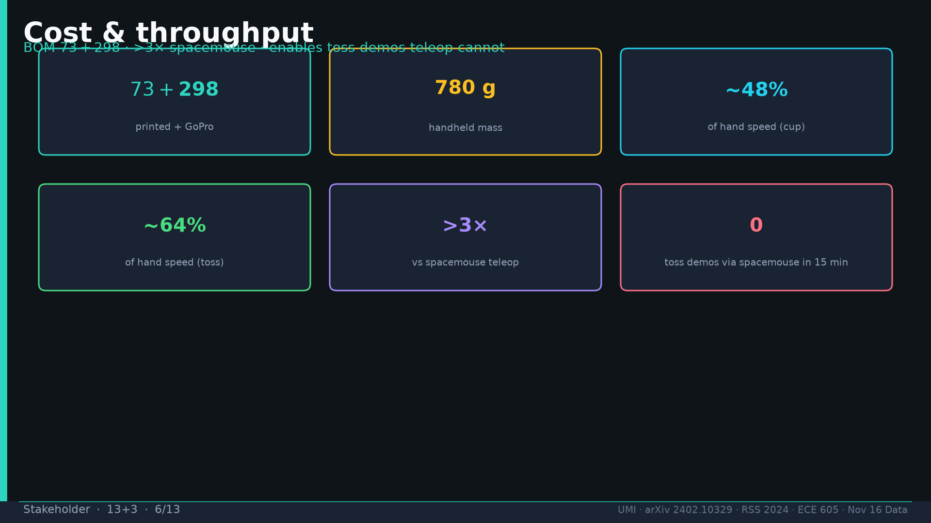
Notes:
Stakeholder · 13+3 · 6/13
Cost/throughput: $73+$298, 780g, ~48% hand cup, ~64% hand toss, >3× spacemouse, 0 toss demos via spacemouse in 15 min.
Tattoo: cup 100%/90% · toss 87.5% (no lat 57.5%) · wild 1400/30 → 71.7% vs narrow 0% · rel 100% vs abs 25% · fisheye vs 69° 55% · cloth 70%/30% · dish 70%/0% · Ta=6 @10Hz (20Hz toss)

Slide 7
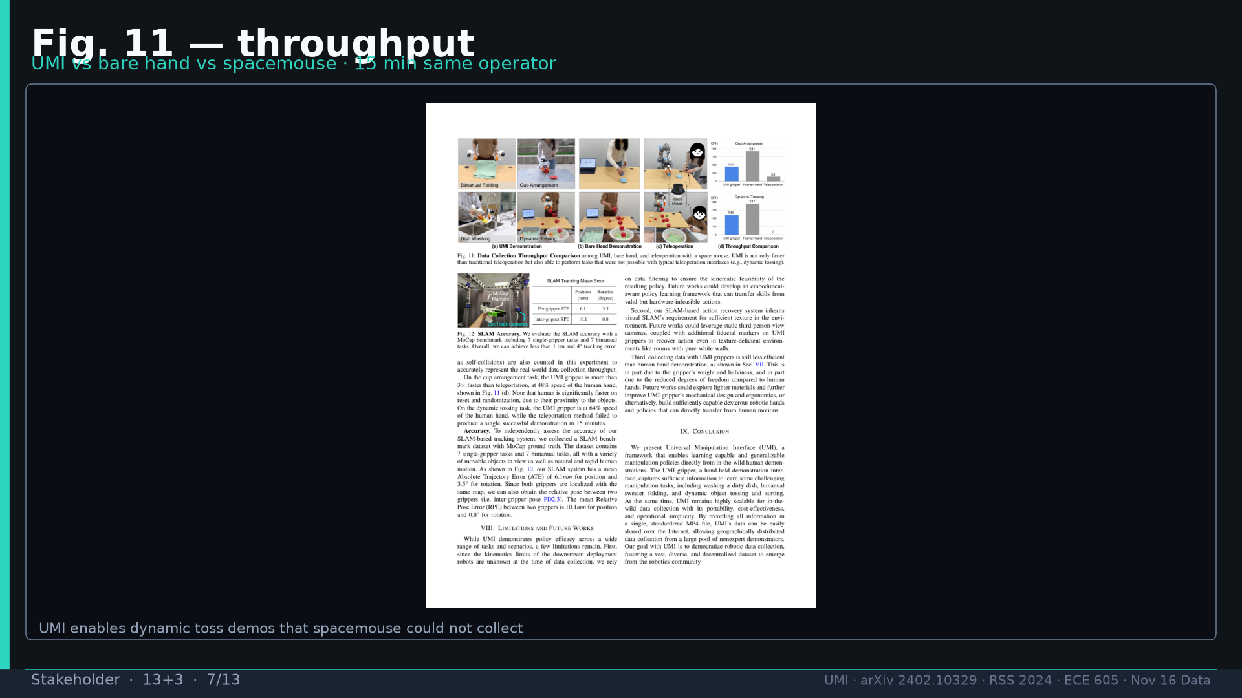
Notes:
Stakeholder · 13+3 · 7/13
Fig.11 throughput visual. UMI enables dynamic demos teleop cannot collect.
Tattoo: cup 100%/90% · toss 87.5% (no lat 57.5%) · wild 1400/30 → 71.7% vs narrow 0% · rel 100% vs abs 25% · fisheye vs 69° 55% · cloth 70%/30% · dish 70%/0% · Ta=6 @10Hz (20Hz toss)

Slide 8
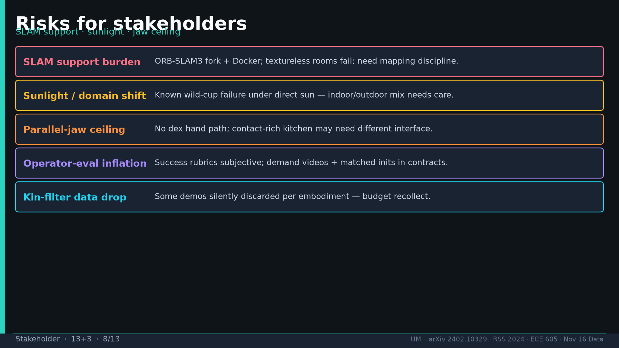
Notes:
Stakeholder · 13+3 · 8/13
Risks: SLAM support burden; sunlight OOD; parallel-jaw ceiling; operator-eval inflation; kin-filter silent drops.
Tattoo: cup 100%/90% · toss 87.5% (no lat 57.5%) · wild 1400/30 → 71.7% vs narrow 0% · rel 100% vs abs 25% · fisheye vs 69° 55% · cloth 70%/30% · dish 70%/0% · Ta=6 @10Hz (20Hz toss)

Slide 9
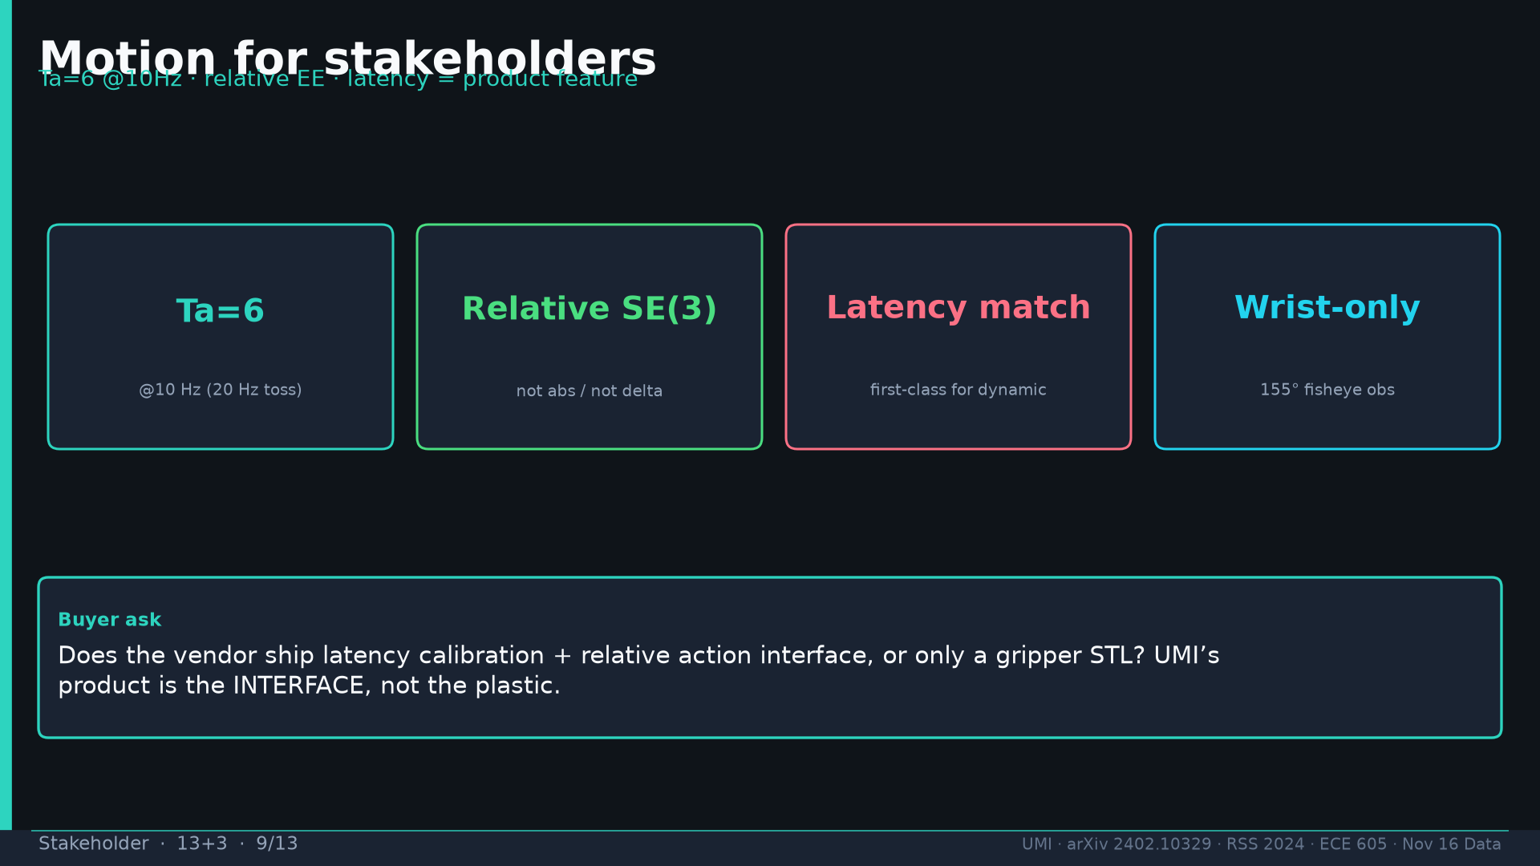
Notes:
Stakeholder · 13+3 · 9/13
Motion as product feature: Ta=6 @10Hz, relative SE(3), latency matching, wrist fisheye. Buyer ask: interface or just STL?
Tattoo: cup 100%/90% · toss 87.5% (no lat 57.5%) · wild 1400/30 → 71.7% vs narrow 0% · rel 100% vs abs 25% · fisheye vs 69° 55% · cloth 70%/30% · dish 70%/0% · Ta=6 @10Hz (20Hz toss)

Slide 10
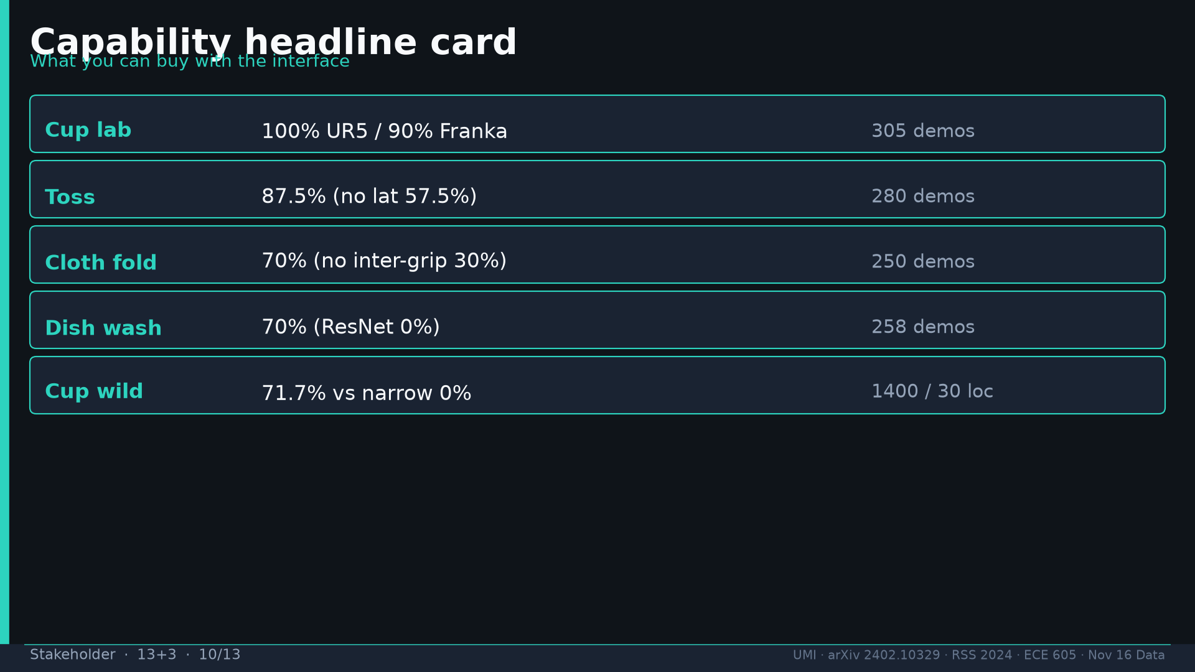
Notes:
Stakeholder · 13+3 · 10/13
Capability card: cup 100/90, toss 87.5/57.5, cloth 70/30, dish 70/0, wild 71.7 vs 0.
Tattoo: cup 100%/90% · toss 87.5% (no lat 57.5%) · wild 1400/30 → 71.7% vs narrow 0% · rel 100% vs abs 25% · fisheye vs 69° 55% · cloth 70%/30% · dish 70%/0% · Ta=6 @10Hz (20Hz toss)

Slide 11
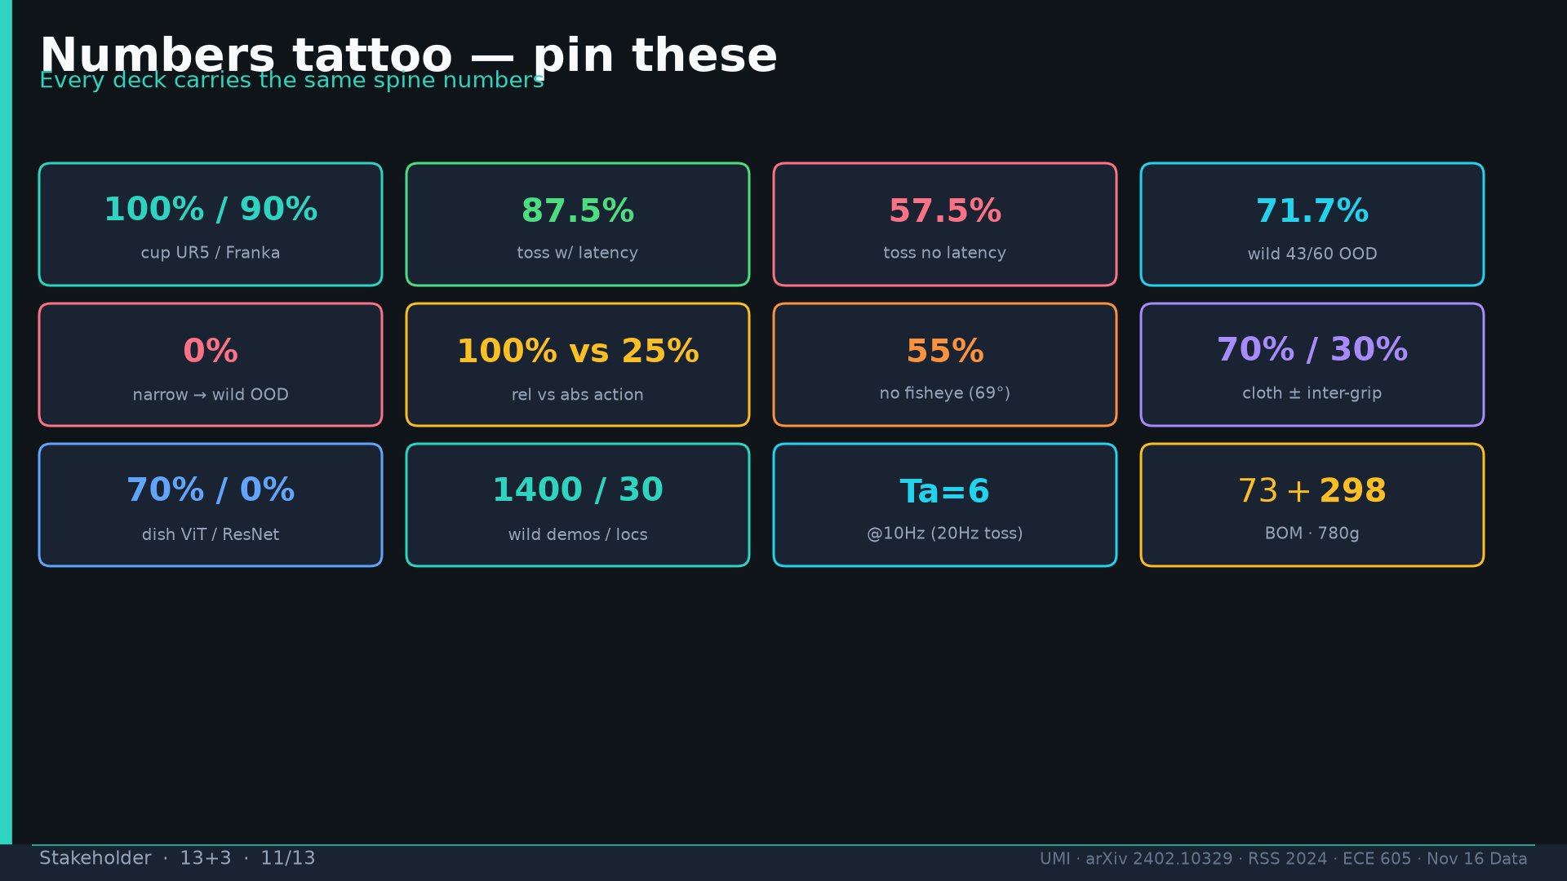
Notes:
Stakeholder · 13+3 · 11/13
Tattoo numbers shared across decks.
Tattoo: cup 100%/90% · toss 87.5% (no lat 57.5%) · wild 1400/30 → 71.7% vs narrow 0% · rel 100% vs abs 25% · fisheye vs 69° 55% · cloth 70%/30% · dish 70%/0% · Ta=6 @10Hz (20Hz toss)

Slide 12
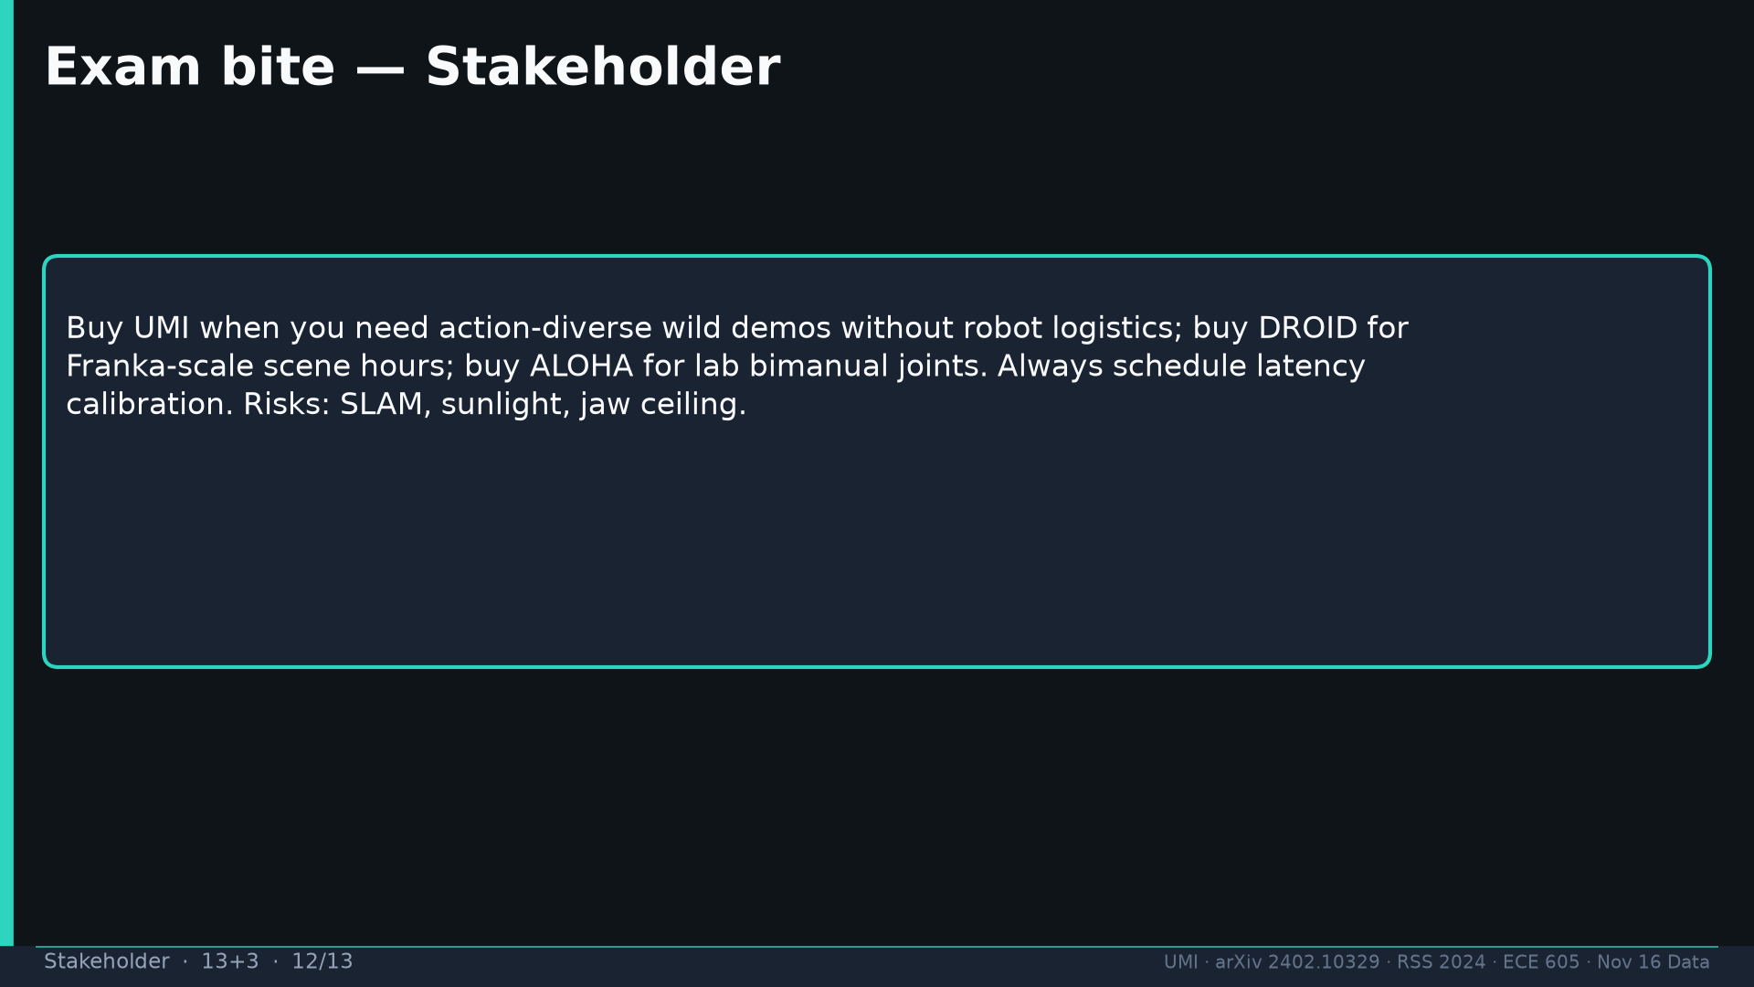
Notes:
Stakeholder · 13+3 · 12/13
Exam bite: buy UMI for action-diverse wild without robot logistics; DROID for Franka scale; ALOHA for lab joints; always latency day.
Tattoo: cup 100%/90% · toss 87.5% (no lat 57.5%) · wild 1400/30 → 71.7% vs narrow 0% · rel 100% vs abs 25% · fisheye vs 69° 55% · cloth 70%/30% · dish 70%/0% · Ta=6 @10Hz (20Hz toss)

Slide 13
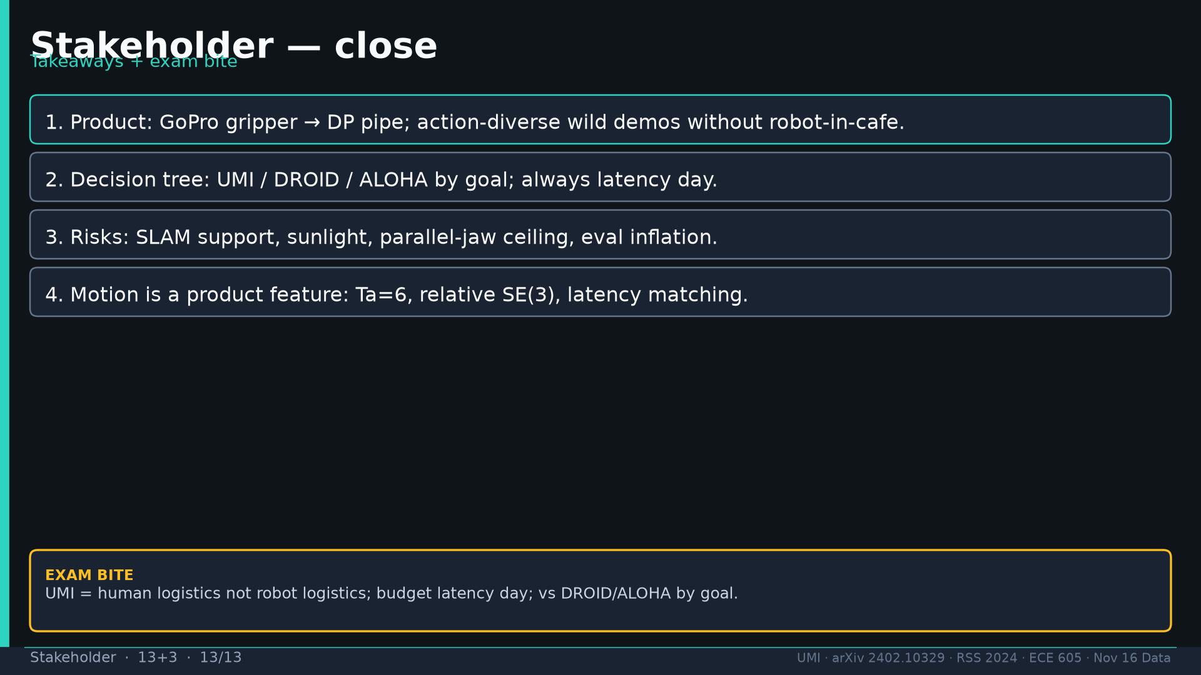
Notes:
Stakeholder · 13+3 · 13/13
Close four takeaways. Q&A.
Tattoo: cup 100%/90% · toss 87.5% (no lat 57.5%) · wild 1400/30 → 71.7% vs narrow 0% · rel 100% vs abs 25% · fisheye vs 69° 55% · cloth 70%/30% · dish 70%/0% · Ta=6 @10Hz (20Hz toss)

