Slide 1
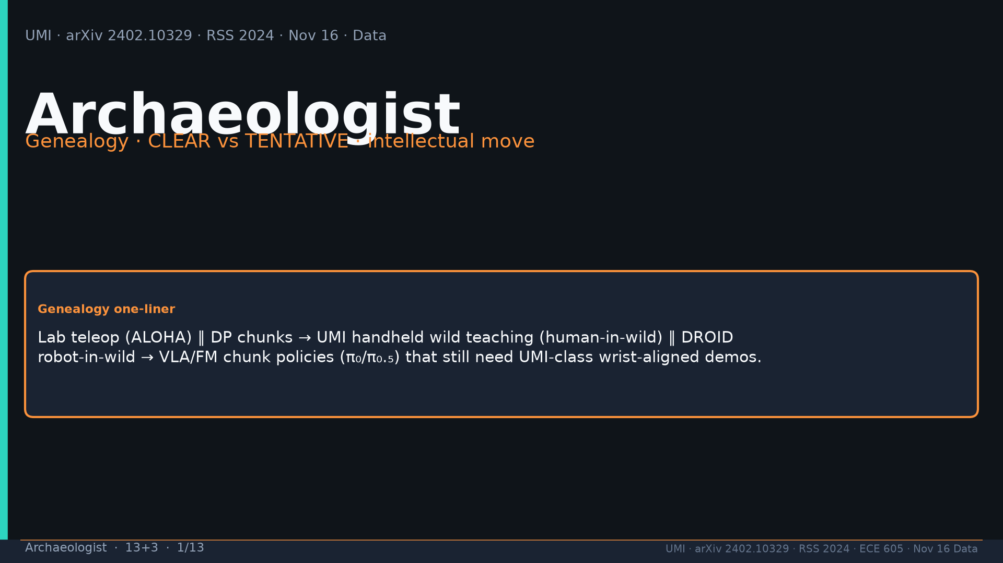
Notes:
Archaeologist · 13+3 · 1/13
Title. Genealogy one-liner: ALOHA∥DP → UMI human-wild ∥ DROID robot-wild → π₀/π₀.₅ needing UMI-class wrist demos.
Tattoo: cup 100%/90% · toss 87.5% (no lat 57.5%) · wild 1400/30 → 71.7% vs narrow 0% · rel 100% vs abs 25% · fisheye vs 69° 55% · cloth 70%/30% · dish 70%/0% · Ta=6 @10Hz (20Hz toss)

Slide 2
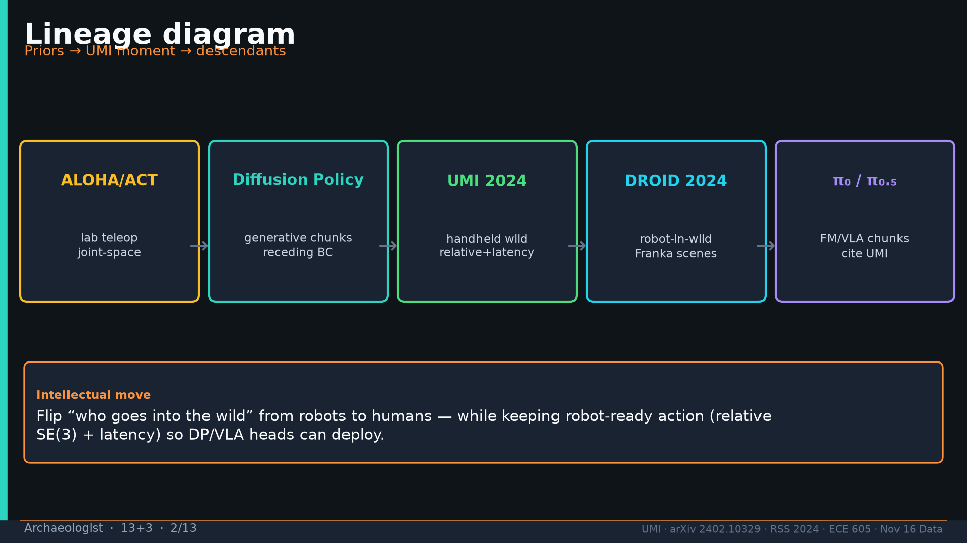
Notes:
Archaeologist · 13+3 · 2/13
Lineage diagram. Intellectual move: flip who enters the wild from robots to humans; keep robot-ready relative+latency actions.
Tattoo: cup 100%/90% · toss 87.5% (no lat 57.5%) · wild 1400/30 → 71.7% vs narrow 0% · rel 100% vs abs 25% · fisheye vs 69° 55% · cloth 70%/30% · dish 70%/0% · Ta=6 @10Hz (20Hz toss)

Slide 3
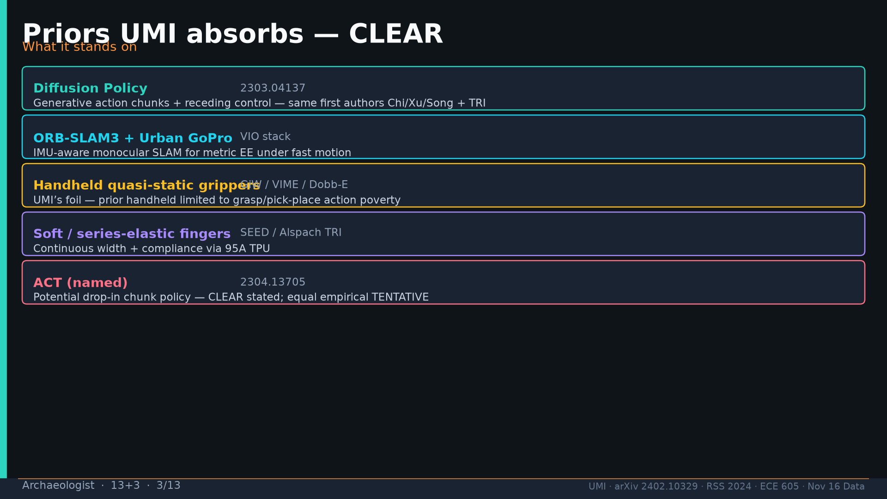
Notes:
Archaeologist · 13+3 · 3/13
Priors CLEAR: Diffusion Policy 2303.04137; ORB-SLAM3+Urban GoPro; handheld GiW/VIME/Dobb-E as foil; soft fingers SEED; ACT named drop-in.
Tattoo: cup 100%/90% · toss 87.5% (no lat 57.5%) · wild 1400/30 → 71.7% vs narrow 0% · rel 100% vs abs 25% · fisheye vs 69° 55% · cloth 70%/30% · dish 70%/0% · Ta=6 @10Hz (20Hz toss)

Slide 4
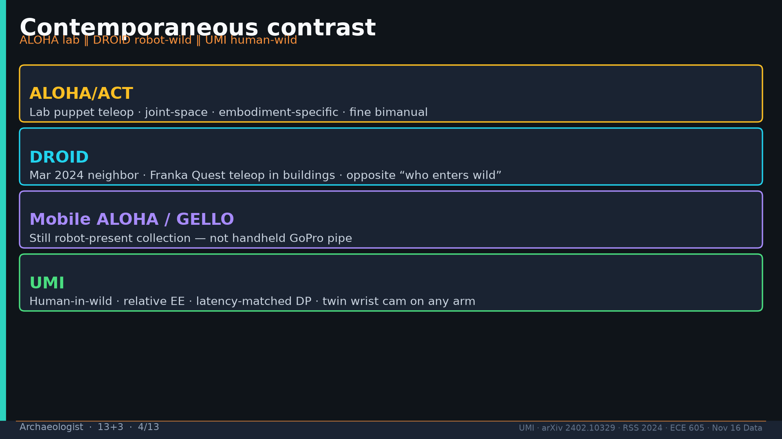
Notes:
Archaeologist · 13+3 · 4/13
Contemporaneous: ALOHA lab joint; DROID Mar 2024 Franka wild (opposite who); Mobile ALOHA/GELLO still robot-present; UMI human-wild relative.
Tattoo: cup 100%/90% · toss 87.5% (no lat 57.5%) · wild 1400/30 → 71.7% vs narrow 0% · rel 100% vs abs 25% · fisheye vs 69° 55% · cloth 70%/30% · dish 70%/0% · Ta=6 @10Hz (20Hz toss)

Slide 5
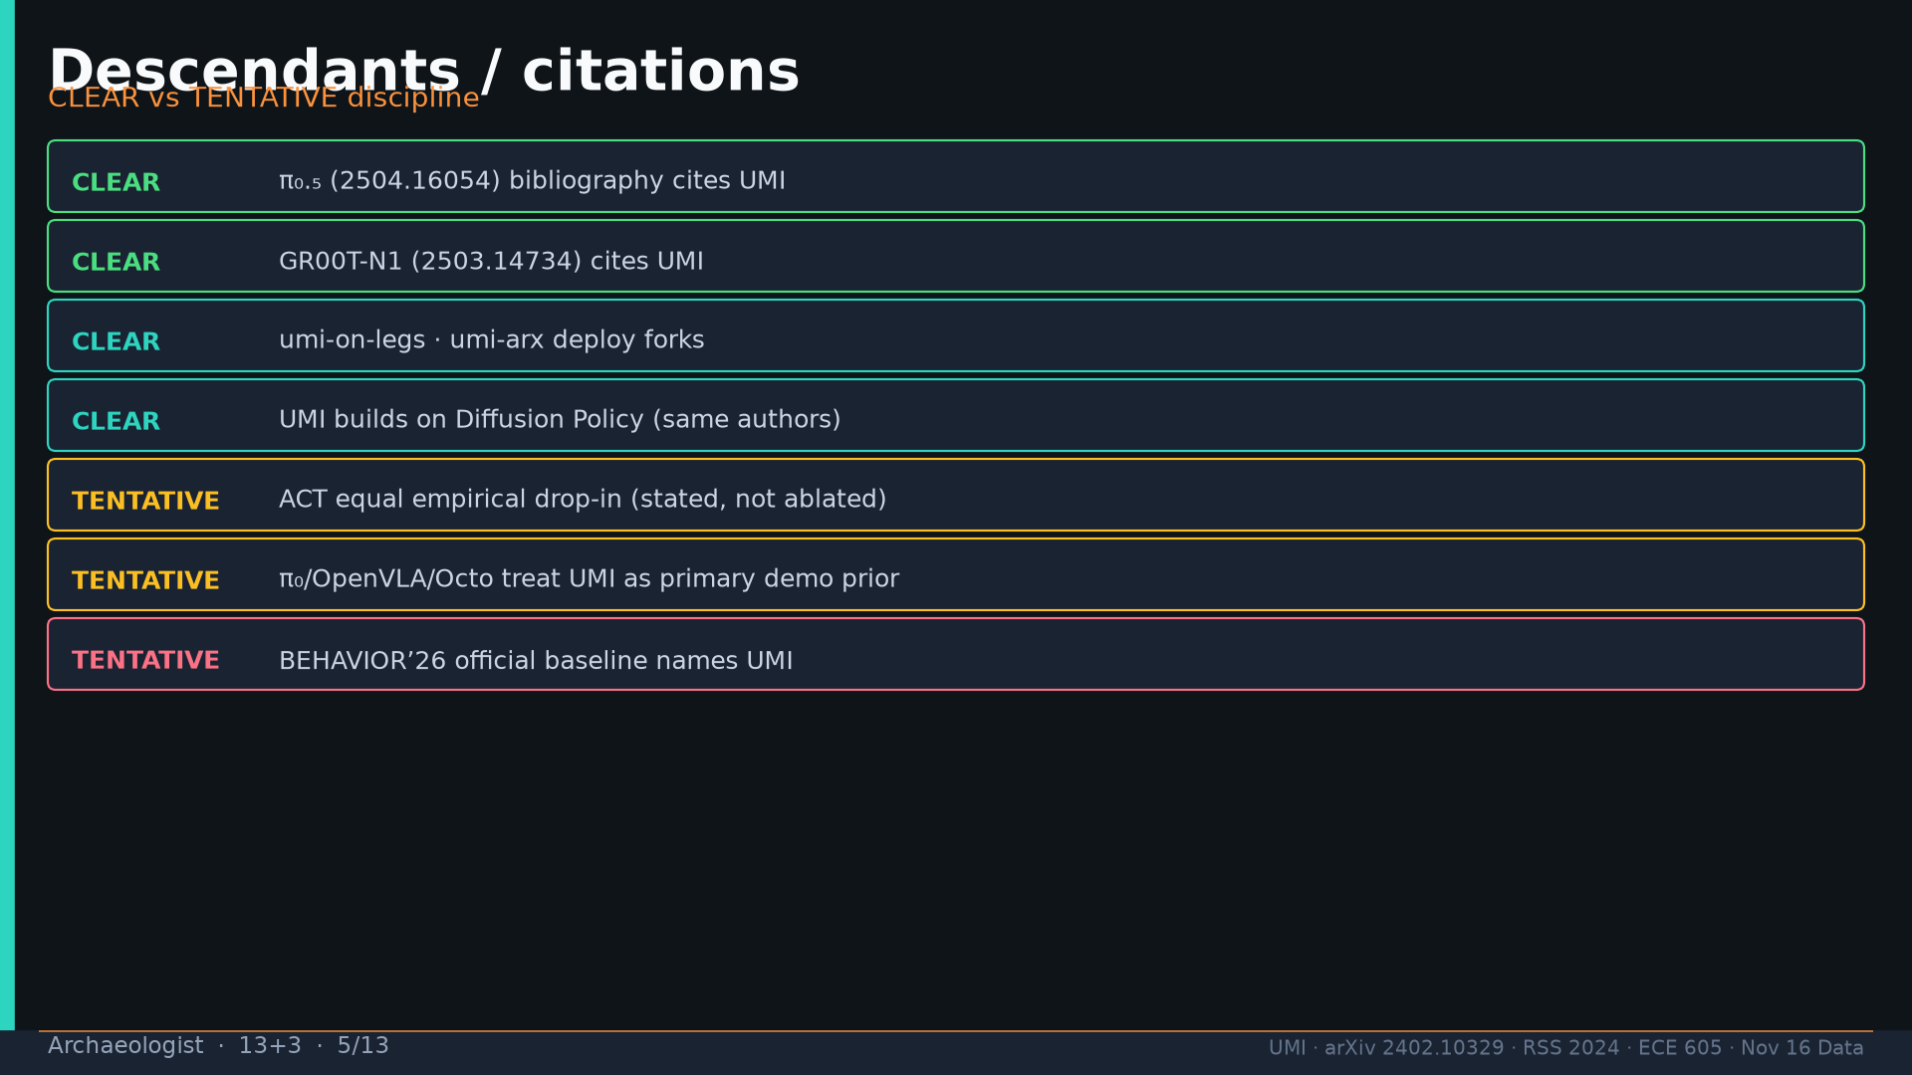
Notes:
Archaeologist · 13+3 · 5/13
CLEAR: π₀.₅ cite; GR00T cite; deploy forks; DP prior. TENTATIVE: ACT equal; π₀/OpenVLA primary-prior; BEHAVIOR’26 official name.
Tattoo: cup 100%/90% · toss 87.5% (no lat 57.5%) · wild 1400/30 → 71.7% vs narrow 0% · rel 100% vs abs 25% · fisheye vs 69° 55% · cloth 70%/30% · dish 70%/0% · Ta=6 @10Hz (20Hz toss)

Slide 6
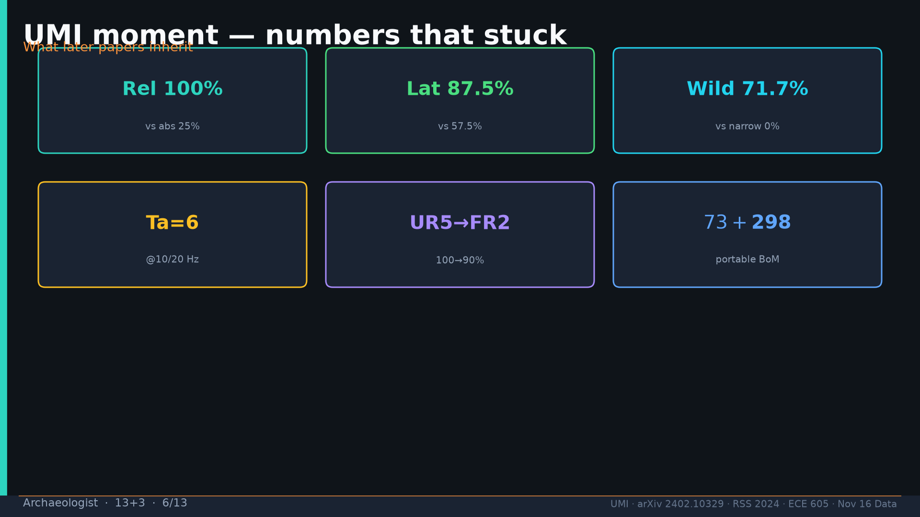
Notes:
Archaeologist · 13+3 · 6/13
Moment numbers that stuck: rel 100 vs abs 25; lat 87.5/57.5; wild 71.7/0; Ta=6; UR5→FR2 100→90; BoM.
Tattoo: cup 100%/90% · toss 87.5% (no lat 57.5%) · wild 1400/30 → 71.7% vs narrow 0% · rel 100% vs abs 25% · fisheye vs 69° 55% · cloth 70%/30% · dish 70%/0% · Ta=6 @10Hz (20Hz toss)

Slide 7
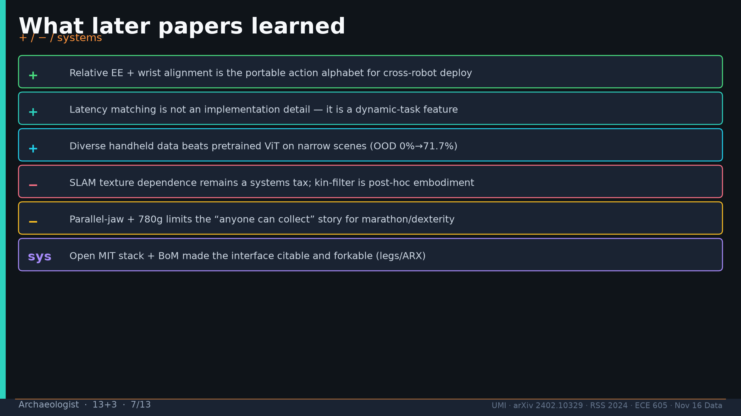
Notes:
Archaeologist · 13+3 · 7/13
Later learned +/-/sys: relative alphabet; latency feature; diversity>ViT; SLAM tax; jaw/weight limits; open stack forkable.
Tattoo: cup 100%/90% · toss 87.5% (no lat 57.5%) · wild 1400/30 → 71.7% vs narrow 0% · rel 100% vs abs 25% · fisheye vs 69° 55% · cloth 70%/30% · dish 70%/0% · Ta=6 @10Hz (20Hz toss)

Slide 8
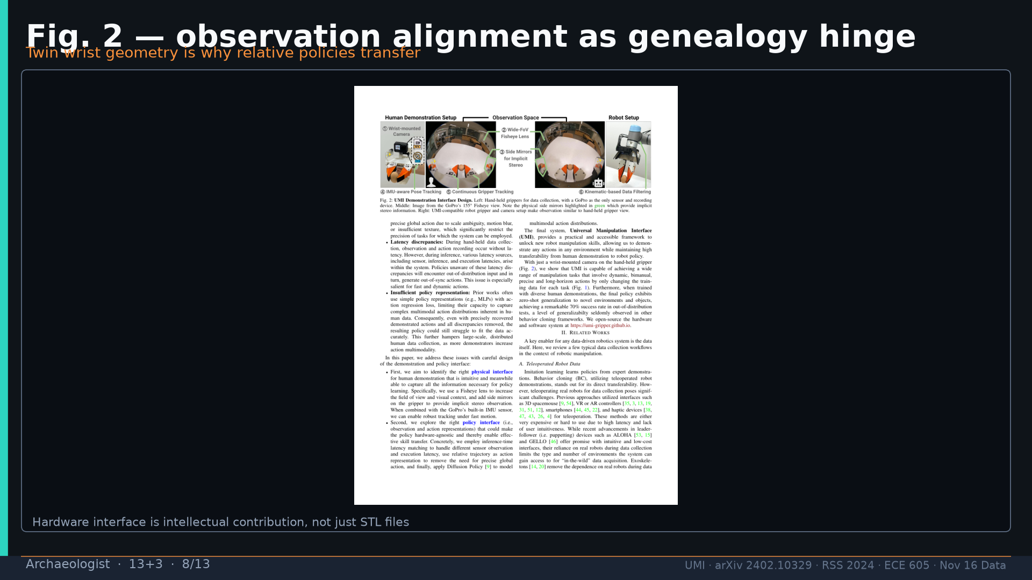
Notes:
Archaeologist · 13+3 · 8/13
Fig.2 observation alignment as genealogy hinge — twin wrist geometry enables transfer.
Tattoo: cup 100%/90% · toss 87.5% (no lat 57.5%) · wild 1400/30 → 71.7% vs narrow 0% · rel 100% vs abs 25% · fisheye vs 69° 55% · cloth 70%/30% · dish 70%/0% · Ta=6 @10Hz (20Hz toss)

Slide 9
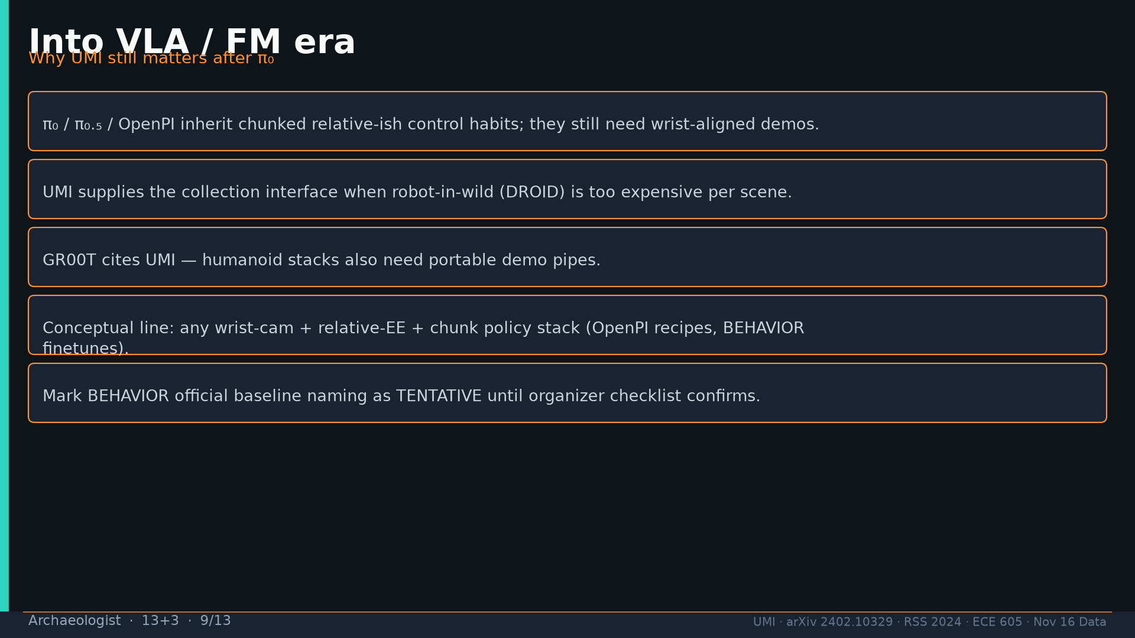
Notes:
Archaeologist · 13+3 · 9/13
VLA/FM era: π family inherits chunk habits; UMI = collection when DROID too expensive; GR00T cites; BEHAVIOR name TENTATIVE.
Tattoo: cup 100%/90% · toss 87.5% (no lat 57.5%) · wild 1400/30 → 71.7% vs narrow 0% · rel 100% vs abs 25% · fisheye vs 69° 55% · cloth 70%/30% · dish 70%/0% · Ta=6 @10Hz (20Hz toss)

Slide 10
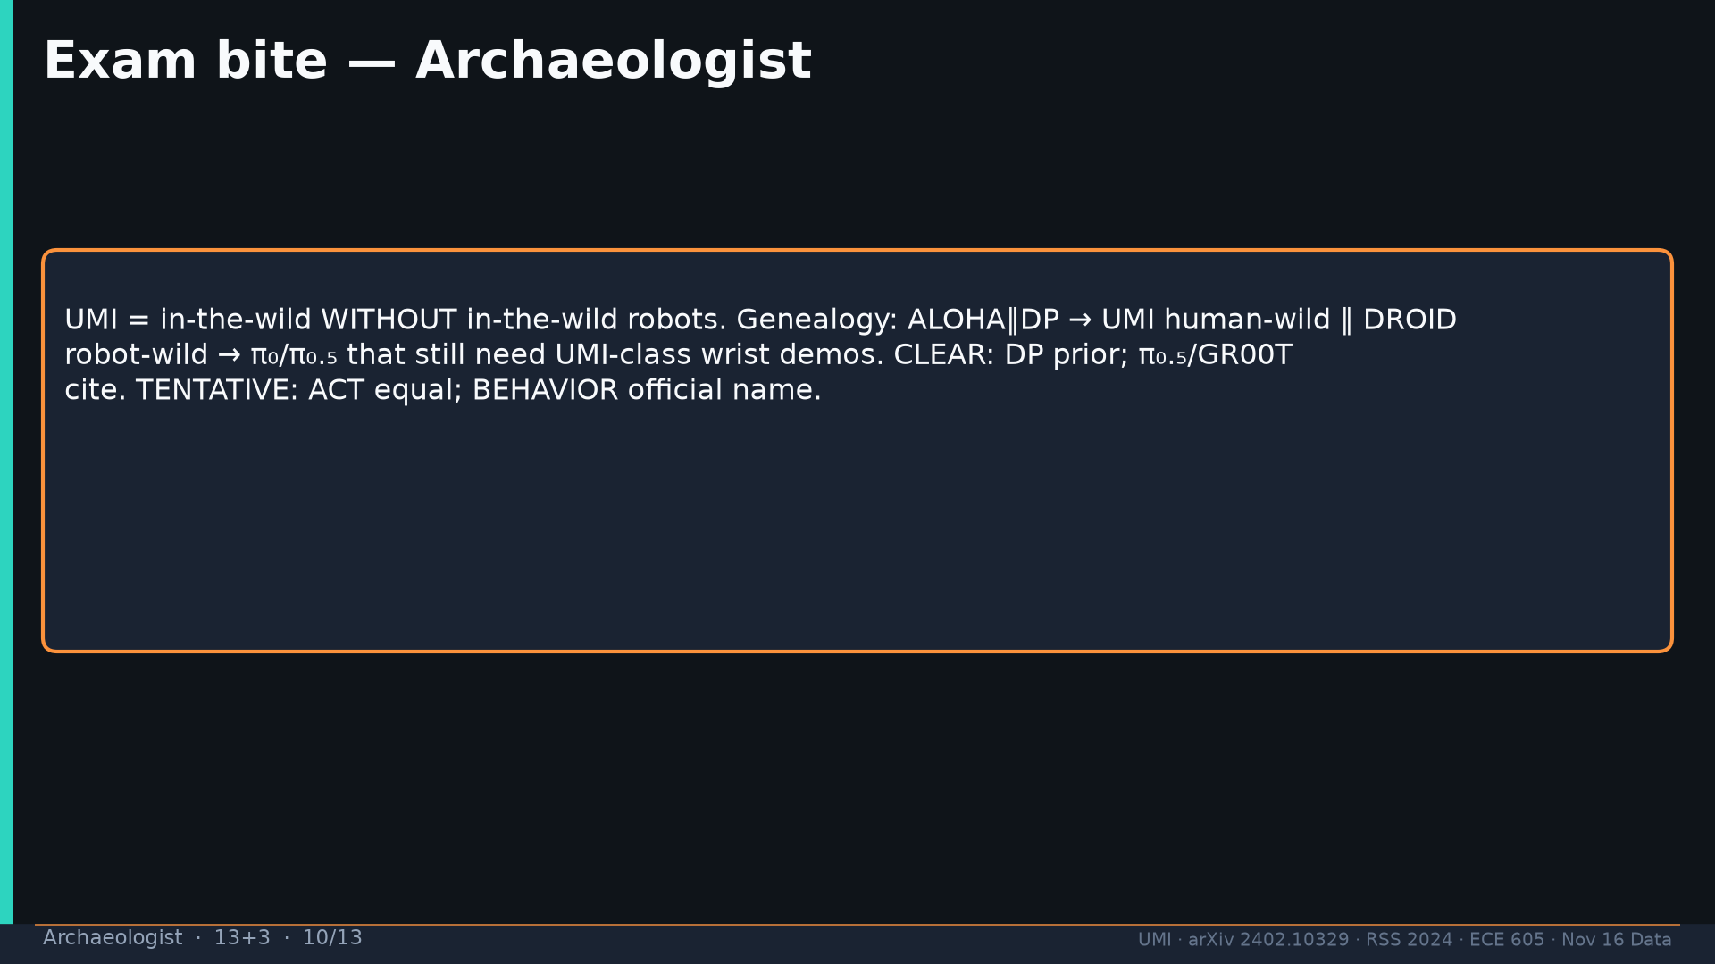
Notes:
Archaeologist · 13+3 · 10/13
Exam bite genealogy + CLEAR/TENTATIVE discipline.
Tattoo: cup 100%/90% · toss 87.5% (no lat 57.5%) · wild 1400/30 → 71.7% vs narrow 0% · rel 100% vs abs 25% · fisheye vs 69° 55% · cloth 70%/30% · dish 70%/0% · Ta=6 @10Hz (20Hz toss)

Slide 11
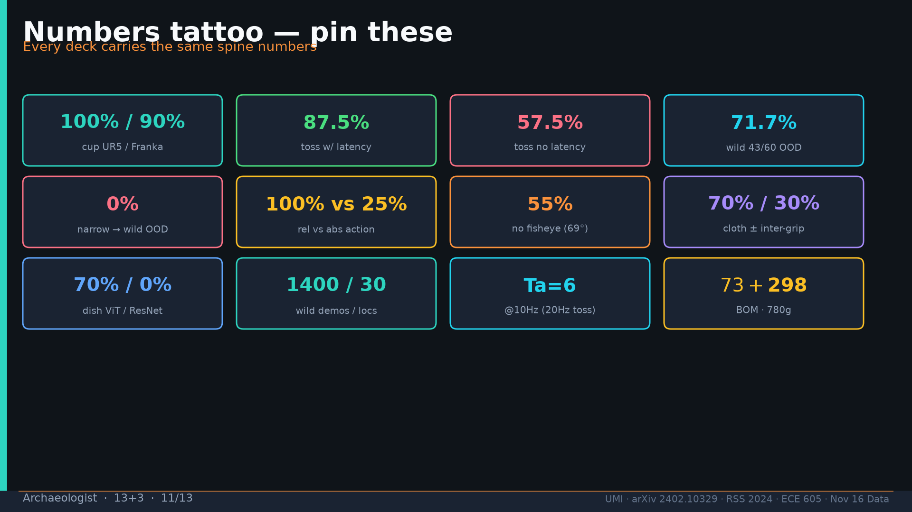
Notes:
Archaeologist · 13+3 · 11/13
Tattoo.
Tattoo: cup 100%/90% · toss 87.5% (no lat 57.5%) · wild 1400/30 → 71.7% vs narrow 0% · rel 100% vs abs 25% · fisheye vs 69° 55% · cloth 70%/30% · dish 70%/0% · Ta=6 @10Hz (20Hz toss)

Slide 12
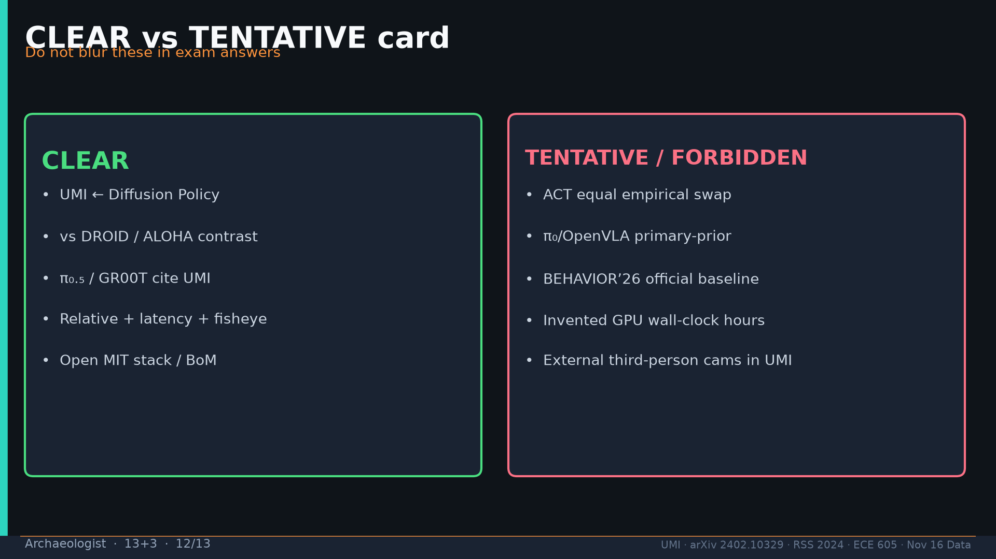
Notes:
Archaeologist · 13+3 · 12/13
CLEAR vs TENTATIVE/FORBIDDEN card — do not blur in exam answers. Forbidden: invented GPU hours; external cams in UMI.
Tattoo: cup 100%/90% · toss 87.5% (no lat 57.5%) · wild 1400/30 → 71.7% vs narrow 0% · rel 100% vs abs 25% · fisheye vs 69° 55% · cloth 70%/30% · dish 70%/0% · Ta=6 @10Hz (20Hz toss)

Slide 13
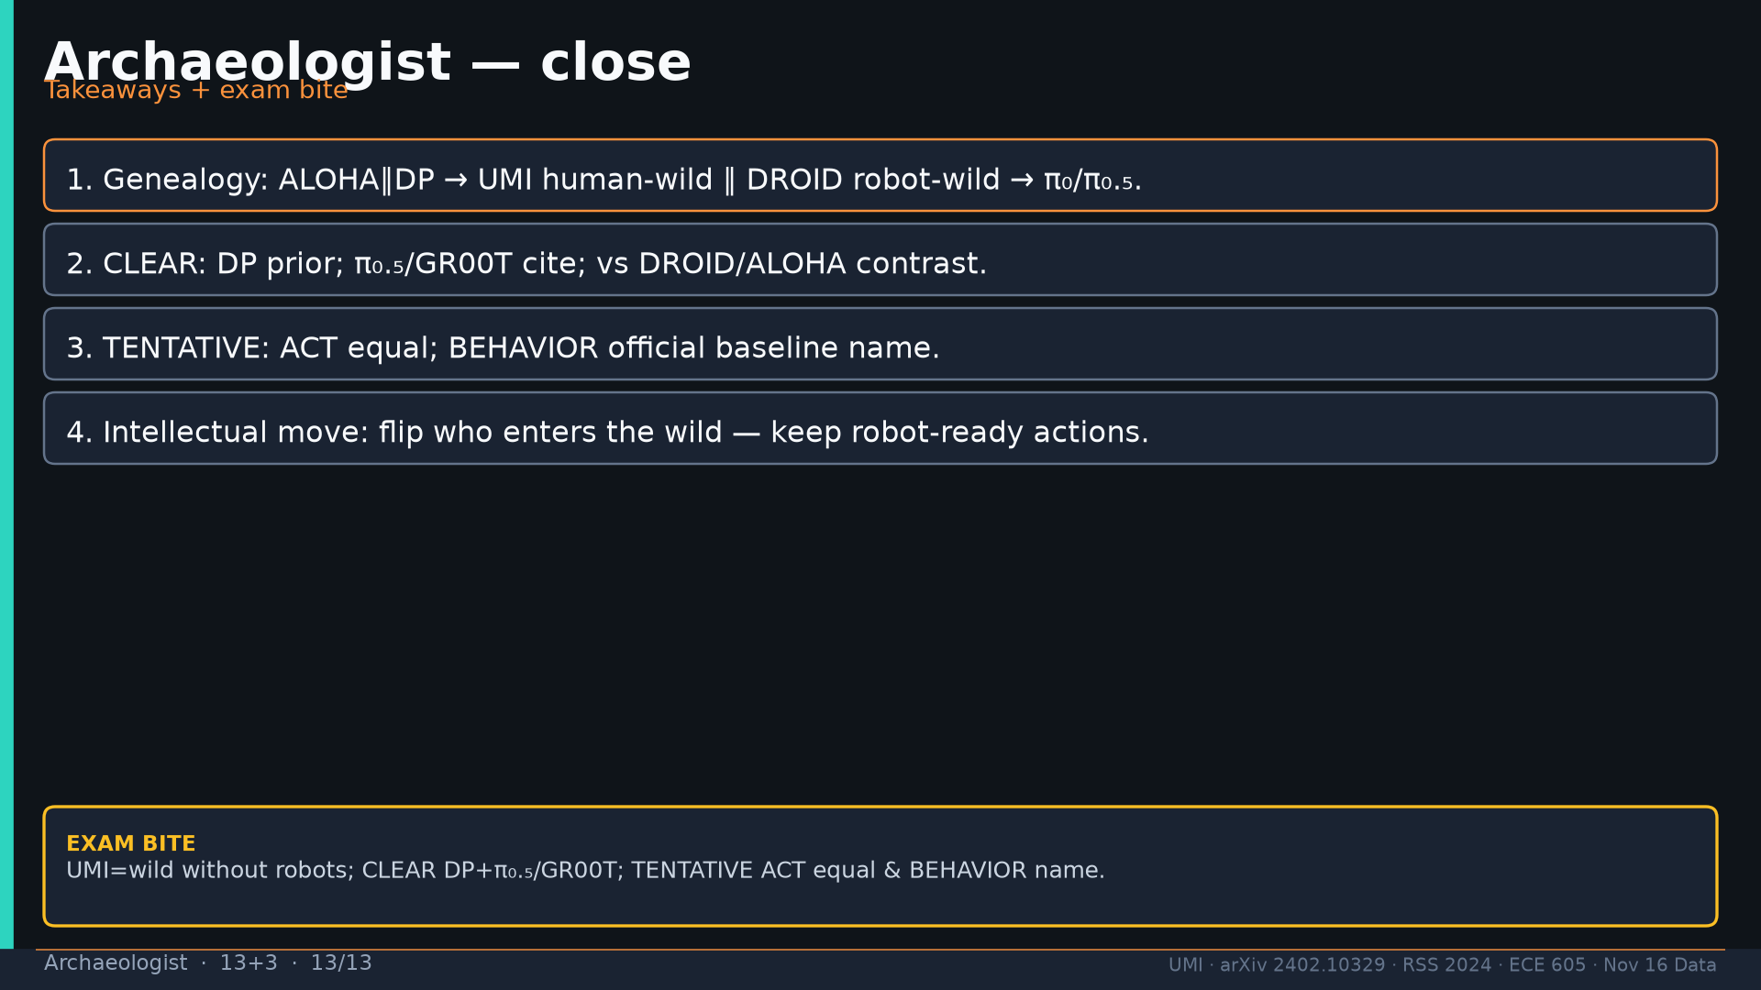
Notes:
Archaeologist · 13+3 · 13/13
Close takeaways.
Tattoo: cup 100%/90% · toss 87.5% (no lat 57.5%) · wild 1400/30 → 71.7% vs narrow 0% · rel 100% vs abs 25% · fisheye vs 69° 55% · cloth 70%/30% · dish 70%/0% · Ta=6 @10Hz (20Hz toss)

